Slide 1
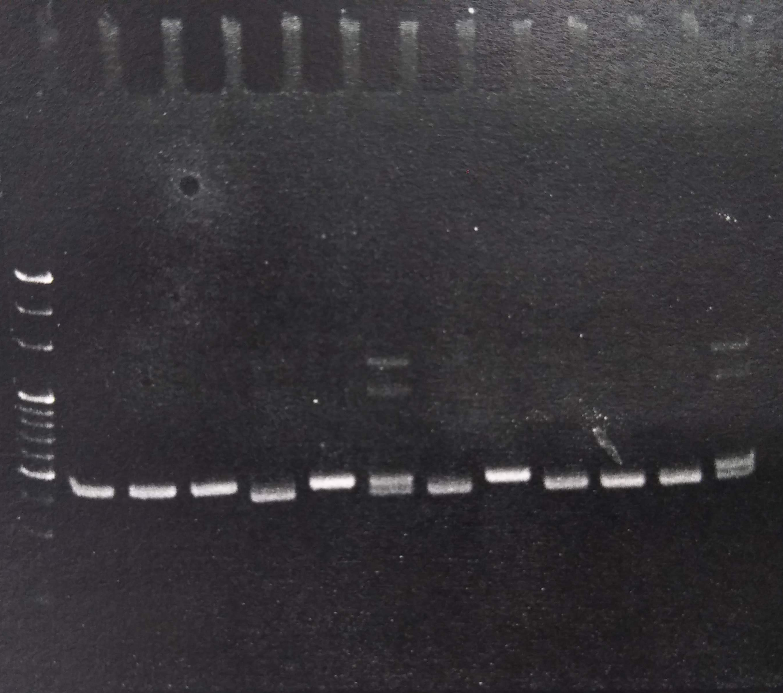
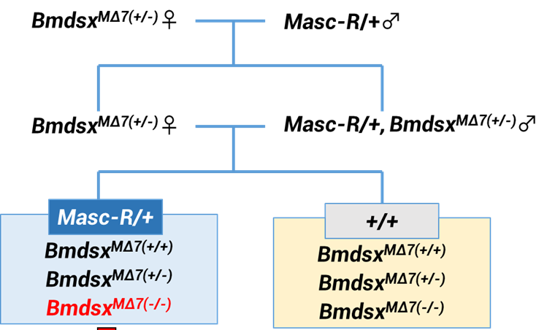
B
Bmdsx^{+/+}
Bmdsx^{MΔ7/MΔ7}
Bmdsx^{MΔ7/MΔ7}
Bmdsx^{MΔ7/MΔ7}
Bmdsx^{MΔ7/+}
Size marker
Bmdsx^{+/+}
Bmdsx^{+/+}
Bmdsx^{MΔ7/+}
A
bp
Bmdsx^{MΔ7} line
Masc-R line
G0
Bmdsx^{MΔ7/MΔ7}♀
Masc-R/+ ♂
G1
+/+, Bmdsx^{MΔ7/+} ♀
Masc-R/+, Bmdsx^{MΔ7/+} ♂
G2
Masc-R/+
+/+
Bmdsx^{+/+}
Bmdsx^{+/+}
100
Bmdsx^{MΔ7/+}
Bmdsx^{MΔ7/+}
70
Bmdsx^{MΔ7/MΔ7}
Bmdsx^{MΔ7/MΔ7}
60
Bmdsx＋
50
Bmdsx^{MΔ7}
40
30
10

