Slide 1
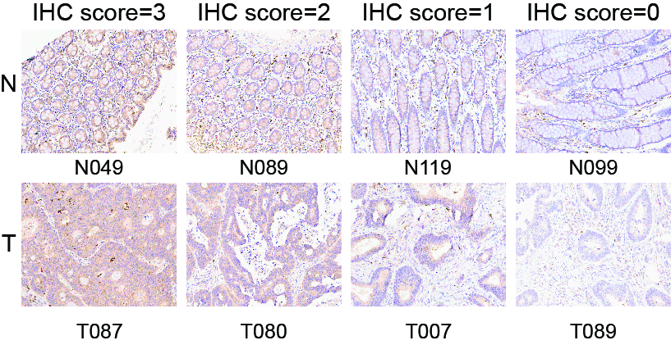
Fig. S1 Representative immunohistochemical staining of DIAPH3 in CRC tissues and adjacent normal tissues (Original magnification ×200). The intensity of DIAPH3 staining was graded as follows: no staining = 0; weak staining = 1; moderate staining = 2; dense staining = 3.

Slide 2
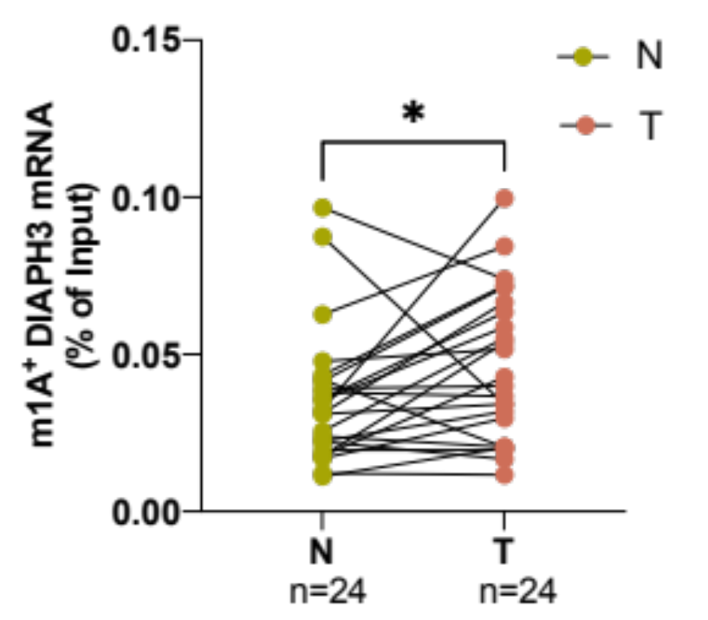
A
B
Fig. S2 The expression of both DIAPH3 mRNA and ^{m1A+}DIAPH3 mRNA is significantly higher in cancer tissues than that of in matched adjacent normal tissues.Paired line scatter plots showing the expression of DIAPH3 mRNA (A) and its methylation level (B) in normal tissues (green dot) (n = 24) and CRC (red dot) (n =24). N, normal tissues; T, CRC tissues. Paired t-test, *p <0.05.

Slide 3
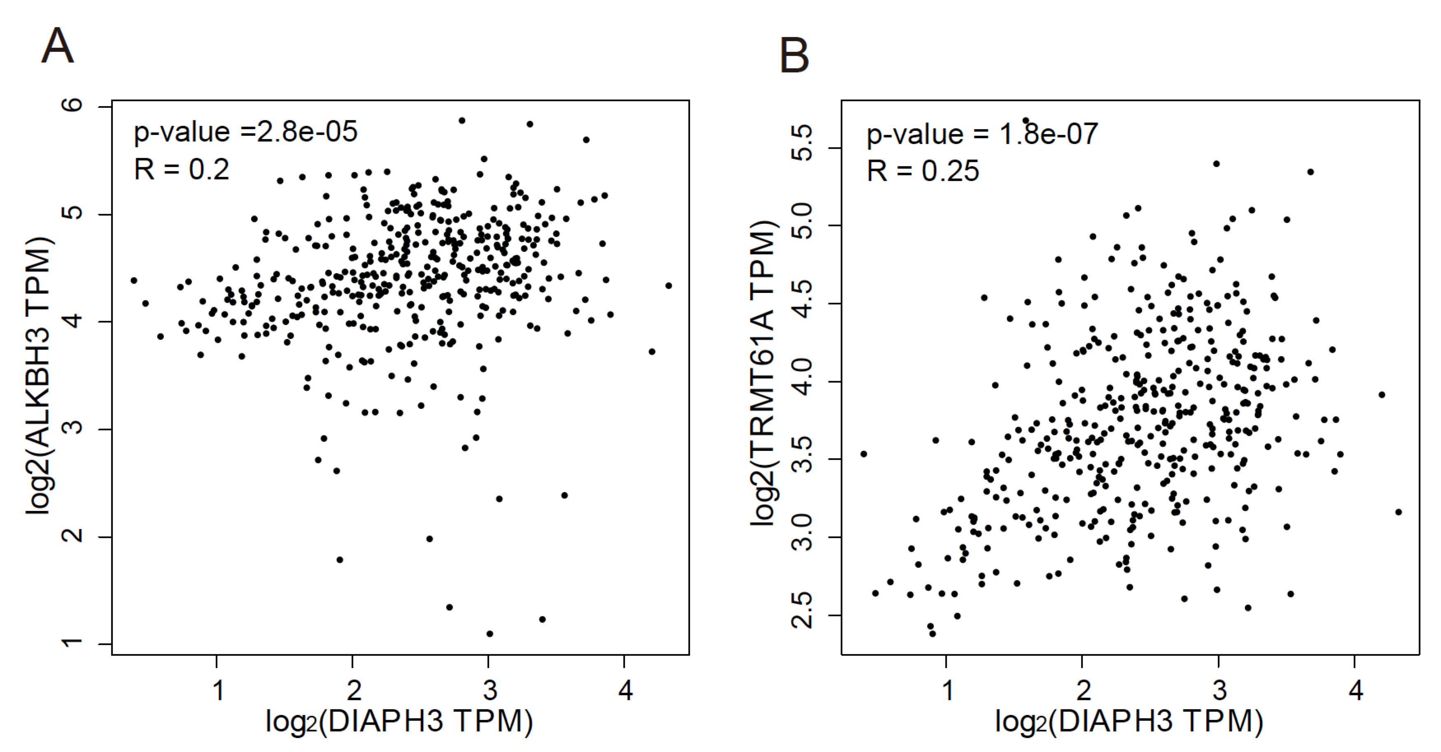
Fig. S3 Correlation analysis between two m1A regulators and DIAPH3 mRNA in CRC according to the GEPIA database. A Correlation analysis between DIAPH3 mRNA and ALKBH3 mRNA in CRC. B Correlation analysis between DIAPH3 mRNA and TRMT61A mRNA in CRC.

Slide 4
Fig. S4 Expression level of DIAPH3 mRNA between non-metastatic CRC patients (M0) and Metastatic CRC patients (M1). *p <0.05.

Slide 5
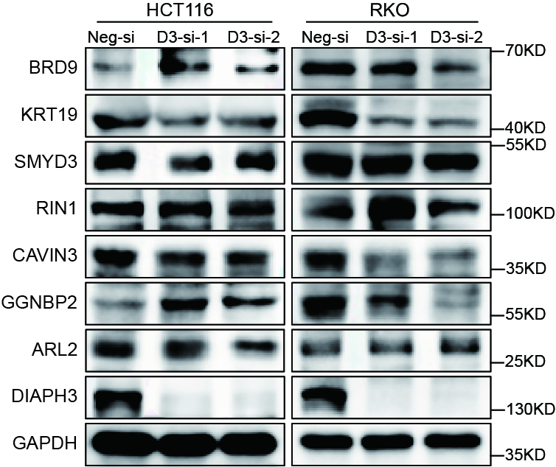
Fig. S5 Seven potential downstream targets of DIAPH3 were validated by western blotting after transfecting si-RNAs into HCT116 and RKO cells. D3, DIAPH3; Neg, Negative; si, siRNA

Slide 6
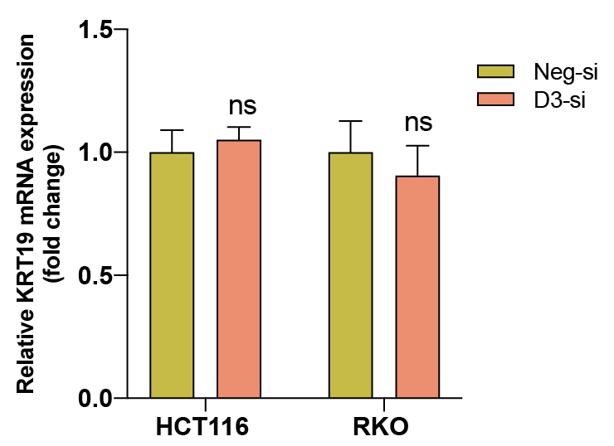
Fig. S6 The relative expression of KRT19 mRNA in HCT116 and RKO cells after transfecting DIAPH3 siRNA. D3, DIAPH3; Neg, Negative; si, siRNA; ns, not significant.

Slide 7
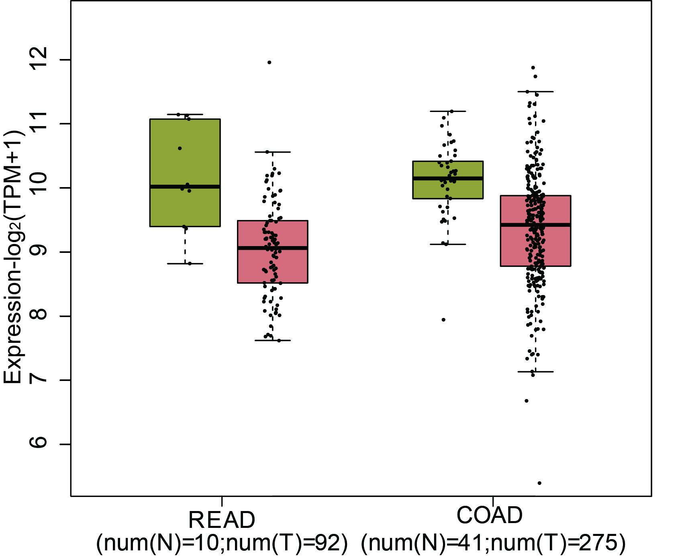
Fig. S7 The mRNA expression level of KRT19 in patients with rectum adenocarcinoma (READ) and colon adenocarcinoma (COAD) in the GEPIA database. Left (green): normal (N = 41 in COAD, N = 10 in READ); right (red): tumor (T = 275 in COAD, T = 92 in READ), P >0.05, error bars denote mean ± SEM. N, adjacent normal tissues; T, CRC tissues; READ, rectum adenocarcinoma; COAD, colon adenocarcinoma.

Slide 8
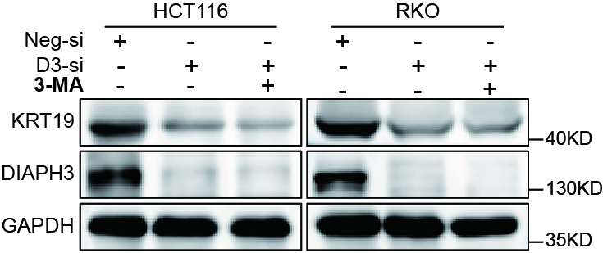
Fig. S8 The expression of KRT19 was measured by western blot after adding 3-MA (2.5 mM, 24 h) into HCT116 and RKO cells with or without DIAPH3 silencing. D3, DIAPH3; Neg, Negative; si, siRNA.

