Slide 1
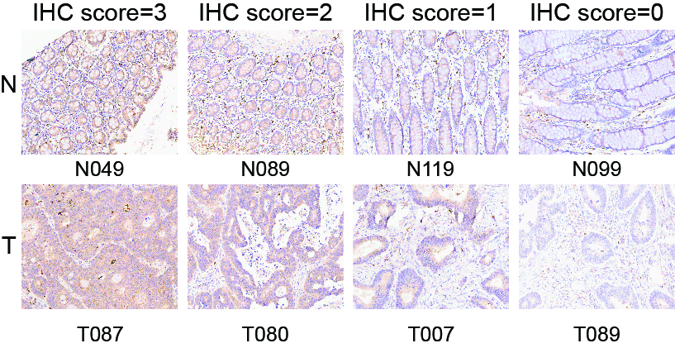
Fig. S1 Representative immunohistochemical staining of DIAPH3 in CRC tissues and adjacent normal tissues (Original magnification ×200). The intensity of DIAPH3 staining was graded as follows: no staining = 0; weak staining = 1; moderate staining = 2; dense staining = 3.

Slide 2
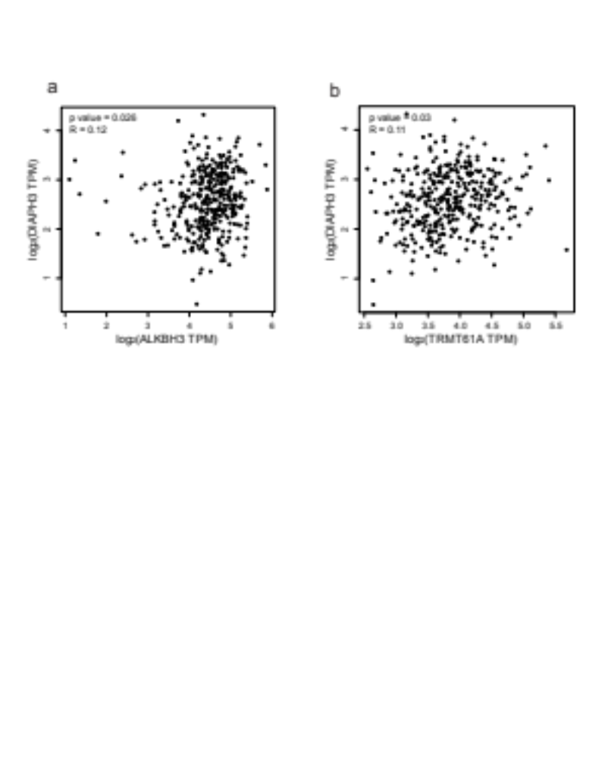
Fig. S2 Correlation analysis between two m1A regulators and DIAPH3 mRNA in CRC according to the GEPIA database. a Correlation analysis between DIAPH3 mRNA and ALKBH3 mRNA in CRC. b Correlation analysis between DIAPH3 mRNA and TRMT61A mRNA in CRC.

Slide 3
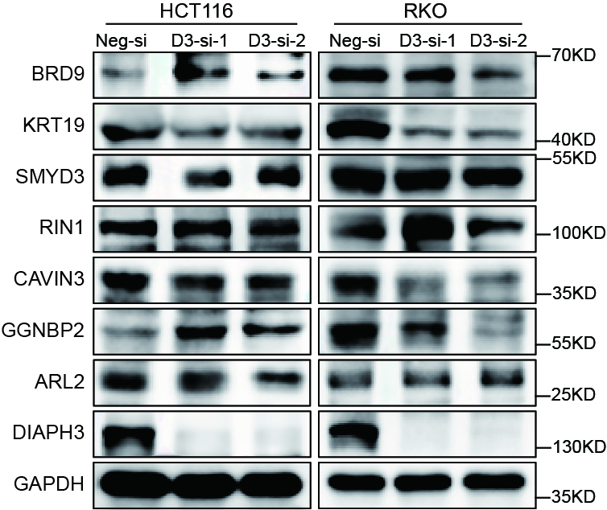
Fig. S3 Seven potential downstream targets of DIAPH3 were validated by western blotting after transfecting si-RNAs into HCT116 and RKO cells. D3, DIAPH3; Neg, Negative; si, siRNA

Slide 4
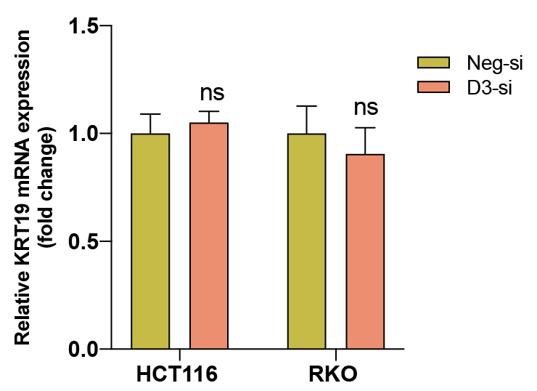
Fig. S4 The relative expression of KRT19 mRNA in HCT116 and RKO cells after transfecting DIAPH3 siRNA. D3, DIAPH3; Neg, Negative; si, siRNA; ns, not significant.

Slide 5
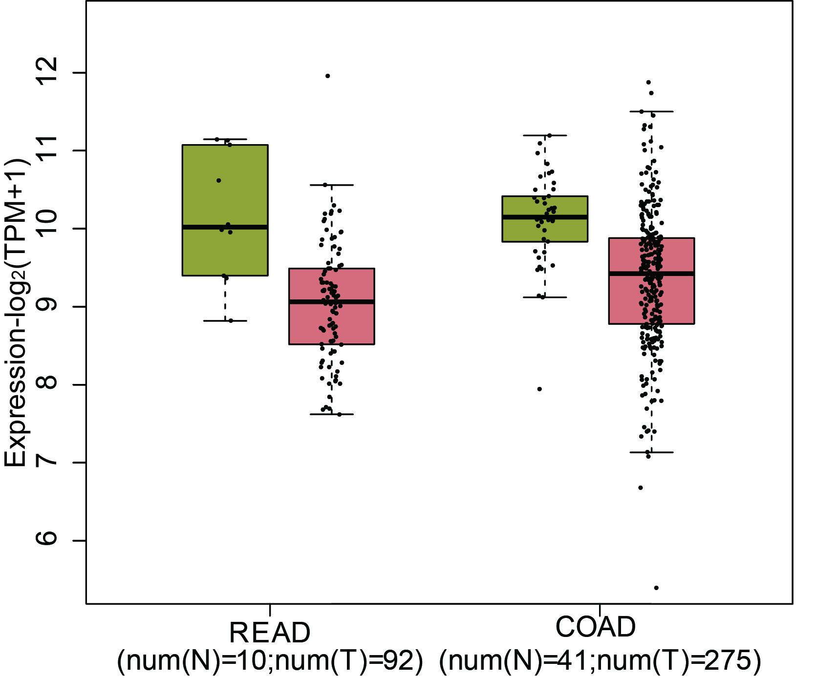
Fig. S5 The mRNA expression level of KRT19 in patients with rectum adenocarcinoma (READ) and colon adenocarcinoma (COAD) in the GEPIA database. Left (green): normal (N = 41 in COAD, N = 10 in READ); right (red): tumor (T = 275 in COAD, T = 92 in READ), P >0.05, error bars denote mean ± SEM. N, adjacent normal tissues; T, CRC tissues; READ, rectum adenocarcinoma; COAD, colon adenocarcinoma.

Slide 6
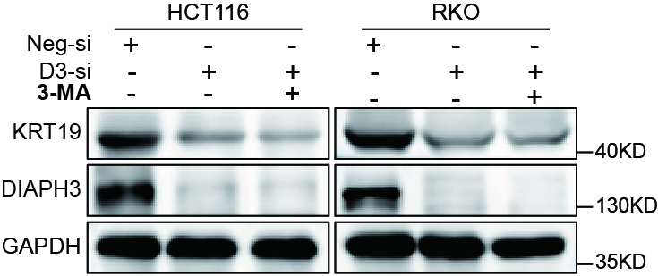
Fig. S6 The expression of KRT19 was measured by western blot after adding 3-MA (2.5 mM, 24 h) into HCT116 and RKO cells with or without DIAPH3 silencing. D3, DIAPH3; Neg, Negative; si, siRNA.

