Slide 1
Supplement

Slide 2
Table S1. X-ray crystallography statistics for 8U15, 8U16, and 8U17
Datasets | DBPB DDB1: DN-67CRBN:ZF1-2(379-432):CC-220 | DBPB DDB1: DN-67CRBN:ZF1-2(379-432):POM | DBPB DDB1: DN-67CRBN:ZF1-2(370-454):POM
 | PDB ID: 8U15 | PDB ID: 8U16 | PDB ID: 8U17
Diffraction-data statistics
X-ray source | APS ID17 | APS ID17 | ALS 5.0.2
Wavelength | 1.00 | 1.00 | 1.00
Space group | P 2₁ | P 2₁ 2₁ 2₁ | P 2₁ 2₁ 2₁
Cell parameters
a, b, c (Å) | 110.73, 95.73, 150.95 | 95.54, 151.99, 218.46 | 116.08, 151.66, 195.38
α, β, γ (°) | 90.00, 91.72, 90.00 | 90.00, 90.00, 90.00 | 90.00, 90.00, 90.00
Resolution range (Å)ª | 55.34-2.95 (3.06-2.95) | 47.77-2.9 (3.00-2.9) | 49.9-3.1 (3.21-3.10)
R-merge^{b} | 10.38 (93.71) | 7.73 (92.16) | 6.31 (212)
CC1/2 | 0.992 (0.38) | 0.997 (0.55) | 0.999 (0.47)
Mean I/σ (I) | 5.22 (0.81) | 5.18 (0.67) | 7.73 (0.38)
Multiplicity | 2.0 (2.0) | 2.0 (2.0) | 2.0 (2.0)
Completeness (%) | 99.87 (99.86) | 99.30 (99.14) | 96.01 (66.86)
Total reflections | 133313 (13266) | 142439 (14016) | 126489 (12488)
Unique reflections | 66744 (6636) | 71220 (7008) | 63245 (6244)
Refinement Statistics
R-work (%) | 21.93 (35.17) | 22.04 (40.16) | 30.48 (49.80)
R-free (%)^{c} | 27.10 (38.77) | 27.30 (42.63) | 34.55 (52.84)
No. of non-hydrogen atoms | 18548 | 18092 | 17033
Protein residues | 2398 | 2410 | 2379
Solvent | 13 | 36 | 0
Ligand | 132 | 50 | 46
RMS deviation
RMS (Å) | 0.002 | 0.01 | 0.002
RMS (°) | 0.52 | 1.15 | 0.52
Ramachandran plot
Ramachandran favored (%) | 93.85 | 94.2 | 89.67
Ramachandran allowed (%) | 5.77 | 5.34 | 9.47
Ramachandran outliers (%) | 0.38 | 0.46 | 0.86
Rotamer outliers (%) | 3 | 4.57 | 0.25
Clashscore | 7.8 | 10.62 | 5.12
ª Value in parentheses is for the highest-resolution shell.
^{b} Rmerge = Σ_{h} Σ_{i} |I(h)_{i} – < I(h) > |/Σh Σ_{i} I(h)_{i}, where I(h) is the intensity for reflection h, Σ_{h} is the sum for all reflections, and Σ_{i} is the sum for i measurements of reflection h.
^{c} R = Σ | |F_{obs}| – |F_{calc}| |/Σ |F_{obs}|, where R_{free} is calculated for a randomly chosen 5% of reflections, which were not used for structure refinement, and R_{work} is calculated for the remaining reflections

Slide 3
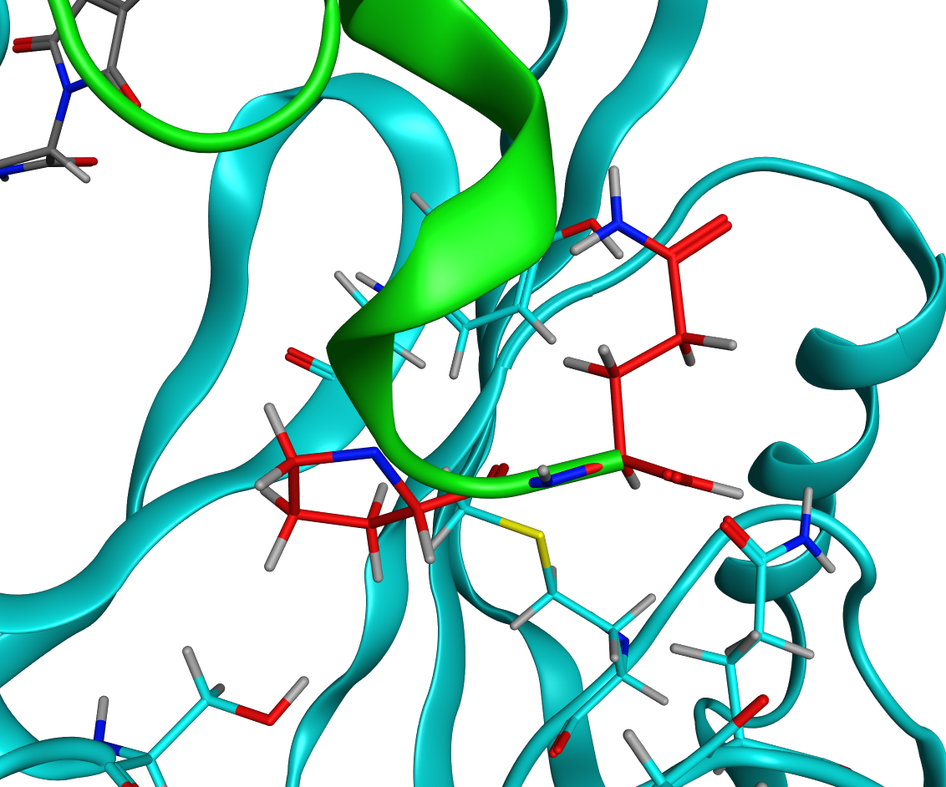
Gln434
Pro433
Figure S1: A model of the interactions of C-terminal SALL4 residues Pro433 and Gln434 in the DDB1:CRBN:POM:ZF1-2(370-434) structure.

Slide 4
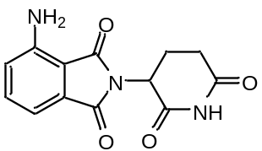
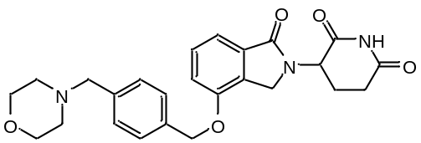
Pomalidomide (POM)
CC-220
Figure S2: Structures of pomalidomide (POM) and CC-220

Slide 5
72 94
379
432
566
648
870
920
1
2
3
4
5
6
7
ZF
CXXCG ZF
379
1
2
432
ZF1-2(379-432): SLYKHKCKYC SKVFGTDSSL QIHLRSHTGE RPFVCSVCGH RFTTKGNLKV HFHRH
370
1
2
454
ZF1-2(370-454): SDVKPKDEAA LYKHKCKYCS KVFGTDSSLQ IHLRSHTGER PFVCSVCGHR FTTKGNLKVHFHRHPQVKAN PQLFAEFQDK VAAGNG
Figure S3: Representation SALL4 zinc fingers and sequences of key zinc finger constructs. Designation of zinc finger 1 is based on prior literature studies. The ZF2 CXXCG motif that interacts with the CRBN:MG complex is underlined.

Slide 6
A
B
C
D
SPR Result | Pomalidomide (N=3) | CC-220 (N=3)
K_{D} (nM) | 170±28 | 9±0.9
k_{on} (1/M*s) | 7.2x10⁵±1.1x10⁵ | 7.0x10⁶±2.1x10⁶
k_{off} (1/s) | 0.13±0.03 | 0.064±0.025
R_{max} (RU) | 10.6±0.4 | 14.9±0.1
Figure S4: SPR data and 1:1 kinetic modeling of data for the interaction of pomalidomide (A, B, 9pt 2X dilution series, top concentration 2.5μM) and CC-220 (C, D, 9pt 2X dilution series, top concentration 0.25μM) with DDB1:CRBN.

Slide 7
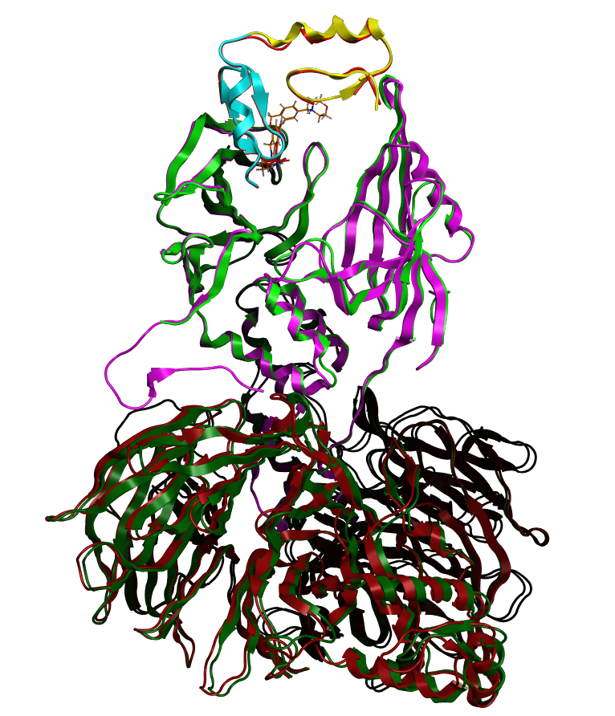
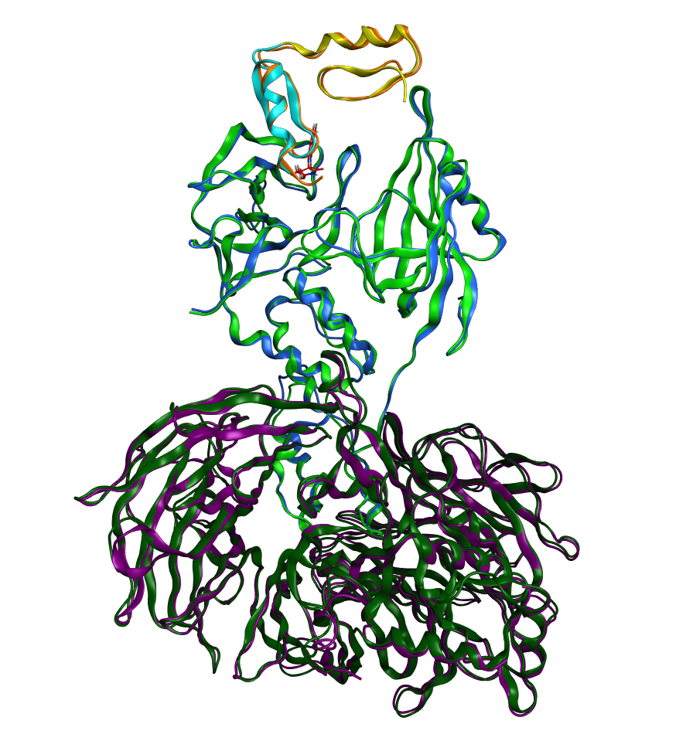
A
B
Figure S5. Structural overlays based on alignment of cereblon residues for A) DDB1:CRBN:POM:ZF1-2(379-432) and the corresponding CC-220/ZF1-2(370-432) structure. Color schemes: DDB1:CRBN:POM:ZF1-2(379-432) is dark green, green, and yellow/cyan, respectively and for the corresponding CC-220 structure, the corresponding colors are dark red, magenta, and red. B) DDB1:CRBN:POM:ZF1-2(379-432) and the corresponding POM/ZF1-2(370-454) structure. The ZF1-2(379-432) structure colors are dark green, green, and yellow/cyan and the ZF1-2(370-454) structure colors are purple, blue, and orange for DDB1, CRBN, and ZF1-2, respectively.

