Slide 1
Figure 2
NGF
TrkA
GADPH

Slide 2
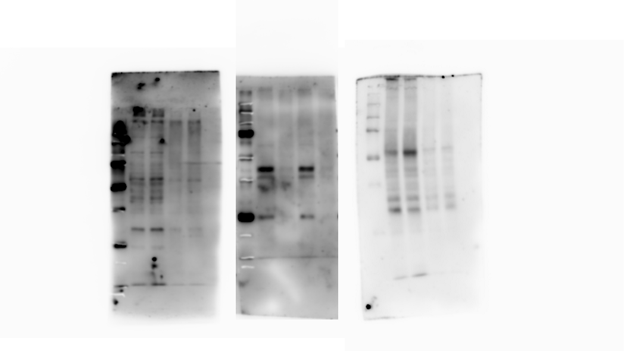
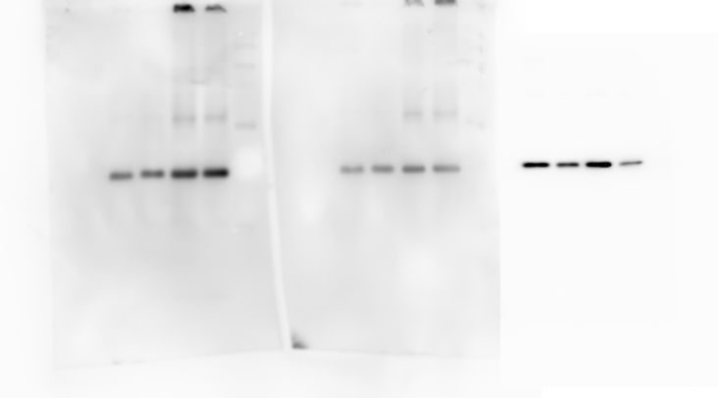
Figure 3
NGF
GADPH

Slide 3
Figure 4
TNFA
IL-1B
GADPH

