Slide 1
Supplementary Figure 1
Enrollment
Cycle 1 (28 days)
Cycle 2 (28 days)
Imatinib 400 mg QD
Imatinib 400 mg QD
Proceed with additional cycles until progression
End of Treatment
Screening
Vactosertib
V
V
V
V
V
V
V
V
Days
1-5
8-12
15-19
22-26
1-5
8-12
15-19
22-26
Vactosertib PK
Combination PK
Imaging
(Q 8 weeks for 16 weeks,
Q 16 weeks thereafter)

Slide 2
Supplementary Figure 2
29 patients assessed for eligibility
1 screening failure
28 patients enrolled and received at least one dose of treatment
1 withdrew consent
27 patients underwent
post-baseline imaging assessment
Cohort -1 (n=4)
Imatinib 400 QD
+ Vactosertib 100 mg BID (1st cycle)
Followed by dose escalation
(200 mg BID, 2nd~ cycle)
Cohort 1 (n=23)
Imatinib 400 mg QD
+ Vactosertib 200 mg BID
(1st cycle ~)
27 evaluable for objective response in the efficacy analysis set
14 on treatment
13 discontinued study treatment
      6 progressive disease
      4 resting after long term treatment
      3 due to toxicity

Slide 3
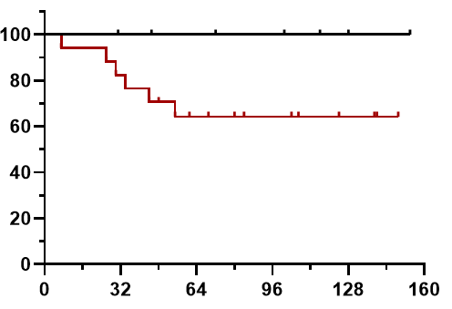
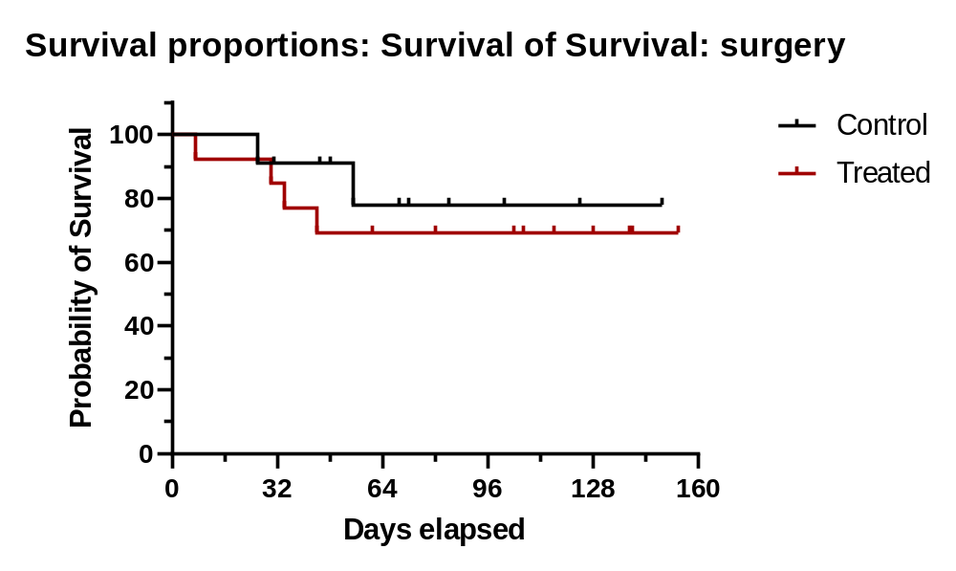
Supplementary Figure 3
(A) Surgery
(B) Chemotherapy
Percentage of Patients
Percentage of Patients
No
No
Yes
Yes
P=0.431
P=0.110
weeks
weeks

Slide 4
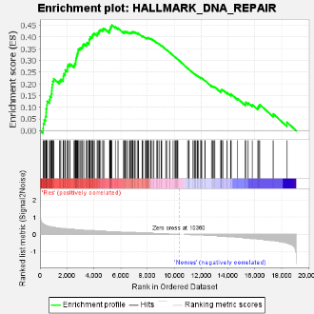
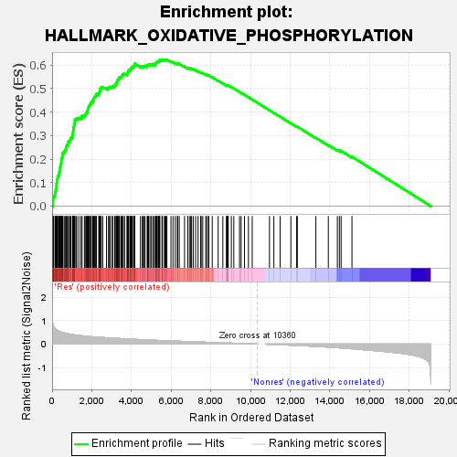
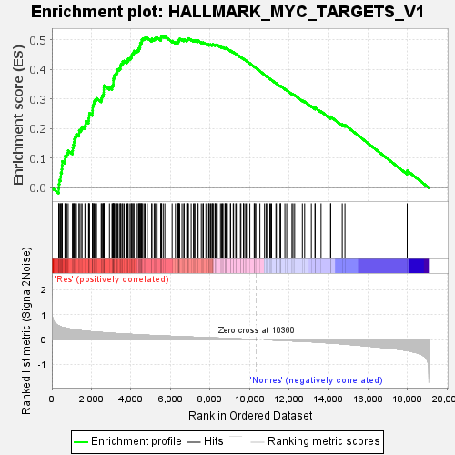
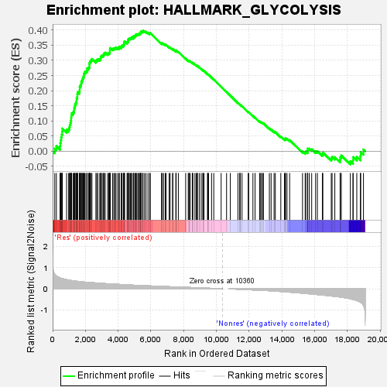
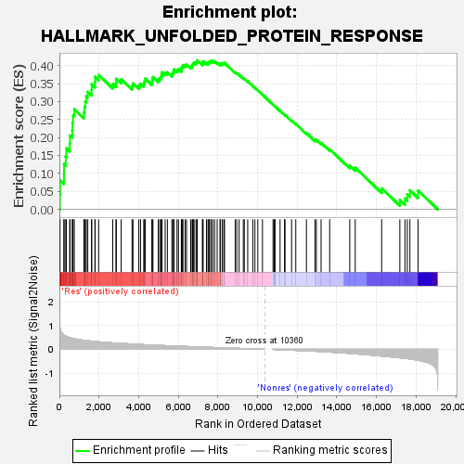
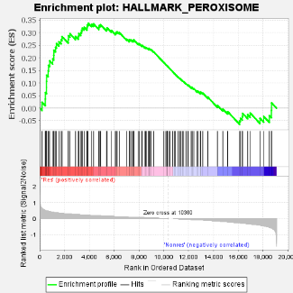
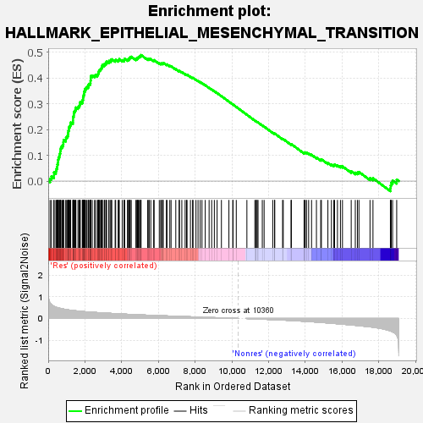
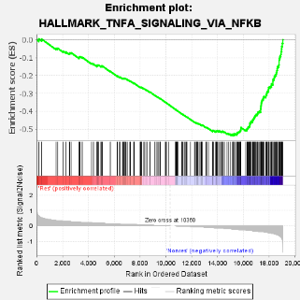
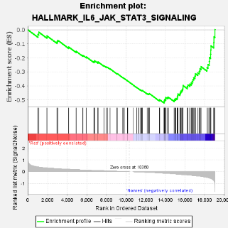
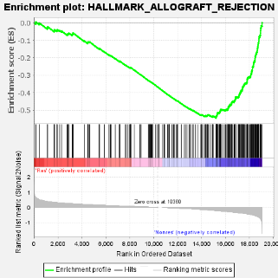
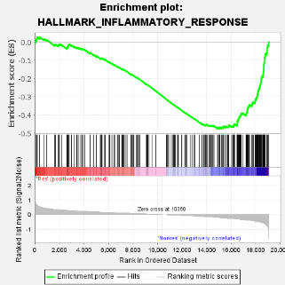
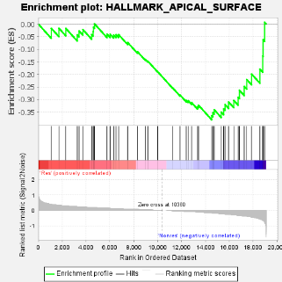
Supplementary Figure 4
(A)
P = 0.352
P = 0.476
P = 0.476
P = 0.476
(B)
(C)

