Slide 1
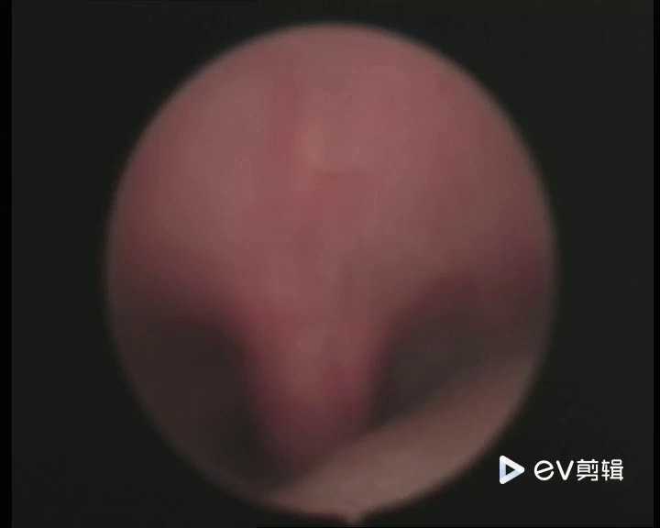
Palatal Tremor Observed in a Patient with HOD After a Pontine Stroke by Laryngoscopy
This video illustrates a palatal tremor observed during a laryngoscopy examination in a 54-year-old male patient with HOD seven months after a pontine stroke. In the video, a clear tremor movement can be seen in the patient's palate, characterized by brief, involuntary, rhythmic muscular contractions of the soft palate.

