Slide 1
Supplementary Figure Legends
Figure S1. Violin plots of alpha diversity among Dhh_M，Dhh_S and Dhh_L. (A)observed_otus, (B) chao1, (C) pielou_e, (D)Simpson’s index
Figure S2. Beta diversity among Dhh_M，Dhh_S and Dhh_L. (A) Principal Component Analysis (PCA) and (B)Principal coordinates analysis (PcoA) analysis revealed the differences among Dhh_M，Dhh_S and Dhh_L.
Figure S3. The composition of genera among Dhh_M，Dhh_S and Dhh_L. (A) The column diagram depicted the top 5 most abundance phyla difference. (B) The stacked plot demonstrated the top 30 most abundance bacterial genera distribution..
Figure S4. Prediction of altered KEGG pathways using PICRUSt2 analysis of the fecal microbiota for groups Dhh_M，Dhh_S and Dhh_L. the prediction of altered KEGG pathways in (A) level 2, (B) level 3 and (C) pathway. Bar plots on the left side display the mean proportion of each KEGG pathway. Dot plots on the right show the differences in mean proportions between the two indicated groups. P-value was calculated using t-test.

Slide 2
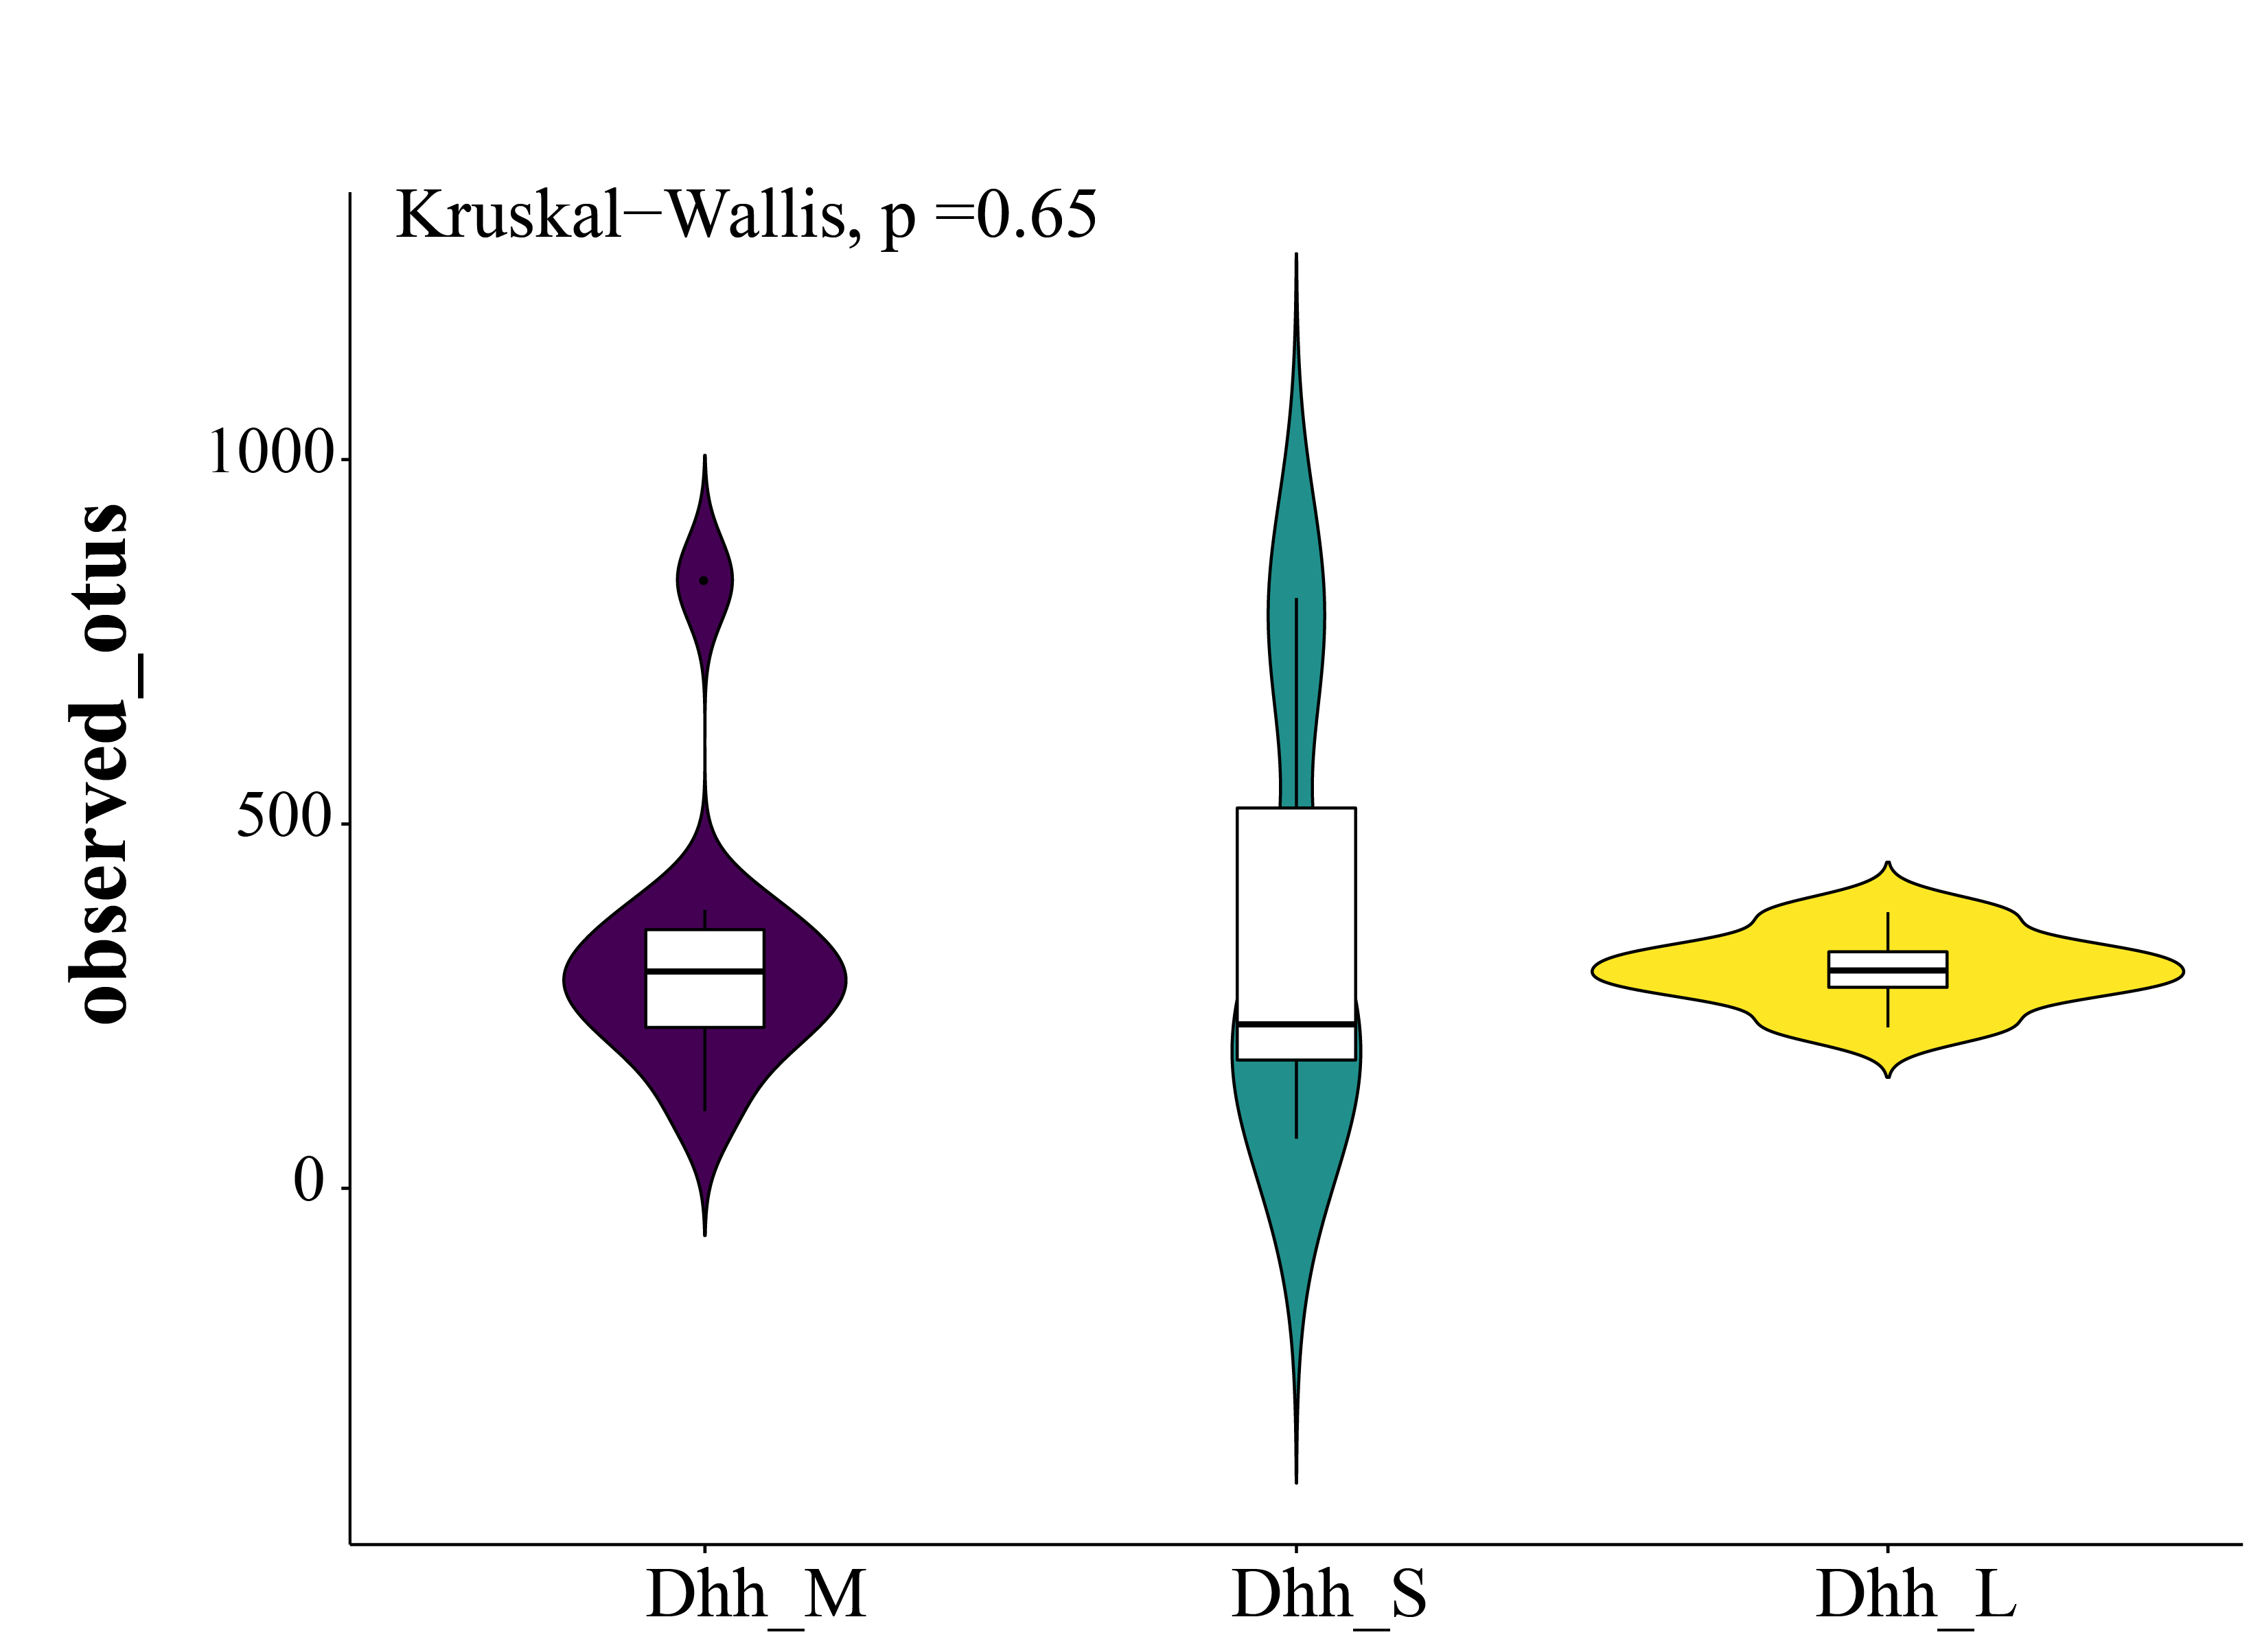
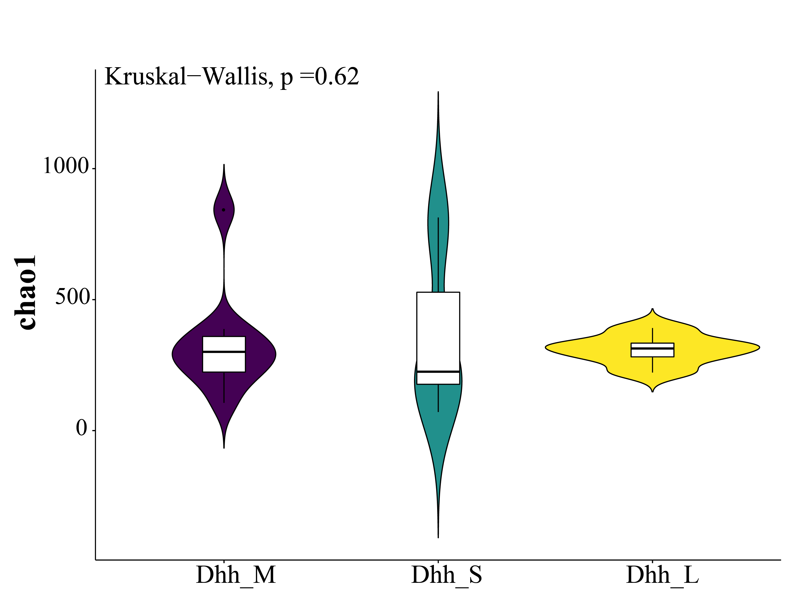
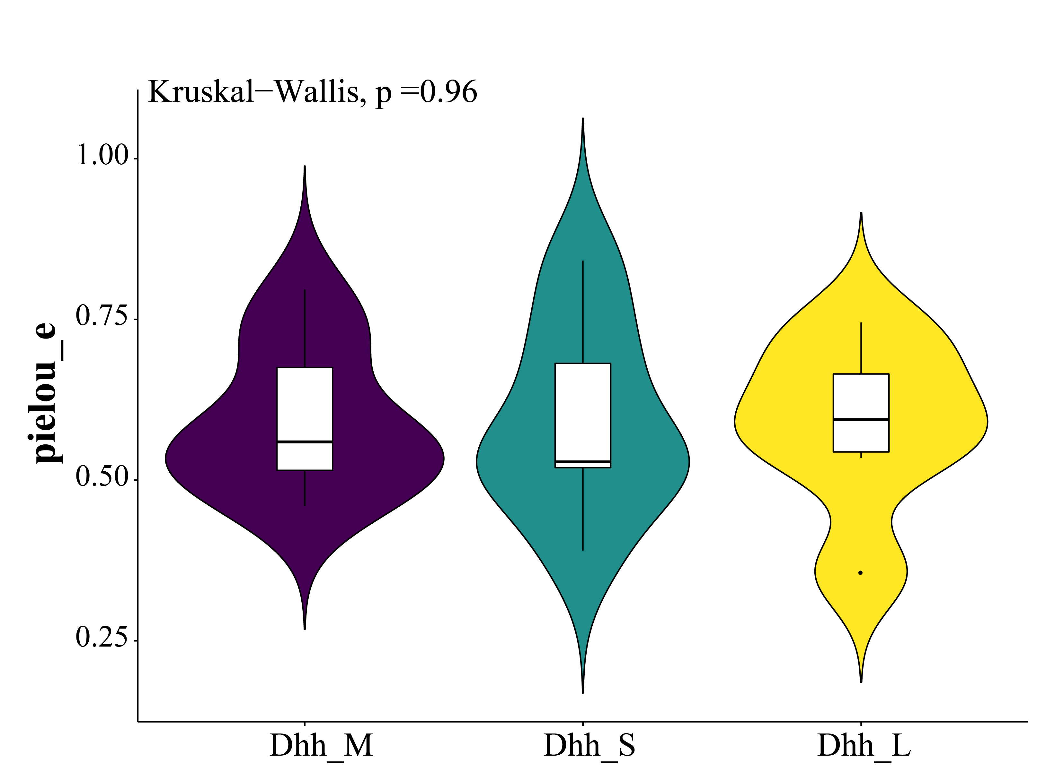
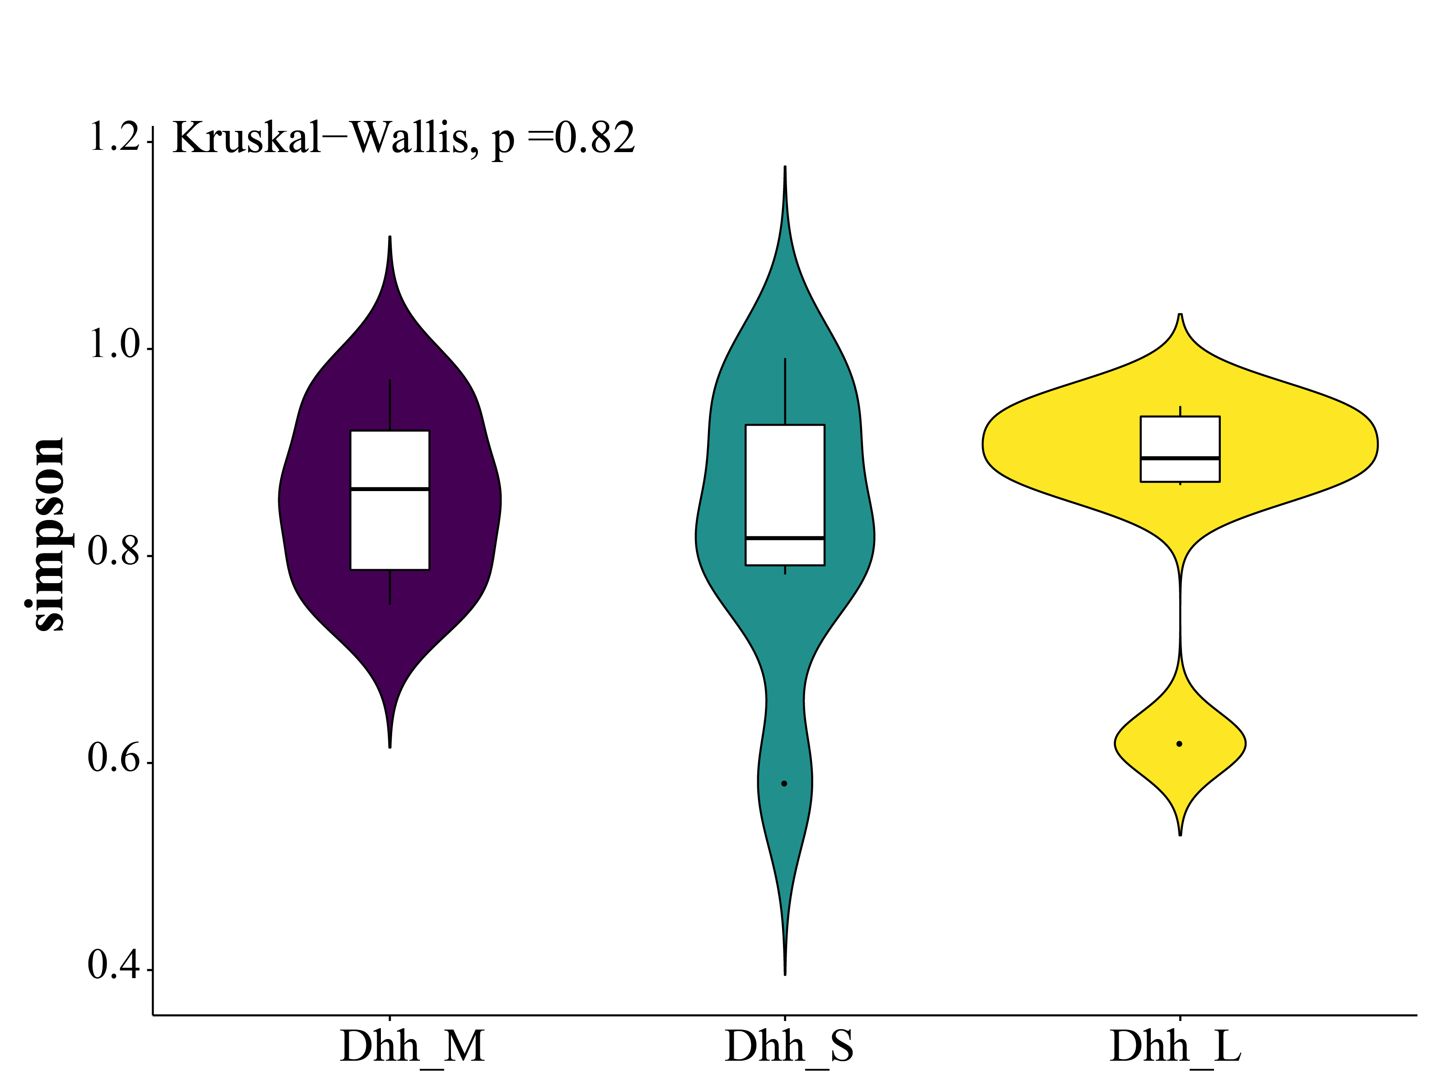
A
B
C
D
Notes:
Figure S1. Violin plots of alpha diversity among Dhh_M，Dhh_S and Dhh_L. (A)observed_otus, (B) chao1, (C) pielou_e, (D)Simpson’s index

Slide 3
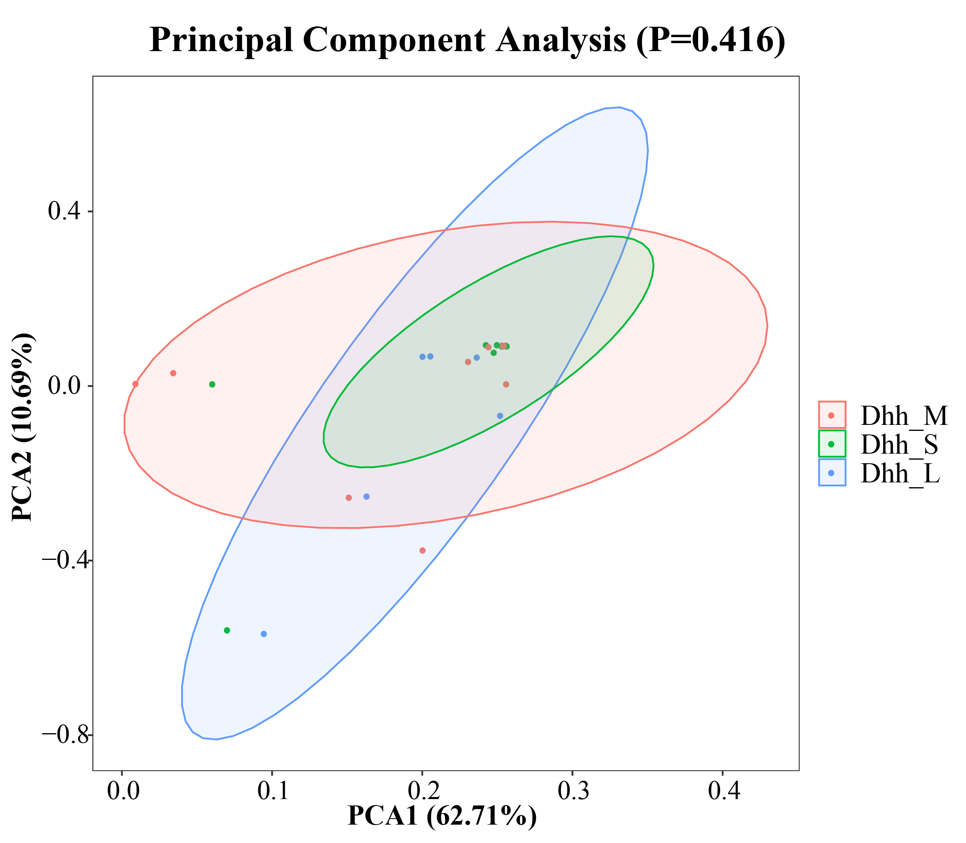
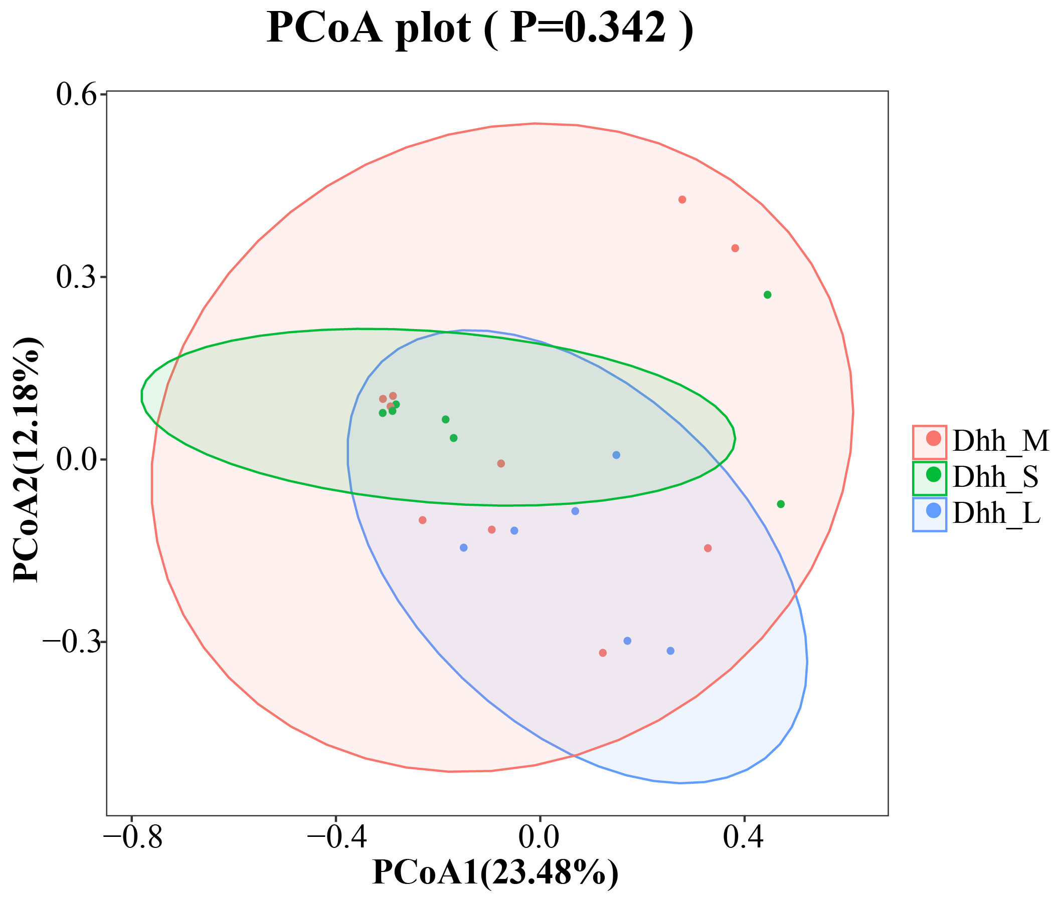
A
B
Dhh_S/Dhh_M P=0.55
Dhh_S/Dhh_L P=0.183
Dhh_M/Dhh_L P=0.487
Notes:
Figure S2. Beta diversity among Dhh_M，Dhh_S and Dhh_L. (A) Principal Component Analysis (PCA) and (B)Principal coordinates analysis (PcoA) analysis revealed the differences among Dhh_M，Dhh_S and Dhh_L.

Slide 4
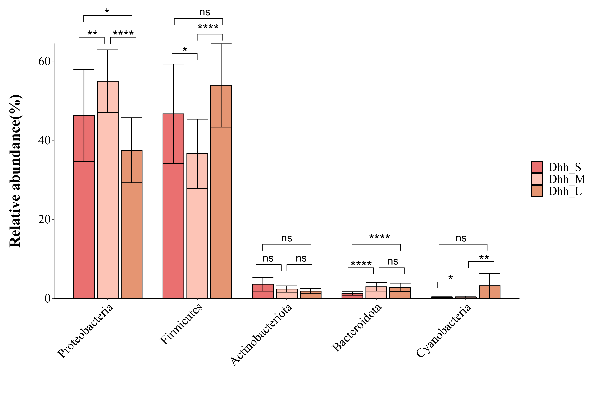
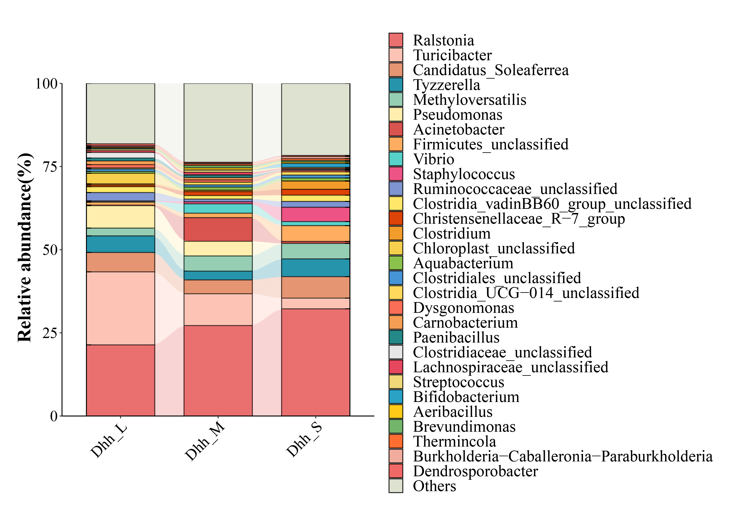
A
B
Notes:
Figure S3. The composition of genera among Dhh_M，Dhh_S and Dhh_L. (A) The column diagram depicted the top 5 most abundance phyla difference. (B) The stacked plot demonstrated the top 30 most abundance bacterial genera distribution.

Slide 5
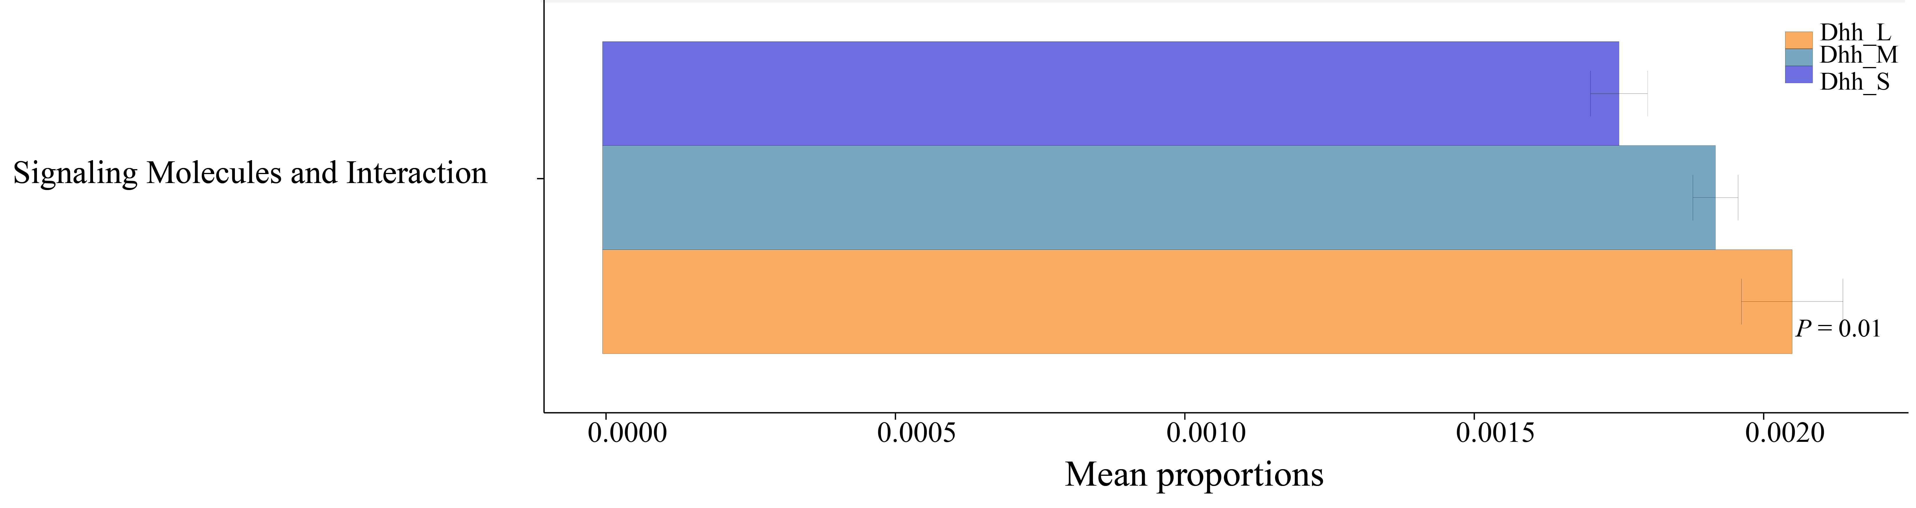
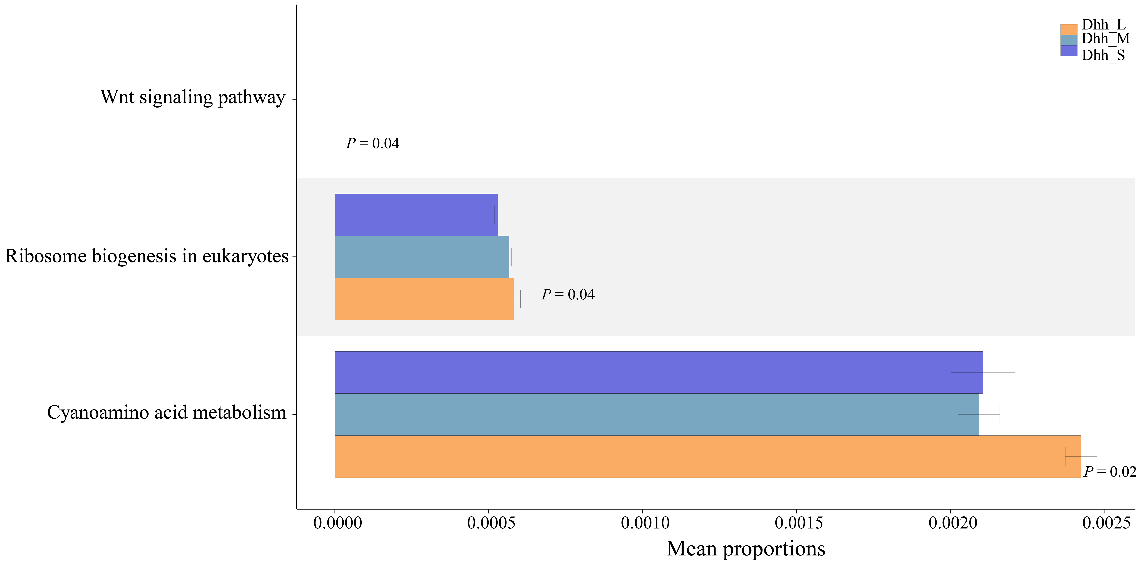
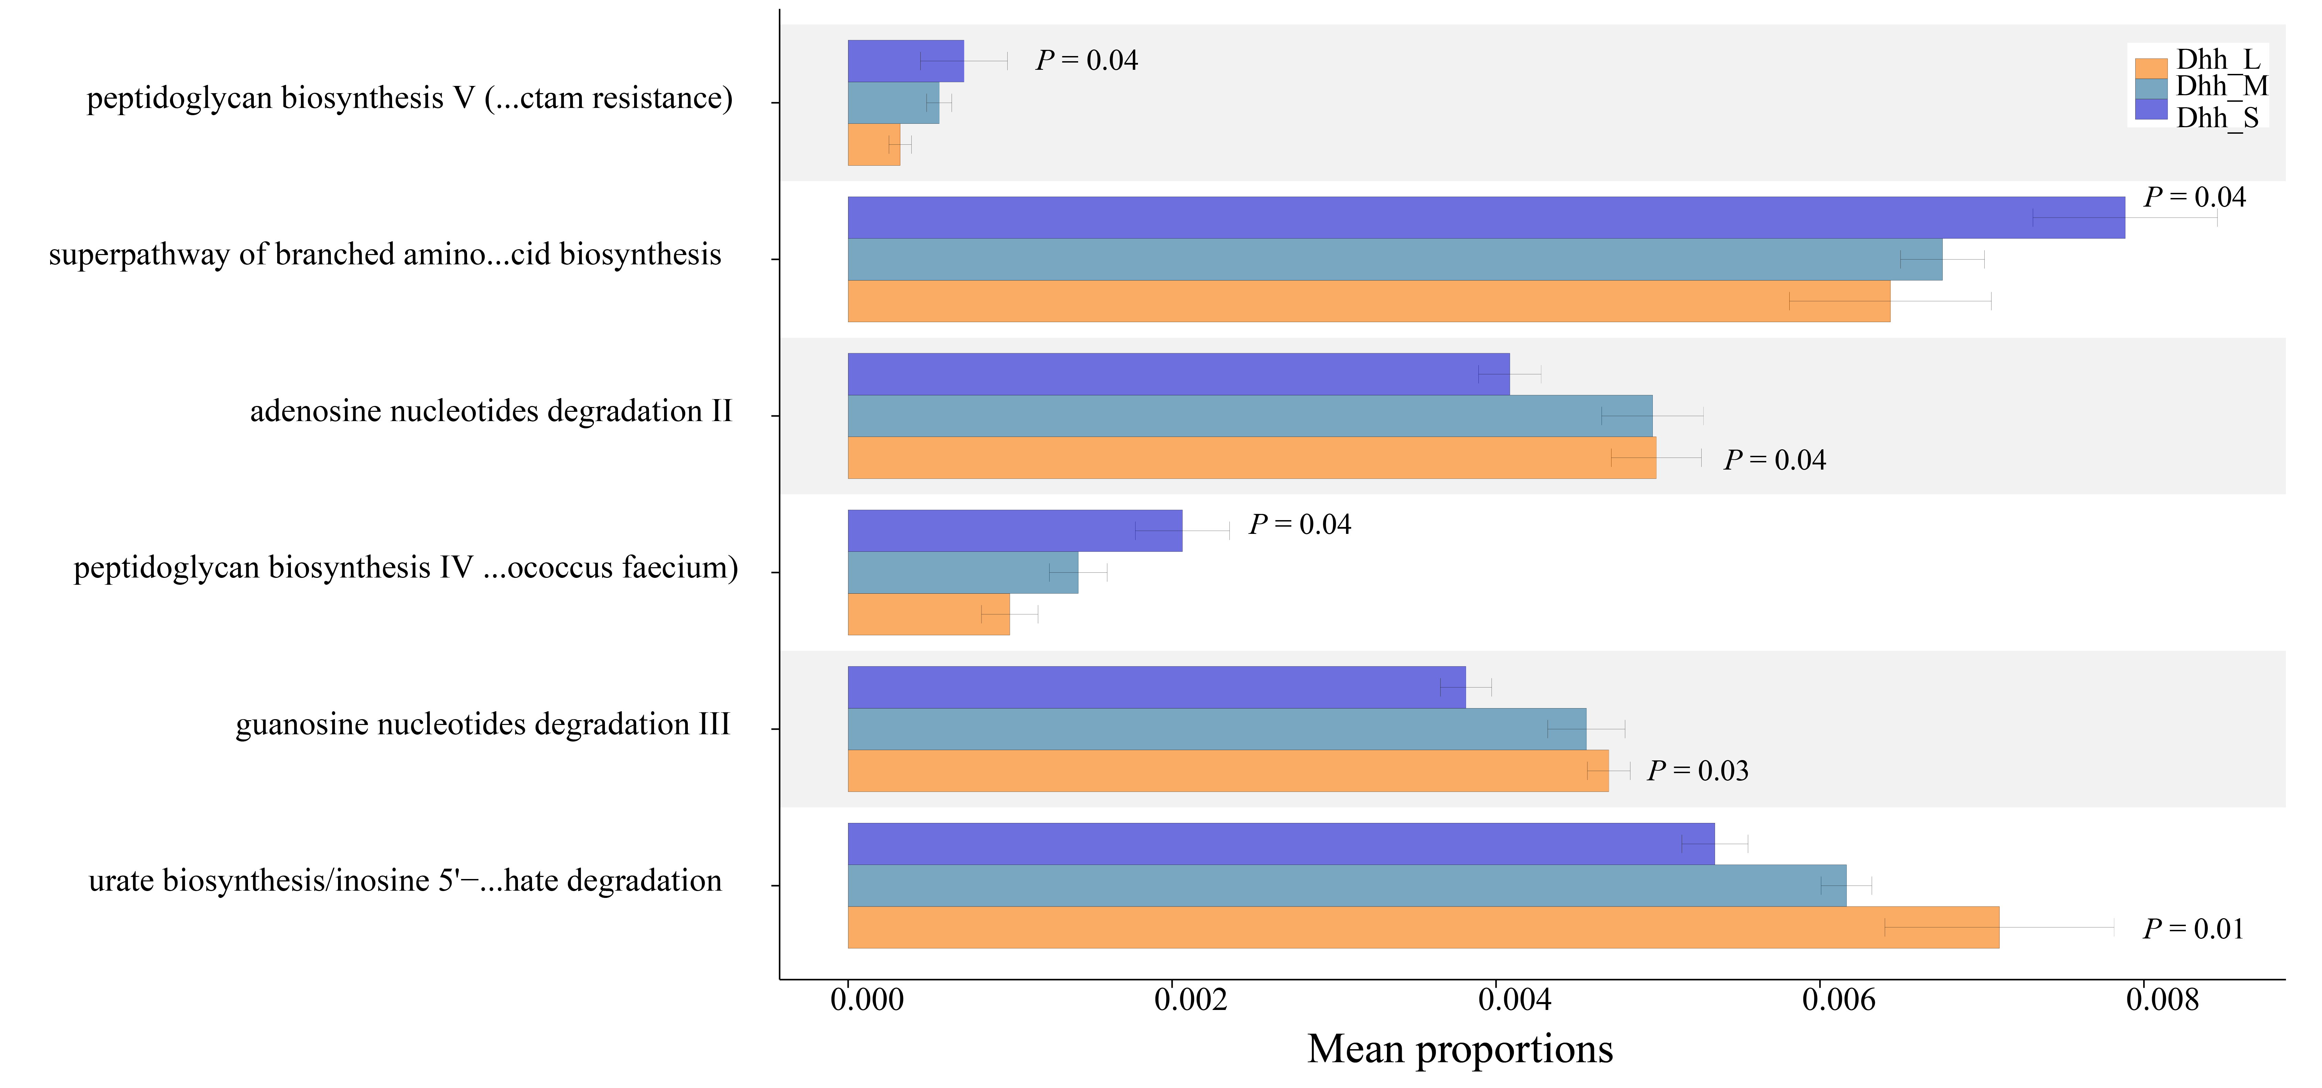
A
B
C
Notes:
Figure S4. Prediction of altered KEGG pathways using PICRUSt2 analysis of the fecal microbiota for groups Dhh_M，Dhh_S and Dhh_L. the prediction of altered KEGG pathways in (A) level 2, (B) level 3 and (C) pathway. Bar plots on the left side display the mean proportion of each KEGG pathway. Dot plots on the right show the differences in mean proportions between the two indicated groups. P-value was calculated using t-test.

