Slide 1
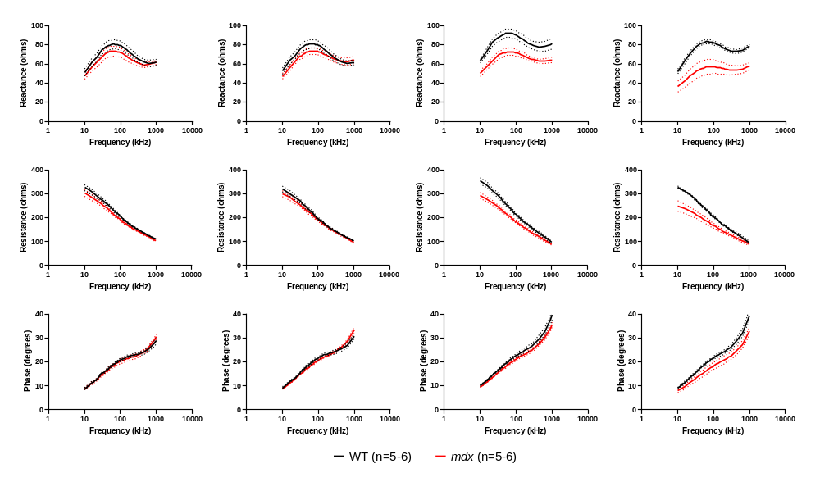
Supplementary fig. 2
Age
6W
12W
18W
24W
Reactance
Resistance
Phase

