Slide 1
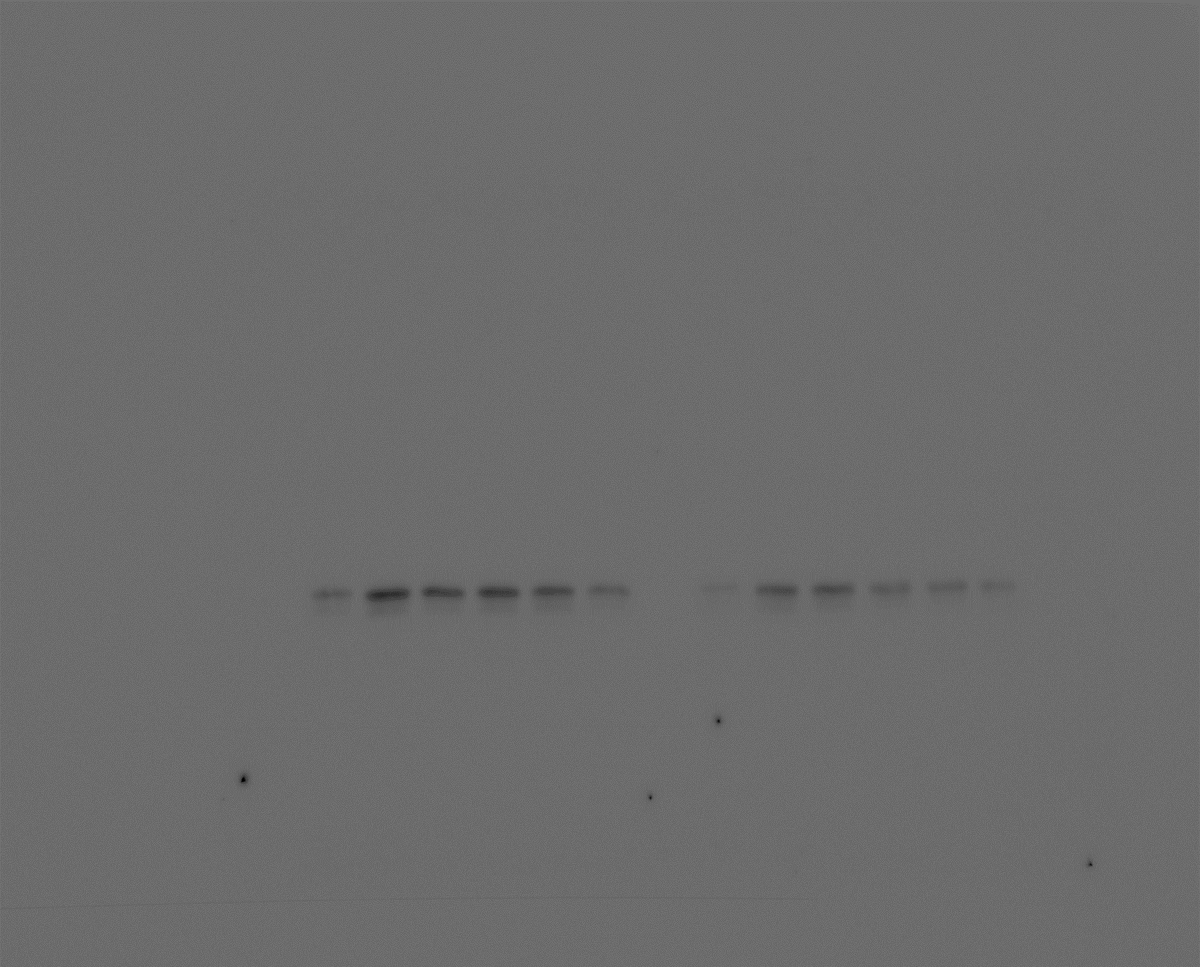
Lane
1
2
3
4
5
6
ExoS-FLAG
Fig S2. The effect of quercetin on secreted ExoS-FLAG. p30 and p137 strains were grown overnight in LB broth supplemented with quercetin and 1 mM EGTA at 37℃ in a rotary shaker. Lysed bacterial protein was quantified and loaded by using a 10% SDS-PAGE. (Lane 1 – only p30, Lane 2 – only p137, Lane 3 – p137+quercetin 2.5 μM, Lane 4- p137+quercetin 5 μM, Lane 5 – p137+quercetin 10 μM, Lane 6 – p137+quercetin 20 μM)

Slide 2
Lane
1
2
3
4
5
6
p-AKT
Fig S3.1. The effect of quercetin on P. aeruginosa-induced NF-κB activation in H292 cells. H292 cells were seeded into 12-well plates at a concentration of 1 × 10⁶ cells/well. The cells were treated with quercetin and PAK ExoS for 4 h. PAK ExoS, PAK ΔST/pUCP18 PAKexoS. (Lane 1 – only uninfected H292 cell, Lane 2 – only infected H292 cell, Lane 3 – infected H292 cell+quercetin 2.5 μM, Lane 4- infected H292 cell+quercetin 5 μM, Lane 5 – infected H292 cell+quercetin 10 μM, Lane 6 – infected H292 cell+quercetin 20 μM)

Slide 3
Lane
1
2
3
4
5
6
AKT
Fig S3.2. The effect of quercetin on P. aeruginosa-induced NF-κB activation in H292 cells. H292 cells were seeded into 12-well plates at a concentration of 1 × 10⁶ cells/well. The cells were treated with quercetin and PAK ExoS for 4 h. PAK ExoS, PAK ΔST/pUCP18 PAKexoS. (Lane 1 – only uninfected H292 cell, Lane 2 – only infected H292 cell, Lane 3 – infected H292 cell+quercetin 2.5 μM, Lane 4- infected H292 cell+quercetin 5 μM, Lane 5 – infected H292 cell+quercetin 10 μM, Lane 6 – infected H292 cell+quercetin 20 μM)

Slide 4
Lane
1
2
3
4
5
6
p-IκBα
Fig S3.3. The effect of quercetin on P. aeruginosa-induced NF-κB activation in H292 cells. H292 cells were seeded into 12-well plates at a concentration of 1 × 10⁶ cells/well. The cells were treated with quercetin and PAK ExoS for 4 h. PAK ExoS, PAK ΔST/pUCP18 PAKexoS. (Lane 1 – only uninfected H292 cell, Lane 2 – only infected H292 cell, Lane 3 – infected H292 cell+quercetin 2.5 μM, Lane 4- infected H292 cell+quercetin 5 μM, Lane 5 – infected H292 cell+quercetin 10 μM, Lane 6 – infected H292 cell+quercetin 20 μM)

Slide 5
Lane
1
2
3
4
5
6
IκBα
Fig S3.4. The effect of quercetin on P. aeruginosa-induced NF-κB activation in H292 cells. H292 cells were seeded into 12-well plates at a concentration of 1 × 10⁶ cells/well. The cells were treated with quercetin and PAK ExoS for 4 h. PAK ExoS, PAK ΔST/pUCP18 PAKexoS. (Lane 1 – only uninfected H292 cell, Lane 2 – only infected H292 cell, Lane 3 – infected H292 cell+quercetin 2.5 μM, Lane 4- infected H292 cell+quercetin 5 μM, Lane 5 – infected H292 cell+quercetin 10 μM, Lane 6 – infected H292 cell+quercetin 20 μM)

Slide 6
Lane
1
2
3
4
5
6
p-p65
Fig S3.5. The effect of quercetin on P. aeruginosa-induced NF-κB activation in H292 cells. H292 cells were seeded into 12-well plates at a concentration of 1 × 10⁶ cells/well. The cells were treated with quercetin and PAK ExoS for 4 h. PAK ExoS, PAK ΔST/pUCP18 PAKexoS. (Lane 1 – only uninfected H292 cell, Lane 2 – only infected H292 cell, Lane 3 – infected H292 cell+quercetin 2.5 μM, Lane 4- infected H292 cell+quercetin 5 μM, Lane 5 – infected H292 cell+quercetin 10 μM, Lane 6 – infected H292 cell+quercetin 20 μM)

Slide 7
Lane
1
2
3
4
5
6
p65
Fig S3.6. The effect of quercetin on P. aeruginosa-induced NF-κB activation in H292 cells. H292 cells were seeded into 12-well plates at a concentration of 1 × 10⁶ cells/well. The cells were treated with quercetin and PAK ExoS for 4 h. PAK ExoS, PAK ΔST/pUCP18 PAKexoS. (Lane 1 – only uninfected H292 cell, Lane 2 – only infected H292 cell, Lane 3 – infected H292 cell+quercetin 2.5 μM, Lane 4- infected H292 cell+quercetin 5 μM, Lane 5 – infected H292 cell+quercetin 10 μM, Lane 6 – infected H292 cell+quercetin 20 μM)

Slide 8
Lane
1
2
3
4
5
6
β-actin
Fig S3.7. The effect of quercetin on P. aeruginosa-induced NF-κB activation in H292 cells. H292 cells were seeded into 12-well plates at a concentration of 1 × 10⁶ cells/well. The cells were treated with quercetin and PAK ExoS for 4 h. PAK ExoS, PAK ΔST/pUCP18 PAKexoS. (Lane 1 – only uninfected H292 cell, Lane 2 – only infected H292 cell, Lane 3 – infected H292 cell+quercetin 2.5 μM, Lane 4- infected H292 cell+quercetin 5 μM, Lane 5 – infected H292 cell+quercetin 10 μM, Lane 6 – infected H292 cell+quercetin 20 μM)

Slide 9
Lane
1
2
3
4
5
6
NLRC4
Fig S4.1. The effect of quercetin on P. aeruginosa-induced NLRC4-Caspase-1 pathway in H292 cells. H292 cells were seeded into 12-well plates at a concentration of 1 × 10⁶ cells/well. The cells were treated with quercetin and PAK ExoS for 2 h. PAK ExoS, PAK ΔST/pUCP18 PAKexoS. (Lane 1 – only uninfected H292 cell, Lane 2 – only infected H292 cell, Lane 3 – infected H292 cell+quercetin 2.5 μM, Lane 4- infected H292 cell+quercetin 5 μM, Lane 5 – infected H292 cell+quercetin 10 μM, Lane 6 – infected H292 cell+quercetin 20 μM)

Slide 10
Lane
1
2
3
4
5
6
NLRC4
Fig S4.2. The effect of quercetin on P. aeruginosa-induced NLRC4-Caspase-1 pathway in H292 cells. H292 cells were seeded into 12-well plates at a concentration of 1 × 10⁶ cells/well. The cells were treated with quercetin and PAK ExoS for 2 h. PAK ExoS, PAK ΔST/pUCP18 PAKexoS. (Lane 1 – only uninfected H292 cell, Lane 2 – only infected H292 cell, Lane 3 – infected H292 cell+quercetin 2.5 μM, Lane 4- infected H292 cell+quercetin 5 μM, Lane 5 – infected H292 cell+quercetin 10 μM, Lane 6 – infected H292 cell+quercetin 20 μM)

Slide 11
Lane
1
2
3
4
5
6
β-actin
Fig S4.3. The effect of quercetin on P. aeruginosa-induced NLRC4-Caspase-1 pathway in H292 cells. H292 cells were seeded into 12-well plates at a concentration of 1 × 10⁶ cells/well. The cells were treated with quercetin and PAK ExoS for 2 h. PAK ExoS, PAK ΔST/pUCP18 PAKexoS. (Lane 1 – only uninfected H292 cell, Lane 2 – only infected H292 cell, Lane 3 – infected H292 cell+quercetin 2.5 μM, Lane 4- infected H292 cell+quercetin 5 μM, Lane 5 – infected H292 cell+quercetin 10 μM, Lane 6 – infected H292 cell+quercetin 20 μM)

