Slide 1
(A)
(B)
(C)

Slide 2
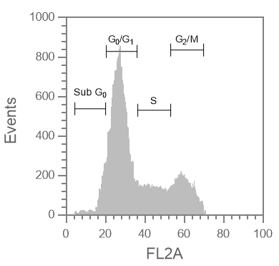
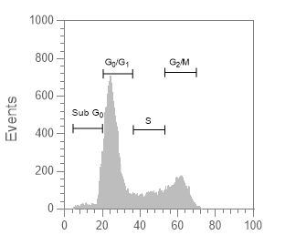
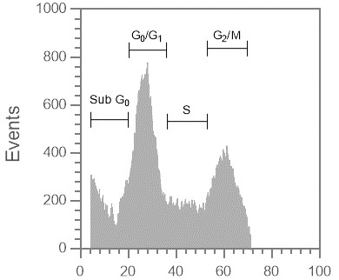
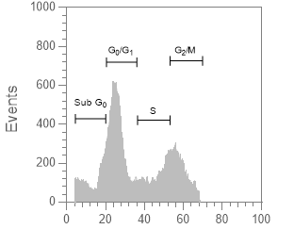
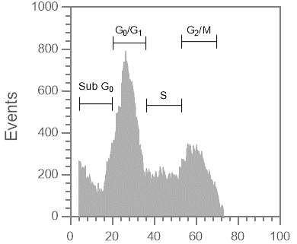
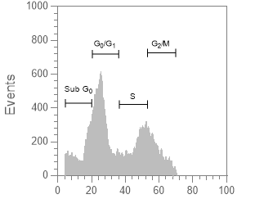
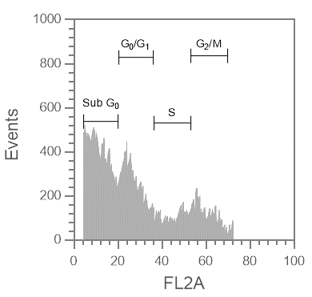
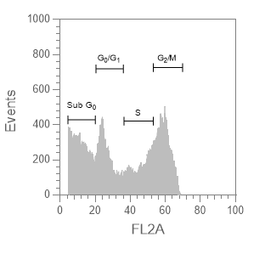
(A) HepG2
(B) SNU-449
NS
NS
Paclitaxel
Paclitaxel
Thymoquinone
Thymoquinone
Paclitaxel + Thymoquinone
Paclitaxel + Thymoquinone

Slide 3
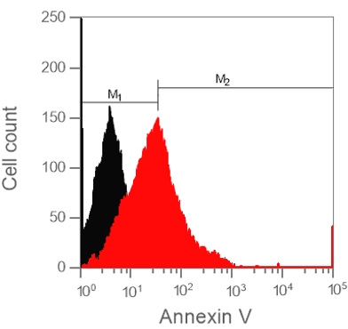
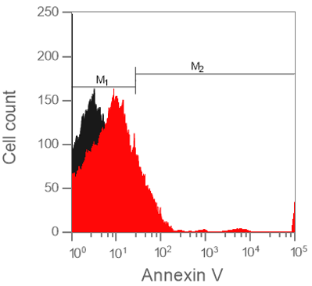
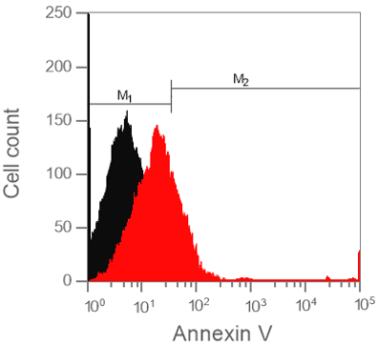
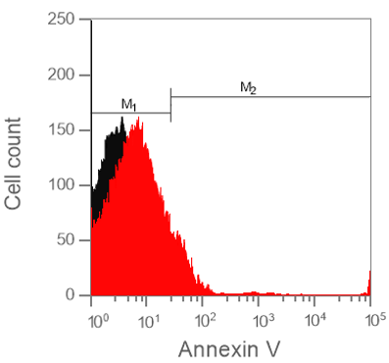
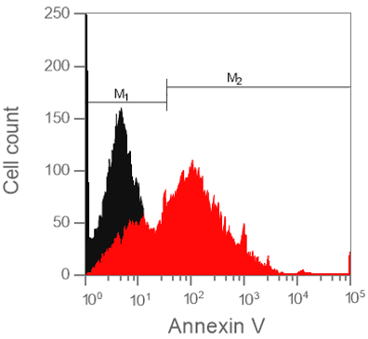
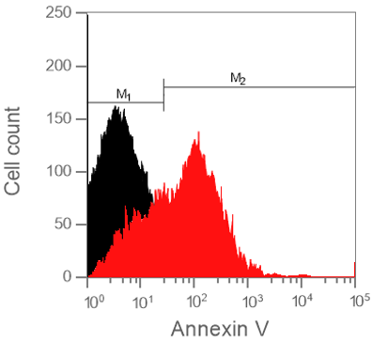
(A) HepG2
(B) SNU-449

Slide 4
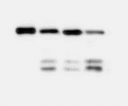
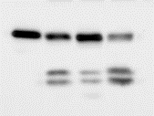

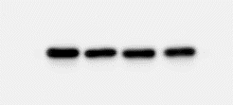
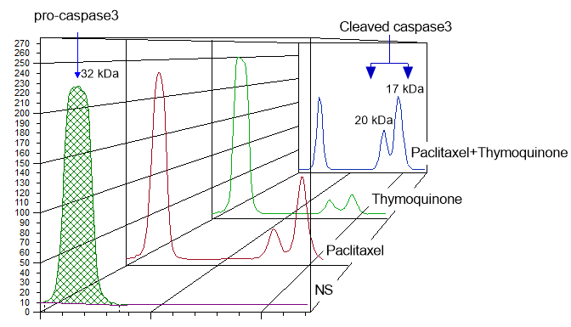
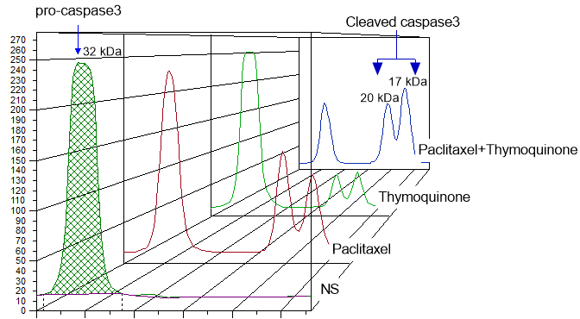
(A)
(B)
HepG2
SNU-449
Paclitaxel
Thymoquinone
- + - +
- - + +
Paclitaxel
Thymoquinone
- + - +
- - + +
Pro-caspase-3 ➔
Cleaved caspase-3 ➔
GAPDH ➔

Slide 5

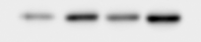
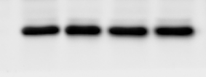

(A)
HepG2
SNU-449
(B)
HepG2
SNU-449
Paclitaxel - + - +
Thymoquinone - - + +
Paclitaxel - + - +
Thymoquinone - - + +
P₅₃ ➔
GAPDH ➔

Slide 6




(A)
HepG2
SNU-449
Ctrl-siRNA + -
P₅₃ siRNA - +
Ctrl-siRNA + -
P₅₃ siRNA - +
P₅₃ ➔
GAPDH ➔
(B)
HepG2
SNU-449

