Slide 1
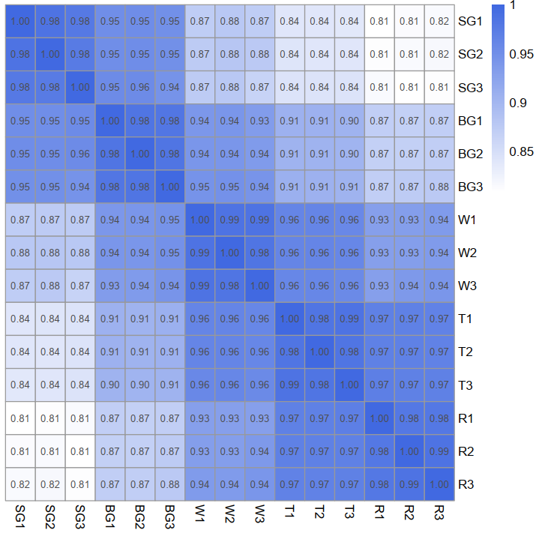
Fig. S1 Correlation analysis based on all the expressed genes among samples. The X and Y axes represent each sample, and color represents the correlation coefficient (darker color means a higher correlation).

Slide 2
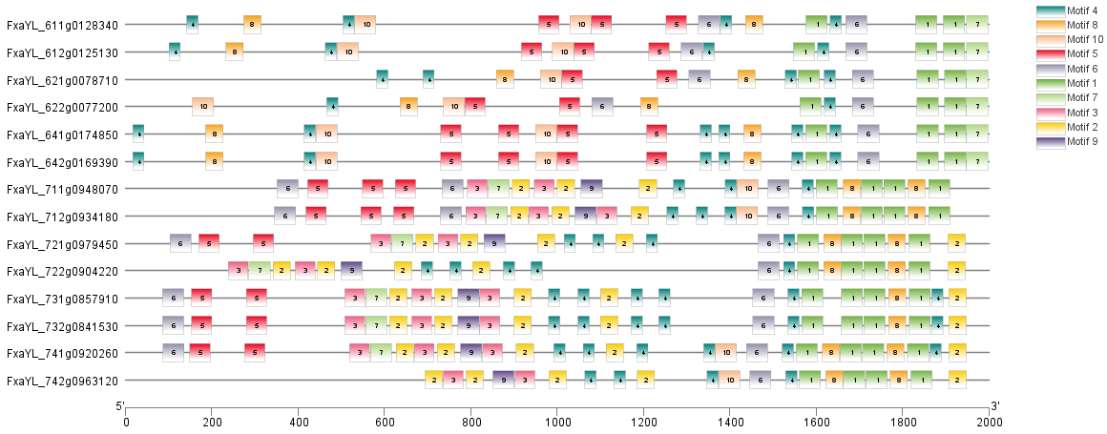
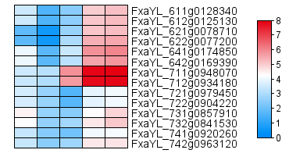
PAL
a
b
SG BG W T R
c
sequence | Motif-ID
SCYGTTTTCMHYHMAYCCWTCKKCCMWYCCCHCYCCCCYCYCHCBHCTNC | Motif-1
YGWAAYCBATKSGMATTTGNWDCMTMCDKGMAWKCWRYWST | Motif-2
AKSTVWWDMHRRWCTAGAHDVGTACWMCYAKCTMRTTTTTWSRTTDC | Motif-3
ANMTCYAAAMHMAAAANMAACMAAWAW | Motif-4
WSMTAAATTWGTCARWWKTWRCAHTTAAWKYWADRANWTWTVAAMTTT | Motif-5
SWAAARDGAWAWYTACYYVCCDCATKAKCARCTKMHTDTGSWWMCRNATC | Motif-6
AAYTYYCHTYTCTSCGRWMAWKWSWGRKTKCAATTCTMASYWMYRACRTA | Motif-7
AAAMACYCNSRTTHTKRDHCAVCAMYTCADNWWMGAWTTTY | Motif-8
CATCAATACTGTGATACTAGTAAGAASTGCCCAGCCTTTCCAGTTTGGAT | Motif-9
ATAWGGTHACTTGAADDRATCHGACDTGASDWWGAAATTGAGCYHTSADT | Motif-10
Fig. S2 Analysis and comparison of promoter conserved motifs of PAL genes. (a) represents the position of the motif on the promoter. (b) genes expression heatmap in different fruit development stage. (c) The motifs sequence.

Slide 3
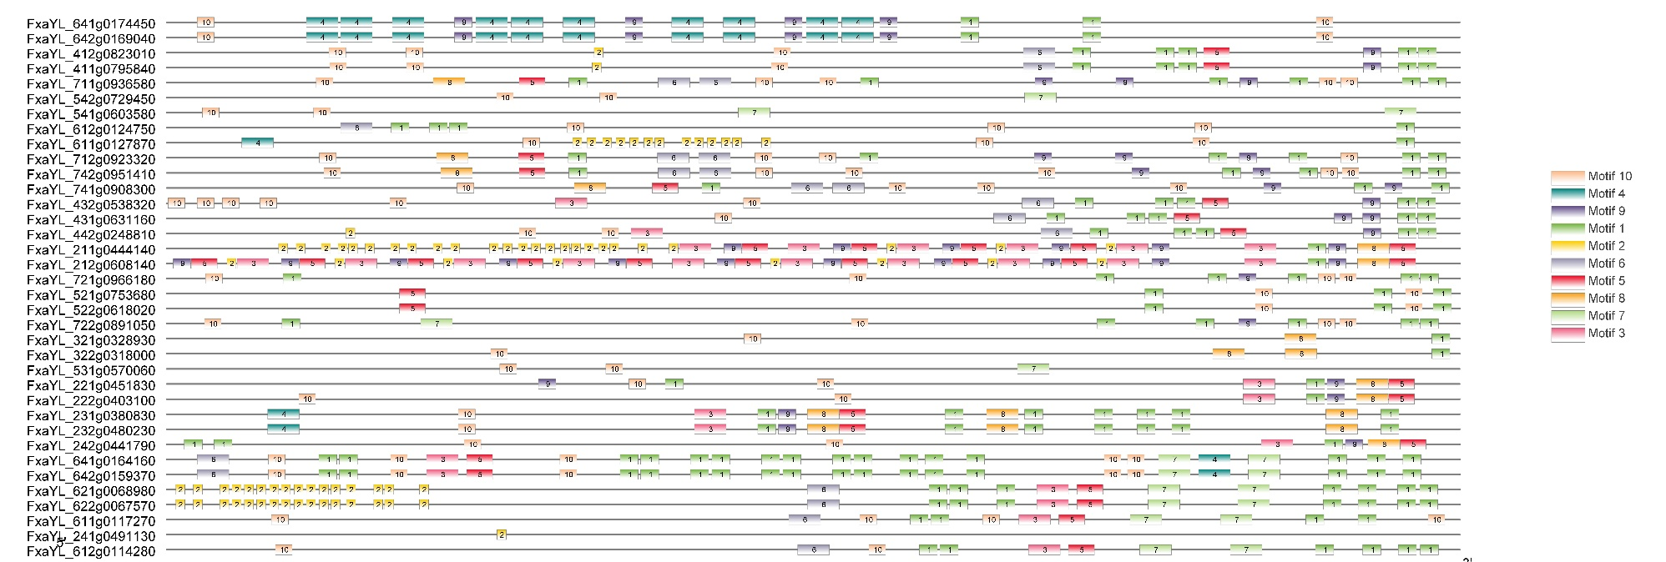
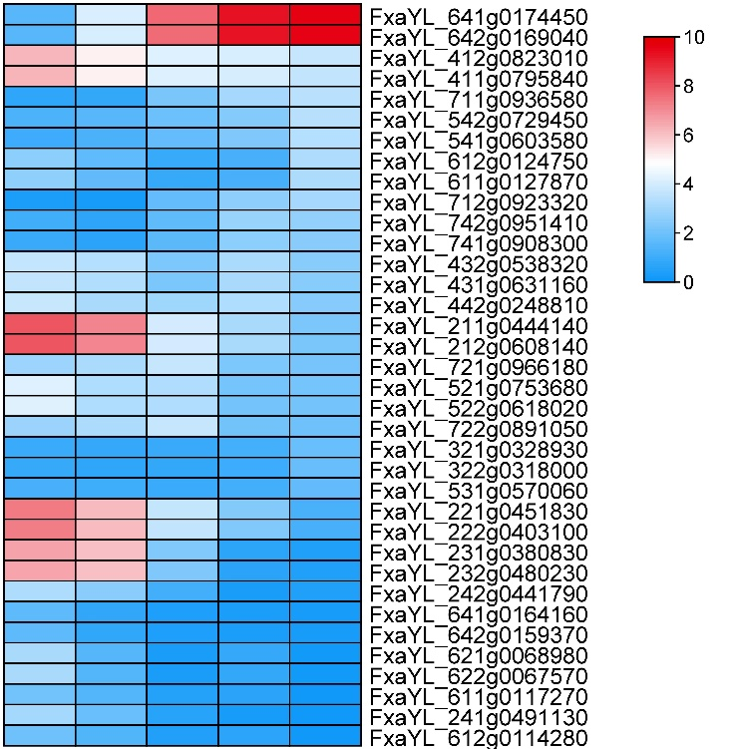
4CL
SG BG W T R
a
b
c
sequence | Motif-ID
HCCCAMCMCMAHCHCCAHYTYCHHCWYCC | Motif-1
TTCGTCGGCTAWAGT | Motif-2
TKWRGGGYAGTTWAMHTTTTTCTTGKYCWYCGTTTTTTTYGWTHKKTTTR | Motif-3
YTCAAATCTCAATTGATTAATRHCTTGATMDWMTCHADDYBCMATVHYHT | Motif-4
KCTYSWSGTYYAWDTBMGTKKRCTCGCGATNGABCGATTWC | Motif-5
SWTBRKCKGAAATGGNAAASMCGBCRMNGCMSTHKATGGGMTGAKMAWAG | Motif-6
CATKWYTKAGRCMACAAATTTTAGACYTYATTKAGGYCWMWWATCAWYKT | Motif-7
SYCGAMRGSATGAMAYKCMWTTSMCMHYACACCCCMATHATGCAVMTTSC | Motif-8
CVTMWWWTGAHCCAANCAAGVMTCMAAM | Motif-9
RAAAAWRAARAAAAAARAADAAWDDTD | Motif-10
Fig. S3 Analysis and comparison of promoter conserved motifs of 4CL genes. (a) represents the position of the motif on the promoter. (b) 4CL genes expression heatmap in different fruit development stage. (c) The motifs sequence.

Slide 4
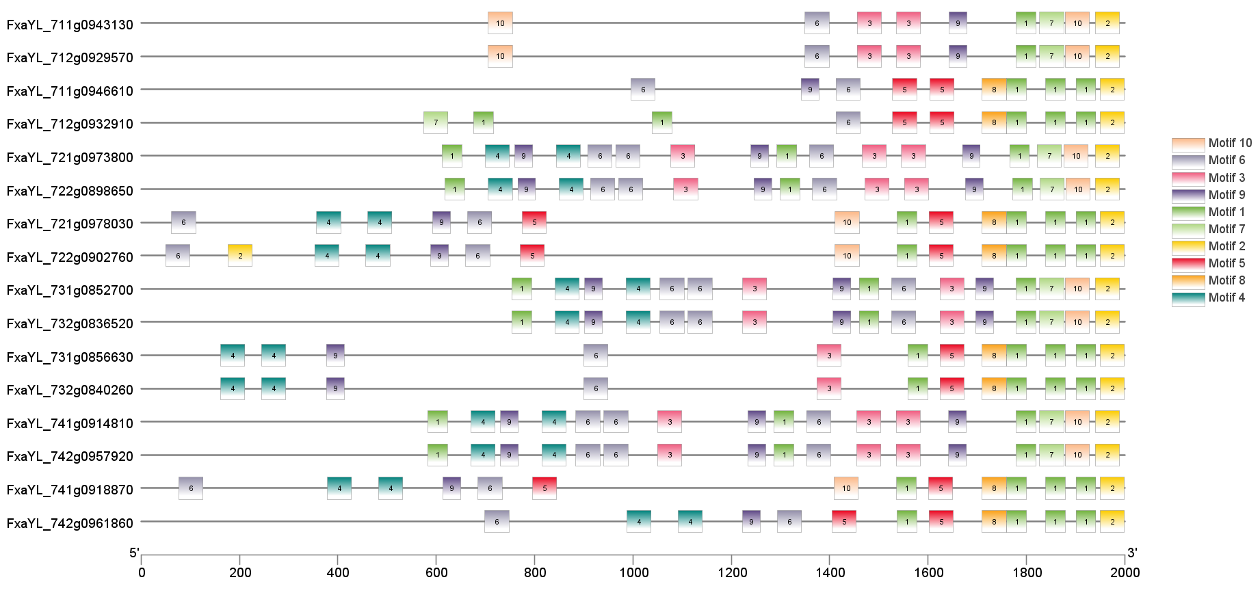
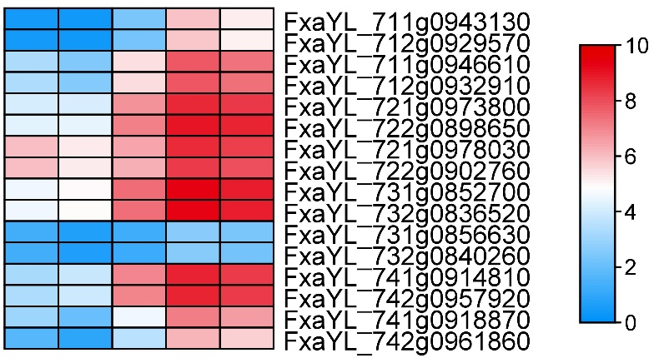
CHI
a
b
SG BG W T R
c
sequence | Motif-ID
TYYMAAGCBTCHVACYMTCYCWCCTTYYAMRHVMCMMBMAC | Motif-1
CSWMMACYAMWWTCATCTCWMCATTKYTAMATYWMWAMYARGAAMMTCAA | Motif-2
ACHTTTTGDATAGTAATTBAATAWGDAAAGAHTAAACCTCAMKAHNDWYW | Motif-3
WMTDGAGTTDGAGTVAHAAYYCMTADHAGTTTGTGGTBARVATSTTKRAG | Motif-4
RGGSWSARCWWGGTAAMWTKAGRAAYSWWTTWTTCTTMTTYYTCVTKTTA | Motif-5
MCWKMGCANMTTBTCAMAACSADTCTAMHAASWKWATTTADATTGASATM | Motif-6
CAACCTACCACCTAGGACAAGACTGGAAGACCTAAGAGTGTCAGCTGGAG | Motif-7
GTCCAGTTTTTCCCTCCCATTTGATCGACCGGTAAAGCTTCCCTCCACGT | Motif-8
AYTAWTTGRVTTTACAACDAACTTCCTCATNTNWYCK | Motif-9
ACACCCACRAGAWAYAYAGAGVCAKTMMTKTAGCRKCWCCSTCTWCCCTC | Motif-10
Fig. S4 Analysis and comparison of promoter conserved motifs of CHI genes. (a) represents the position of the motif on the promoter. (b) CHI genes expression heatmap in different fruit development stage. (c) The motifs sequence.

Slide 5
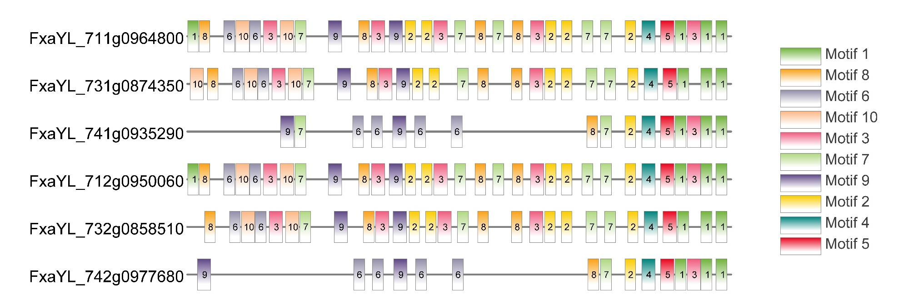
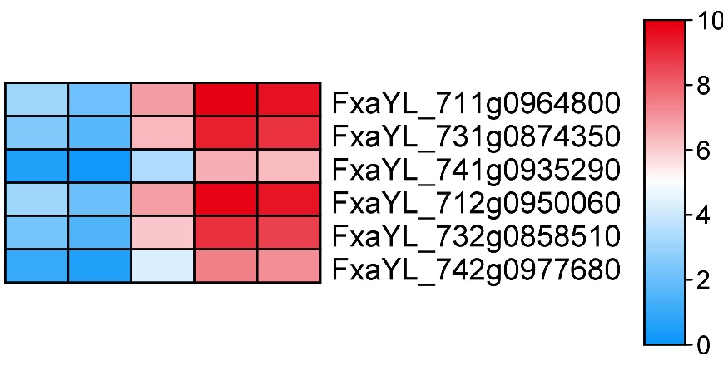
a
CHS
b
SG BG W T R
c
sequence | Motif-ID
BKKCMKCCWTGCSTTCCCMCTKYDACCCWACHCBMMCYTYY | Motif-1
AAYGWBARTRAGTTAAGTGABWAAYGDRWTHAAARTYRA | Motif-2
TTTTWHRTGDHWABACAAMTMYAHYTTYNATRYHADYRGWTTCTAACNVY | Motif-3
TTTCGCAGCCCTTTTGTTTGGTAGGTAAGACGAGAGAAGCAACRCATCCC | Motif-4
CACACAARAATACCATGCACGTGCCATTCTCTTGGGGGTTCTAACWAGGC | Motif-5
CYTSRSGGARYSVAKTGABBCCARRWMCAAMMMVAARMYKC | Motif-6
TRASAWTRAARTMKGAWVAVAWTTWWAWATRAKTTWHTTTY | Motif-7
TTTTYTTWDTWTWAAVCBRRAAHTMATTTAATAACTTTCA | Motif-8
GMYKWMRTTGCGTCKWAGYTWKAASMWYWRWYAMMATKATRAHATWHYAS | Motif-9
VTSWATAGRGASRAAWYYYGRTKTSSWCHGTKTTYYTYTTKTSRAAATTM | Motif-10
Fig. S5 Analysis and comparison of promoter conserved motifs of CHS genes. (a) represents the position of the motif on the promoter. (b) CHS genes expression heatmap in different fruit development stage. (c) The motifs sequence.

Slide 6
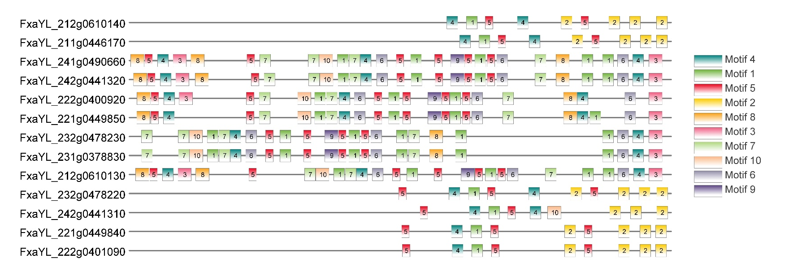
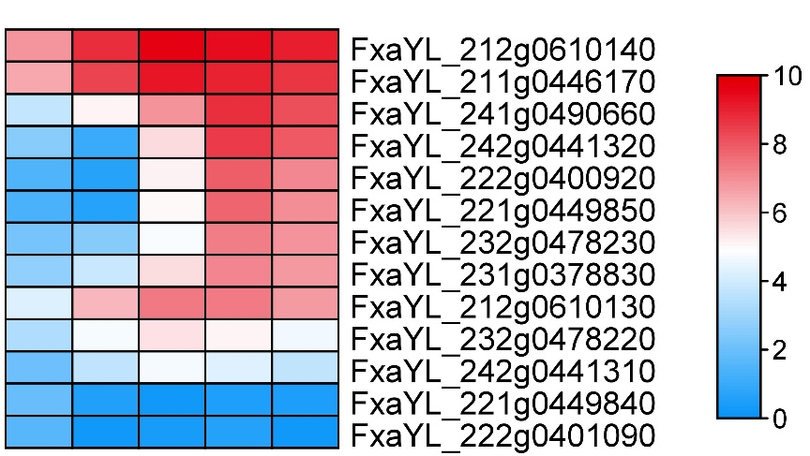
DFR
SG BG W T R
a
b
c
sequence | Motif-ID
AAACMAAKHATGWSAAMSAAWGYBAGKRWBHDYCAYCVARA | Motif-1
BATABRTGCSSCBATMSCGRHGAVYAWCCAABACYVCAYCR | Motif-2
RARCGYMYTGAKARGAKSRTATMARWCATTCMCCKSAYCKMACKKCSTYS | Motif-3
TGAAHRGRKRARCATGGAMGTATGHMVSAGVAAACRABATK | Motif-4
TGAKAWCNAABTTWNGRTTTKGGSHWTGK | Motif-5
SKTYGGKYTCWBHTKYMGGKBBKADYWCRTRGDHTYHKGDM | Motif-6
TYATATAHMAWTAGNATAGCAAAWTHGAGKSAWMCADATAB | Motif-7
WMAMYRTMAGAAABYRACTCTKCACATVHWHAYACATSHRCTTGTRTYCS | Motif-8
TGAATCCATGGTGTAGTTGTTATGCCAAAGCCCAACTYTAATGAATAACG | Motif-9
AGTTGGAGCCGAACTAGCTAKGAAGCAGAGTGCCCCCMCTYTTCAVHATT | Motif-10
Fig. S6 Analysis and comparison of promoter conserved motifs of DFR genes. (a) represents the position of the motif on the promoter. (b) DFR genes expression heatmap in different fruit development stage. (c) The motifs sequence.

Slide 7
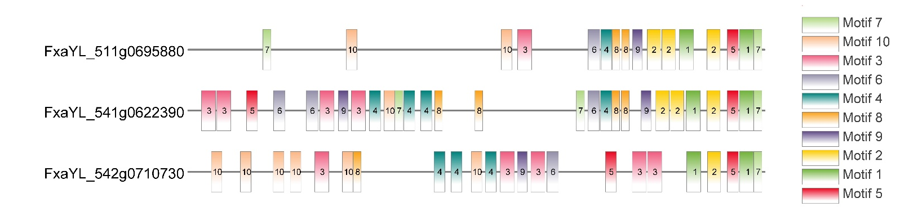
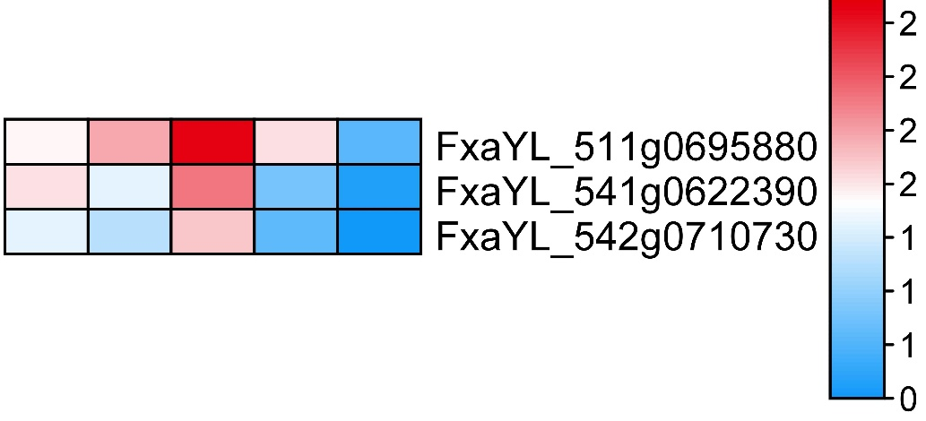
F3’5’H
SG BG W T R
b
a
c
sequence | Motif-ID
WGCARGYTAGTSYARTTGWWMATGRAAGMAYRAWRGATAASSWYYWSTWT | Motif-1
CTACRGYGKTGDMTTHHCTAGAHWTYHATCBATMYCTTATCTYMMWG | Motif-2
GSDCGHNABKVCKSGMNSGCGVGGWKSGMNHGGTGCTCKHWTTCKNSTGS | Motif-3
YCBCVYCHTKBACYGAARAAKACCMMANGRACTGRMHCW | Motif-4
CTCWSASCYTATCTSKAMTCKYMTTTTCTTCCCACYWGK | Motif-5
AAYTGYTGAGTCYGAARWTRATYGTKWTTVGRTYTCTGNGR | Motif-6
GAATACAAAAAASAAAMMAGTKGGARTTT | Motif-7
WWCAVCTGKYCADWAATTGAYCRTGAGA | Motif-8
GTGGGATGAYRYGASKYKGTSWGMAAGAYMTAWGS | Motif-9
KSCCHCSDTKCBSMDACCMMBCNASVWYCDMYGYCSBS | Motif-10
Fig. S7 Analysis and comparison of promoter conserved motifs of F3’5’H genes. (a) represents the position of the motif on the promoter. (b) F3’5’H genes expression heatmap in different fruit development stage. (c) The motifs sequence.

Slide 8
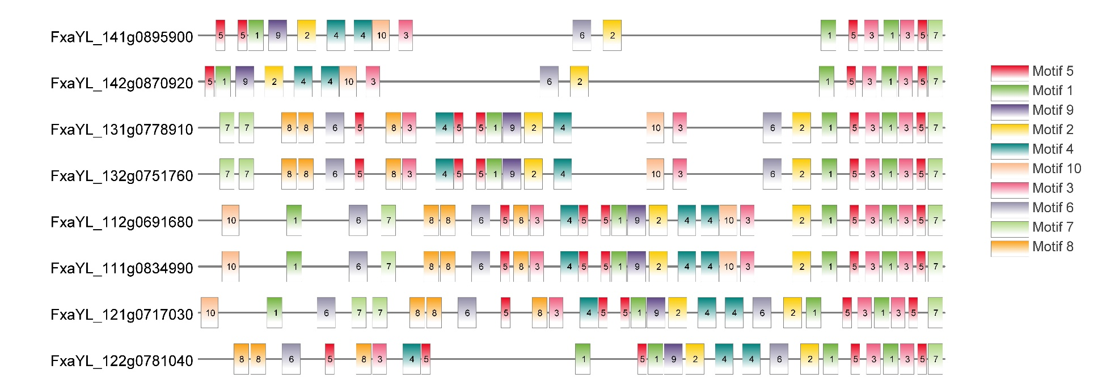
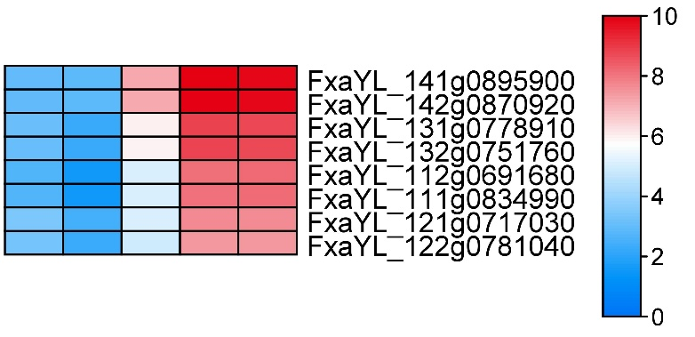
F3H
b
SG BG W T R
a
c
sequence | Motif-ID
VSCAACWTVDWTTYWDSKMMATYCAWWMMYSMAATRTMHRB | Motif-1
TCWBGWMGGTYAMATMGTAGACTTWTYARWKKKGRKRAKWATRGTAMRTT | Motif-2
CCWWCMTCMSASMYCRARRCTVATCTYCTYYTYYYTBW | Motif-3
RHATDAGVRDATASGCACTVATTTTRGTYDGTYATTAMMWAAAMAAAAW | Motif-4
TABGKGKKTTWGGTRKAGMAWGARG | Motif-5
ARMAAMYRTTTGYASGKMCCRWWARAWMYTTGKRTWGASASATRRAMWKW | Motif-6
WTRKATRYYYTCTARCSATYWGMYTGAGWAAWDTTAAYRT | Motif-7
AKMKVRWSAWMRACTYDSAHRSDHAKWKWKTKGWGAYGARG | Motif-8
AACCTTGATTAAGAAACTTATCCTAGATGCGATGTCTATAATAABGGCGG | Motif-9
GSAAGGGMHGGTWGGWMTGYMMATGCSTSYCYBYVTKDBRCBHAGTY | Motif-10
Fig. S8 Analysis and comparison of promoter conserved motifs of F3H genes. (a) represents the position of the motif on the promoter. (b) F3H genes expression heatmap in different fruit development stage. (c) The motifs sequence.

Slide 9
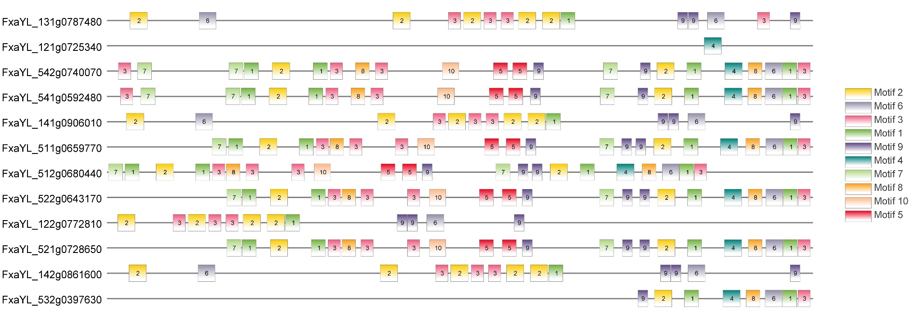
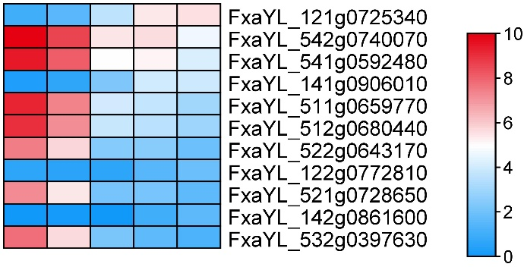
LDOX
SG BG W T R
a
b
c
sequence | Motif-ID
AWAKMKWGASMAAVAASSAAWSAAGNYTGDHAATGAKGTAA | Motif-1
TMTRGTCTCWKDGTKNKTTYCCTBGDCYRGNTKKRTTBSAHWTTHKGTKG | Motif-2
TVHTCWCYHTSMTTHCARAMCWHWDSTTYCWYCTST | Motif-3
CGGCATGCACATTYGATRGAATCAATCAAGAAAAACTTGGTCAGCTTTGG | Motif-4
GCYWRKMYGGAAGMMTMCRTARGWRAAGACYAARRMCWTWW | Motif-5
KRYMMAACCCBTCTTYTYTCRGCTAYARATAGYAACCHAGACATTCATC | Motif-6
TTTATKSRTAAGGAGGACTTKAMAWTASAGMTTSAARWRSA | Motif-7
AARKGTTWRBTTWKCTATATKWWAKTAMGTRGTKCYGMAM | Motif-8
AWRWTGWAKAWATSATKYYAGAAWYAARA | Motif-9
GTACGTACCTGTATCAACCATATGGTTRTCTTACCATATTTTATATCT | Motif-10
Fig. S9 Analysis and comparison of promoter conserved motifs of LDOX genes. (a) represents the position of the motif on the promoter. (b) LDOX genes expression heatmap in different fruit development stage. (c) The motifs sequence.

Slide 10
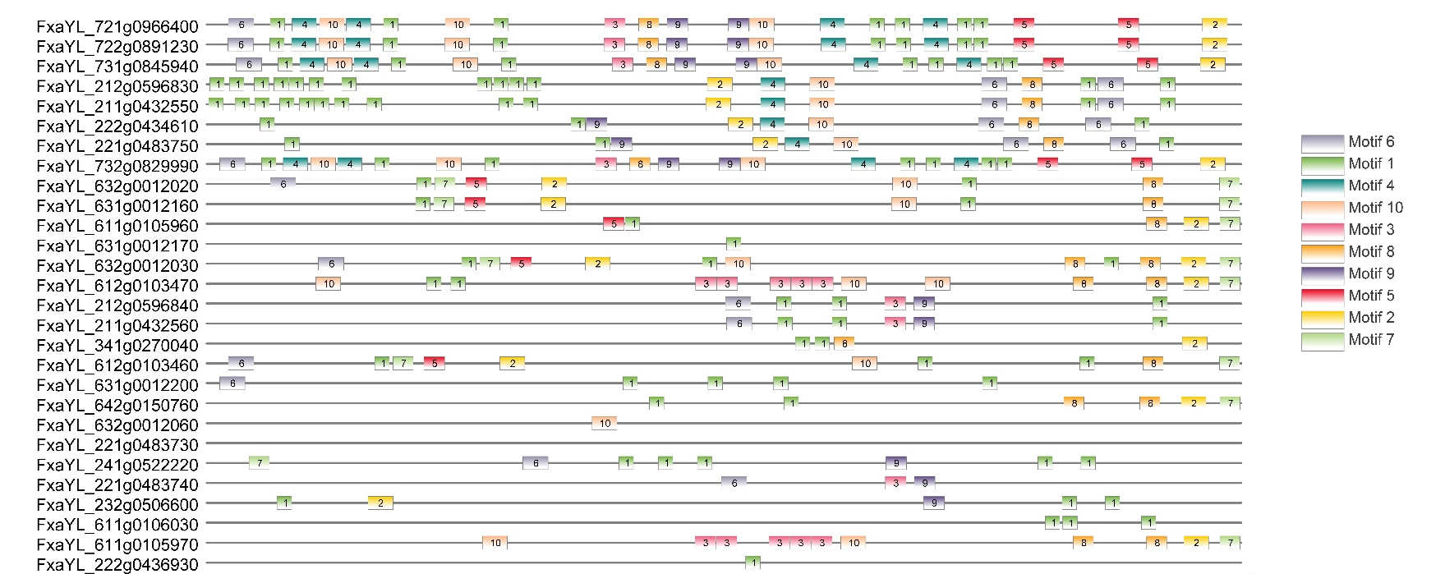
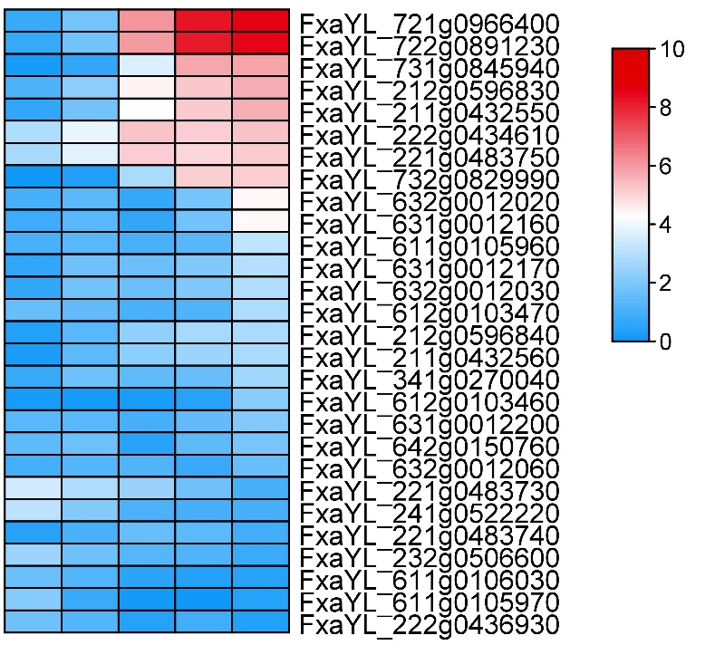
UFGT
SG BG W T R
a
b
c
sequence | Motif-ID
ARAAVAVAAMARVAVAVARWRRNADMWMA | Motif-1
GCATGCANWTGNAYATVTAHAGACATCTAKCRGCTKRGSKTTTYRTWKY | Motif-2
TTKAVTAMCATCAGATTTTAAAAGACTTKTCAAMWDCWTVW | Motif-3
AAGTMAGAATTTCAARDAACTTGWVCCDAADNDANNAMAVTTMAANHC | Motif-4
VCGGDGGBKDTCGVKTKYTDBRRWSMSWAMGBYMKCCTSVA | Motif-5
CYWTTCGRAAMGTBNWCCWGTCGATHMTCAAACAGCAASWHGATNSGBTK | Motif-6
TCWTHYWYBKRGWHYTCTYAGMAKCATCYCAWKCTCCCRA | Motif-7
YWKKACATVAACTACAASBTRDRAWACAAAAAAYRAAATT | Motif-8
RATCAMAKTHGATMCGWKAARDATABRTGCTDVTTTWTAHM | Motif-9
BMDRWDBARGATKRTGDTGWWGAYDVTBTRRRGVRWKDGWGTMYWGKAK | Motif-10
Fig. S10 Analysis and comparison of promoter conserved motifs of UFGT genes. (a) represents the position of the motif on the promoter. (b) UFGT genes expression heatmap in different fruit development stage. (c) The motifs sequence.

Slide 11
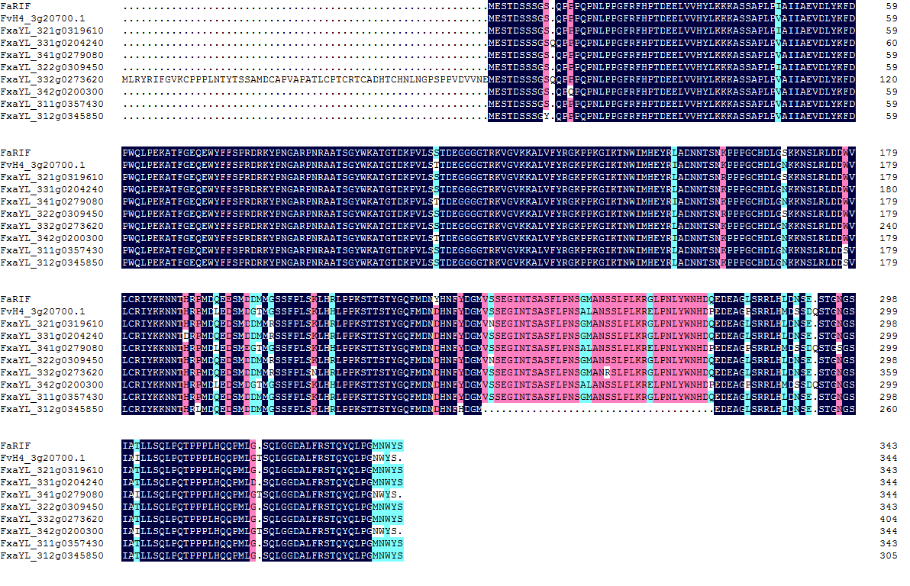
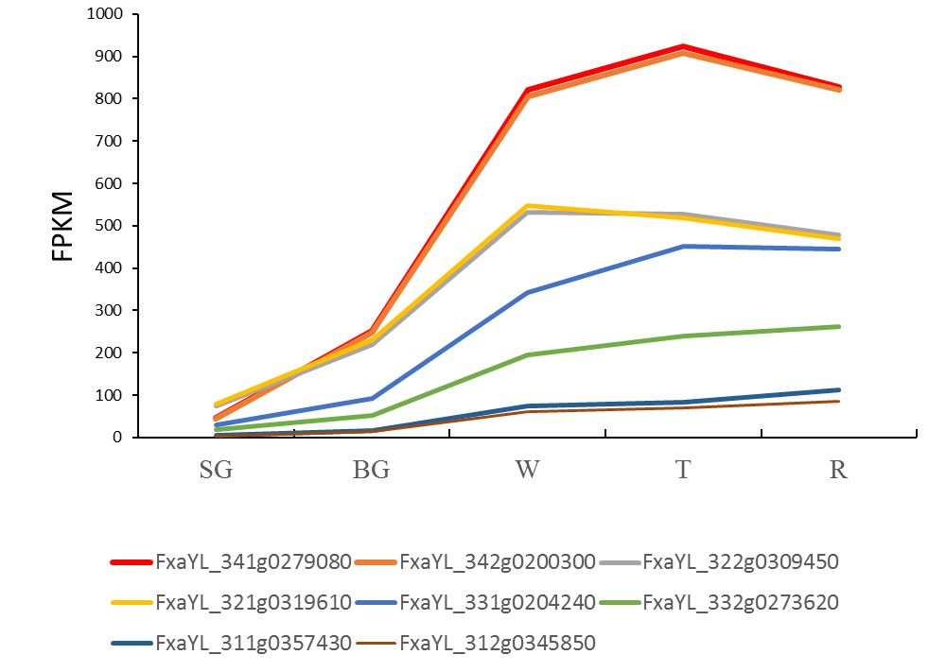
a
b
FaNAC035
FvNAC021
FaNAC 18
Fig. S11 Sequence alignment and expression analysis of NAC transcription factors. (a) Alignment analysis of amino
acid sequence of NAC transcription factors. (b) Expression of NAC transcription factor in different fruit development stages.

Slide 12
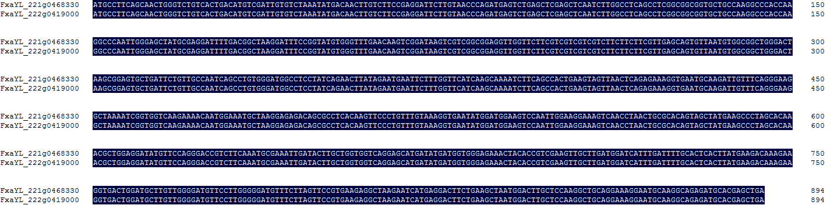
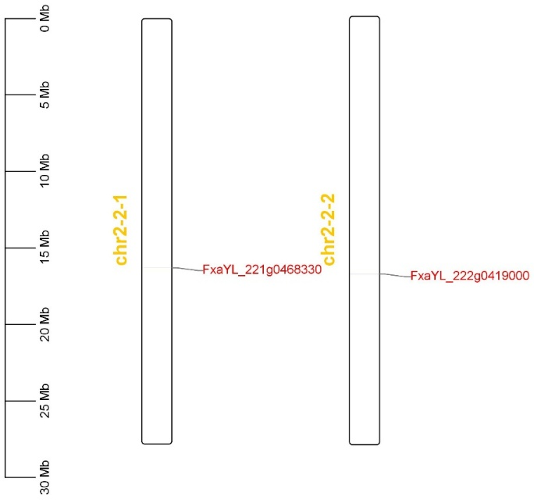
a
IAA-11
b
Fig.S 12 Nucleotide sequence alignment (a) and chromosome location (b) analysis of allele IAA-11

Slide 13
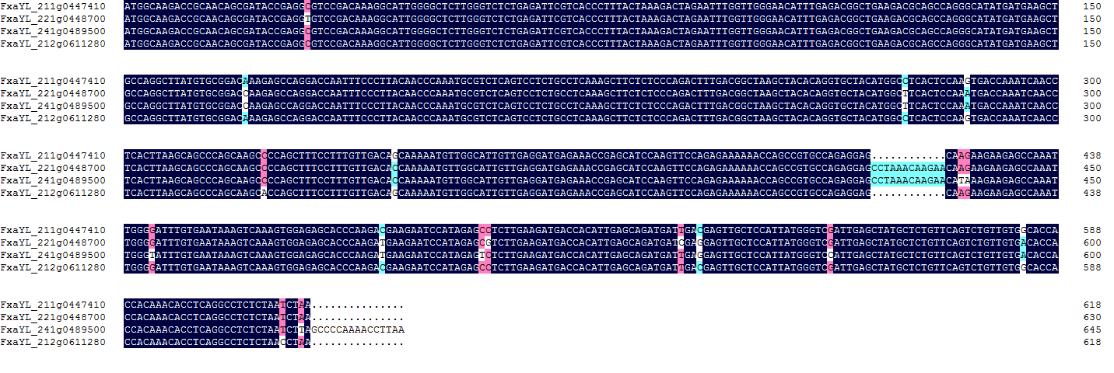
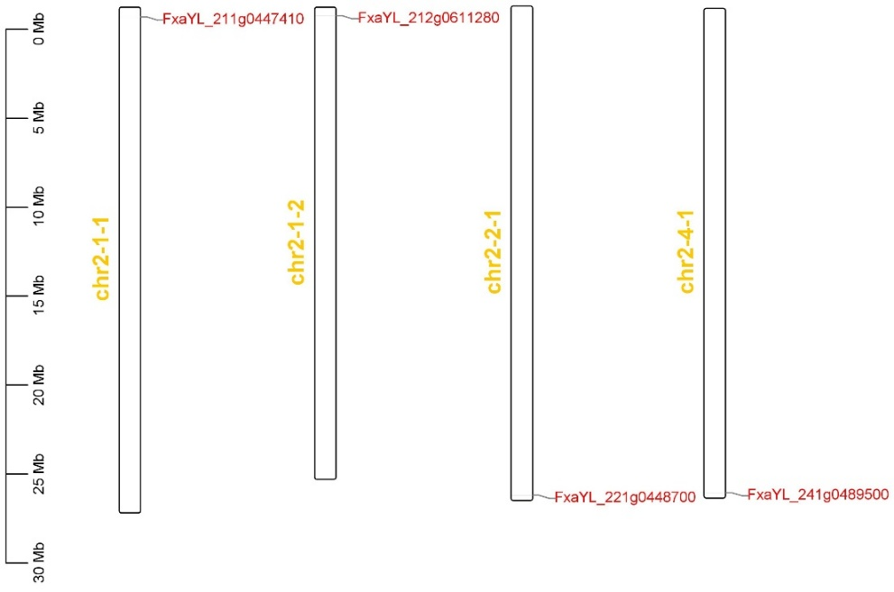
a
ERF3
b
Fig.S13 Nucleotide sequence alignment (a) and chromosome location (b) analysis of allele ERF3

Slide 14
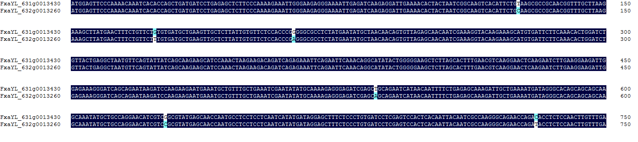
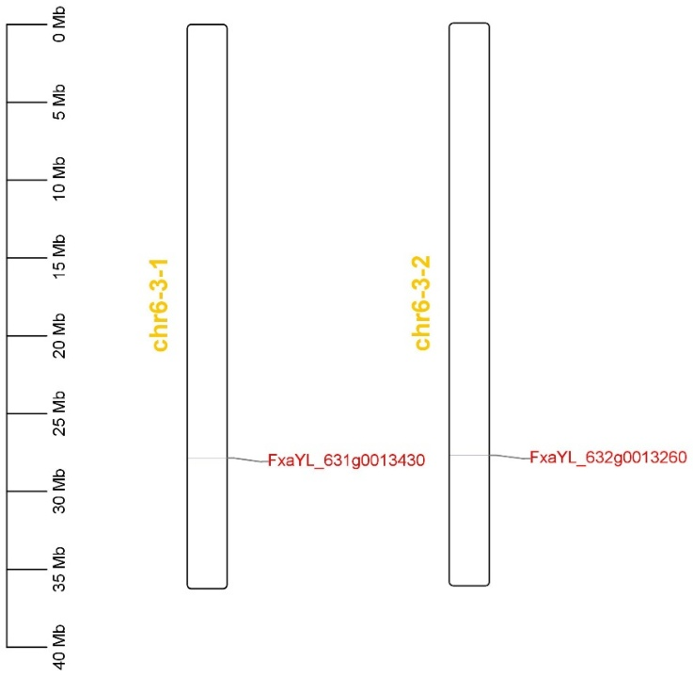
AG
a
b
Fig.S 14 Nucleotide sequence alignment (a) and chromosome location (b) analysis of allele AG

Slide 15
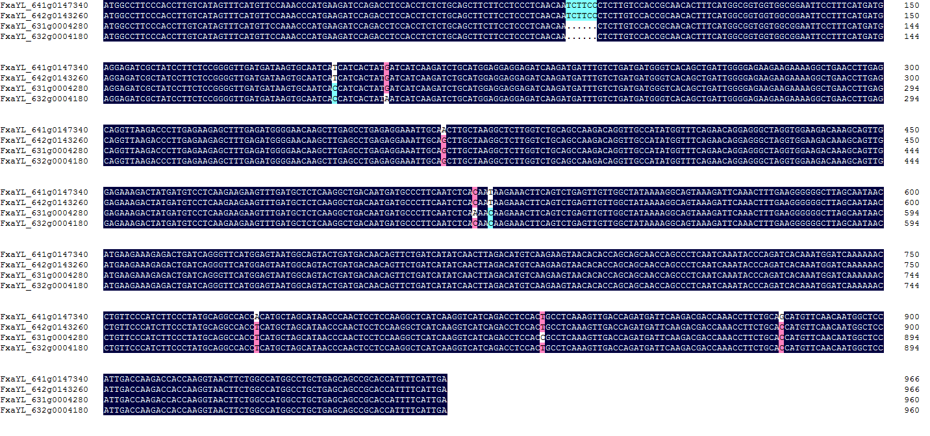
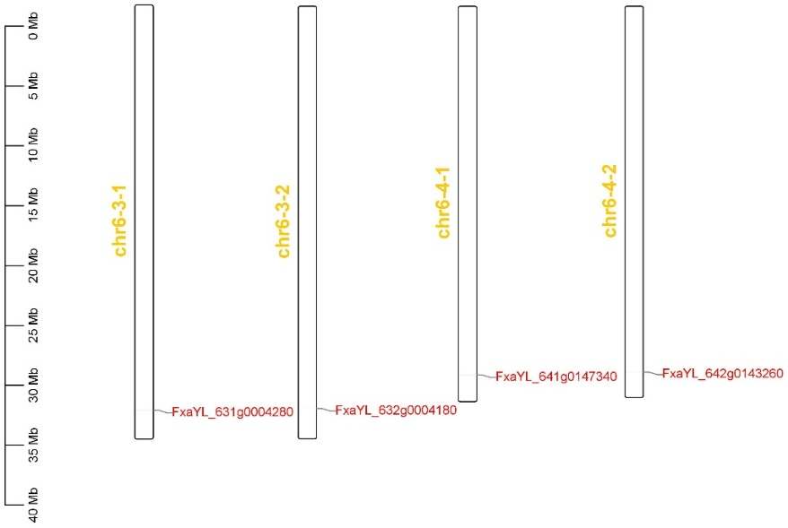
ATHB-20-like
a
b
Fig.S 15 Nucleotide sequence alignment (a) and chromosome location (b) analysis of allele ATHB-20-like

Slide 16
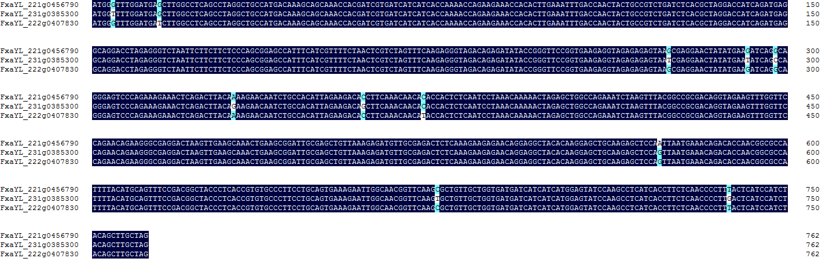
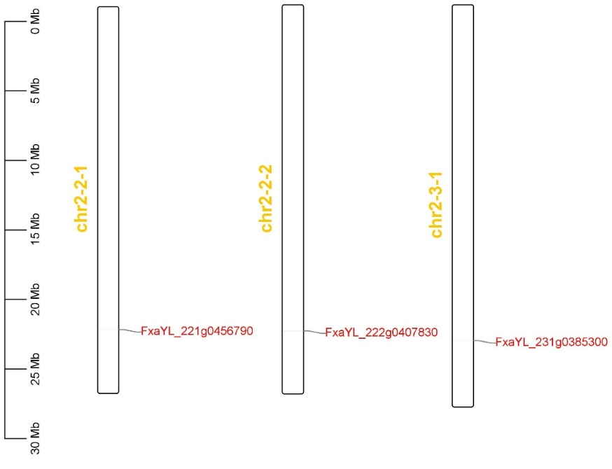
HOX19-like
a
b
Fig. S16 Nucleotide sequence alignment (a) and chromosome location (b) analysis of allele HOX19-like

Slide 17
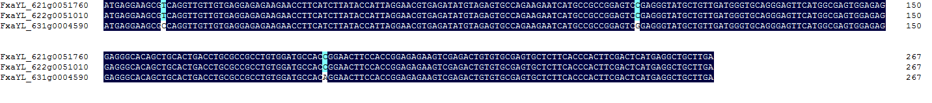
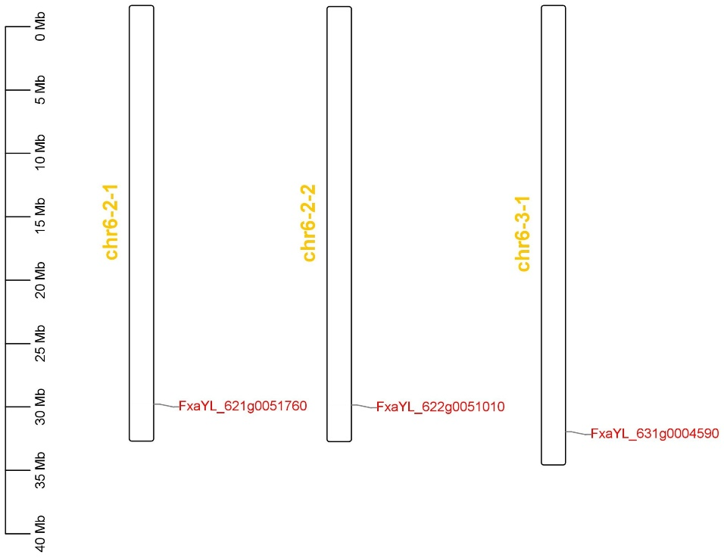
MIF2
a
b
Fig.S 17 Nucleotide sequence alignment (a) and chromosome location (b) analysis of allele MIF2

Slide 18
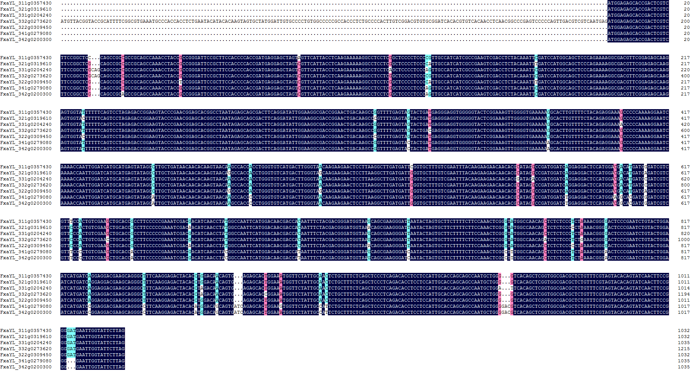
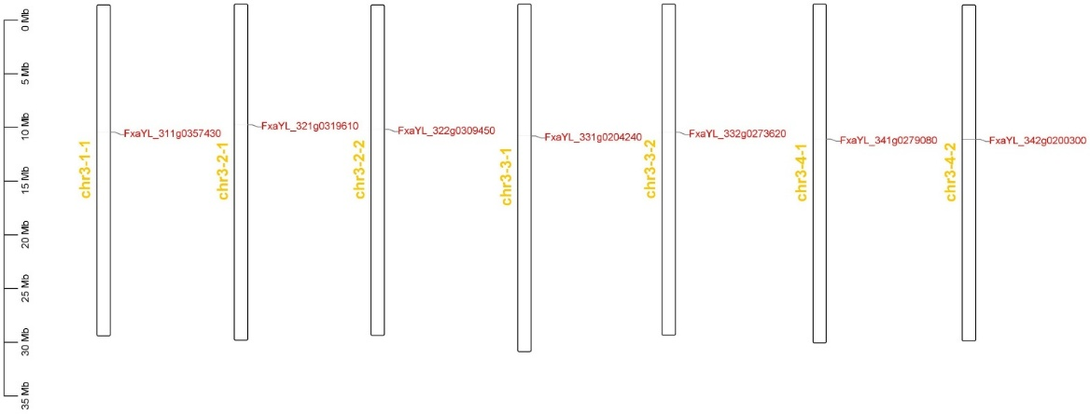
NAC18-like
a
b
Fig.S 18 Nucleotide sequence alignment (a) and chromosome location (b) analysis of allele NAC18-like

Slide 19
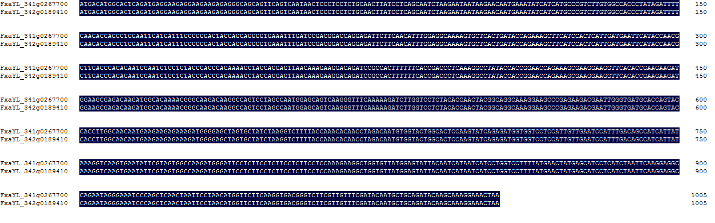
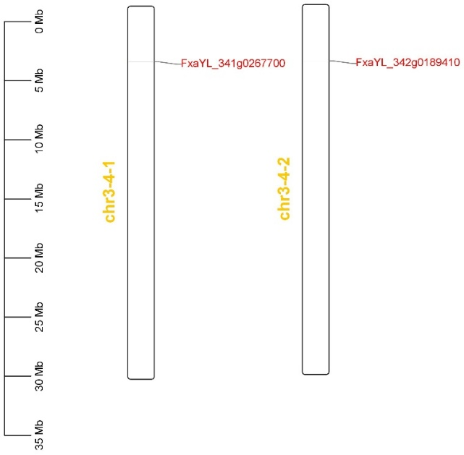
NAC8
a
b
Fig.S 19 Nucleotide sequence alignment (a) and chromosome location (b) analysis of allele NAC8

Slide 20
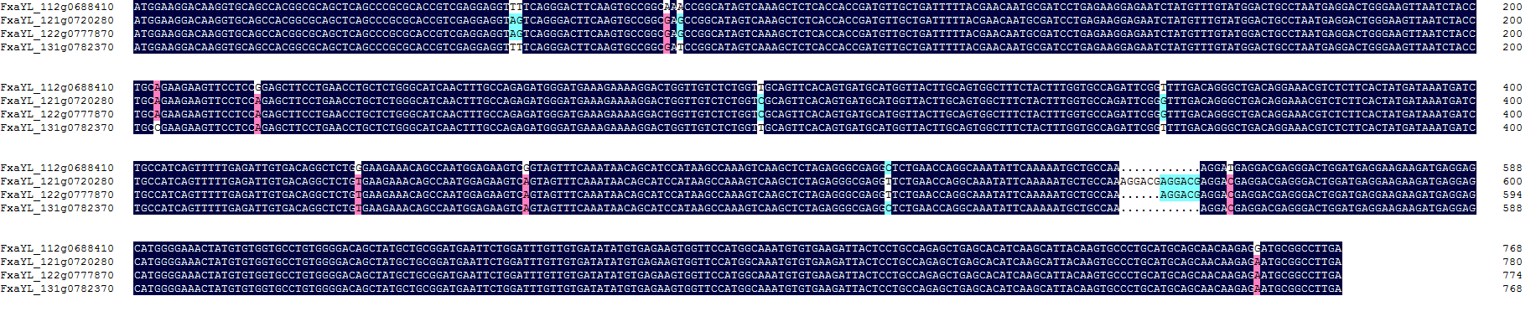
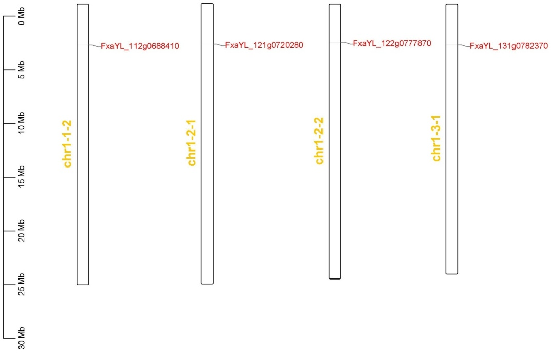
ALFL5
a
b
Fig. S20 Nucleotide sequence alignment (a) and chromosome location (b) analysis of allele ALFL5

Slide 21
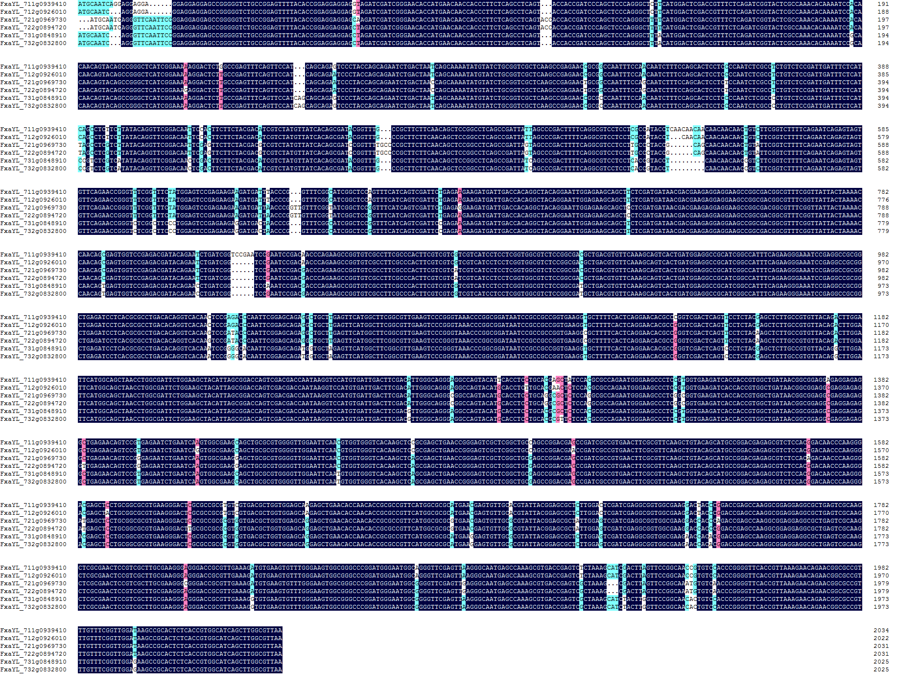
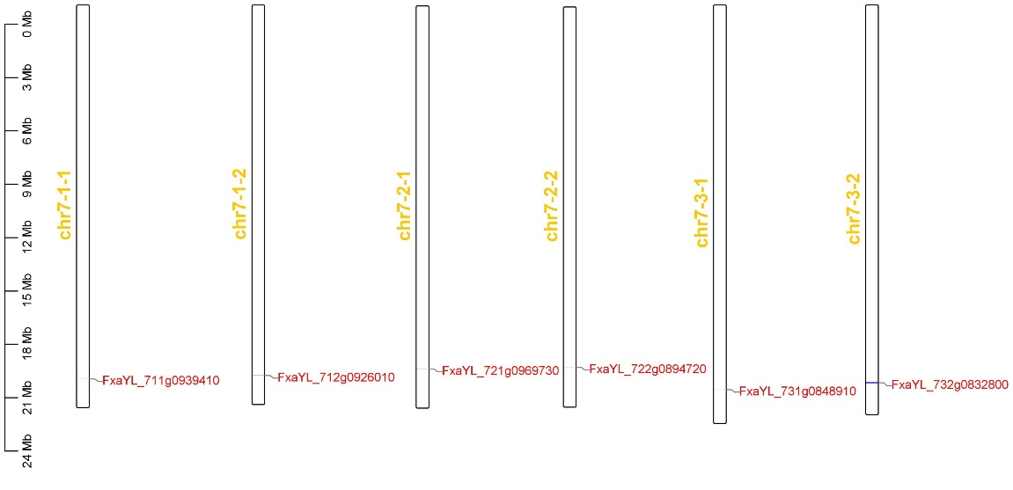
SCL8
a
b
Fig. S21 Nucleotide sequence alignment (a) and chromosome location (b) analysis of allele SCL8

Slide 22
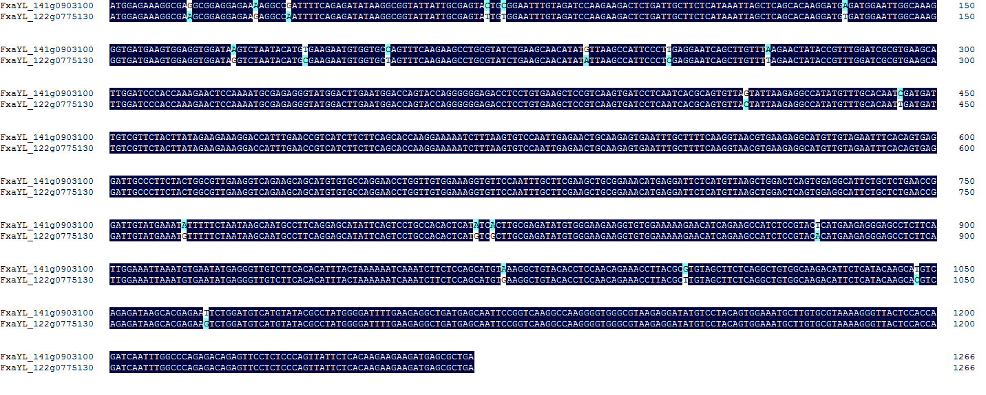
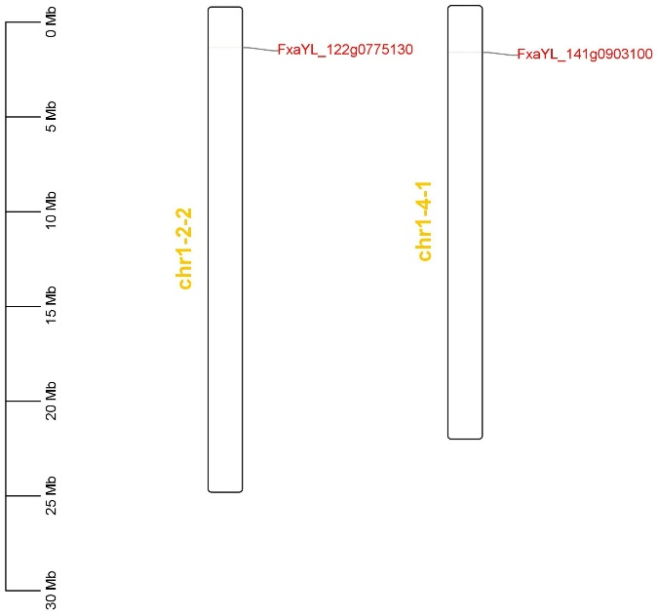
a
TF3A
b
Fig. S22 Nucleotide sequence alignment (a) and chromosome location (b) analysis of allele TF3A

Slide 23
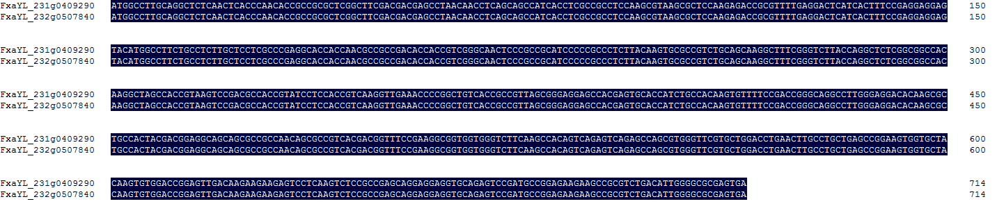
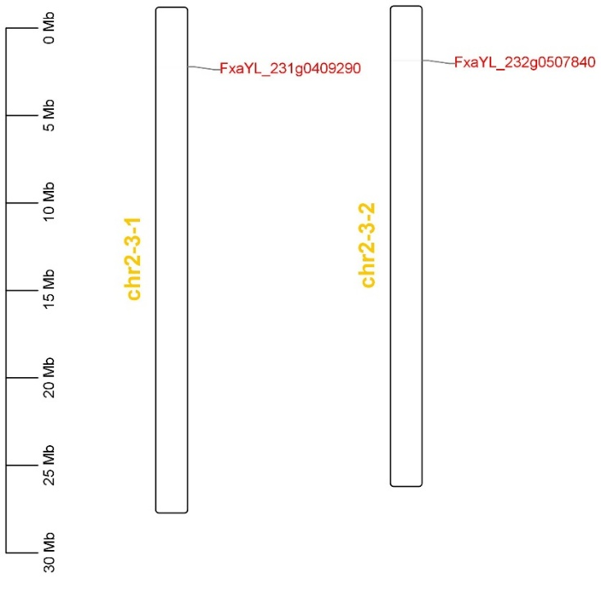
ZAT6
a
b
Fig. S23 Nucleotide sequence alignment (a) and chromosome location (b) analysis of allele ZAT6

