Slide 1
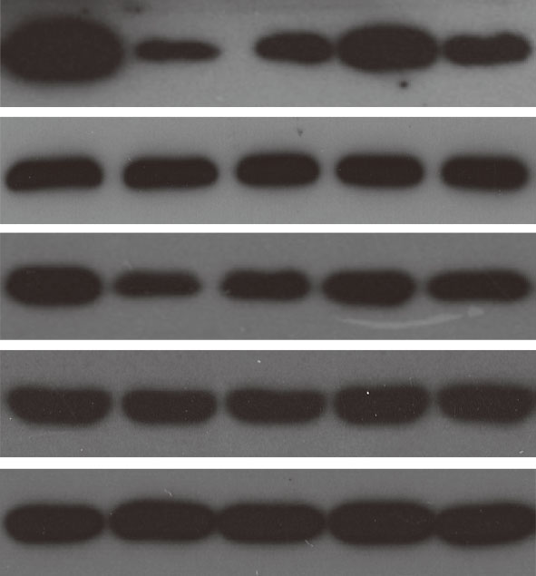
Figure4：control, LPS , LPS+negative control, LPS+miR-31, LPS + miR-31+LY294002
P-PI3K
Total PI3K
P-AKT
Total AKT
GAPDH

Slide 2
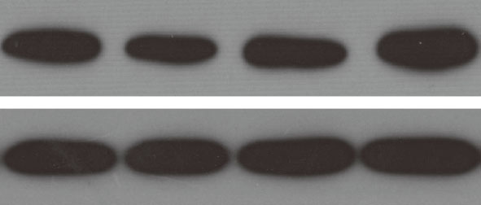
Figure5：NC, miR-31 mimic. NC, miR-31 inhibitor
ROCK1
GAPDH

Slide 3
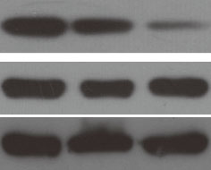
Figure5：LPS+miR-31, LPS+ negative control，LPS+miR-31+ROCK1
P-PI3K
Total PI3K
GAPDH

