Slide 1
(A)
Leader_fw
5’
CRISPR array
3’
Terminator_rev
S#21_fw
S#19_fw
(B)
5’
CRISPR array
3’
S#18_rev
S#02_rev
Figure S1. Primer design for PCR amplification of the CRISPR array from X. citri pv. citri. A, amplification of the full-length CRISPR arrays using primers Leader_fw and Terminator_rev. B, amplification to internal regions of the CRISPR arrays using spacer-specific primers. Forward primers are shown as red rectangles with an arrow, reverse primers are represented by blue rectangles with an arrow.

Slide 2
Leader_fw
IS-2_fw
(A)
5’
…….
3’
23
22
21
IS element
20
19
18
17
16
IS-1_rev
S#18_rev
Leader_fw
IS-2_fw
(B)
5’
…..
3’
23
22
20
19
18
IS element
17
16
2
1
S#18_rev
IS-1_rev
Terminator_rev
Figure S2. Primer design for PCR amplification of CRISPR regions adjacent to an IS element. A, primer combinations used for strains LB302, LB305, LG115 and NCPPB 3608; B, primer combinations used for strain LG097. Forward primers are shown as red rectangles with an arrow, reverse primers are represented by blue rectangles with an arrow. The yellow triangle indicates the leader sequence and the red triangle indicates the terminator sequence. Deep blue rectangles indicate CRISPR repeats. CRISPR spacers are represented by green diamonds. Spacers are numbered from 1 to 23, starting with the terminator proximal spacer, which presumably represents the oldest spacer. Orange rectangles indicate IS elements.

Slide 3
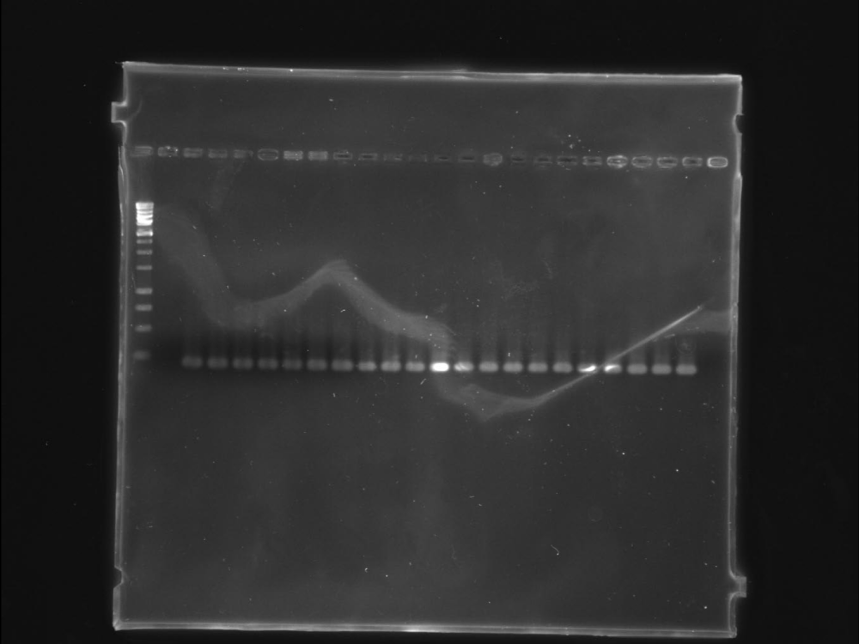
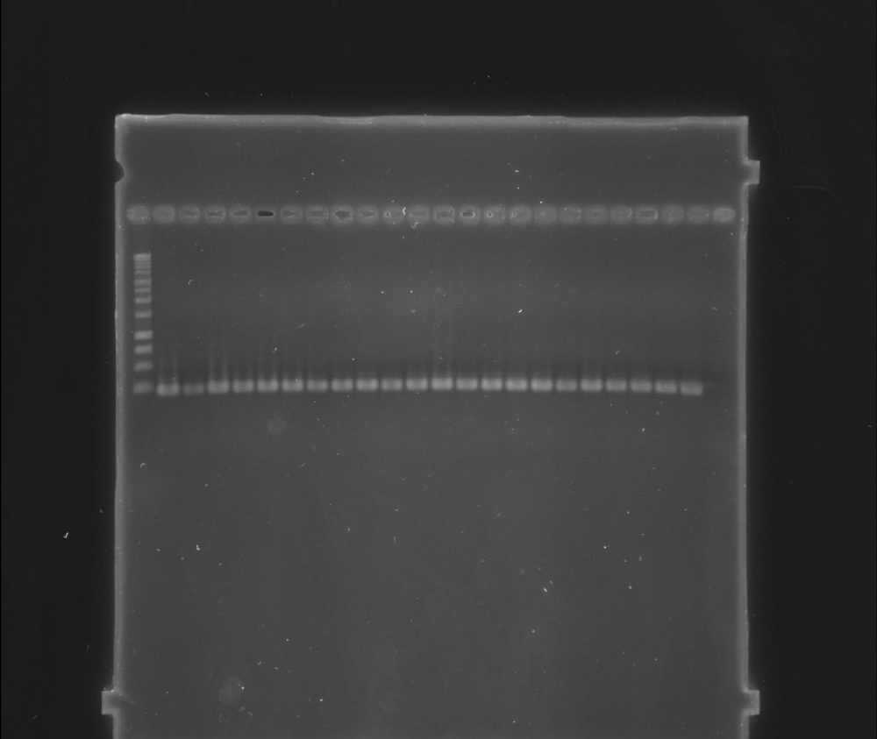
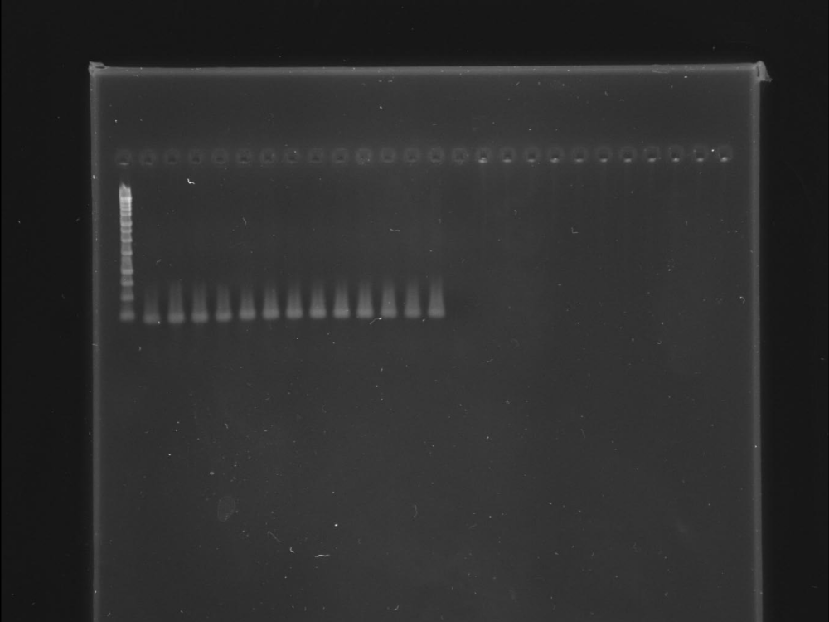
--------------------------------------------------
n
5
22
4
21
3
20
2
1
M
A
250 bp
--------------------------------------------------
n
27
44
26
43
25
42
24
23
M
B
250 bp
---------------------------
n
47
46
45
M
56
57
C
250 bp
Figure S3: PCR amplification of a 220-bp cas1 gene fragment from strains of X. citri pv. citri. M, molecular weight marker (1-kb ladder, Promega); n, negative control (PCR reaction without template DNA). A, strains no. 1-22 of Table 1; B, strains no. 23-44 of Table 1; C, strains no. 45-57 of Table 1. The red box indicates X. citri pv. bilvae strain NCPPB 3213.

Slide 4
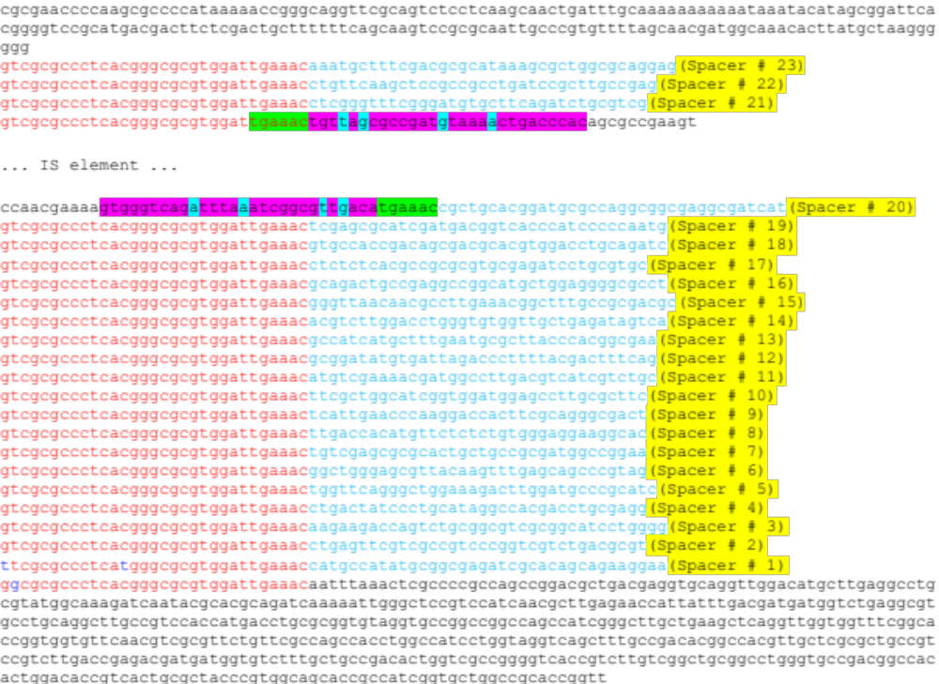
Figure S4. Structure of the CRISPR array of X. citri pv. citri strain NCPPB 3608. Red characters indicate direct repeat sequences. Blue characters indicate spacer sequences. 6 bp (tgaaac) in green boxes represent the target site duplication. Pink boxes represent the inverted repeats (28 bp). Blue boxes represent base pairs that do not match within the inverted repeats.

Slide 5
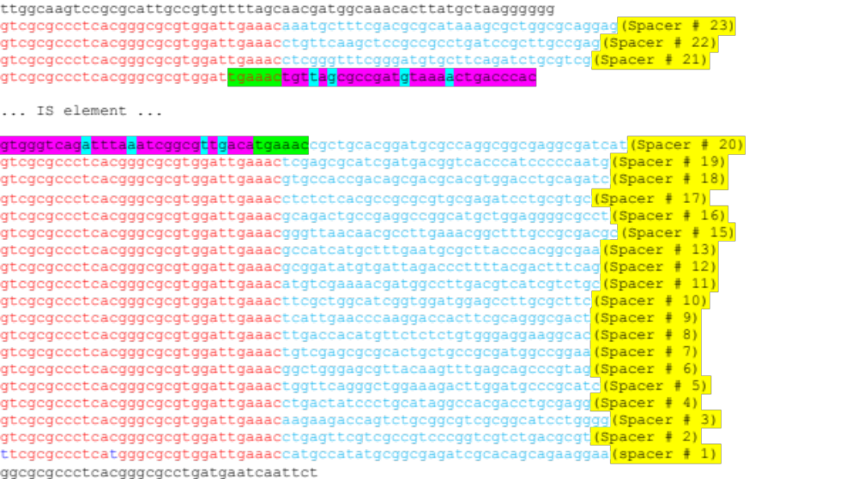
Figure S5. Structure of the CRISPR array of X. citri pv. citri strains LB302, LG115 and LB305. Red characters indicate direct repeat sequences. Blue characters indicate spacer sequences. 6 bp (tgaaac) in green boxes represent the target site duplication. Pink boxes represent the inverted repeats (28 bp). Blue boxes represent base pairs that do not match within the inverted repeats.

Slide 6
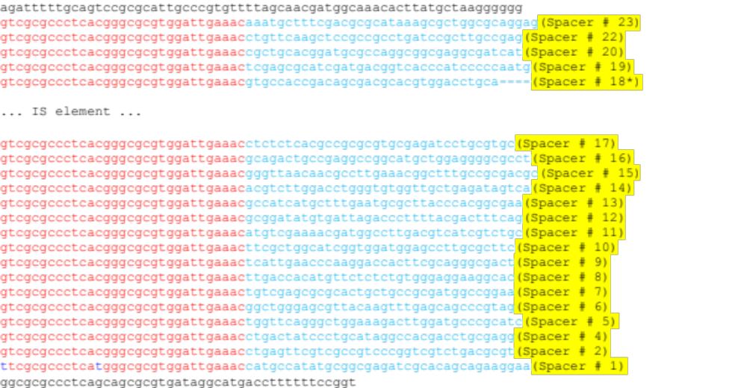
Figure S6. Structure of the CRISPR array of X. citri pv. citri strain LG097. Red characters indicate direct repeat sequences. Blue characters indicate spacer sequences. Spacer#18*, 4 bp, indicated by dashes, are deleted due to the IS element insertion.

Slide 7
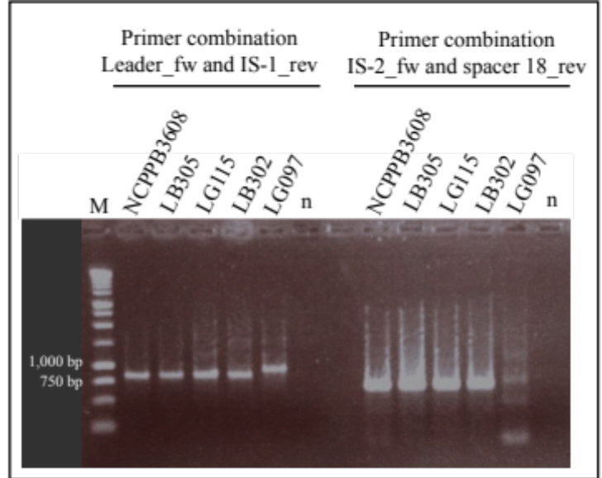
Figure S7. PCR amplification of spacer/repeat units next to the IS element of five X. citri pv. citri strains. M, molecular weight marker (1-kb ladder, Promega); n, negative control (PCR reaction without template DNA). Lanes 2-7, primer combination Leader_fw and IS-1_rev; lanes 9-14, primer combination IS-2_fw and Spacer#18_rev.

