Slide 1
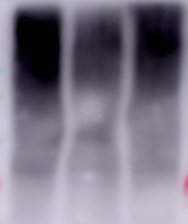


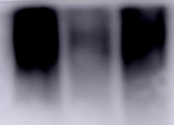


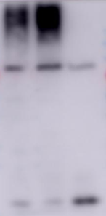


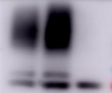
A
B
C
WT
_
C1030S
HeLa Cells
DMSO
ML-792
kDa
HA-SENP6
_
_____
___
+
siSENP6
_
SUMO1-
conjugates
kDa
+
+
VSV
kDa
+
+
+
siSENP6
-
+
+
VSV
180
-
100
-
VSV-G
70
VSV-G
-
55
-
-
55
130
SENP6
-
SUMO2/3-
conjugates
130
SENP6
-
GAPDH
180
-
-
GAPDH
-
35
35
100
-
180
SUMO1-
conjugates
-
130
70
-
HA
-
SUMO1-adduct
-
GAPDH
15
35
-
180
SUMO2/3-
conjugates
-
70
Figure S1

Slide 2
A
ns
B
C
Relative Ifnβ mRNA
8.0
Relative Isg15 mRNA
**
Relative Isg54 mRNA
*
_______
8
_______
25
________
ns
6.0
_______
6
20
4.0
4
ns
15
ns
_______
10
________
2.0
2
5
0.0
_
_
+
0
_
_
0
_______
_______
SeV
+
VSV
+
+
_
_
_______
_______
VSV
+
+
siCON
siSENP6
siCON
siSENP6
_______
_______
D
E
F
siCON
siSENP6
Relative Isg15 mRNA
***
25
_______
Relative Isg54 mRNA
150
***
**
Relative Isg54 mRNA
250
________
20
________
200
15
ns
100
**
10
_______
ns
150
_____
5
50
________
100
0
0
50
IFNα
_
+
_
+
_
_
0
_
_______
_______
IFNα
+
+
_______
_______
IFNα
+
+
+
siCON
siSENP6
siCON
siSENP6
HA-SENP6
_
_
WT
C1030S
G
Relative Isg54 mRNA
*
**
80
____
____
60
40
20
0
_
IFNα
+
+
+
+
_
_
siSENP6
+
+
+
_
_
_
ML-792
Ruxolitinib
Figure S2

Slide 3
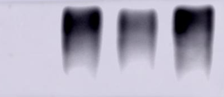




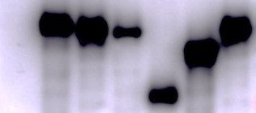
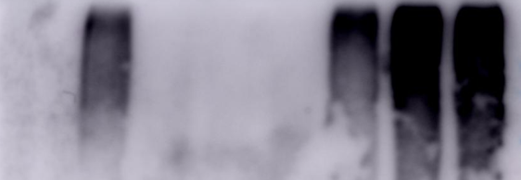

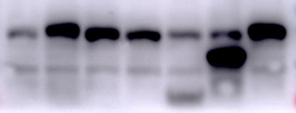


















A
B
_
_
WT
C786G
_
Flag-USP8
kDa
+
+
+
+
HA-IFNAR2
MIT
Rhod
USP
+
+
+
Myc-Ub
___________
-
IP:HA
IB:Myc
IFNAR2
33
1109
180
116
1
195
313
777
1118
Myc
C786
USP8^{FL}
-
USP8^{∆MIT}
100
IFNAR2
USP8^{∆Rhod}
-
USP8^{∆USP}
70
130
__________
USP8^{∆314-776}
-
USP8 (eluate)
WCL
130
-
USP8
35
GAPDH
-
C
D
WT
ΔMiddle region
ΔUSP
ΔMIT
C786G
WT
ΔMiddle region
_
_
ΔRHO
Flag-USP8
ΔMIT
ΔRHO
ΔUSP
_
C786G
_
+
+
+
+
+
+
+
HA-IFNAR2
Flag-USP8
kDa
+
+
kDa
+
+
+
+
+
+
+
+
Myc-Ub
-
+
+
+
+
+
HA-IFNAR2
____________
130
IP:Flag
IB:USP8
IFNAR2
IP:HA
IB:Myc
IFNAR2
USP8
_________
-
-
180
70
-
100
IFNAR2
-
Myc
70
100
-
-
-
100
130
USP8
___________
70
IFNAR2
70
-
-
WCL
-
100
-
IFNAR2
130
______
-
USP8
70
-
WCL
GAPDH
70
GAPDH
-
-
35
35
E
F
G
WCL
IP:Flag
ns
IP:
______
______
Relative Isg54 mRNA
200
__________
kDa
IgG
SENP6
kDa
_
+
_
+
Flag-USP8
*
______
-
SENP6
IP:SENP6
IB:USP8
SENP6
130
______
-
USP8
150
-
130
130
USP8
-
SENP6
100
130
-
__________
SENP7
50
130
SENP6
-
WCL
100
-
USP8
SENP1
0
130
-
IFNα
_
+
+
+
70
_
_
WT
C786G
-
GAPDH
GAPDH
Flag-USP8
-
35
35
H
_
_
+
_
+
siSENP6
I
_
_
_
+
+
siUSP8
Relative Isg54 mRNA
250
*
kDa
_
+
+
+
+
IFNα
____
-
SENP6
200
130
150
ns
-
USP8
____
130
p-STAT1
100
100
-
50
-
100
STAT1
0
_
IFNα
_
+
+
+
+
35
GAPDH
siSENP6
_
+
_
+
-
_
_
_
siUSP8
+
+
Figure S3

Slide 4
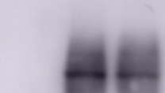

























A
B
HA-SUMO3
HA-SUMO2
_
_
HA-SUMO1
kDa
_
+
+
Flag-USP8
____________________
kDa
_
+
+
+
+
Flag-USP8
SUMO1-
conjugated USP8
IP:Flag
IB:Flag
SUMO1
SUMO2/3
IP:Flag
IB:HA
Flag
_______
-
HA-SUMO-
conjugated USP8
180
-
-
180
130
Flag-USP8
-
130
Flag-USP8
-
SUMO2/3-
conjugated USP8
HA-SUMOs-
conjugates
___________
180
-
180
WCL
-
-
130
130
Flag-USP8
Flag-USP8
-
GAPDH
DMSO
ML-792
35
______
___
C
_
_
+
+
siSENP6
_
+
+
+
Flag-USP8
kDa
+
+
+
+
HA-IFNAR2
D
-
SUMO-conjugated
USP8
________________________
*
180
Relative Isg54 mRNA
__________
***
SUMO-conjugated
USP8
IP:Flag
IB:USP8
IFNAR2
30
____
-
180
**
130
20
____
-
USP8 (long exposure)
130
-
USP8 (short exposure)
10
-
100
IFNAR2
-
70
0
_
___________________
IFNα
+
+
+
+
-
SENP6
_
_
_
130
siSENP6
+
+
_
_
Flag-USP8
_
+
+
+
-
USP8
_
_
_
130
WCL
ML-792
+
-
100
IFNAR2
-
70
GAPDH
35
-
E
_
+
+
Flag-USP8
G
∆Peptidase2
_
_
C1030S
_
+
HA-SENP6 N
_
_
WT
kDa
_
+
HA-SENP6 C
_
HA-SENP6
-
+
+
+
+
Flag-USP8
130
Flag-USP8
IP:HA
IB:HA
Flag
______
kDa
+
+
+
+
+
HA-IFNAR2
-
HA-SENP6 N
100
-
HA-SENP6 C
SUMO-conjugated
USP8
70
-
_______________________
-
Flag-USP8
180
IP:Flag
IB:USP8
IFNAR2
SENP6
130
_________
SUMO-conjugated
USP8
WCL
-
HA-SENP6 N
100
-
HA-SENP6 C
70
-
-
GAPDH
130
USP8 (long exposure)
35
-
USP8 (short exposure)
F
Relative Isg54 mRNA
**
130
100
___________
SENP6^{FL}
*
-
_______
130
SENP6^{∆Piptidase2}
80
***
-
____
100
IFNAR2
-
60
70
-
SENP6^{FL}
40
130
______________
20
SENP6^{∆Piptidase2}
-
USP8
WCL
0
_
130
-
IFNα
_
+
+
+
+
100
IFNAR2
HA-SENP6
_
WT
C1030S
∆Peptidase2
-
GAPDH
35
Figure S4

