Slide 1
Supplemental Table 1. Clinical and surgical characteristics of patients with cT2 CRC before and after PSM
Parameters | Before PSM |  |  |  | After PSM(1:1)
 | D2 LND | D3 LND | p-value |  | D2 LND | D3 LND | p-value
 | (N=107) | (N=483) |  |  | (N=98) | (N=98)
Gender
Male | 71 (66.4%) | 282 (58.4%) | N.S. |  | 63 (64.3%) | 68 (69.4%) | N.S.
Female | 36 (33.6%) | 201 (41.6%) |  |  | 35 (35.7%) | 30 (30.6%)
Age(year)
<70 | 35 (32.7%) | 283 (58.6%) | <0.001 |  | 35 (35.7%) | 43 (43.9%) | N.S.
≥70 | 72 (67.3%) | 200 (41.4%) |  |  | 63 (64.3%) | 55 (56.1%)
Mean (SD) | 73.2 ±11.0 | 66.3 ±10.0 | <0.001 |  | 72.4 ±11.1 | 70.5 ±8.62 | N.S.
BMI
Mean (SD) | 22.9 ±3.55 | 22.8 ±3.26 | N.S. |  | 23.0 ±3.50 | 22.5 ±3.39 | N.S.
CEA(ng/mL)
<5 | 84 (78.5%) | 415 (85.9%) | N.S. |  | 78 (79.6%) | 84 (85.7%) | N.S.
≥5 | 23 (21.5%) | 68 (14.1%) |  |  | 20 (20.4%) | 14 (14.3%)
Tumor loction
Colon | 69 (64.5%) | 232 (48.0%) | 0.003 |  | 61 (62.2%) | 68 (69.4%) | N.S.
Rectum | 38 (35.5%) | 251 (52.0%) |  |  | 37 (37.8%) | 30 (30.6%)
Family cancer history
No | 80 (74.8%) | 421 (87.2%) | 0.002 |  | 75 (76.5%) | 75 (76.5%) | N.S.
Yes | 27 (25.2%) | 62 (12.8%) |  |  | 23 (23.5%) | 23 (23.5%)
Abdominal surgery history
No | 52 (48.6%) | 305 (63.1%) | 0.007 |  | 48 (49.0%) | 55 (56.1%) | N.S.
Yes | 55 (51.4%) | 178 (36.9%) |  |  | 50 (51.0%) | 43 (43.9%)
Neoadjuvant chemotherapy
No | 104 (97.2%) | 467 (96.7%) | N.S. |  | 95 (96.9%) | 97 (99.0%) | N.S.
Yes | 3 (2.8%) | 16 (3.3%) |  |  | 3 (3.1%) | 1 (1.0%)
Comorbidity
No | 26 (24.3%) | 170 (35.2%) | 0.04 |  | 25 (25.5%) | 33 (33.7%) | N.S.
Yes | 81 (75.7%) | 313 (64.8%) |  |  | 73 (74.5%) | 65 (66.3%)
Operation method
Laparoscopic surgery | 85 (79.4%) | 460 (95.2%) | <0.001 |  | 80 (81.6%) | 79 (80.6%) | N.S.
Open surgery | 22 (20.6%) | 23 (4.8%) |  |  | 18 (18.4%) | 19 (19.4%)
Operative time(min)
Mean (SD) | 211 ±94.6 | 210 ±73.9 | N.S. |  | 216 ±93.3 | 218 ±83.4 | N.S.
Postoperative complications
No | 77 (72.0%) | 407 (84.3%) | 0.004 |  | 73 (74.5%) | 69 (70.4%) | N.S.
Yes | 30 (28.0%) | 76 (15.7%) |  |  | 25 (25.5%) | 29 (29.6%)
Operative blood loss(ml)
<100 | 85 (79.4%) | 437 (90.5%) | 0.002 |  | 78 (79.6%) | 80 (81.6%) | N.S.
≥100 | 22 (20.6%) | 46 (9.5%) |  |  | 20 (20.4%) | 18 (18.4%)
BMI, body mass index; CEA, carcinoembryonic antigen; PSM, propensity score matching; D2 LND, D2 lymph node dissection; D3 LND, D3 lymph node dissection.
Notes:
590总，PSM前后基线

Slide 2
Supplemental Table 2. Pathologic findings in patients with cT2 CRC before and after PSM
Parameters | Before PSM |  |  |  | After PSM(1:1)
 | D2 LND | D3 LND | p-value |  | D2 LND | D3 LND | p-value
 | (N=107) | (N=483) |  |  | (N=98) | (N=98)
Tumor size(cm)
Mean (SD) | 2.54 ±1.10 | 2.67 ±1.17 | N.S. |  | 2.53 ±1.09 | 2.79 ±1.31 | N.S.
Proximal resection margin (cm)
Mean (SD) | 11.9 ±4.55 | 13.0 ±4.51 | 0.0199 |  | 11.8 ±4.52 | 12.6 ±5.13 | N.S.
Distal resection margin (cm)
Mean (SD) | 7.32 ±4.70 | 6.17 ±4.30 | 0.026 |  | 7.08 ±4.73 | 7.13 ±4.06 | N.S.
Postoperative hospital stay (days)
Mean (SD) | 11.6 ±8.71 | 9.28 ±8.22 | 0.012 |  | 11.2 ±8.19 | 11.8 ±9.72 | N.S.
Time to first food intake (days)
Mean (SD) | 3.84 ±3.08 | 3.55 ±2.80 | N.S. |  | 3.55 ±1.94 | 4.40 ±4.30 | N.S.
Gross type
Protruding | 55 (51.4%) | 192 (39.8%) | 0.0356 |  | 49 (50.0%) | 46 (46.9%) | N.S.
Infiltrate or ulcerative | 52 (48.6%) | 291 (60.2%) |  |  | 49 (50.0%) | 52 (53.1%)
Histology type
Well, Mod | 102 (95.3%) | 457 (94.6%) | N.S. |  | 94 (95.9%) | 90 (91.8%) | N.S.
Poor, Sig, Muc | 5 (4.7%) | 26 (5.4%) |  |  | 4 (4.1%) | 8 (8.2%)
Infiltration form
a | 14 (13.1%) | 66 (13.7%) | N.S. |  | 11 (11.2%) | 10 (10.2%) | N.S.
b and c | 93 (86.9%) | 417 (86.3%) |  |  | 87 (88.8%) | 88 (89.8%)
Lymphatic invasion
No | 82 (76.6%) | 348 (72.0%) | N.S. |  | 74 (75.5%) | 73 (74.5%) | N.S.
Yes | 25 (23.4%) | 129 (26.7%) |  |  | 24 (24.5%) | 25 (25.5%)
Venous invasion
No | 49 (45.8%) | 225 (46.6%) | N.S. |  | 43 (43.9%) | 45 (45.9%) | N.S.
Yes | 58 (54.2%) | 258 (53.4%) |  |  | 55 (56.1%) | 53 (54.1%)
Harvested lymph nodes
Mean (SD) | 19.7 ±9.71 | 23.1 ±10.9 | 0.0013 |  | 19.8 ±9.85 | 25.7 ±13.0 | <0.001
pT
0 | 5 (4.7%) | 22 (4.6%) | N.S. |  | 4 (4.1%) | 3 (3.1%) | N.S.
1 | 37 (34.6%) | 130 (26.9%) |  |  | 31 (31.6%) | 28 (28.6%)
2 | 33 (30.8%) | 203 (42.0%) |  |  | 32 (32.7%) | 37 (37.8%)
3 | 29 (27.1%) | 119 (24.6%) |  |  | 28 (28.6%) | 28 (28.6%)
4 | 3 (2.8%) | 9 (1.9%) |  |  | 3 (3.1%) | 2 (2.0%)
Nodal metastasis
No | 79 (73.8%) | 339 (70.2%) | N.S. |  | 71 (72.4%) | 66 (67.3%) | N.S.
Yes | 28 (26.2%) | 144 (29.8%) |  |  | 27 (27.6%) | 32 (32.7%)
Pathological Stage
0 | 5 (4.7%) | 21 (4.3%) | N.S. |  | 4 (4.1%) | 3 (3.1%) | N.S.
Ⅰ | 56 (52.3%) | 254 (52.6%) |  |  | 49 (50.0%) | 47 (48.0%)
Ⅱ | 17 (15.9%) | 59 (12.2%) |  |  | 17 (17.3%) | 14 (14.3%)
Ⅲ | 25 (23.4%) | 134 (27.7%) |  |  | 25 (25.5%) | 30 (30.6%)
Ⅳ | 4 (3.7%) | 15 (3.1%) |  |  | 3 (3.1%) | 4 (4.1%)
Protruding:Type 0, superficial; Type 1, protuberant, infiltrative or ulcerative; Type 2, expansive ulceration; Type 3, infiltrative ulcerating; Type 4, diffusely ulcerating; Well, well-differentiated adenocarcinoma; Mod, moderately differentiated adenocarcinoma; Poor, poorly differentiated adenocarcinoma; Muc, mucinous carcinoma; Sig, signet ring carcinoma; D2 LND D2 lymph node dissection, D3 LND D3 lymph node dissection.
Notes:
590总，PSM前后基线

Slide 3
Supplemental Table 3. Multivariate logistic regression analysis of OS in patients with cT2 CRC before and after PSM
Variable | OS before PSM |  |  |  | OS after PSM
 | HR | 95%CI | p-value |  | HR | 95%CI | p-value
D3 LND vs. D2 LND | 2.3 | 1.2-4.3 | 0.012 |  | 1.6 | 0.69-3.8 | 0.270
Age (years) | 1 | 1-1.1 | 0.034 |  | 1.1 | 1-1.1 | 0.004
CEA(ng/ml), <5 vs ≥5 | 1.5 | 0.76-3 | 0.24 |  | 0.77 | 0.26-2.3 | 0.630
Family cancer history, No vs. Yes | 1.8 | 0.87-3.7 | 0.11 |  | 2.1 | 0.87-5 | 0.100
Tumor location, Colon vs. Rectum | 0.92 | 0.5-1.7 | 0.79 |  | 1 | 0.4-2.6 | 0.950
Operation method, laparoscopic vs. open | 1.1 | 0.48-2.7 | 0.77 |  | 1 | 0.34-2.9 | 0.990
Tumor size(cm) | 1.3 | 1-1.6 | 0.025 |  | 1.3 | 0.9-1.8 | 0.180
pT 0-1 vs. pT 2-4 | 2.9 | 1.1-7.7 | 0.028 |  | 2.9 | 0.83-10 | 0.095
Histology type, Well, Mod vs. Por, Sig, Muc | 0.36 | 0.082-1.6 | 0.18 |  | 0.26 | 0.031-2.2 | 0.220
Lymphatic invasion, No vs. Yes | 1.3 | 0.7-2.6 | 0.37 |  | 1.2 | 0.47-3.1 | 0.700
Venous invasion, No vs. Yes | 2.2 | 1.1-4.3 | 0.024 |  | 1.9 | 0.79-4.6 | 0.150
Supplemental Table 4. Multivariate logistic regression analysis of CSS in patients with cT2 CRC before and after PSM
Variable | CSS before PSM |  |  |  | CSS after PSM
 | HR | 95%CI | p-value |  | HR | 95%CI | p-value
D3 LND vs. D2 LND | 1.8 | 0.69-4.9 | 0.23 |  | 0.041 | 0.0086-0.19 | <0.001
Age (years) | 1 | 0.97-1 | 0.83 |  | 1.4 | 1.2-1.6 | <0.001
CEA(ng/ml), <5 vs ≥5 | 2.6 | 1.1-6.4 | 0.031 |  | 3.4 | 0.68-17 | 0.140
Family cancer history, No vs. Yes | 3 | 1-8.6 | 0.047 |  | 2.5 | 0.59-11 | 0.210
Tumor location, Colon vs. Rectum | 1.1 | 0.45-2.8 | 0.81 |  | 57 | 10-320 | <0.001
Operation method, laparoscopic vs. open | 0.38 | 0.073-2 | 0.25 |  | 0.086 | 0.01-0.75 | 0.026
Tumor size(cm) | 1.5 | 1.1-2 | 0.0035 |  | 2.8 | 1.6-5 | <0.001
pT 0-1 vs. pT 2-4 | 1.00E+08 | 0-Inf | 1 |  | 1.20E+09 | 0-Inf | 1.000
Histology type, Well, Mod vs. Por, Sig, Muc | 0.25 | 0.03-2.1 | 0.21 |  | 0.29 | 0.034-2.4 | 0.250
Lymphatic invasion, No vs. Yes | 3.1 | 1.2-7.7 | 0.015 |  | 2.5 | 0.58-10 | 0.220
Venous invasion, No vs. Yes | 3.4 | 0.99-12 | 0.052 |  | 24 | 2.8-200 | 0.004

Slide 4
Supplemental Table 5. Tumor recurrence status of patients with cT2 CRC
 | Before PSM |  |  |  |  | After PSM
 | Total (n=590) | D2 LND (n=107) | D3 LND (n=483) | p-value |  | Total (n=196) | D2 LND (n=98) | D3 LND (n=98) | p-value
Total metastasis | 47(8.0%) | 8(7.5%) | 39(8.1%) | N.S |  | 16(8.2%) | 7(7.1%) | 9(9.2%) | N.S
liver | 19(3.2%) | 4(3.7%) | 15(3.1%) | N.S |  | 9(4.6%) | 4(4.1%) | 5(5.1%) | N.S
lung | 22(3.7%) | 3(2.8%) | 19(3.9%) | N.S |  | 5(2.6%) | 2(2.0%) | 3(3.1%) | N.S
Lymph node | 6(1.0%) | 2(1.9%) | 4(0.8%) | N.S |  | 2(1.0%) | 1(1.0%) | 1(1.0%) | N.S
Peritoneum | 4(0.7%) | 1(0.9%) | 3(0.6%) | N.S |  | 1(0.5%) | 1(1.0%) | 0(0%) | N.S
Local recurrence | 6(1.0%) | 1(0.9%) | 5(1.0%) | N.S |  | 3(1.5%) | 1(1.0%) | 2(2.0%) | N.S
Bone | 2(0.3%) | 0(0%) | 2(0.4%) | N.S |  | 0(0%) | 0(0%) | 0(0%) | N.S
Brain | 1(0.2%) | 0(0%) | 1(0.2%) | N.S |  | 0(0%) | 0(0%) | 0(0%) | N.S
Adrenal gland | 1(0.2%) | 1(0.9%) | 0(0%) | N.S |  | 1(0.5%) | 1(1.0%) | 0(0%) | N.S
Mediastinum | 2(0.3%) | 1(0.9%) | 1(0.2%) | N.S |  | 2(1.0%) | 1(1.0%) | 1(1.0%) | N.S
Supplemental Table 6. Tumor recurrence status of patients with nWDA (cT2 CRC) before and after PSM
 | Before PSM |  |  |  |  | After PSM
 | Total (n=360) | D2 LND (n=58) | D3 LND (n=302) | p-value |  | Total (n=151) | D2 LND (n=54) | D3 LND (n=97) | p-value
Total metastasis | 35(9.7%) | 8(13.8%) | 27(8.9%) | N.S |  | 16(10.6%) | 7(13.0%) | 9(9.3%) | N.S
liver | 13(3.6%) | 4(6.9%) | 9(3.0%) | N.S |  | 5(3.3%) | 3(5.6%) | 2(2.1%) | N.S
lung | 17(4.7%) | 3(5.2%) | 14(4.6%) | N.S |  | 8(5.3%) | 3(5.6%) | 5(5.2%) | N.S
Lymph node | 6(1.7%) | 2(3.4%) | 4(1.3%) | N.S |  | 4(2.6%) | 2(3.7%) | 2(2.1%) | N.S
Peritoneum | 3(0.8%) | 1(1.7%) | 2(0.7%) | N.S |  | 2(1.3%) | 1(1.9%) | 1(1.0%) | N.S
Local recurrence | 5(1.4%) | 1(1.7%) | 4(1.3%) | N.S |  | 2(1.3%) | 1(1.9%) | 1(1.0%) | N.S
Bone | 2(0.6%) | 0(0%) | 2(0.7%) | N.S |  | 0(0%) | 0(0%) | 0(0%) | N.S
Brain | 1(0.3%) | 0(0%) | 1(0.3%) | N.S |  | 1(0.7%) | 0(0%) | 1(1.0%) | N.S
Adrenal gland | 1(0.3%) | 1(1.7%) | 0(0%) | N.S |  | 1(0.7%) | 1(1.9%) | 0(0%) | N.S
Mediastinum | 1(0.3%) | 1(1.7%) | 0(0%) | N.S |  | 1(0.7%) | 1(1.9%) | 0(0%) | N.S
Supplemental table 7: Tumor recurrence status of patients with WDA (cT2 CRC) before and after PSM
 | Before PSM |  |  |  |  | After PSM
 | Total (n=230) | D2 LND (n=49) | D3 LND (n=181) | p-value |  | Total (n=124) | D2 LND (n=46) | D3 LND (n=78) | p-value
Total metastasis | 12(5.2%) | 0(0%) | 12(6.6%) | N.S |  | 3(2.4%) | 0(0%) | 3(3.8%) | N.S
liver | 6(2.6%) | 0(0%) | 6(3.3%) | N.S |  | 2(1.6%) | 0(0%) | 2(2.6%) | N.S
lung | 5(2.2%) | 0(0%) | 5(2.8%) | N.S |  | 1(0.8%) | 0(0%) | 1(1.3%) | N.S
Lymph node | 0(0%) | 0(0%) | 0(0%) | N.S |  | 0(0%) | 0(0%) | 0(0%) | N.S
Peritoneum | 1(0.4%) | 0(0%) | 1(0.6%) | N.S |  | 0(0%) | 0(0%) | 0(0%) | N.S
Local recurrence | 1(0.4%) | 0(0%) | 1(0.6%) | N.S |  | 0(0%) | 0(0%) | 0(0%) | N.S
Bone | 0(0%) | 0(0%) | 0(0%) | N.S |  | 0(0%) | 0(0%) | 0(0%) | N.S
Brain | 0(0%) | 0(0%) | 0(0%) | N.S |  | 0(0%) | 0(0%) | 0(0%) | N.S
Adrenal gland | 0(0%) | 0(0%) | 0(0%) | N.S |  | 0(0%) | 0(0%) | 0(0%) | N.S
Mediastinum | 1(0.4%) | 0(0%) | 1(0.6%) | N.S |  | 0(0%) | 0(0%) | 0(0%) | N.S

Slide 5
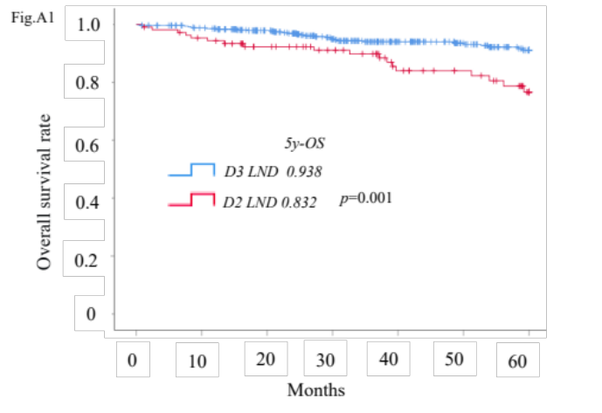
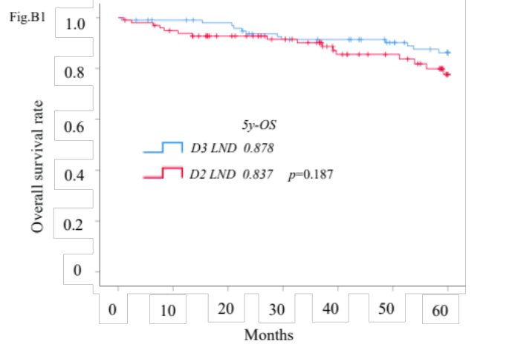
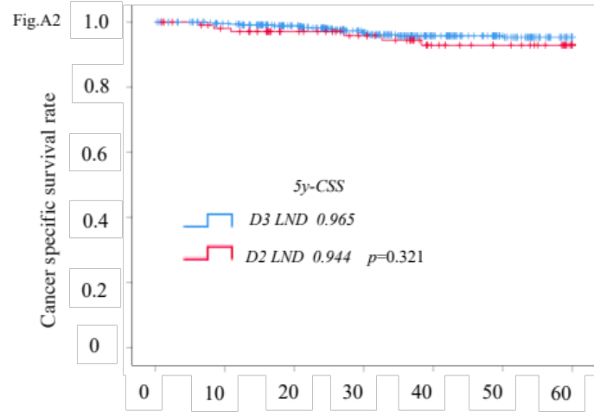
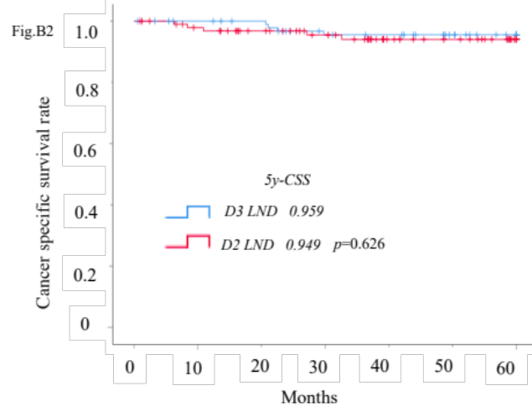
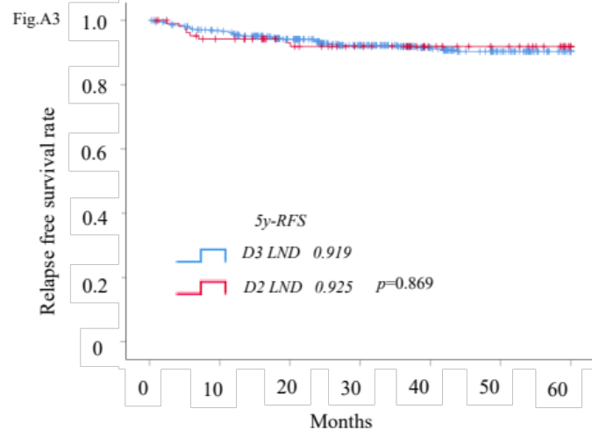
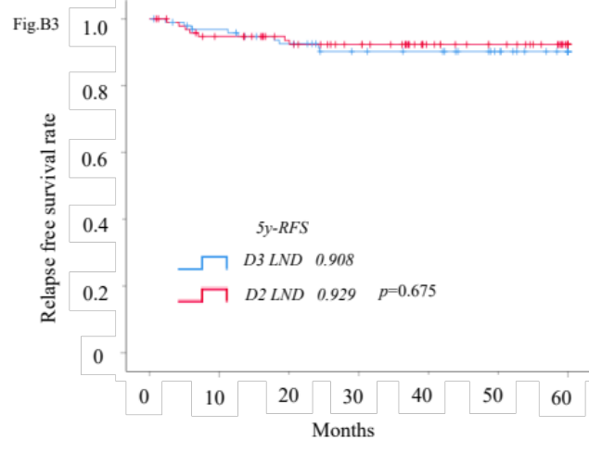
Supplemental Figure. Survival outcomes of patients with cT2 CRC, stratified by LND (D2 vs D3) before and PSM (A1: OS before PSM, A2: CSS before PSM, A3: RFS before PSM; B1: OS after PSM, B2: CSS after PSM, B3: RFS after PSM)
Before PSM
After PSM

