Slide 1
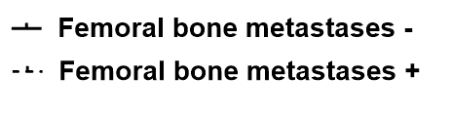
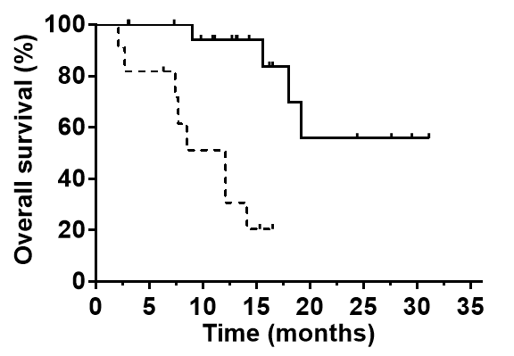
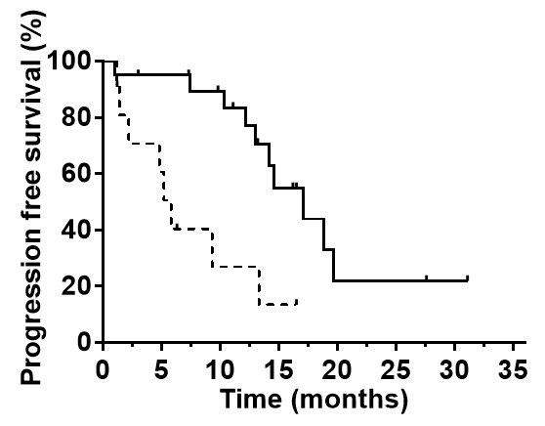
Supplementary Figure 2
2A
(N=20)
(N=11)
P = 0.0001
Number at risk
Femoral bone metastasis -
20 18 15 9 4 3 1 0
Femoral bone metastasis +
11 9 5 2 0 0 0 0
2B
P = 0.0018
Number at risk
Femoral bone metastasis -
20 18 15 7 2 2 1 0
Femoral bone metastasis +
11 6 2 1 0 0 0 0

