Slide 1
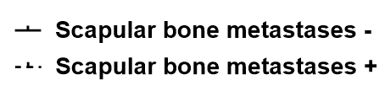
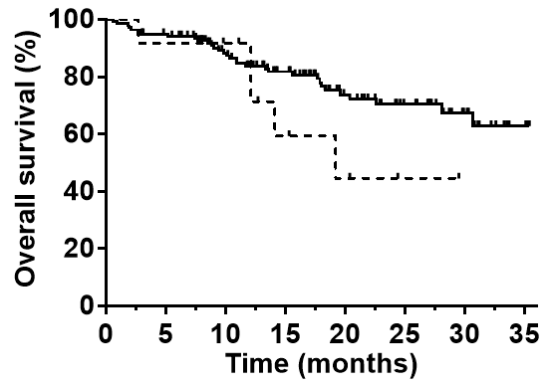
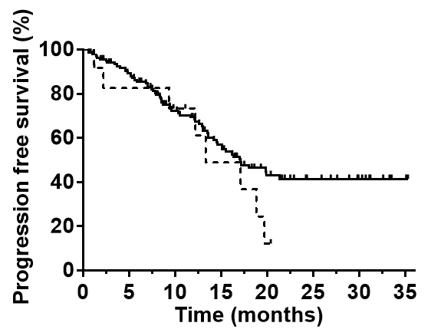
Supplementary Figure 2
2A
(N = 138)
(N = 12)
P = 0.1708
Number at risk
Femoral bone metastasis -
138 127 99 78 47 30 17 3
Femoral bone metastasis +
12 11 10 5 3 1 0 0
2B
P = 0.2050
Number at risk
Femoral bone metastasis -
138 113 76 53 26 16 10 2
Femoral bone metastasis +
12 9 7 4 1 0 0 0

Slide 2
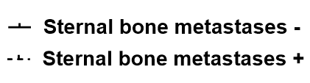
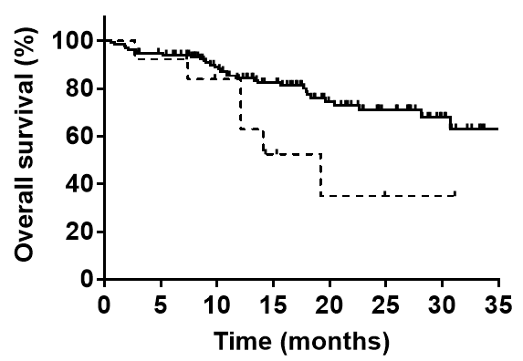
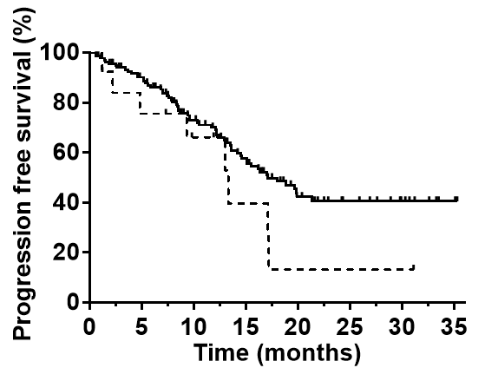
Supplementary Figure 2
2C
(N = 137)
(N = 13)
P = 0.0354
Number at risk
Femoral bone metastasis -
137 126 100 79 48 30 16 3
Femoral bone metastasis +
13 12 9 4 2 1 1 0
2D
P = 0.1197
Number at risk
Femoral bone metastasis -
137 113 77 54 26 15 9 2
Femoral bone metastasis +
13 9 6 3 1 1 1 0

