Slide 1
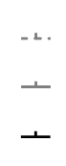
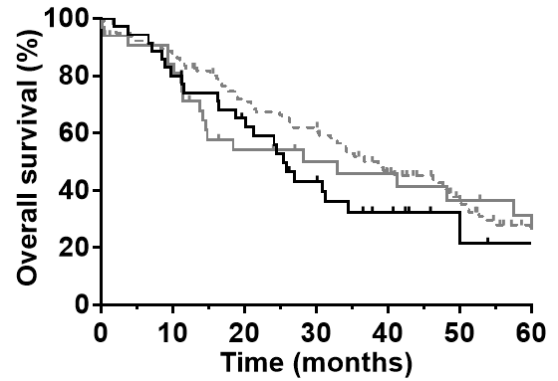
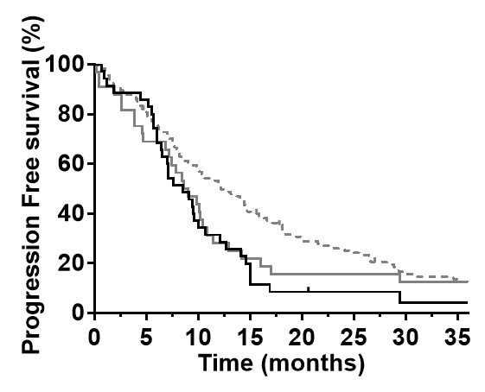
Supplementary Figure 1
1A
NB group (N=115)
SDB group (N=33)
MB group (N=35)
MB vs. NB, P = 0.1253
MB vs. SDB, P = 0.6563
Number at risk
NB group
115 101 80 69 47 29 13
SDB group
33 26 15 12 10 8 6
MB group
35 28 21 13 7 3 1
1B
MB vs. NB, P = 0.0125
MB vs. SDB, P = 0.5431
Number at risk
NB group
115 92 66 46 31 26 16 14
SDB group
33 22 14 7 5 5 4 4
MB group
35 30 13 7 3 2 1 1

