Slide 1

1 2 3 4 5 6 7 8 9
GAD4-CaMBD
Fig. S1. In vitro CaM-binding assay with recombinant OsGAD4-CaMBD fusion protein. Coding sequence for the C-terminal peptide of OsGAD4 cDNA was subcloned in-frame in pET32a (Novagen). Expression of the fusion protein (OsGAD4-CaMBD), its purification and an in vitro CaM binding assay were performed in accordance with Akama et al. (2001). Protein samples were electrophoresed on a 12.5% SDS-polyacrylamide gel, followed by Coomassie Brilliant Blue staining. Lane 1: fusion protein, Lanes 2-6: effluent fractions, Lanes 7-9: eluted fractions with EGTA.

Slide 2
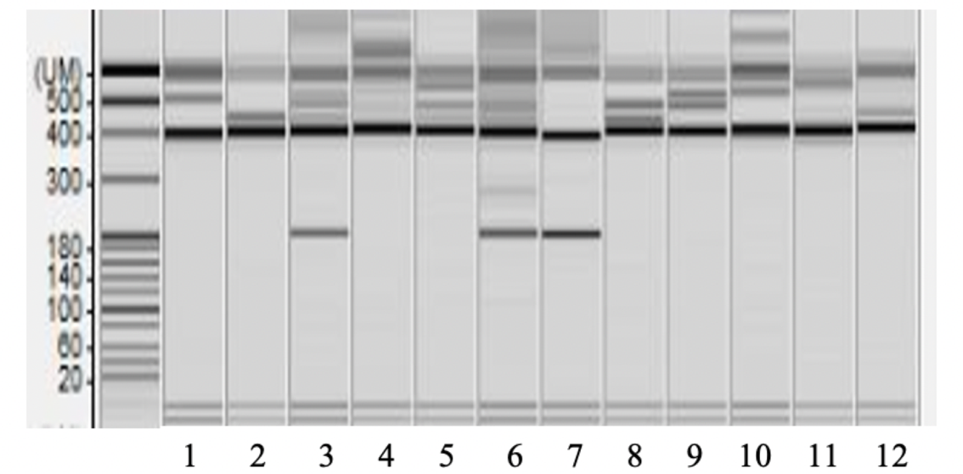
Base pair (bp)
500
400
300
200
100
20
Fig. S2. Screening of regenerated candidates (T₀) through PCR and electrophoresis analysis by MULTINA (Shimadzu, Kyoto, Japan). We selected ten lines (three lines are shown) producing shorter band (along with the 400 bp band), B-type; as numbers 3, 6 and 7 in this figure. The rest are W-type lines producing only one band of 400 bp.

Slide 3
Table S1.Quantification of transgenic lines
Total number of transgenic lines | Type of transgenic lines | Number of individual plants | Percentage (%)
T₀(27) | W type | 170 | 94.4
 | Bi-allelic (B) type | 10 | 5.6
T₁ (10) | W type | ~114 | ~44
 | Bi-allelic (B) type | ~75 | ~29
 | C type (expected band size) | ~70 | ~27
Table S1. Number of transgenic plants produced (T₀ & T₁) and their allelic states. We used the symbol ~, because during electrophoresis, some samples produced unclear bands, and few produced no band. So, this value is approximately or roughly counted.

Slide 4
Fig. S3. GABA content comparison in vegetative tissues of wild-type Ni and GAD4 genome-edited line (#14-1). Measured by GABase assay. L=leaf, S=stem and R=root tissue

Slide 5
Table S2. Primers used in present study
Name | Sequence (5’ to 3’) | Experiment
gRNAF1-F | GTTGGCCCGCGTCGTCGCCAACGG | Genome editing
gRNAF1-R | AAACCCGTTGGCGACGACGCGGGC
gRNAR1-F | GTTGGGATGAGAGCAGACTTGAGA
gRNAR1-R | AAACTCTCAAGTCTGCTCTCATCC
GAD4- F1 | CATCCGCGAGGACTTCAG | Analysis of genome edited plants
GAD4- R356 | TCAATACGAAGCATT
GAD4-F | ACCGTCTCAAGTCTGCTCTCAT | RT-qPCR
GAD4-R | TCAATTCACTGCTACACACCCA
TBP2-F | TGGTCTGGAGGAGCGTATAGCA | Internal control in RT-qPCR
TBP2-R | CAAGTCTCTCAGTCACCCAAGC

