Slide 1
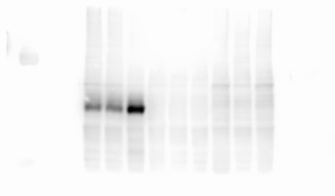
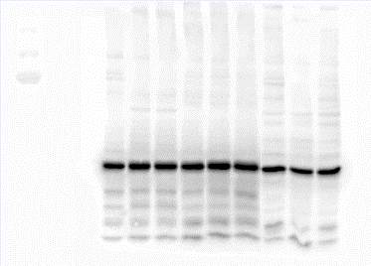
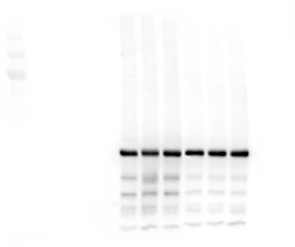
Supplement Figure 1.
(A)
WTC11
GLA KO
GLA/A4GALT
dual KO
PC1
PC2
CMC-Fb02
CMC-Fb02
-A4GALT KO
― 75KDa
α-GLA
― 50KDa
― 37KDa
WTC11
GLA KO
GLA/A4GALT
dual KO
PC1
PC2
CMC-Fb02
CMC-Fb02
-A4GALT KO
― 75KDa
β-actin
― 50KDa
― 37KDa
(B)
GLA/A4GALT
dual KO
CMC-Fb02
-A4GALT KO
WTC11
GLA KO
CMC-Fb02
― 75KDa
― 50KDa
A4GALT
― 37KDa
WTC11
GLA KO
GLA/A4GALT
dual KO
CMC-Fb02
CMC-Fb02
-A4GALT KO
― 75KDa
β-actin
― 50KDa
― 37KDa

Slide 2
Supplement Figure 2.
(A)
WTC11
GLA KO
GLA/A4GALT
dual KO
WTC11
GLA KO
GLA/A4GALT
dual KO
― 75 KDa
p-p38 MAPK
p38 MAPK
― 50 KDa
― 37 KDa
WTC11
GLA KO
GLA/A4GALT
dual KO
WTC11
GLA KO
GLA/A4GALT
dual KO
p-AKT
AKT
― 75 KDa
― 50 KDa
― 37 KDa
(B)
WTC11
GLA KO
GLA/A4GALT
dual KO
WTC11
GLA KO
GLA/A4GALT
dual KO
β-actin
― 50 KDa
SOD/MNSOD
― 37 KDa
― 25 KDa
WTC11
GLA KO
GLA/A4GALT
dual KO
WTC11
GLA KO
GLA/A4GALT
dual KO
Catalase
― 75 KDa
β-actin
― 50 KDa
― 37 KDa

