Slide 1
Sup Figure 1. Correlation between MTMR14 expression and patient survival in multiple of cancers
Kaplan-Meier survival curves comparing the overall survival and disease free survival of the higher (red) and lower (blue) expression of MTMR14 in cholangiocarcinoma ACC, BLCA, BRCA, CESC, CHOL, COAD, DLBC, ESCA, GBM, HNSC, KIRC, KIRP, LUAD, LUSC, MESO, OV, PAAD, PCPG, READ, SARC, CKCM, STAD, TGCT, UCEC and UCS.

Slide 2
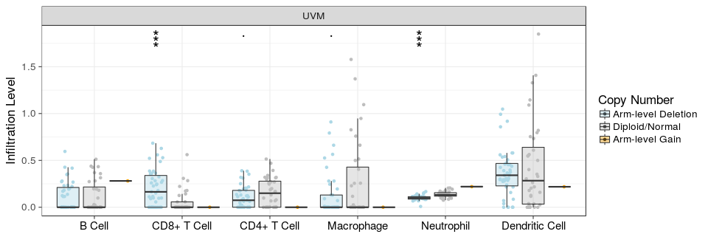
Sup Figure 2. MTMR14 CNV was significantly correlated with the infiltration levels of CD8 + T cells and neutrophils

