Slide 1
Supplementary figures manuscript:
Inhibitors of Bruton’s tyrosine kinase interfere with neutrophil functions in vitro
Mirre De Bondt^{1,3,4}, Janne Renders¹, Paloma Petit de Prado¹, Nele Berghmans¹, Noëmie Pörtner¹, Lotte Vanbrabant¹, Gayel Duran³^{,4}, Paulien Baeten³^{,4}, Bieke Broux³^{,4}, Mieke Gouwy¹, Patrick Matthys², Niels Hellings^{3,4*}, Sofie Struyf^{1*}.
¹ Laboratory of Molecular Immunology, Department of Microbiology, Immunology and Transplantation, Rega Institute for Medical Research, KU Leuven, Belgium;
² Laboratory of Immunobiology, Department of Microbiology, Immunology and Transplantation, Rega Institute for Medical Research, KU Leuven, Belgium;
³ Neuro Immune Connections & Repair Lab, Department of Immunology and Infection, Biomedical Research Institute, Hasselt University, Belgium;
⁴ University MS Center, Pelt-Hasselt, Campus Hasselt, Belgium;
* Senior authors contributed equally.
corresponding author: sofie.struyf@kuleuven.be
Journal of Neuroimmune Pharmacology

Slide 2
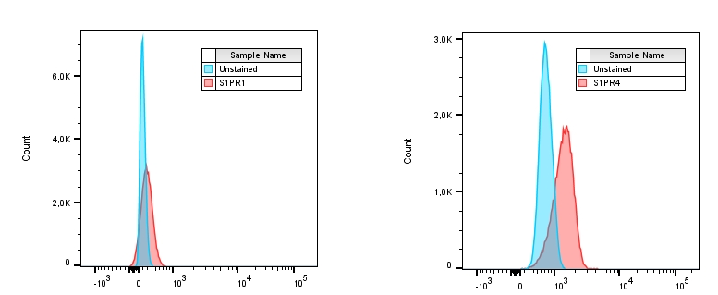
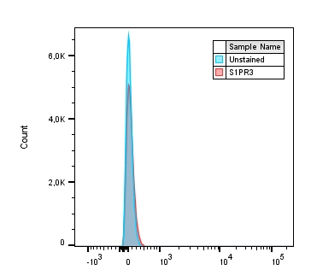
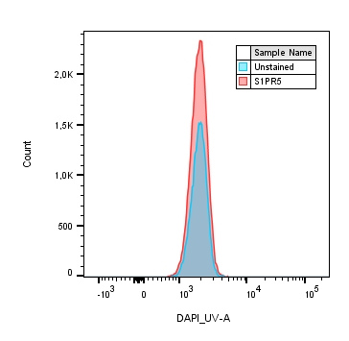
Supplementary fig. 1
Supplementary fig. 1 Expression of sphingosine-1-phosphate receptors (S1PR) on the surface of human neutrophils. Purified neutrophils from healthy human blood samples were blocked with Fc blocking agent and stained for viability with Zombie Aqua. Next, cells were stained with following antibodies for 25 minutes at 4°C: S1PR1 – PE (FAB2016P), S1PR3 – APC (FAB7524A), S1PR4 – AF488 (FAB10321G) and S1PR5 – AF405 (FAB3964V), all from R&D Systems. Cells were washed and data were acquired using the BD LSR Fortessa and analyzed using FlowJo.
Notes:
Fingolimod: S1PR1, 3, 4, 5
Siponimod: S1PR1, 5
Ponesimod: S1PR1

Slide 3
Supplementary fig. 2
PGN PMA
Supplementary fig. 2 NETs release in response to PGN and PMA is not affected by treatment with BTK inhibitors. Purified neutrophils from healthy donors (n=4) were pre-treated for 1 hour with BTKi (evobrutinib, fenebrutinib and tolebrutinib) at concentrations of 1 µM or 10 µM or 0.01% DMSO. Afterwards, neutrophils were stimulated with PGN from S. aureus (10 µg/ml) or PMA (150 ng/ml) and stained with sytox green (0.5 mM) to visualize extracellular DNA release. This was imaged for 5 hours with the IncuCyte system. The area of NETs (green) after 5 hours of stimulation was divided by the cell area (at T=0) to calculate the percentage NET release. Data are represented as the mean ± SEM

Slide 4
Supplementary fig. 3
Supplementary fig. 3 Expression of surface receptors on neutrophils is not affected by treatment with BTK inhibitors. Purified neutrophils from healthy donors (n=4) were pre-treated for 1 hour with tolebrutinib
(1 µM) or vehicle control (0.01% DMSO). Afterwards, cells were blocked with Fc blocking agent and stained for viability with Zombie Aqua. Next, cells were stained with following antibodies: CD66b – BV421, CD16 – AF700, CXCR1 – PE, CXCR2 – FITC and FPR1 – AF647. Data were acquired using the BD LSR Fortessa and analyzed using FlowJo. Median fluorescence intensity (MFI) was calculated and data are represented as mean ± SEM and analyzed with a paired t-test with Bonferroni correction

Slide 5
Supplementary fig. 4
B
Buffer LPS fMLF PMA
A
C
D
Supplementary fig. 4 Spontaneous and stimulus-induced ROS production is inhibited after treatment with BTK inhibitors. Neutrophils purified from bone marrow of healthy mice (n=2) were pre-treated for 30 minutes with the BTKi tolebrutinib and evobrutinib (10 µM) or 0.01% DMSO control. Afterwards, neutrophils were stimulated with inducers, and luminol (5 mM) was added to quantify ROS release with the Clariostar. Following inducers were used: A) buffer, as a measure for spontaneous ROS release, B) LPS (10 µg/ml), C) fMLF (500 ng/ml), or D) PMA (150 ng/ml), as positive control. The percentage inhibition of ROS release by the BTKi was calculated compared to solvent control (0.01% DMSO), on the maximal luminescence value over time. Data are represented as the mean ± SEM and dot shapes represent different sample collection dates

Slide 6
Supplementary fig. 5
Supplementary fig. 5 ROS production is reduced in peritoneal neutrophils from mice that were pre-treated with tolebrutinib. Mice were i.v. injected with tolebrutinib (1 mg/kg) or DMSO control. After 30 minutes, CXCL1 (100 ng) was injected i.p. to attract neutrophils. After 2 hours, mice were sacrificed and peritoneum was washed for 1 minute with PBS + 2% FBS and 20 U/mL heparin. Cells from the peritoneal lavage were stained with DCFH-DA reagent (5 µM) in RPMI for 20 minutes at 37°C. Afterwards, cells were put on ice to stop the reaction for 10 minutes. Cells were then washed with RPMI and fixed with 0.4% formaldehyde. Samples were analyzed with the BD LSR Fortessa and analyzed with FlowJo. MFI = median fluorescent intensity

