Slide 1
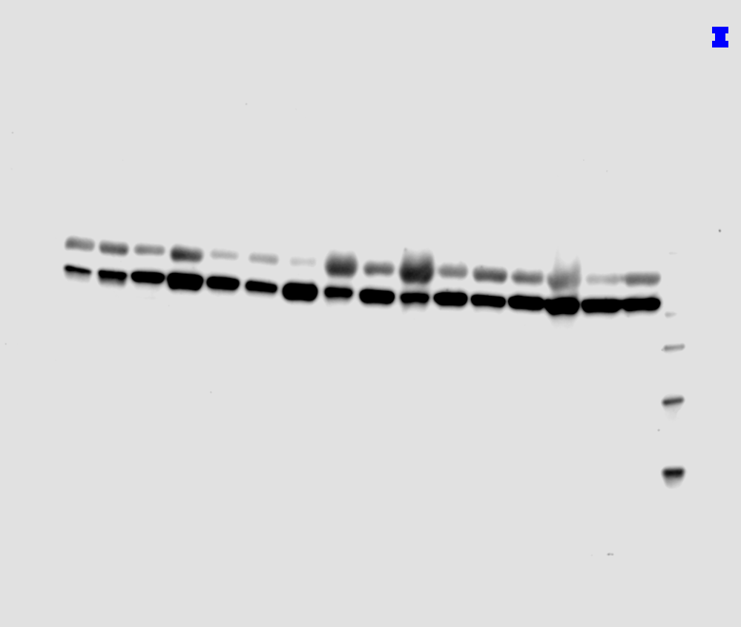
Supplementary Figure S1. Original images of Western blot.
220 kDa
120 kDa
Caco-2
80 kDa
N T N T N T N T N T N T N T N T
T N T N T N T N T N T N T N T N T N T N T N T
60 kDa
50 kDa
DcpS
40 kDa
30 kDa
20 kDa
Β-tubulin
50 kDa
40 kDa
30 kDa
20 kDa

