Slide 1
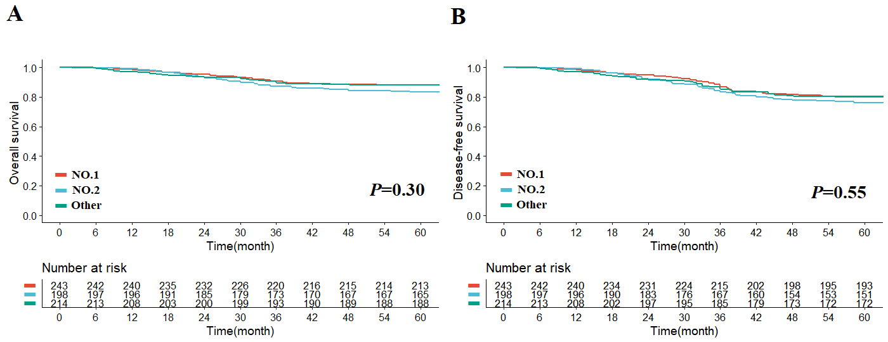
The impact of surgical case order on short-term and long-term outcomes in patients undergoing laparoscopic gastrectomy: a propensity matched study
Background and aim
Results
Whether the surgical case order is an important factor affecting the short- and long-term outcomes of patients with GC has always been a concern.
To compare the short- and long-term outcomes of different surgical case orders
Methods
included patients who underwent laparoscopy-assisted radical gastrectomy between January 2016 and December 2017. In total, 1235 patients (No.1 (n=497), No.2 (n=426), and Other groups (n=312)) were included in the propensity score matching (PSM, 1:1:1).
Conclusions
  Surgeons should reasonably schedule surgeries to provide better medical services and to improve patient motivation and care.

