Slide 1
Additional file

Slide 2
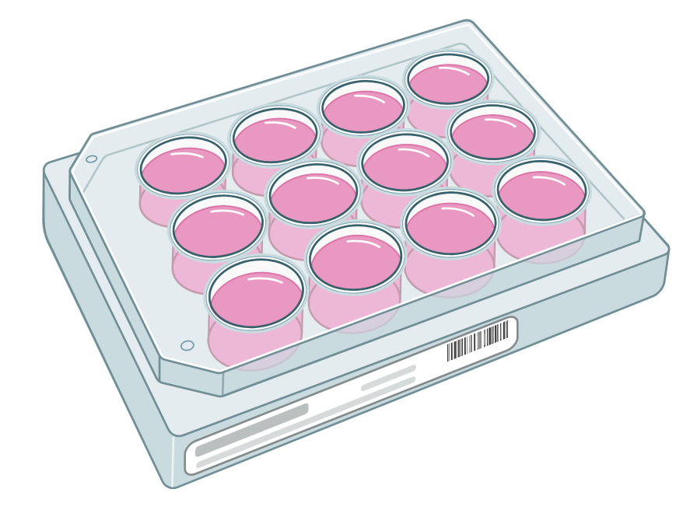
a
GM-CSF 10 ng/mL
IFN-γ 10ng/mL
LPS 10pg/mL
4 days
2 days
Flow cytometry
ZAG 5 μg/mL
or
Vehicle control
b
GM-CSF 10 ng/mL
IL-4 20ng/mL
4 days
2 days
Flow cytometry
ZAG 5 μg/mL
or
Vehicle control
c
GM-CSF 10 ng/mL
4 days
2 days
Flow cytometry
ZAG 5 μg/mL
or
Vehicle control
Fig. S1 Construction of M1/M2 differentiation models using PBMC-derived Mφ. To obtain macrophages, monocytes were incubated for 4 days in a basal medium supplemented with 10 ng/mL GM-CSF at 37℃ and 5% CO₂. The medium was replaced with a basal medium with each of the following supplements: (a) M1 polarized group—with 10 ng/mL IFN-γ + 10 pg/mL LPS; (b) M2 polarized group—with 20 ng/mL IL-4; and (c) non-polarized group—no supplement. In all polarization models, the indicated concentrations of recombinant human-ZAG or vehicle control were added. After 2 days of incubation, the cells were harvested and subjected to an FCM analysis.
Abbreviations: FCM, flow cytometry; GM-CSF, granulocyte macrophage colony-stimulating factor; IFN-γ, interferon gamma; IL-4, interleukin 4; PBMC, human peripheral blood mononuclear cells; and ZAG: alpha-2-glycoprotein 1, zinc-binding

Slide 3
a
PMA 10 ng/mL
IFN-γ 10ng/mL
LPS 10pg/mL
3 days
2 days
Flow cytometry
ZAG 1 μg/mL
ZAG 5 μg/mL
or
Vehicle control
b
PMA 10 ng/mL
IL-4 20ng/mL
3 days
2 days
Flow cytometry
ZAG 1 μg/mL
ZAG 5 μg/mL
or
Vehicle control
c
PMA 10 ng/mL
3 days
2 days
Flow cytometry
ZAG 1 μg/mL
ZAG 5 μg/mL
or
Vehicle control
Fig. S2 Construction of M1/M2 differentiation models using THP-1 cells. To obtain macrophage like cells, THP-1 was incubated for 3 days in a basal medium supplemented with 10 ng/mL PMA at 37 ℃ and 5% CO₂. The medium was replaced with a basal medium with each of the following supplements: (a) M1 polarized group—with 10 ng/mL IFN-γ + 10 pg/mL LPS; (b) M2 polarized group—with 20 ng/mL IL-4; and (c) non-polarized group—no supplement. In all polarization models, the indicated concentrations of recombinant human-ZAG or vehicle control were added. After 2 days of incubation, the cells were harvested and subjected to an FCM analysis. All experiments were performed in triplicate.
Abbreviations: FCM, flow cytometry; IFN-γ, interferon gamma; IL-4, interleukin 4; and ZAG: alpha-2-glycoprotein 1, zinc-binding

Slide 4
a
PD-L1
b
PD-L1-iso
c
CD86
d
CD86-iso
Fig. S3 Gating strategy for the identification of PD-L1-, CD86-positive cells. Gating diagrams for PD-L1-, CD86-positive cells are depicted using Mo/Mφ of a representative case. Appropriate isotype controls serve as the cut-off between positive and negative cells. (a, b) A positive gate for PD-L1 is set to include <1% of the cells in each specimen with a matched isotype control. (c, d) A positive gate for CD86 is set to include <0.5% of the cells in each specimen with a matched isotype control.
Abbreviations: PD-L1, programmed death-ligand 1; CD86, Cluster of Differentiation 86

Slide 5
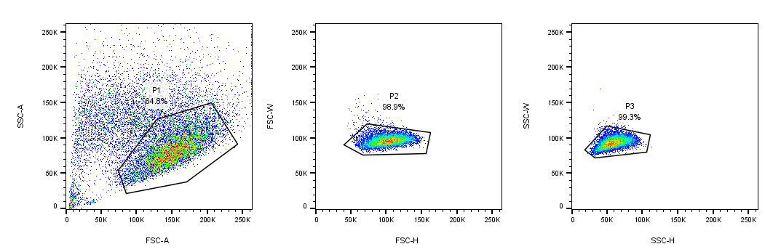
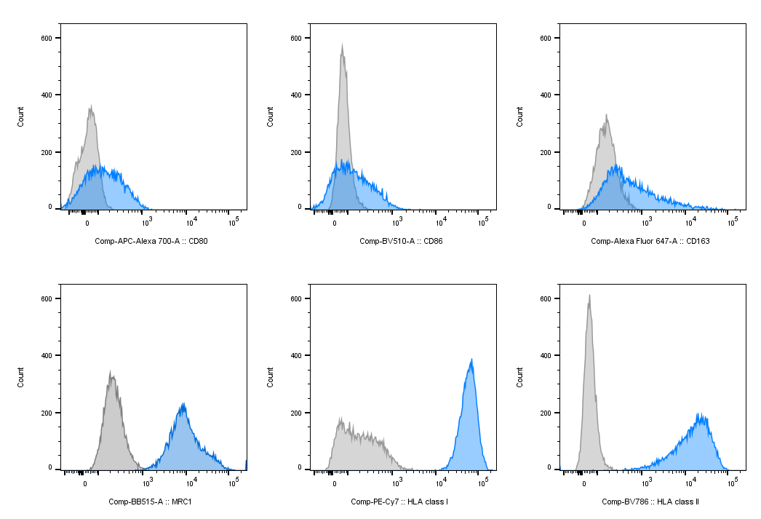
a
b
Fig. S4 The gating strategy for single cell detection and representative histograms of fluorescence intensity for surface antigens. (a) The gating strategy for the removal of dead cells and doublets in flow cytometry. Subsequent assessment for fluorescence intensity derived from the indicated surface antigen is performed on cell populations within the P3 gate. (b) Representative histograms of fluorescence intensity derived from Mφ polarization markers and HLAs. Gray and dashed lines indicate the signals of isotype control. Blue and solid lines indicate the signals derived from the indicated surface antigens.
Abbreviation: HLA, human leukocyte antigen

Slide 6
a
b
c
d
e
f
g
h
i
j
k
Fig. S5 Association between the ZAG status and percentages of PD-L1 positive cells in each lineage of tumor-infiltrating immune cells. (a–k) Percentages of PD-L1 positive cells in each immune cell lineage according to the ZAG status. Unpaired t-test or Mann–Whitney U test are conducted depending on the data distribution. The statistical test method used, statistics values, and recalculated values, excluding outliers, are summarized in the Additional file (Tables S5 and S6). ns p>0.05 (insignificant); * p<0.05
Abbreviations: PD-L1, programmed death-ligand 1; ZAG, alpha-2-glycoprotein 1, zinc-binding

Slide 7
a
b
c
d
e
f
g
h
i
j
k
Fig. S6 Association between the ZAG status and percentages of CD86 positive cells in each lineage of tumor-infiltrating immune cells. (a–k) Percentages of CD86 positive cells in each immune cell lineage according to the ZAG status. Unpaired t-test or Mann–Whitney U test are conducted depending on the data distribution. The statistical tests, statistics values, and recalculated values, excluding outliers, are summarized in the Additional file (Tables S7 and S8). ns p>0.05 (insignificant); * p<0.05; ** p<0.01
Abbreviations: CD86, Cluster of Differentiation 86; ZAG, alpha-2-glycoprotein 1, zinc-binding

Slide 8
a
b
c
d
e
f
M1 polarization model
g
h
i
j
k
l
M2 polarization model
m
n
o
p
q
r
Non polarization model
Fig. S7 The action of ZAG in THP-1-derived Mφ-like cells. The expression levels of the indicated surface antigens are denoted as ΔMFI by subtracting the MFI of the isotype control from their MFI. The graph depicts expressions of the indicated surface antigens, with and without indicated concentrations of ZAG (1 μg/mL or 5 μg/mL) in the M1 polarized (a–f), M2 polarized (g–l), and non-polarized condition (m–r). The Kruskal–Wallis test and Dunn's multiple comparisons test are conducted for multiple comparisons. Actual p-values are denoted at the top.
Abbreviations: MFI, mean fluorescence intensity; ZAG, alpha-2-glycoprotein 1, zinc-binding

Slide 9
a
b
c
d
e
f
g
h
i
j
k
m

Slide 10
Fig. S8 Summary of the GSEA results from the METABRIC datasets. (a–m) GSEA results from the METABRIC datasets. Biological processes positively or negatively correlated with the indicated gene expression are depicted in a descending order of the absolute value of the NSE with absolute values of the log-transformed nominal p-values and FDR q-values. Thresholds of the nominal p-value and FDR q-value are set to <0.05 and <0.25, respectively, and the boundaries are denoted by dashed lines.
Abbreviations: GSEA, Gene Set Enrichment Analysis; METABRIC, Molecular Taxonomy of Breast Cancer International Consortium; and NSE, normalized enrichment score

Slide 11
a
b
Fig. S9 AZGP1 expression in normal and cancerous tissues. Raw data evaluated by RNA sequencing for AZGP1 expression in (a) normal and (2) cancer tissues are downloaded from The Human Protein Atlas website (https://www.proteinatlas.org/ENSG00000160862-AZGP1; accessed on November 07, 2022). The expression values (i.e., TPM and FPKM values) are log-transformed and summarized. The Kruskal–Wallis test and Dunn's multiple comparisons test are conducted for multiple comparisons. Compared with the mammary gland or breast cancer tissues, significant differences (p<0.05) are indicated by "*".
Abbreviations: FPKM, Fragments Per Kilobase Million; TPM, transcripts per million

Slide 12
Table S1. Antibodies used for the histological evaluation of breast cancer tissues
Antigen | Antibody | Clone | Vender
ER | rabbit monoclonal antibodie | SP1 | Ventana Medical Systems Japan Inc. Tokyo, Japan
PgR | rabbit monoclonal antibodie | 1E2 | Ventana Medical Systems Japan Inc. Tokyo, Japan
HER2 | rabbit monoclonal antibodie | 4B5 | Roche Diagnostics K.K. Tokyo, Japan
AR | rabbit monoclonal antibodie | AR27 | Leica Biosystems Inc. Wetzlar, Germany
PD-L1 | rabbit monoclonal antibodie | SP142 | Spring Bioscience, Pleasanton, CA, USA
ZAG | mouse monoclonal antibody | 1D4 | Santa Cruz Biotechnology, Inc. Dallas, TX, US
Abbreviations- ZAG: Alpha-2-glycoprotein 1, zinc-binding; HER2: Human epidermal growth factor receptor 2; PD-L1: programmed death-1 (PD-1) ligand 1; ER: estrogen receptor; PgR: progesterone receptor; and AR: androgen receptor

Slide 14
Table S3. Immune cell composition (count/g) by the ZAG status
ZAG | High | Low | p-value
Lineage | Median | Median
Leukocyte | 135692 | 238138 | 0.294*
Total T | 74889 | 126212 | 0.478*
CD4＋T | 36223 | 45364 | 0.677*
CD8＋T | 26723 | 50227 | 0.521*
B | 10071 | 11070 | 0.884*
Mo / Mφ | 6302 | 17327 | 0.021*
CD16+ Mo | 682 | 1761 | 0.049*
MDSC | 182 | 911 | 0.005*
DC | 5972 | 9316 | 0.126*
mDC | 3177 | 5968 | 0.105*
NK | 5866 | 3764 | 0.536*
minor NK | 2048 | 2782 | 0.468*
NKT | 5912 | 6790 | 0.478*
*Mann–Whitney U test
Abbreviations- CD: Cluster of Differentiation; NK: natural killer; NKT: natural killer T cells; MDSC: myeloid-derived suppressor cells; ZAG: Alpha-2-glycoprotein 1, zinc-binding; and DC: dendritic cells
Table S4. Immune cell composition (count/g) by the ZAG status: recalculated by removing the outliers
ZAG | High | Low | p-value
Lineage | Median | Median
Leukocyte | 98875 | 196002 | 0.323*
Total T | 53493 | 85043 | 0.224*
CD4＋T | 23819 | 28174 | 0.328**
CD8＋T | 23465 | 37318 | 0.628*
B | 6471 | 7004 | 0.490*
Mo / Mφ | 4971 | 15750 | 0.009*
CD16+ Mo | 334.5 | 1195 | 0.020*
MDSC | 147.4 | 687.7 | <0.001*
DC | 4825 | 9307 | 0.061*
mDC | 2912 | 4864 | 0.083*
NK | 4117 | 3372 | 0.834**
minor NK | 1356 | 2067 | 0.666*
NKT | 4783 | 6058 | 0.507**
*Mann–Whitney U test, **Student t-test
Abbreviations- CD: Cluster of Differentiation; NK: natural killer; NKT: natural killer T cells; MDSC: myeloid-derived suppressor cells; ZAG: Alpha-2-glycoprotein 1, zinc-binding; and DC: dendritic cells

Slide 15
Table S5. Percentage of PD-L1 positive cells in each lineage by the ZAG status
ZAG | High | Low | p-value
Lineage | Median | Median
CD4＋T | 1.4 | 2.3 | 0.015*
CD8＋T | 1.7 | 1.2 | 0.257*
B | 3.2 | 4.2 | 0.779*
Mo / Mφ | 16.5 | 24.4 | 0.132*
CD16+ Mo | 38.0 | 38.5 | 0.559**
MDSC | 12.9 | 16.7 | 0.550*
DC | 6.6 | 7.4 | 0.711*
mDC | 7.5 | 10.6 | 0.095*
NK | 1.0 | 1.8 | 0.184*
minor NK | 0.9 | 3.0 | 0.175*
NKT | 4.9 | 5.2 | 0.955*
*Mann–Whitney U test, **Student t-est
Abbreviations- CD: Cluster of Differentiation; NK: natural killer; NKT: natural killer T cells; MDSC: myeloid-derived suppressor cells; ZAG: Alpha-2-glycoprotein 1, zinc-binding; PD-L1: programmed death-1 (PD-1) ligand 1; and DC: dendritic cells
Table S6. Percentage of PD-L1 positive cells in each lineage by the ZAG status: recalculated by removing the outliers
ZAG | High | Low | p-value
Lineage | Median | Median
CD4＋T | 1.2 | 2.1 | 0.009*
CD8＋T | 1.7 | 1.2 | 0.134*
B | 2.2 | 3.5 | 0.209*
Mo / Mφ | 16.5 | 24.4 | 0.132*
CD16+ Mo | 38.0 | 38.5 | 0.559**
MDSC | 9.8 | 16.7 | 0.124**
DC | 6.6 | 6.9 | 0.447**
mDC | 7.5 | 9.8 | 0.114**
NK | 1.0 | 1.8 | 0.030**
minor NK | 0.4 | 2.9 | 0.005*
NKT | 4.9 | 4.8 | 0.215**
*Mann–Whitney U test, **Student t-test
Abbreviations- CD: Cluster of Differentiation; NK: natural killer; NKT: natural killer T cells; MDSC: myeloid-derived suppressor cells; ZAG: Alpha-2-glycoprotein 1, zinc-binding; PD-L1: programmed death-1 (PD-1) ligand 1; and DC: dendritic cells

Slide 16
Table S7. Percentage of CD86 positive cells in each lineage by the ZAG status
ZAG | High | Low | p-value
Lineage | Median | Median
CD4＋T | 5.7 | 10.8 | 0.006*
CD8＋T | 5.6 | 16.7 | 0.004*
B | 18.0 | 25.5 | 0.69*
Mo / Mφ | 23.5 | 48.3 | 0.010*
CD16+ Mo | 77.8 | 74.9 | 0.373**
MDSC | 72.1 | 93.6 | 0.075*
DC | 21.6 | 35.8 | 0.052*
mDC | 34.1 | 44.1 | 0.057*
NK | 3.8 | 3.0 | 0.886*
minor NK | 7.7 | 7.8 | 0.331*
NKT | 12.9 | 18.3 | 0.796*
*Mann–Whitney U test, **Student t-test
Abbreviations- CD: Cluster of Differentiation; NK: natural killer; NKT: natural killer T cells; MDSC: myeloid-derived suppressor cells; ZAG: Alpha-2-glycoprotein 1, zinc-binding; and DC: dendritic cells
Table S8. Percentage of CD86 positive cells in each lineage by the ZAG status: recalculated by removing the outliers
ZAG | High | Low | p-value
Lineage | Median | Median
CD4＋T | 4.8 | 6.7 | 0.003**
CD8＋T | 5.6 | 16.7 | 0.002*
B | 17.4 | 25.5 | 0.496*
Mo / Mφ | 23.5 | 48.4 | 0.010*
CD16+ Mo | 77.8 | 74.9 | 0.373**
MDSC | 72.1 | 93.7 | 0.017*
DC | 21.6 | 33.6 | 0.068**
mDC | 34.1 | 44.1 | 0.057*
NK | 3.8 | 3.0 | 0.913*
minor NK | 7.7 | 7.4 | 0.458*
NKT | 12.9 | 16.9 | 0.453**
*Mann–Whitney U test, **Student t-test
Abbreviations- CD: Cluster of Differentiation; NK: natural killer; NKT: natural killer T cells; MDSC: myeloid-derived suppressor cells; ZAG: Alpha-2-glycoprotein 1, zinc-binding; and DC: dendritic cells

