Slide 1
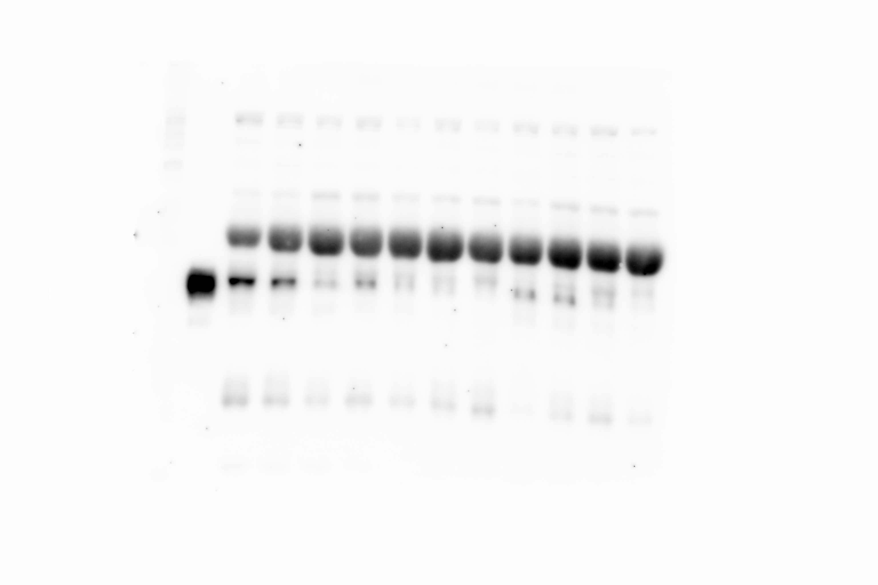
Supplementary figure 1
LRG1
LRG1

Slide 2
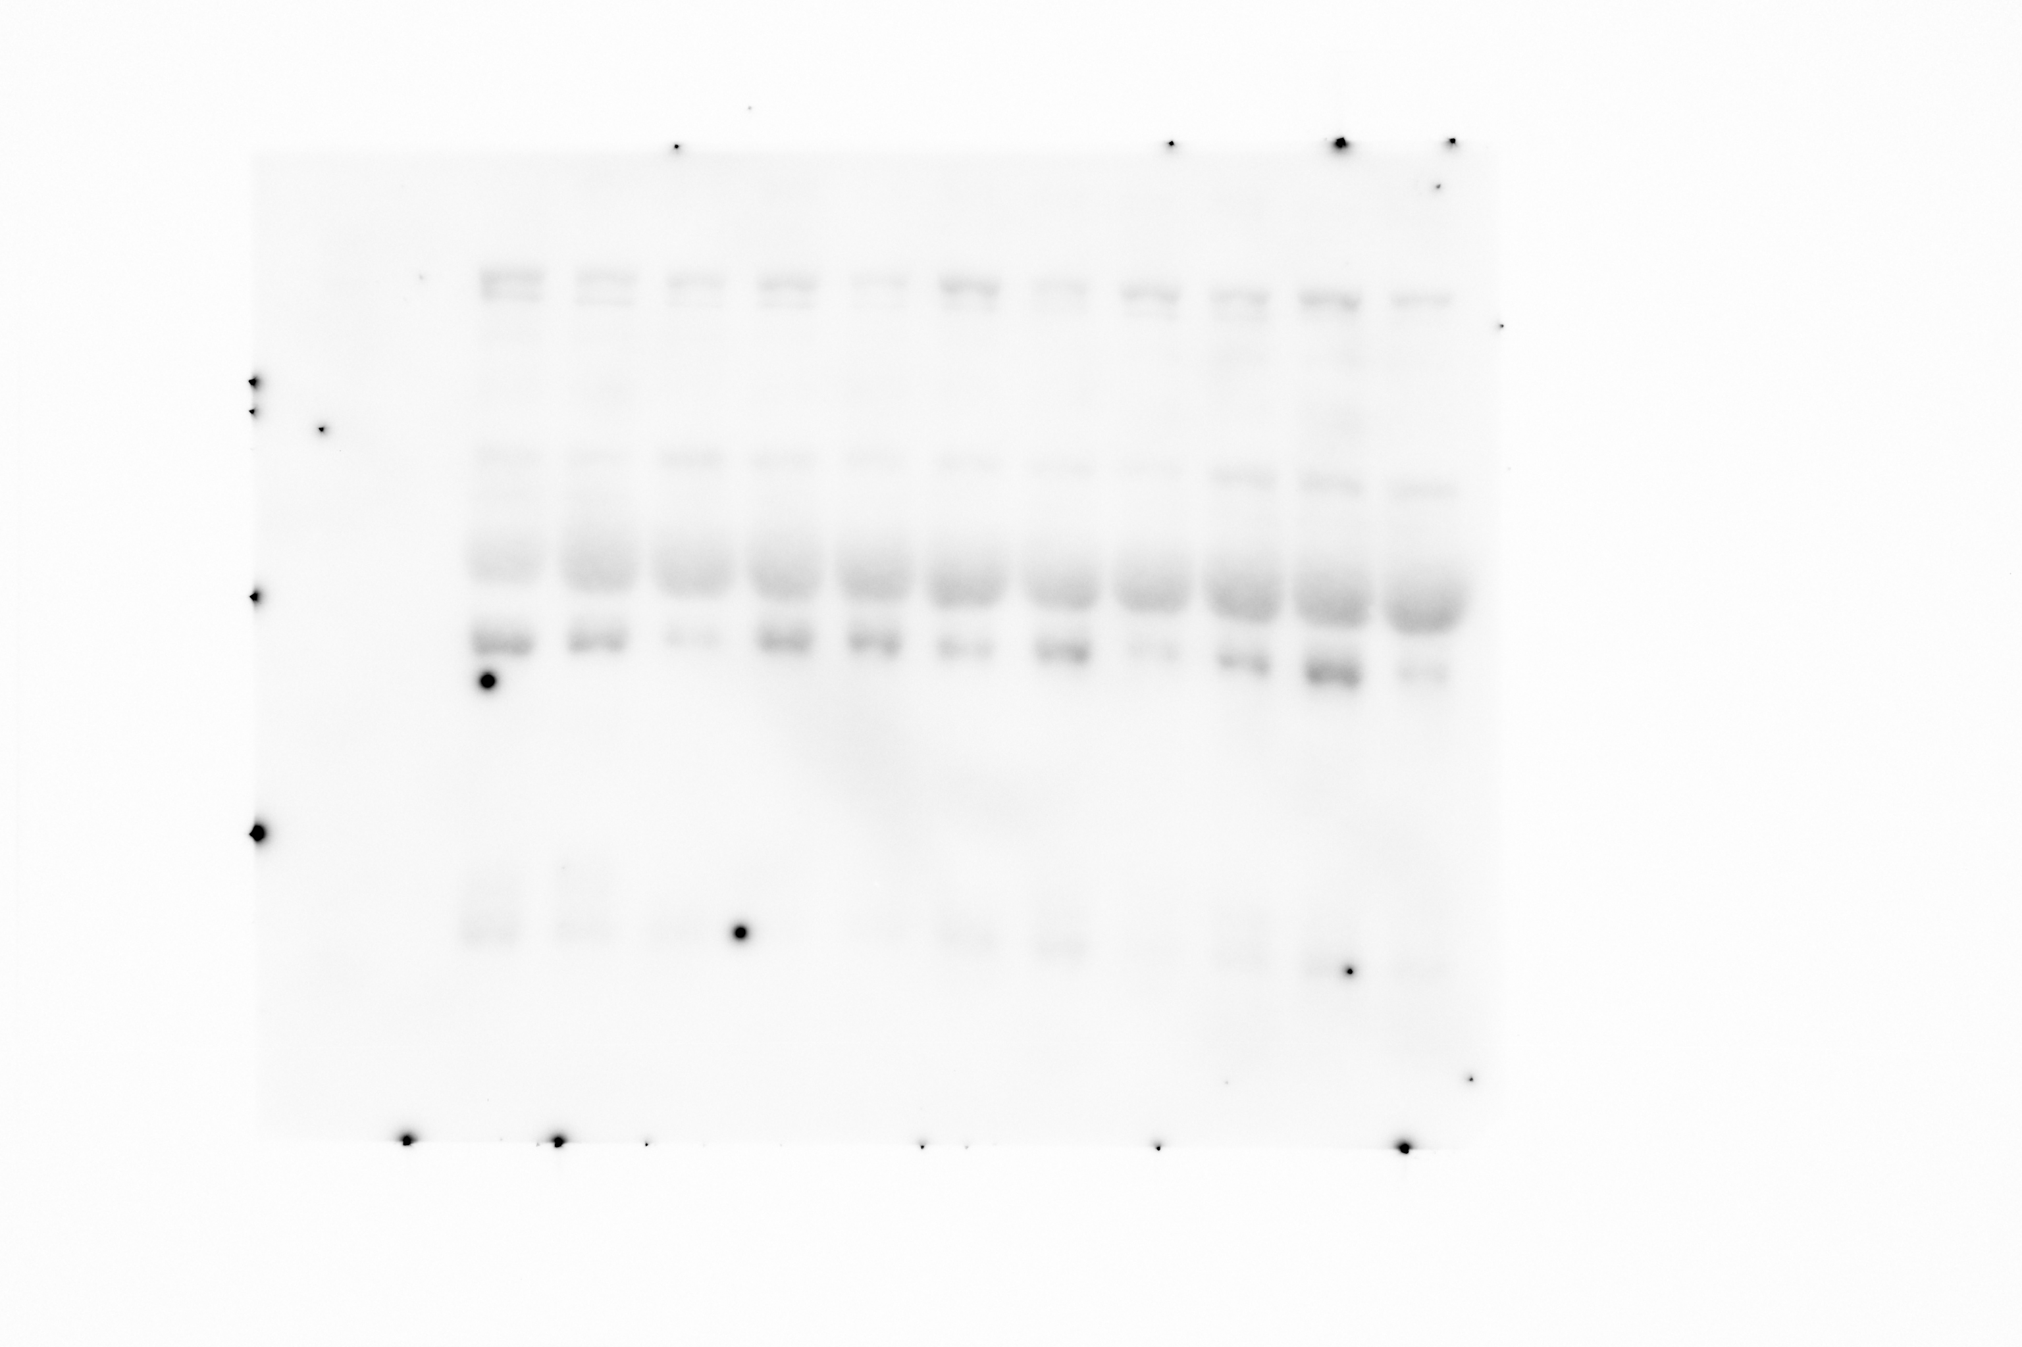
Supplementary figure 2
Transferrin
Transferrin

