Slide 1
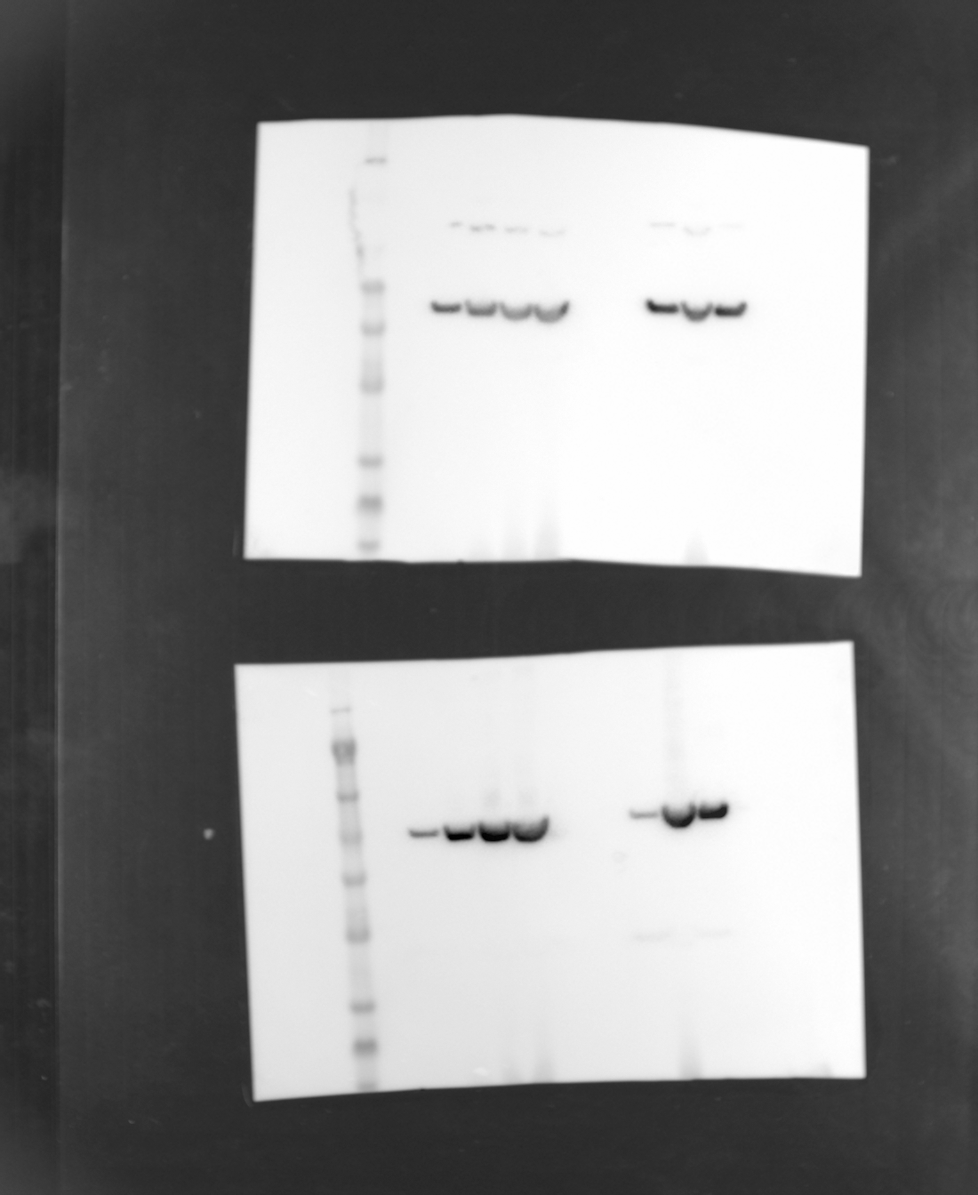
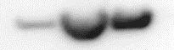
antibody
β-actin (45kDa)
antibody
CK-18 (48kDa)
day(s)
0
4
10
15
0
10
10+3
day(s)
0
4
10
15
0
10
10+3
198
198
98
98
62
62
49
49
38
38
28
28
17
17
14
14
6
6
3
3
day(s)
0
4
10
15
0
10
10+3
CK-18 (48kDa)
β-actin (45kDa)

