Slide 1
Supplementary Figure 1
a
∗
b
∗
c
∗
d
e
Supplementary Figure 1. Characteristics of ZL and ZDF rats at the age of eight weeks. (a) Body weight, (b) blood glucose, and (c) serum triacylglycerol levels after 12-hour overnight fasting. (d) Change in the blood glucose levels in the Insulin tolerance test. (e) Change in the blood glucose levels in the oral glucose tolerance test.

Slide 2
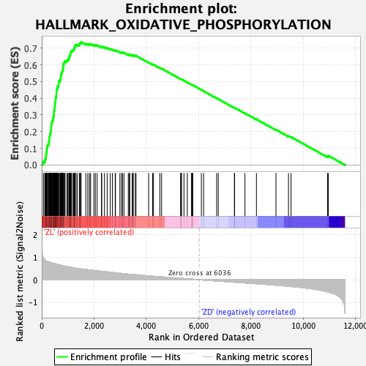
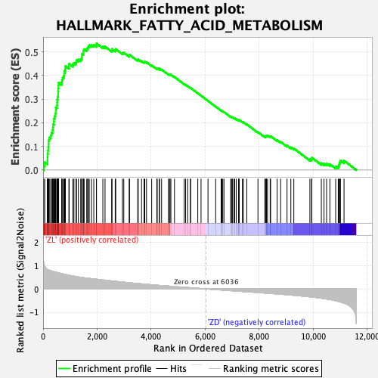
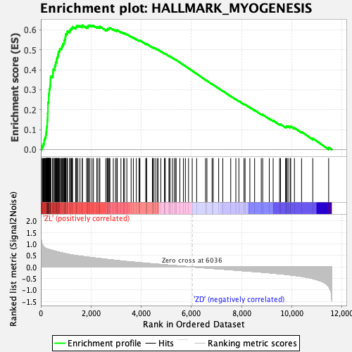

Supplementary Figure 2
a
b
c
d
Supplementary Figure 2. GSEA with hallmark gene sets were enriched in the ZDF group compared with the ZL group (n = 5). (a) Oxidative phosphorylation. (b) Fatty Acid metabolism. (c) Myogenesis. (d) Adipogenesis

Slide 3
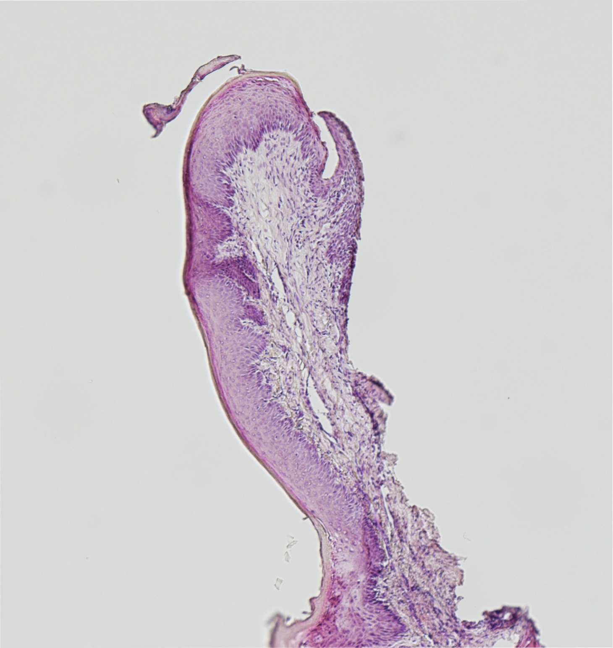
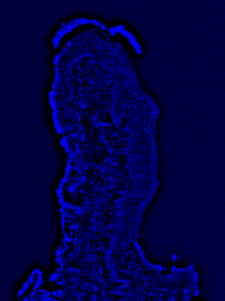
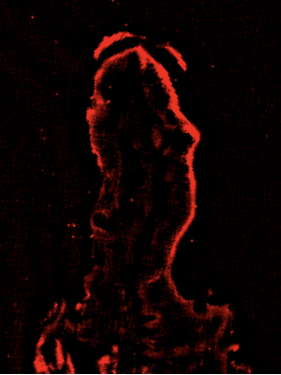
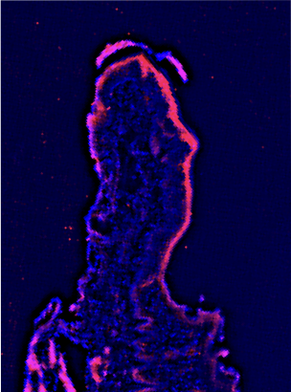
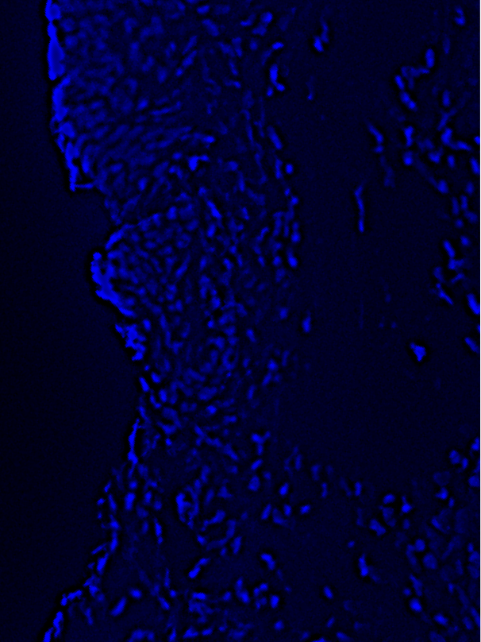
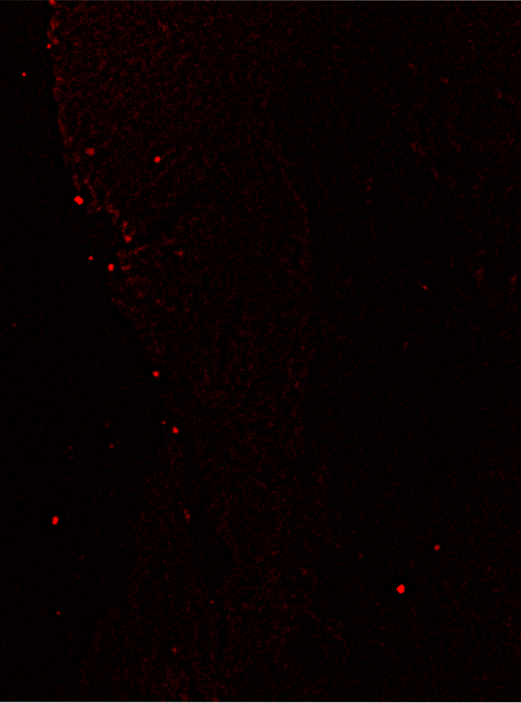
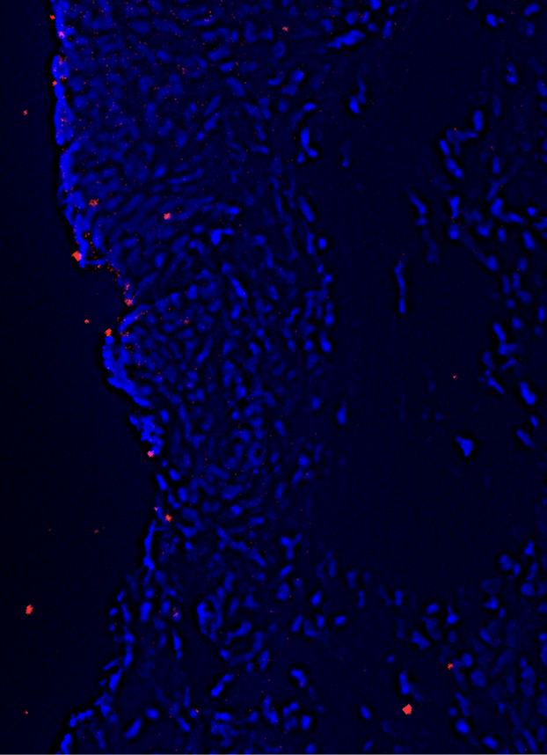
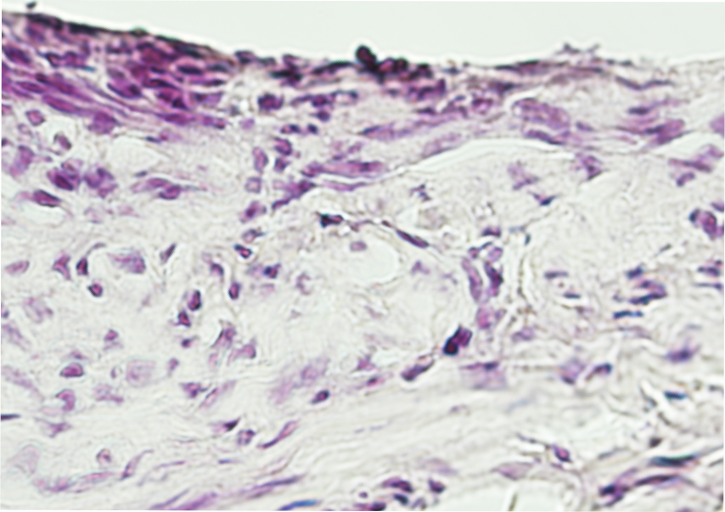
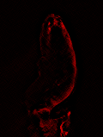
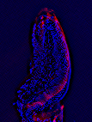
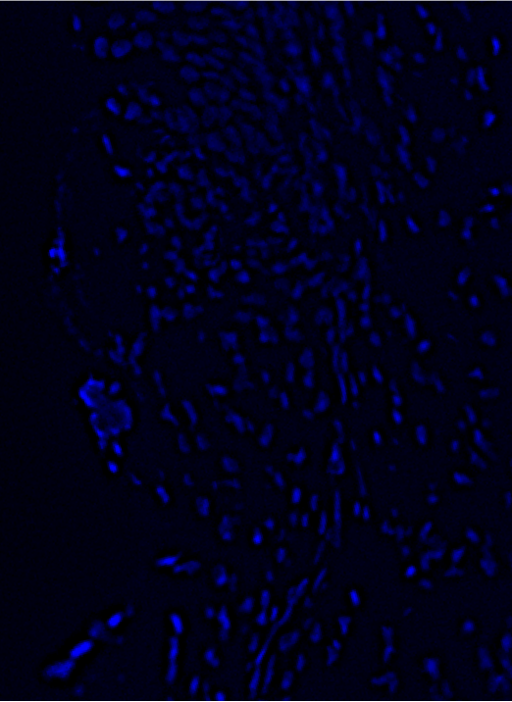
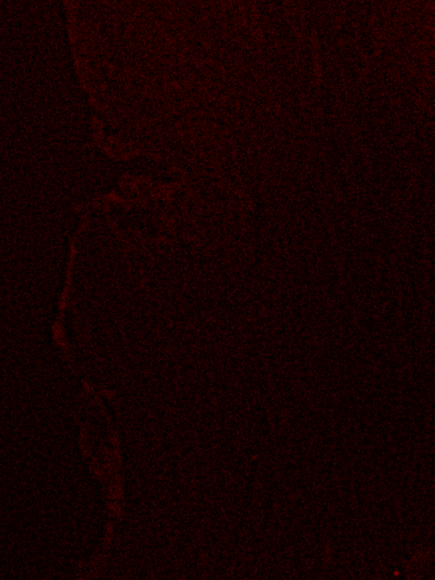
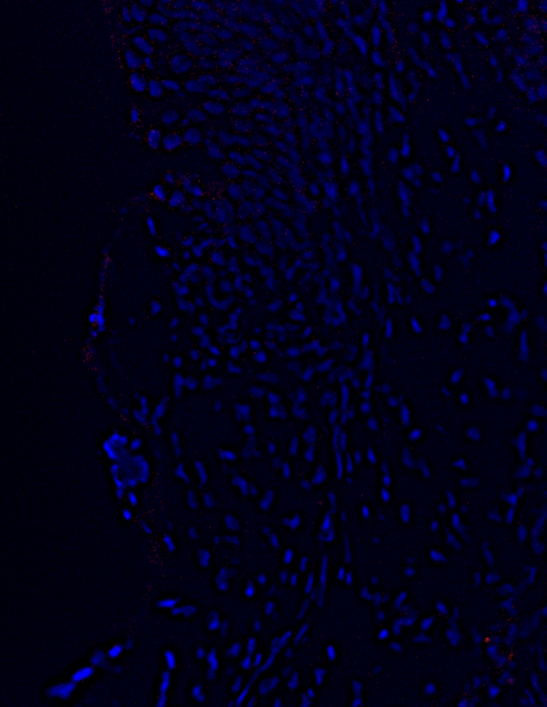
Supplementary Figure 3
HE
DAPI
PPARγ
merge
ZL
Overlay_HR_2g-1.tif
ZDF
Supplementary Figure 3. Immunohistochemical analyses for PPARγ. Representative histological and immunohistochemical photographs of gingiva in the ZL and ZDF groups for hematoxylin and eosin staining; 4′,6-diamidino-2-phenylindole (DAPI), nuclear staining; PPARγ; and merge of immunofluorescence staining. Magnification: ×40 and ×200, Scale bar: 300 and 50 μm, representatively.

