Slide 1
Supplementary File 4. Verification of 19 false-positive de novo calls of Sniffles2

Slide 2
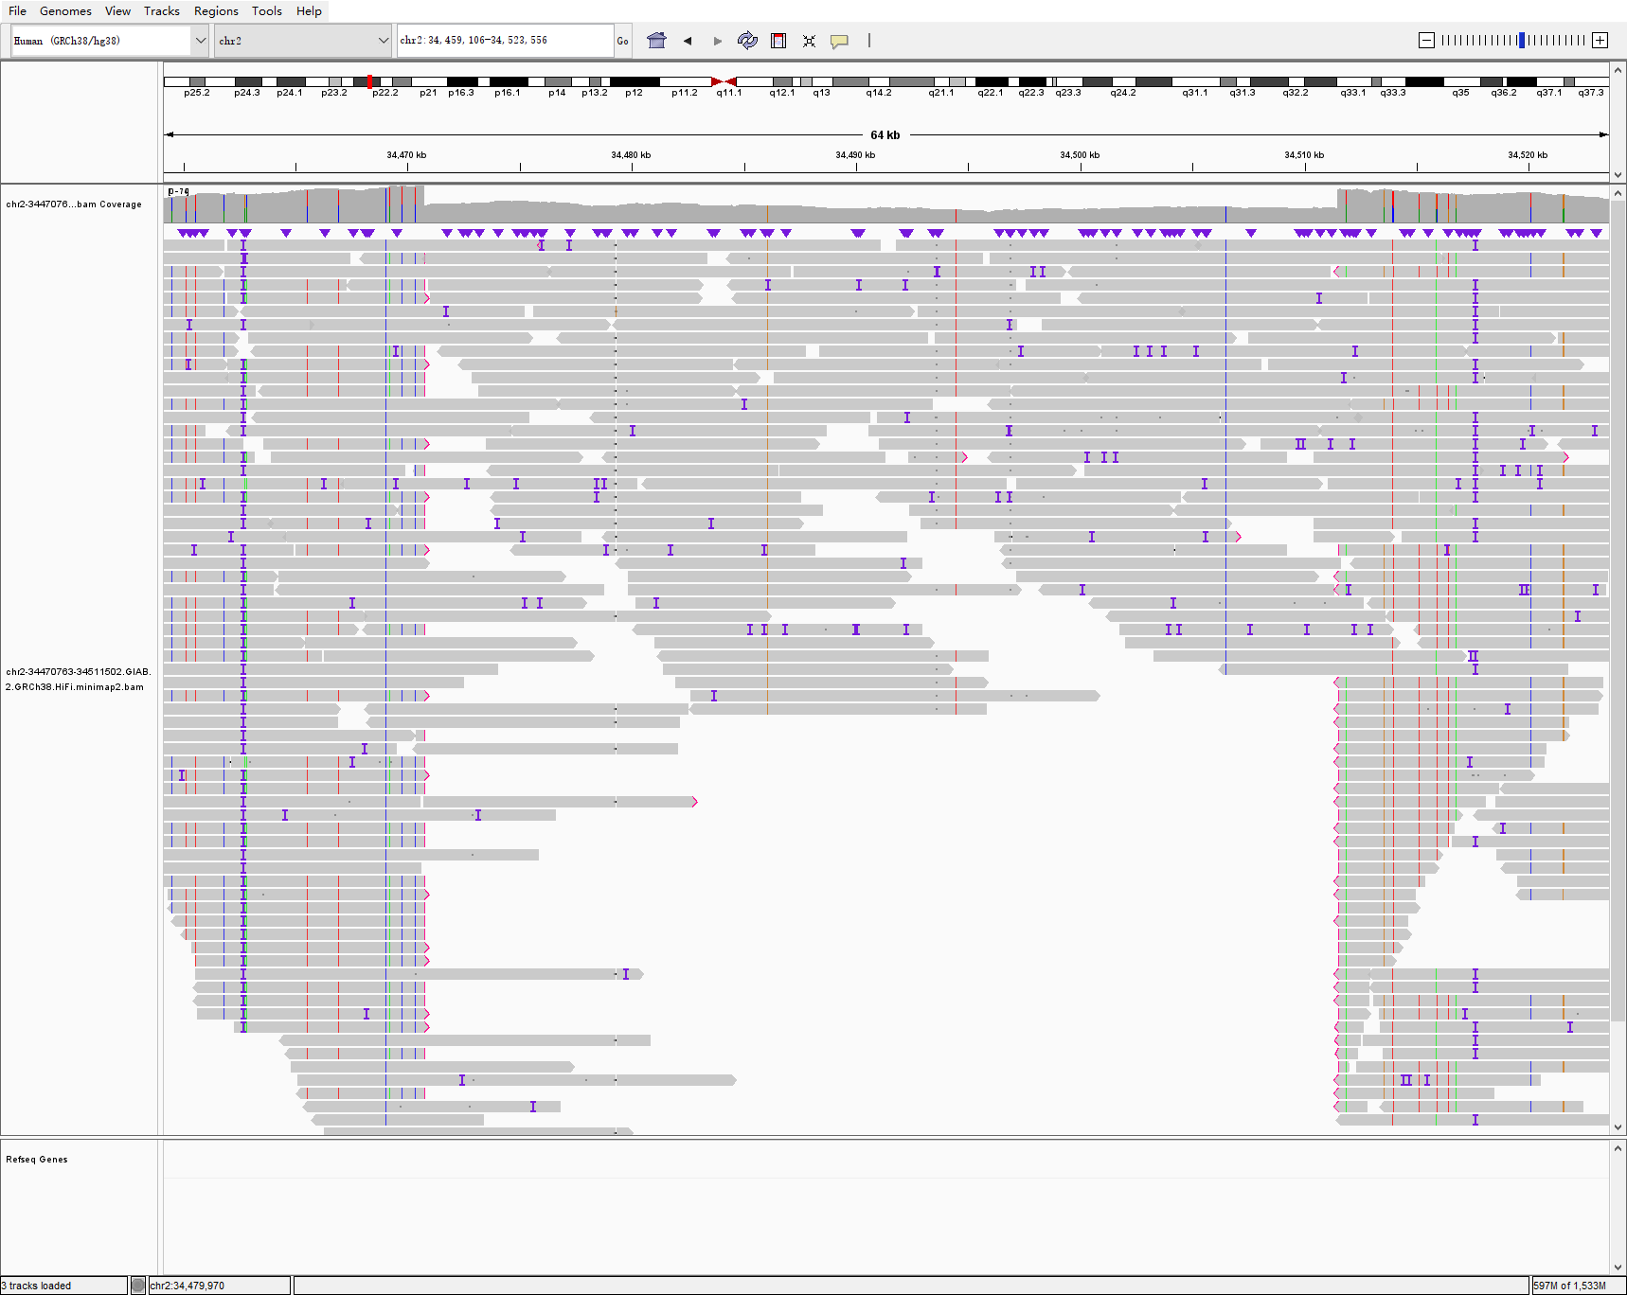
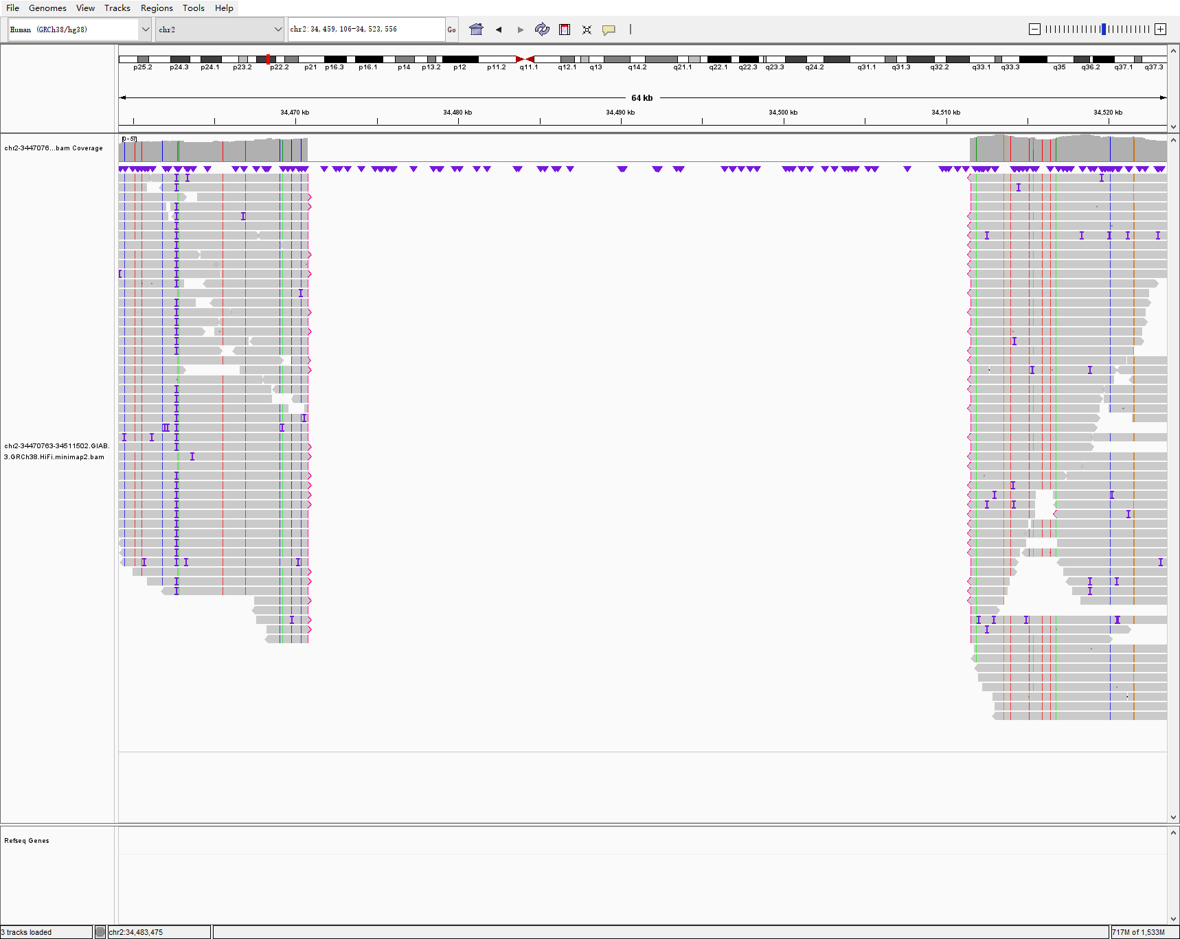
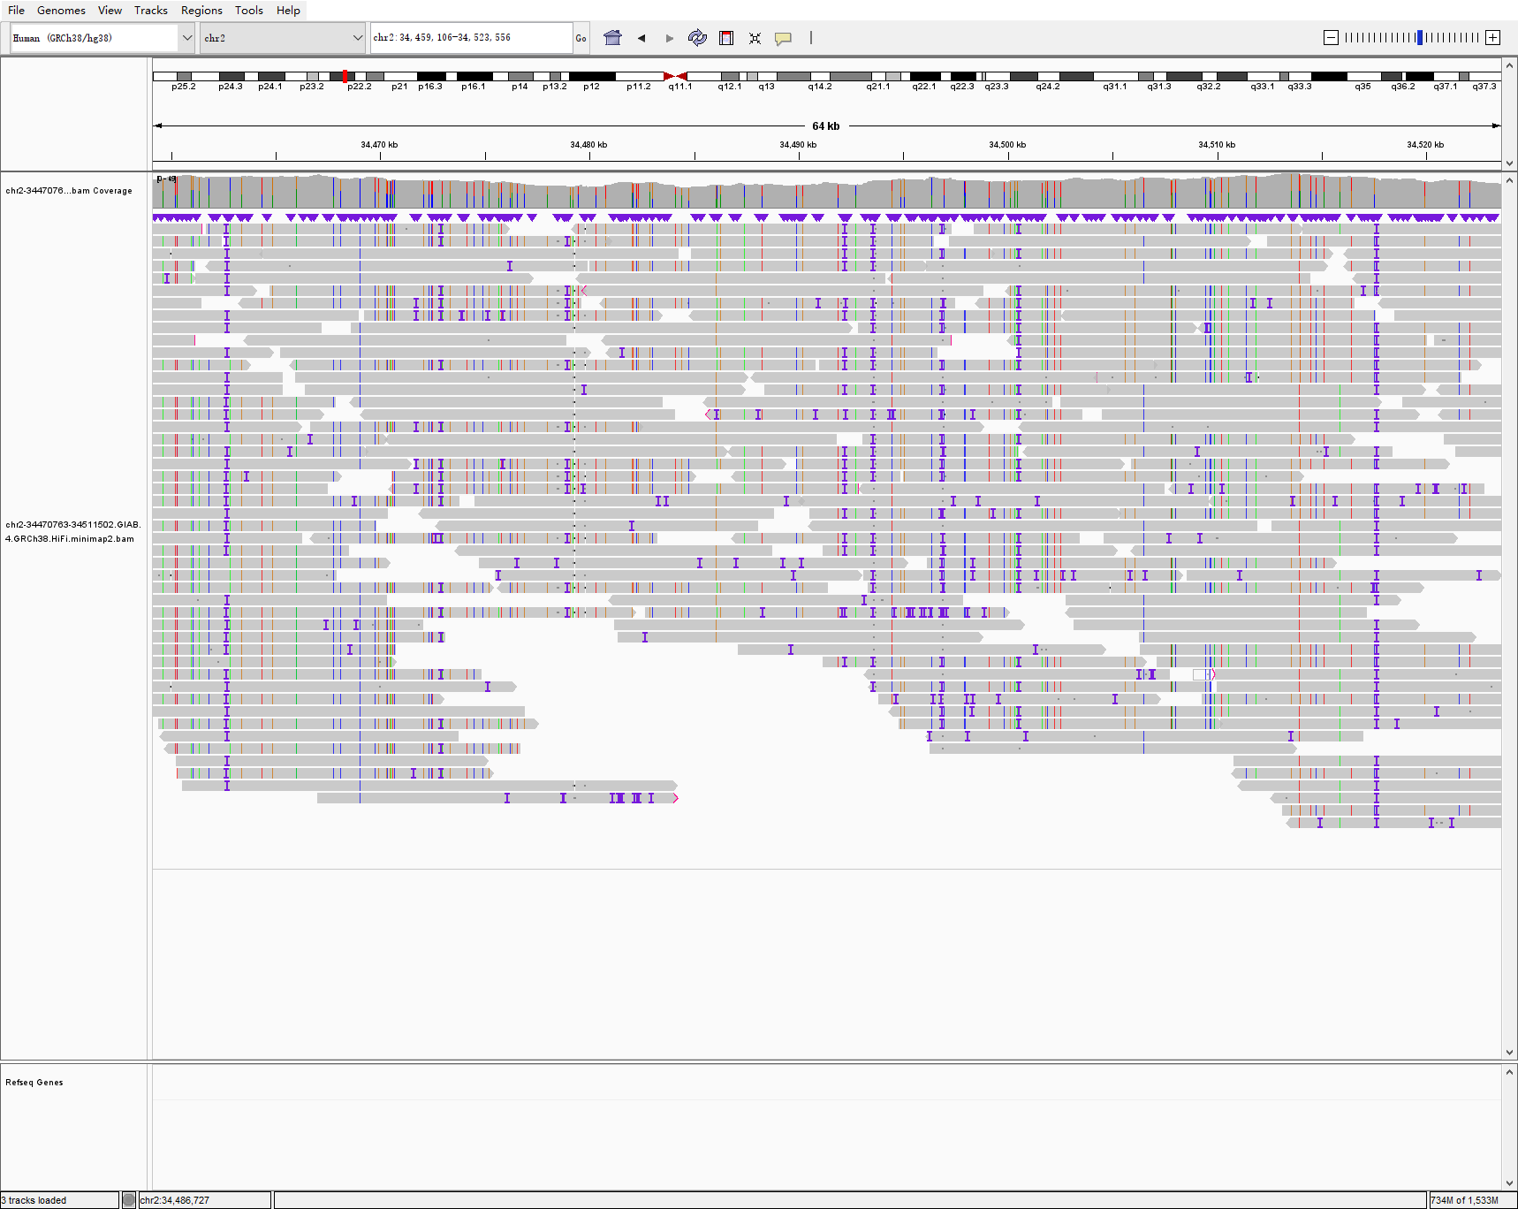
chr2 34470763 34511502 40738 DEL hg002-3-4 sniffles2
HG002
HG003
HG004

Slide 3
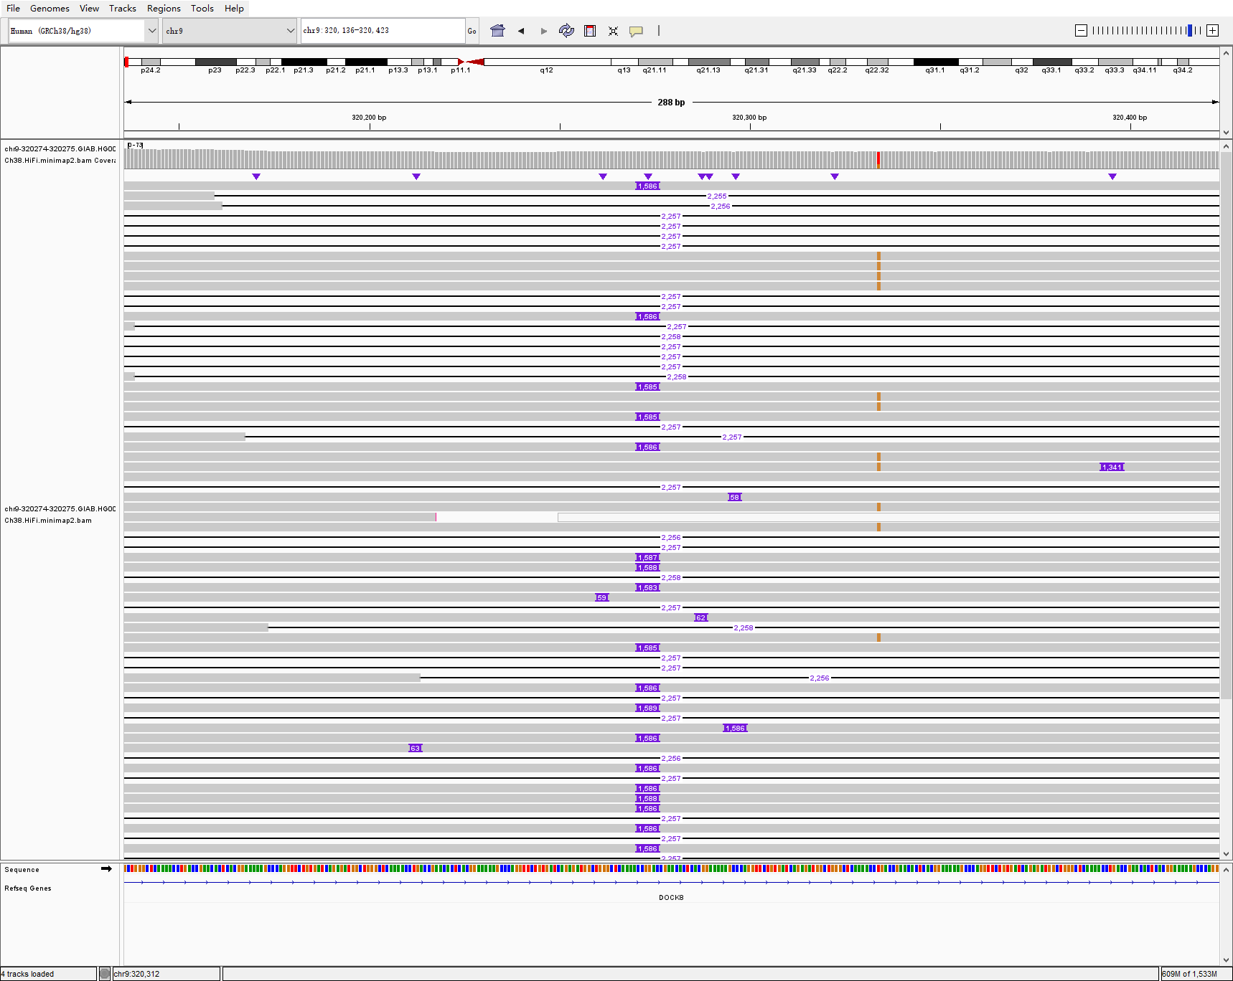
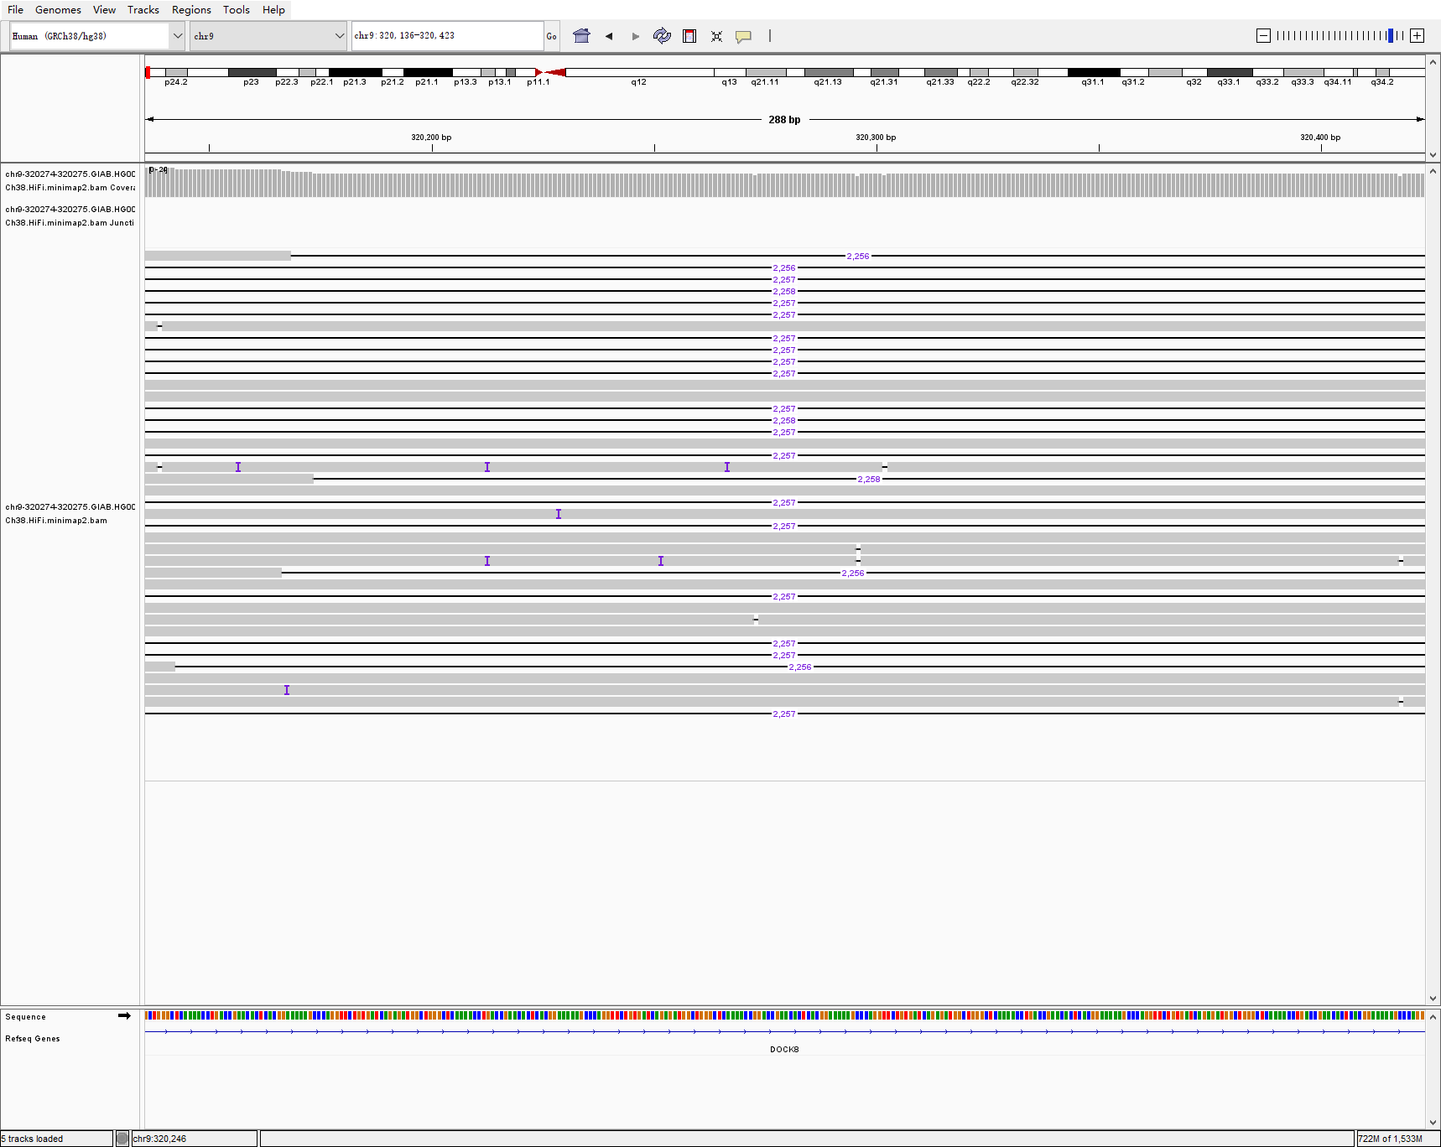
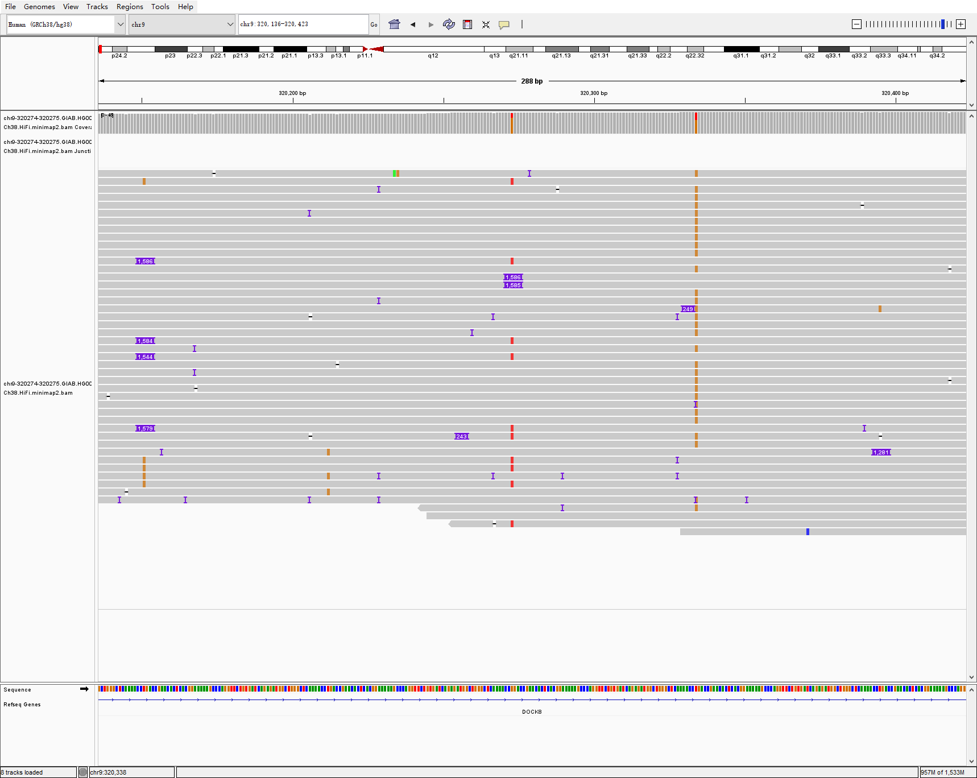
chr9 320274 320275 1586 INS hg002-3-4 sniffles2
HG002
HG003
HG004

Slide 4
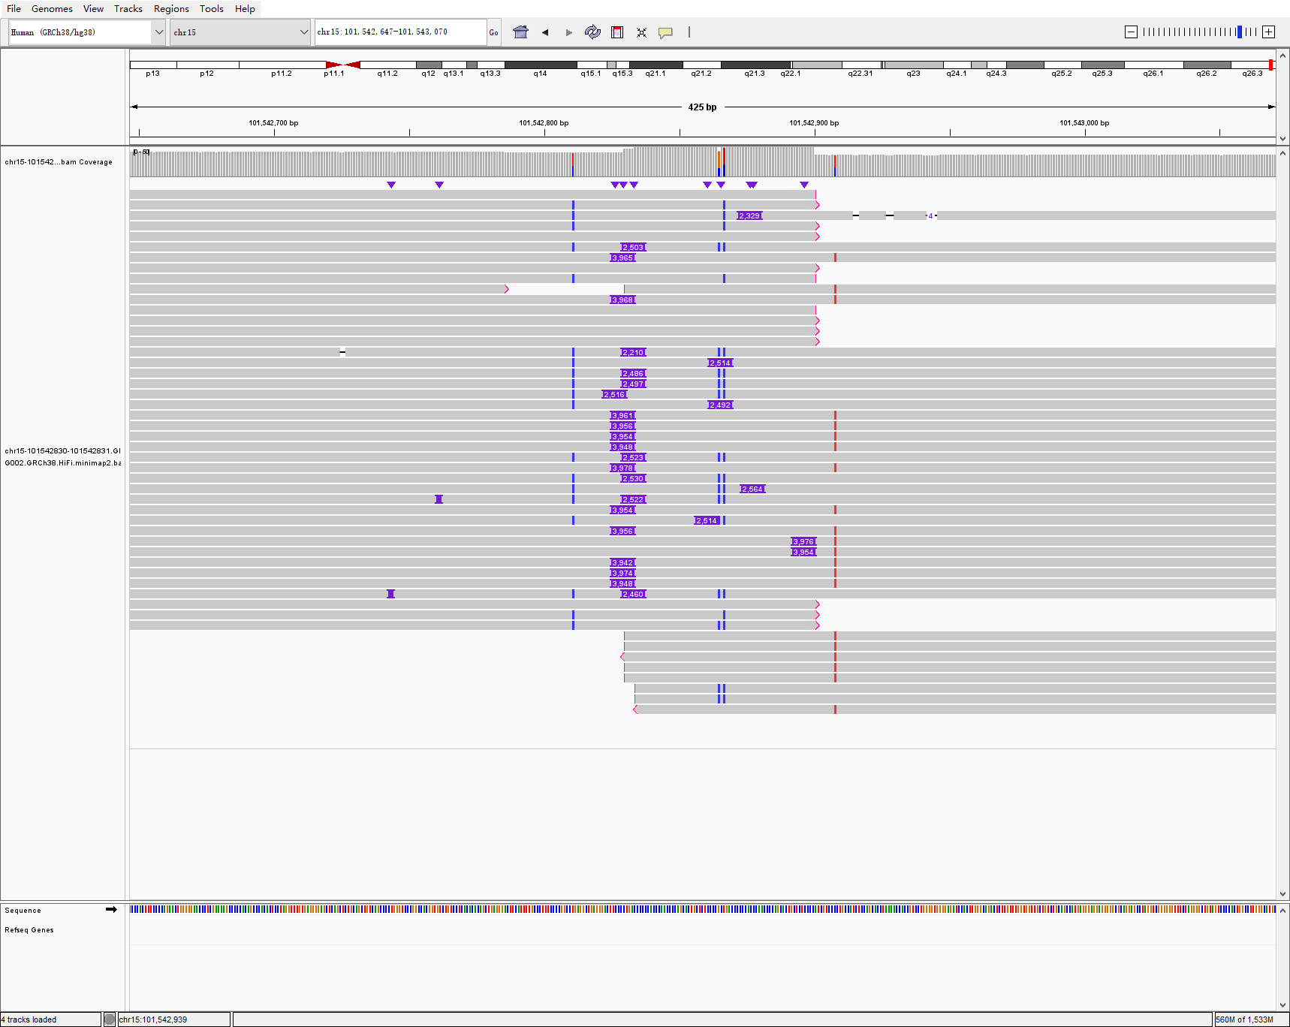
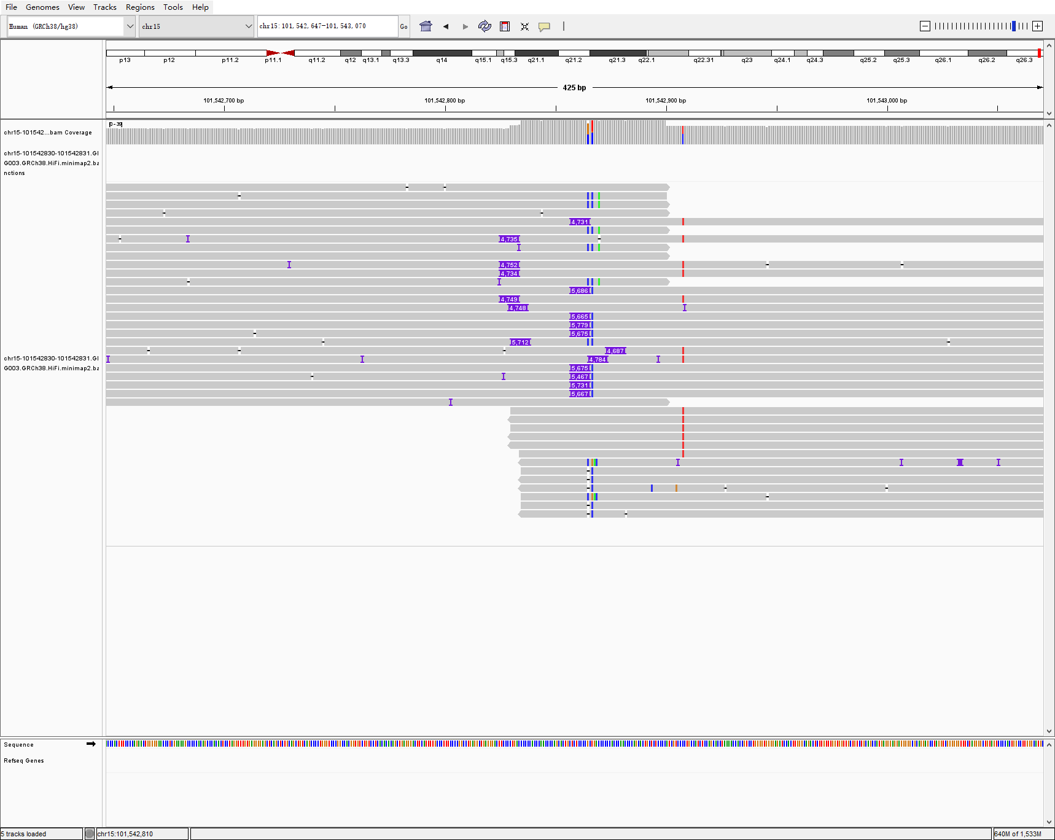
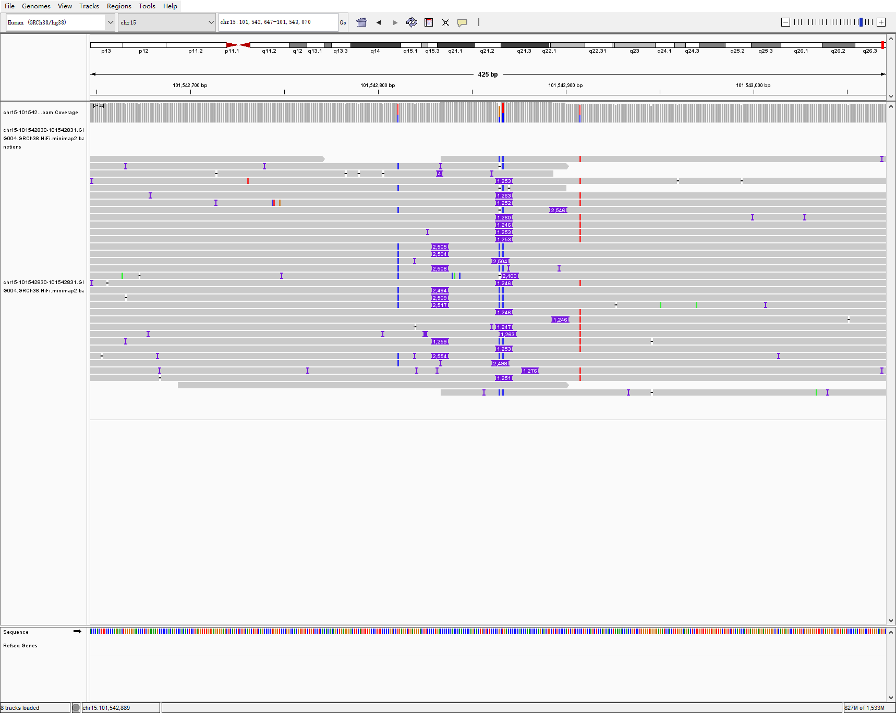
chr15 101542830 101542831 3961 INS hg002-3-4 sniffles2
HG002
HG003
HG004

Slide 5
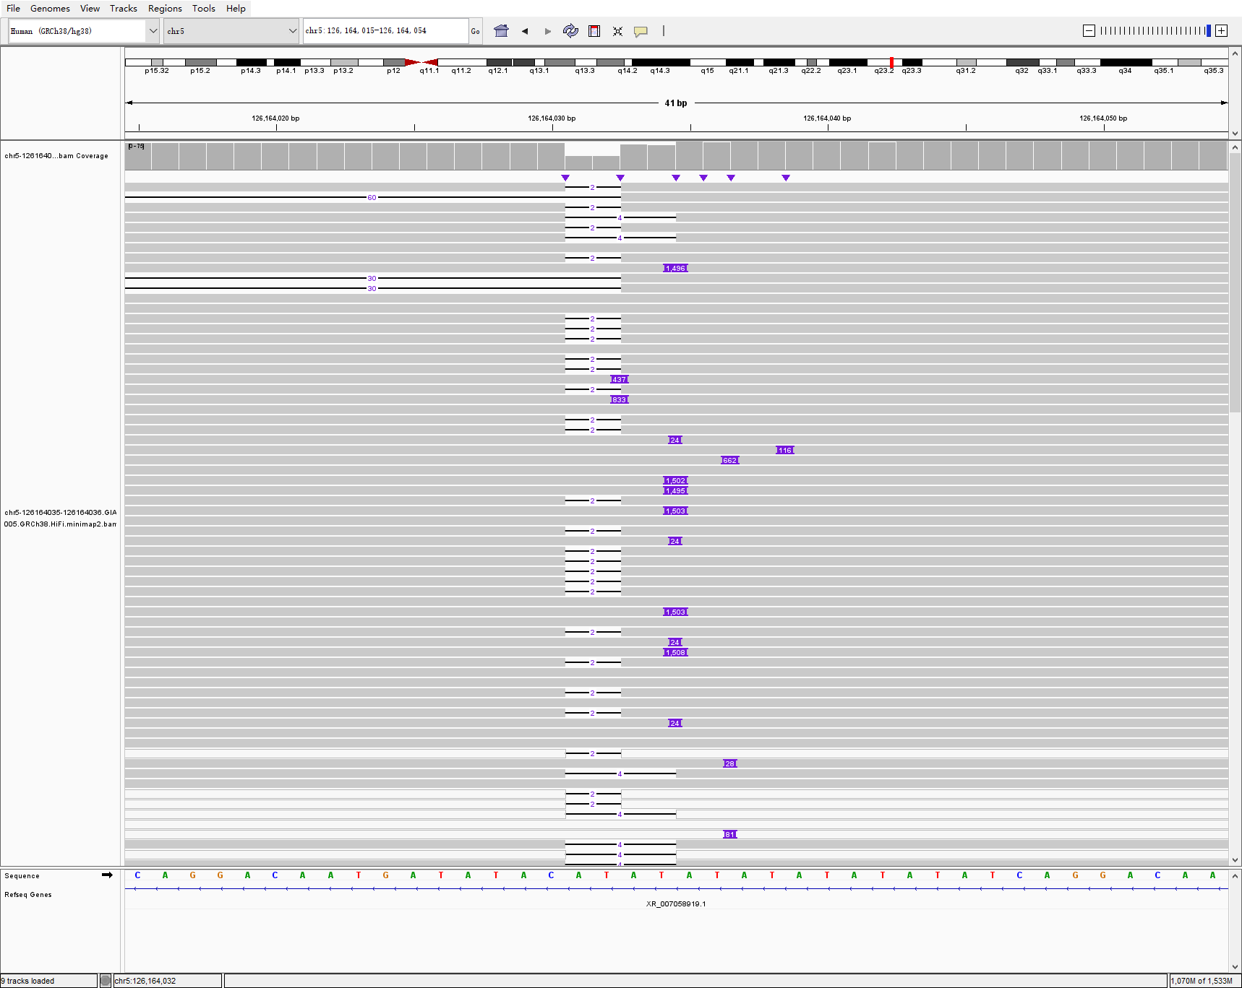
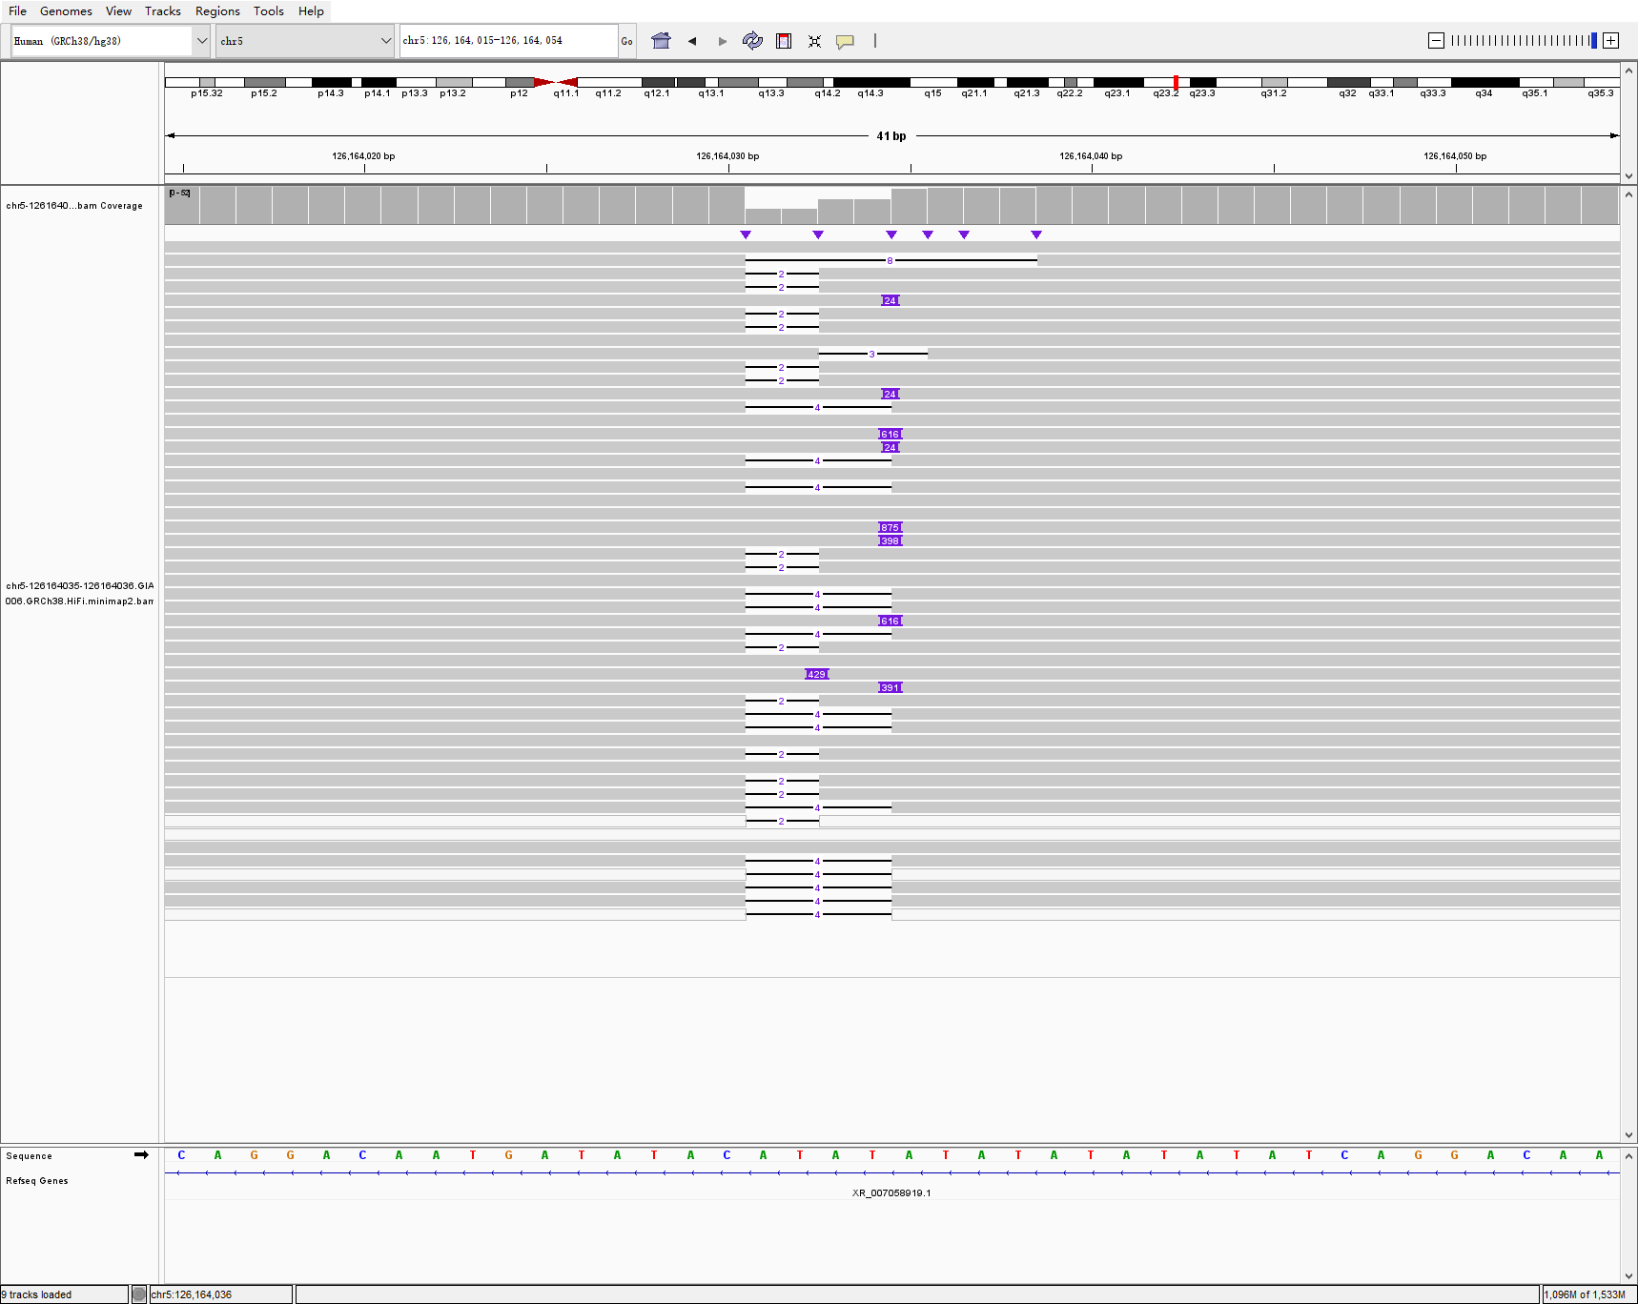
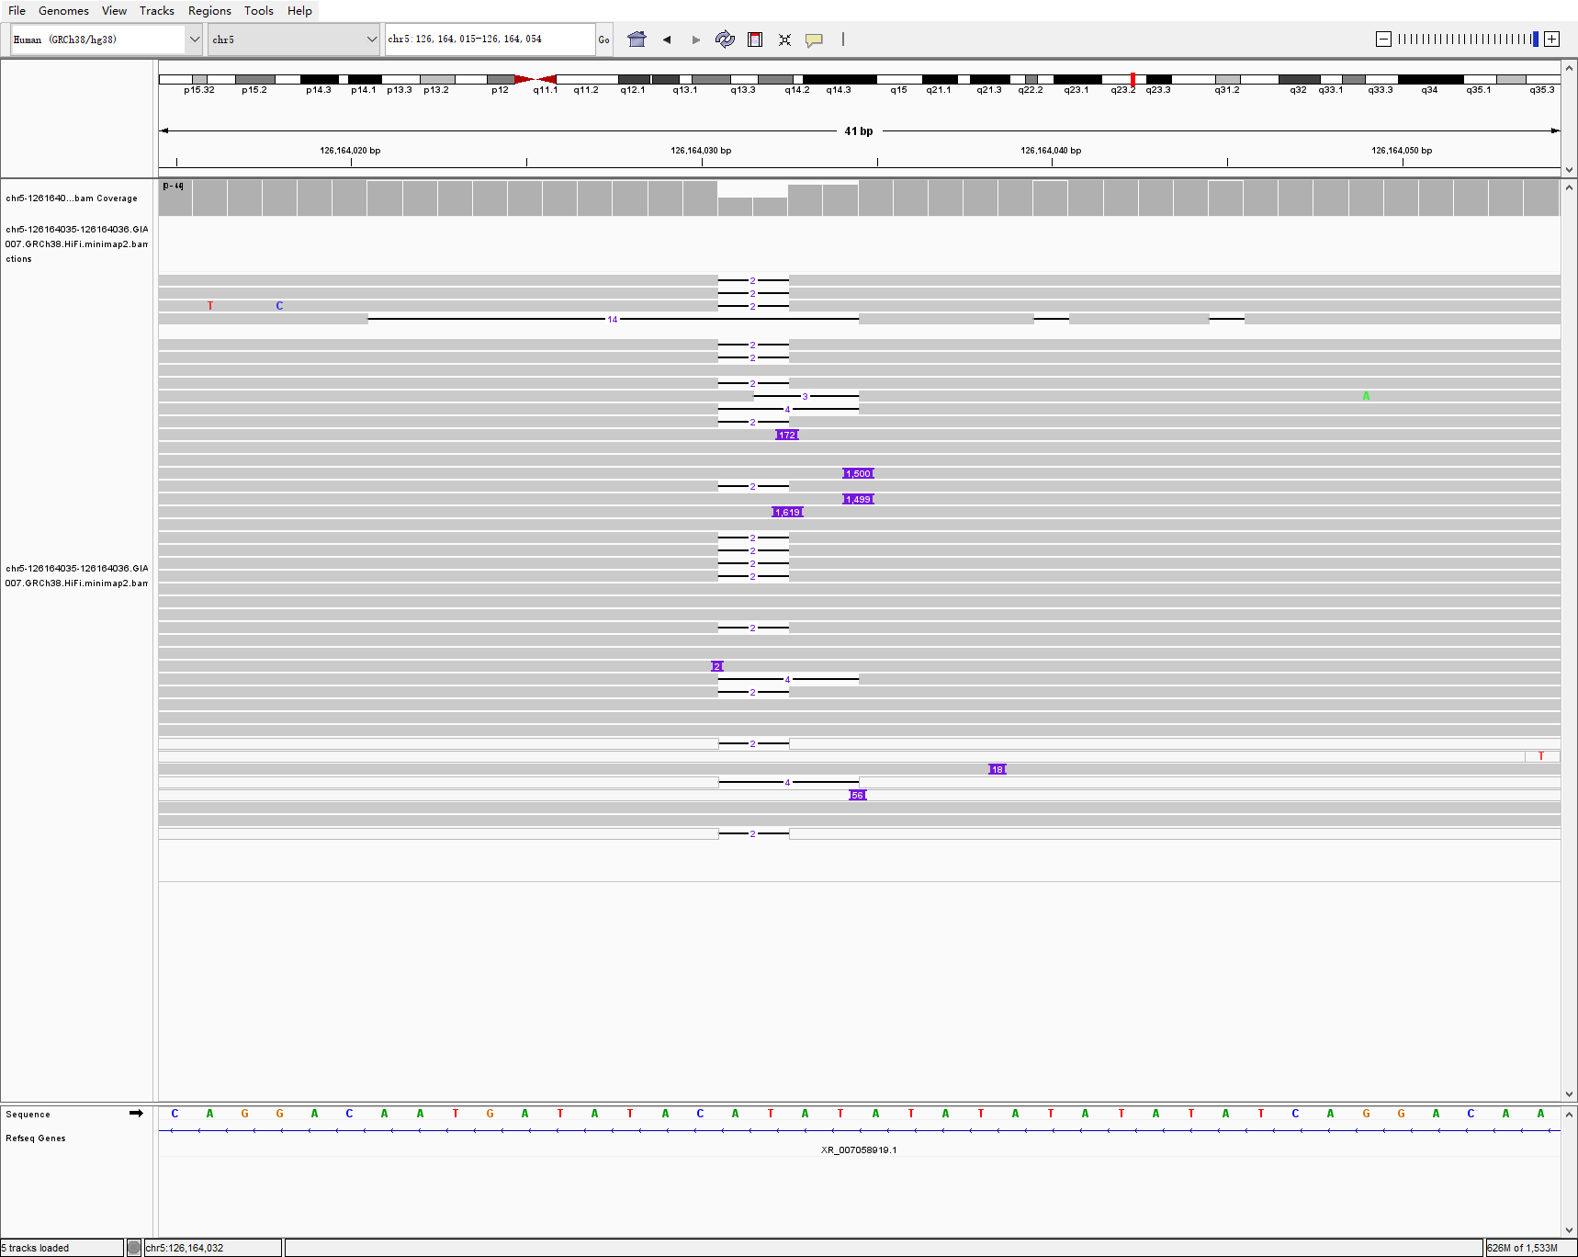
chr5 126164035 126164036 1503 INS hg005-6-7 sniffles2
HG005
HG006
HG006

Slide 6
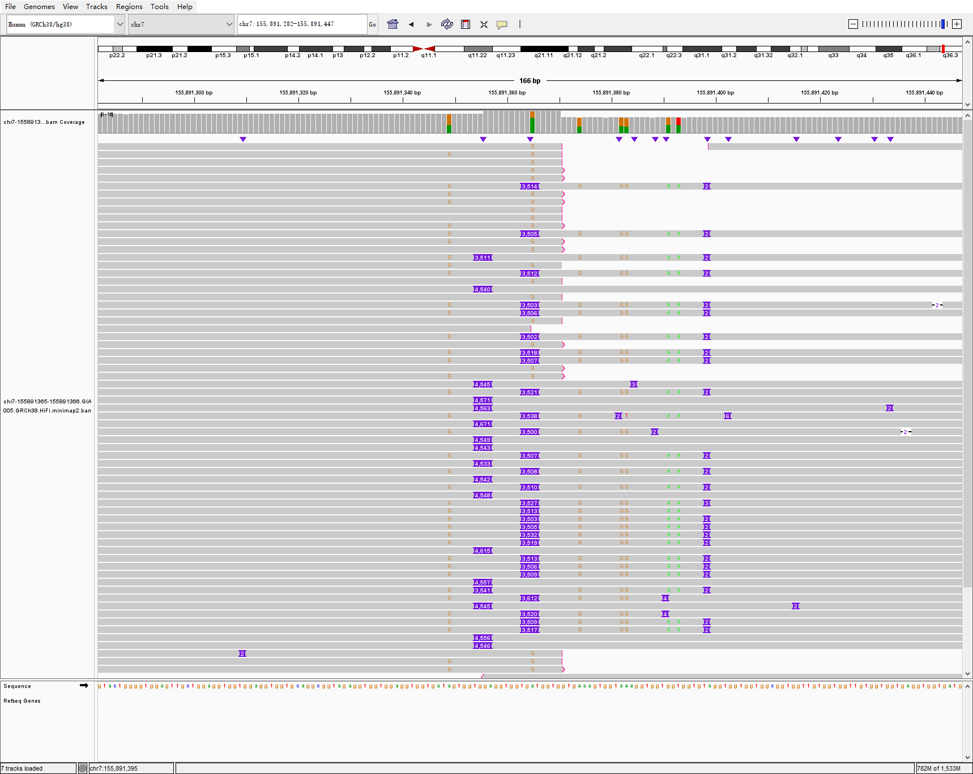
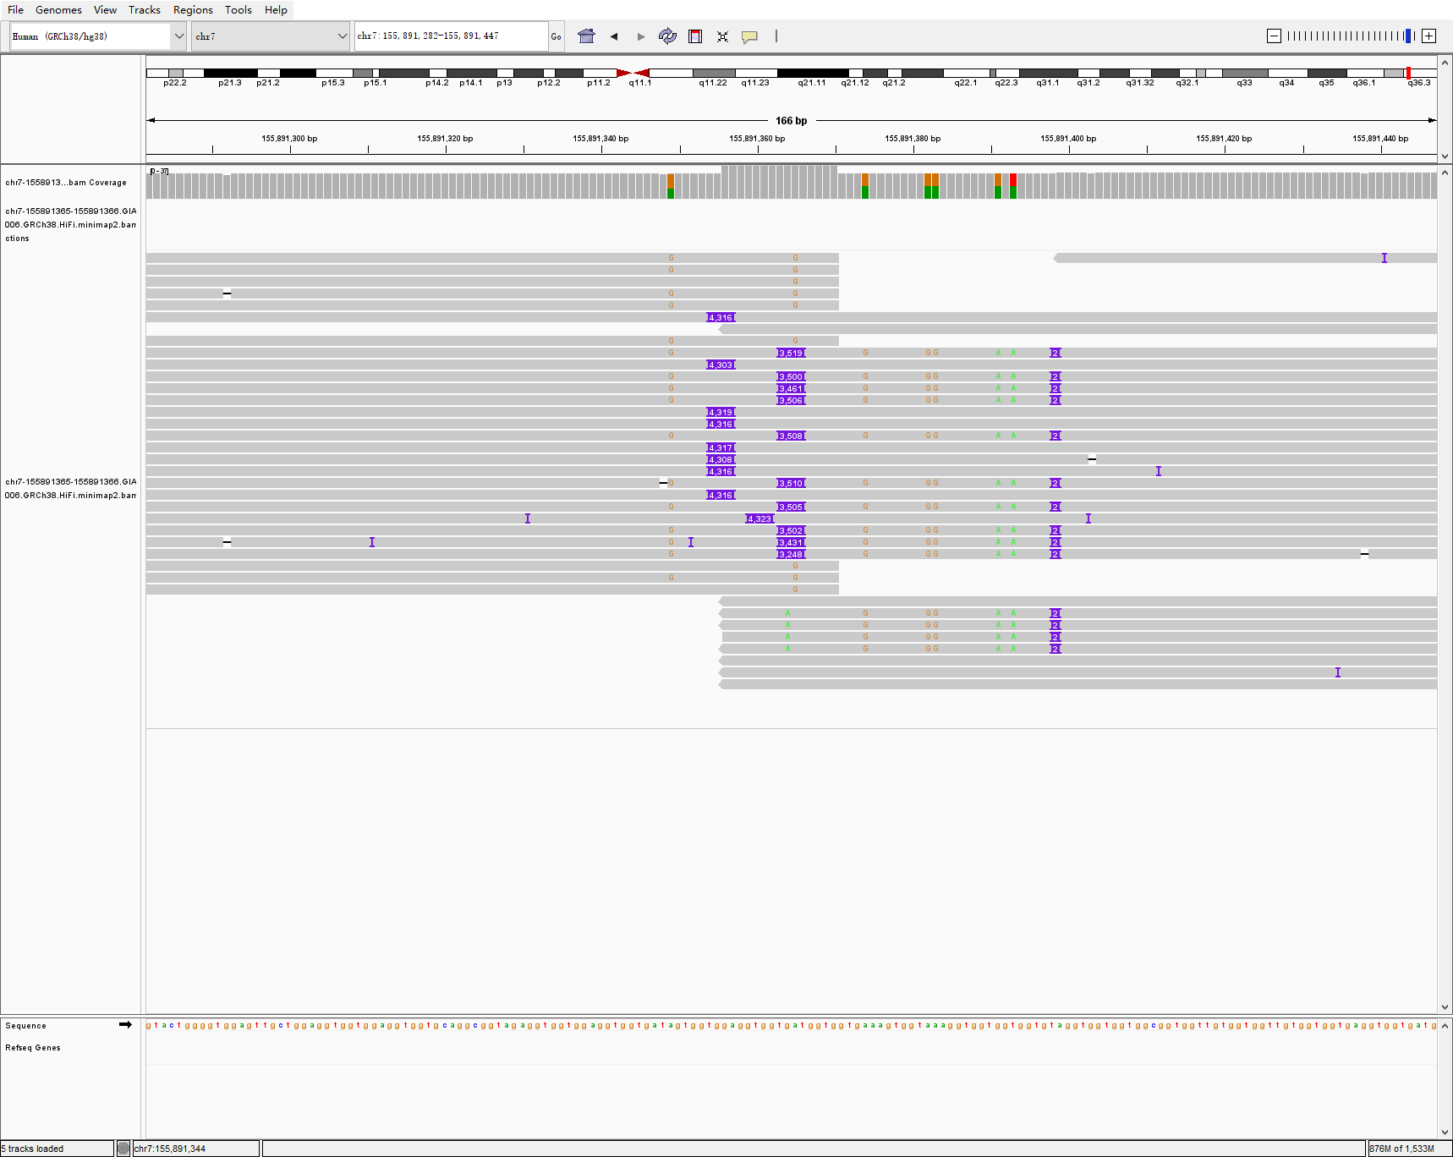
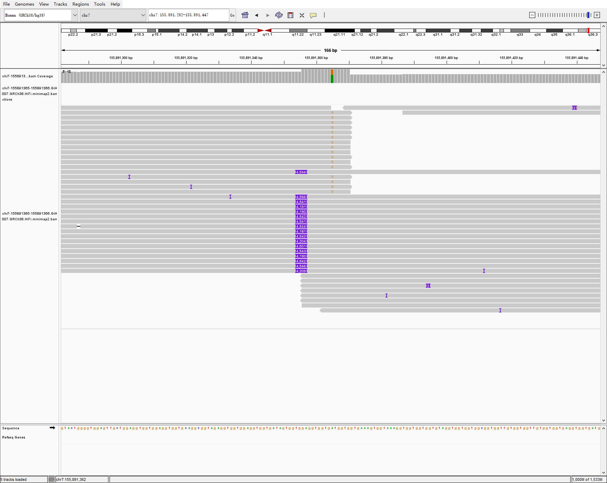
chr7 155891365 155891366 3527 INS hg005-6-7 sniffles2
HG005
HG006
HG006

Slide 7
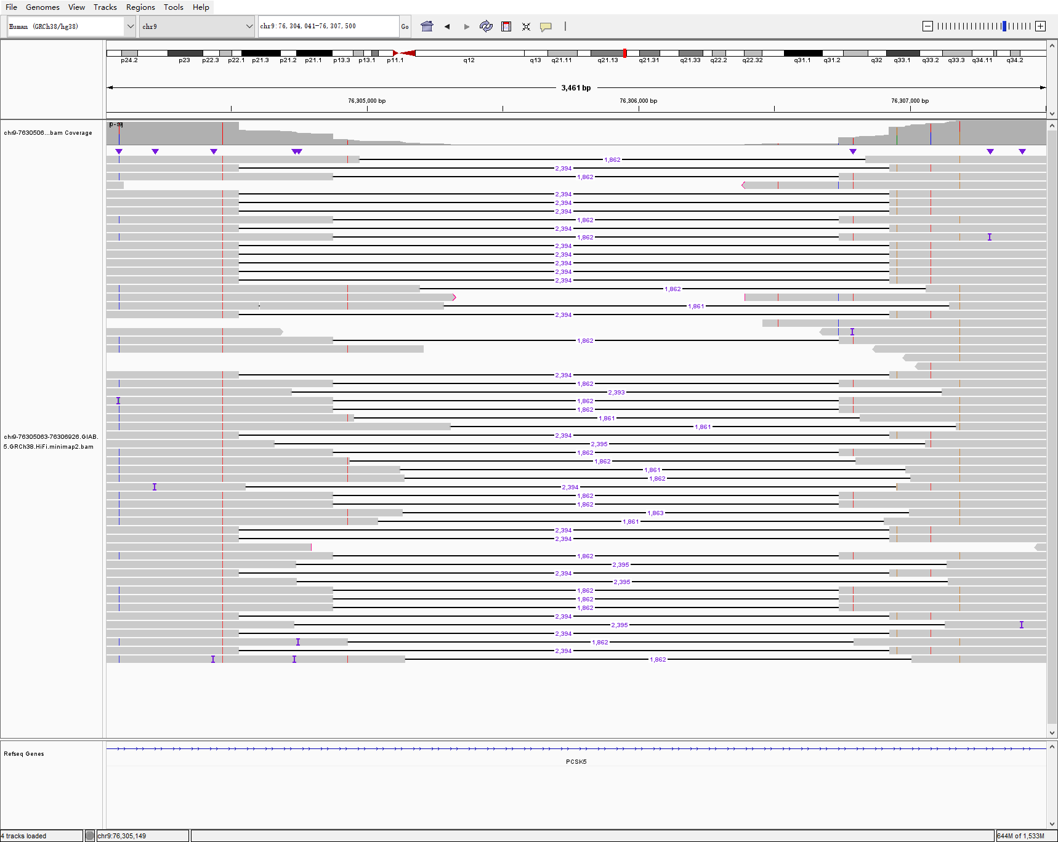
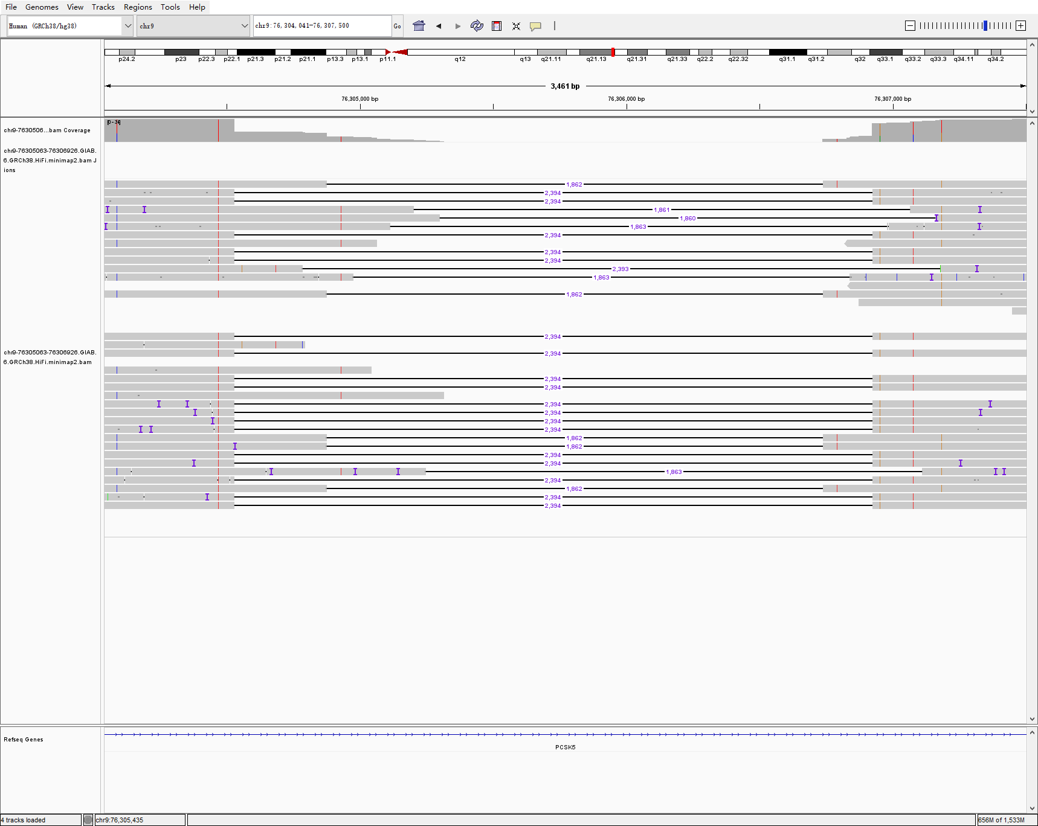
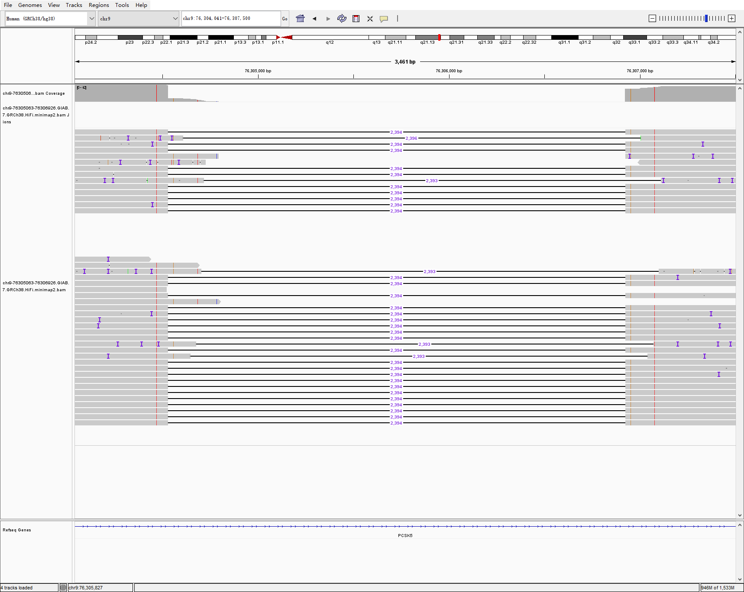
chr9 76305063 76306926 1862 DEL hg005-6-7 sniffles2
HG005
HG006
HG006

Slide 8
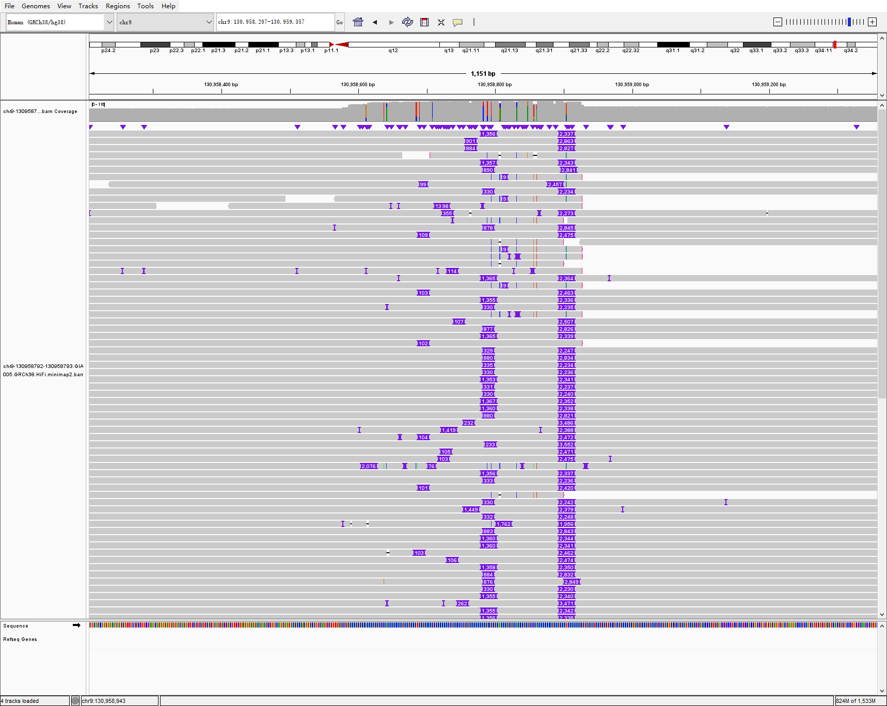
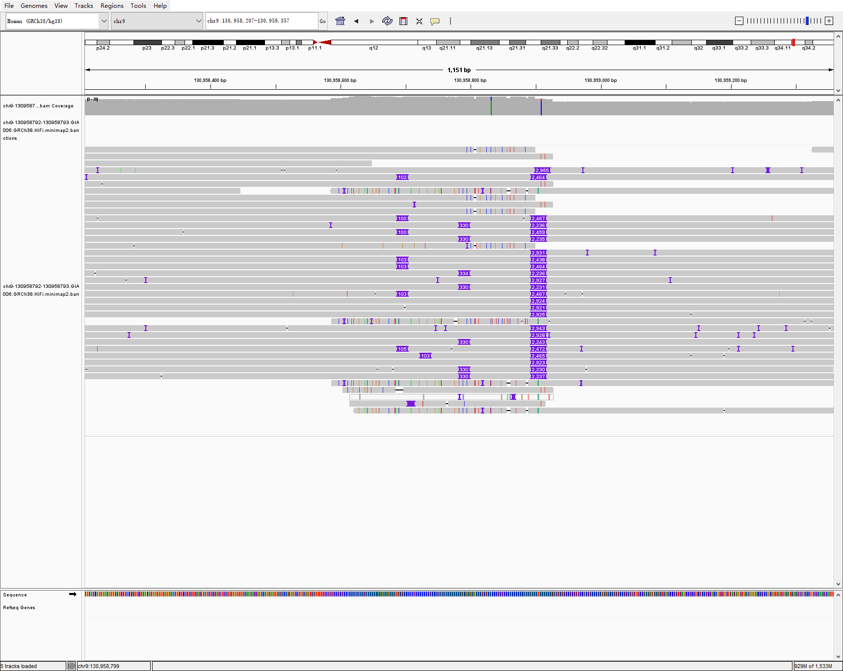
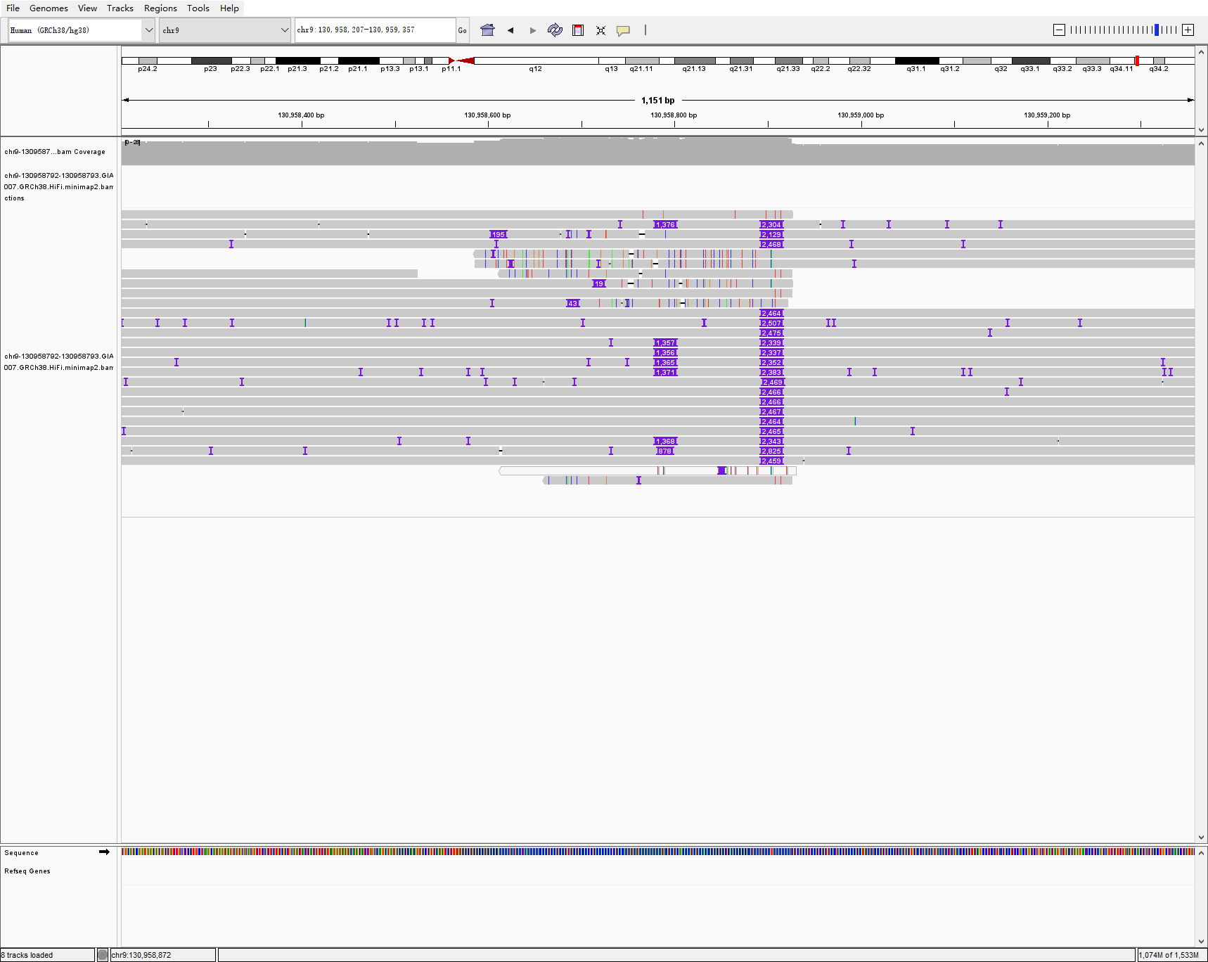
chr9 130958792 130958793 3714 INS hg005-6-7 sniffles2
HG005
HG006
HG006

Slide 9
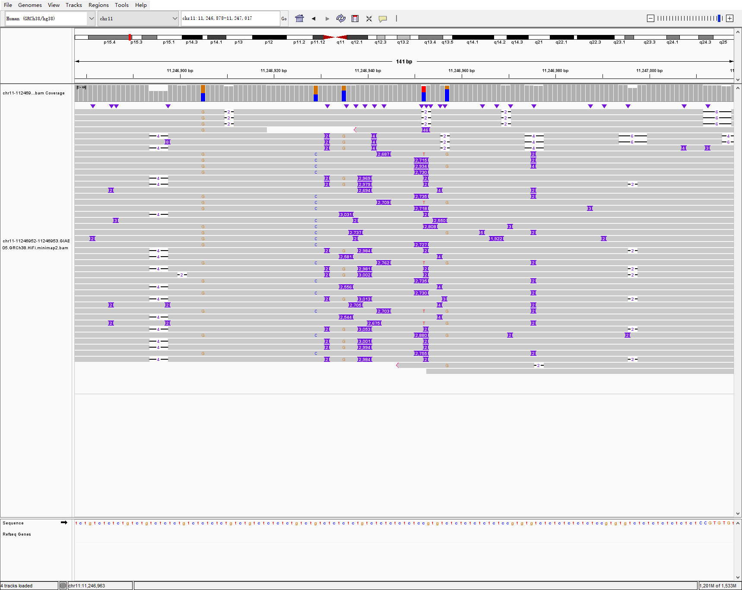
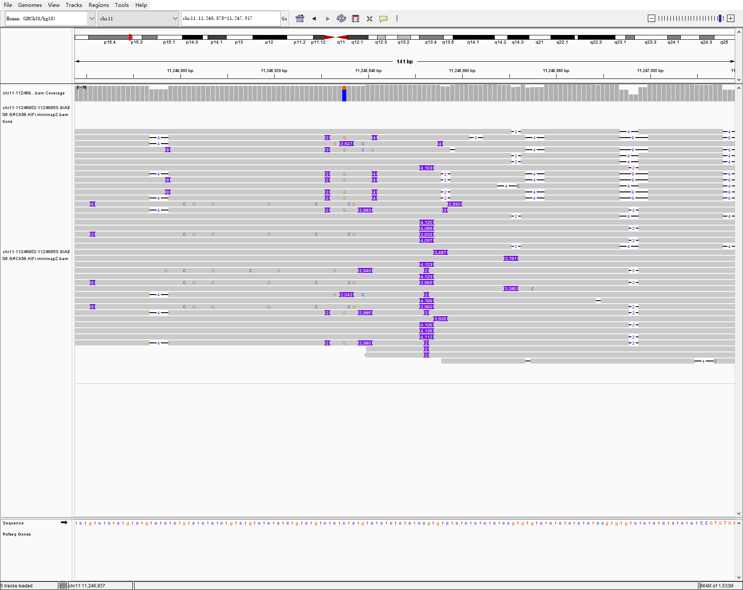
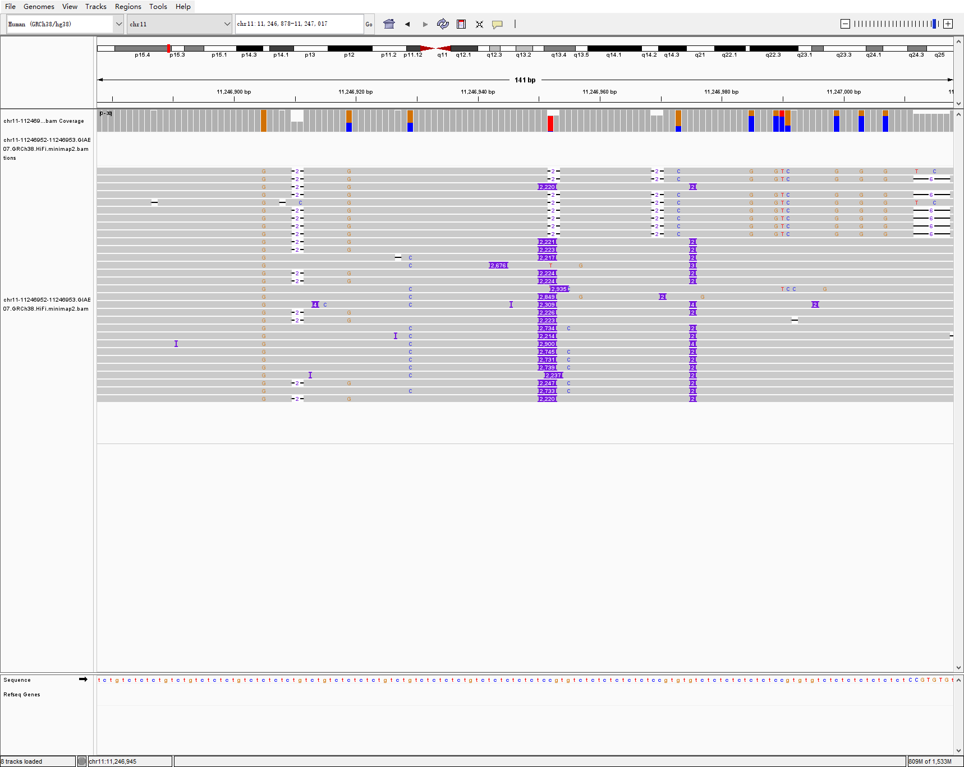
chr11 11246952 11246953 2946 INS hg005-6-7 sniffles2
HG005
HG006
HG006

Slide 10
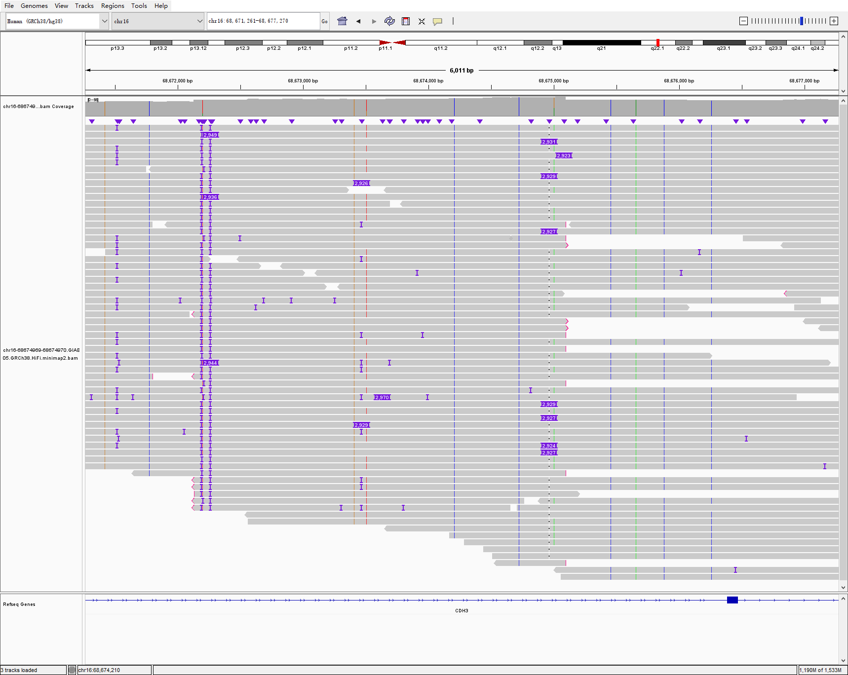
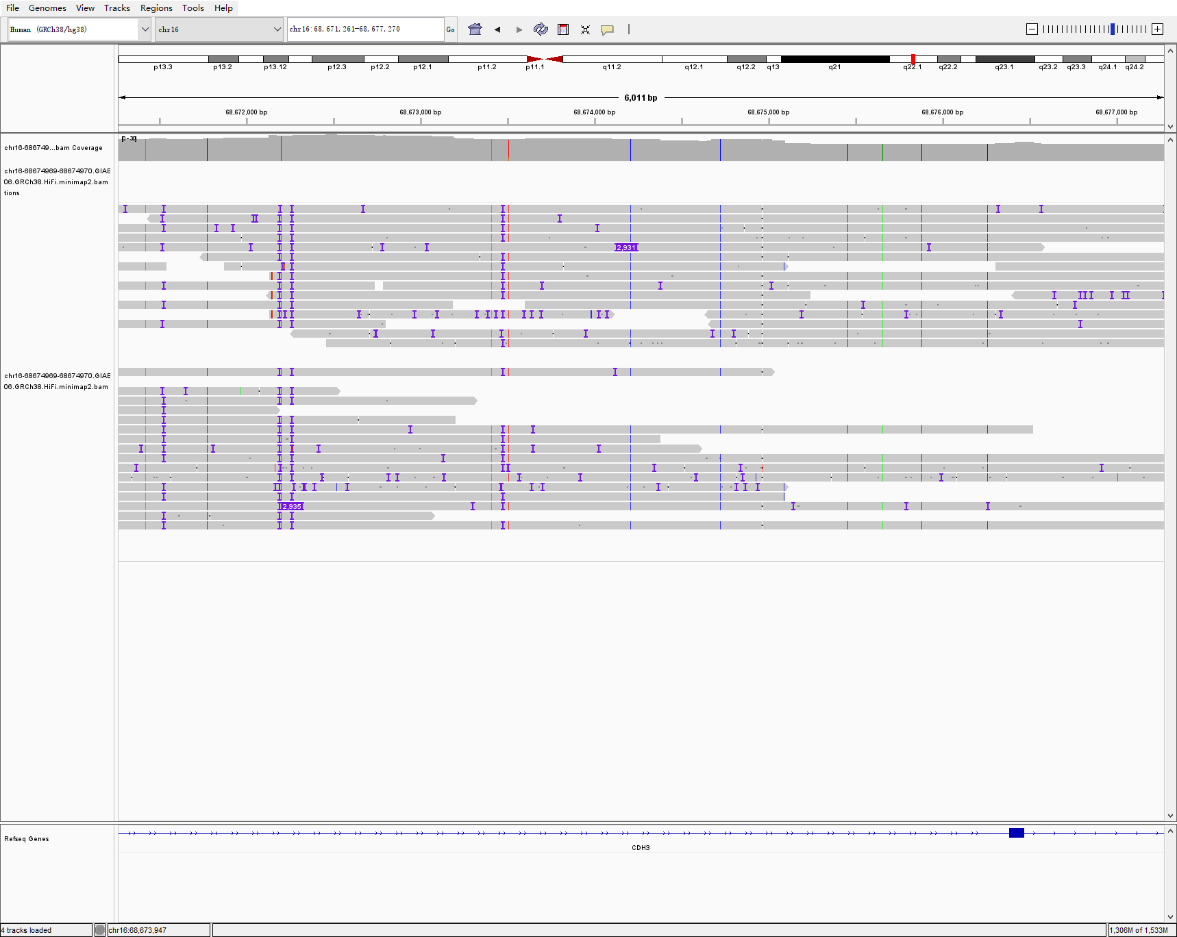
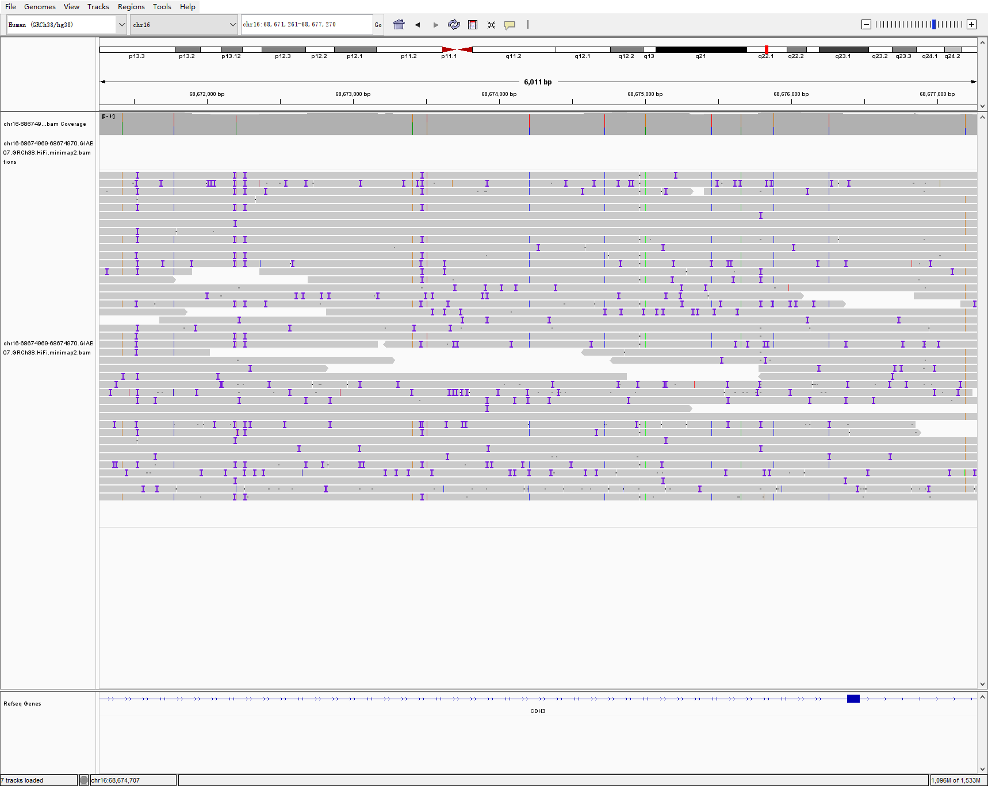
chr16 68674969 68674970 2927 INS hg005-6-7 sniffles2
HG005
HG006
HG006

Slide 11
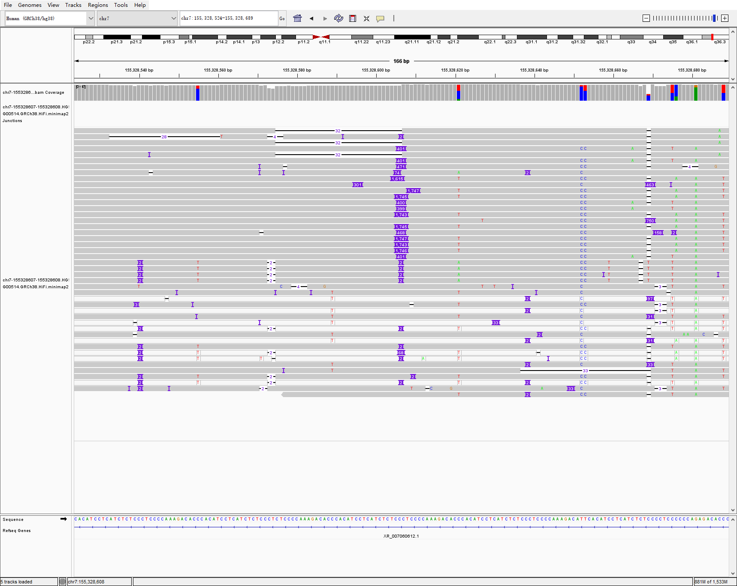
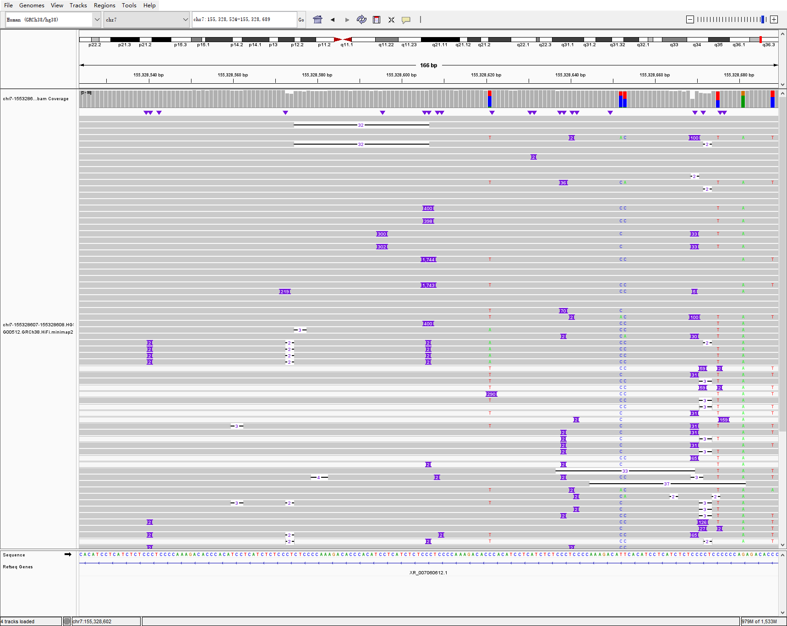
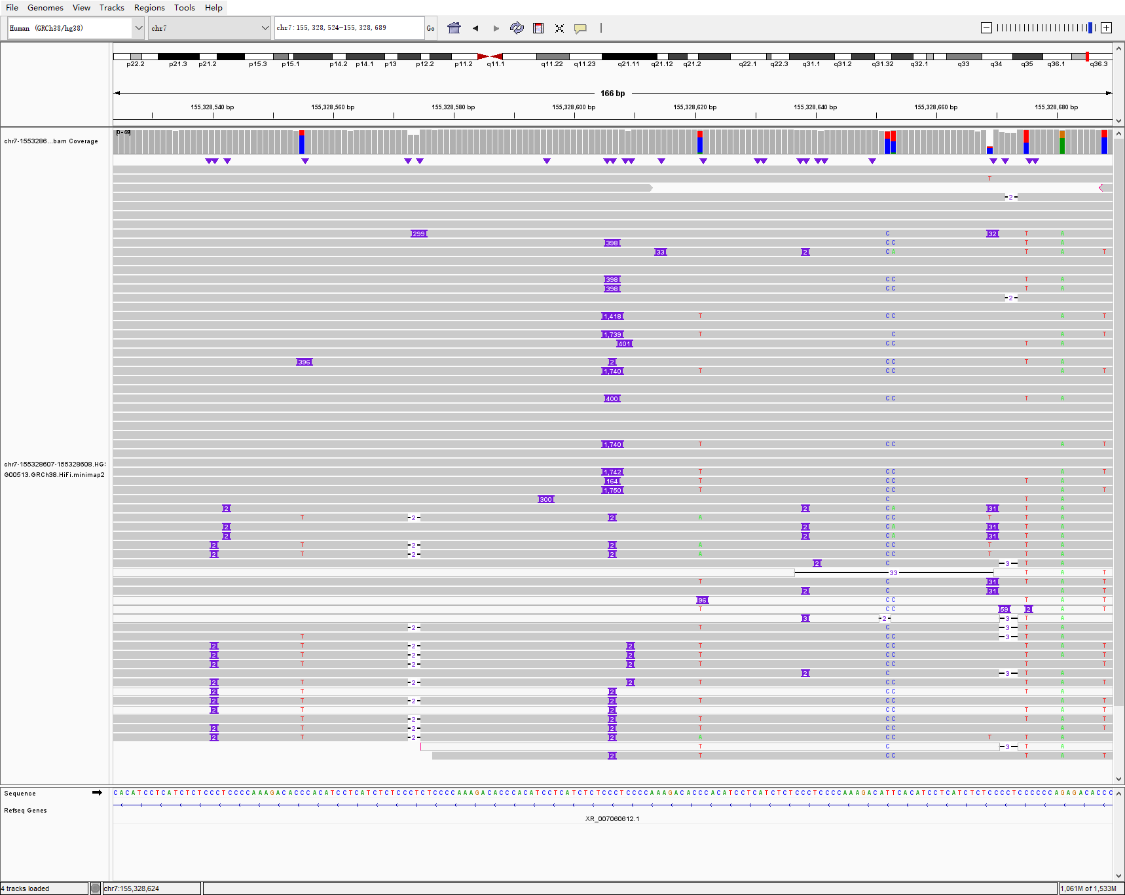
chr7 155328607 155328608 631 INS hg00514-2-3 sniffles2
HG00514
HG00512
HG00513

Slide 12
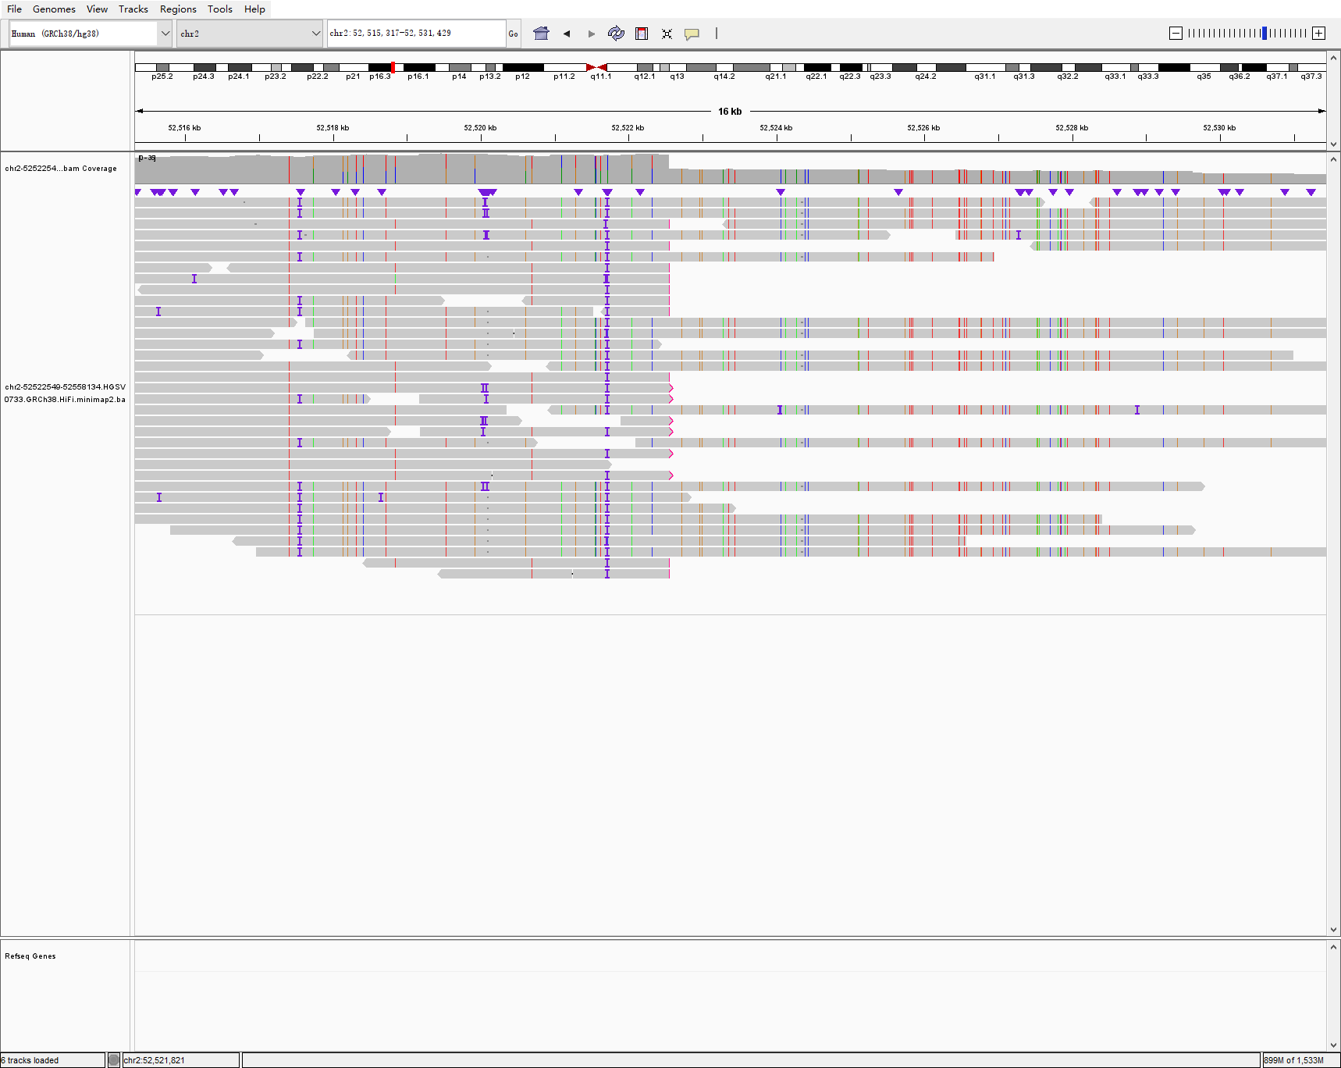
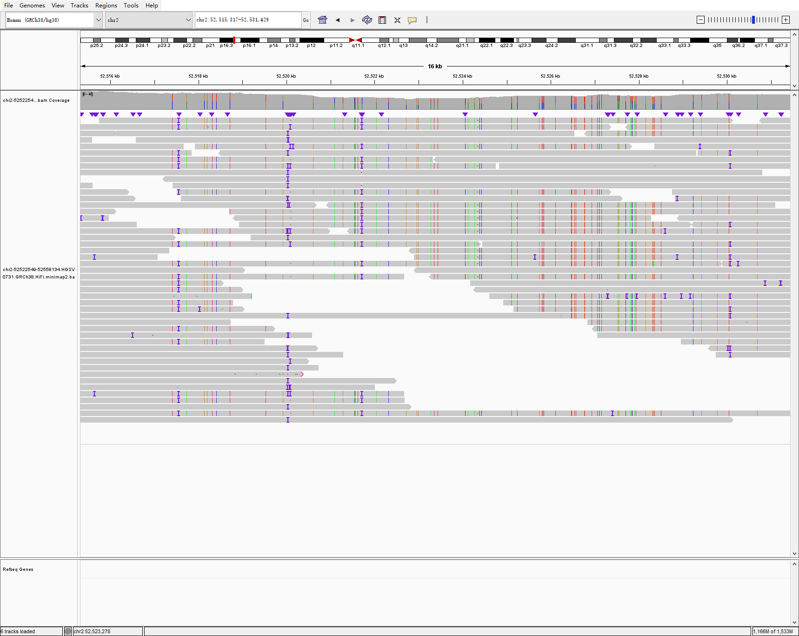
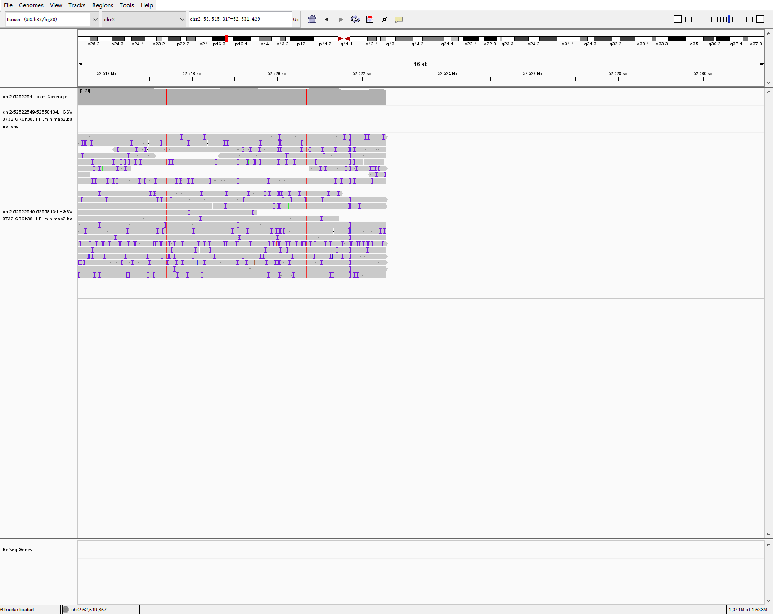
chr2 52522549 52558134 35584 DEL hg00733-1-2 sniffles2
HG00733
HG00731
HG00732

Slide 13
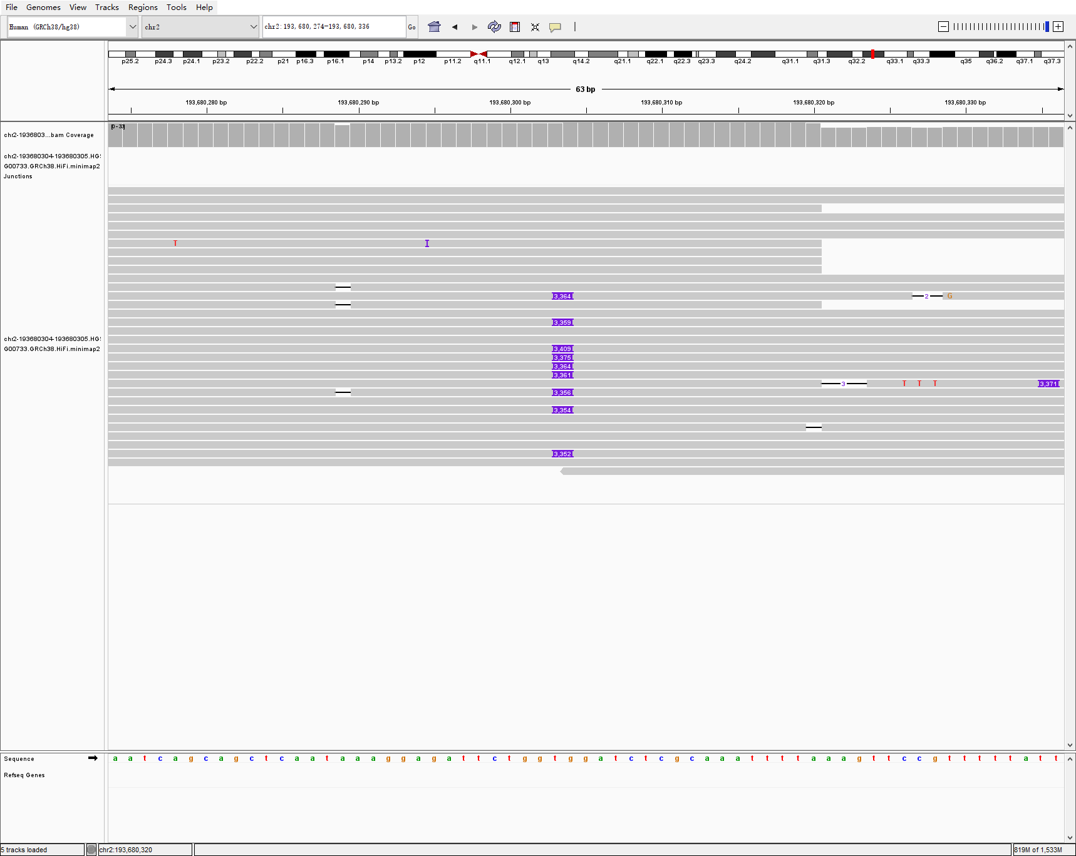
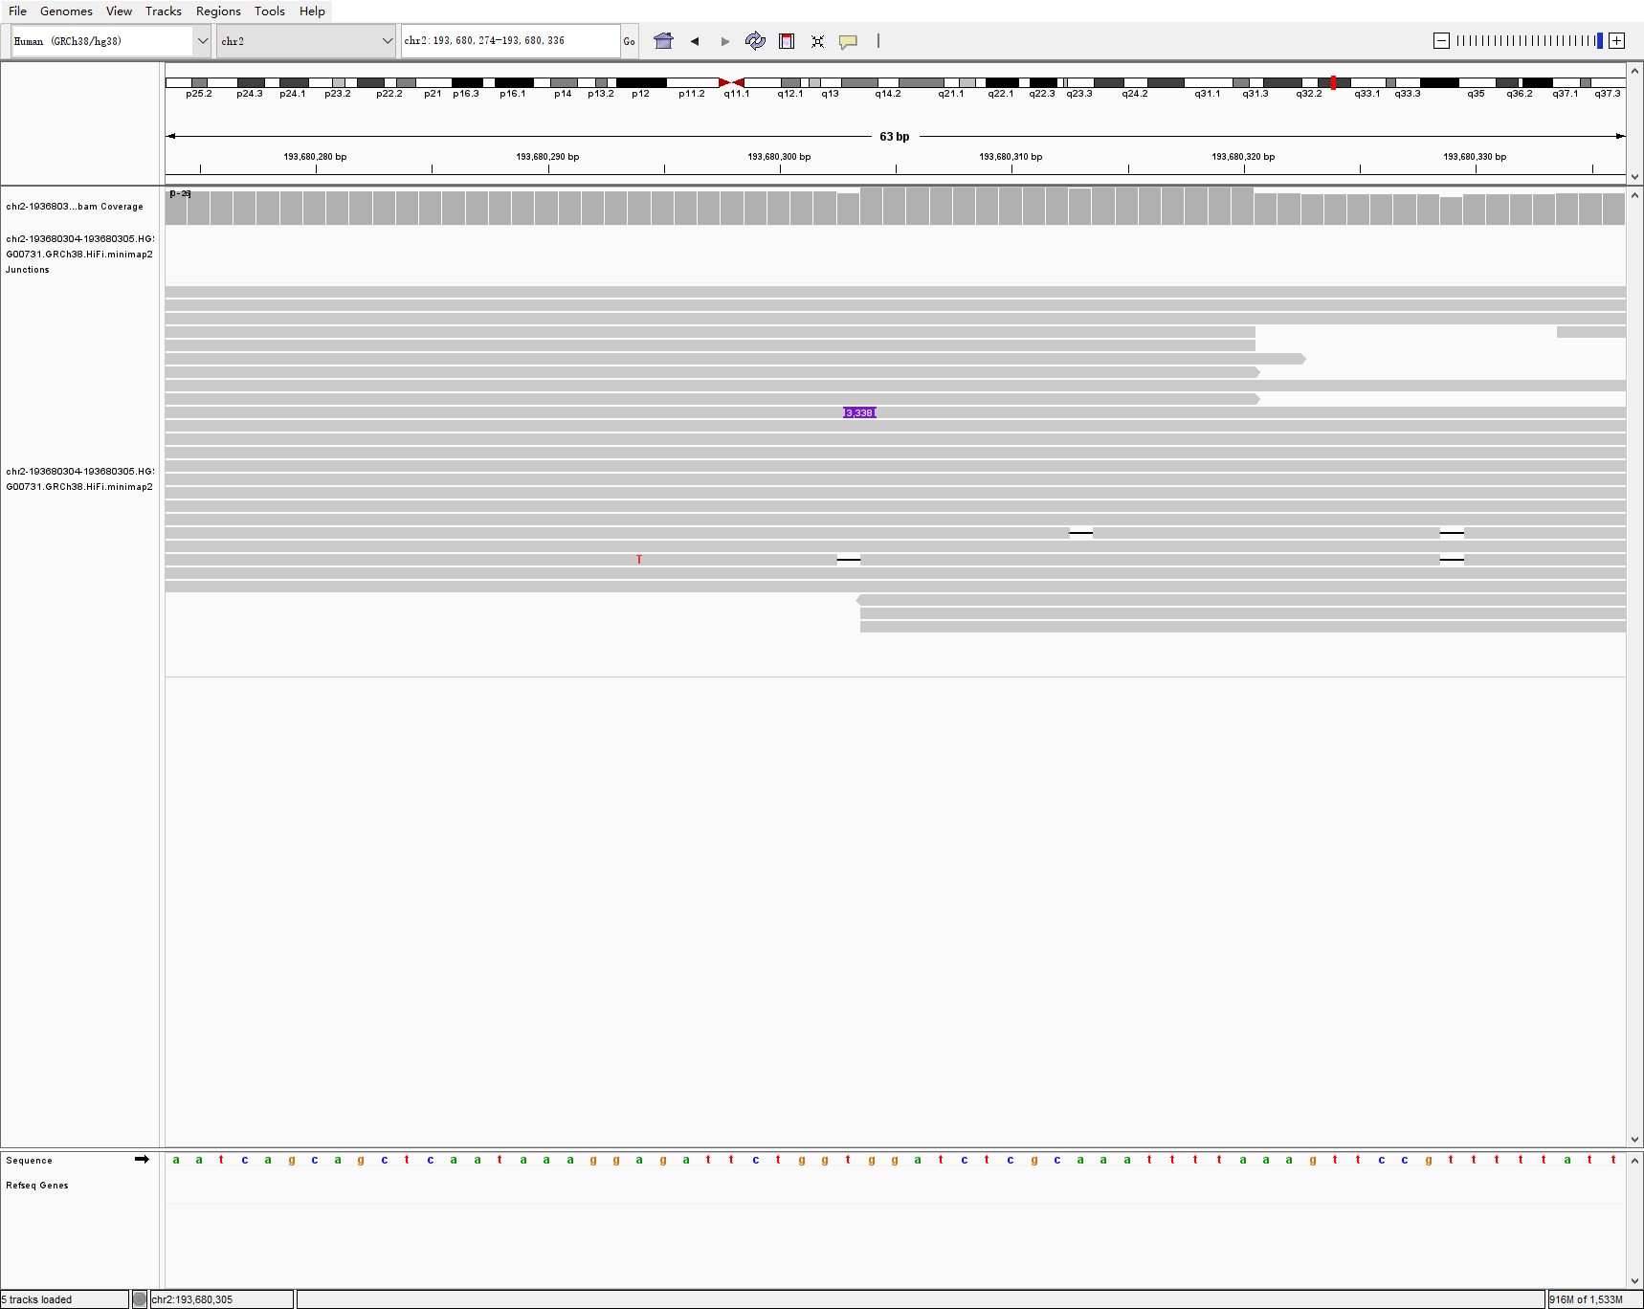
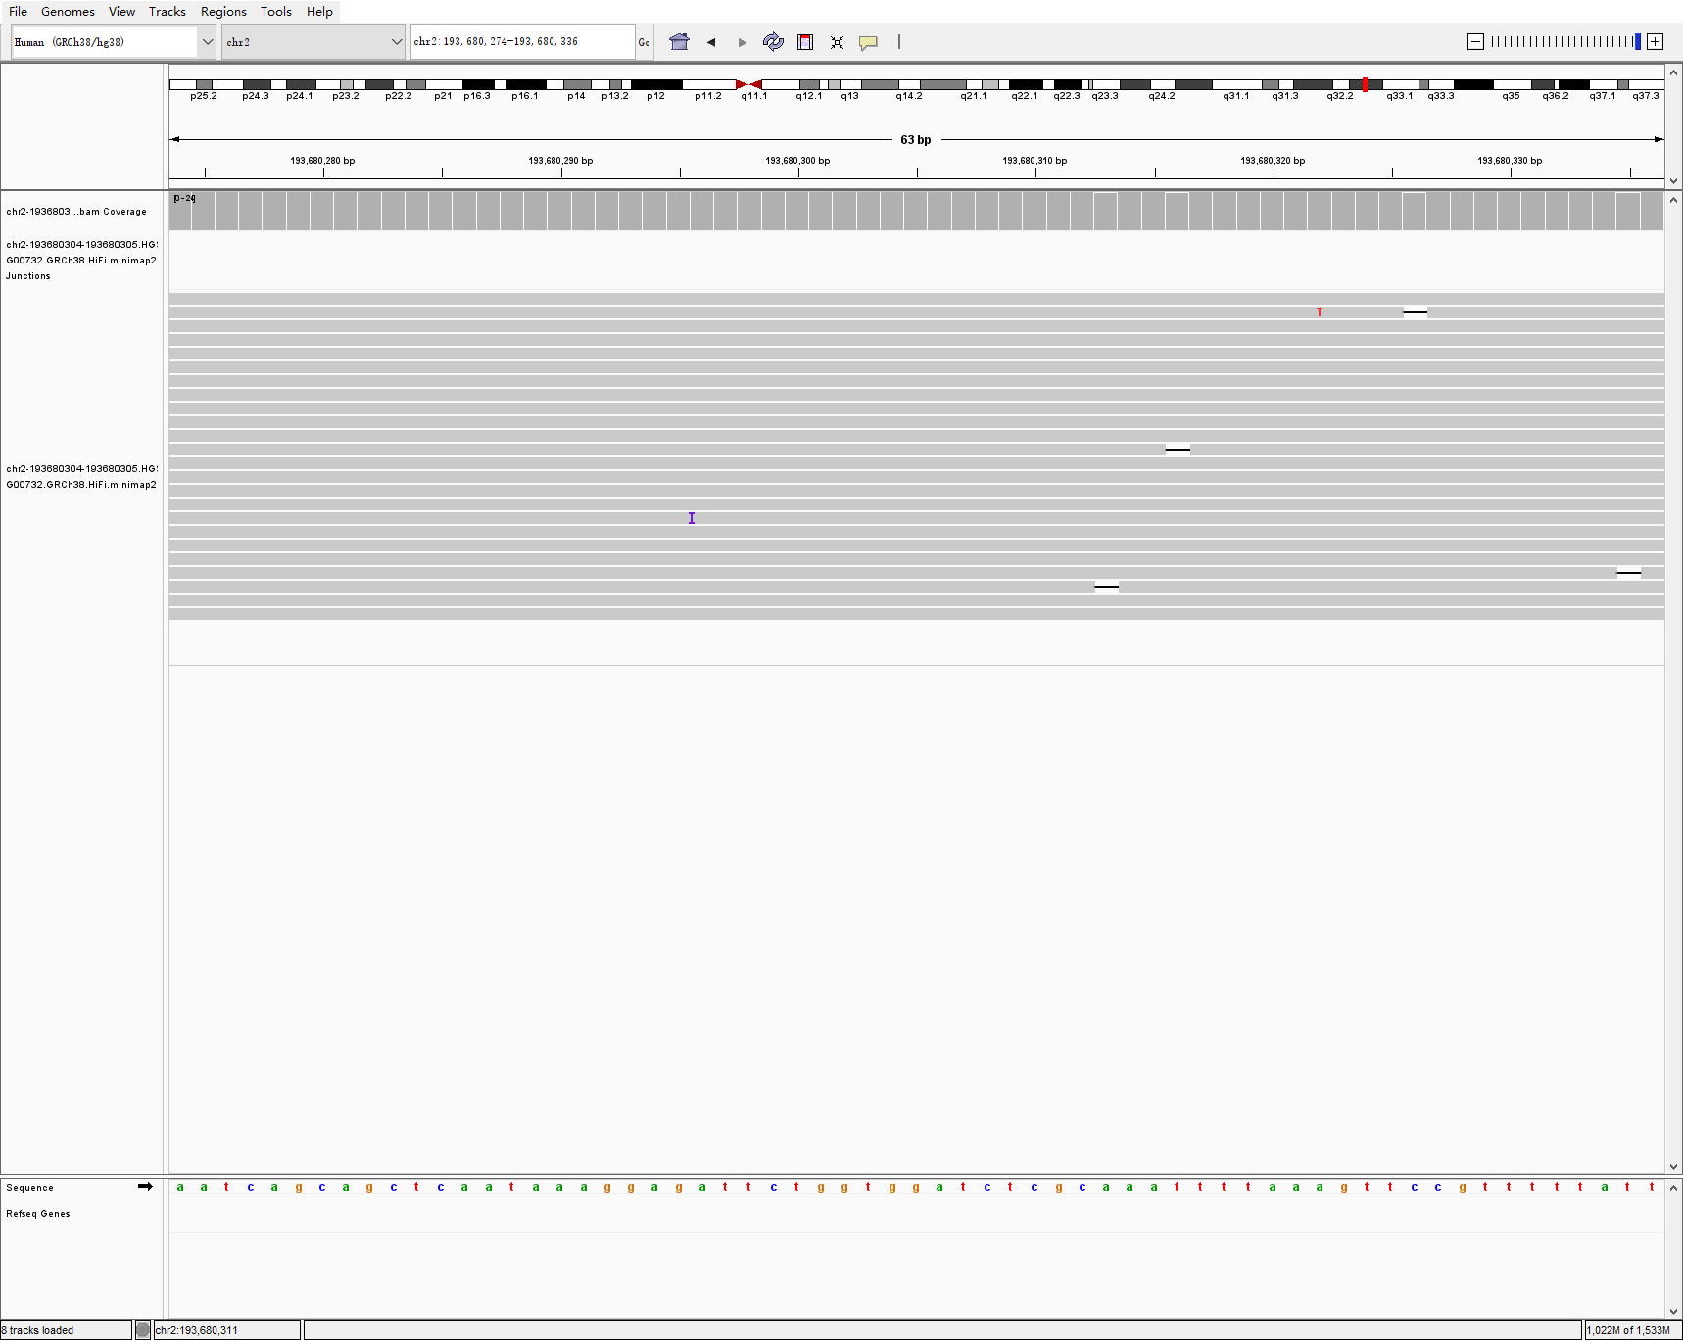
chr2 193680304 193680305 3349 INS hg00733-1-2 sniffles2
HG00733
HG00731
HG00732

Slide 14
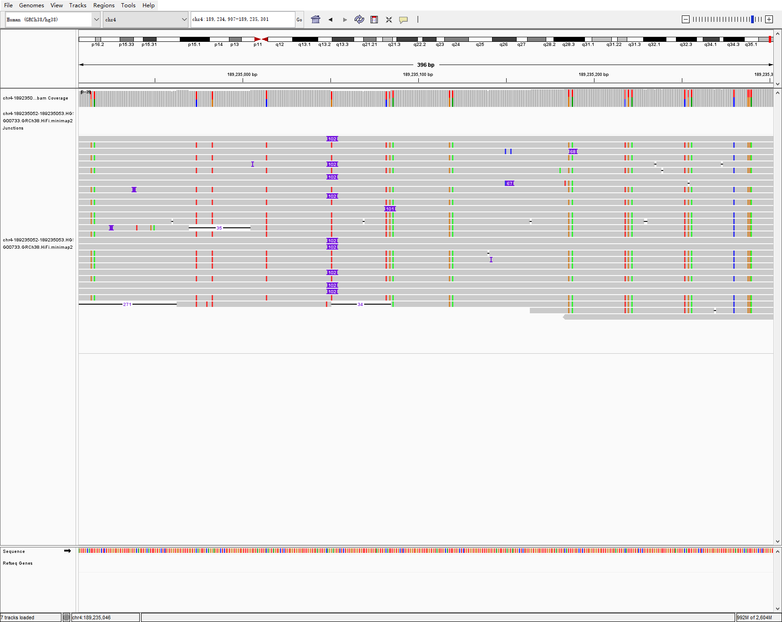
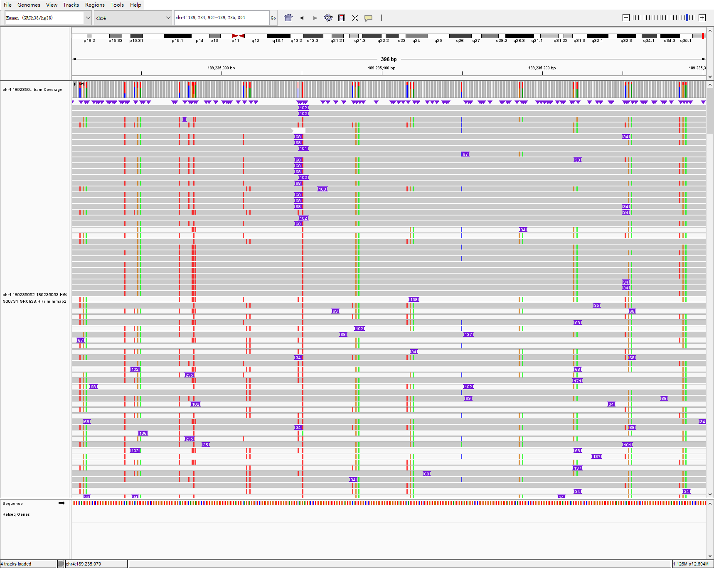
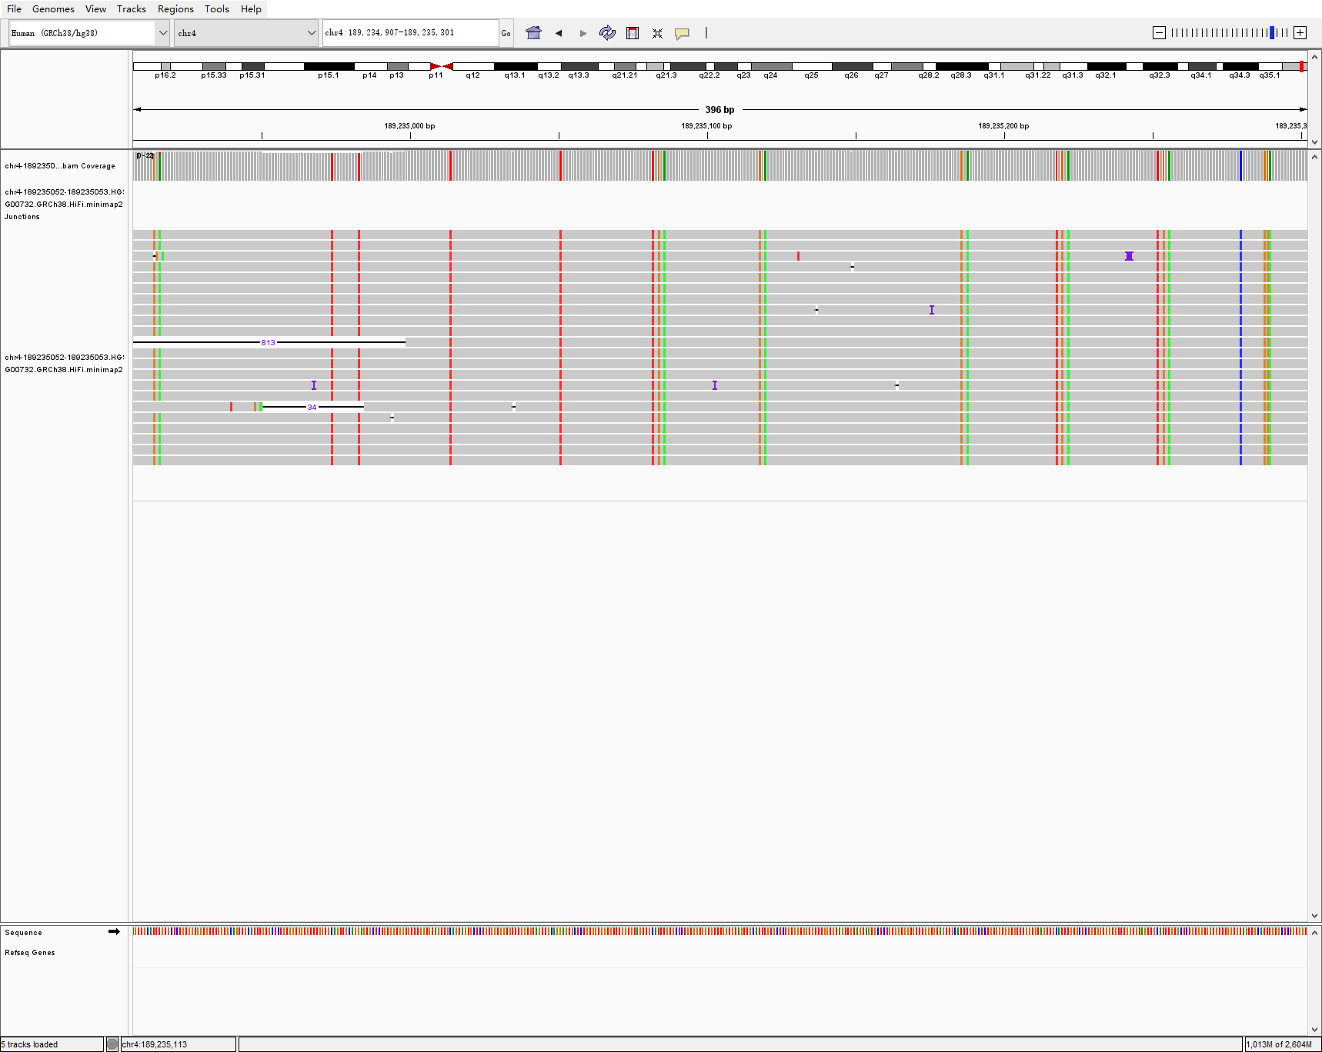
chr4 189235052 189235053 102 INS hg00733-1-2 sniffles2 PRECISE
HG00733
HG00731
HG00732

Slide 15
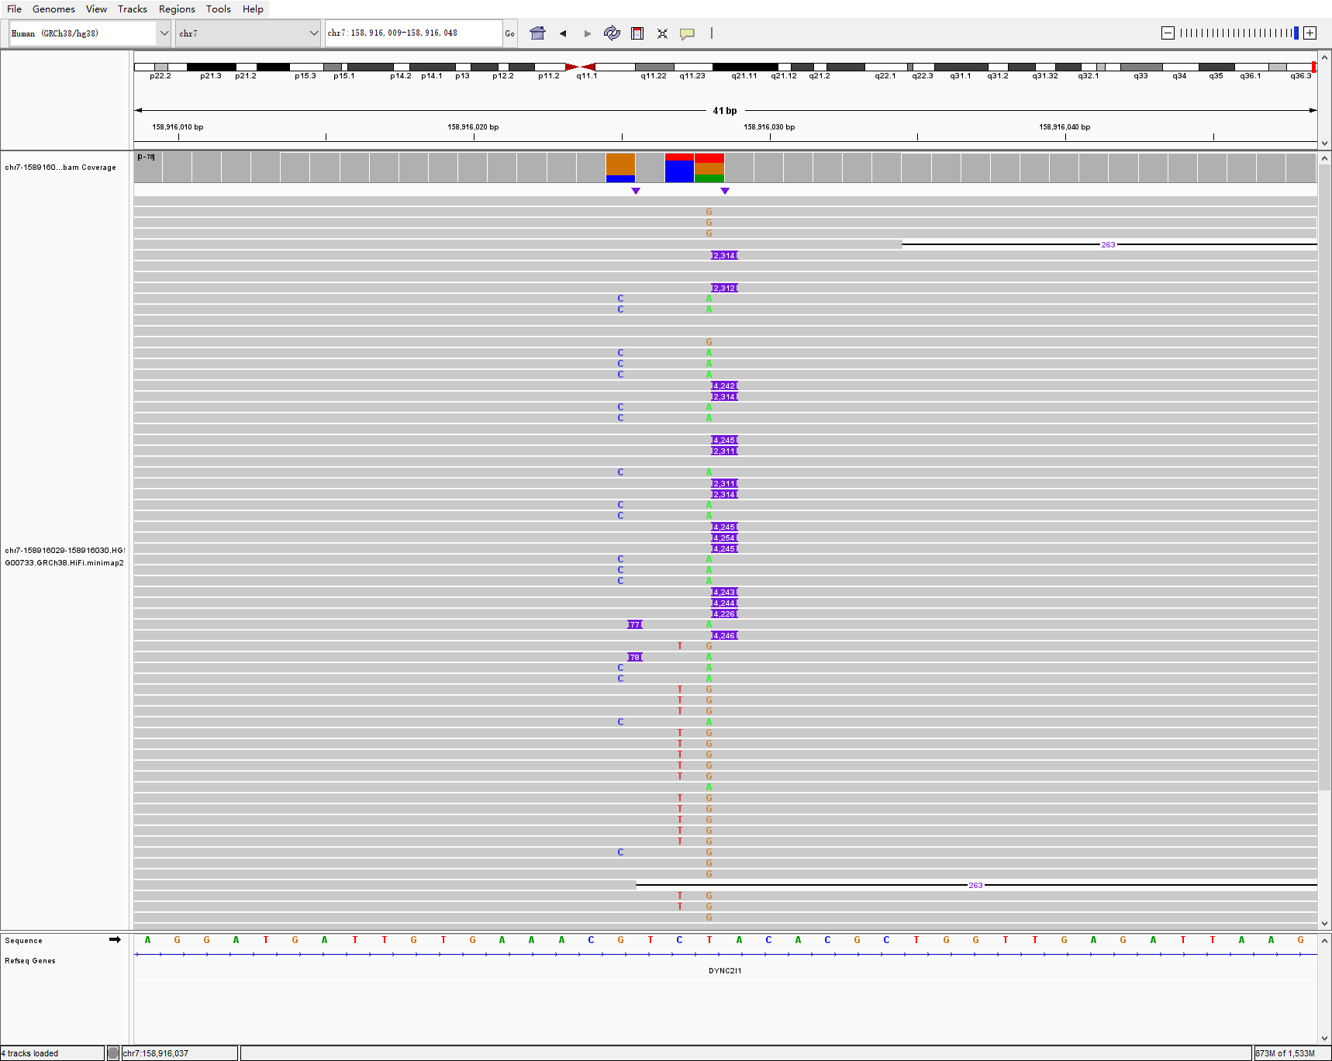
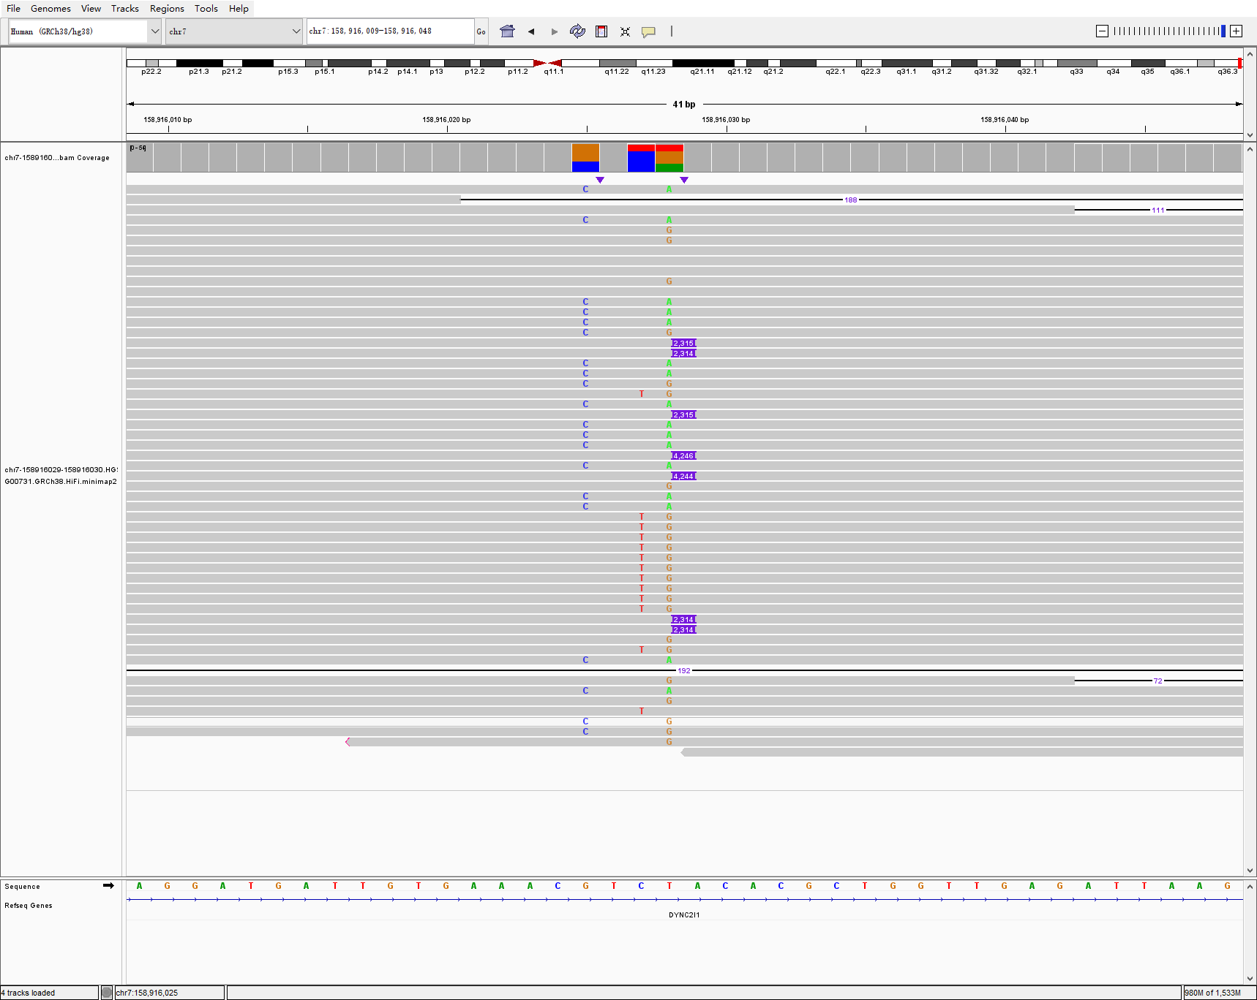
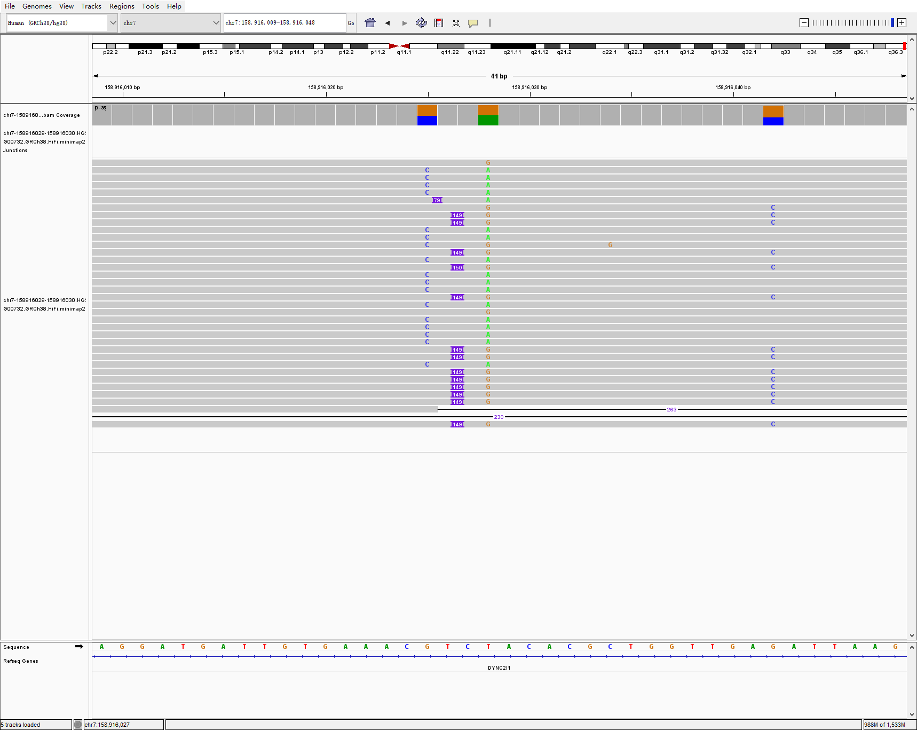
chr7 158916029 158916030 4245 INS hg00733-1-2 sniffles2
HG00733
HG00731
HG00732

Slide 16
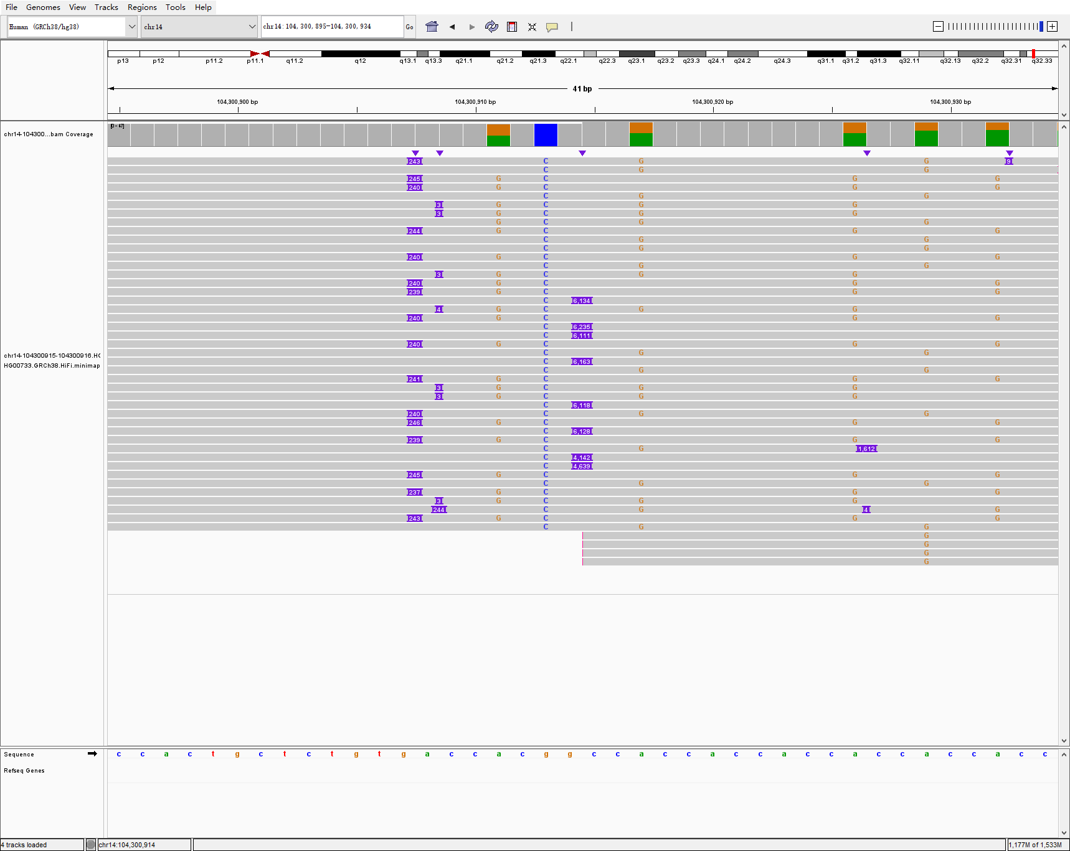
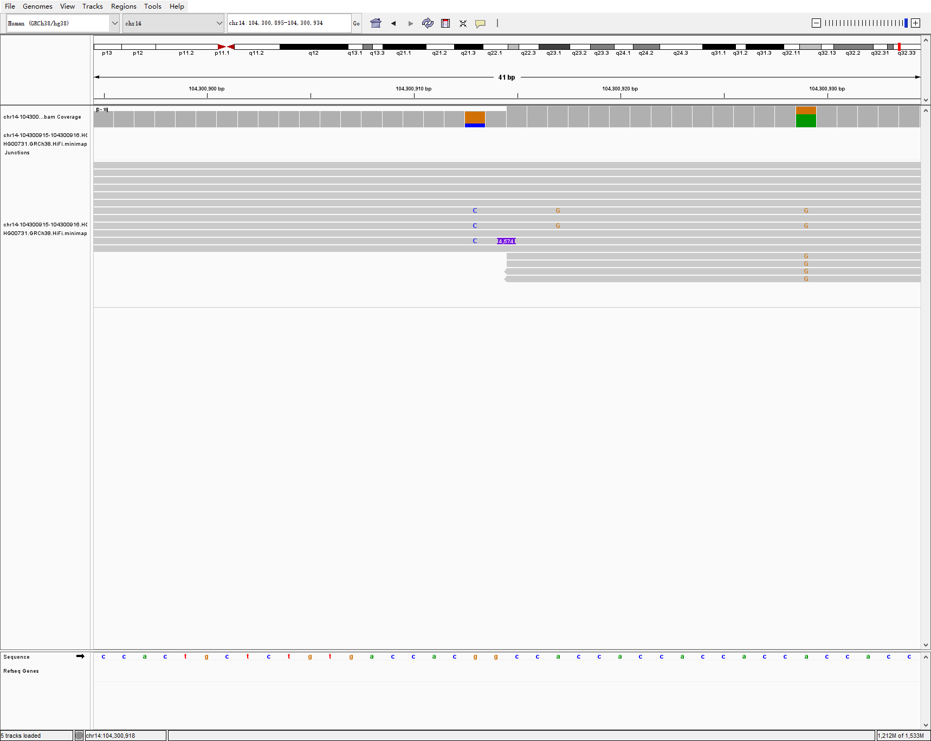
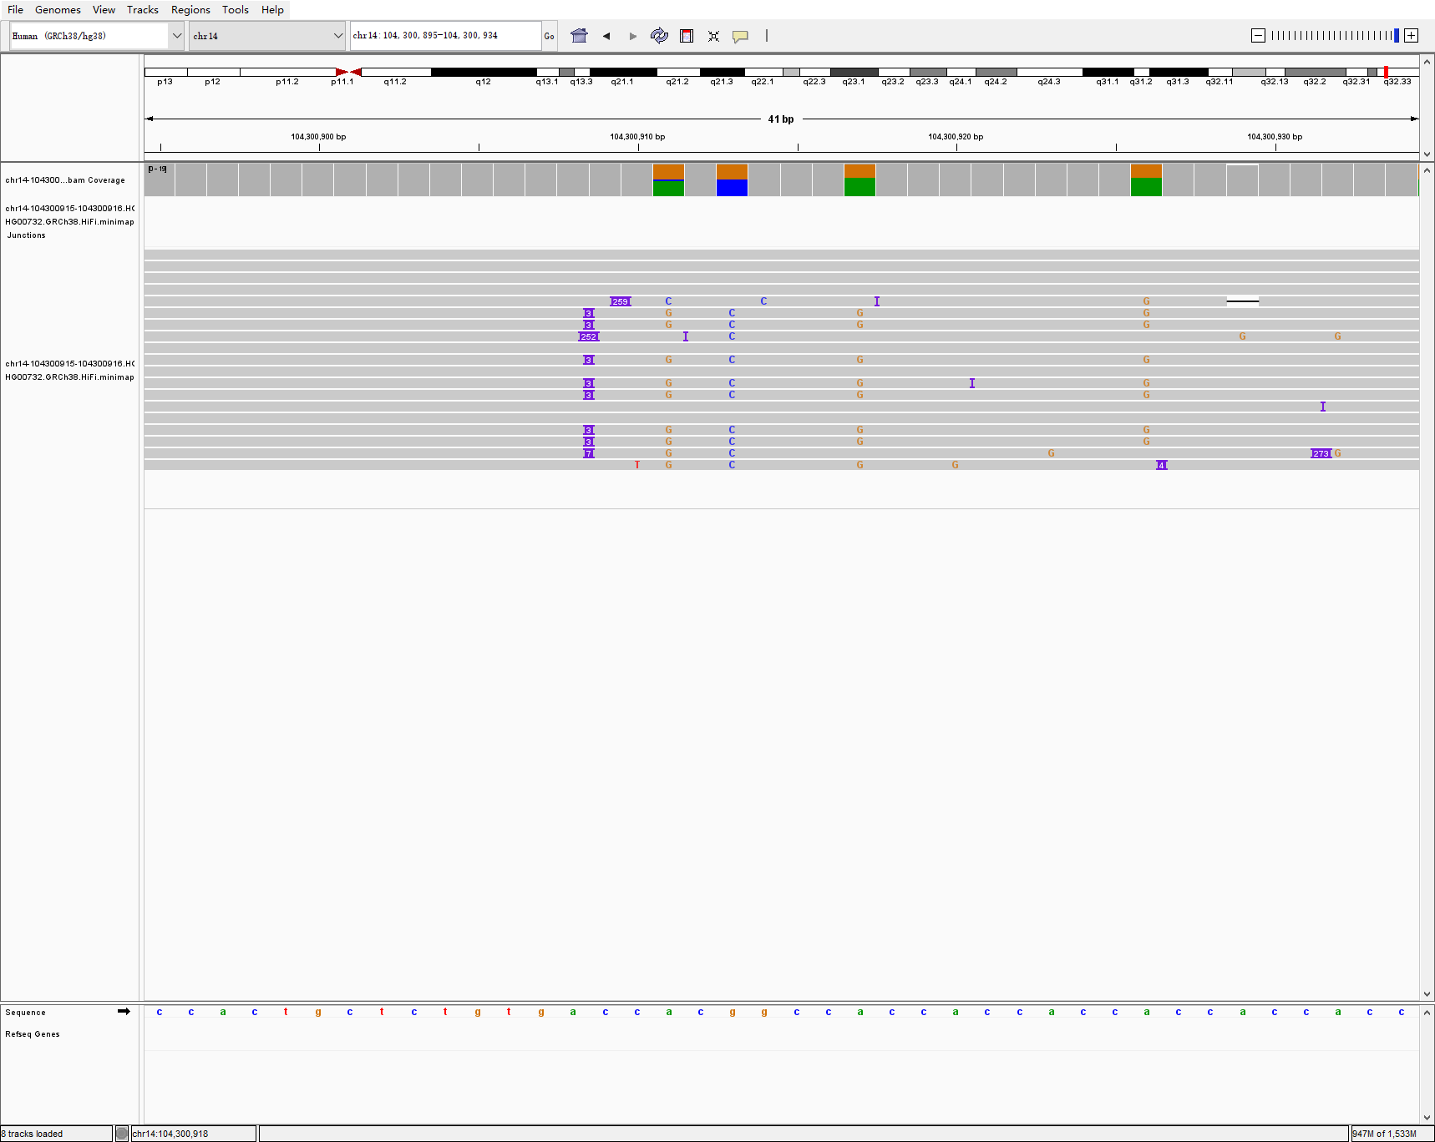
chr14 104300915 104300916 6112 INS hg00733-1-2 sniffles2
HG00733
HG00731
HG00732

Slide 17
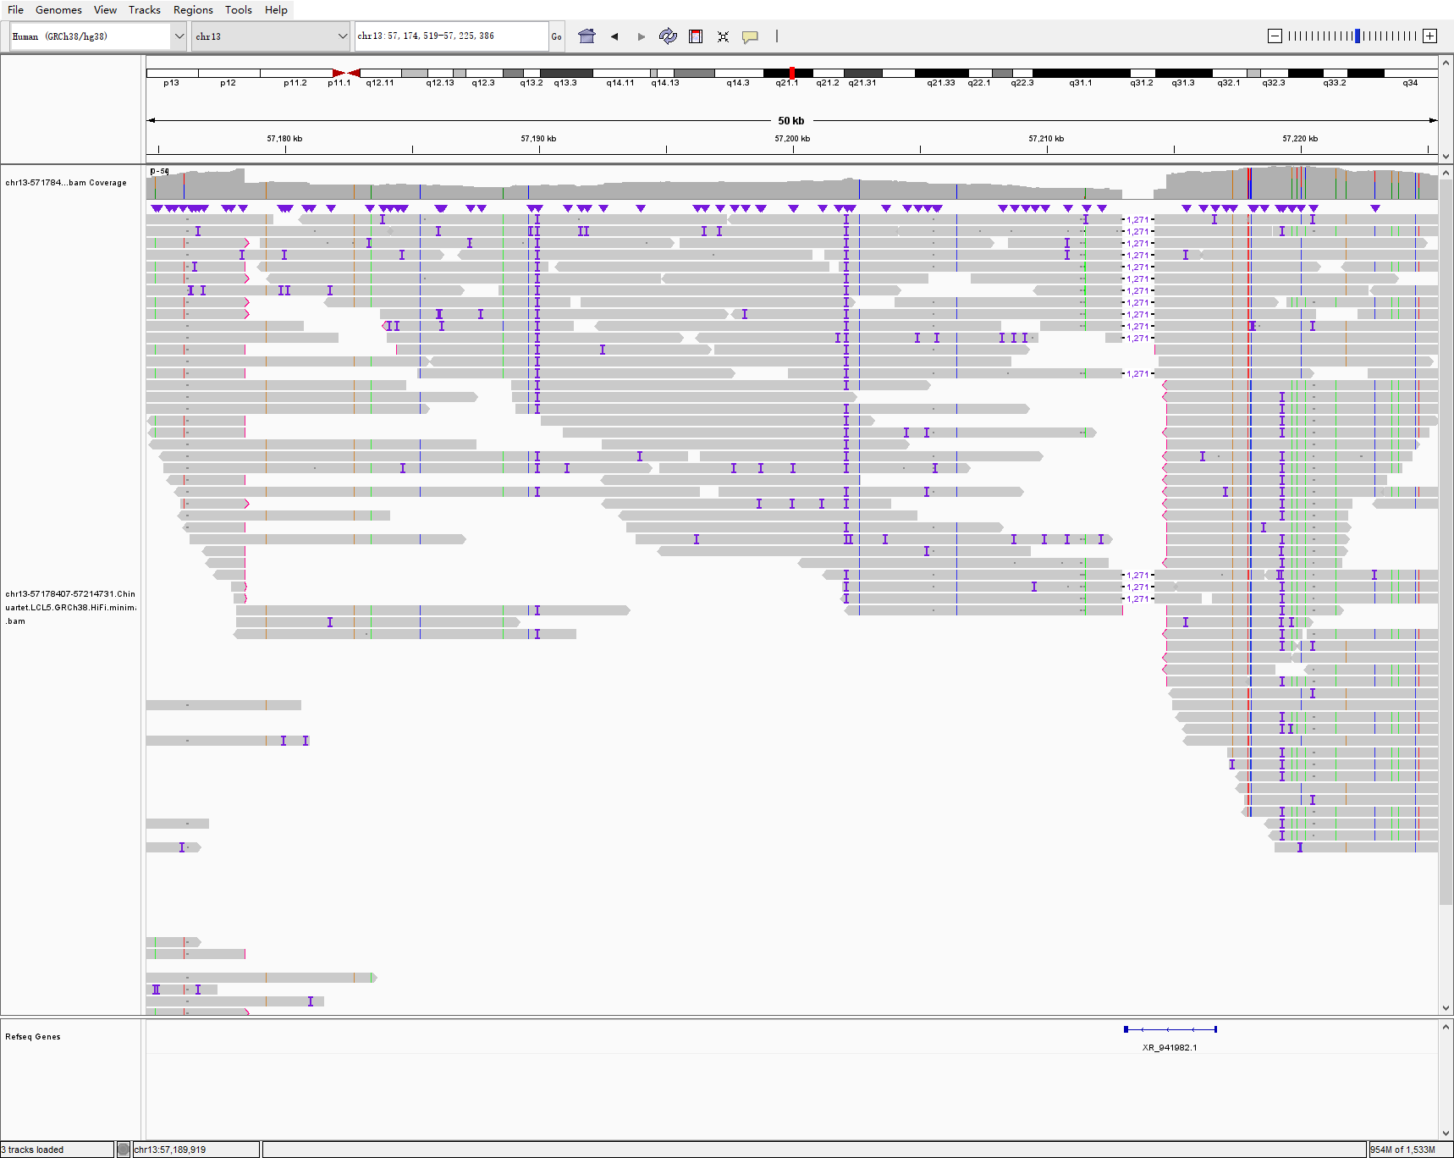
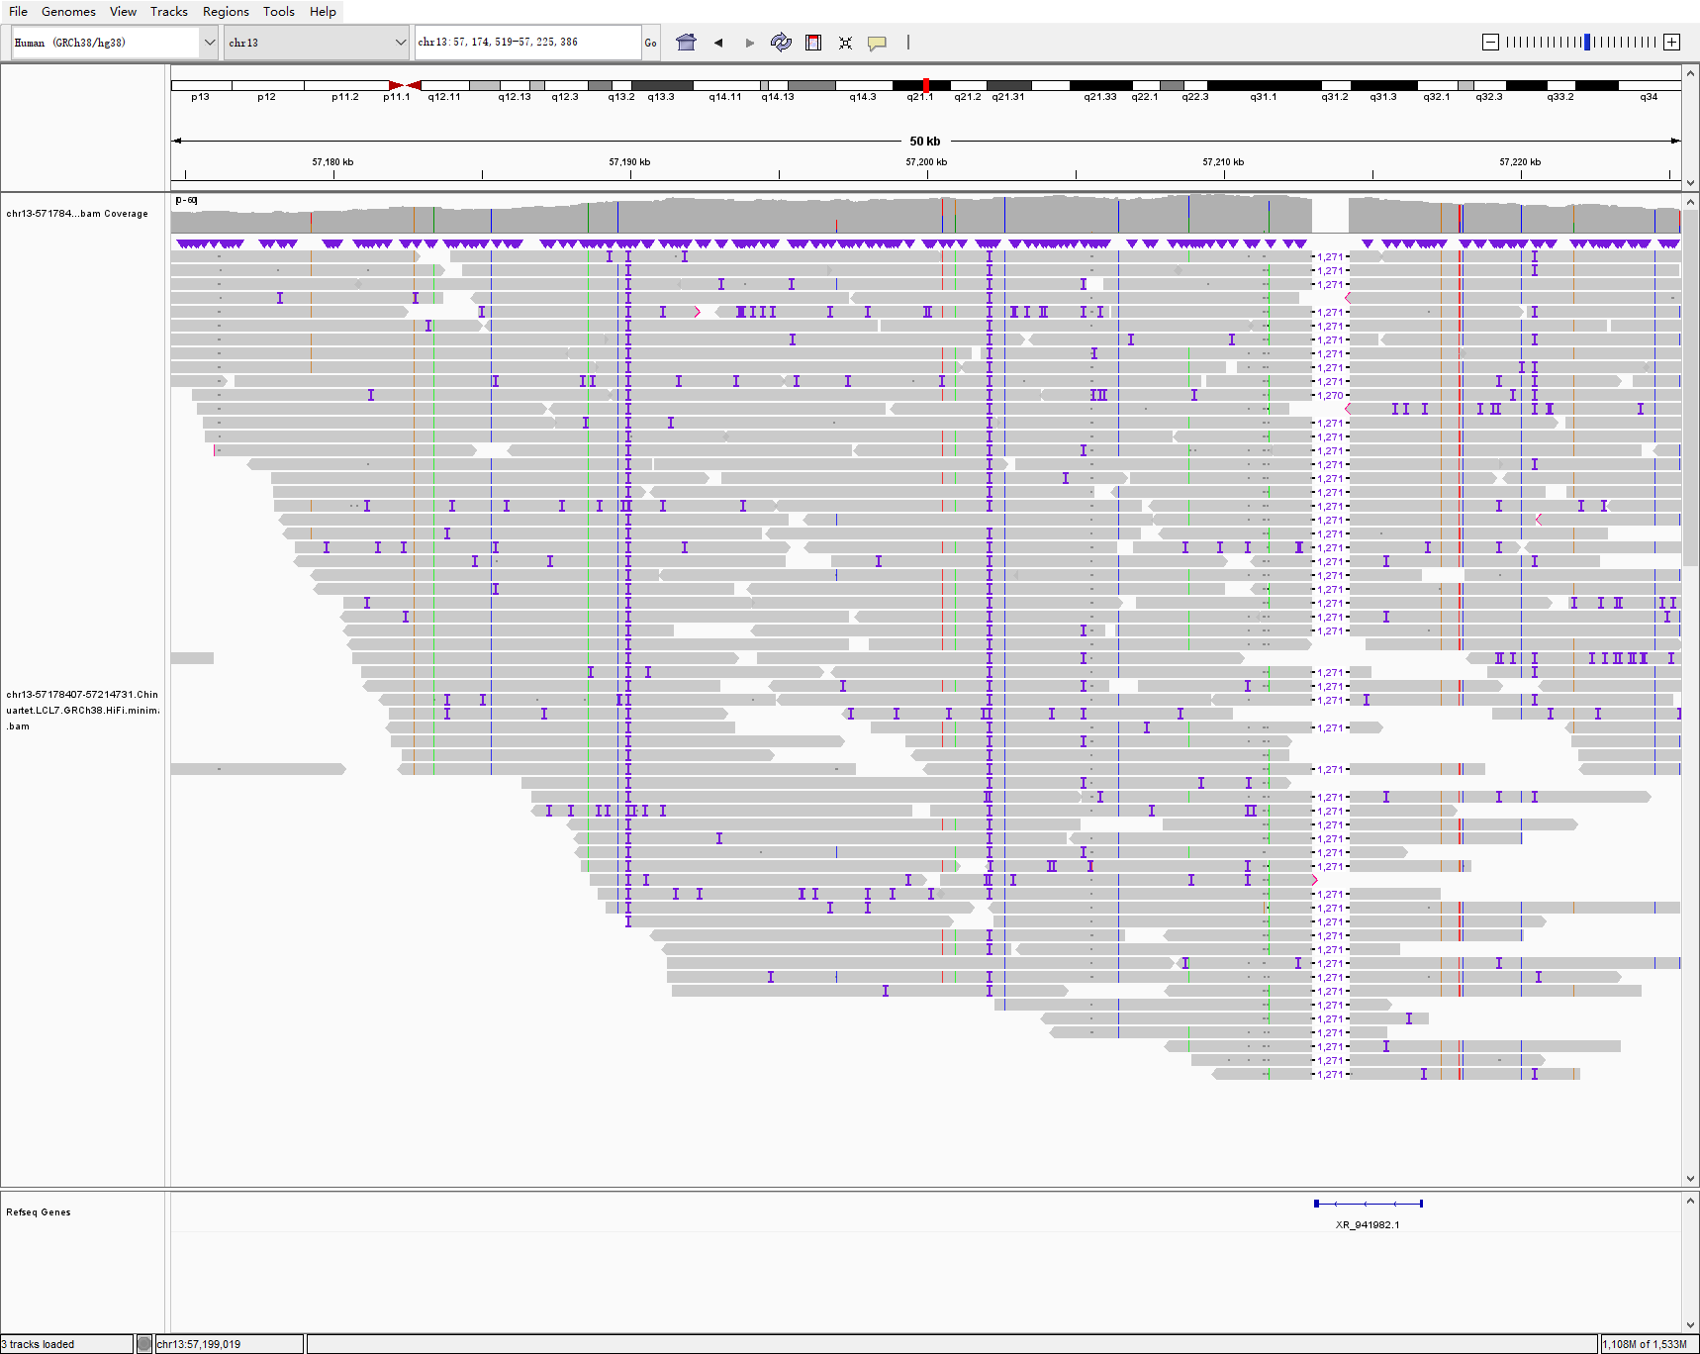
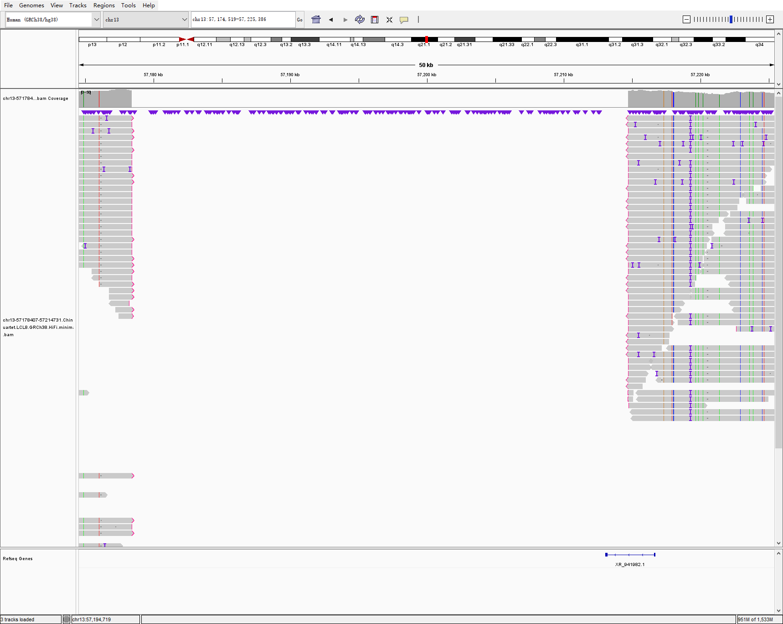
chr13 57178407 57214731 36323 DEL lcl5-6-7-8 sniffles2
LCL5
LCL7
LCL8

Slide 18
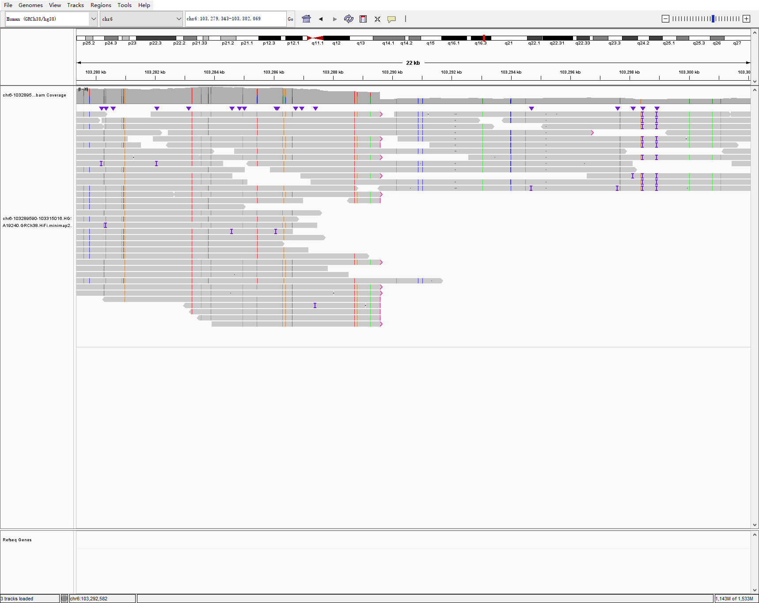
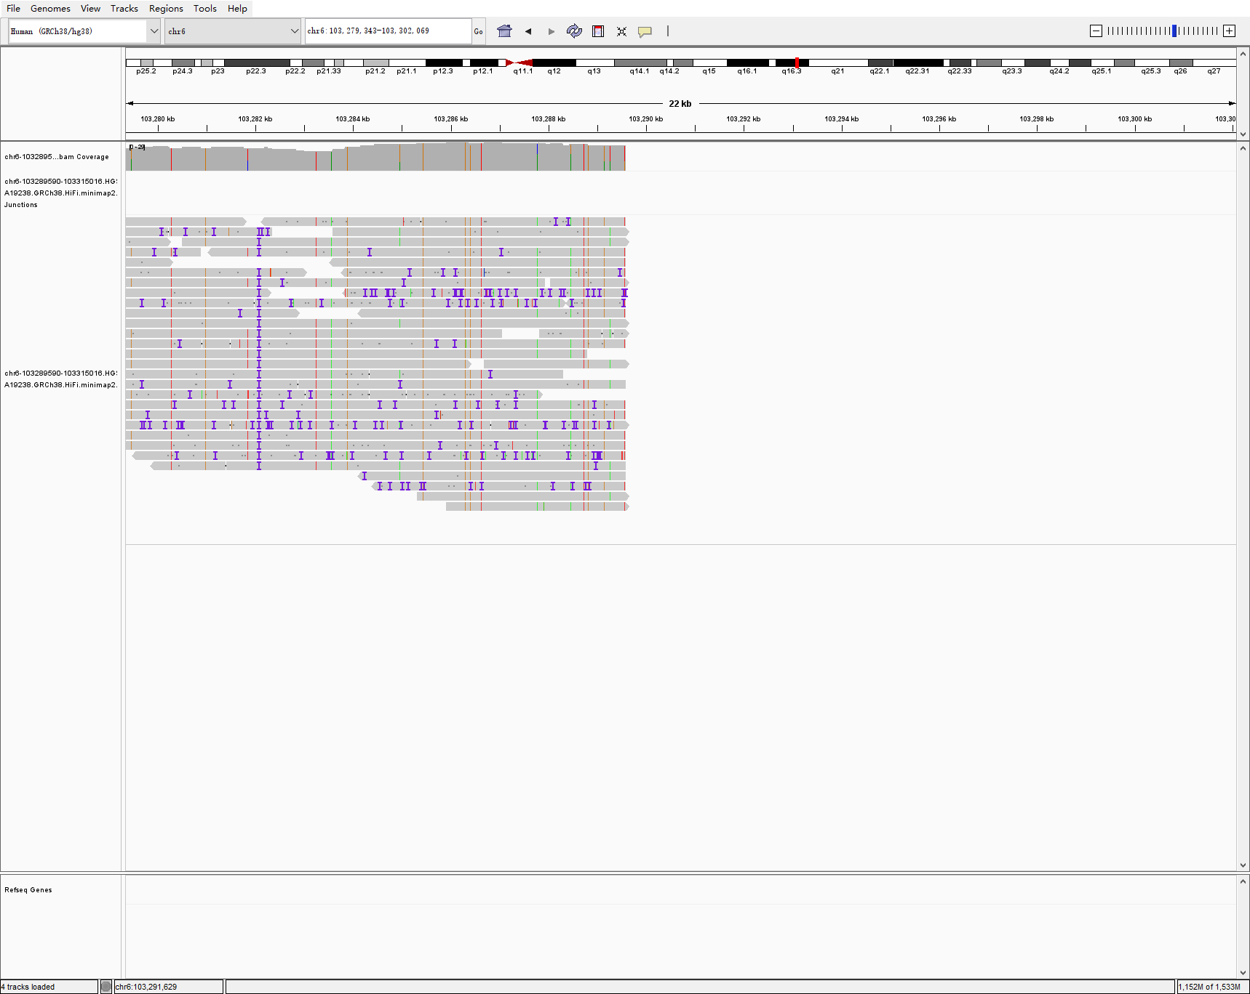

chr6 103289590 103315016 25425 DEL na19240-38-39 sniffles2
NA19240
NA19238
NA19239

Slide 19



chr20 61389838 61389839 794 INS na19240-38-39 sniffles2
NA19240
NA19238
NA19239

Slide 20



chr22 48990163 48998384 8220 DEL na19240-38-39 sniffles2
NA19240
NA19238
NA19239

