Slide 1
Supplementary File 3. Verification of 26 de novo SVs of SVision-pro

Slide 2
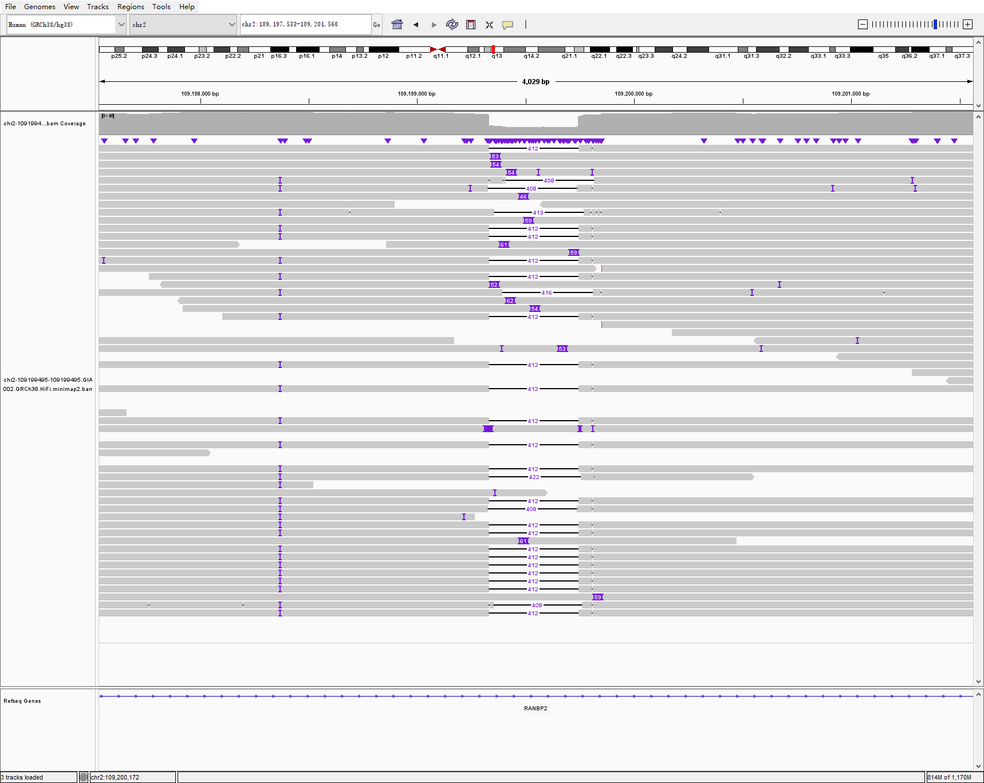
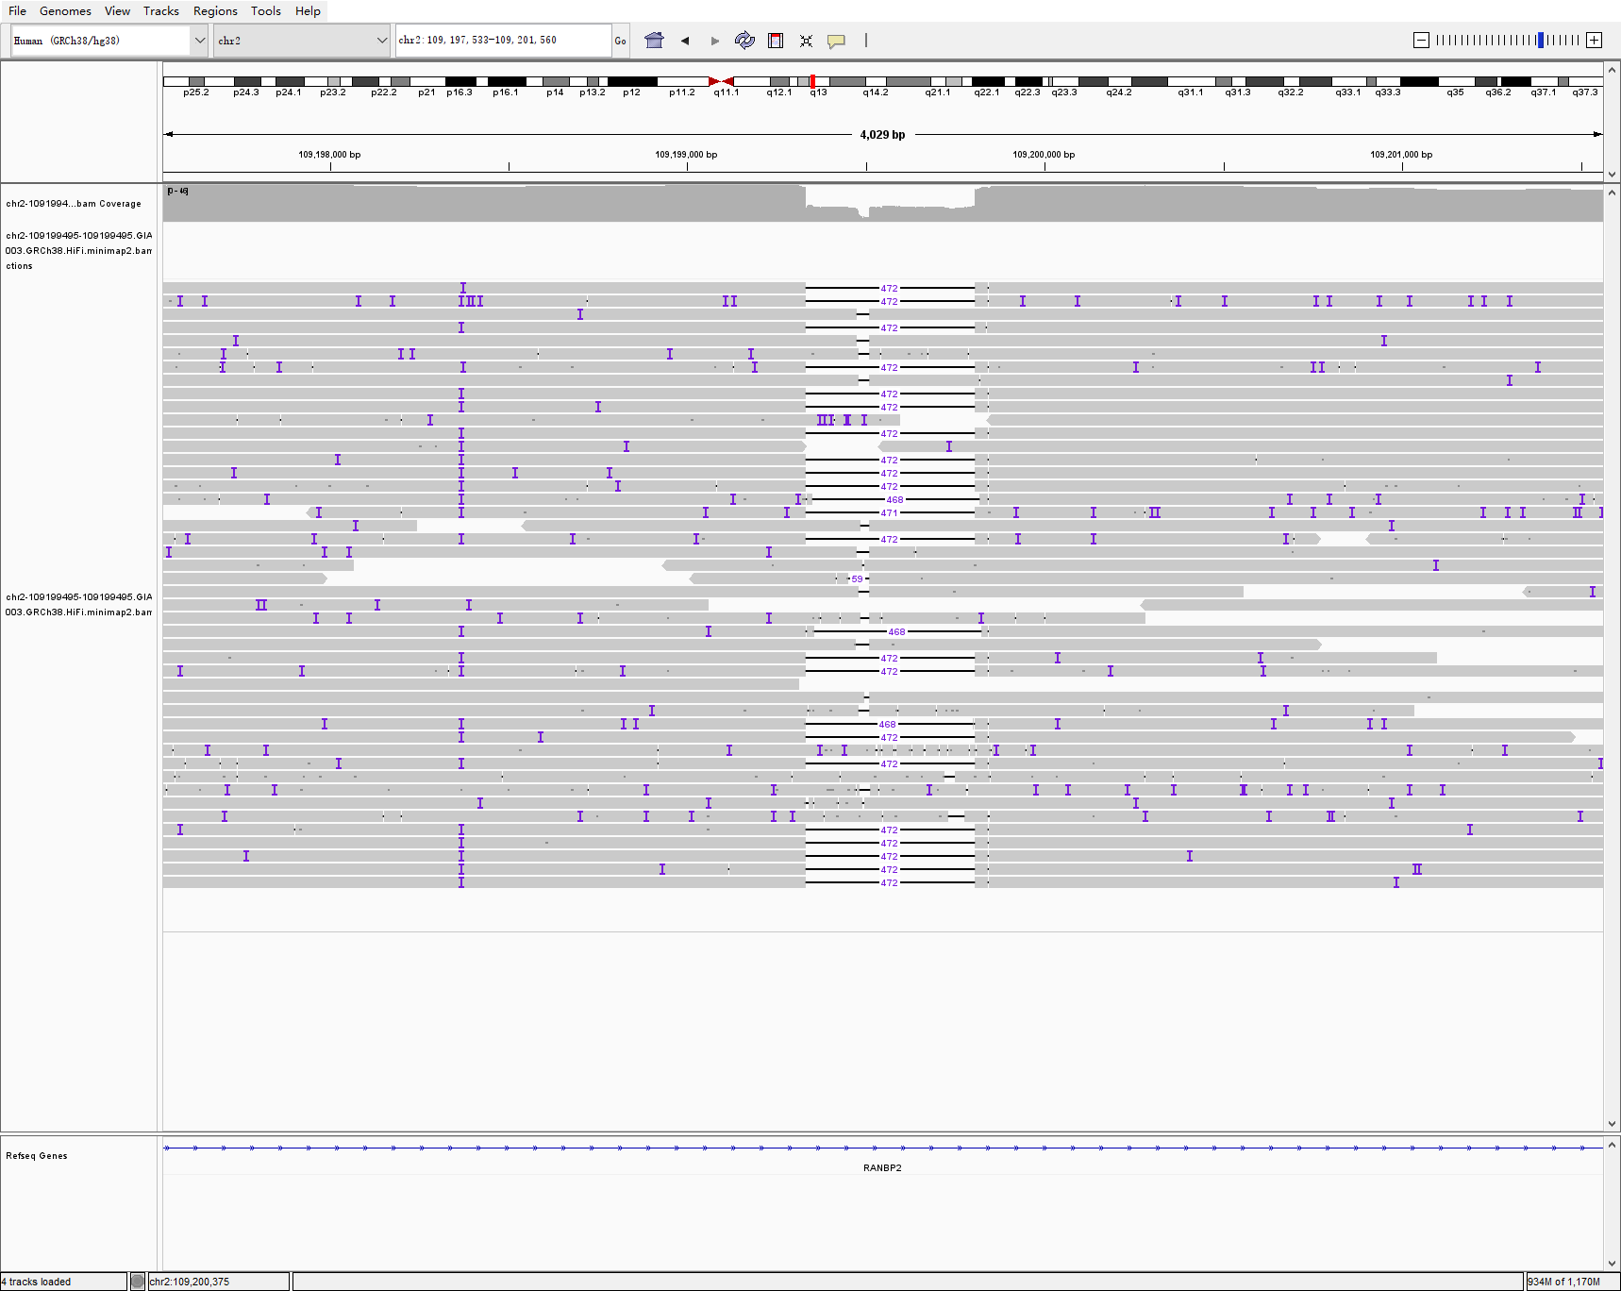
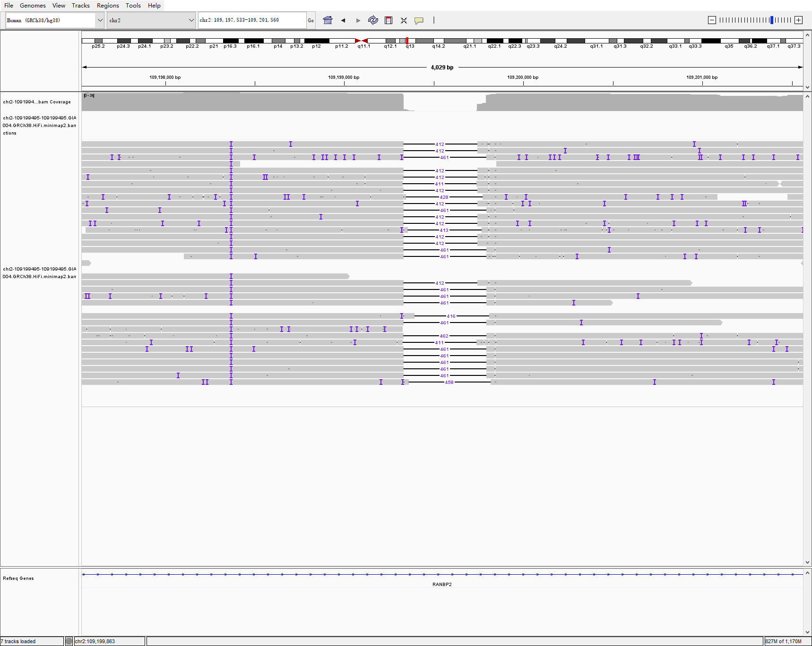
chr2 109199495 109199495 59 INS hg002-3-4 svision_pro
HG002
HG003
HG004

Slide 3
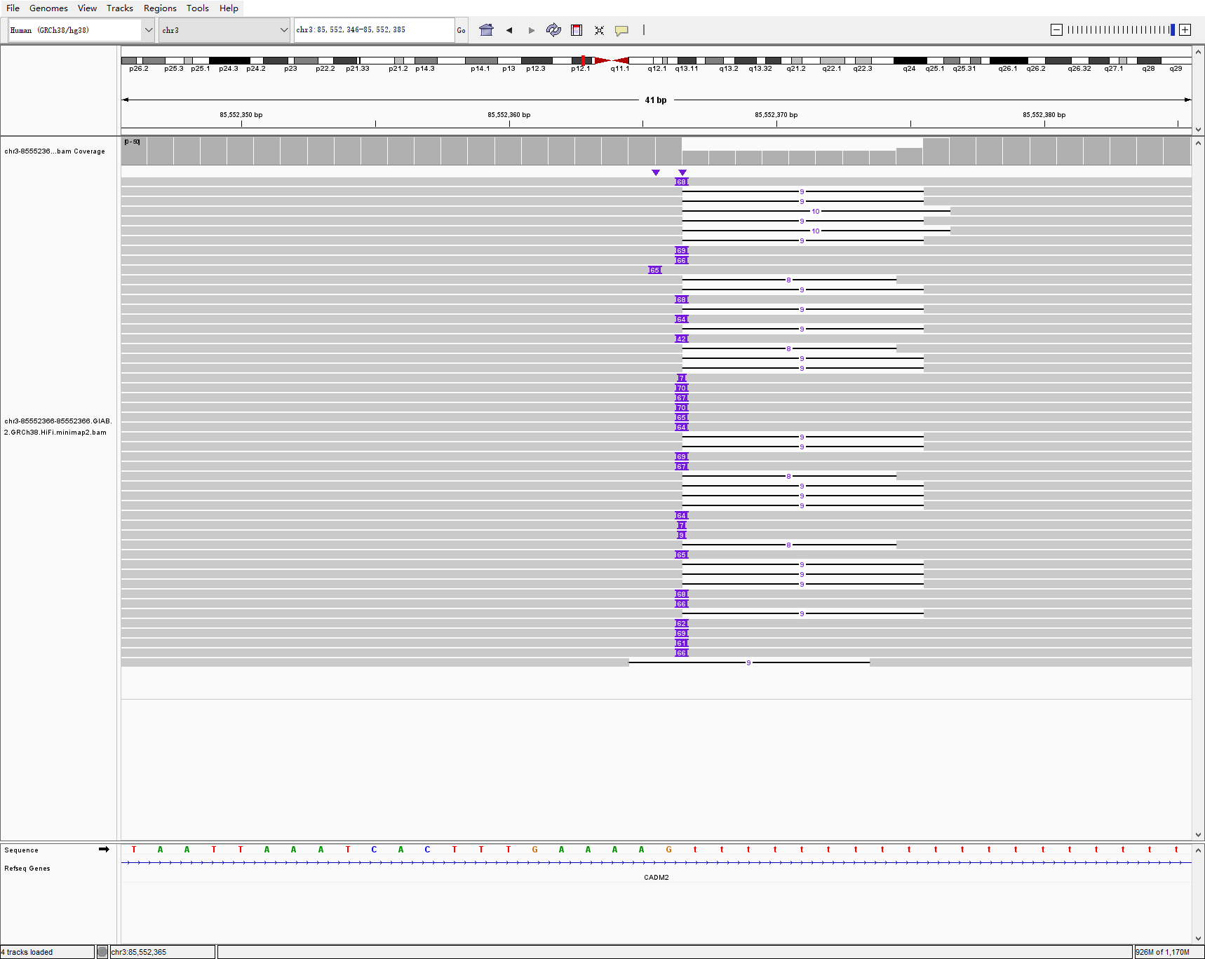
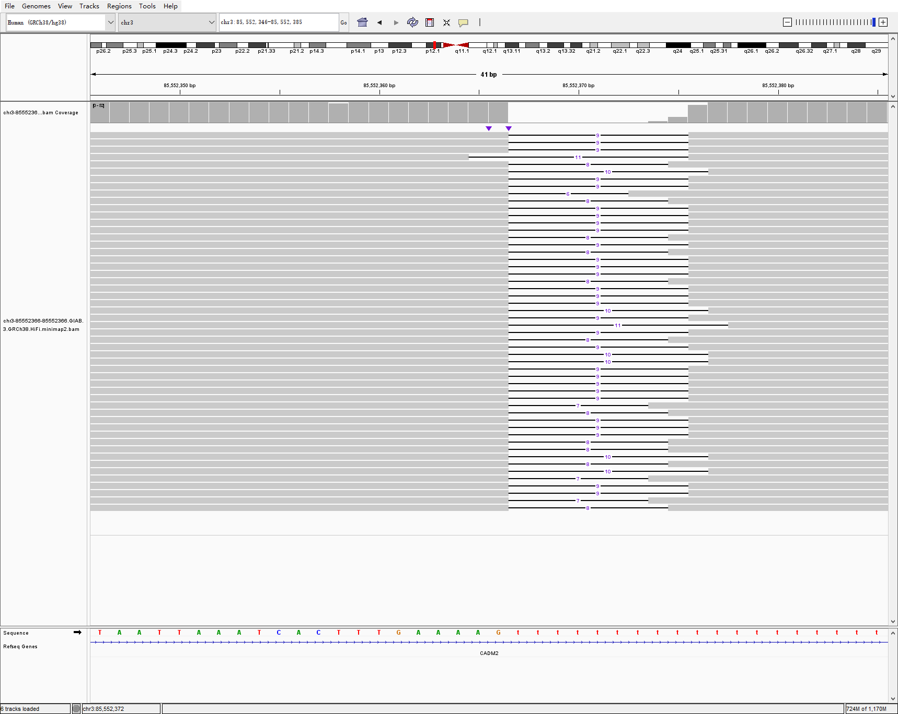
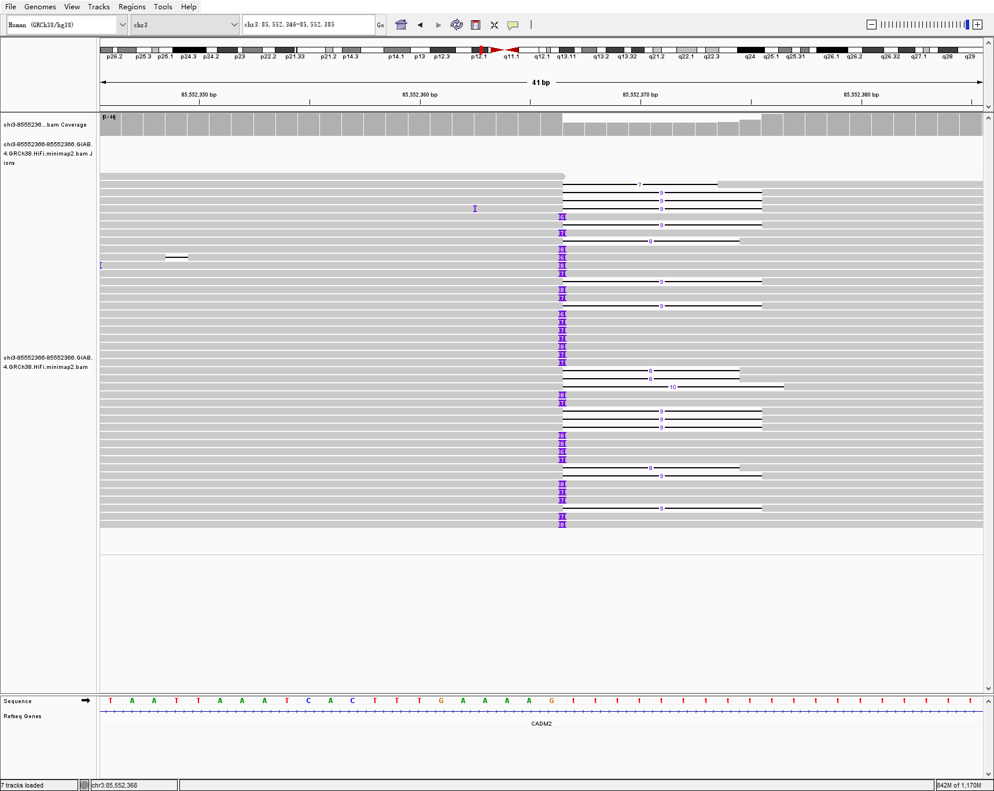
chr3 85552366 85552366 66 INS hg002-3-4 svision_pro
HG002
HG003
HG004

Slide 4
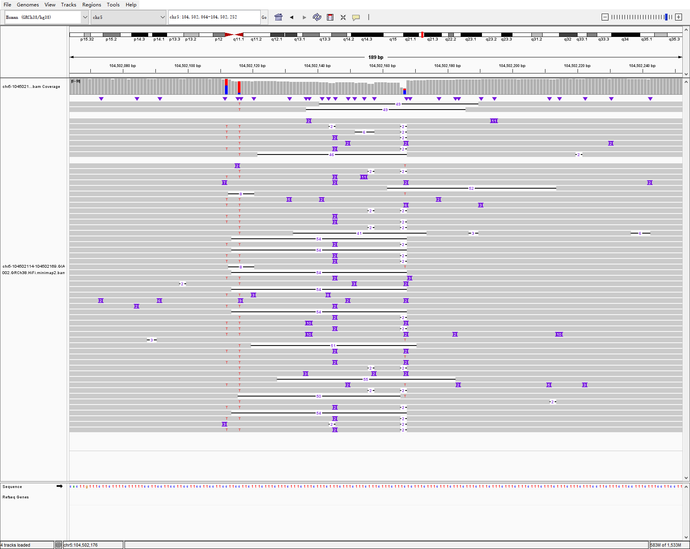
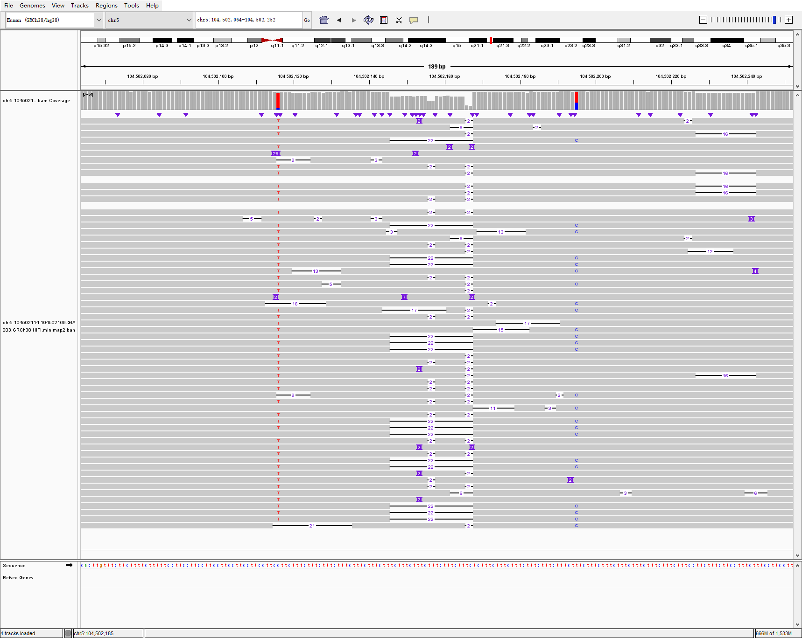
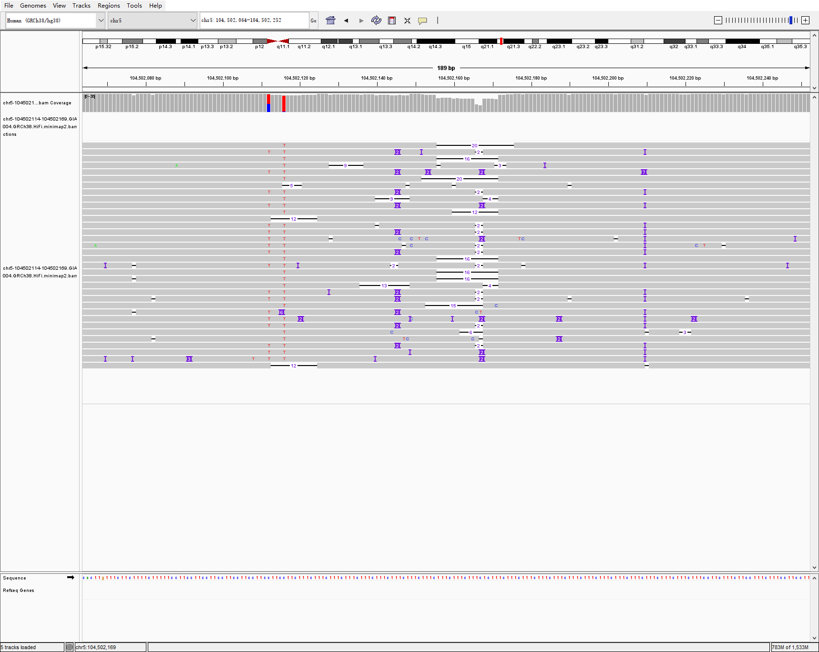
chr5 104502114 104502169 54 DEL hg002-3-4 svision_pro
HG002
HG003
HG004

Slide 5
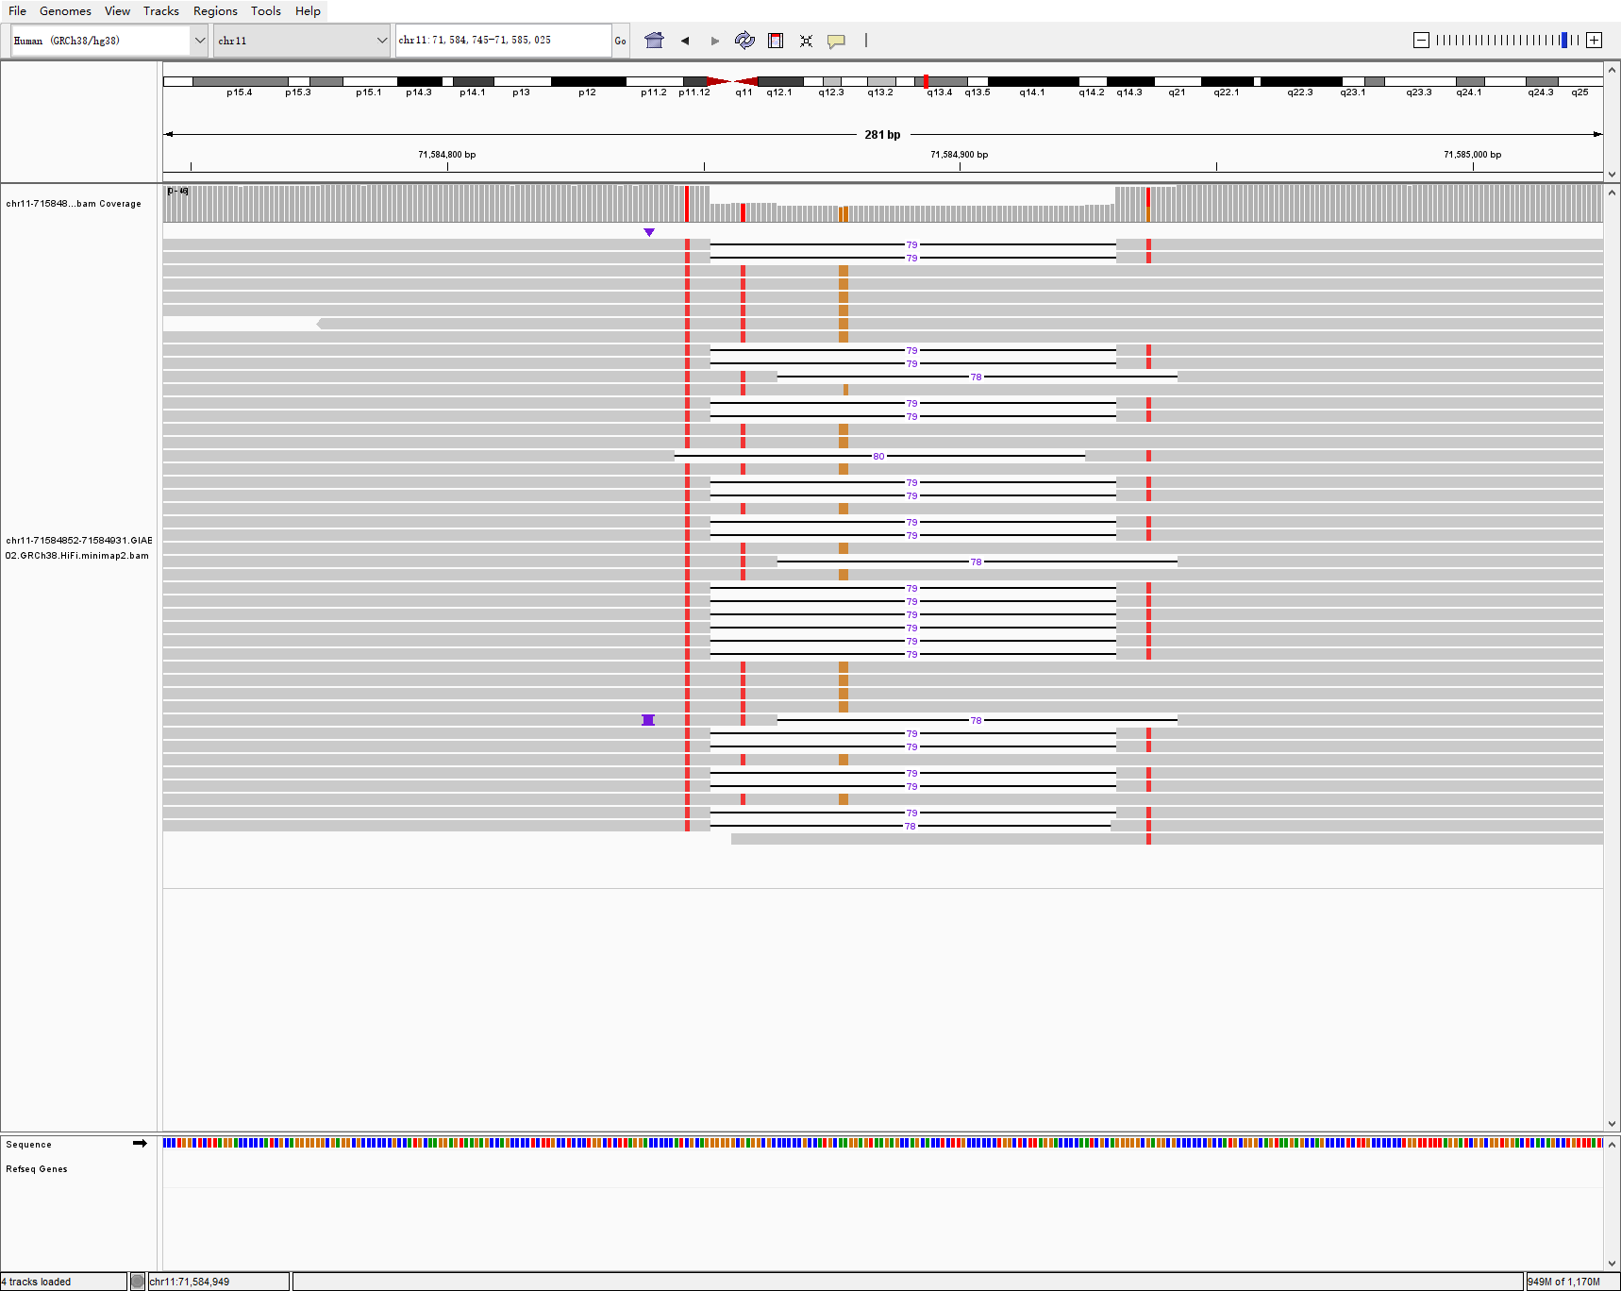
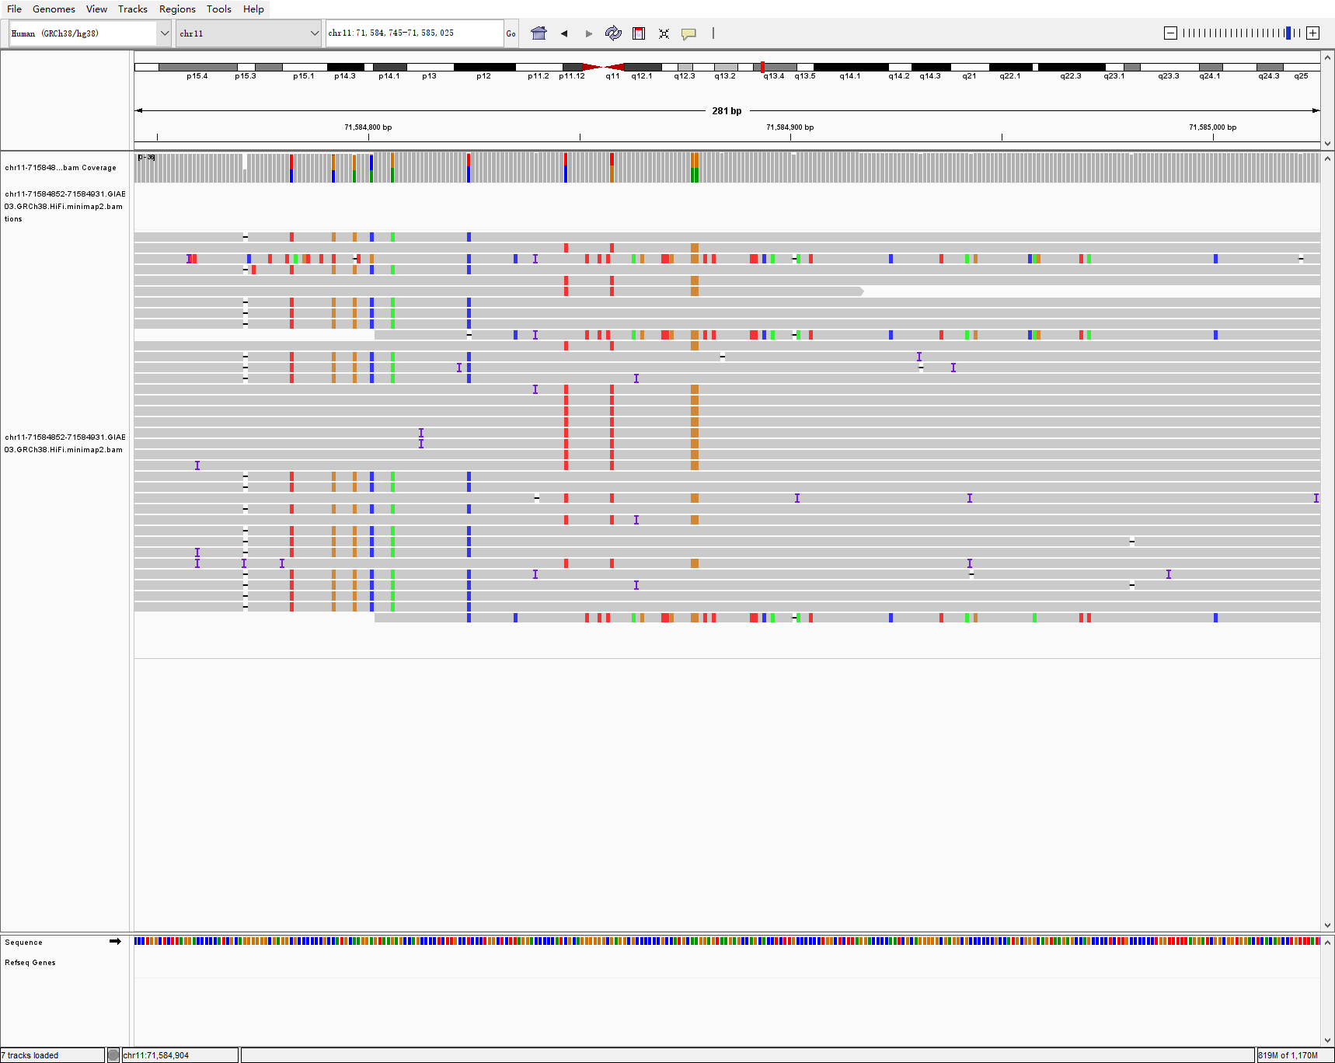
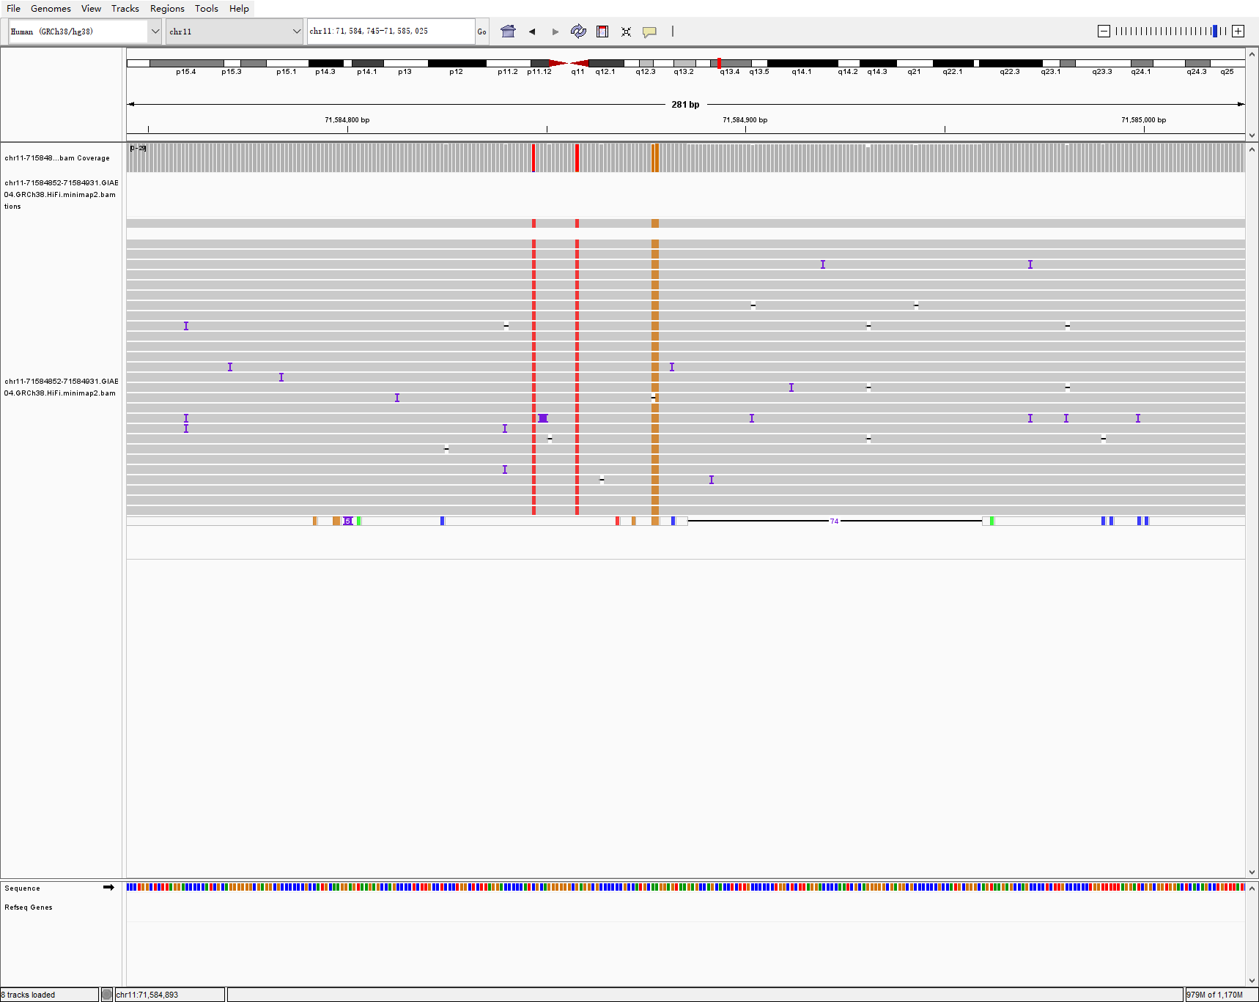
chr11 71584852 71584931 79 DEL hg002-3-4 svision_pro
HG002
HG003
HG004

Slide 6
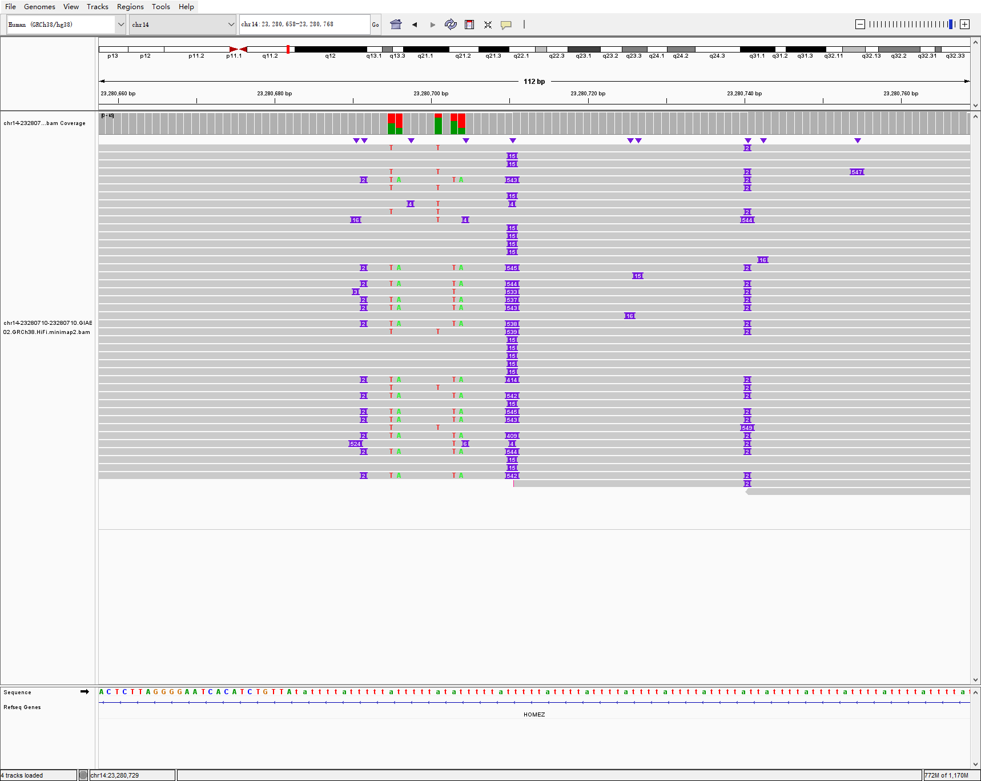
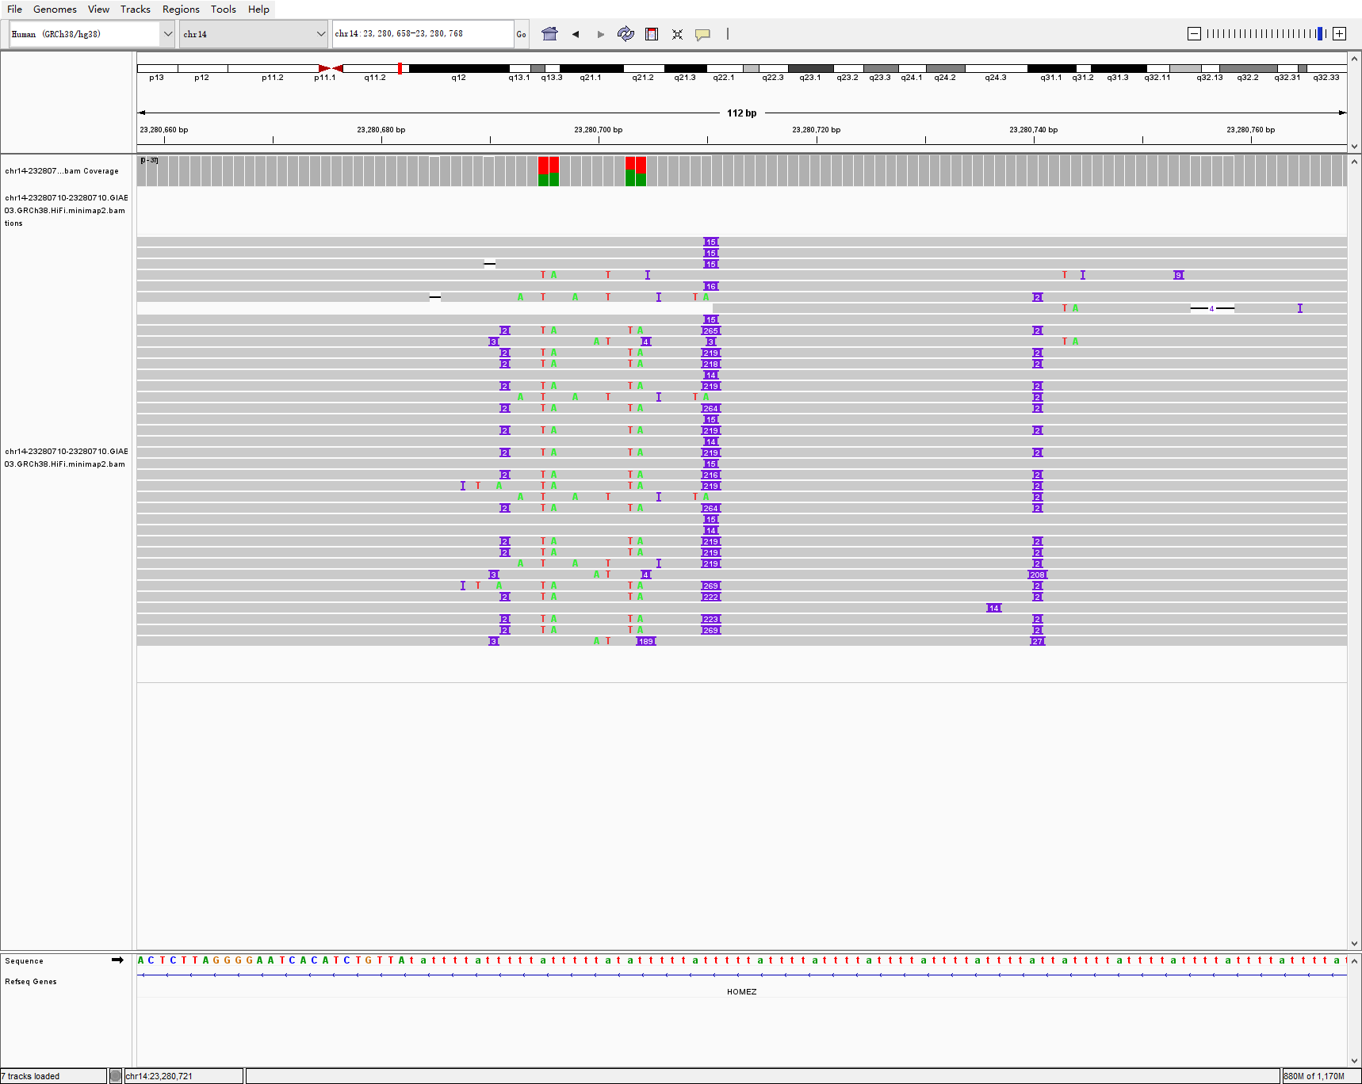
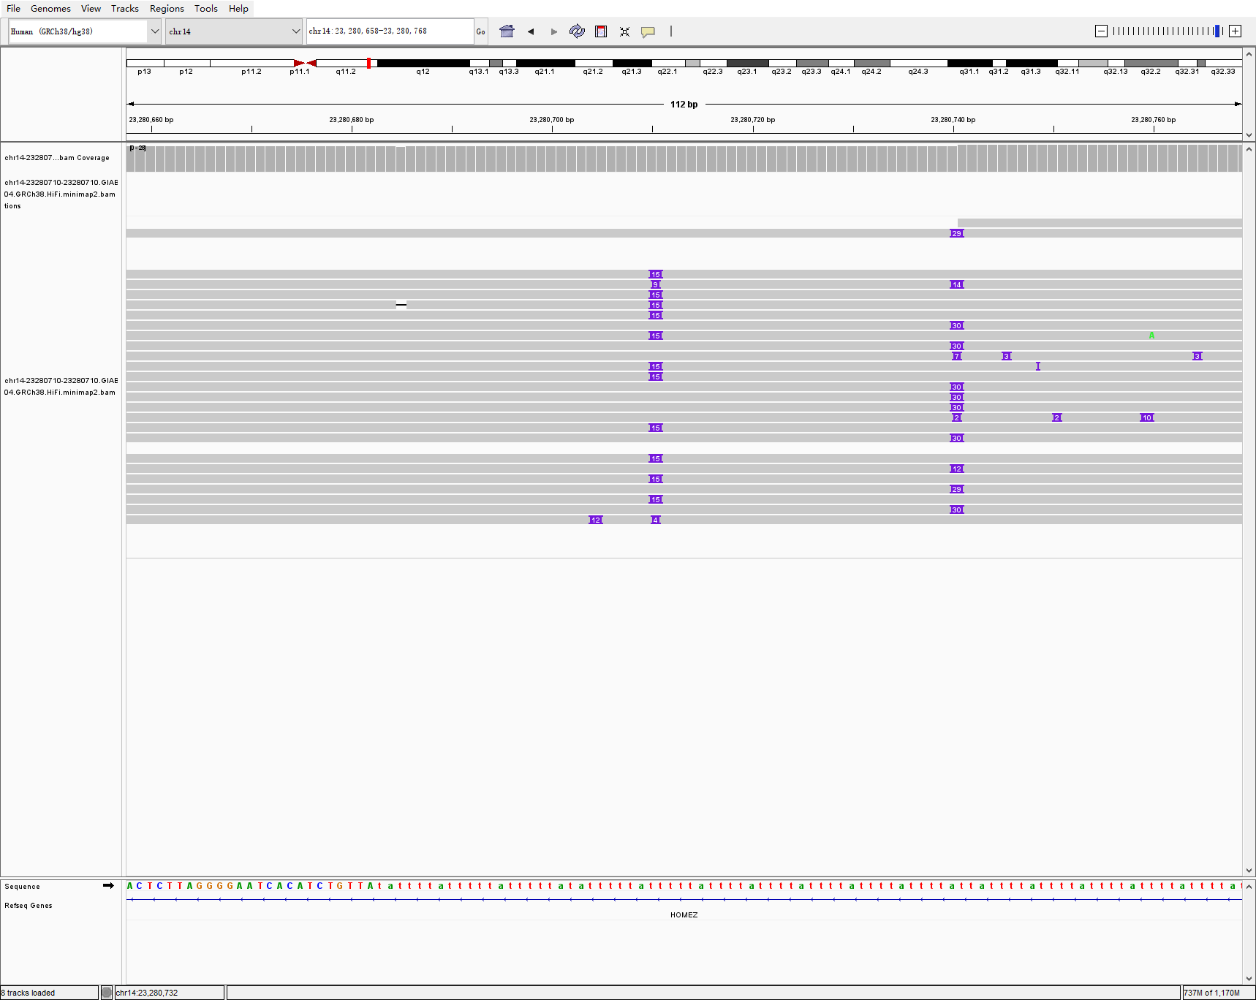
chr14 23280710 23280710 543 INS hg002-3-4 svision_pro
HG002
HG003
HG004

Slide 7
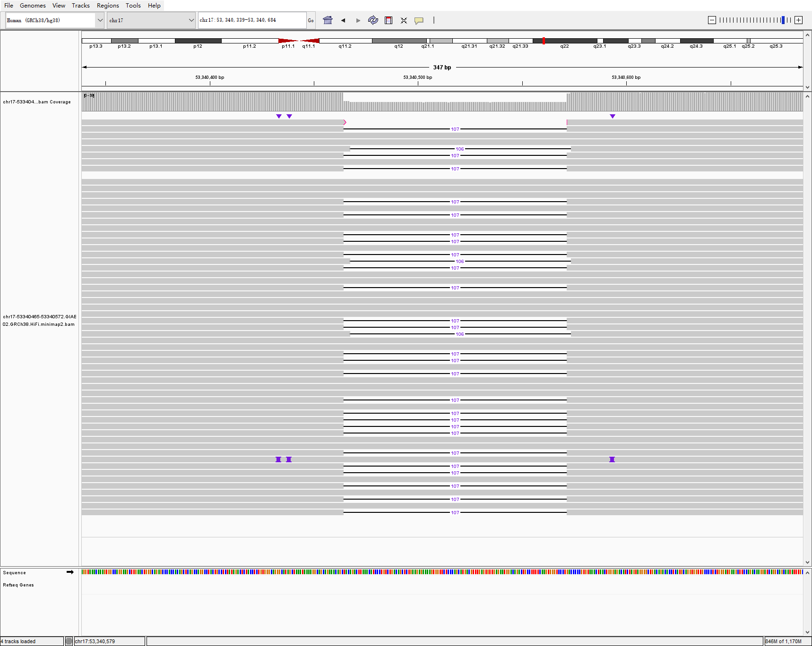
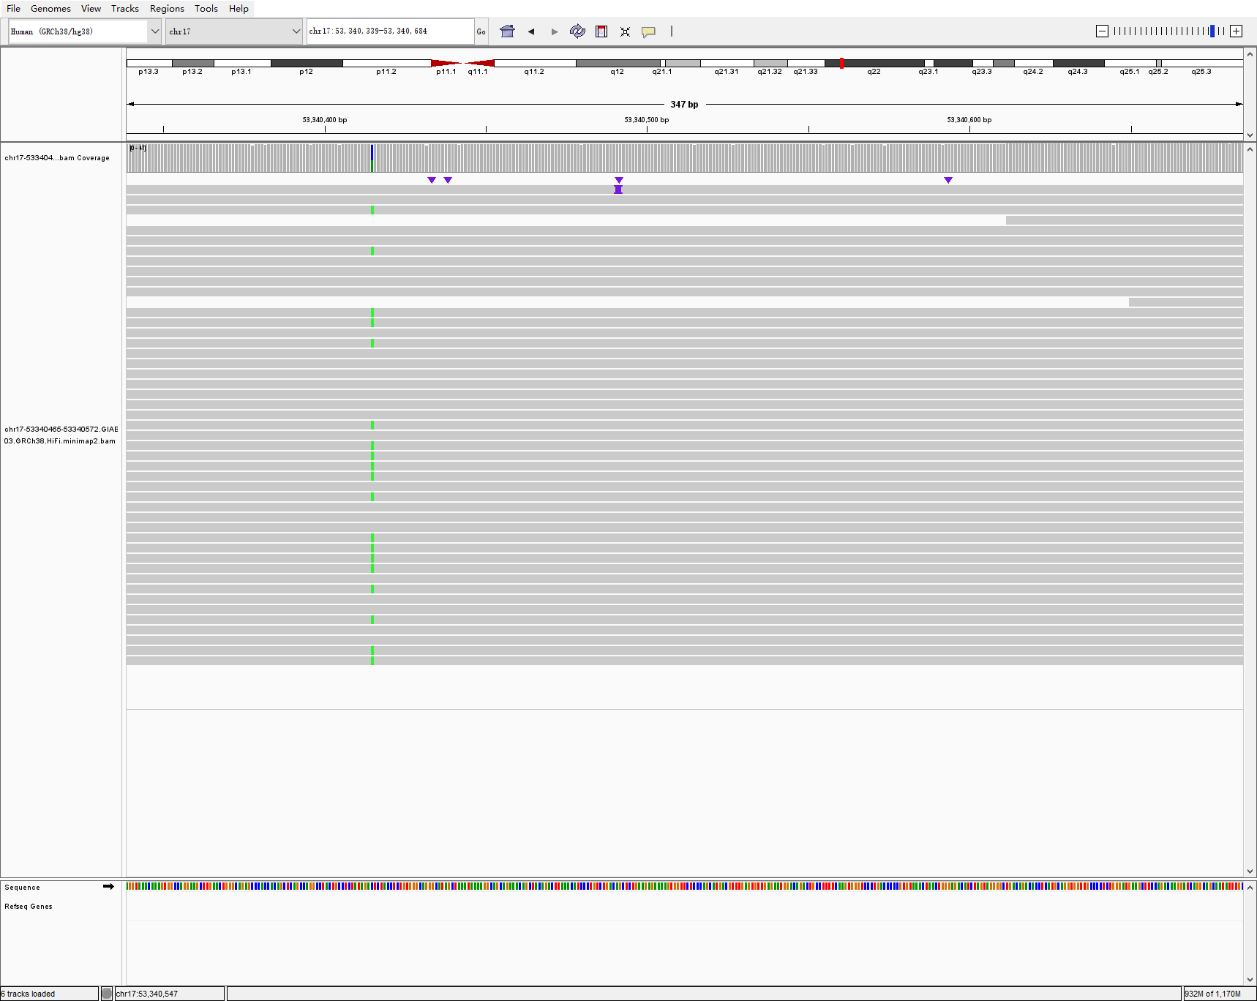
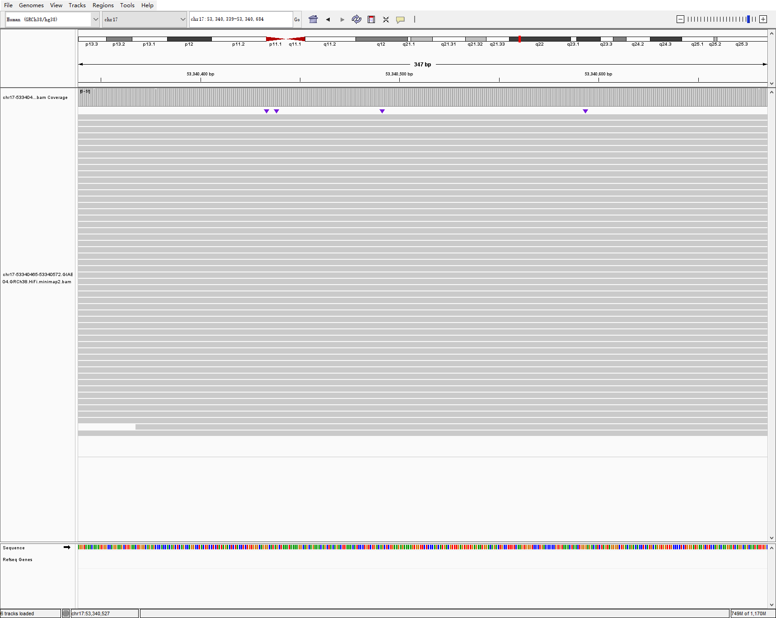
chr17 53340465 53340572 107 DEL hg002-3-4 svision_pro
HG002
HG003
HG004

Slide 8
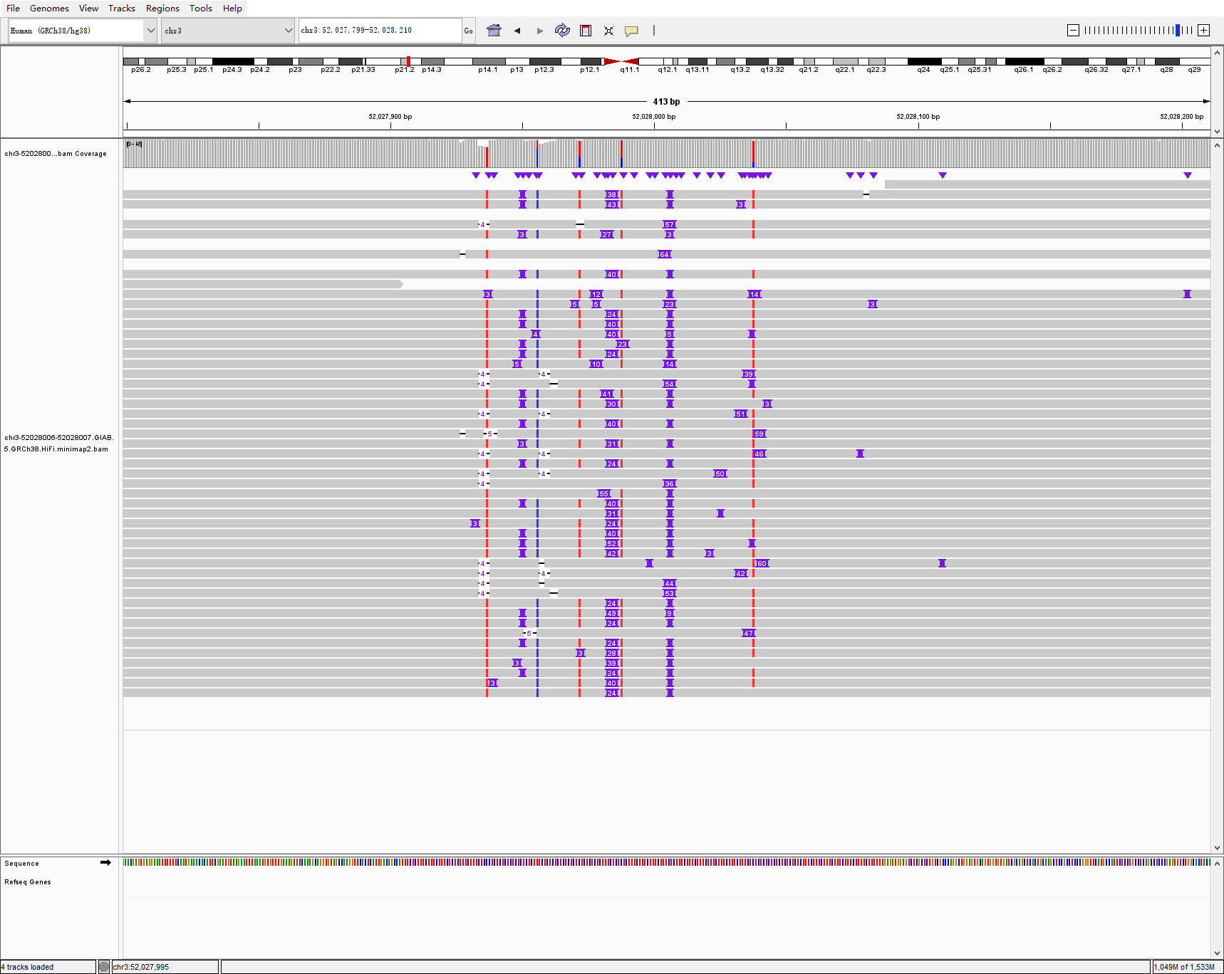
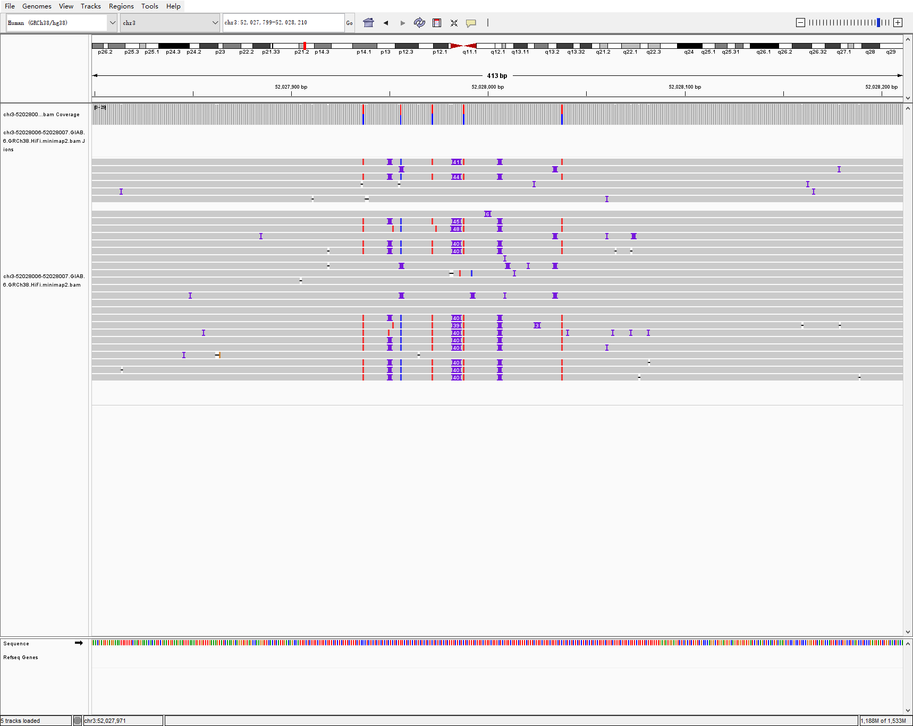
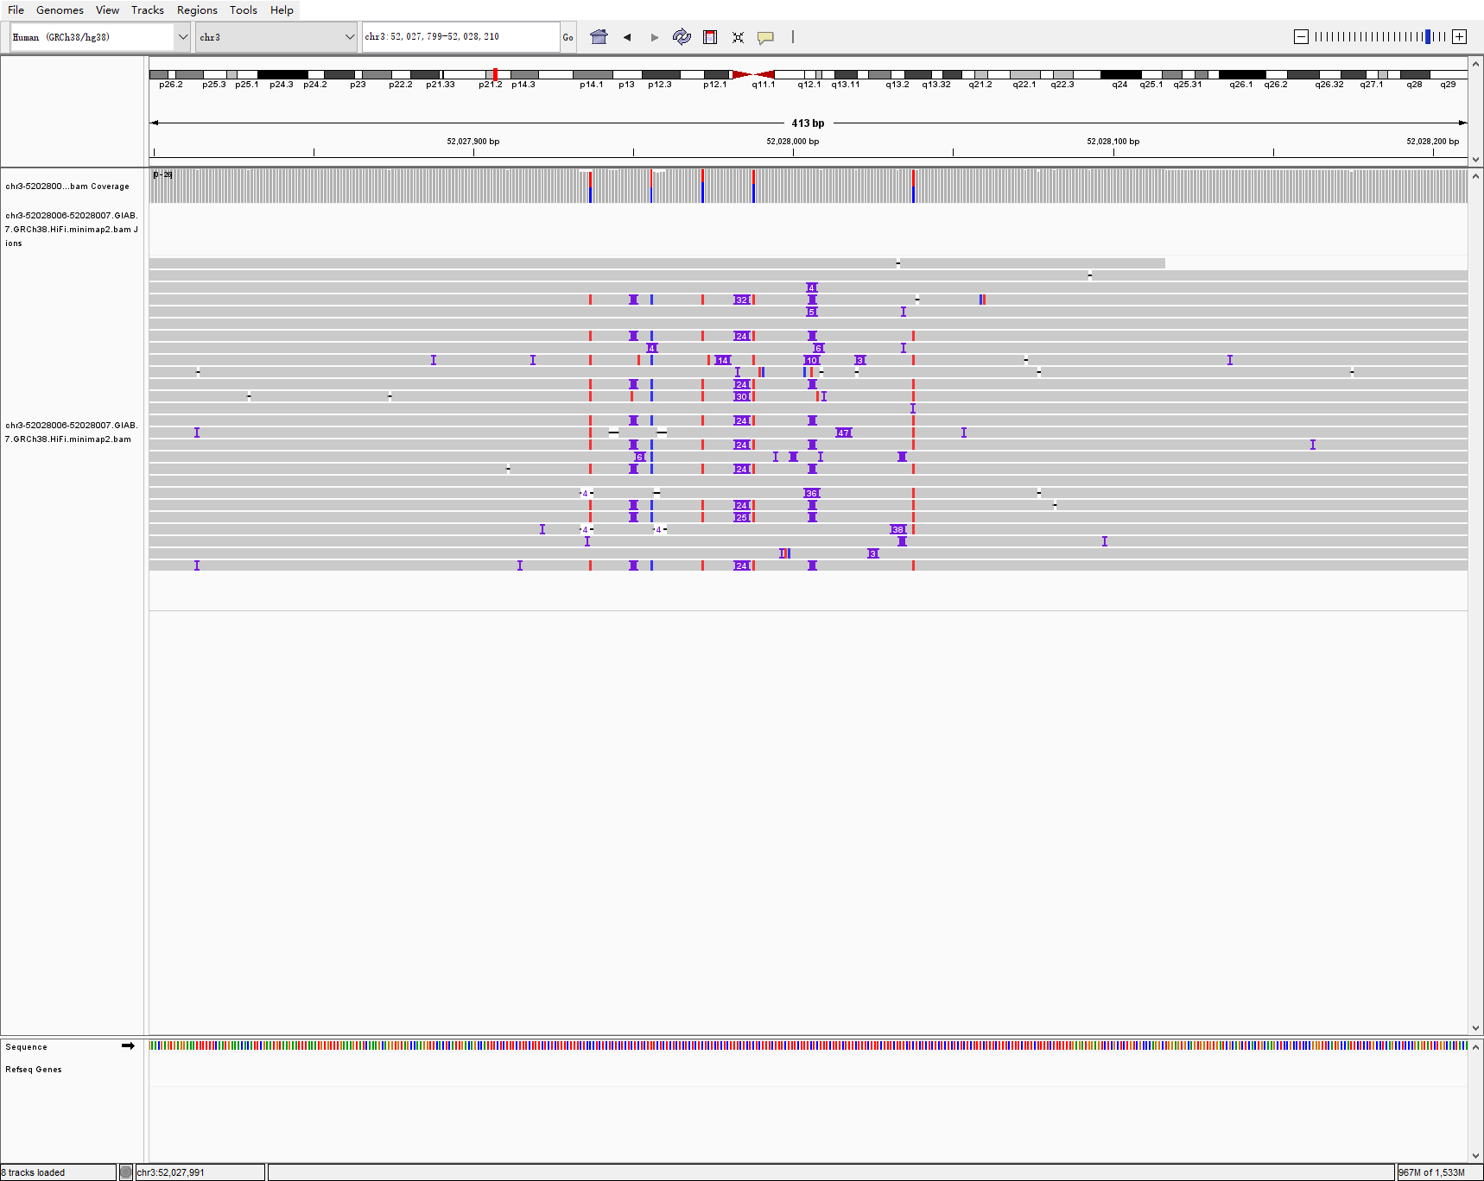
chr3 52028006 52028007 55 INS hg005-6-7 svision_pro
HG002
HG003
HG004

Slide 9
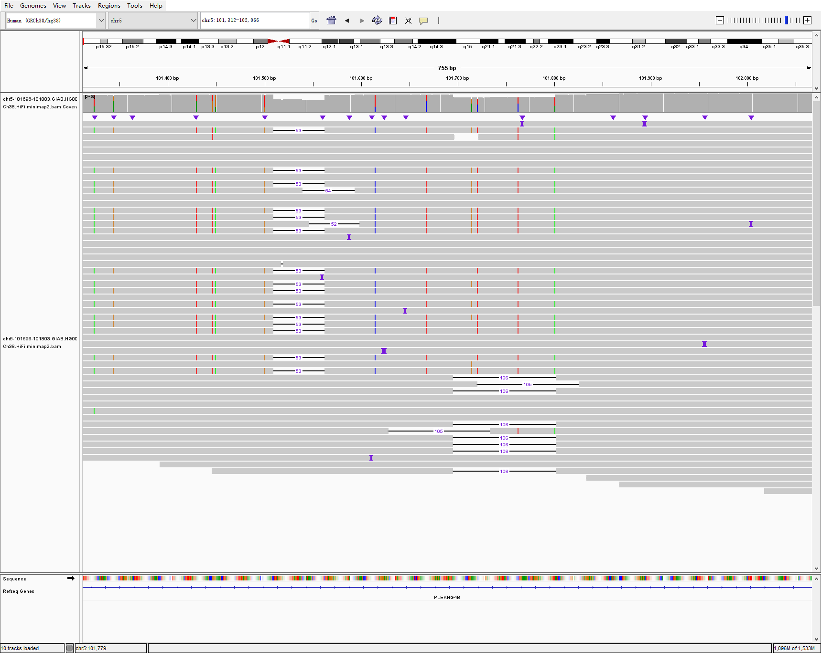
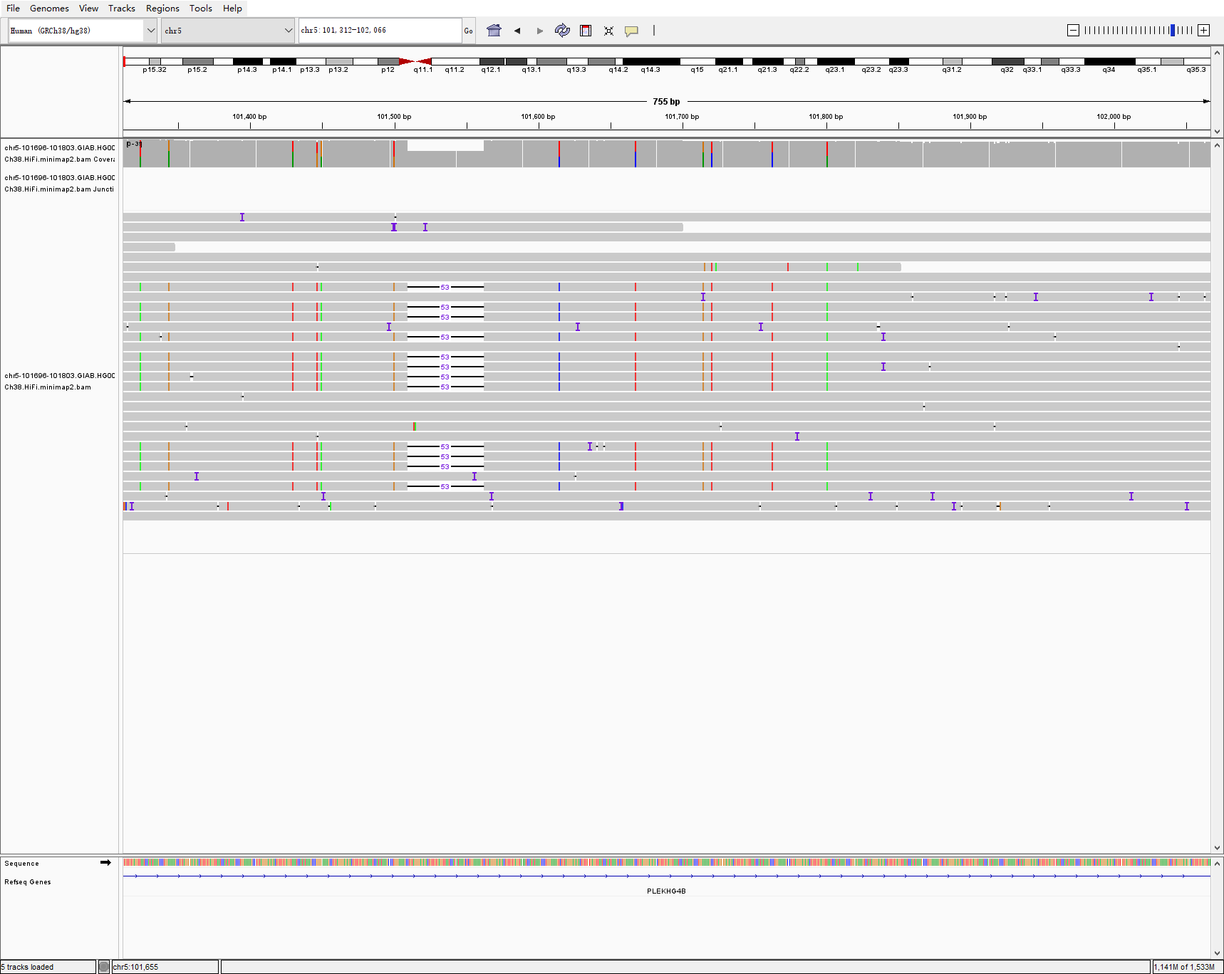
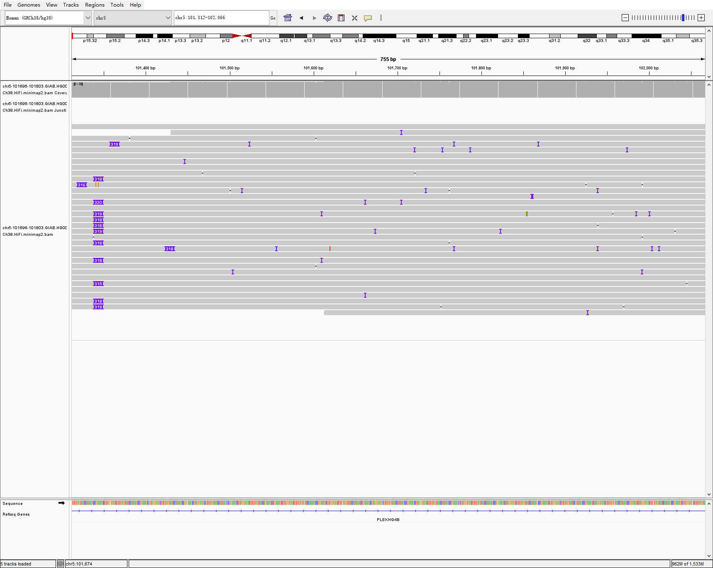
chr5 101696 101803 106 DEL hg005-6-7 svision_pro
HG002
HG003
PAV call：
NA
HG004
PAV call：
NA

Slide 10
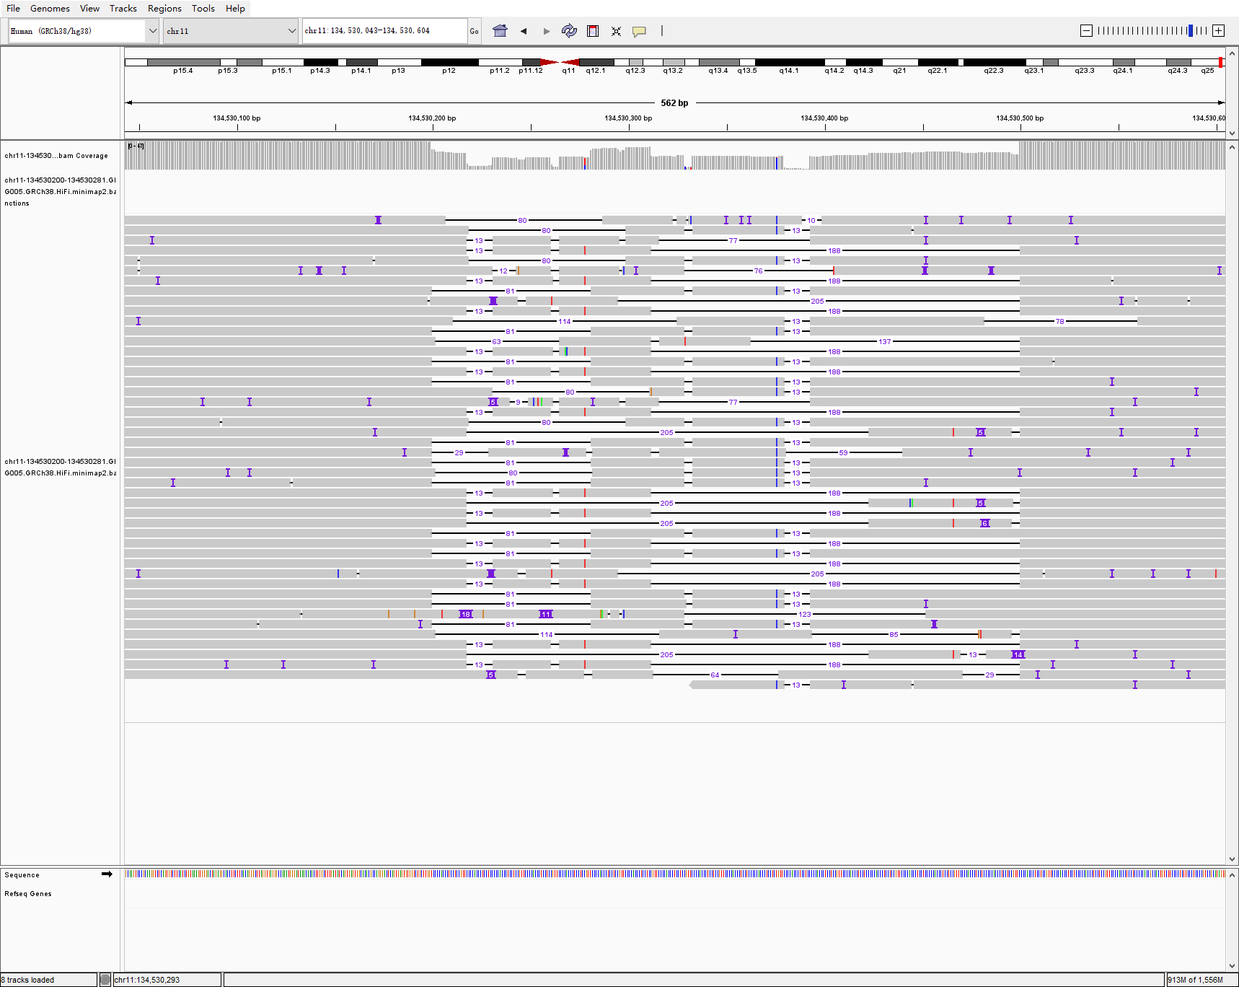
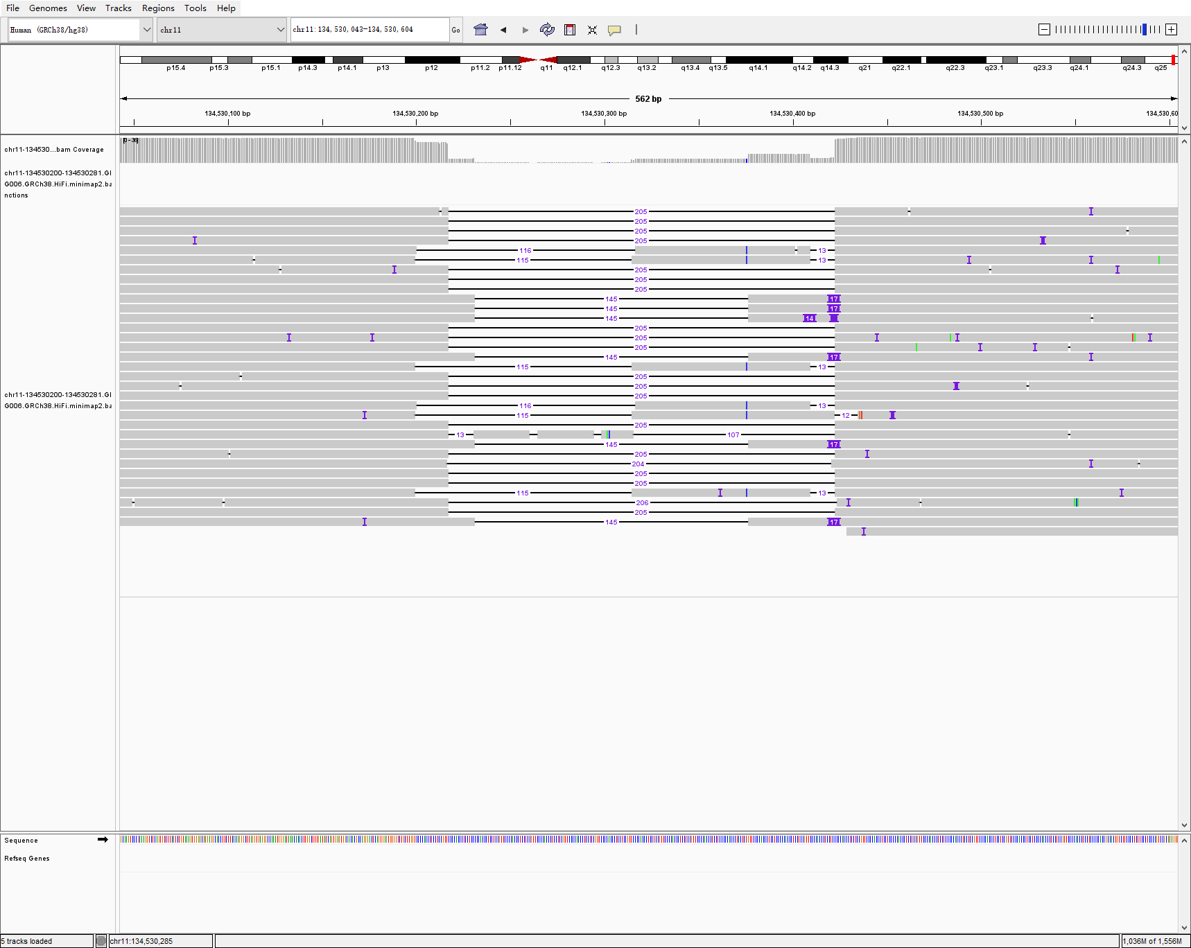
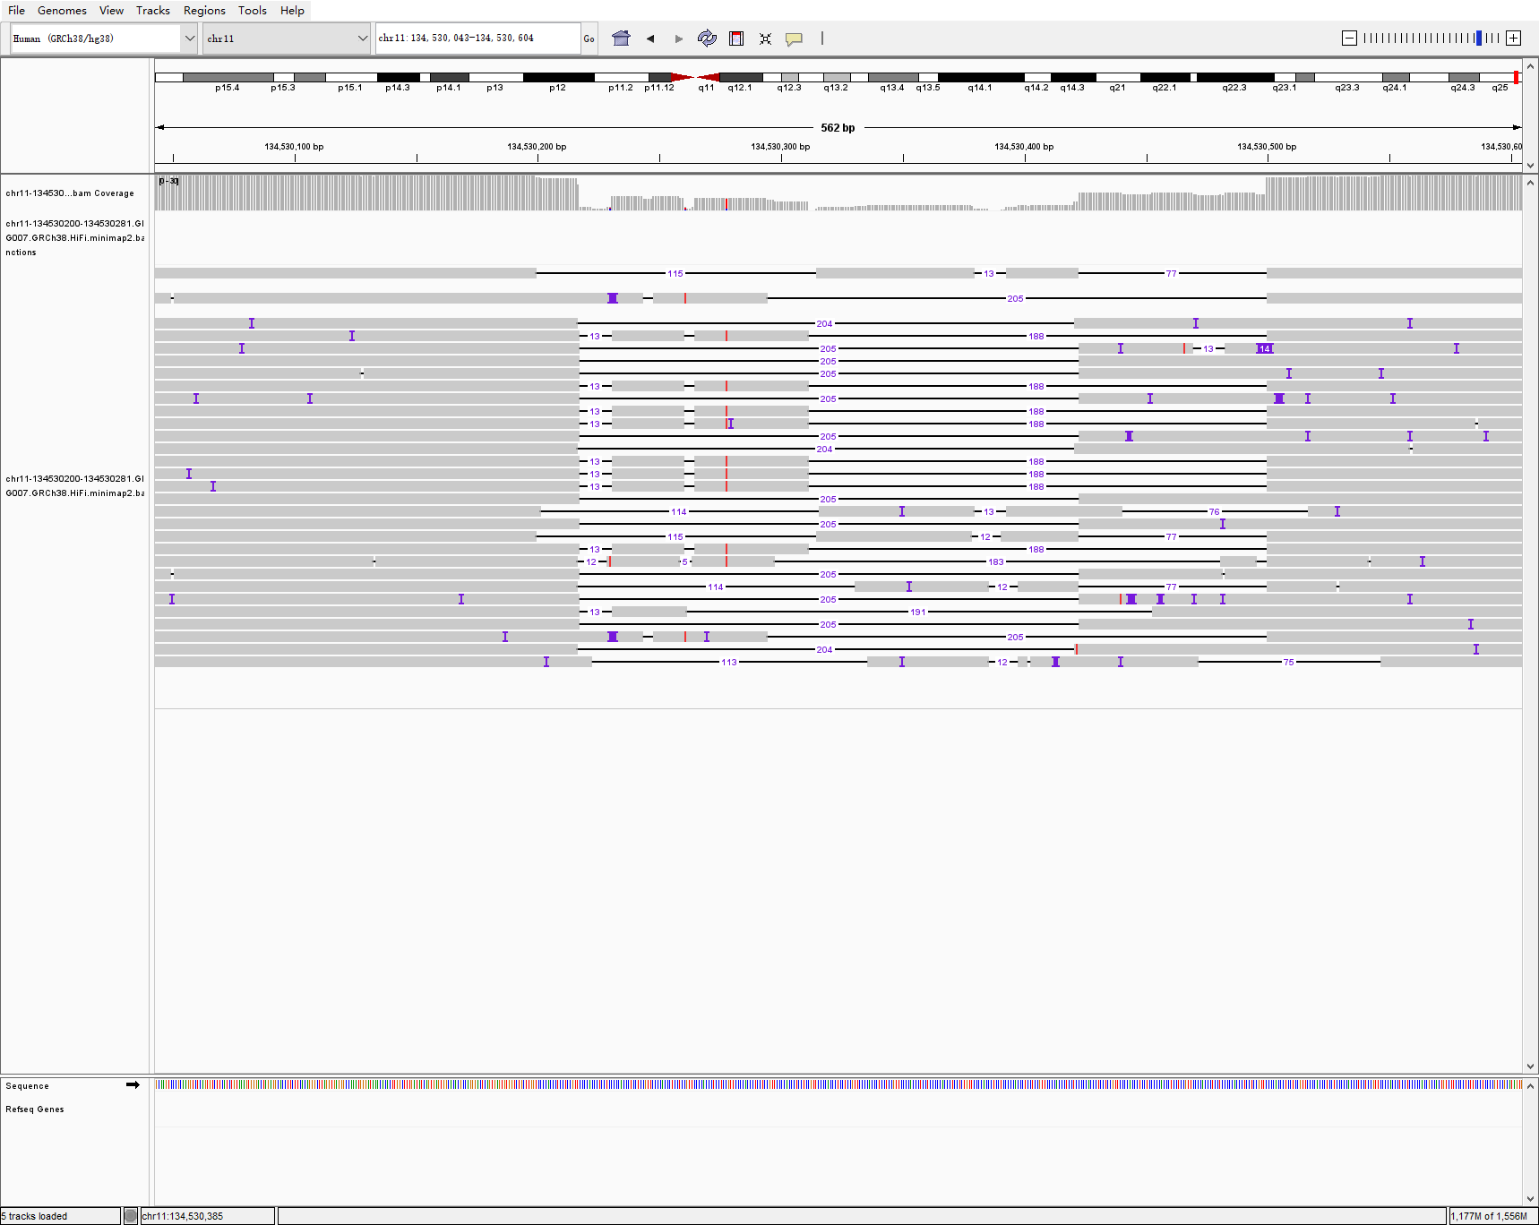
chr11 134530200 134530281 81 DEL hg005-6-7 svision_pro
HG005
HG006
HG007

Slide 11
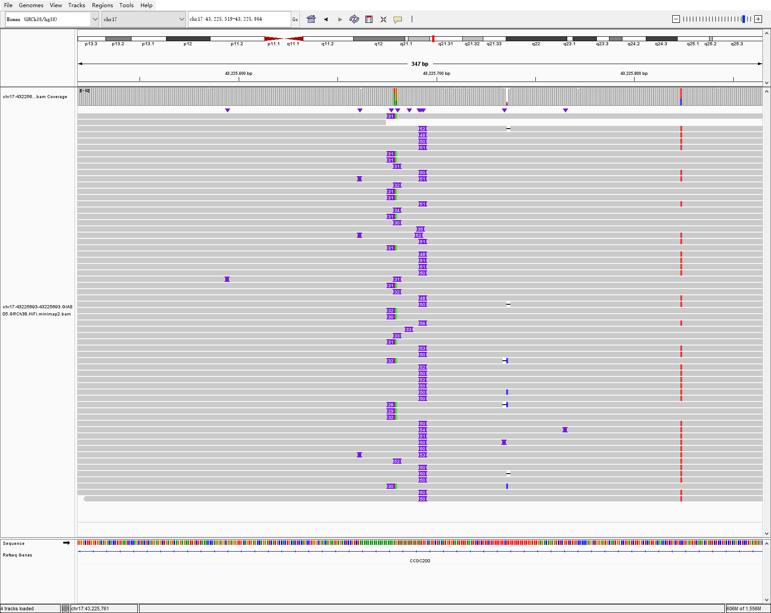
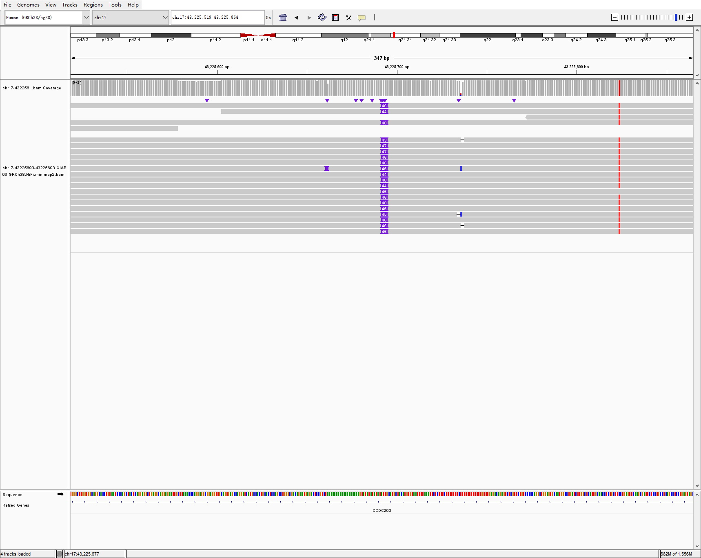
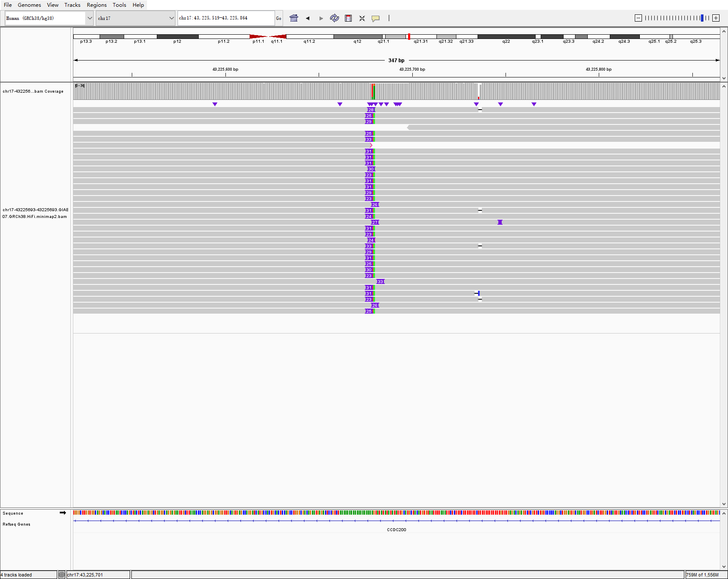
chr17 43225693 43225693 50 INS hg005-6-7 svision_pro
HG005
HG006
HG007

Slide 12
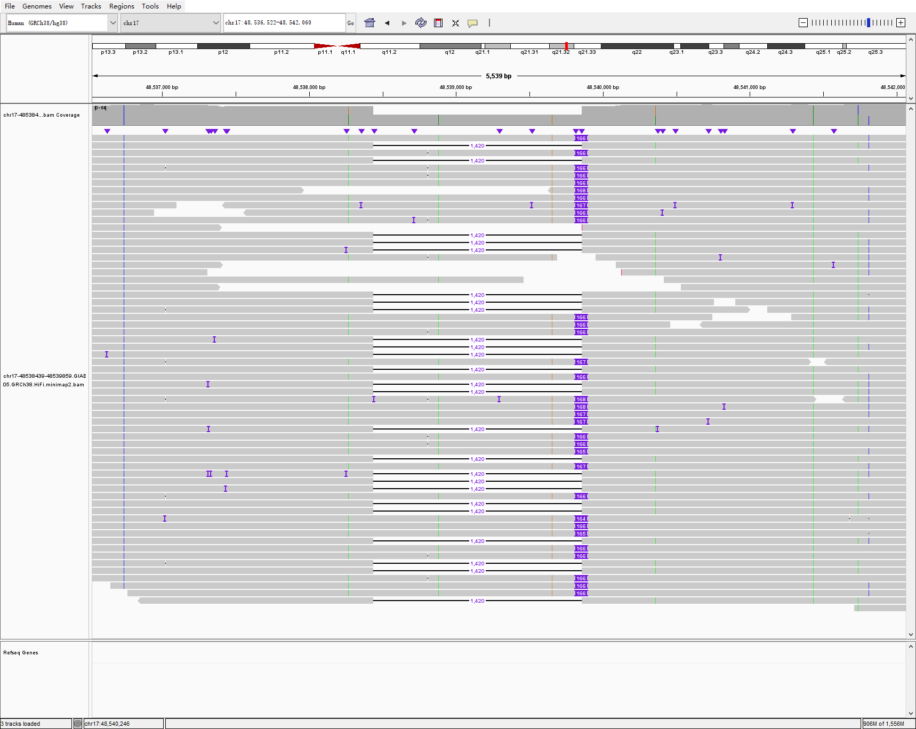
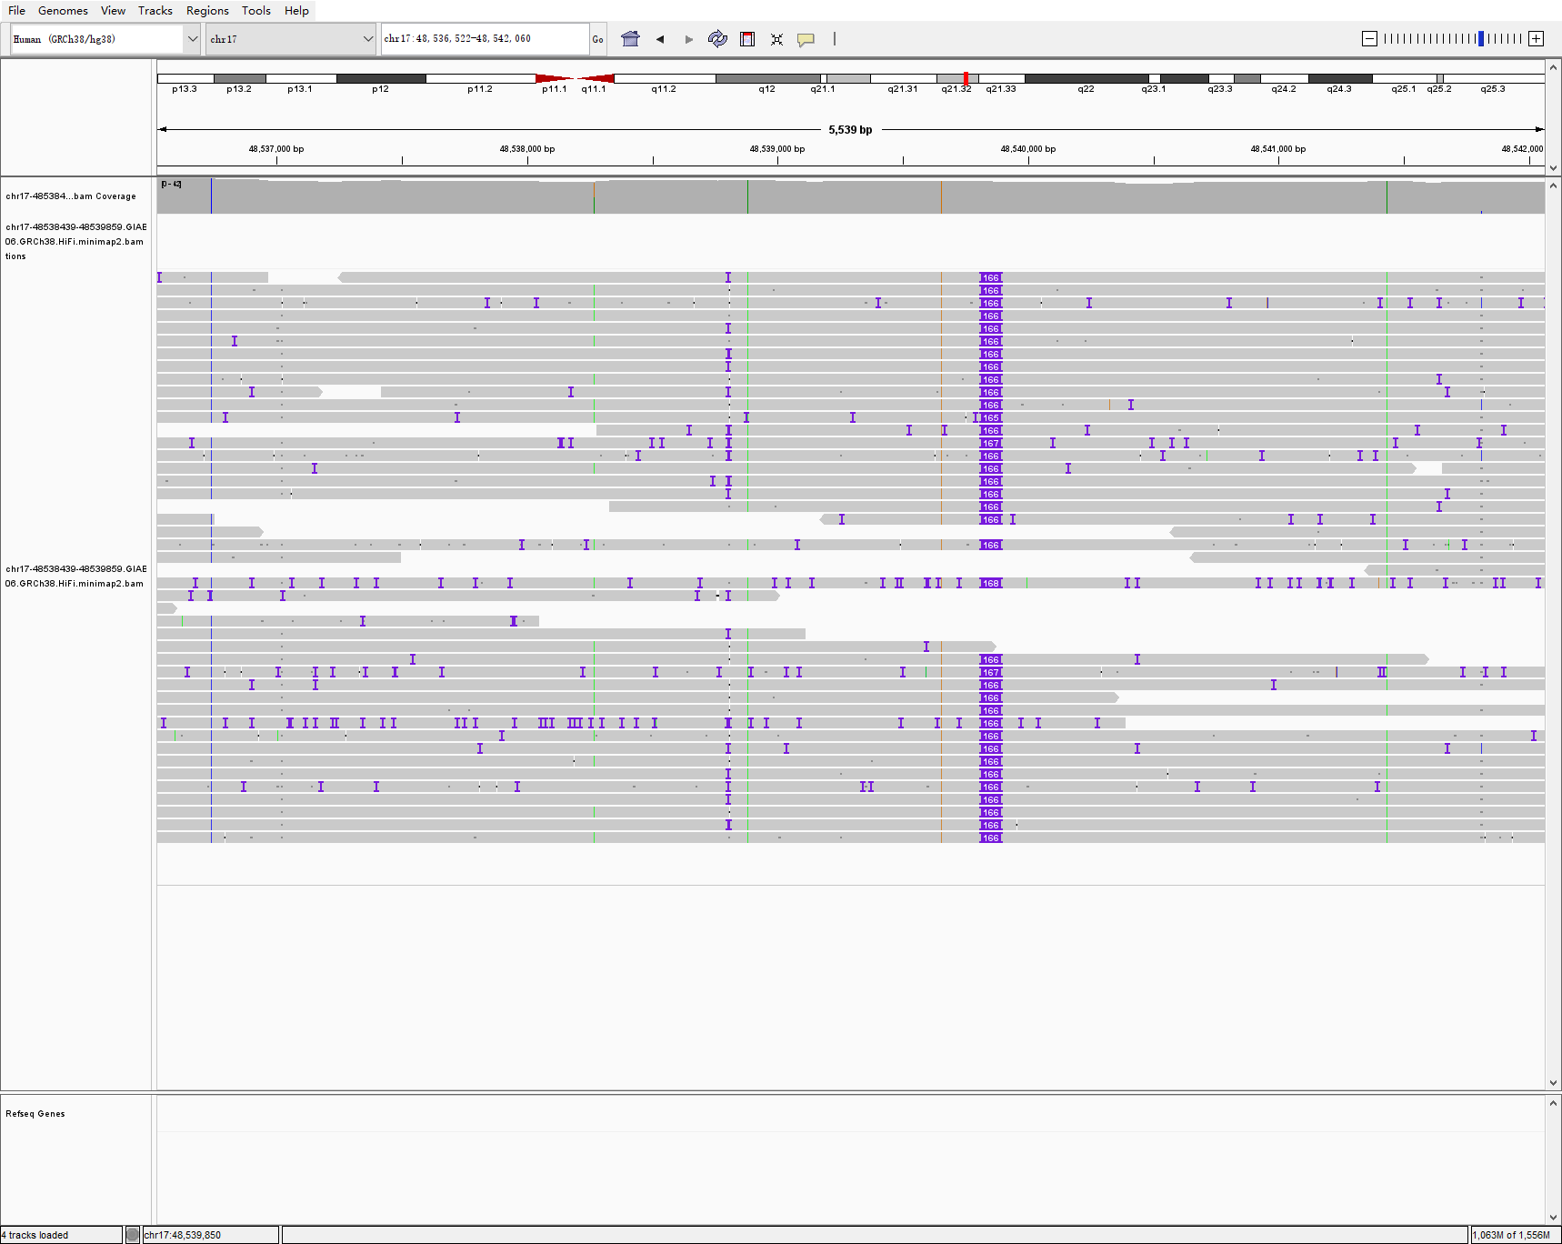
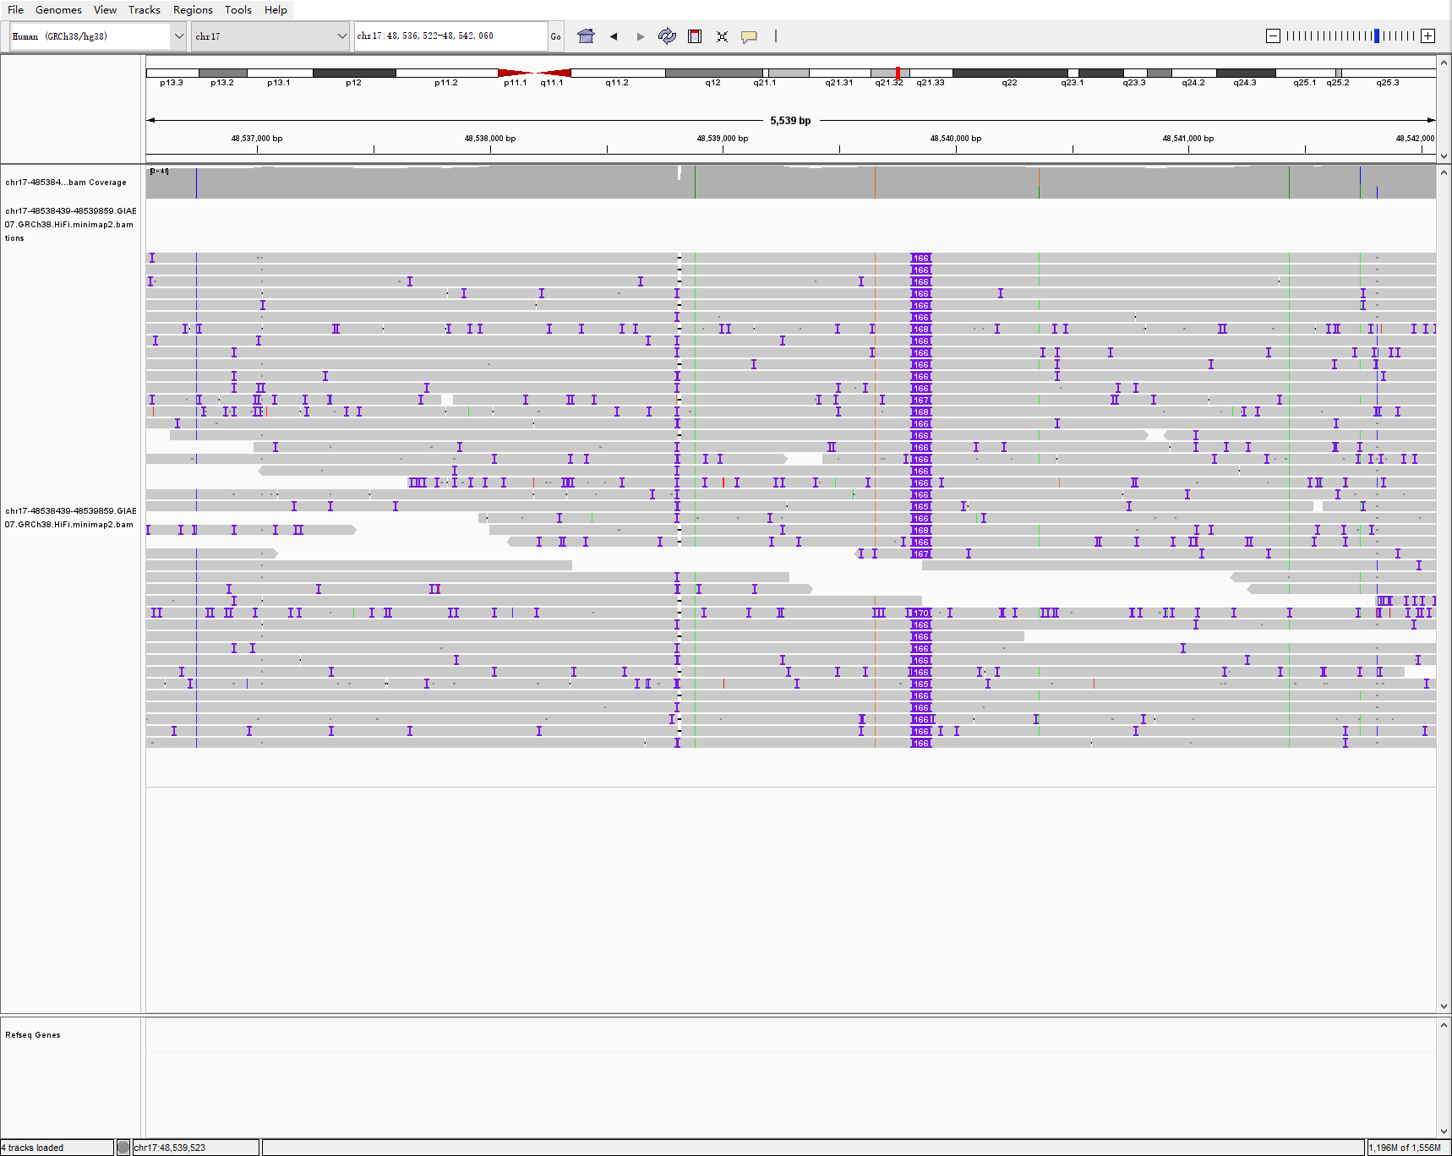
chr17 48538439 48539859 1420 DEL hg005-6-7 svision_pro
HG005
HG006
HG007

Slide 13
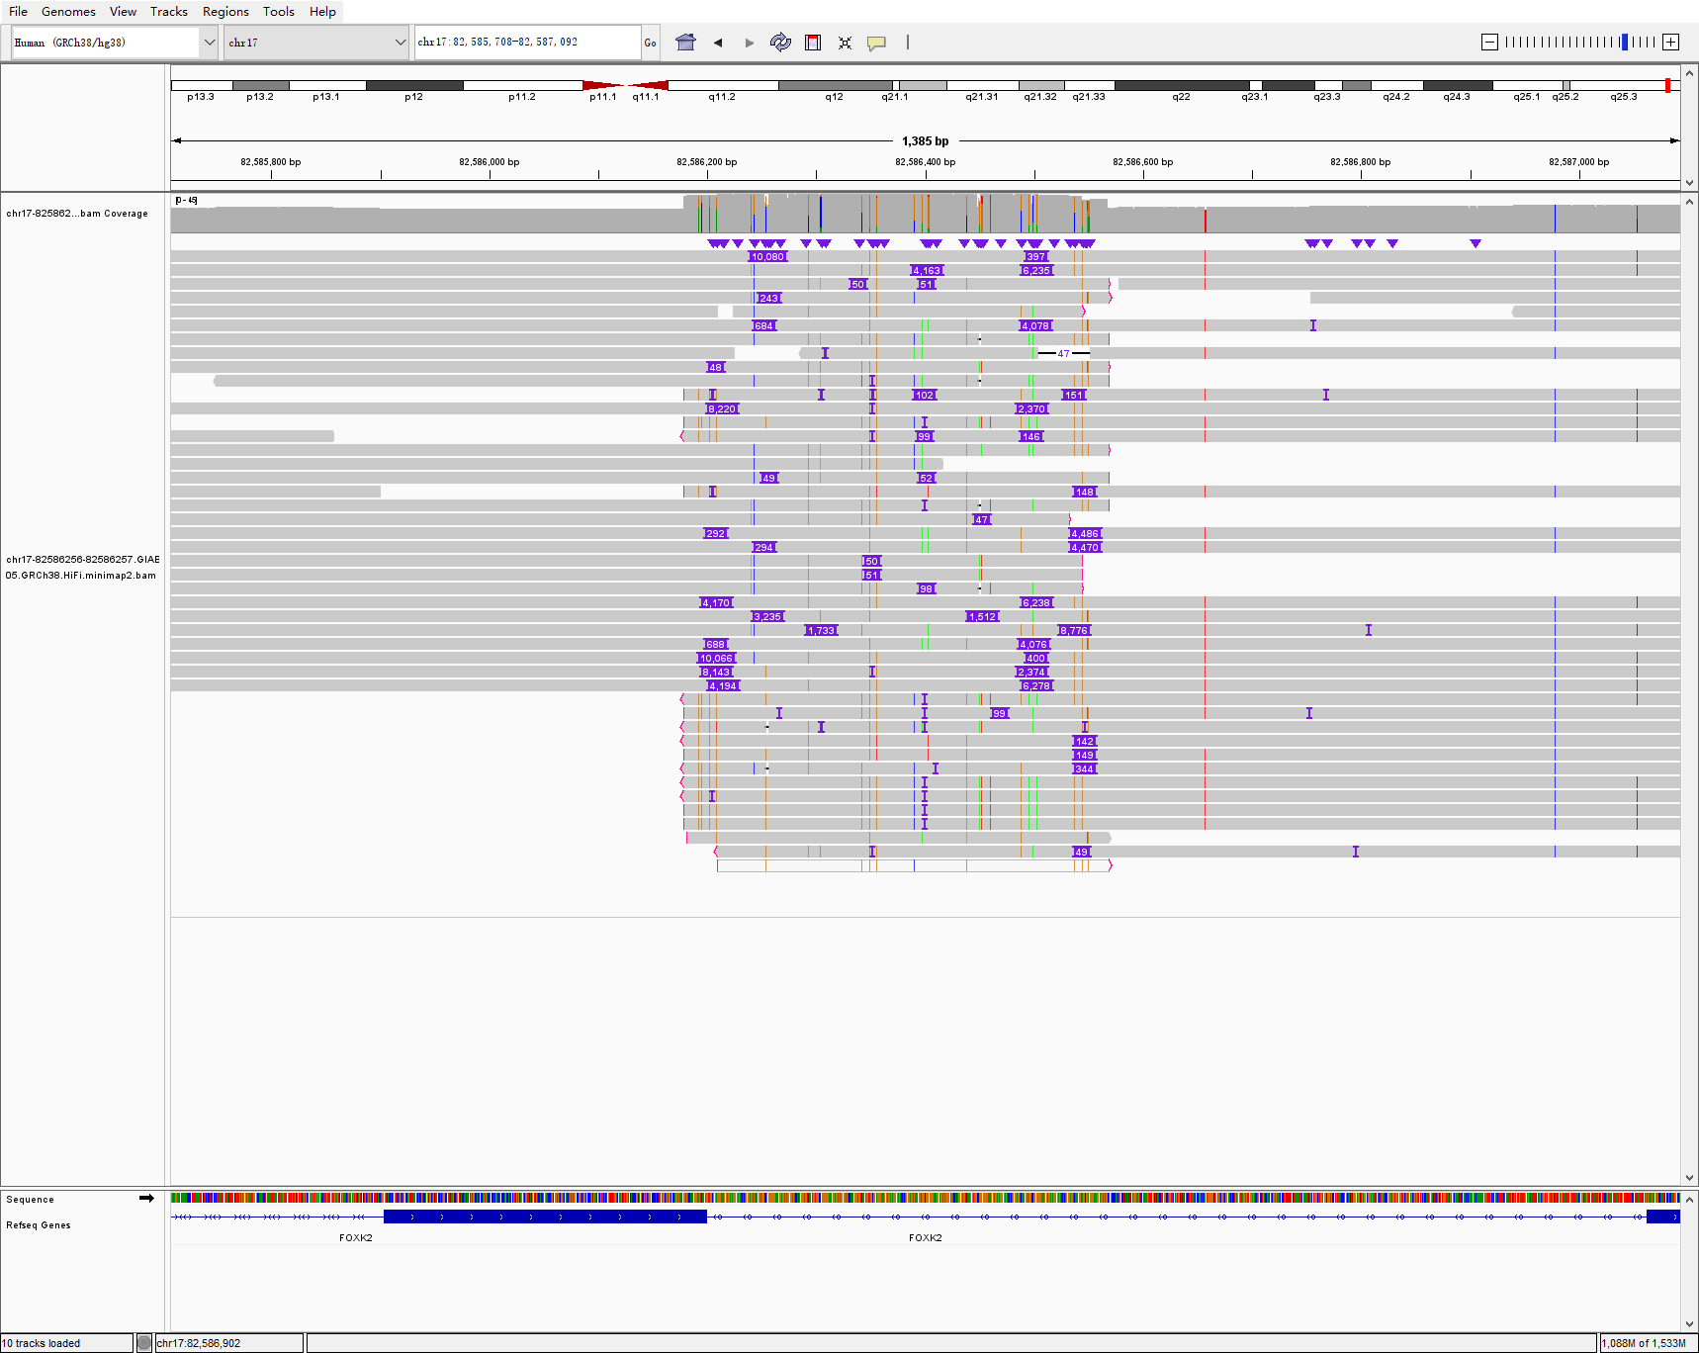
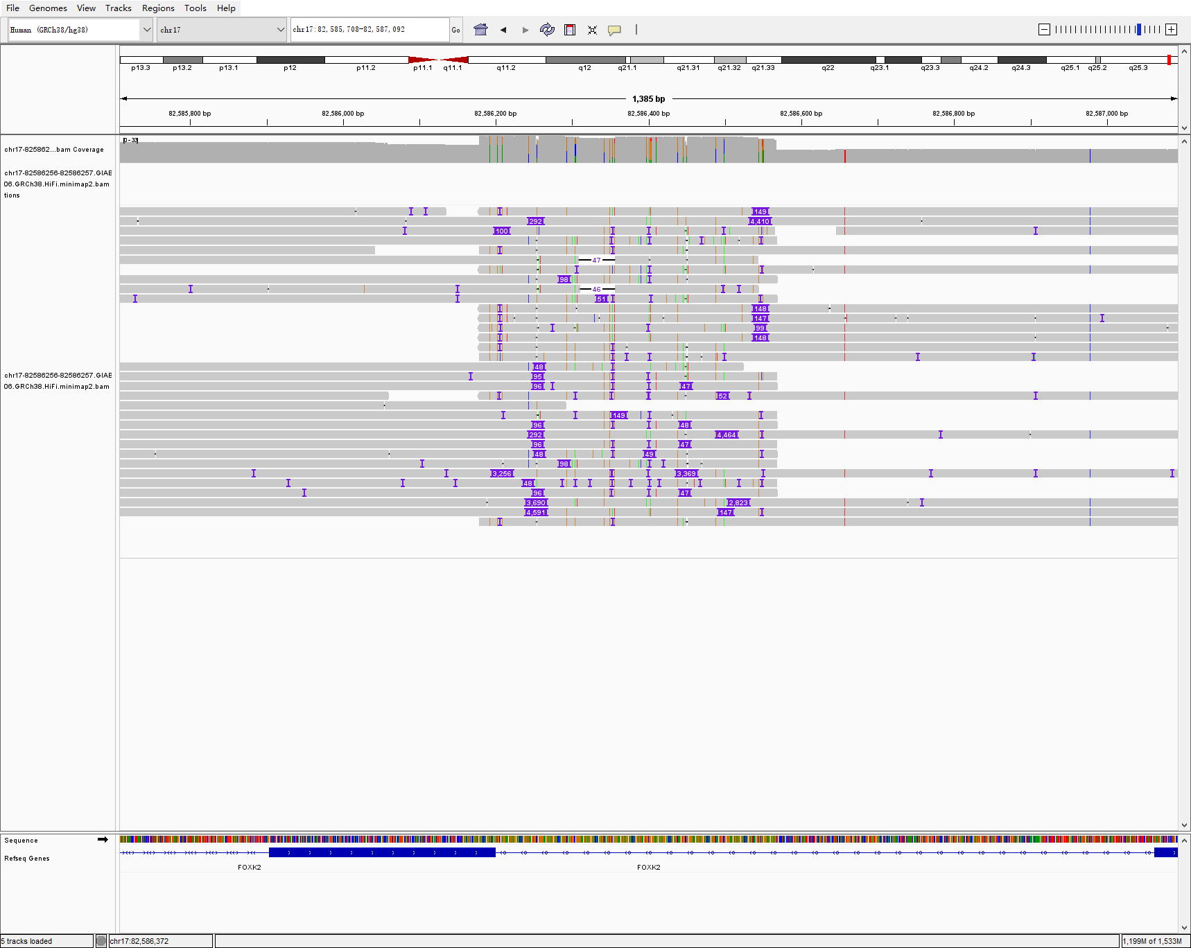
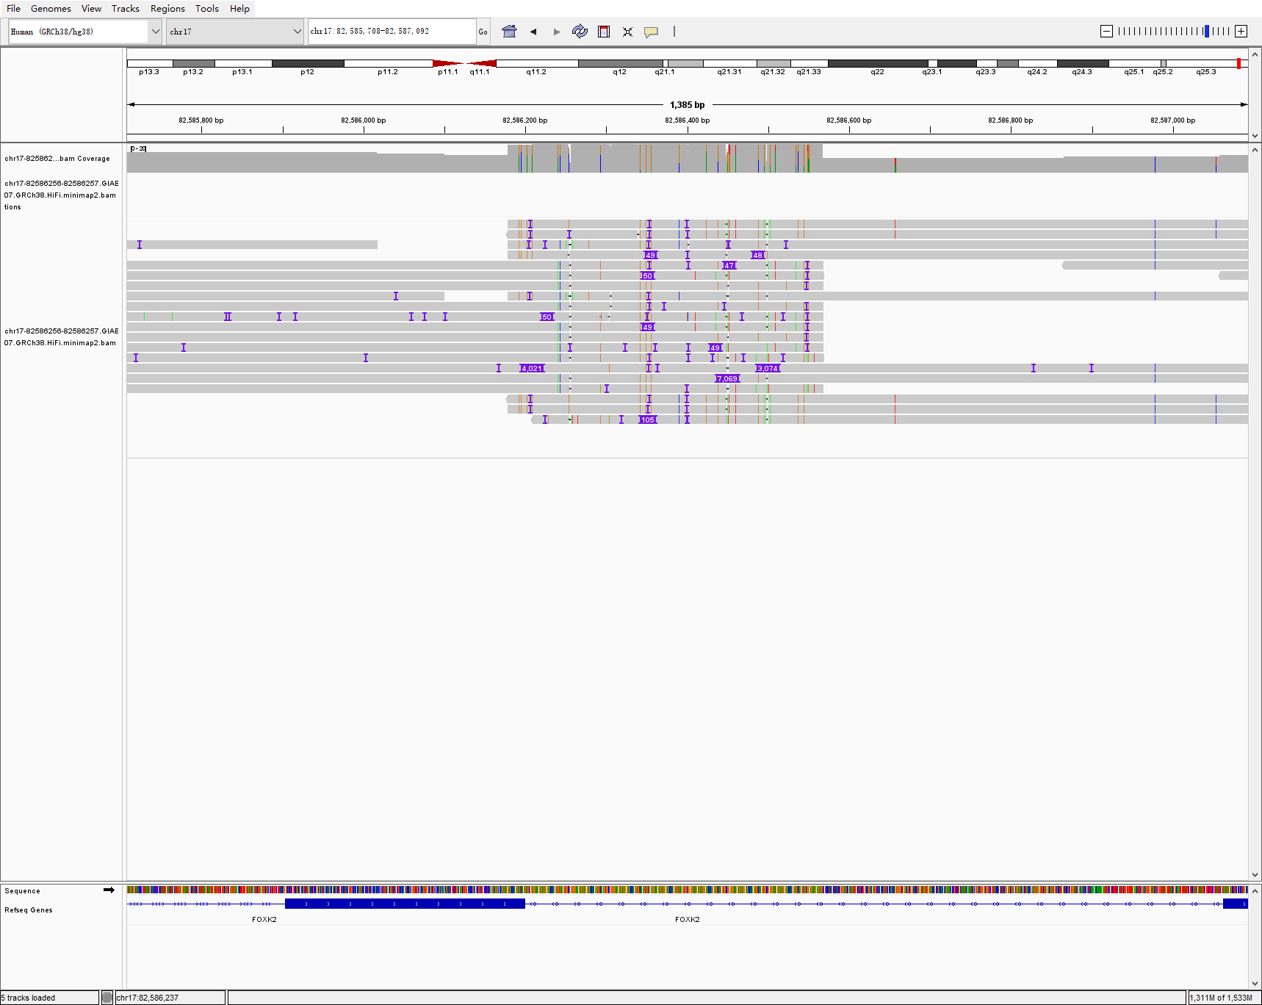
chr17 82586256 82586257 10472 INS hg005-6-7
HG005
HG006
HG007

Slide 14
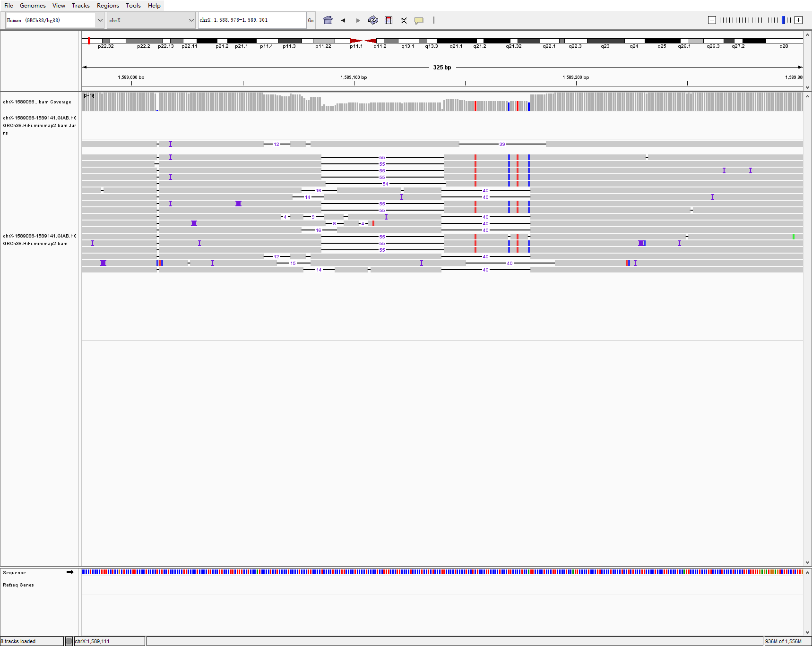
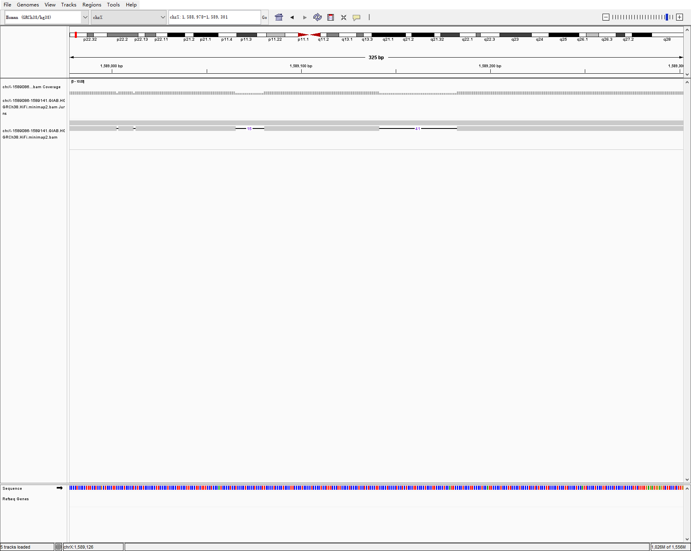
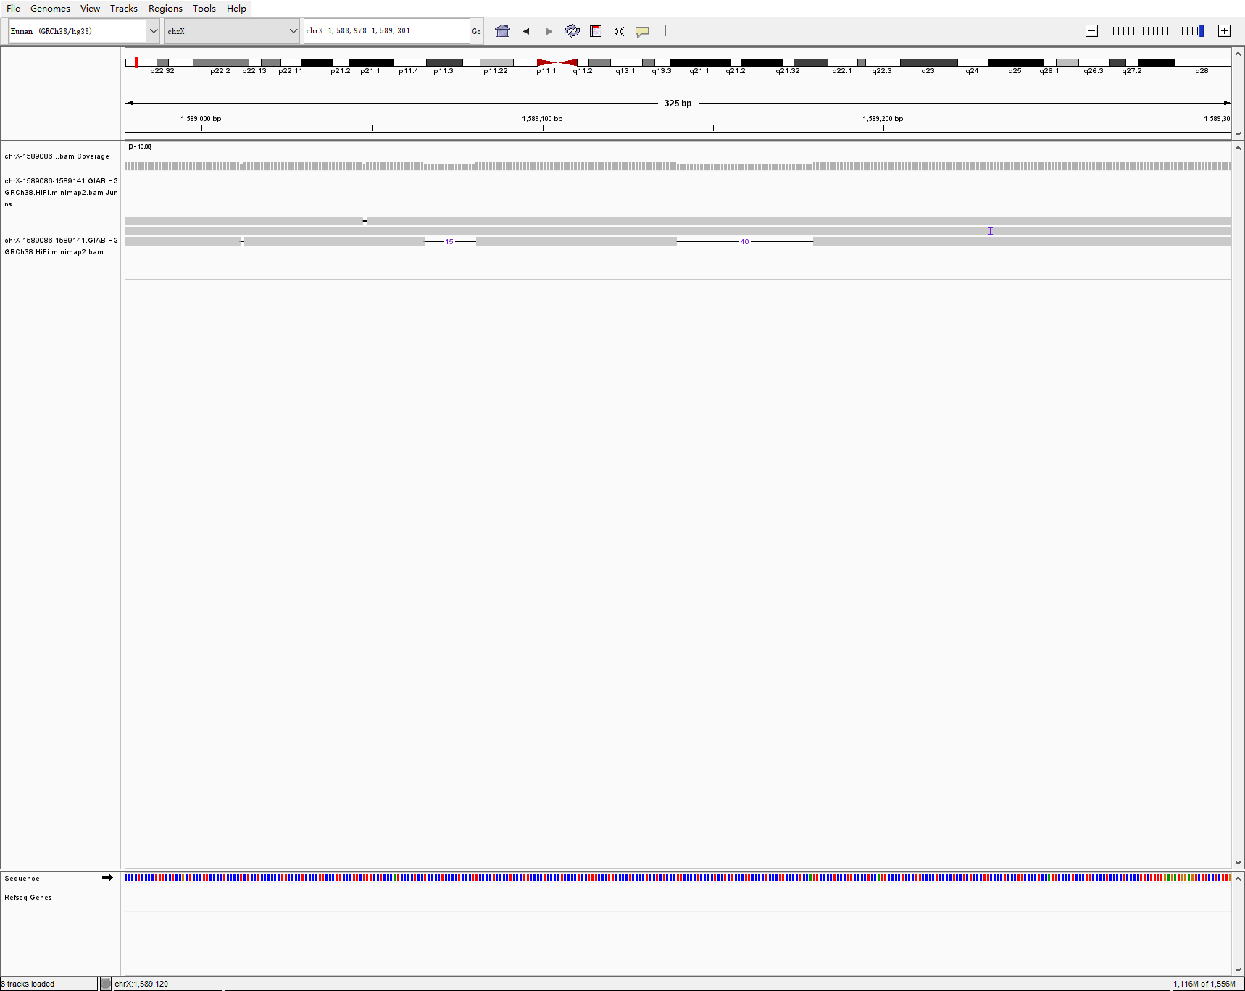
chrX 1589086 1589141 55 DEL hg005-6-7 svision_pro
HG005
HG006
HG007

Slide 15
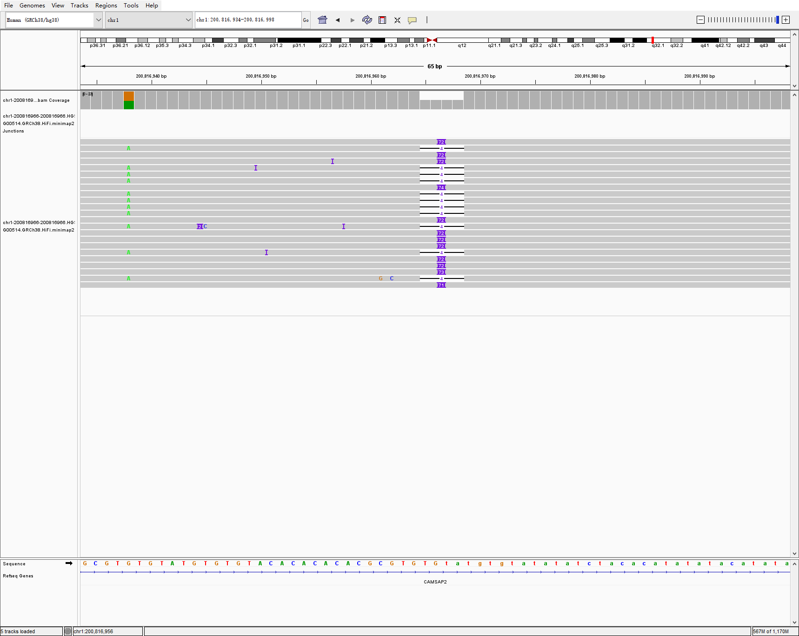
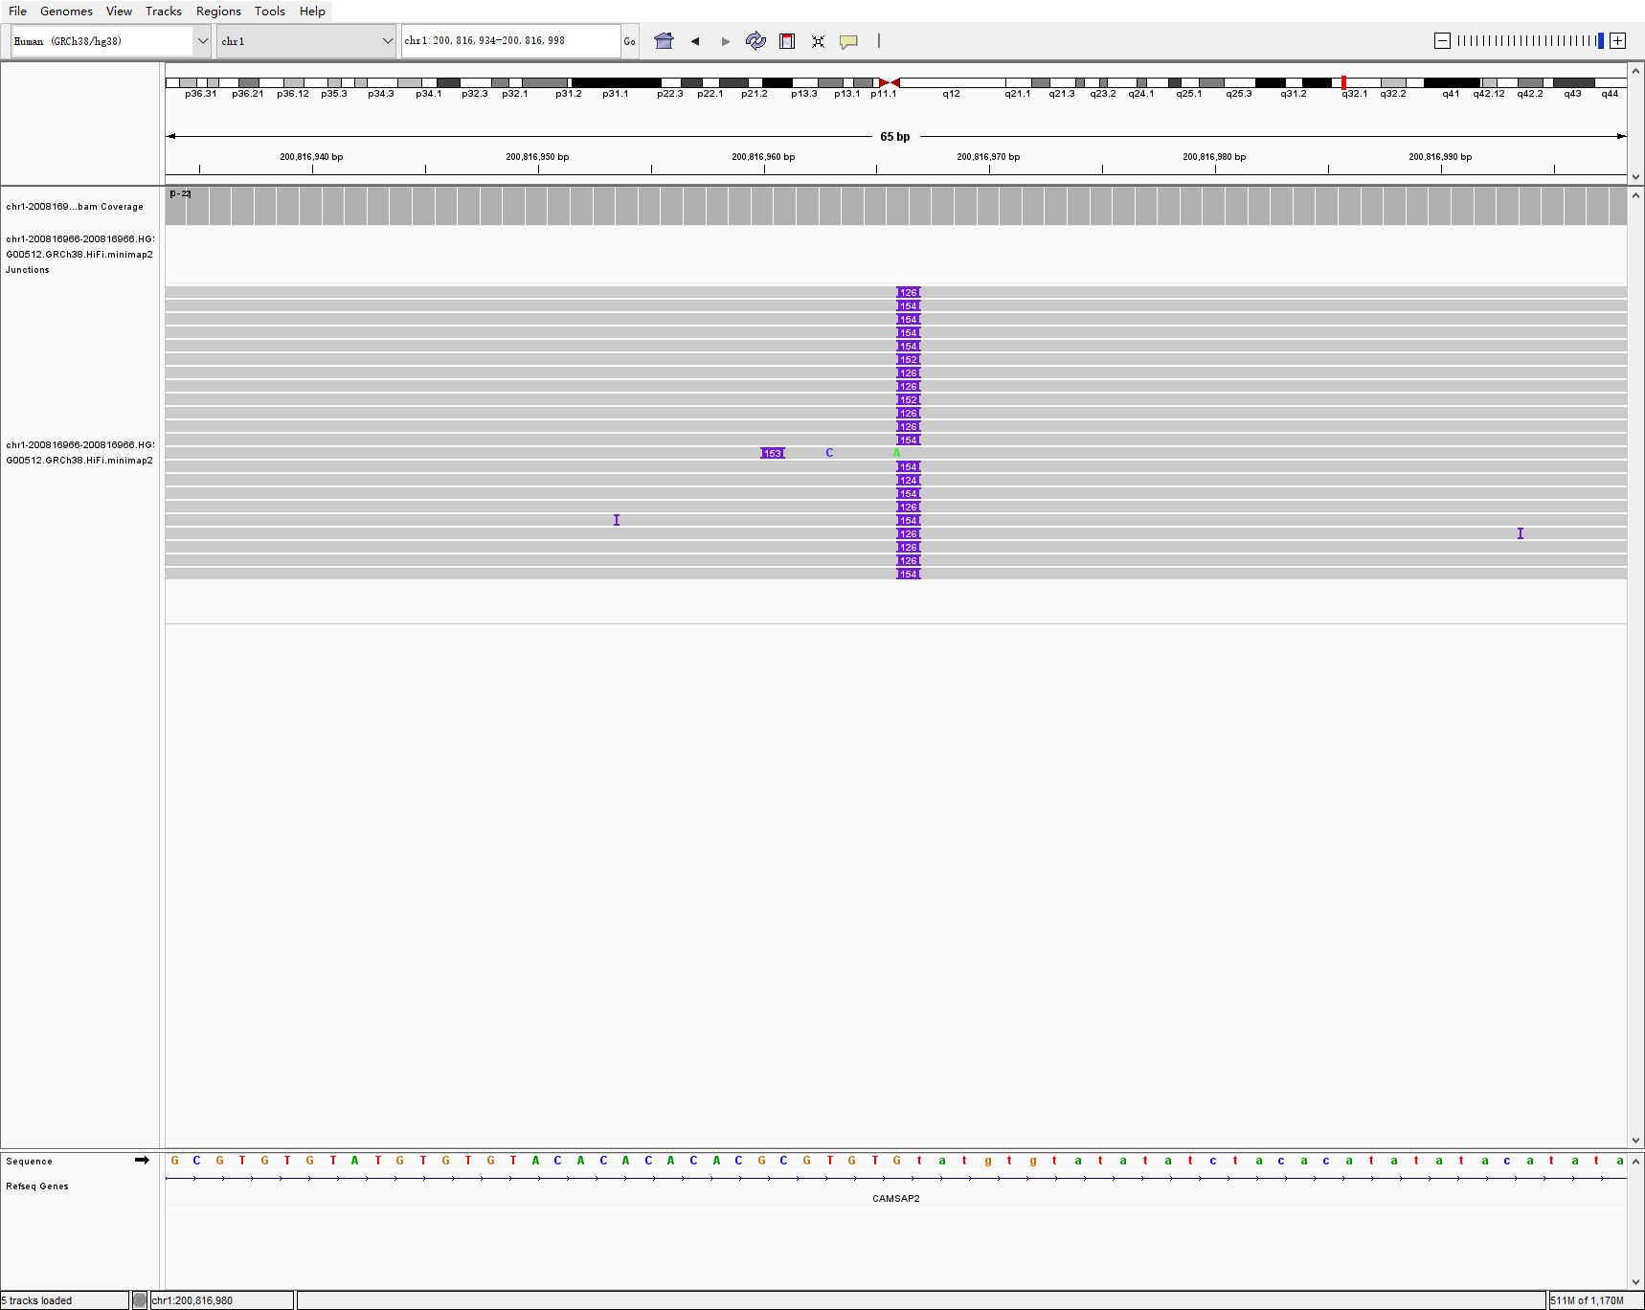
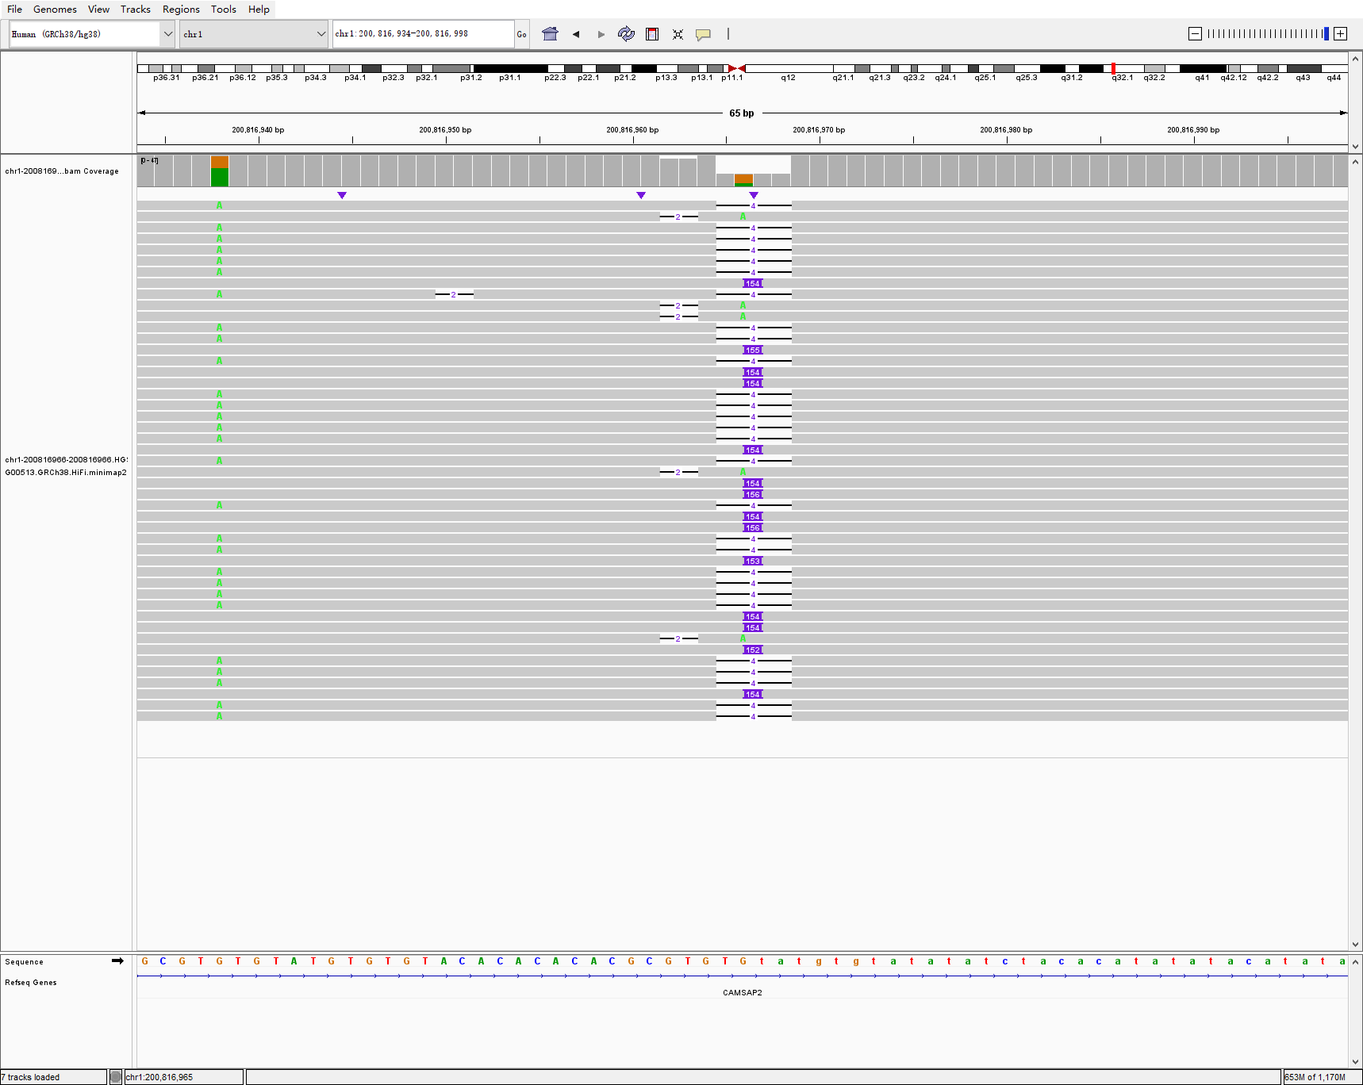
chr1 200816966 200816966 72 INS hg00514-2-3 svision_pro
HG00514
HG00512
HG00513

Slide 16
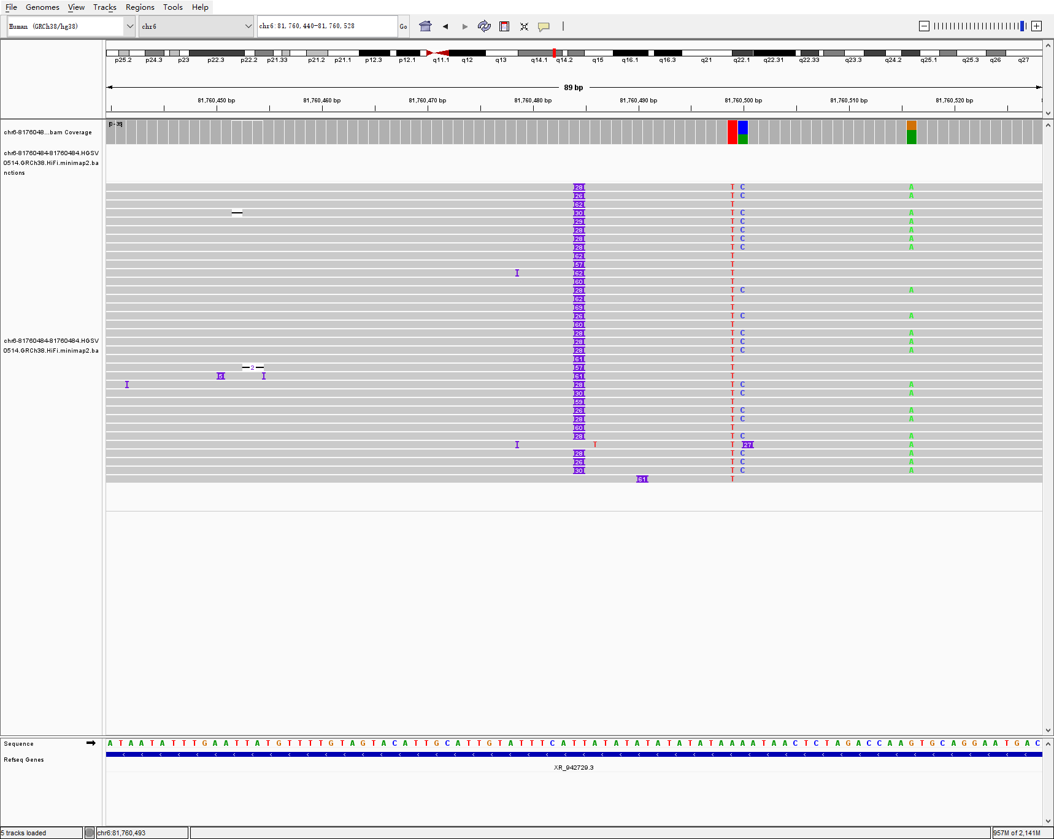
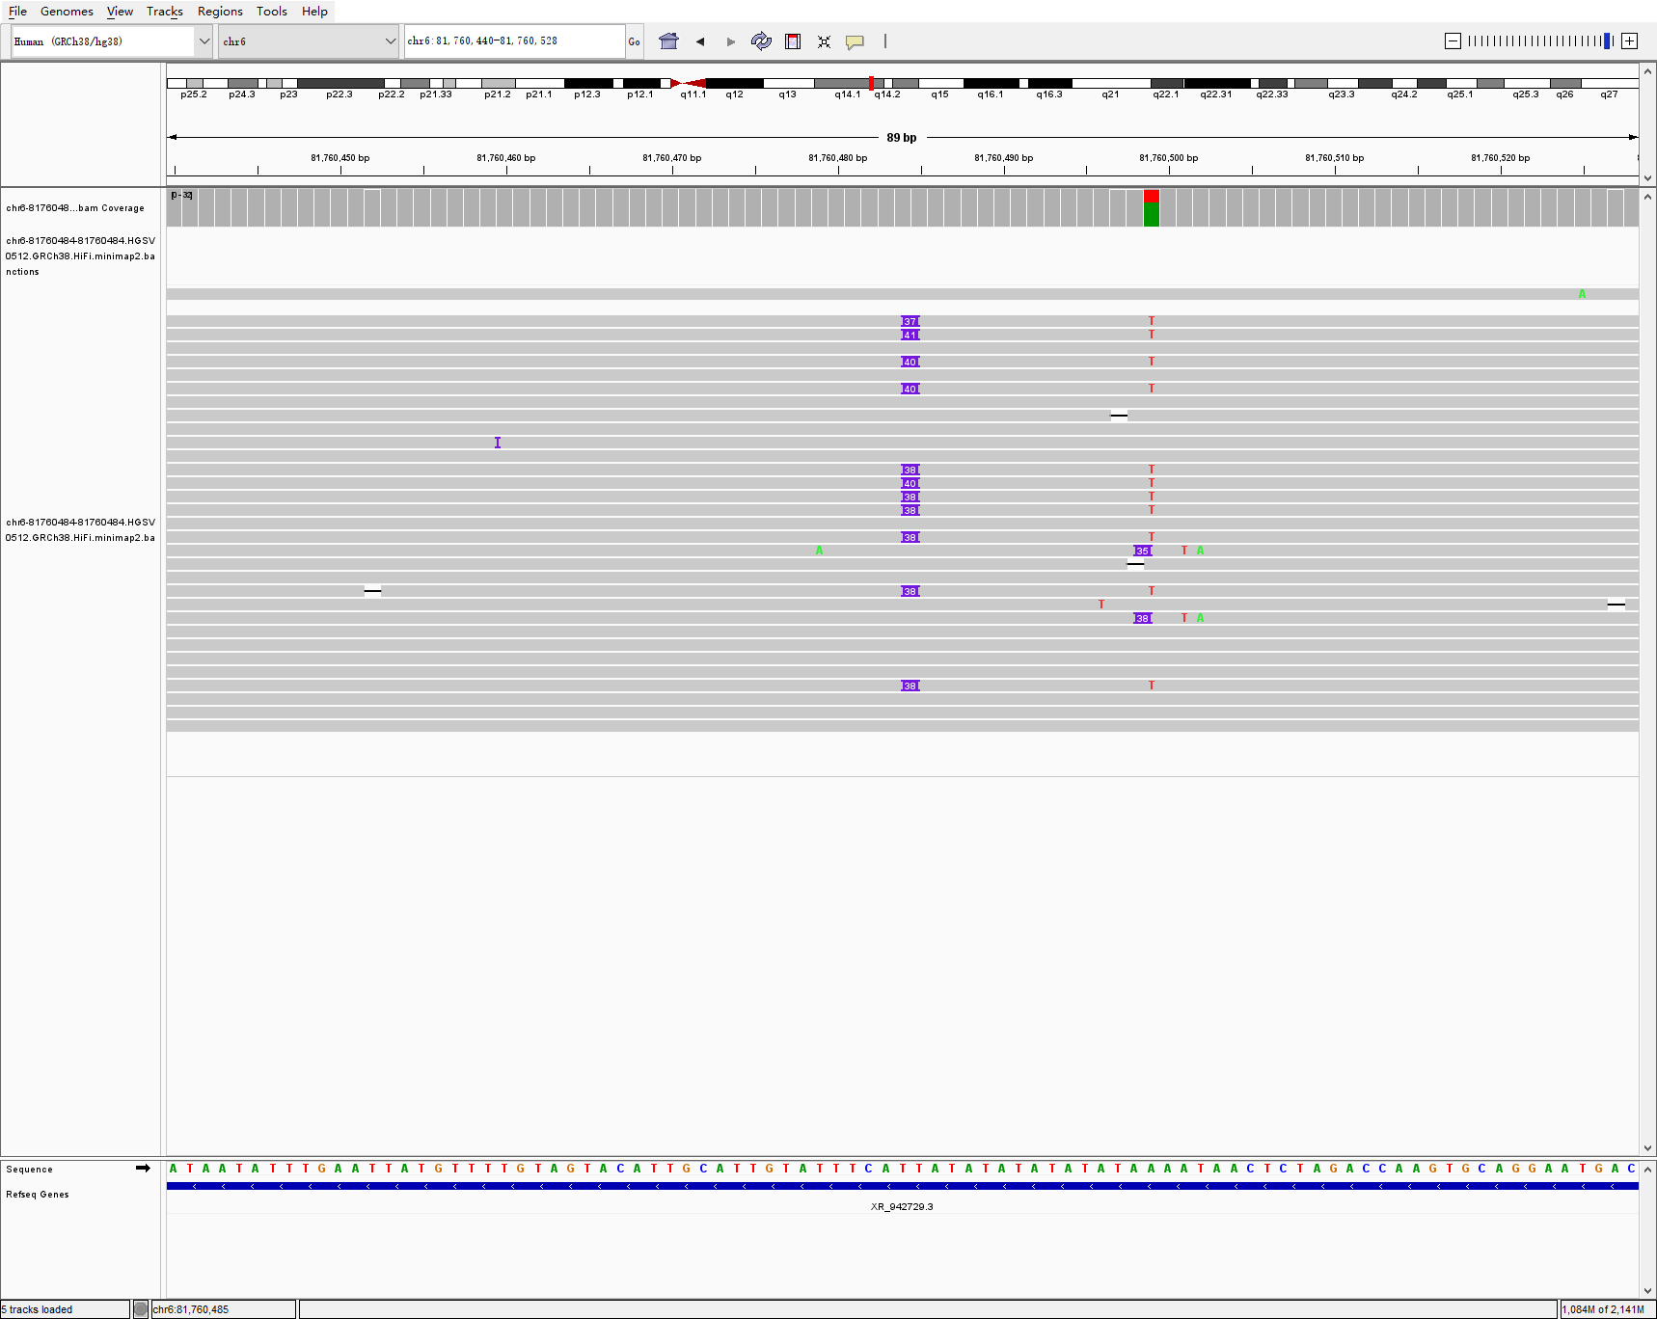
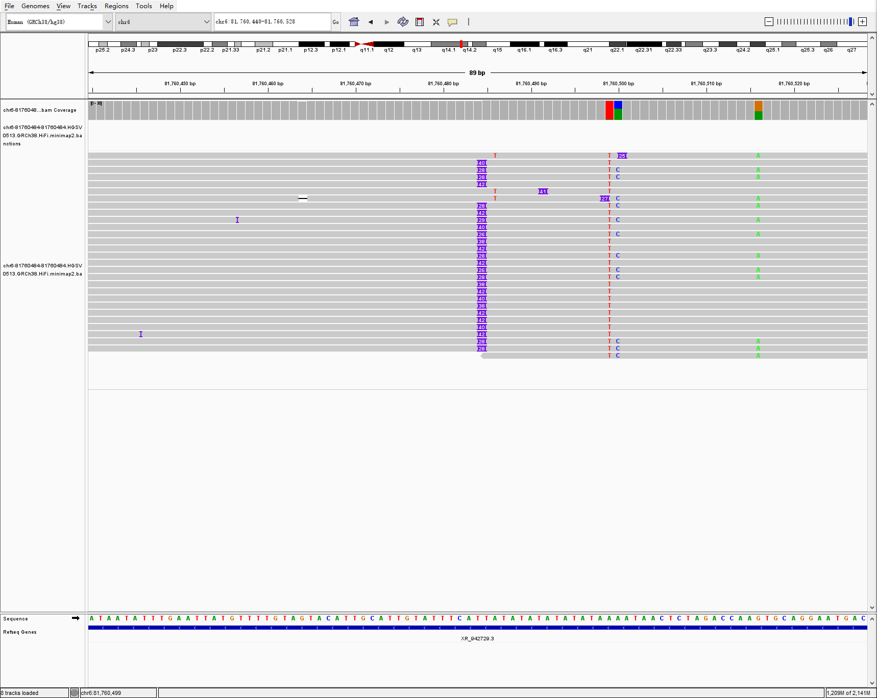
chr6 81760484 81760484 61 INS hg00514-2-3 svision_pro
HG00514
HG00512
HG00513

Slide 17
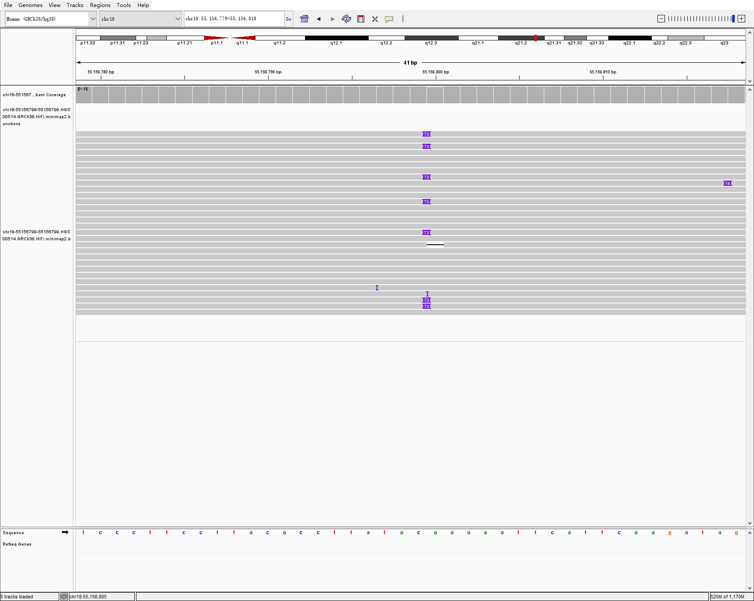
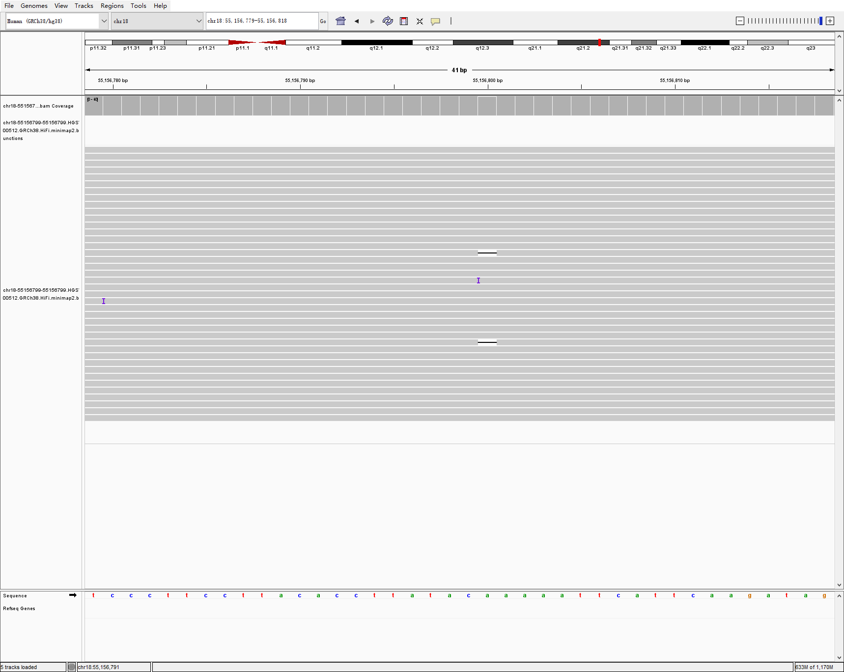

chr18 55156799 55156799 73 INS hg00514-2-3 svision_pro
HG00514
HG00512
HG00513

Slide 18
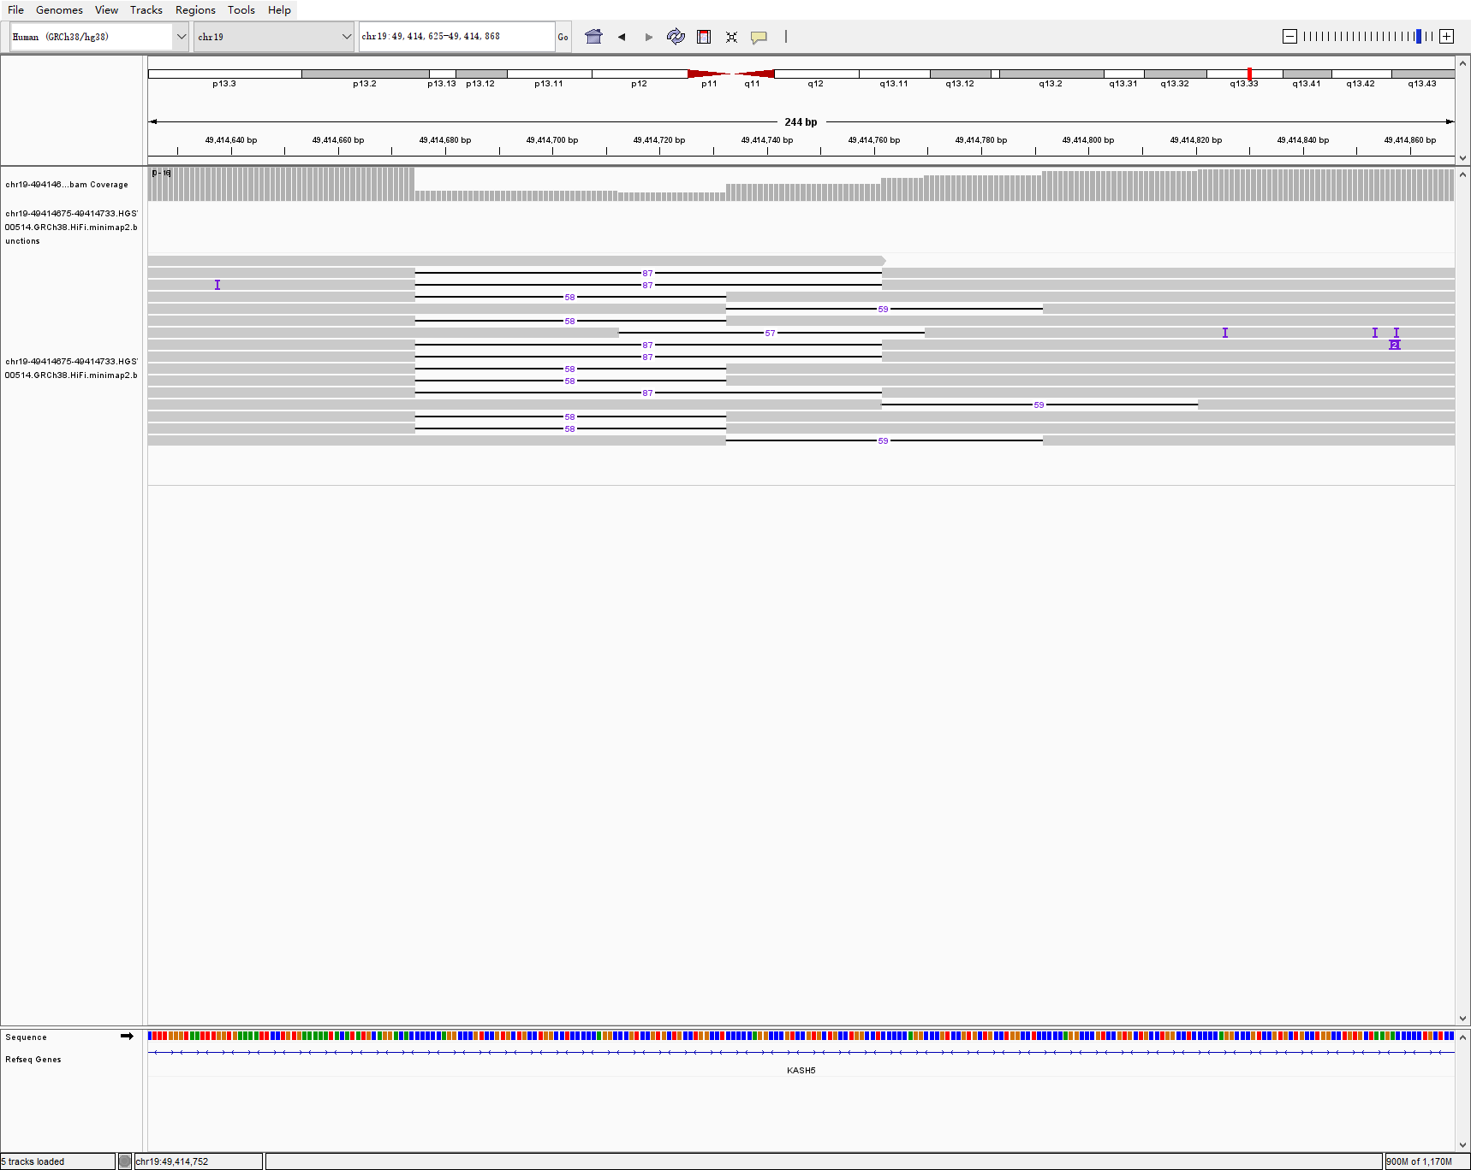
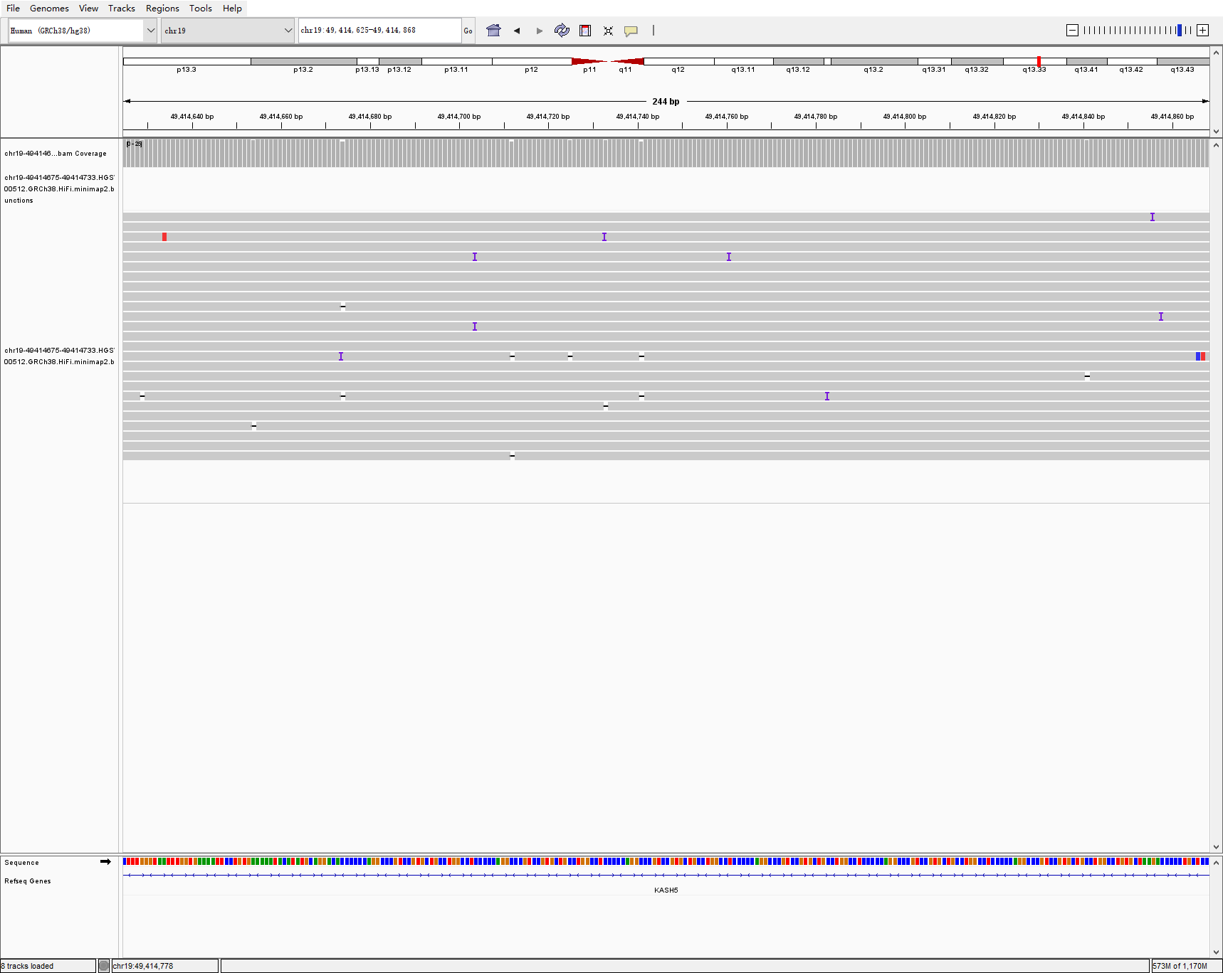
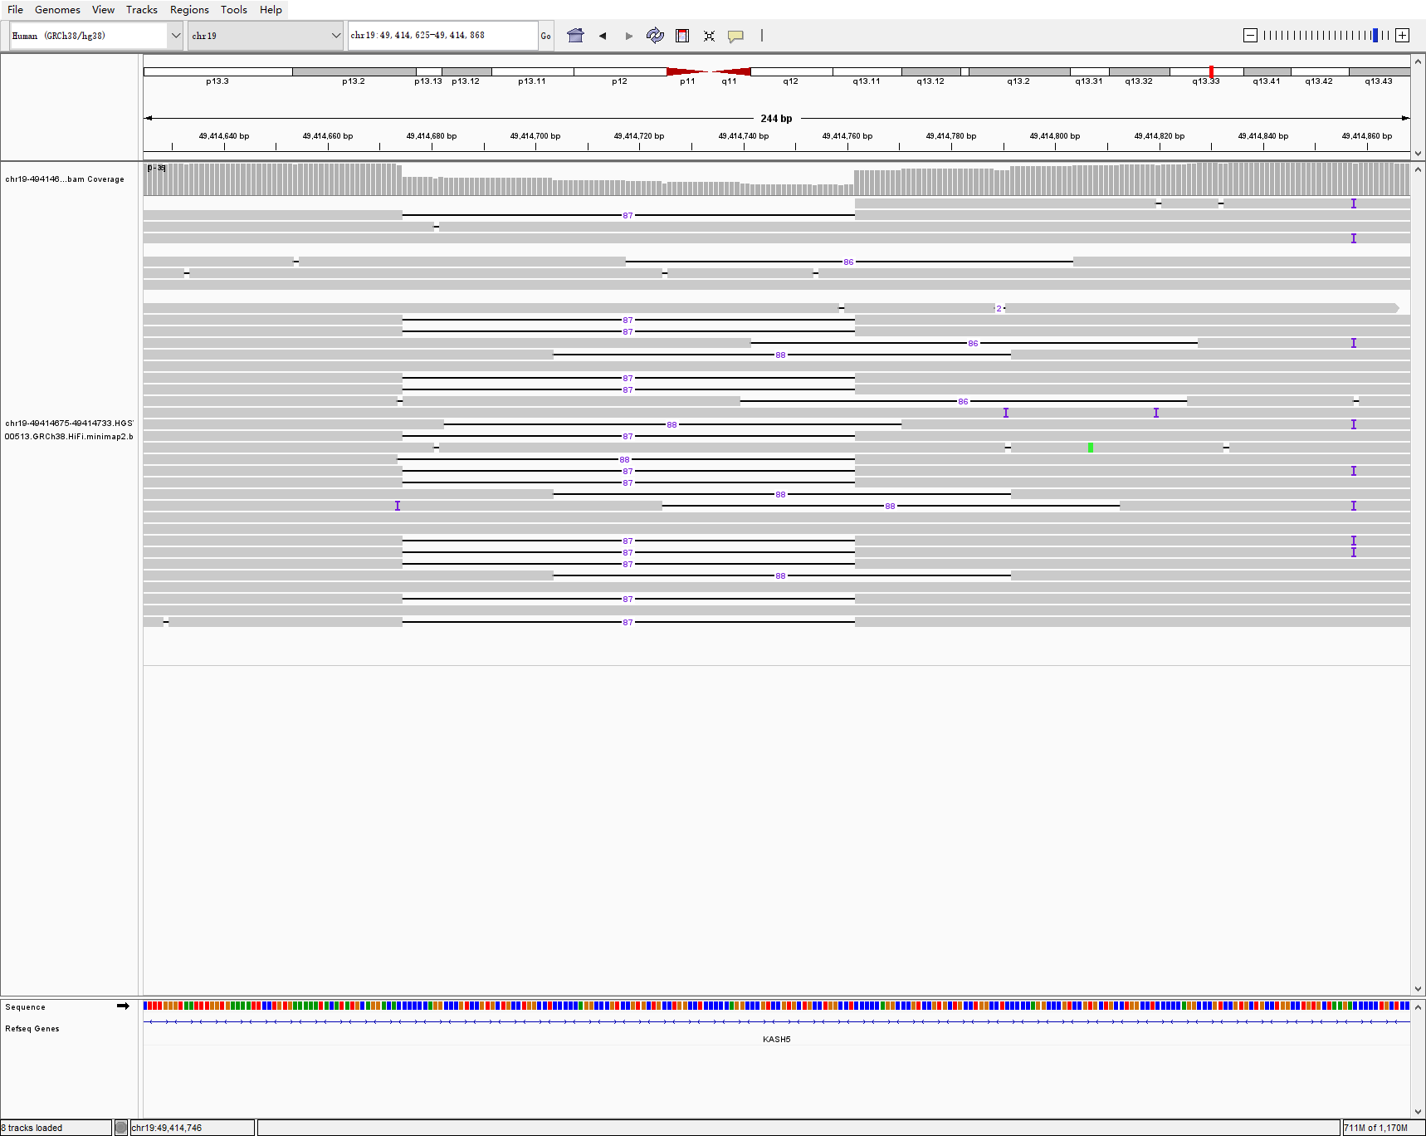
chr19 49414675 49414733 58 DEL hg00514-2-3 svision_pro
HG00514
HG00512
HG00513

Slide 19



chr20 1149893 1149893 155 INS hg00514-2-3 svision_pro
HG00514
HG00512
HG00513

Slide 20



chrX 155575615 155575977 362 DEL hg00514-2-3 svision_pro
HG00514
HG00512
HG00513

Slide 21



chr2 62406515 62406515 168 INS hg00733-1-2 svision_pro
HG00733
HG00731
HG00732

Slide 22



chr6 166221900 166222002 102 DEL hg00733-1-2 svision_pro
HG00733
HG00731
HG00732

Slide 23



chr7 76997297 76997385 87 DEL hg00733-1-2 svision_pro
HG00733
HG00731
HG00732

Slide 24



chr1 190983080 190983080 52 INS LCL5-6-7-8 svision_pro
LCL5
LCL7
LCL8

Slide 25



chr7 2492244 2492337 92 DEL lcl5-6-7-8 svision_pro
LCL5
LCL7
LCL8

Slide 26



chr10 128035258 128035258 379 INS na19240-38-39 svision_pro
NA19240
NA19238
NA19239

Slide 27



chr16 30145094 30145149 55 DEL na19240-38-39 svision_pro
NA19240
NA19238
NA19239

