Slide 1
Supplementary File 5. Retrieved eight CSVs from HCC1395 N-T paired cell line

Slide 2
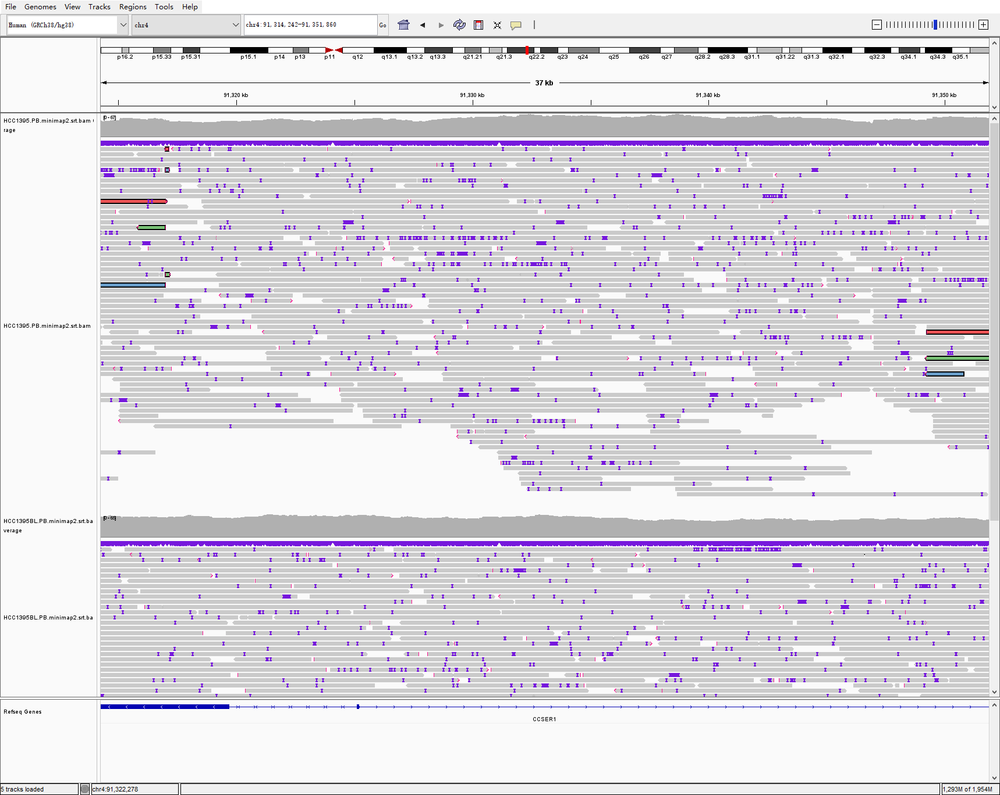
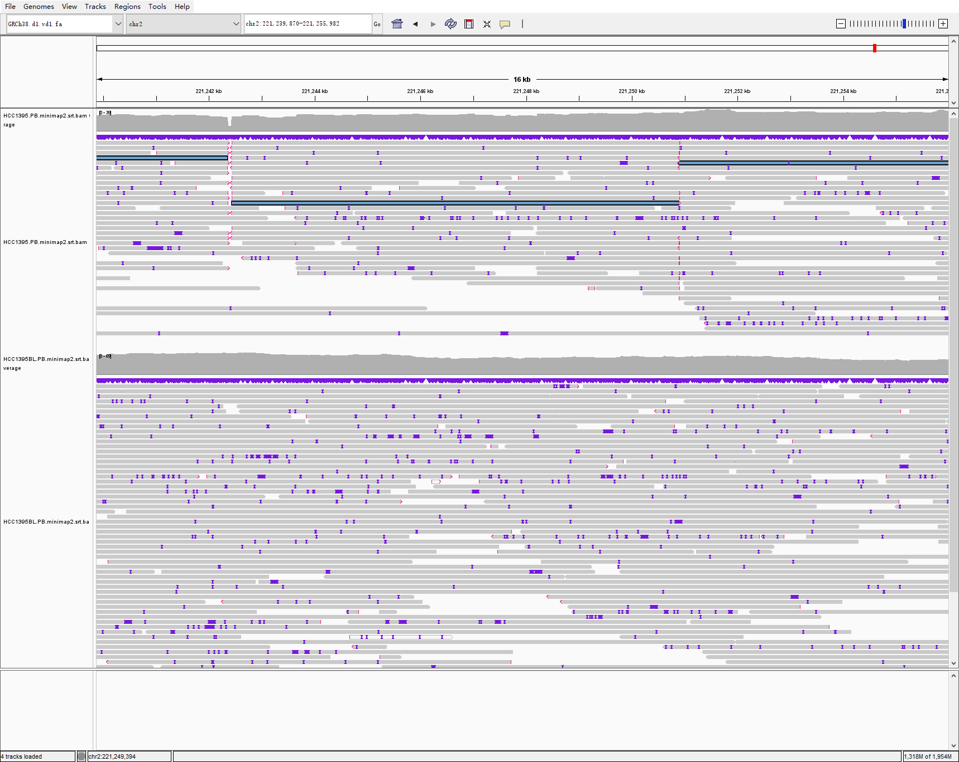
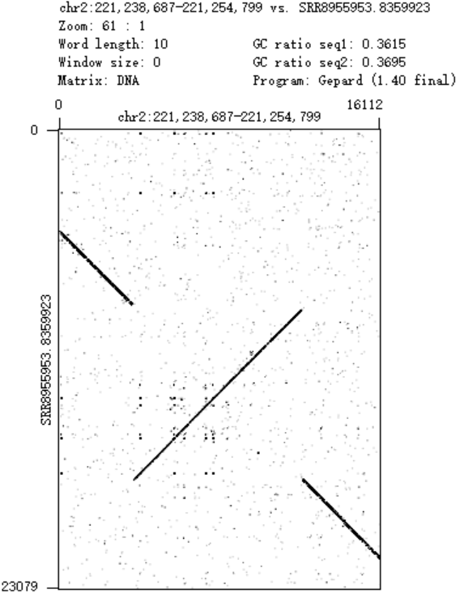
chr2_221242363_chr6_52995665_+-, TRA and chr2_221242434_chr2_221250908_++, INV
IGV evidence
Read Dotplot evidence
HCC1395
HCC1395BL
Callset
Types
Details
Previous: two SSVs a TRA and a INV TRA: chr2-221242363-chr6-52995665, INV: 8499bp, chr2-221242434-221250908
SVision-pro: one CSV dDUP+DEL+INV dDUP: 202bp, chr6-52995665-52995866, DEL: 71bp, chr2-221242364-221242435, INV: 8464bp, chr2-221242434-221250898

Slide 3
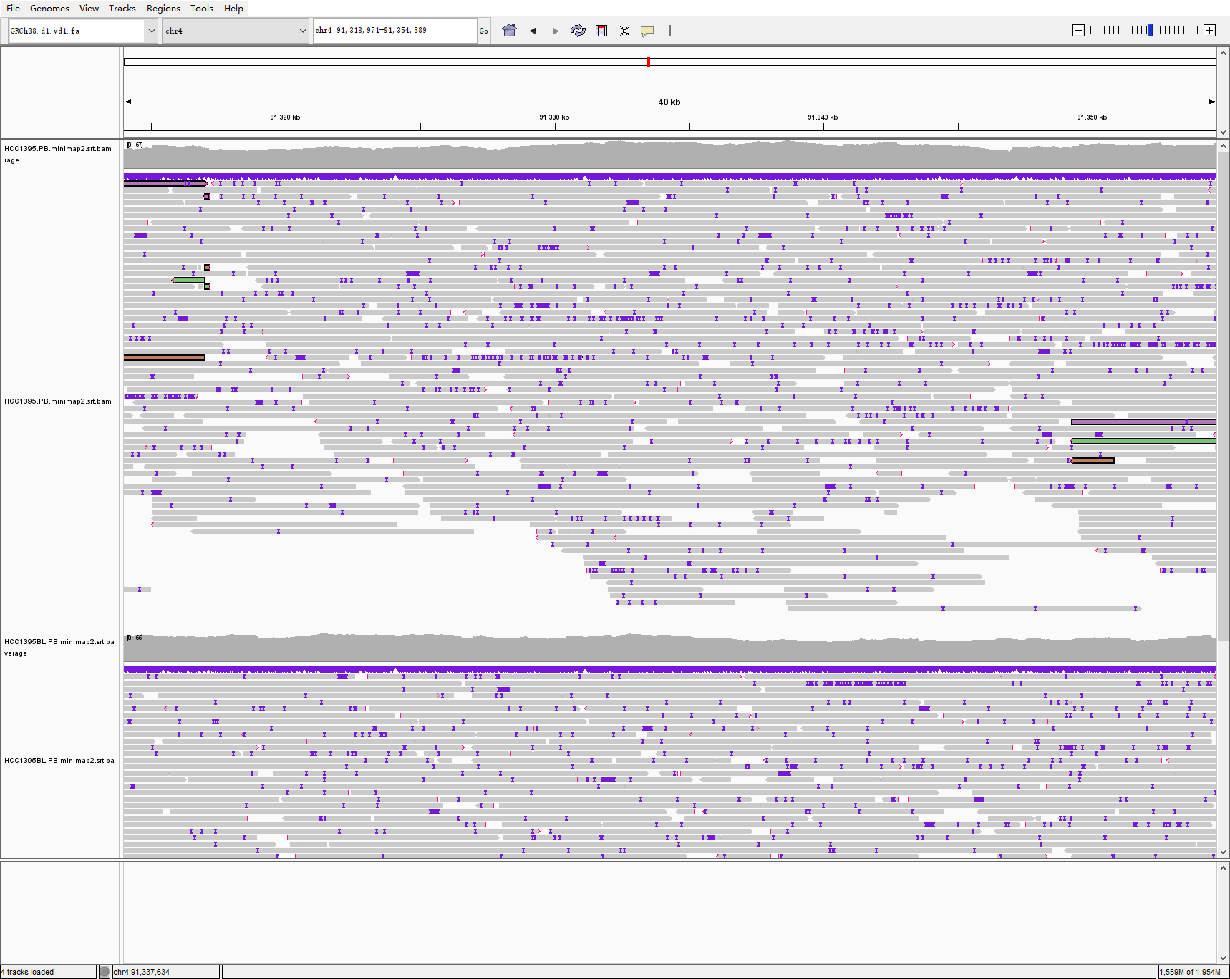
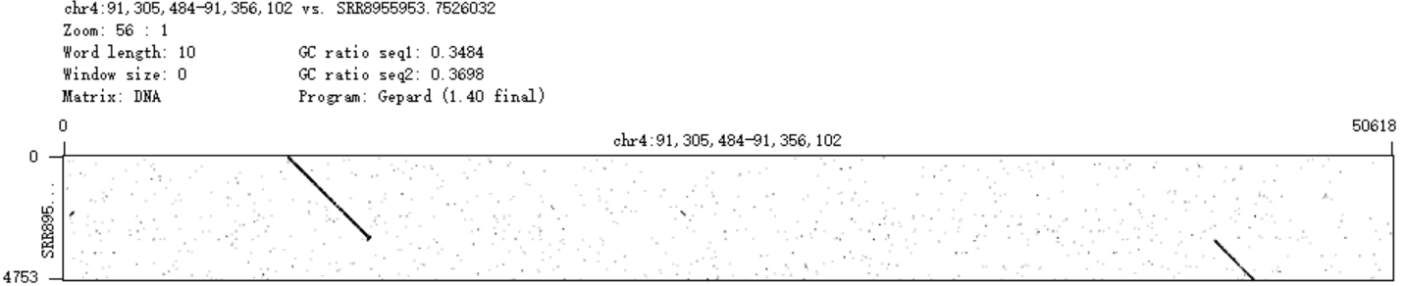
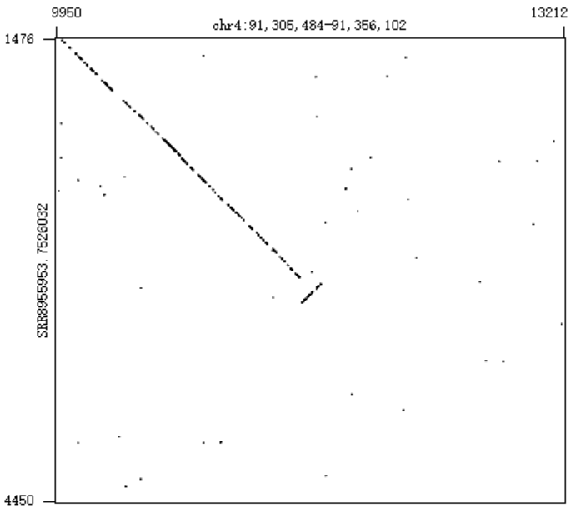
chr4_91316996_chr4_91317164_++, INV and chr4_91316993_chr4_91349253, INV
IGV evidence
Read Dotplot evidence
HCC1395
Zoom in
HCC1395BL
Callset
Types
Details
Previous: two SSVs two INVs INV: 166bp, chr4-91316996-91317164, INV: 32273bp, chr4-91316993-91349253
SVision-pro: one CSV INV+DEL INV: 168bp, chr4-91317011-91317179, DEL:32090bp, chr4-91317163-91349253

Slide 4
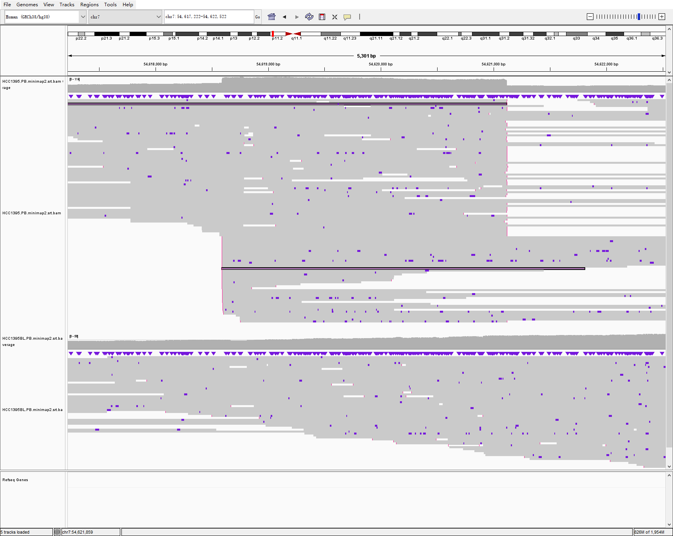
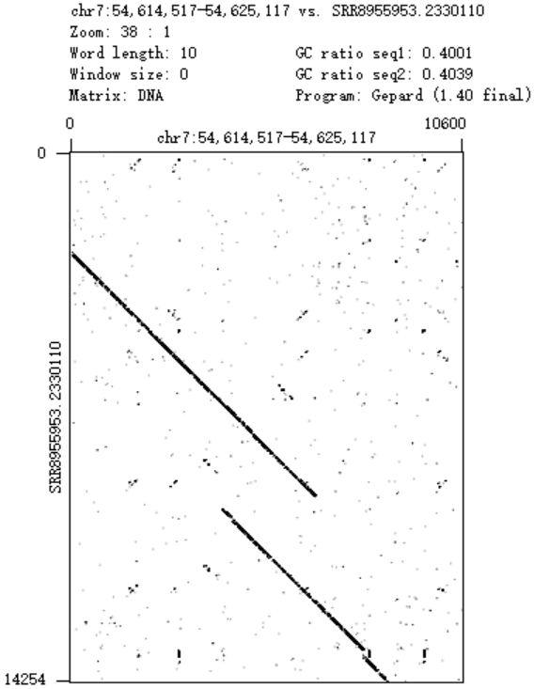
chr7_54618433_chr7_54621260_-+, DUP and chr7_54618592_chr10_37277919_++, TRA
IGV evidence
Read Dotplot evidence
HCC1395
HCC1395BL
Callset
Types
Details
Previous: two SSVs a DUP and a TRA TRA: chr7-54618592-chr10-37277919, DUP: 2715bp, chr7-54618433-54621260,
SVision-pro: one CSV idDUP+tDUP idDUP:353bp, chr10-37277919-37278271, tDUP: 2526bp, chr7-54618592-54621117

Slide 5
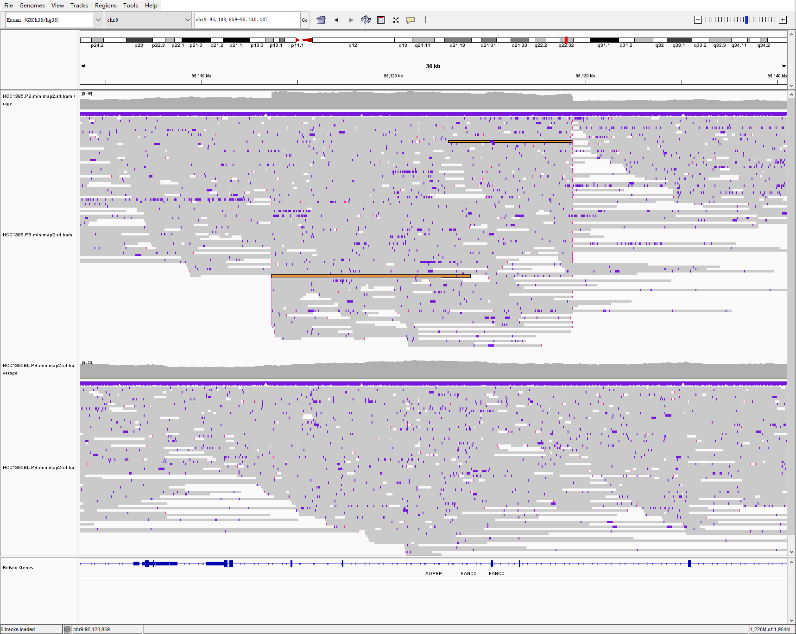
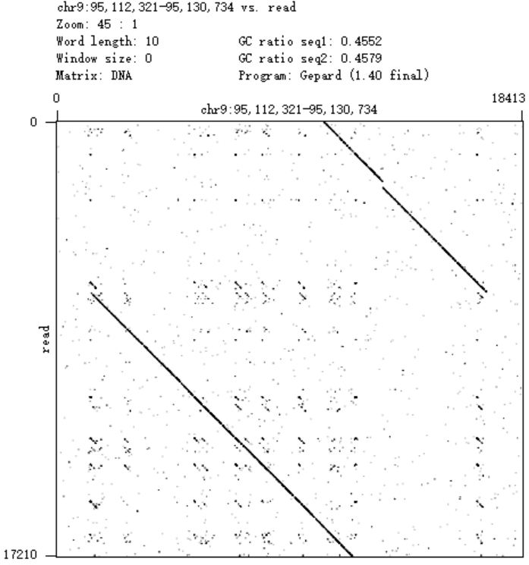
chr9_95113650_chr9_95129312_-+, DUP
IGV evidence
Read Dotplot evidence
HCC1395
HCC1395BL
Callset
Types
Details
Previous: one SSVs DUP DUP: 15662bp, chr9-95113650-95129312
SVision-pro: one CSV tDUP+INS tDUP: 15689bp, chr9-95113651-95129339, INS: 2492bp, chr9-95129315-95129315

Slide 6
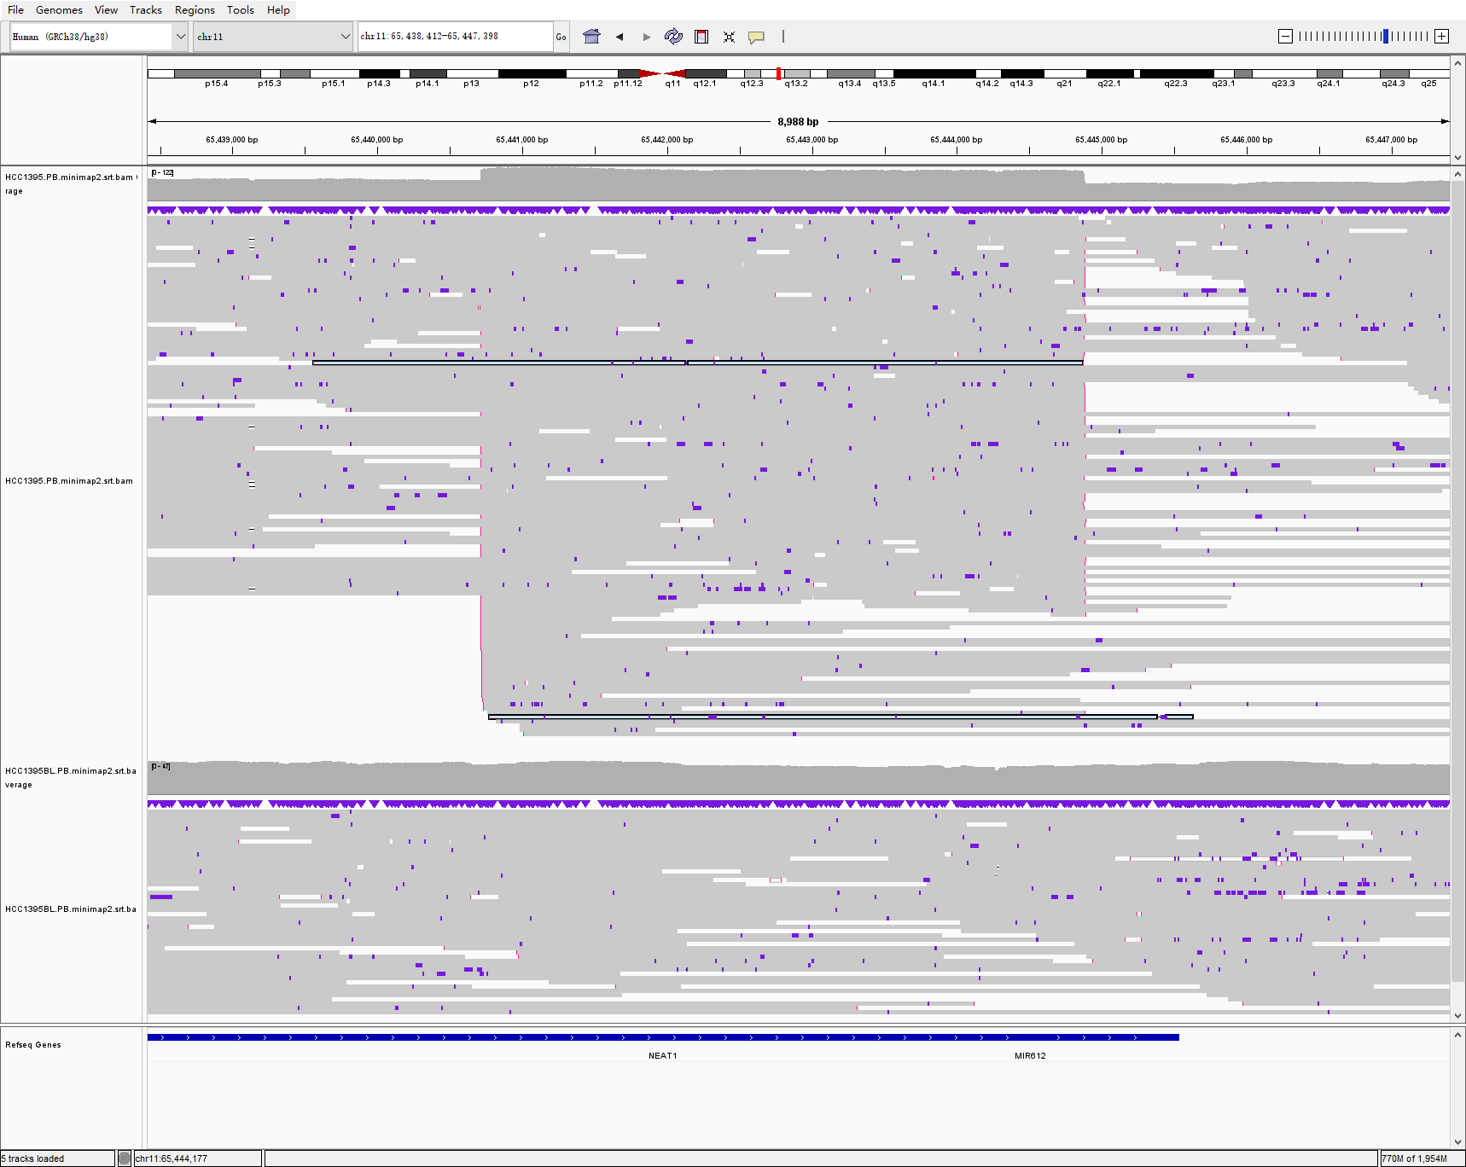
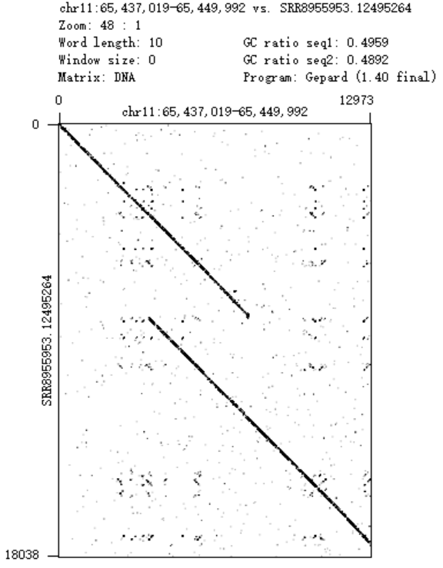
chr11_65440714_chr11_65444882_-+, DUP
IGV evidence
Read Dotplot evidence
HCC1395
HCC1395BL
Callset
Types
Details
Previous: one SSV DUP DUP: 4168bp, chr11-65440714-65440714
SVision-pro: one CSV INS+tDUP INS: 80bp, chr11-65444884-65444884, tDUP: 4170bp, chr11-65440715-65444884

Slide 7
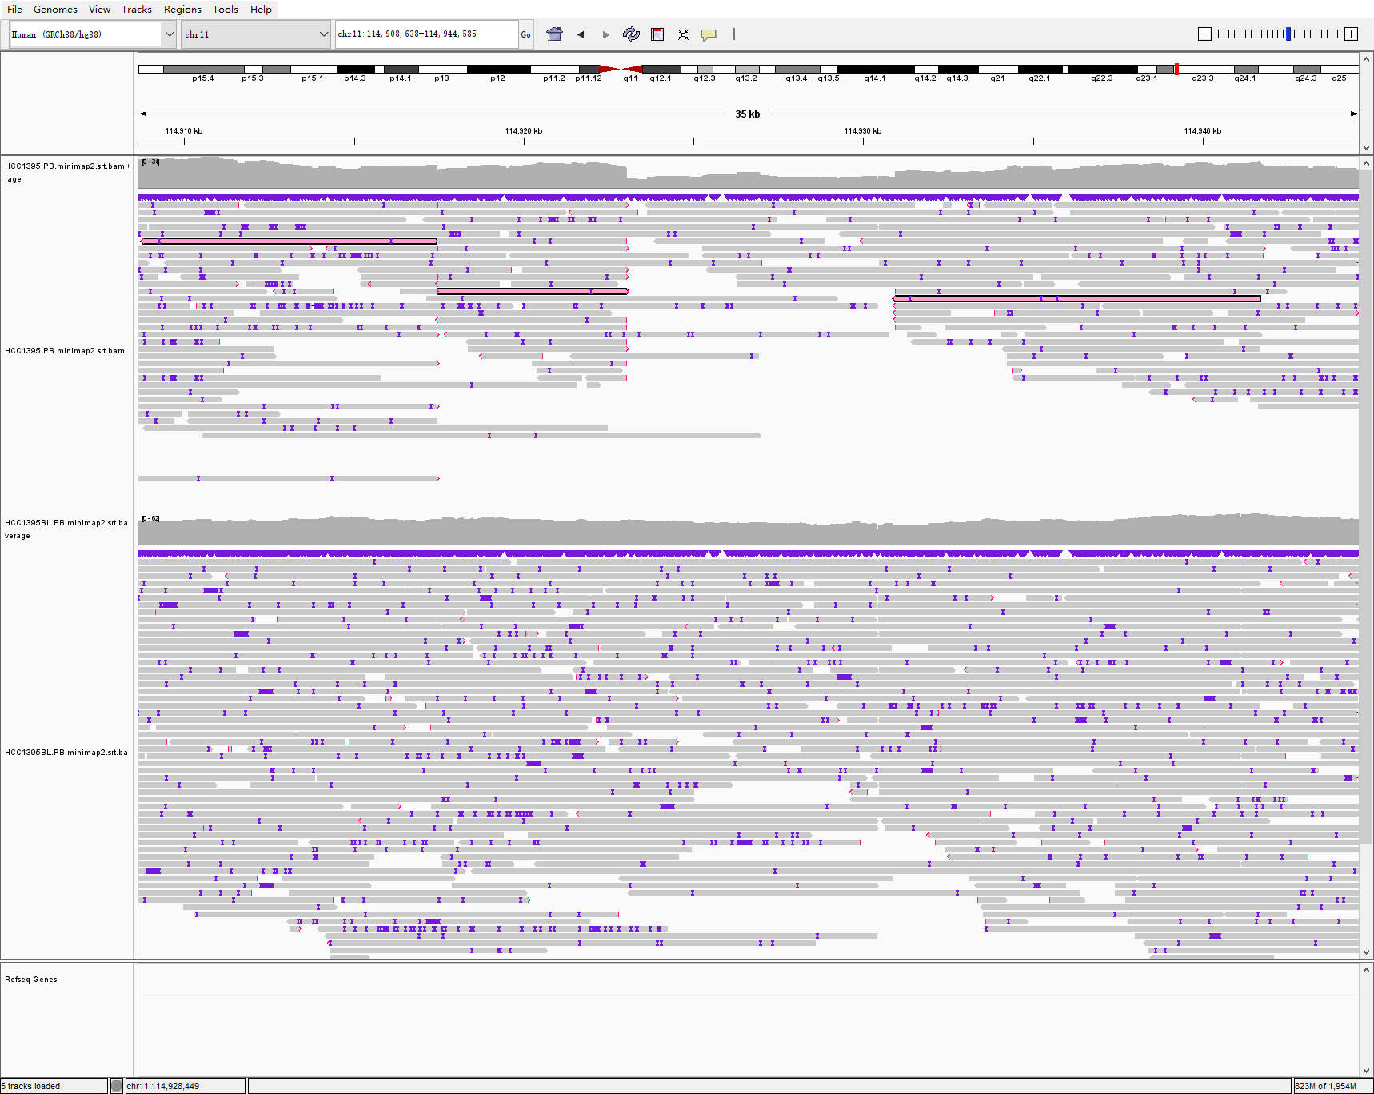
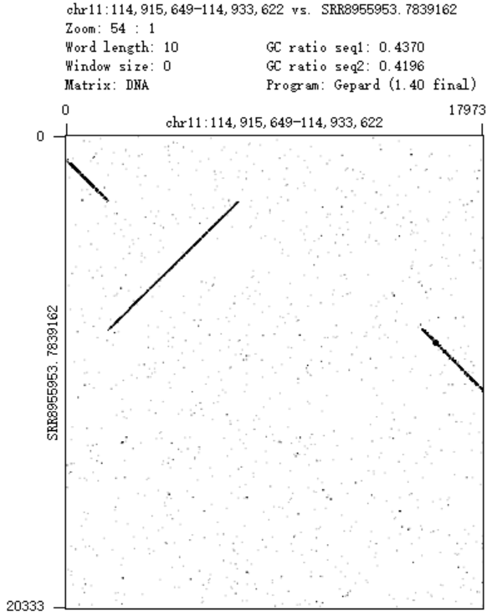
chr11_114917471_chr11_114930951_++, INV
IGV evidence
Read Dotplot evidence
HCC1395
HCC1395BL
Callset
Types
Details
Previous: one SSV INV INV_21903bp_ chr11_114917471_114930951
SVision-pro: one CSV INV+DEL INV_5558bp_chr11_114917471_114923029_, DEL_7913bp_chr11_114923039_114930952

Slide 8
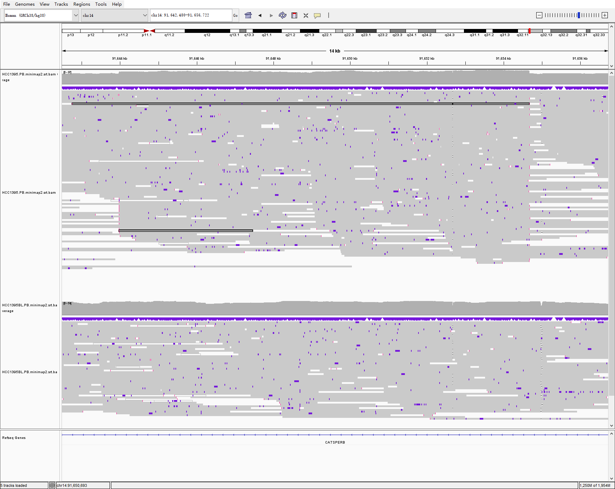
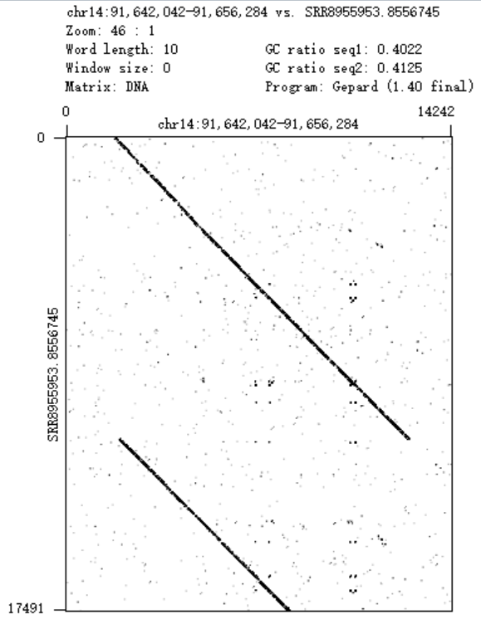
chr14_91643971_chr14_91654678_+-, DUP
IGV evidence
Read Dotplot evidence
HCC1395
HCC1395BL
Callset
Types
Details
Previous: one SSV DUP DUP: 21903bp, chr14-91643971-91654678
SVision-pro: one CSV INS+tDUP INS: 67bp, chr14-91654641-91654641, tDUP: 10660bp, chr14-91643981-91654640

Slide 9
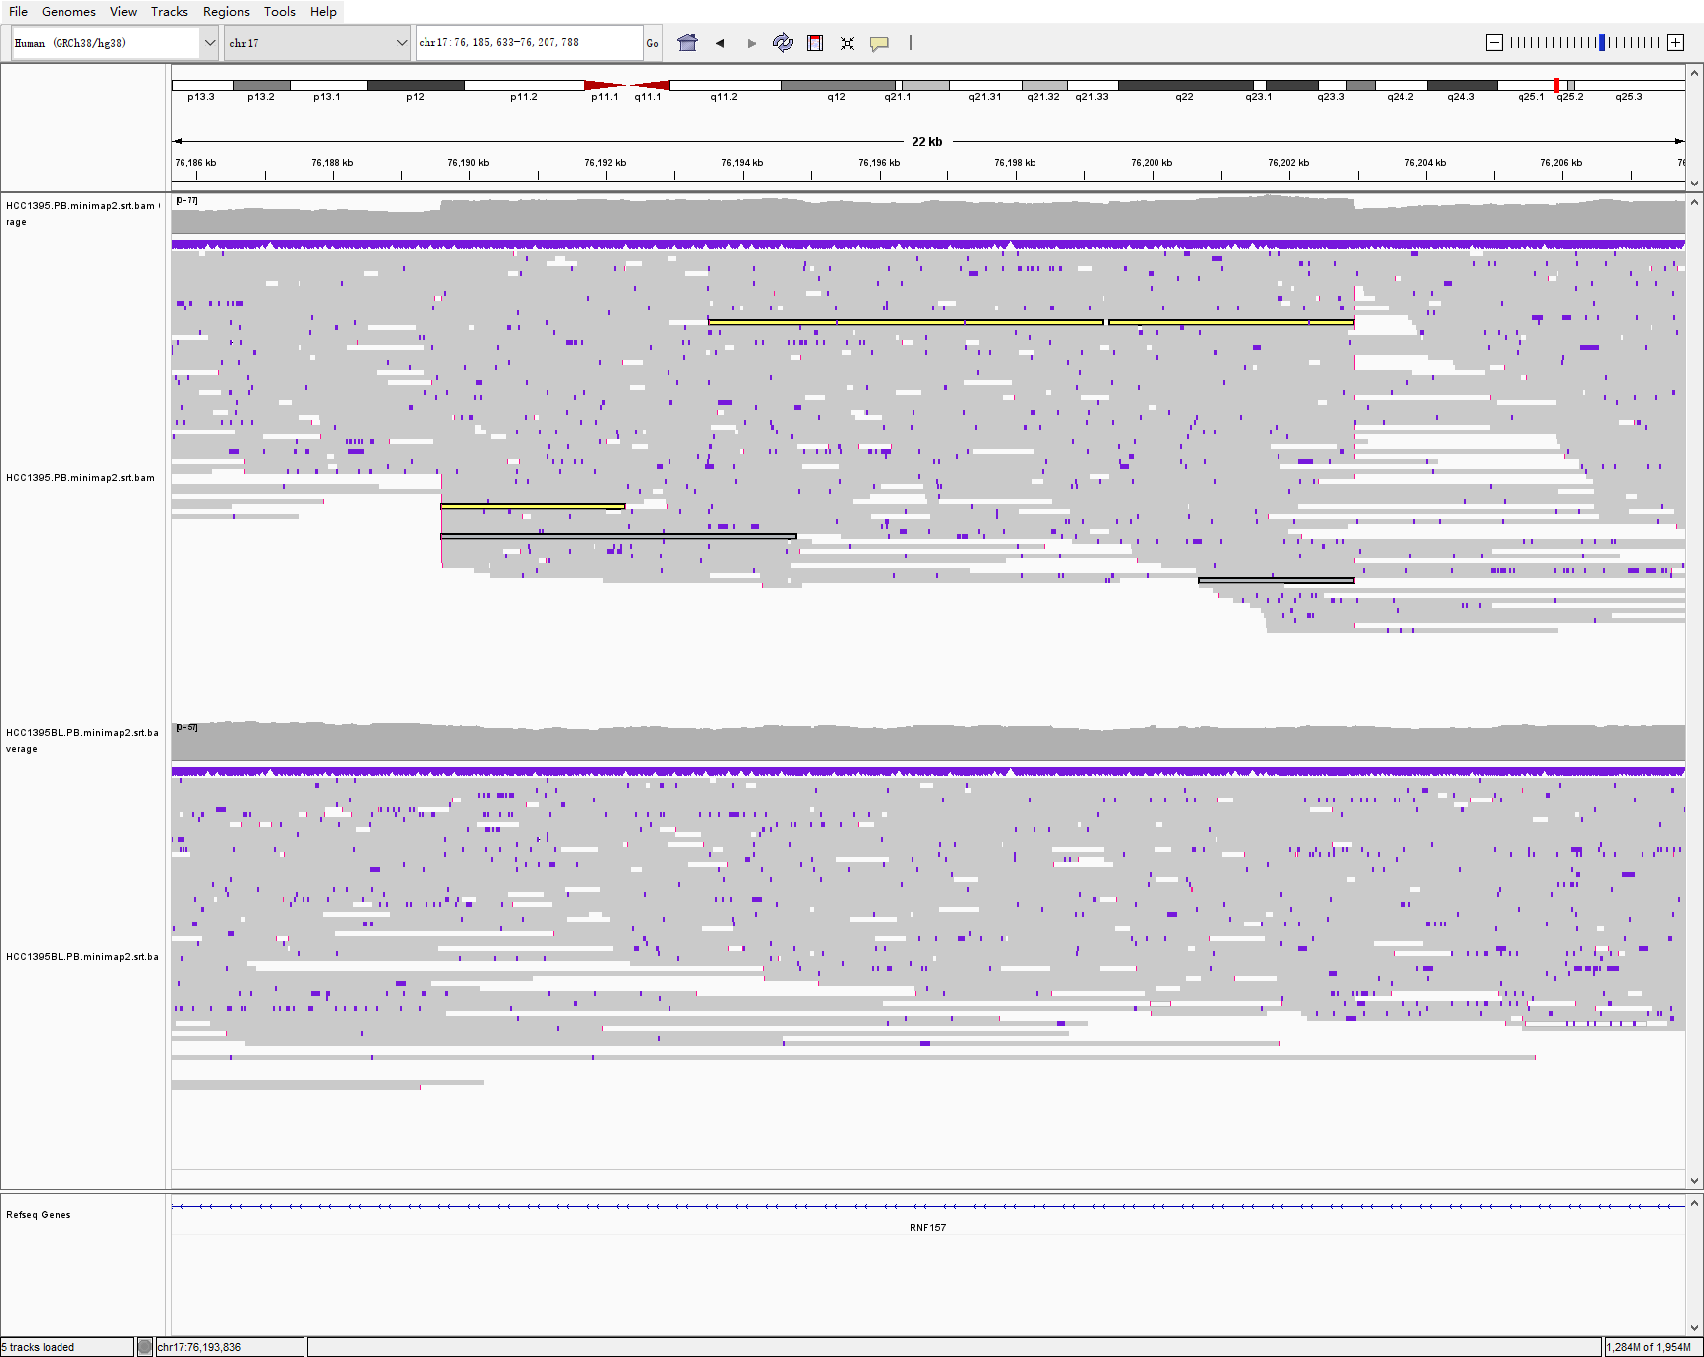
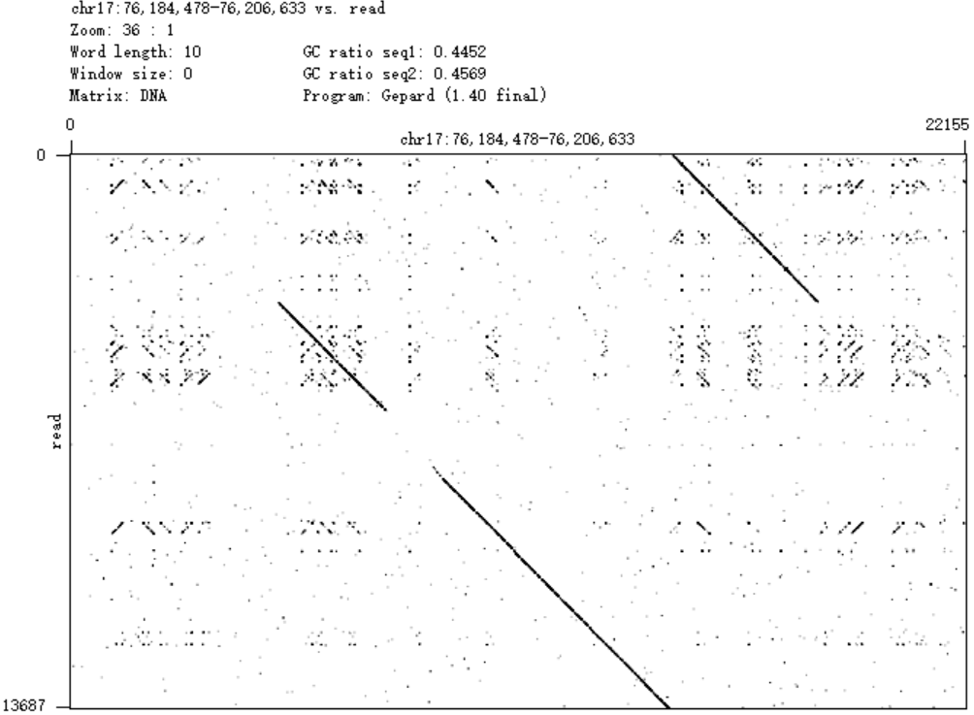
chr17_76189596_chr17_76202952_-+, DUP
IGV evidence
Read Dotplot evidence
HCC1395
HCC1395BL
Callset
Types
Details
Previous: one SSVs DUP DUP: 13356bp, chr17-76189596-76202952
SVision-pro: one CSV tDUP+INS+tDUP tDUP: 499bp, chr17-76202452-76202950, INS: 61bp, chr17-76202424, tDUP: 12827bp, chr17-76189597-76202423

