Slide 1
Supplementary File 1. Verification of the 32,549bp deletion in chromosome 1

Slide 2
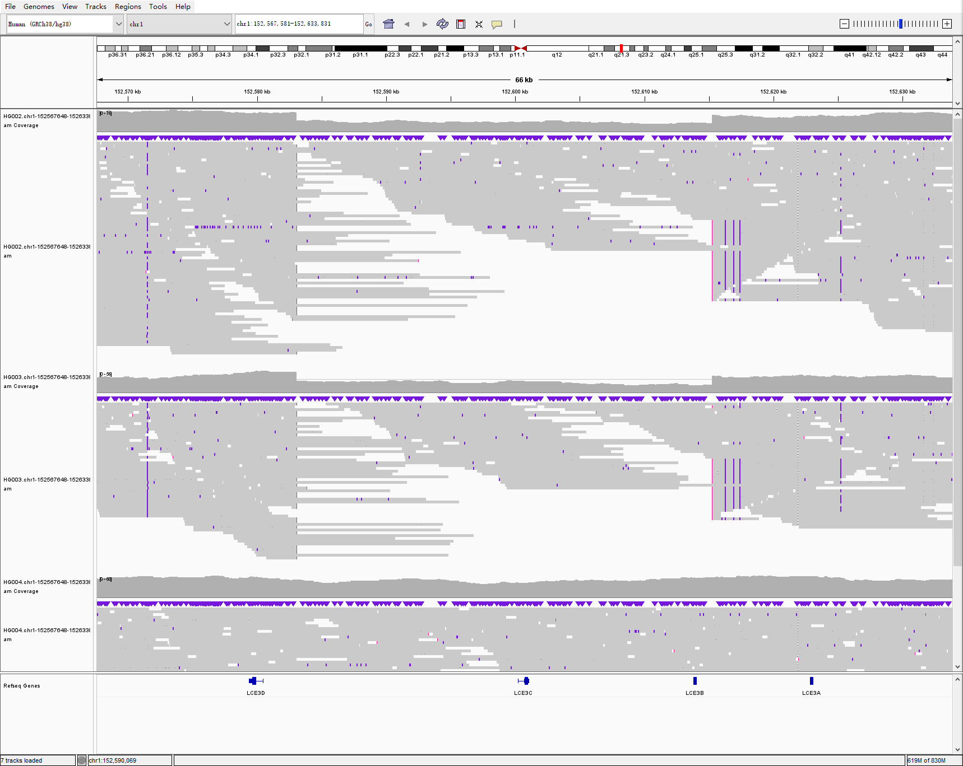
HiFi long reads
chr1:152,567,581-152,633,831
SVision-pro
Sniffles2
HG002, child
DEL: 0/1
0/1
1/1
HG003: father
DEL: 0/1
0/1
1/1
HG004, mother
DEL: 0/0
0/0
0/0

Slide 3
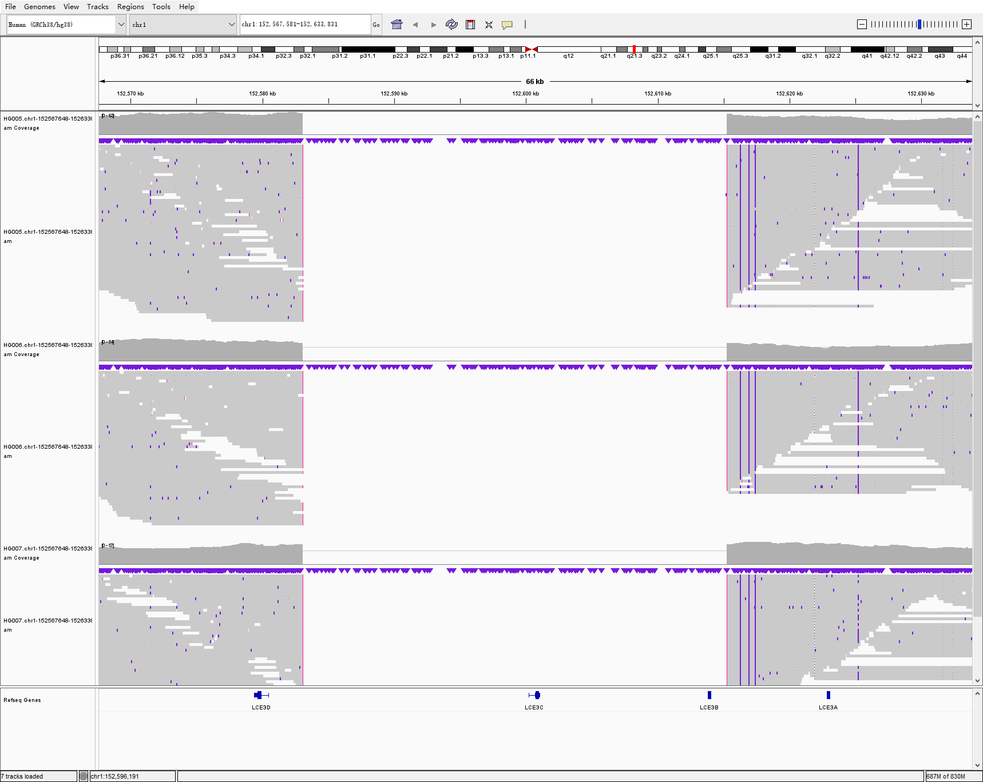
HiFi long reads
chr1:152,567,581-152,633,831
SVision-pro
Sniffles2
HG005, child
DEL: 1/1
1/1
Not called
HG006: father
DEL: 1/1
1/1
Not called
HG007, mother
DEL: 1/1
1/1
Not called

Slide 4
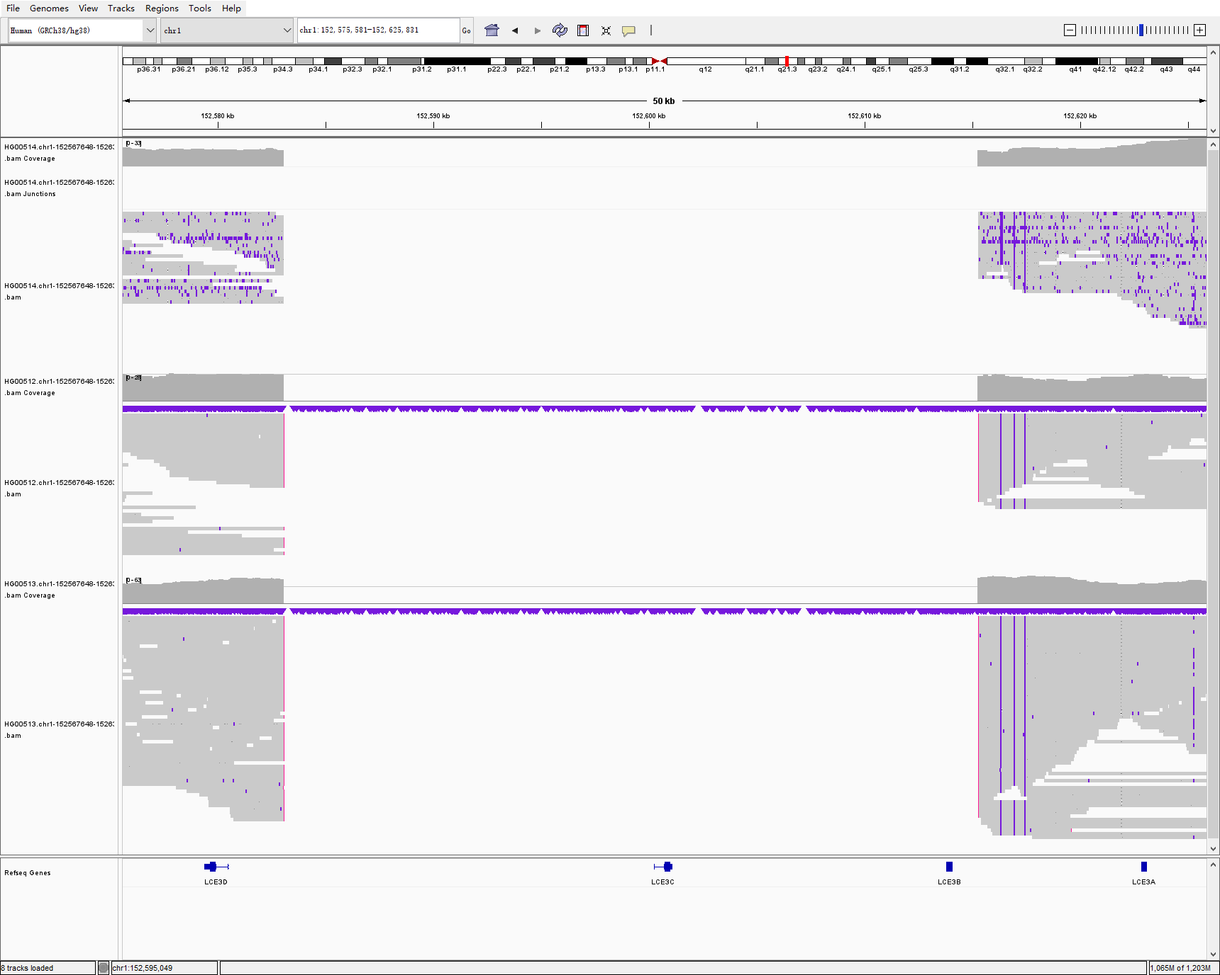
HiFi long reads
chr1:152,567,581-152,633,831
SVision-pro
Sniffles2
HG00514, child
DEL: 1/1
1/1
Not called
HG00512: father
DEL: 1/1
1/1
Not called
HG00513, mother
DEL: 1/1
1/1
Not called

Slide 5
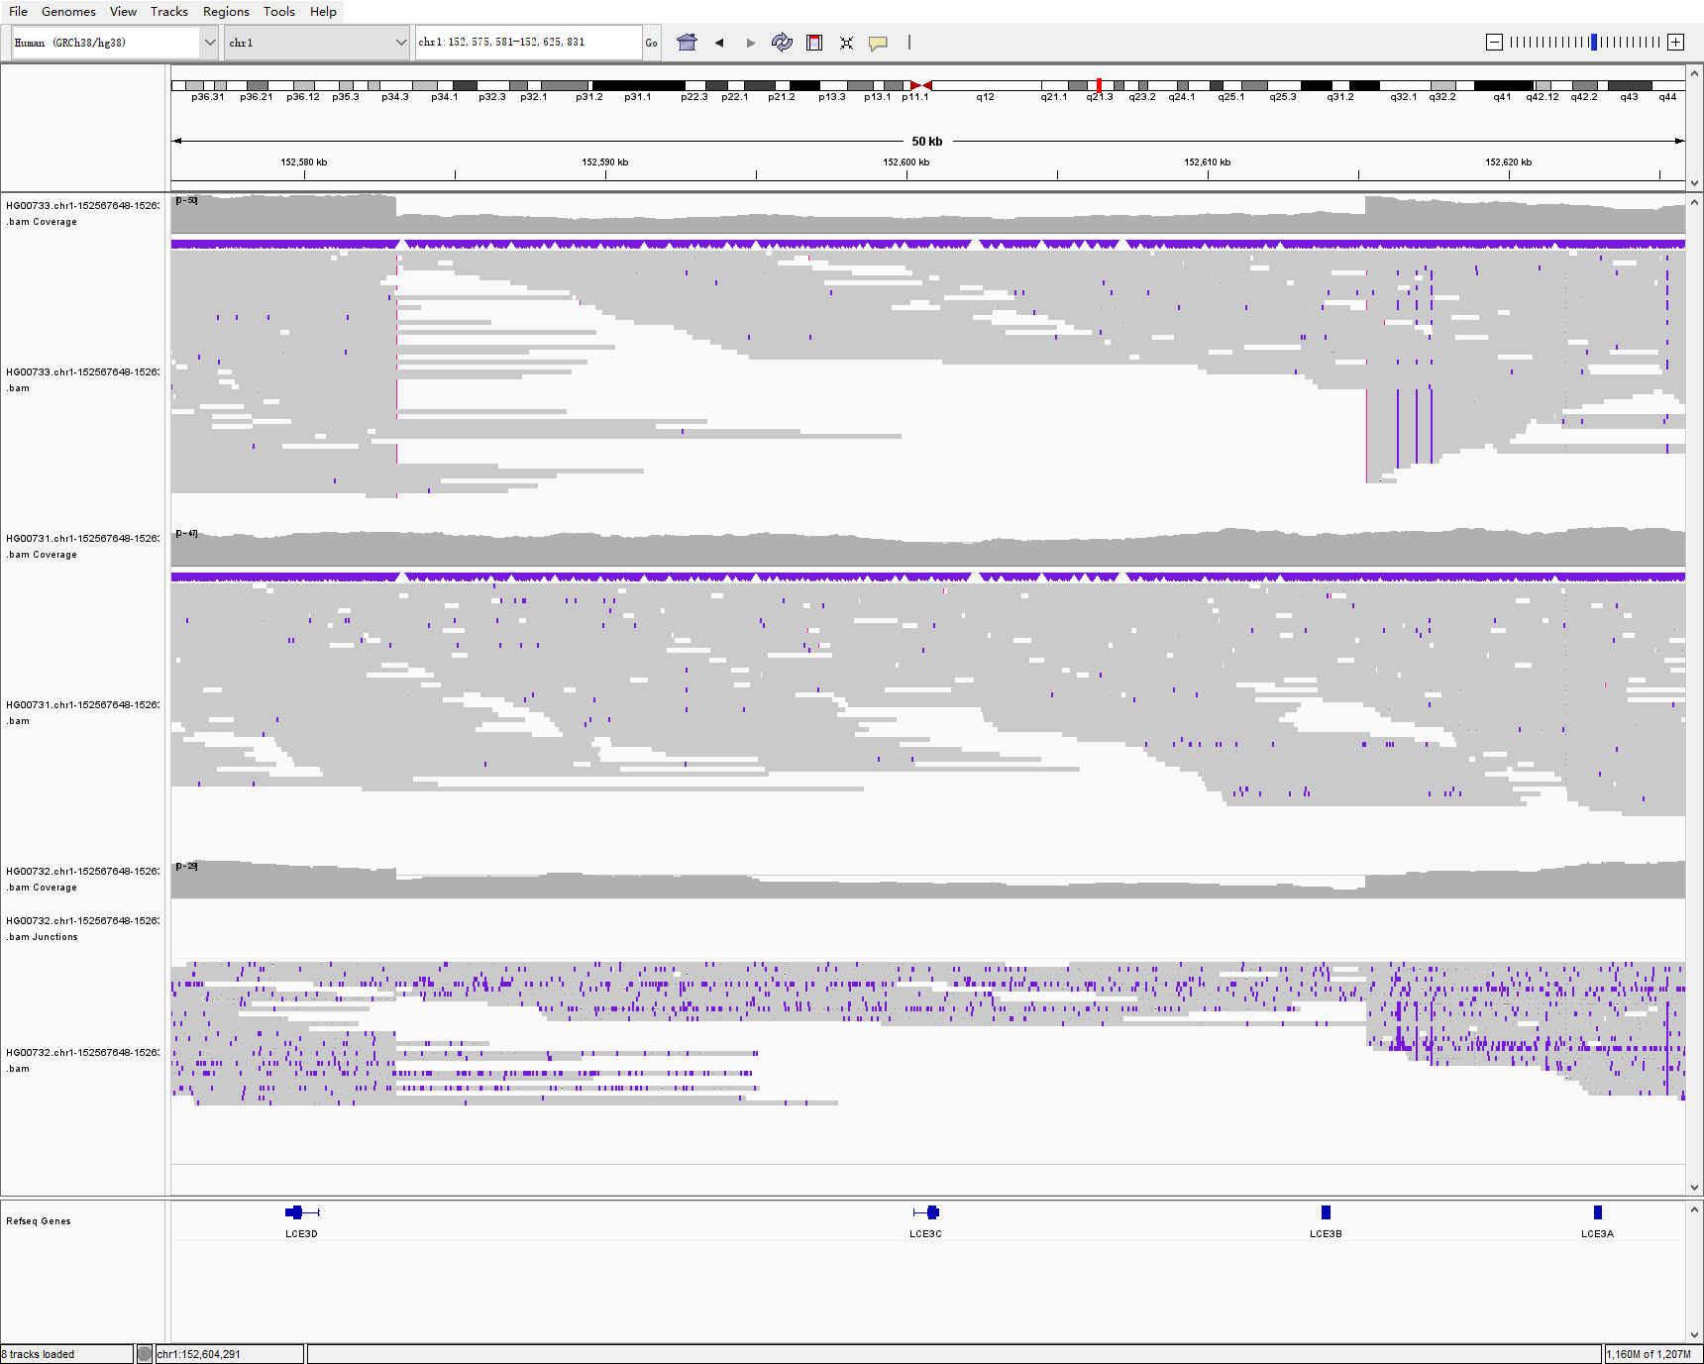
HiFi long reads
chr1:152,567,581-152,633,831
SVision-pro
Sniffles2
HG00733, child
DEL: 0/1
0/1
1/1
HG00731: father
DEL: 0/0
0/0
0/0
HG00732, mother
DEL: 0/1
0/1
1/1

Slide 6
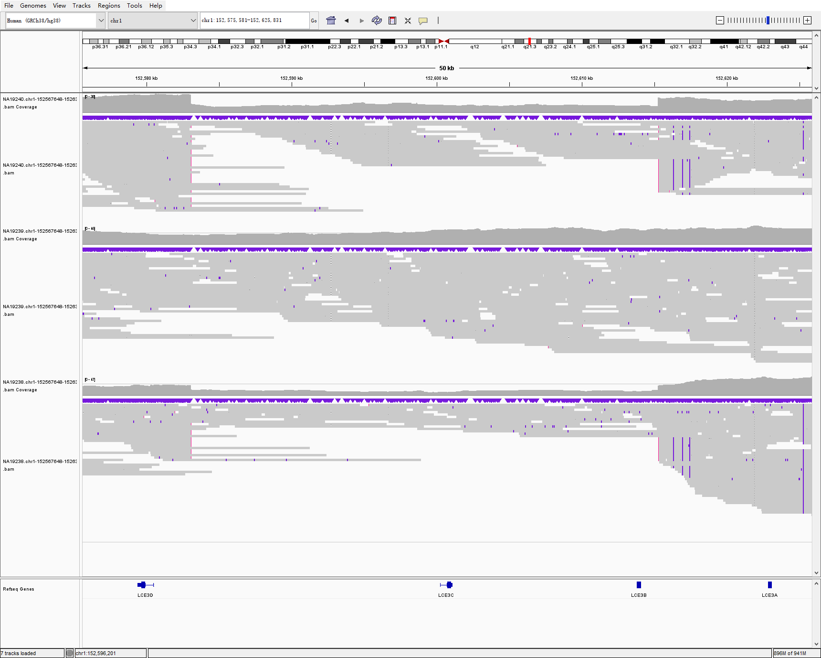
HiFi long reads
chr1:152,567,581-152,633,831
SVision-pro
Sniffles2
NA19240, child
DEL: 0/1
0/1
1/1
NA19239: father
DEL: 0/0
0/0
0/0
NA19238, mother
DEL: 0/1
0/1
1/1

Slide 7
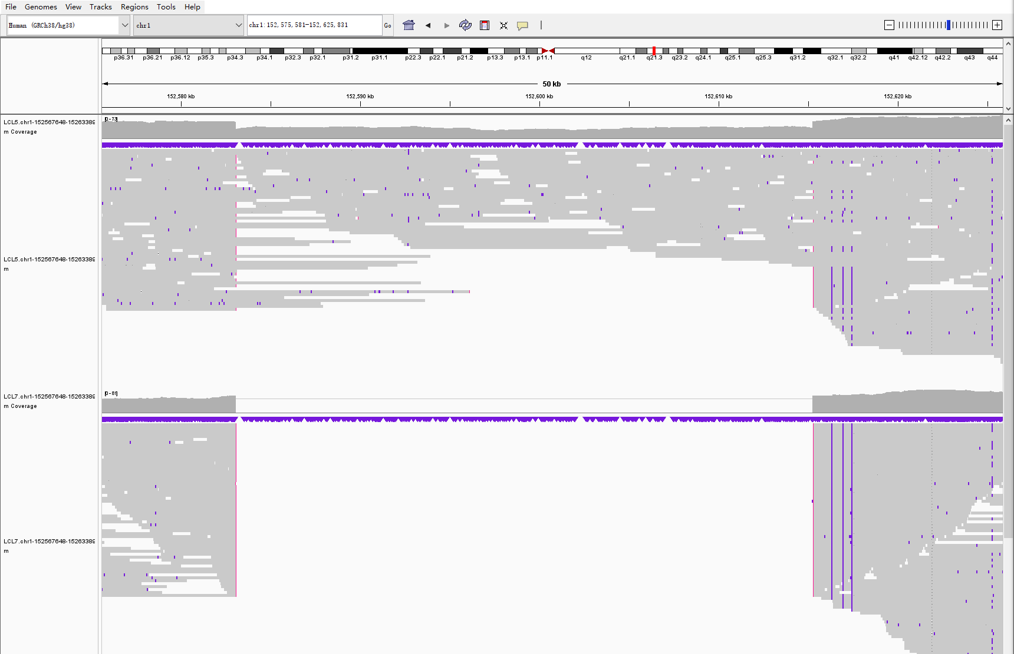
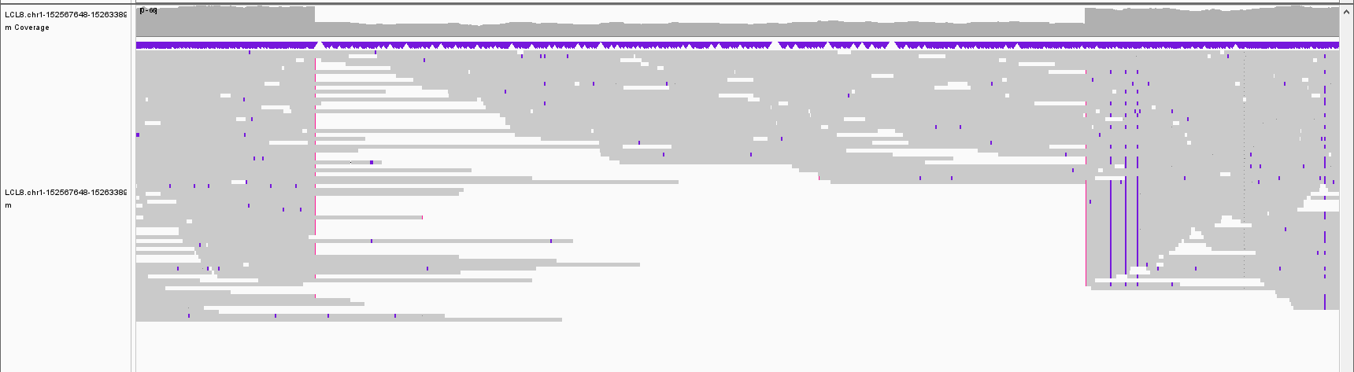
HiFi long reads
chr1:152,567,581-152,633,831
SVision-pro
Sniffles2
LCL5, child
DEL: 0/1
0/1
1/1
LCL7: father
DEL: 1/1
1/1
./.
LCL8, mother
DEL: 0/1
0/1
1/1

