Slide 1
Supplementary File 2. Verification of the complex locus at chr11:34,686,676

Slide 2
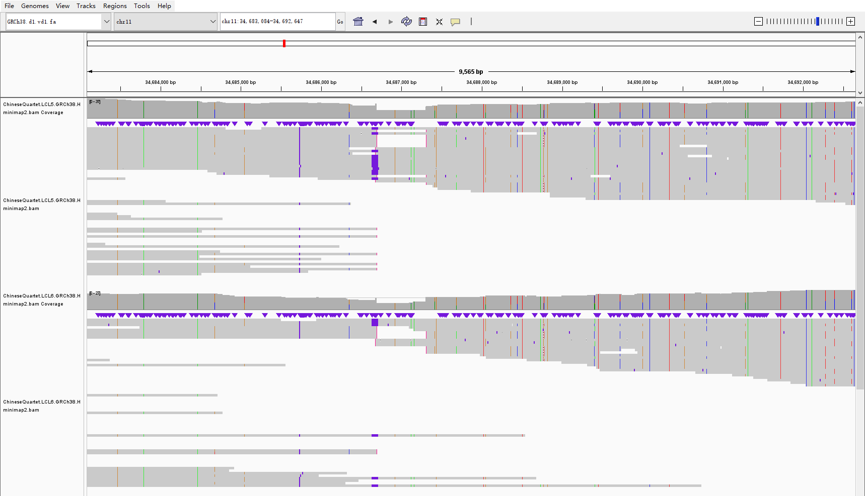
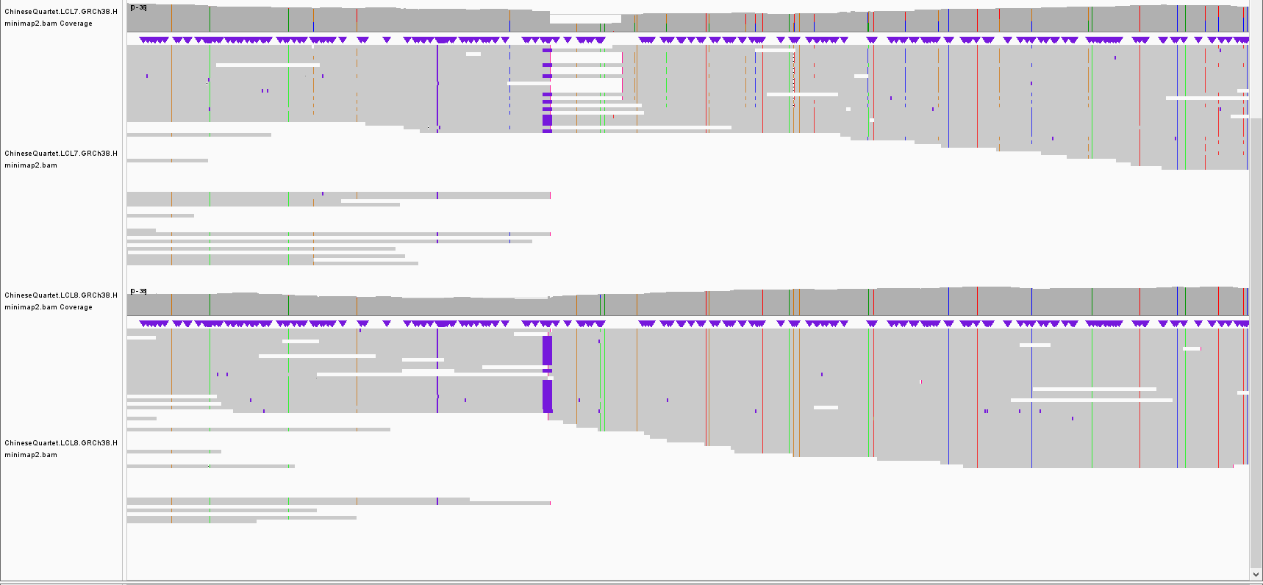
HiFi long reads
chr11:34,683,084-34,692,647
LCL5, child
INS: 0/1
INS+DEL: 0/1
LCL6, child
INS: 0/1
INS+DEL: 0/1
LCL7: father
INS: 0/1
INS+DEL: 0/1
LCL8, mother
INS: 1/1

Slide 3
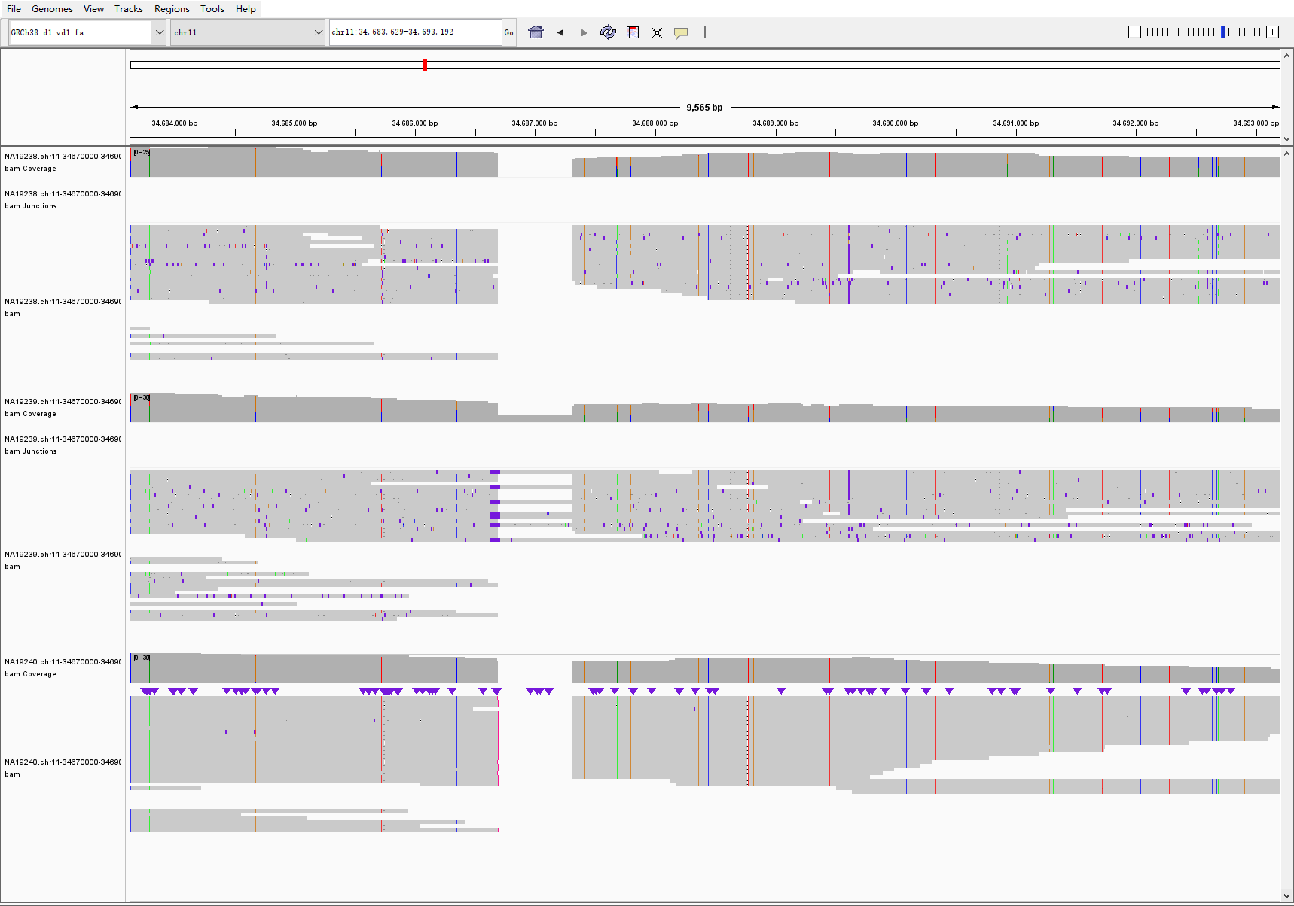
HiFi long reads
chr11:34,683,084-34,692,647
NA19238, mother
INS+DEL: 1/1
NA19239, father
INS : 0/1
INS+DEL: 0/1
NA19240, child
INS+DEL: 1/1

Slide 4
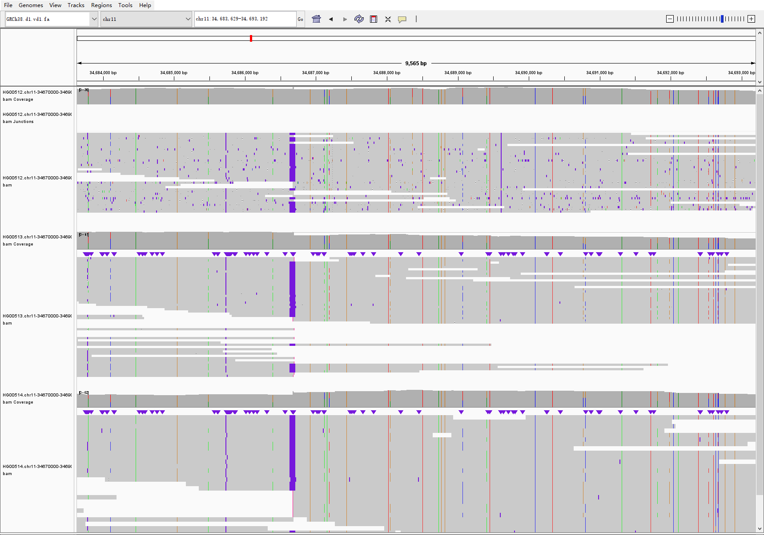
HiFi long reads
chr11:34,683,084-34,692,647
HG00512, father
INS: 1/1
HG00513, mother
INS : 1/1
HG00514, child
INS : 1/1

Slide 5
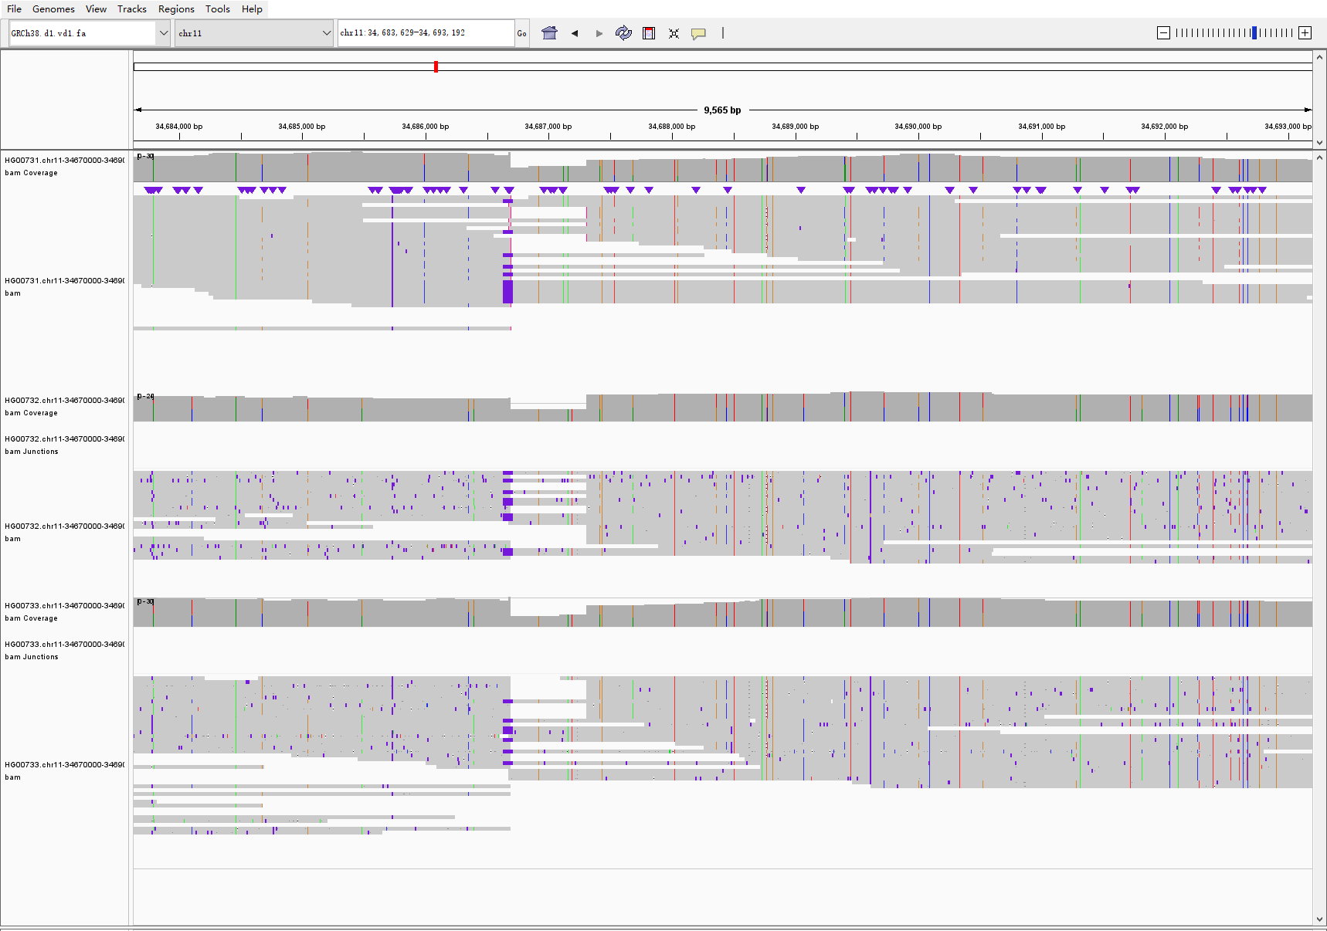
HiFi long reads
chr11:34,683,084-34,692,647
HG00731, father
INS: 0/1
INS+DEL: 0/1
HG00732: mother
INS: 0/1
INS+DEL: 0/1
HG00733, child
INS: 0/1
INS+DEL: 0/1

Slide 6
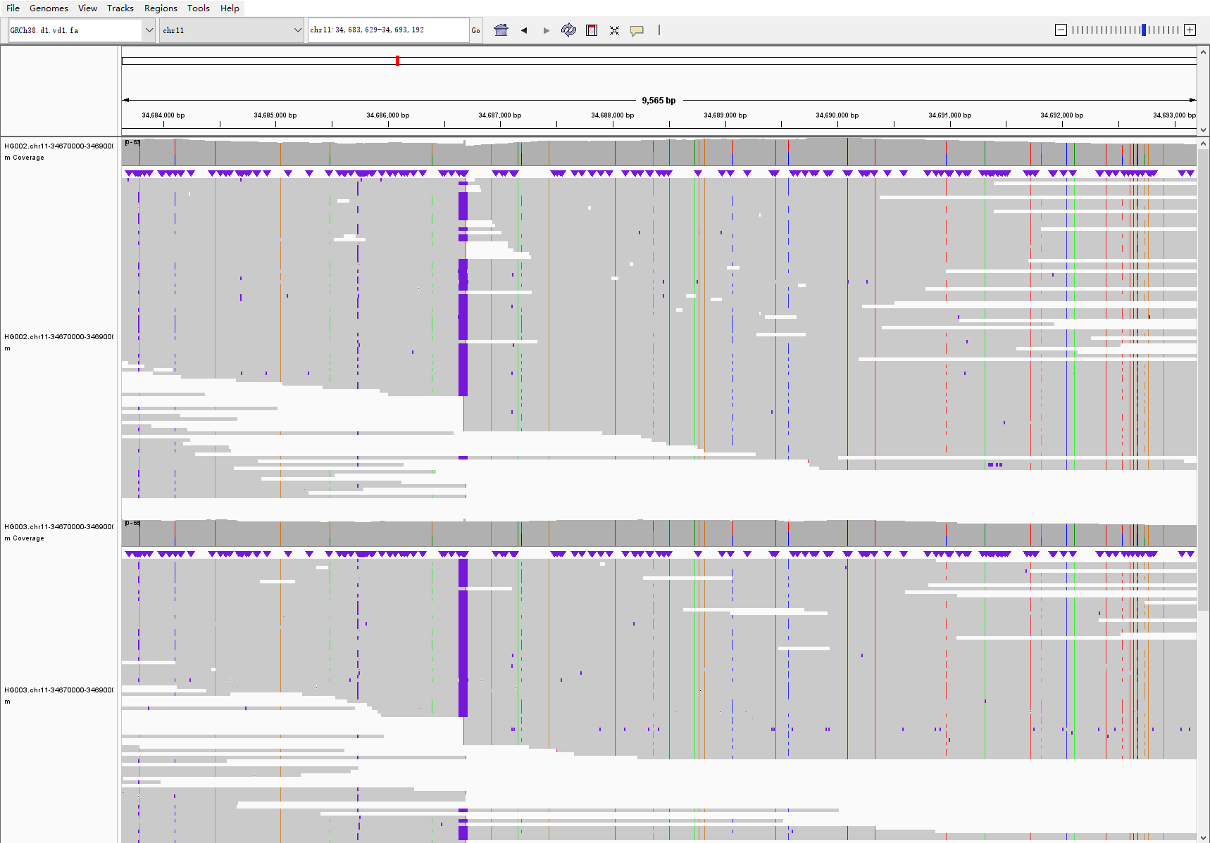
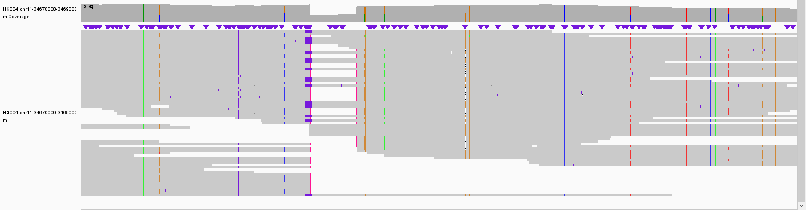
HiFi long reads
chr11:34,683,084-34,692,647
HG002, child
INS: 1/1
HG003: father
INS: 1/1
HG004, mother
INS: 0/1
INS+DEL: 0/1

Slide 7
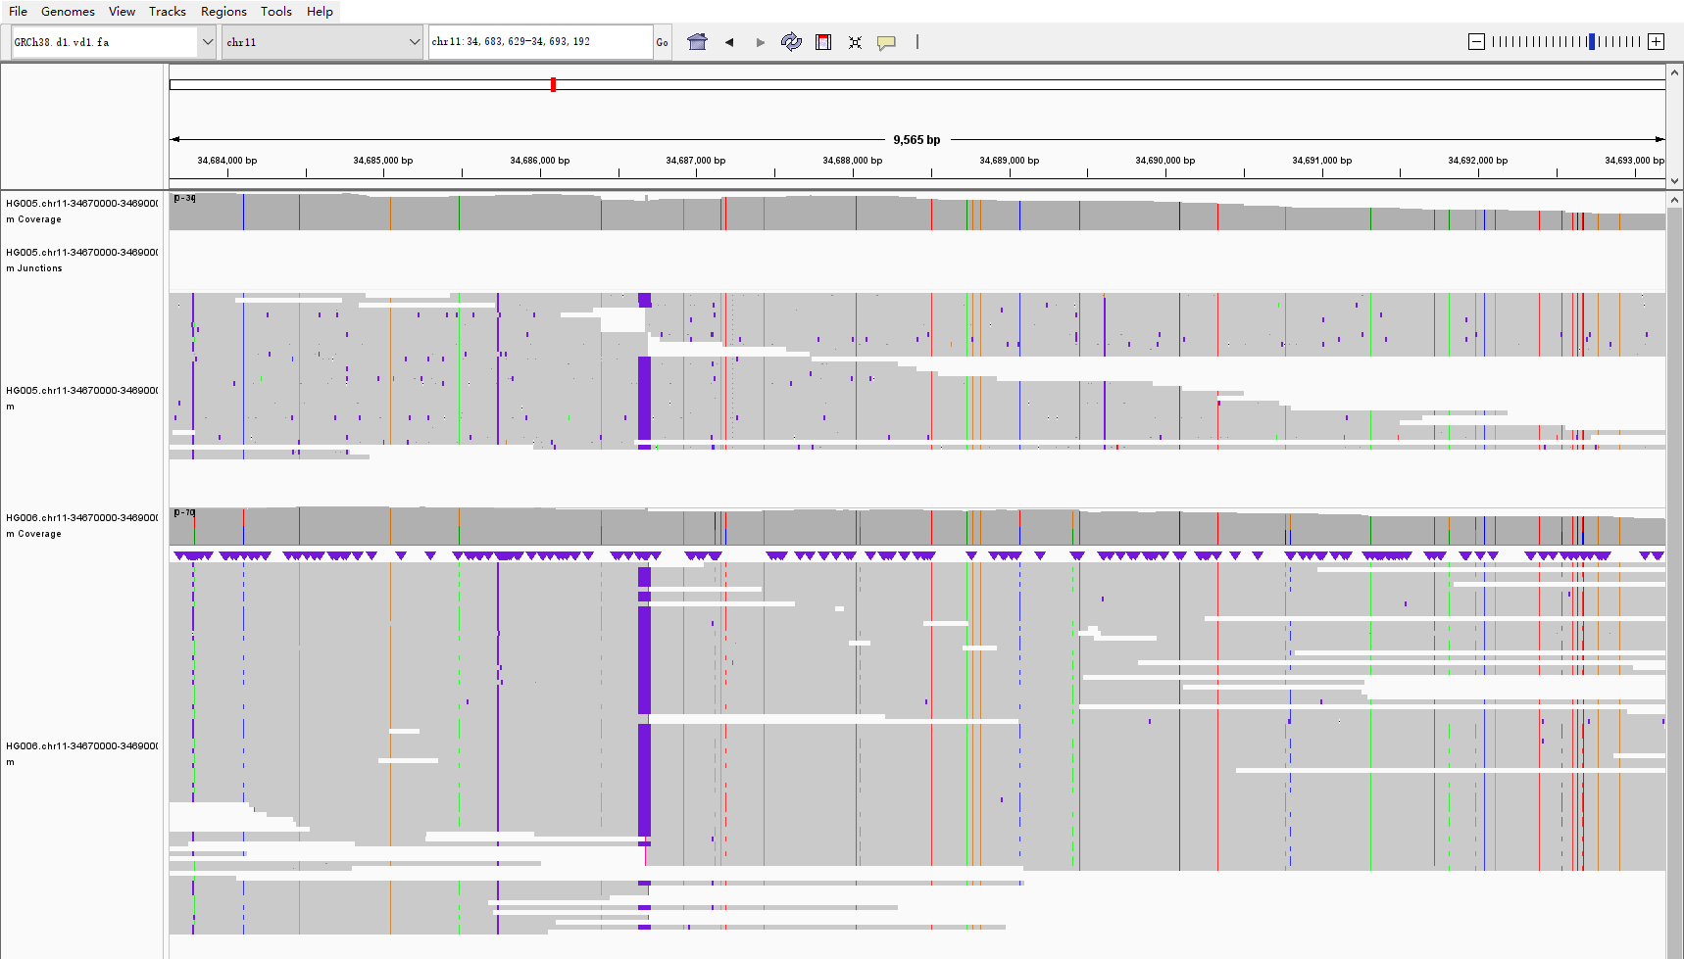
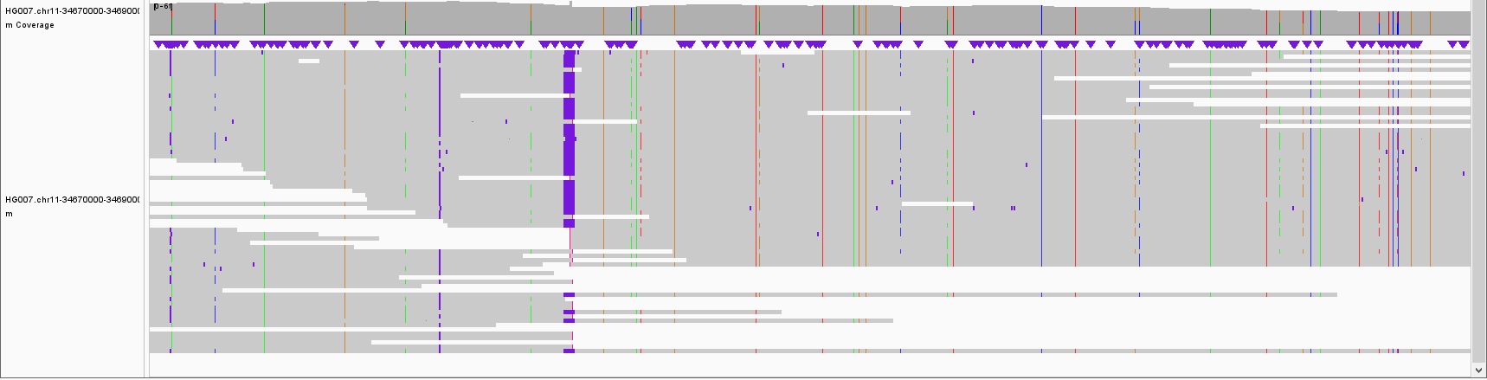
HiFi long reads
chr11:34,683,084-34,692,647
HG005, child
INS: 1/1
HG006: father
INS: 1/1
HG007, mother
INS: 1/1

Slide 8
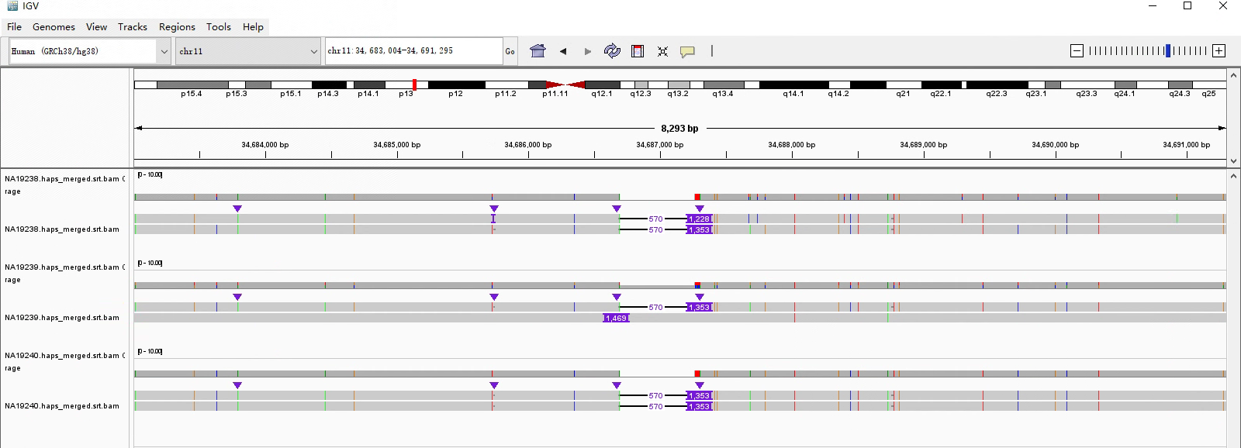
HGSVC2 published assemblies
chr11:34,683,084-34,692,647
NA19238, mother
INS+DEL: 1/1
NA19239, father
INS : 0/1
INS+DEL: 0/1
NA19240, child
INS+DEL: 1/1

Slide 9
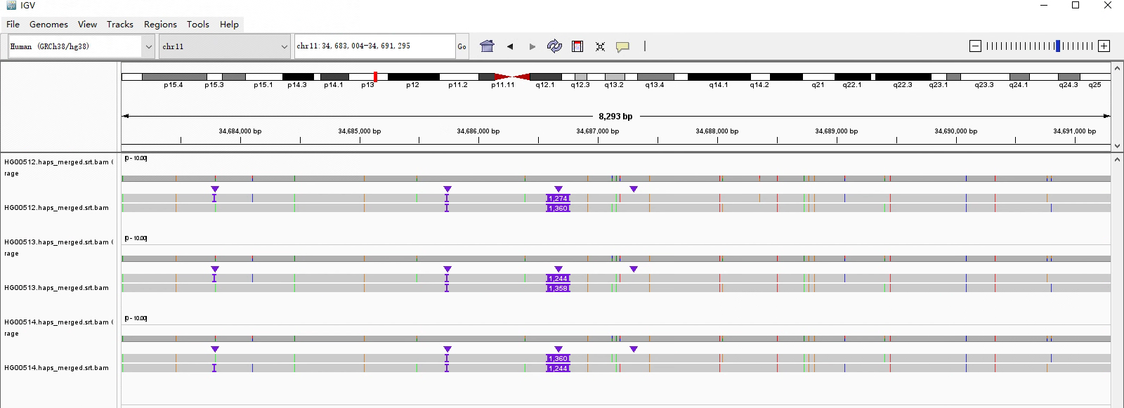
HGSVC2 published assemblies
chr11:34,683,084-34,692,647
HG00512, father
INS: 1/1
HG00513, mother
INS : 1/1
HG00514, child
INS : 1/1

Slide 10
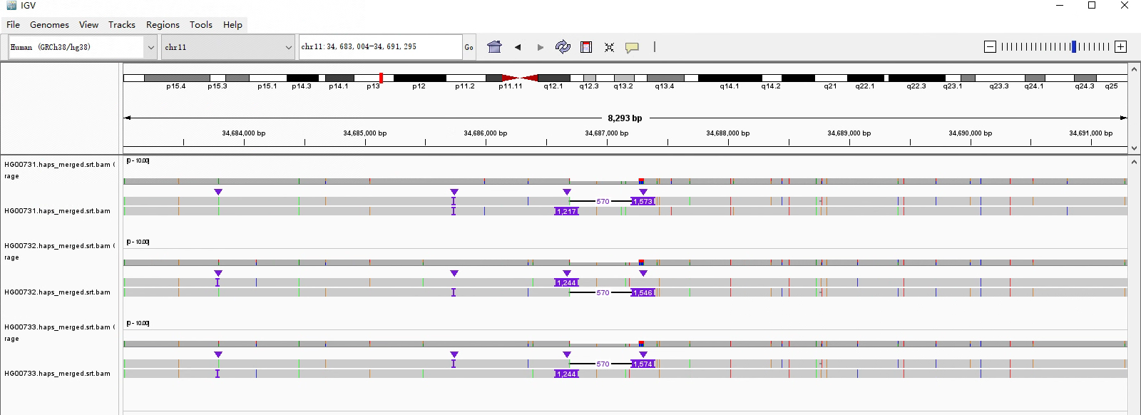
HGSVC2 published assemblies
chr11:34,683,084-34,692,647
HG00731, father
INS: 0/1
INS+DEL: 0/1
HG00732: mother
INS: 0/1
INS+DEL: 0/1
HG00733, child
INS: 0/1
INS+DEL: 0/1

