Slide 1
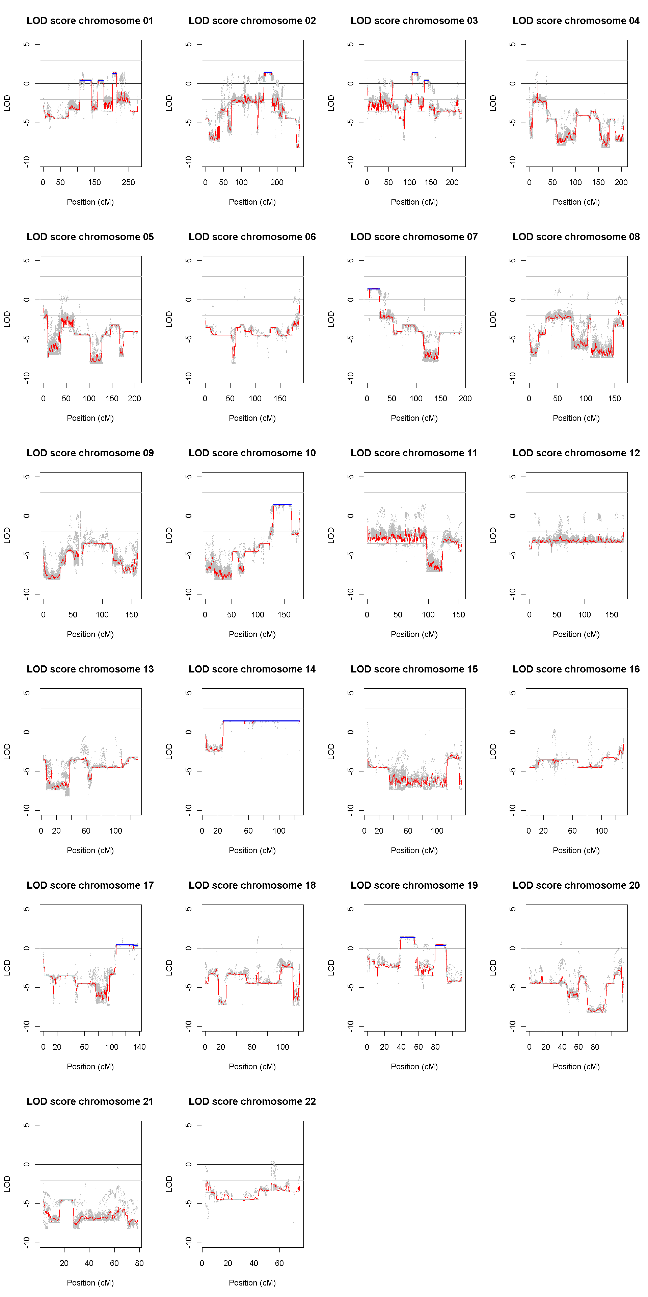
Supplemental figure 1 : LODscore graphical representation

