Slide 1
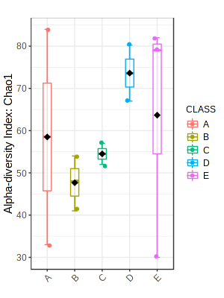
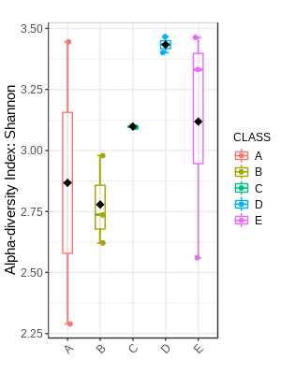
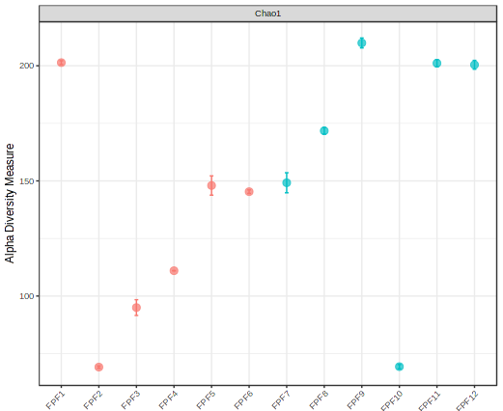
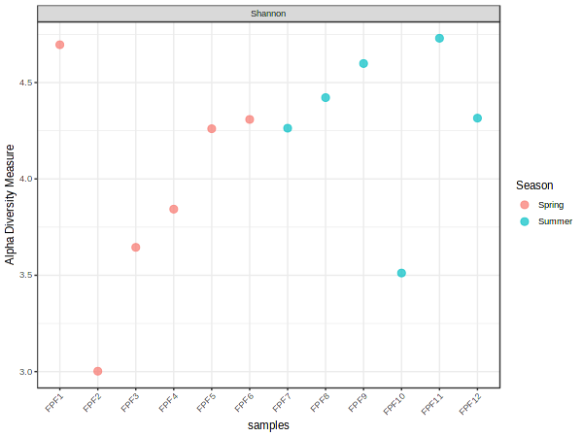
Fig. S1A The richness (Chao 1) and diversity (Shannon) of bacterioplankton during the low FSI (Fish Stock Index) state in the Kvítkovický pond. The box-plots in top panels show monthly averages, minima and maxima, from April (A) to August and September (E). The bottom panels show values for all conducted bi-weekly samplings, from 3rd of April (FPF1) to 18th September (FPF12). Significant effect of progressing season on the beta-diversity was observed (PERMANOVA, F = 1.71, p = 0.04).

Slide 2
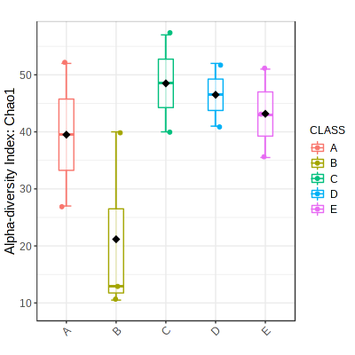
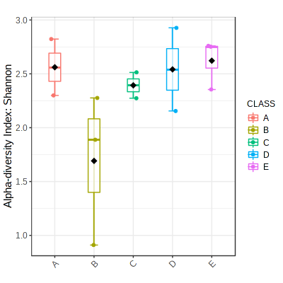
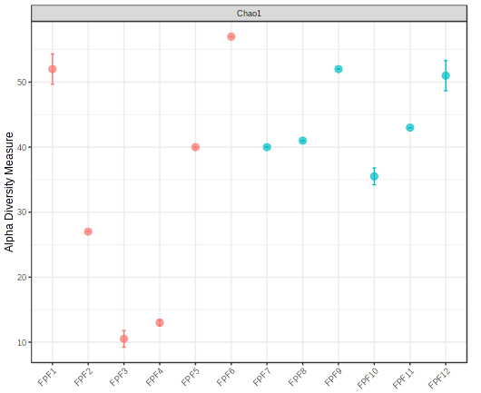
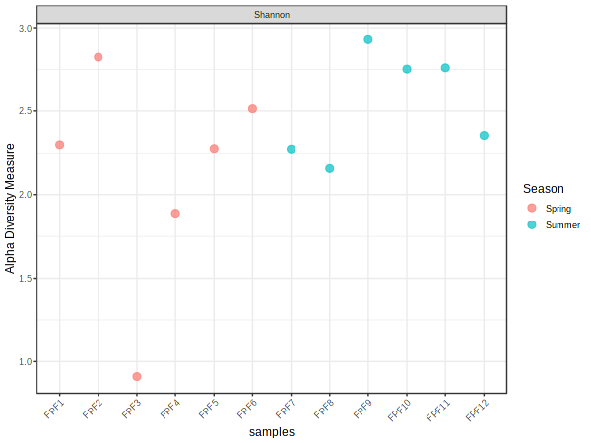
Fig. S1B The richness (Chao 1) and diversity (Shannon) of fungal assemblages during the low FSI (Fish Stock Index) state in the Kvítkovický pond. The box-plots in top panels show monthly averages, minima and maxima, from April (A) to August and September (E). The bottom panels show values for all conducted bi-weekly samplings, from 3rd of April (FPF1) to 18th September (FPF12). Only ASVs identifiable to at least phylum level were included in the analysis. Significant effect of progressing season on the beta-diversity was observed (PERMANOVA, F = 1.24, p = 0.01).

Slide 3
Fig. S2A Correlation matrix visualized by a heat map generated using the ggplot2 package for the high FSI state bacterioplankton, from April (A) to September (F). Significant p values at the 0.001, 0.01, and 0.05 level are represented by "***", "**", and "*", respectively. Positive correlations are shown in red, negative in blue.

Slide 4
Fig. S2B Correlation matrix visualized by a heat map generated using the ggplot2 package for the high FSI state bacterioplankton, from April (A) to September (F). CN: Carbon to Nitrogen molar ratios in particulate organic matter; CH4: methane concentration in the watercolumn; TC200: Total Carbon concentration in the sample fraction filtered through 200 µm mesh. Significant p values at the 0.001, 0.01, and 0.05 level are represented by "***", "**", and "*", respectively. Positive correlations are shown in red, negative in blue.

Slide 5
Fig. S2C Correlation matrix visualized by a heat map generated using the ggplot2 package for the high FSI state bacterioplankton, from April (A) to September (F). DIN: Dissolved Inorganic Nitrogen, DON: Dissolved Organic Nitrogen, NH4: ammonia, TN: Total Nitrogen (GFC fraction). Significant p values at the 0.001, 0.01, and 0.05 level are represented by "***", "**", and "*", respectively. Positive correlations are shown in red, negative in blue.

Slide 6
Fig. S2D Correlation matrix visualized by a heat map generated using the ggplot2 package for the high FSI state bacterioplankton, from April (A) to September (F). DIN: Dissolved Inorganic Nitrogen, DON: Dissolved Organic Nitrogen, NH4: ammonia, TN: Total Nitrogen (GFC fraction). Significant p values at the 0.001, 0.01, and 0.05 level are represented by "***", "**", and "*", respectively. Positive correlations are shown in red, negative in blue.

Slide 7
Fig. S2E Correlation matrix visualized by a heat map generated using the ggplot2 package for the high FSI state bacterioplankton, from April (A) to September (F). A: excitation-emission matrix peak, excitation maximum 250-260 nm, emission maximum 380-480, fulvic acid proxy; B: excitation-emission matrix peak, excitation maximum 270-280 nm, emission maximum 300-320, tyrosine-like OM proxy; FI: fluorescence index, indicator of allochthonous vs autochthonous origin of OM; M: excitation-emission matrix peak, excitation maximum 310-320 nm, emission maximum 380-420, proxy for OM of microbial origin; SR: slope ratio, negative correlation with molecular size, higher values indicate photochemical OM degradation. Significant p values at the 0.001, 0.01, and 0.05 level are represented by "***", "**", and "*", respectively. Positive correlations are shown in red, negative in blue.

Slide 8
Fig. S3A Correlation matrix visualized by a heat map generated using the ggplot2 package for the high FSI state fungal assemblages, from April (A) to September (F). Significant p values at the 0.001, 0.01, and 0.05 level are represented by "***", "**", and "*", respectively. Positive correlations are shown in red, negative in blue. Only ASVs identifiable to at least phylum level were included in the analysis.

Slide 9
Fig. S3B Correlation matrix visualized by a heat map generated using the ggplot2 package for the high FSI state fungal assemblages, from April (A) to September (F). Significant p values at the 0.001, 0.01, and 0.05 level are represented by "***", "**", and "*", respectively. Positive correlations are shown in red, negative in blue. Only ASVs identifiable to at least phylum level were included in the analysis. CN: Carbon to Nitrogen molar ratios in particulate organic matter; CH4: methane concentration in the watercolumn; POC: Particulate Organic Phosphorus; TC200: Total Carbon concentration in the sample fraction filtered through 200 µm mesh; TOC: Total Organic Carbon.

Slide 10
Fig. S3C Correlation matrix visualized by a heat map generated using the ggplot2 package for the high FSI state fungal assemblages, from April (A) to September (F). Significant p values at the 0.001, 0.01, and 0.05 level are represented by "***", "**", and "*", respectively. Positive correlations are shown in red, negative in blue. Only ASVs identifiable to at least phylum level were included in the analysis. TN200: Total Nitrogen concentration in the sample fraction filtered through 200 µm mesh.

Slide 11
Fig. S3D Correlation matrix visualized by a heat map generated using the ggplot2 package for the high FSI state fungal assemblages, from April (A) to September (F). Significant p values at the 0.001, 0.01, and 0.05 level are represented by "***", "**", and "*", respectively. Positive correlations are shown in red, negative in blue. Only ASVs identifiable to at least phylum level were included in the analysis. DOP: Dissolved Organic Phosphorus; DRP: Dissolved Reactive Phosphorus; TPGFC: Total Phosphorus (GFC fraction).

Slide 12
Fig. S3E Correlation matrix visualized by a heat map generated using the ggplot2 package for the high FSI state fungal assemblages, from April (A) to September (F). Significant p values at the 0.001, 0.01, and 0.05 level are represented by "***", "**", and "*", respectively. Positive correlations are shown in red, negative in blue. Only ASVs identifiable to at least phylum level were included in the analysis. A: excitation-emission matrix peak, excitation maximum 250-260 nm, emission maximum 380-480, fulvic acid proxy; C: excitation-emission matrix peak, excitation maximum 330-350 nm, emission maximum 420-480, humic acid proxy; M: excitation-emission matrix peak, excitation maximum 310-320 nm, emission maximum 380-420, proxy for OM of microbial origin; T: excitation-emission matrix peak, excitation maximum 270-280 nm, emission maximum 320-350, tryptofan-like OM proxy.

Slide 13
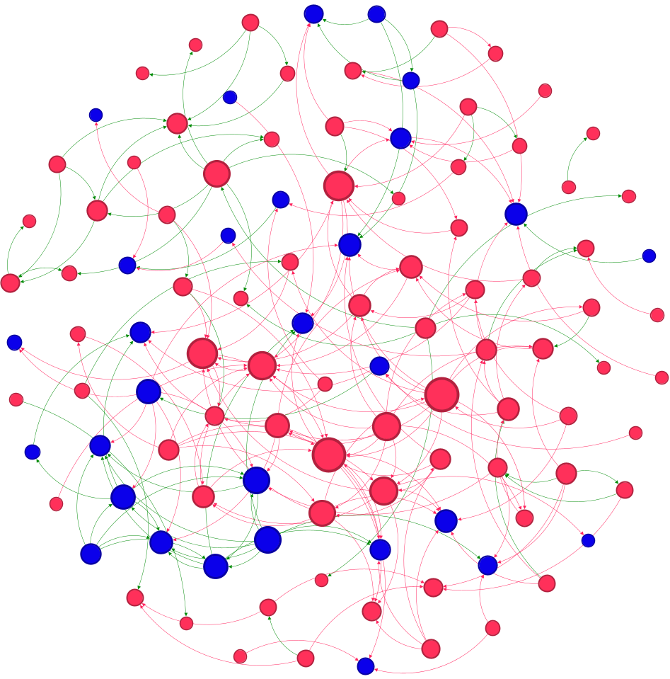
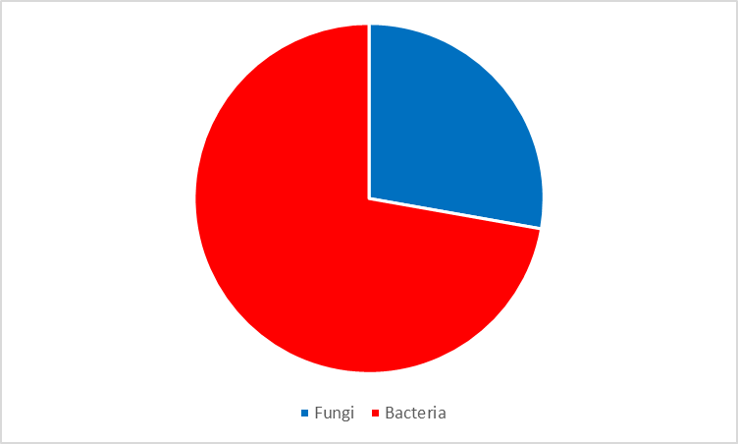
28%
72%
Actinobacteria (46.3%)
Gammaproteobacteria (13.9%)
Alphaproteobacteria (8.3%)
Basidiomycota (7.4%)
Leotiomycetes (3.7%)
Bacteroidia (3.7%)
Dothideomycetes (2.8%)
Microbotryomycetes (2.8%)
Tremellomycetes (1.8%)
Hyaloraphidiomycetes (1.8%)
Ascomycota (1.8%)
Chytridiomycota (1.8%)
Figure S4A Cross-kingdom (bacterial-fungal) co-occurrence network in the high FSI (Fish Stock Index) plankton during the spring period. Color of nodes denotes taxonomy (see legend). The size of the node is proportional to degree of connectivity (genus level). Green links are co-occurrence network edges with positive correlation coefficients. Red links are co-occurrence network edges with negative correlation coefficients. The proportion of bacterial to fungal nodes in the network are shown in the upper left corner pie-chart and simplified network overview.

Slide 14
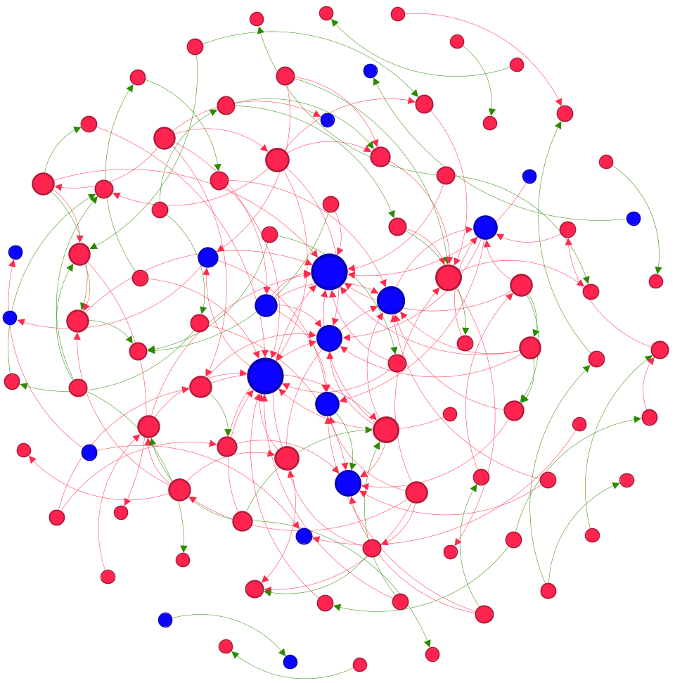
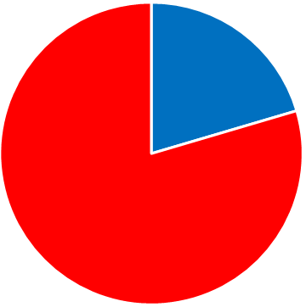
20%
80%
Actinobacteria (52.6%)
Alphaproteobacteria (19.3%)
Verrucomicrobiae (6.4%)
Ascomycota (6.4%)
Basidiomycota (4.3%)
Agaricomycetes (3.2%)
Leotiomycetes (2.1%)
Chytridiomycota (2.1%)
Gammaproteobacteria (1.0%)
Dothideomycetes (1.0%)
Hyaloraphidiomycetes (1.0%)
Figure S4B Cross-kingdom (bacterial-fungal) co-occurrence network in the high FSI (Fish Stock Index) plankton during the summer period. Color of nodes denotes taxonomy (see legend). The size of the node is proportional to degree of connectivity (genus level). Green links are co-occurrence network edges with positive correlation coefficients. Red links are co-occurrence network edges with negative correlation coefficients. The proportion of bacterial to fungal nodes in the network are shown in the upper left corner pie-chart and simplified network overview.

Slide 15
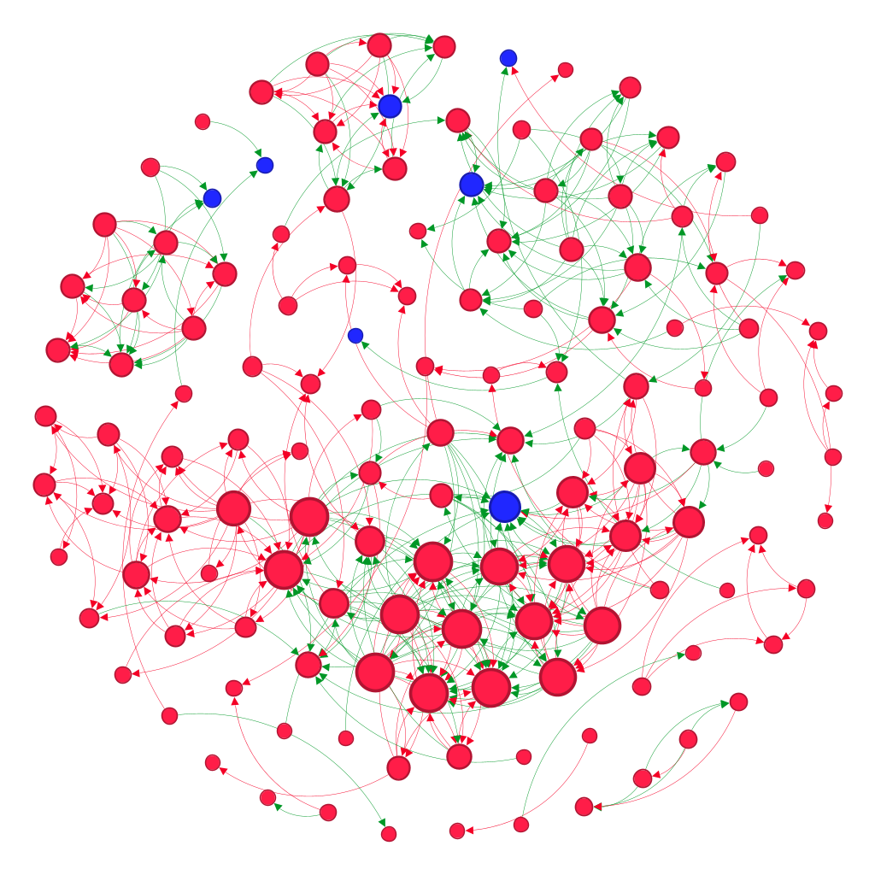
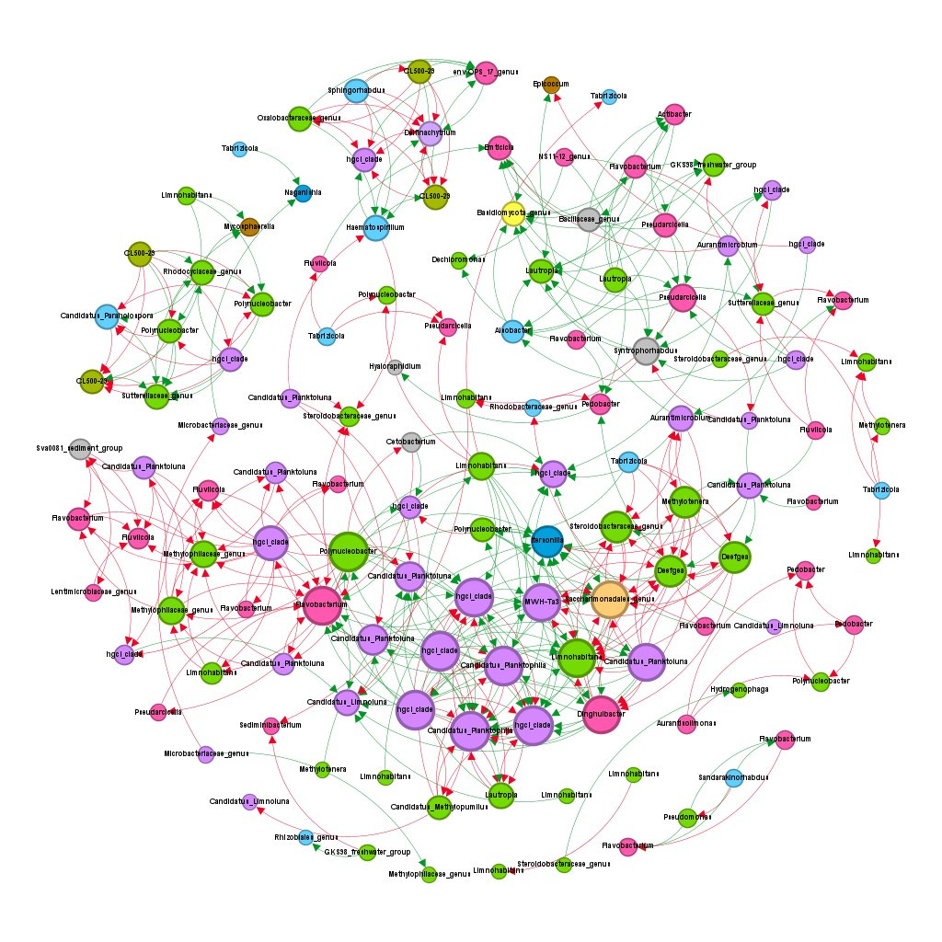
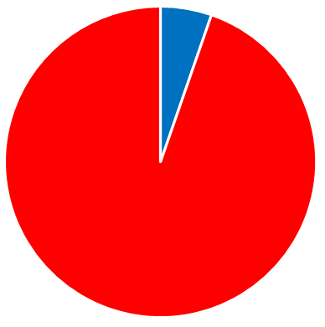
5%
95%
Gammaproteobacteria (31.8%)
Actinobacteria (24.2%)
Bacteroidia (22.7%)
Alphaproteobacteria (9.0%)
Acidimicrobiia (3.0%)
Tremellomycetes (1.5%)
Dothideomycetes (2.8%)
Saccharimonadia (0.7%)
Basidiomycota (0.7%)
Chytridiomycota (0.7%)
Figure S4C Cross-kingdom (bacterial-fungal) co-occurrence network in the low FSI (Fish Stock Index) plankton during the spring period. Color of nodes denotes taxonomy (see legend). The size of the node is proportional to degree of connectivity (genus level). Green links are co-occurrence network edges with positive correlation coefficients. Red links are co-occurrence network edges with negative correlation coefficients. The proportion of bacterial to fungal nodes in the network are shown in the upper left corner pie-chart and simplified network overview.

Slide 16
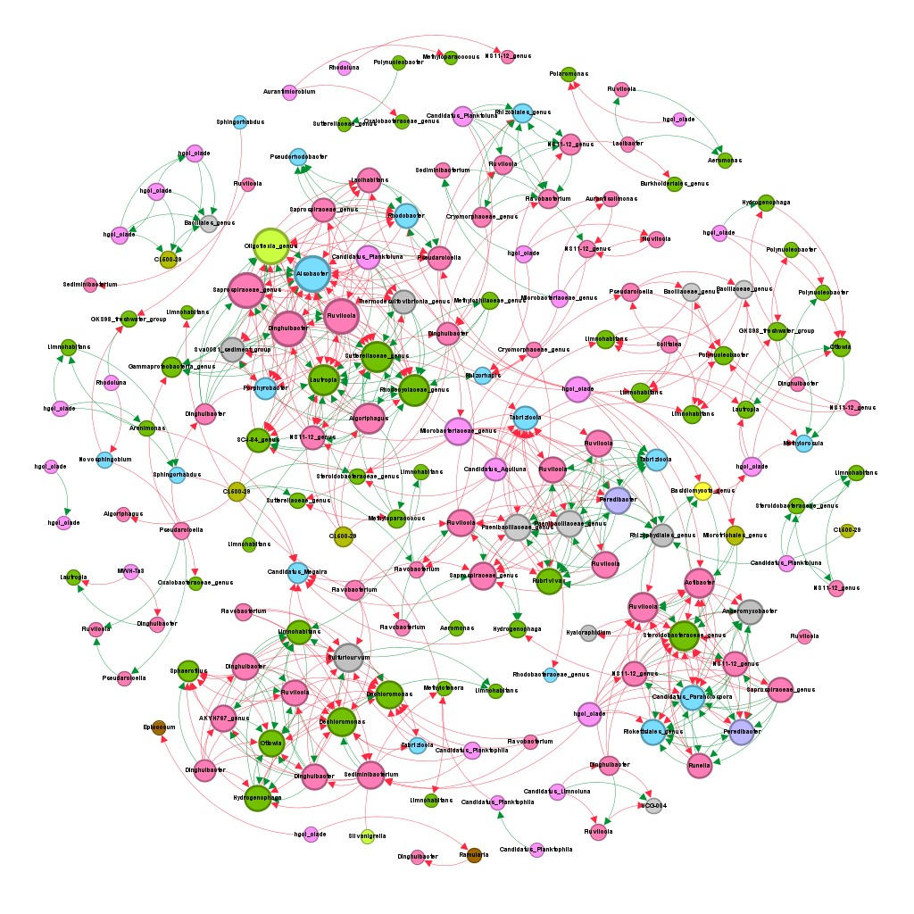
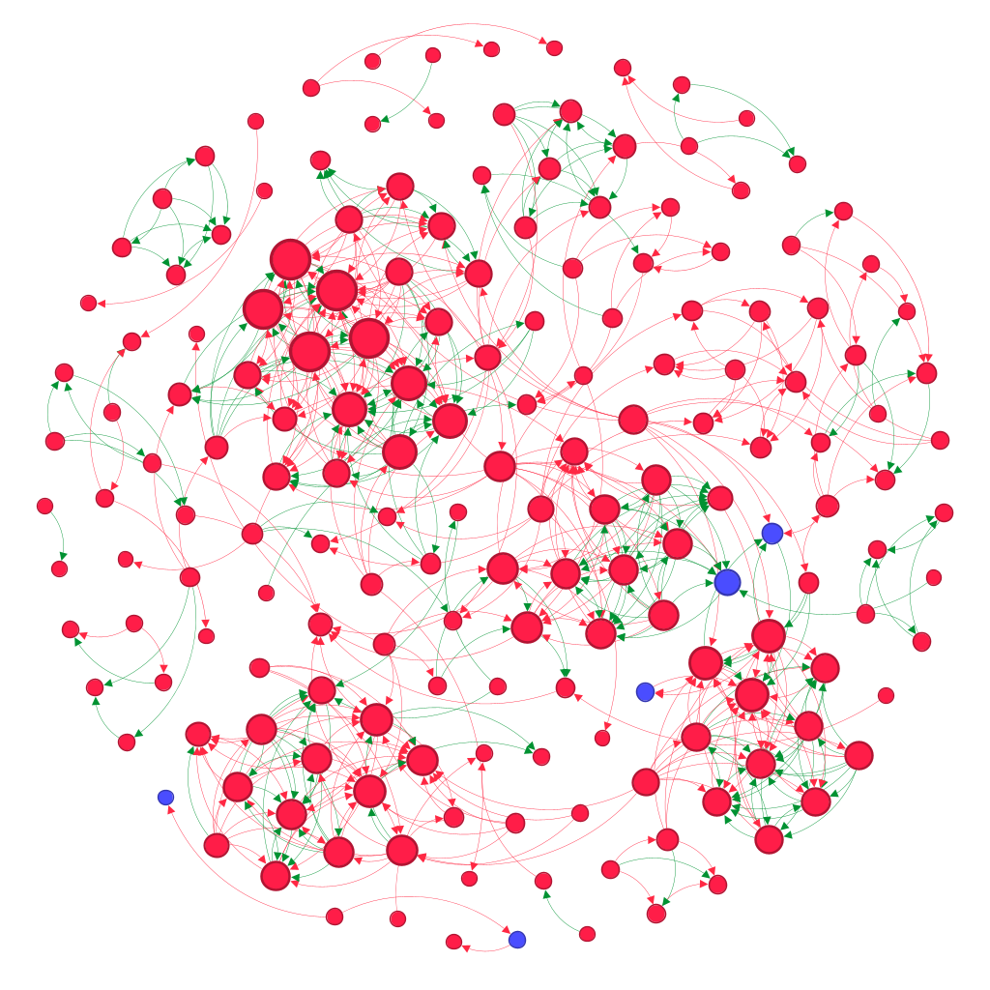
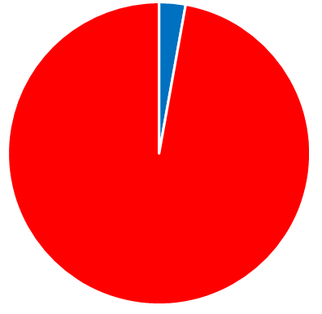
3%
97%
Bacteroidia (33.9%)
Gammaproteobacteria (27.6%)
Actinobacteria (15.2%)
Alphaproteobacteria (9.6%)
Bacilli (3.3%)
Acidimicrobiia (2.8%)
Dothideomycetes (1.1%)
Bdellovibrionia (1.1%)
Oligoflexia (1.1%)
Basidiomycota (0.5%)
Figure S4D Cross-kingdom (bacterial-fungal) co-occurrence network in the low FSI (Fish Stock Index) plankton during the summer period. Color of nodes denotes taxonomy (see legend). The size of the node is proportional to degree of connectivity (genus level). Green links are co-occurrence network edges with positive correlation coefficients. Red links are co-occurrence network edges with negative correlation coefficients. The proportion of bacterial to fungal nodes in the network are shown in the upper left corner pie-chart and simplified network overview.

