Slide 1
Scaffold for the Minimally Invasive Repair of Soft Tissue Inspired by Soggy Shrunk Puffed Food
Mingjun Xie^{#,1,2,3,6}, Shengxi Jin^{#,4}, Kang Yu^{#,1,2,3}, Hui Lin^{*,4,5}, Yong He^{*,1,2,3}
1. State Key Laboratory of Fluid Power and Mechatronic Systems, School of Mechanical Engineering, Zhejiang University, Hangzhou 310027, China
2. Key Laboratory of 3D Printing Process and Equipment of Zhejiang Province, College of Mechanical Engineering, Zhejiang University, Hangzhou 310027, China
3. Cancer Center, Zhejiang University, Hangzhou, Zhejiang 310058 China
4. Department of General Surgery, Sir Run Run Shaw Hospital, School of Medicine, Zhejiang University, Hangzhou, China;
5. College of Biomedical Engineering and Instrument Science, Zhejiang University, Hangzhou, China.
6. Plastic and Reconstructive Surgery Center, Department of Plastic and Reconstructive Surgery, Zhejiang Provincial People's Hospital (Affiliated People's Hospital), Hangzhou Medical College, Hangzhou, Zhejiang, China
# The authors are equal to this work.
* Corresponding author. E-mail: yongqin@zju.edu.cn; 369369@zju.edu.cn

Slide 2
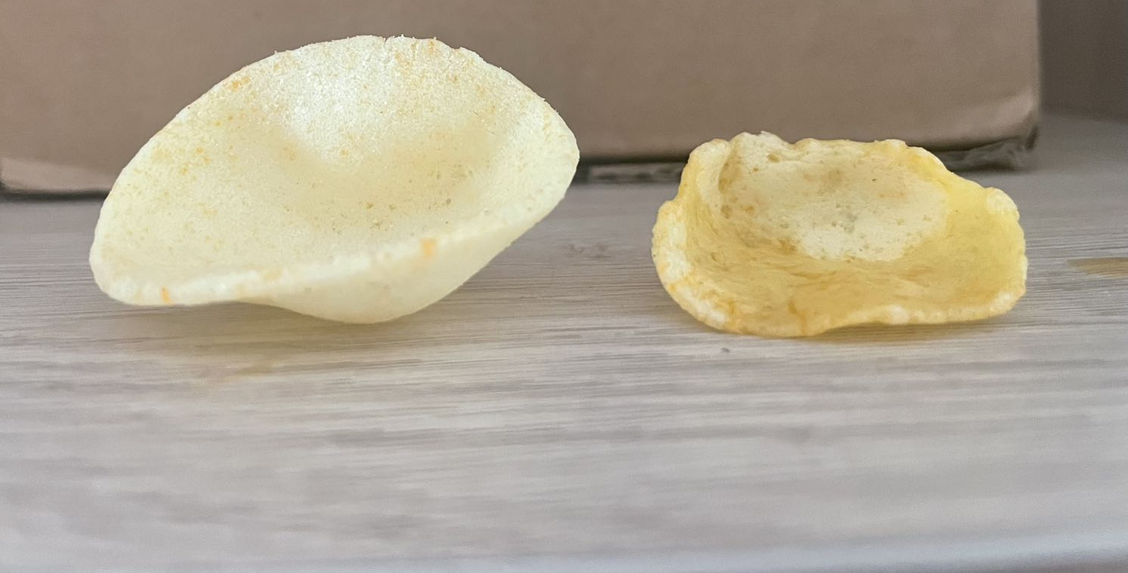
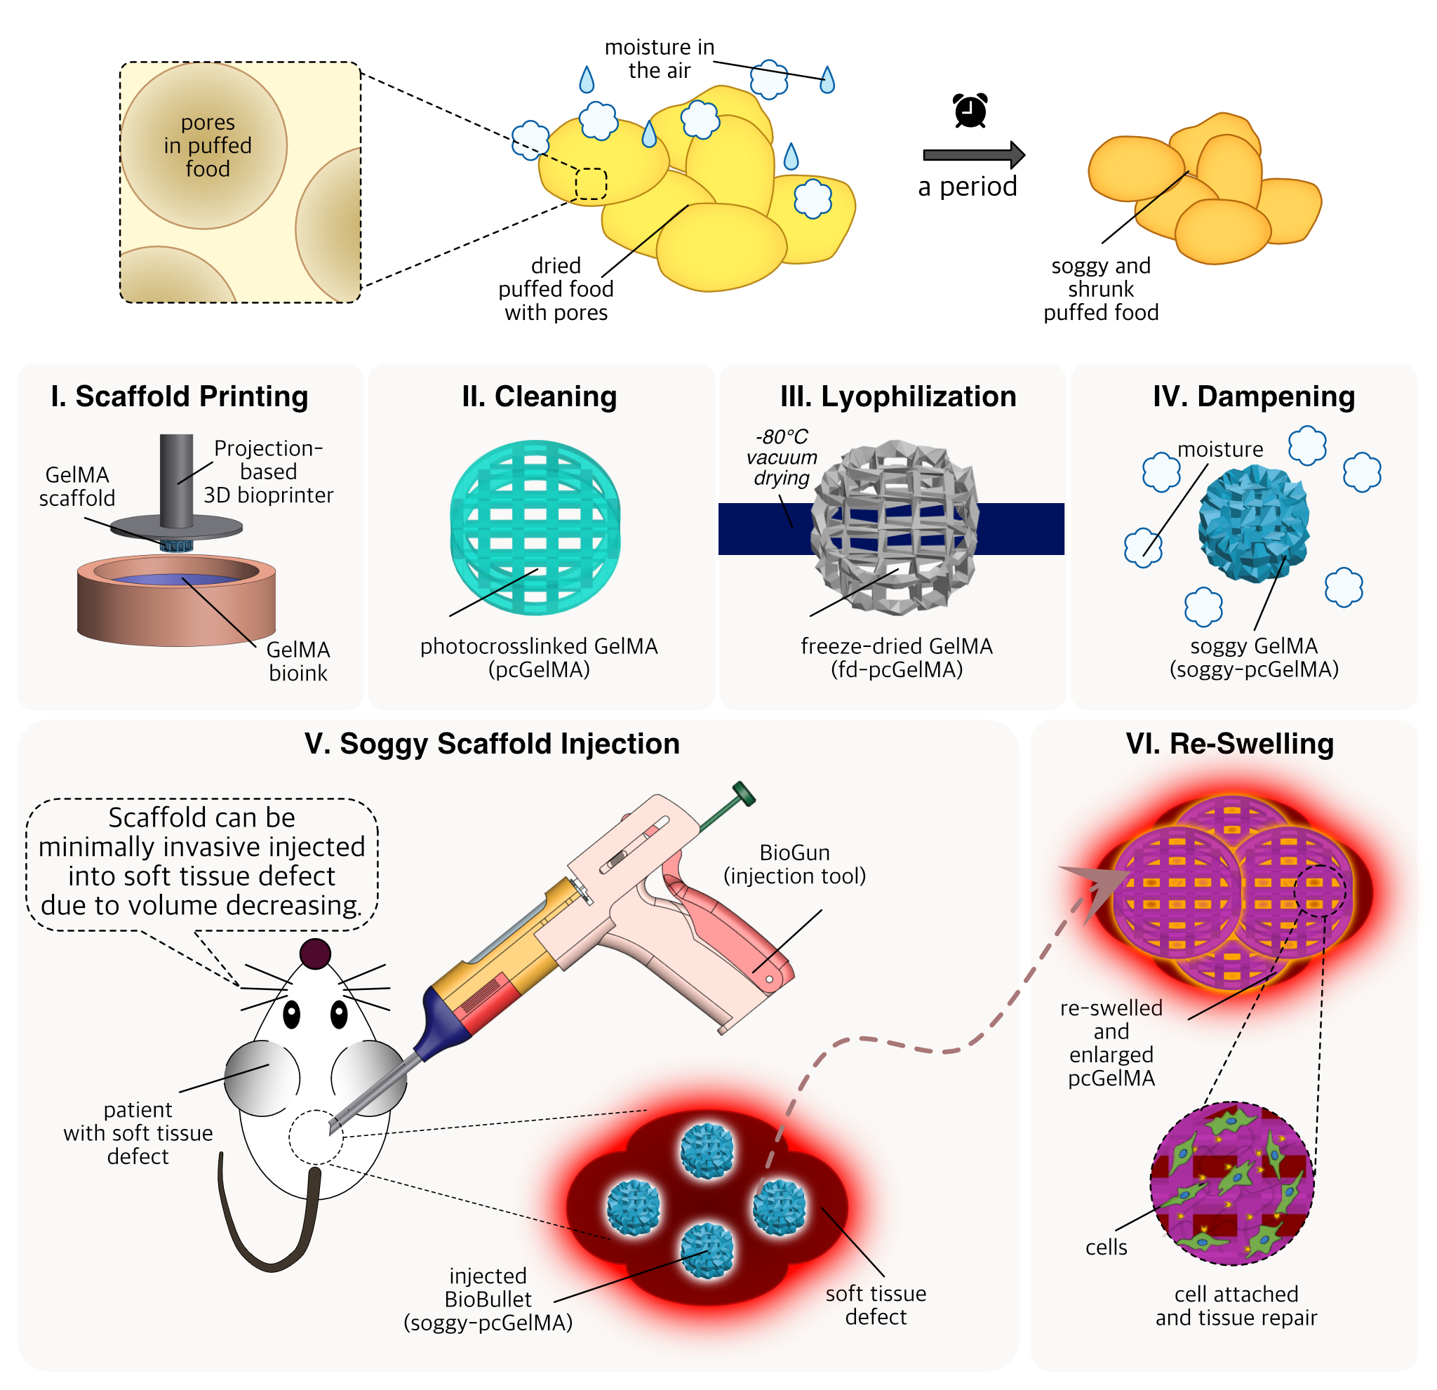
The phenomenon that puffed food gets soggy and shrunk
Dry puffed food
Soggy puffed food
Puffed food, which owns an ocean of inner pores, would get soggy in the wet air. Simultaneously, the volume of the puffed food would get shrunk. We are considering if this phenomenon can be applied in the hydrogel scaffold scale varying.

Slide 3
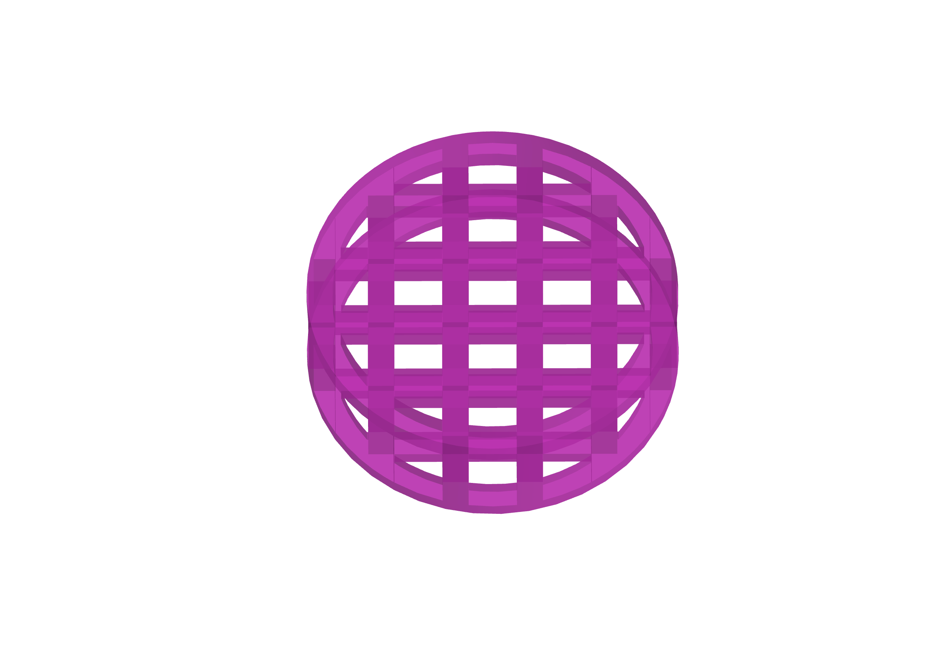
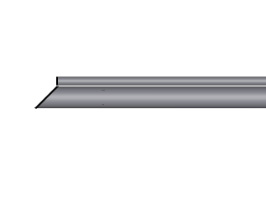
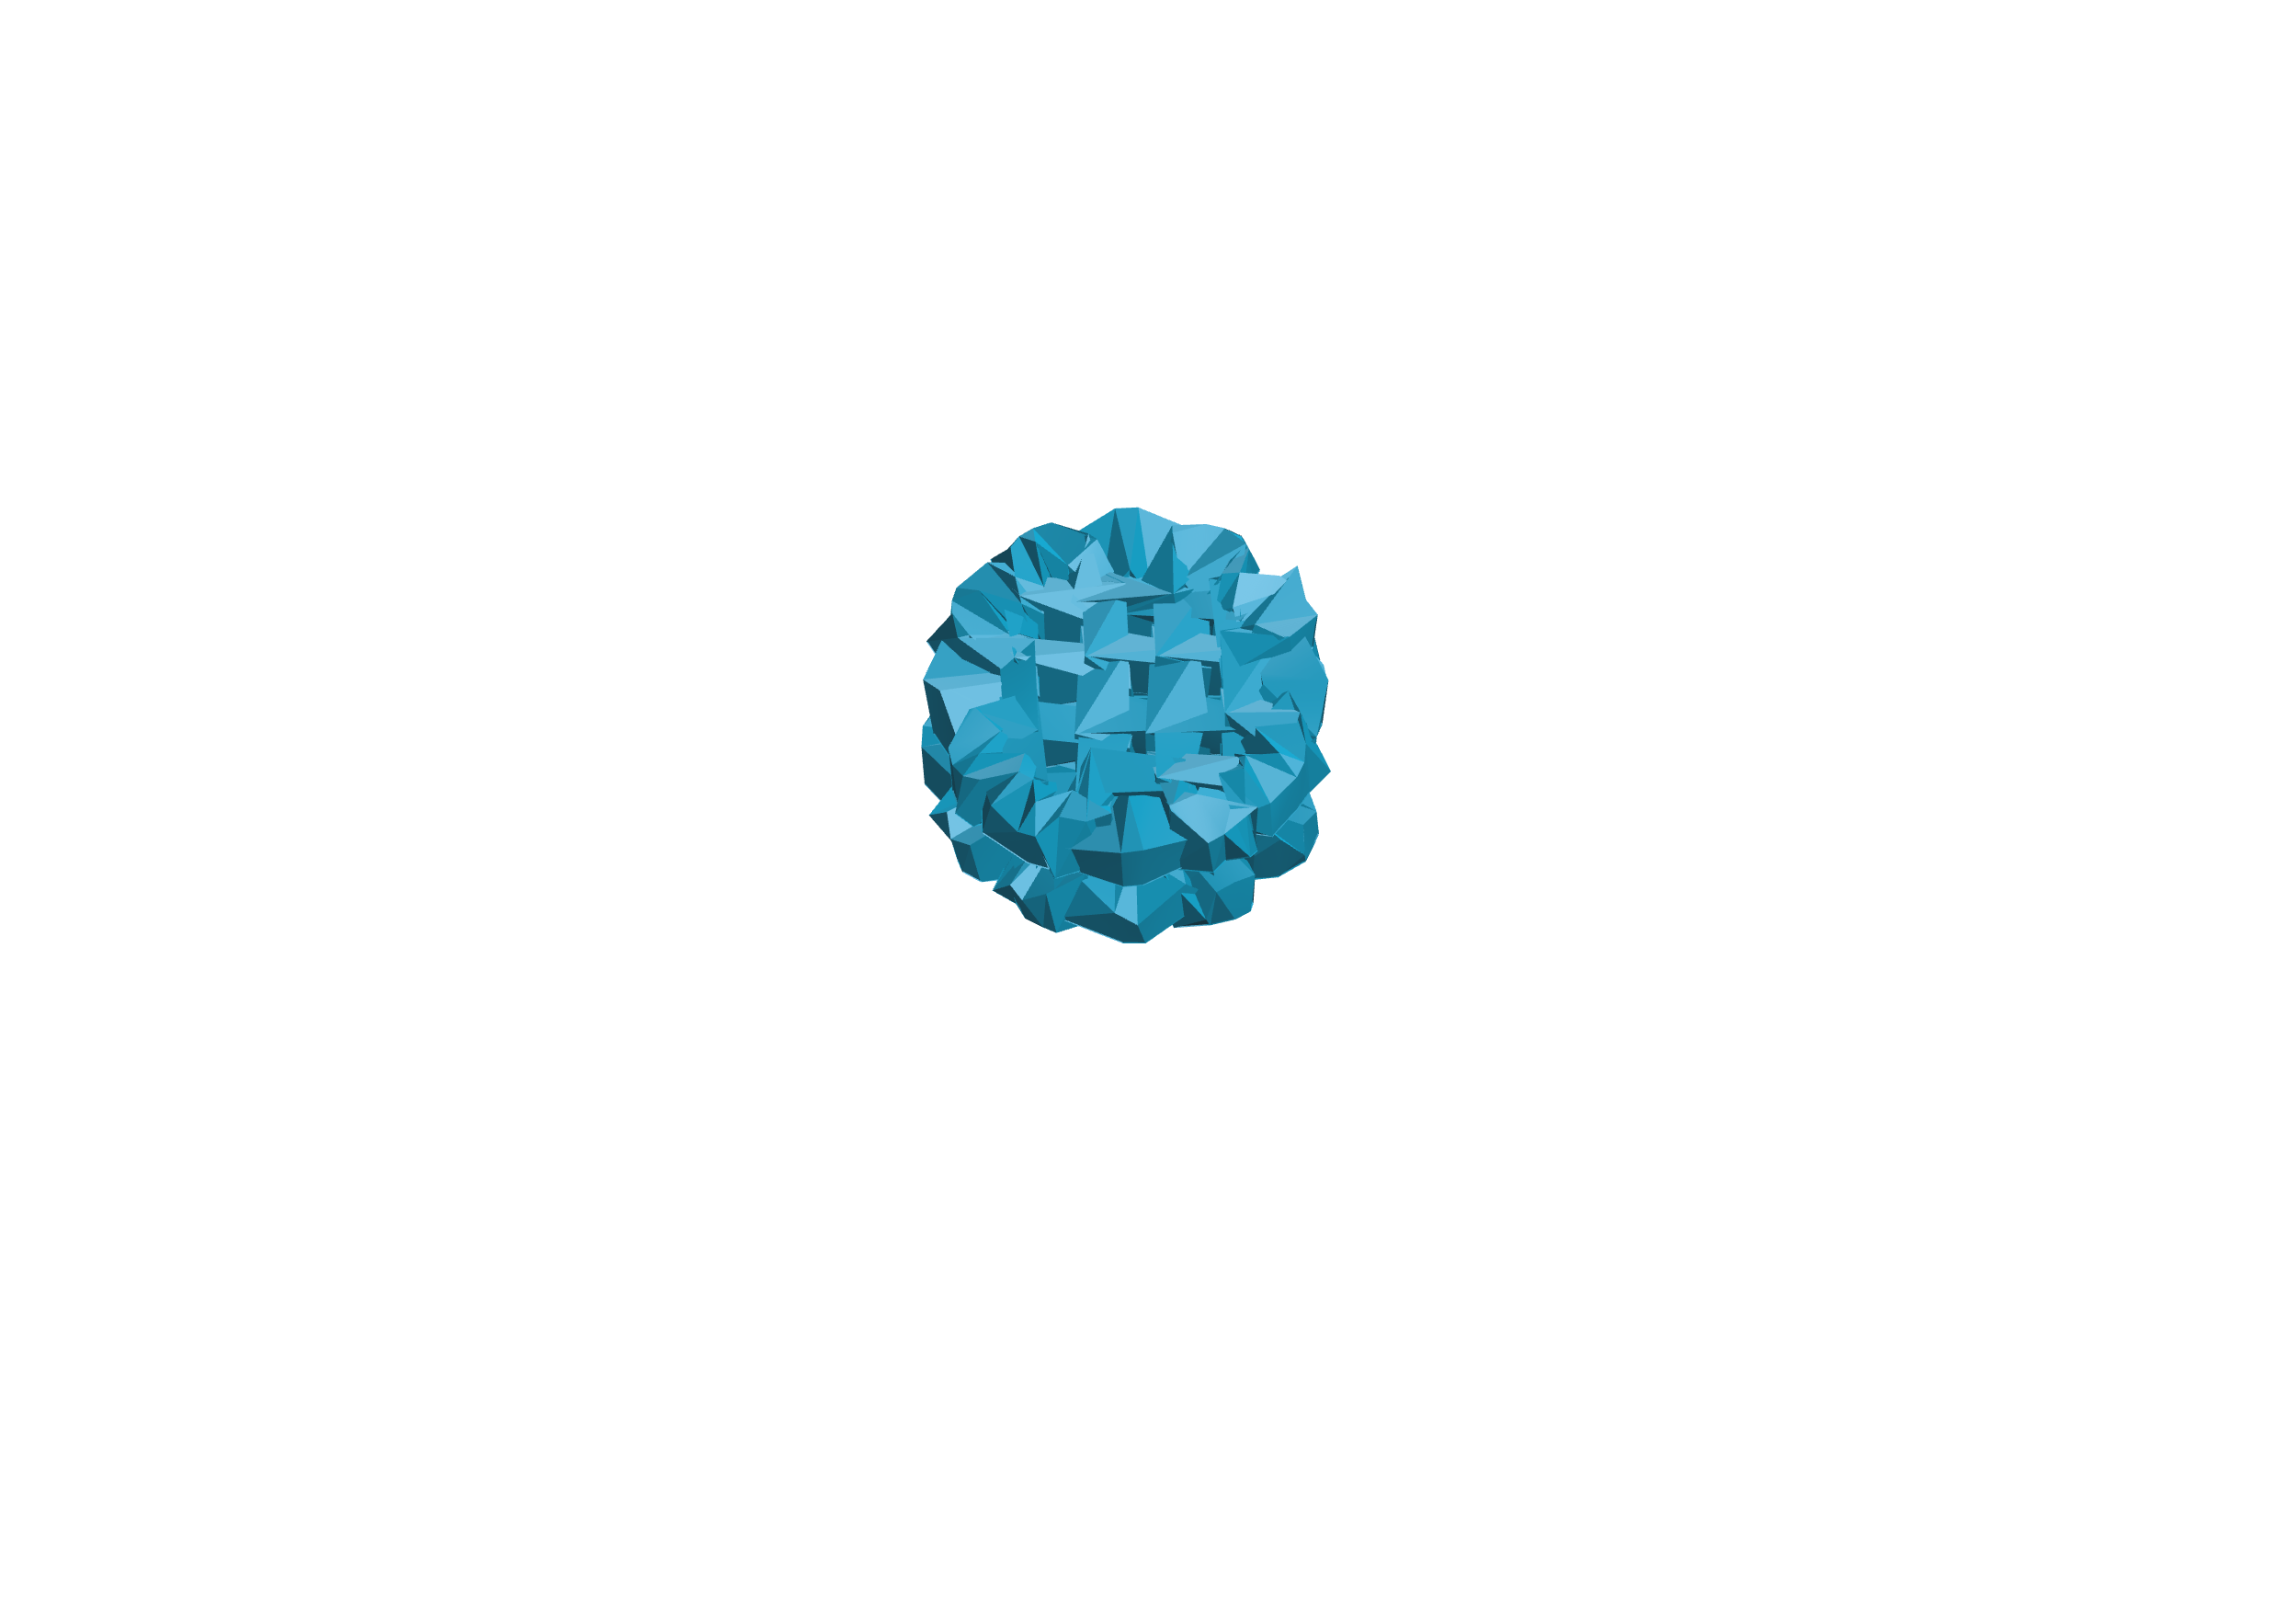
Special requirements of in minimally invasive injection using hydrogel scaffold
Suitable Tiny Size
Low Foreign Body Sensation
Defect Filling
Good Biocompatibility
patient
enlarged hydrogel scaffold
injection
needle
soft tissue defect
hydrogel
scaffold
implantation
place
cells
Large-scale soft tissue defect always requires integrated large-scale hydrogel scaffold, which, however, can be only directly implanted by breaking skin rather than minimally invasive injection.
Special requirements of in minimally invasive injection using hydrogel scaffold: suitable tiny size, low foreign body sensation, defect filling, good biocompatibility.

Slide 4
Bran-new lyophilization & dampening treatment method for minimally invasive injection hydrogel scaffold
We will develop lyophilization & dampening (L&D) treatment, which reduces the printed hydrogel scaffold volume by around 90%.
Lyophilization treatment can remove water inside the scaffolds; Dampening treatment, that is, placing the freeze-dried scaffolds into a vapor atmosphere, can make scaffolds shrunk to a suitable size for minimally invasive injection.

Slide 5
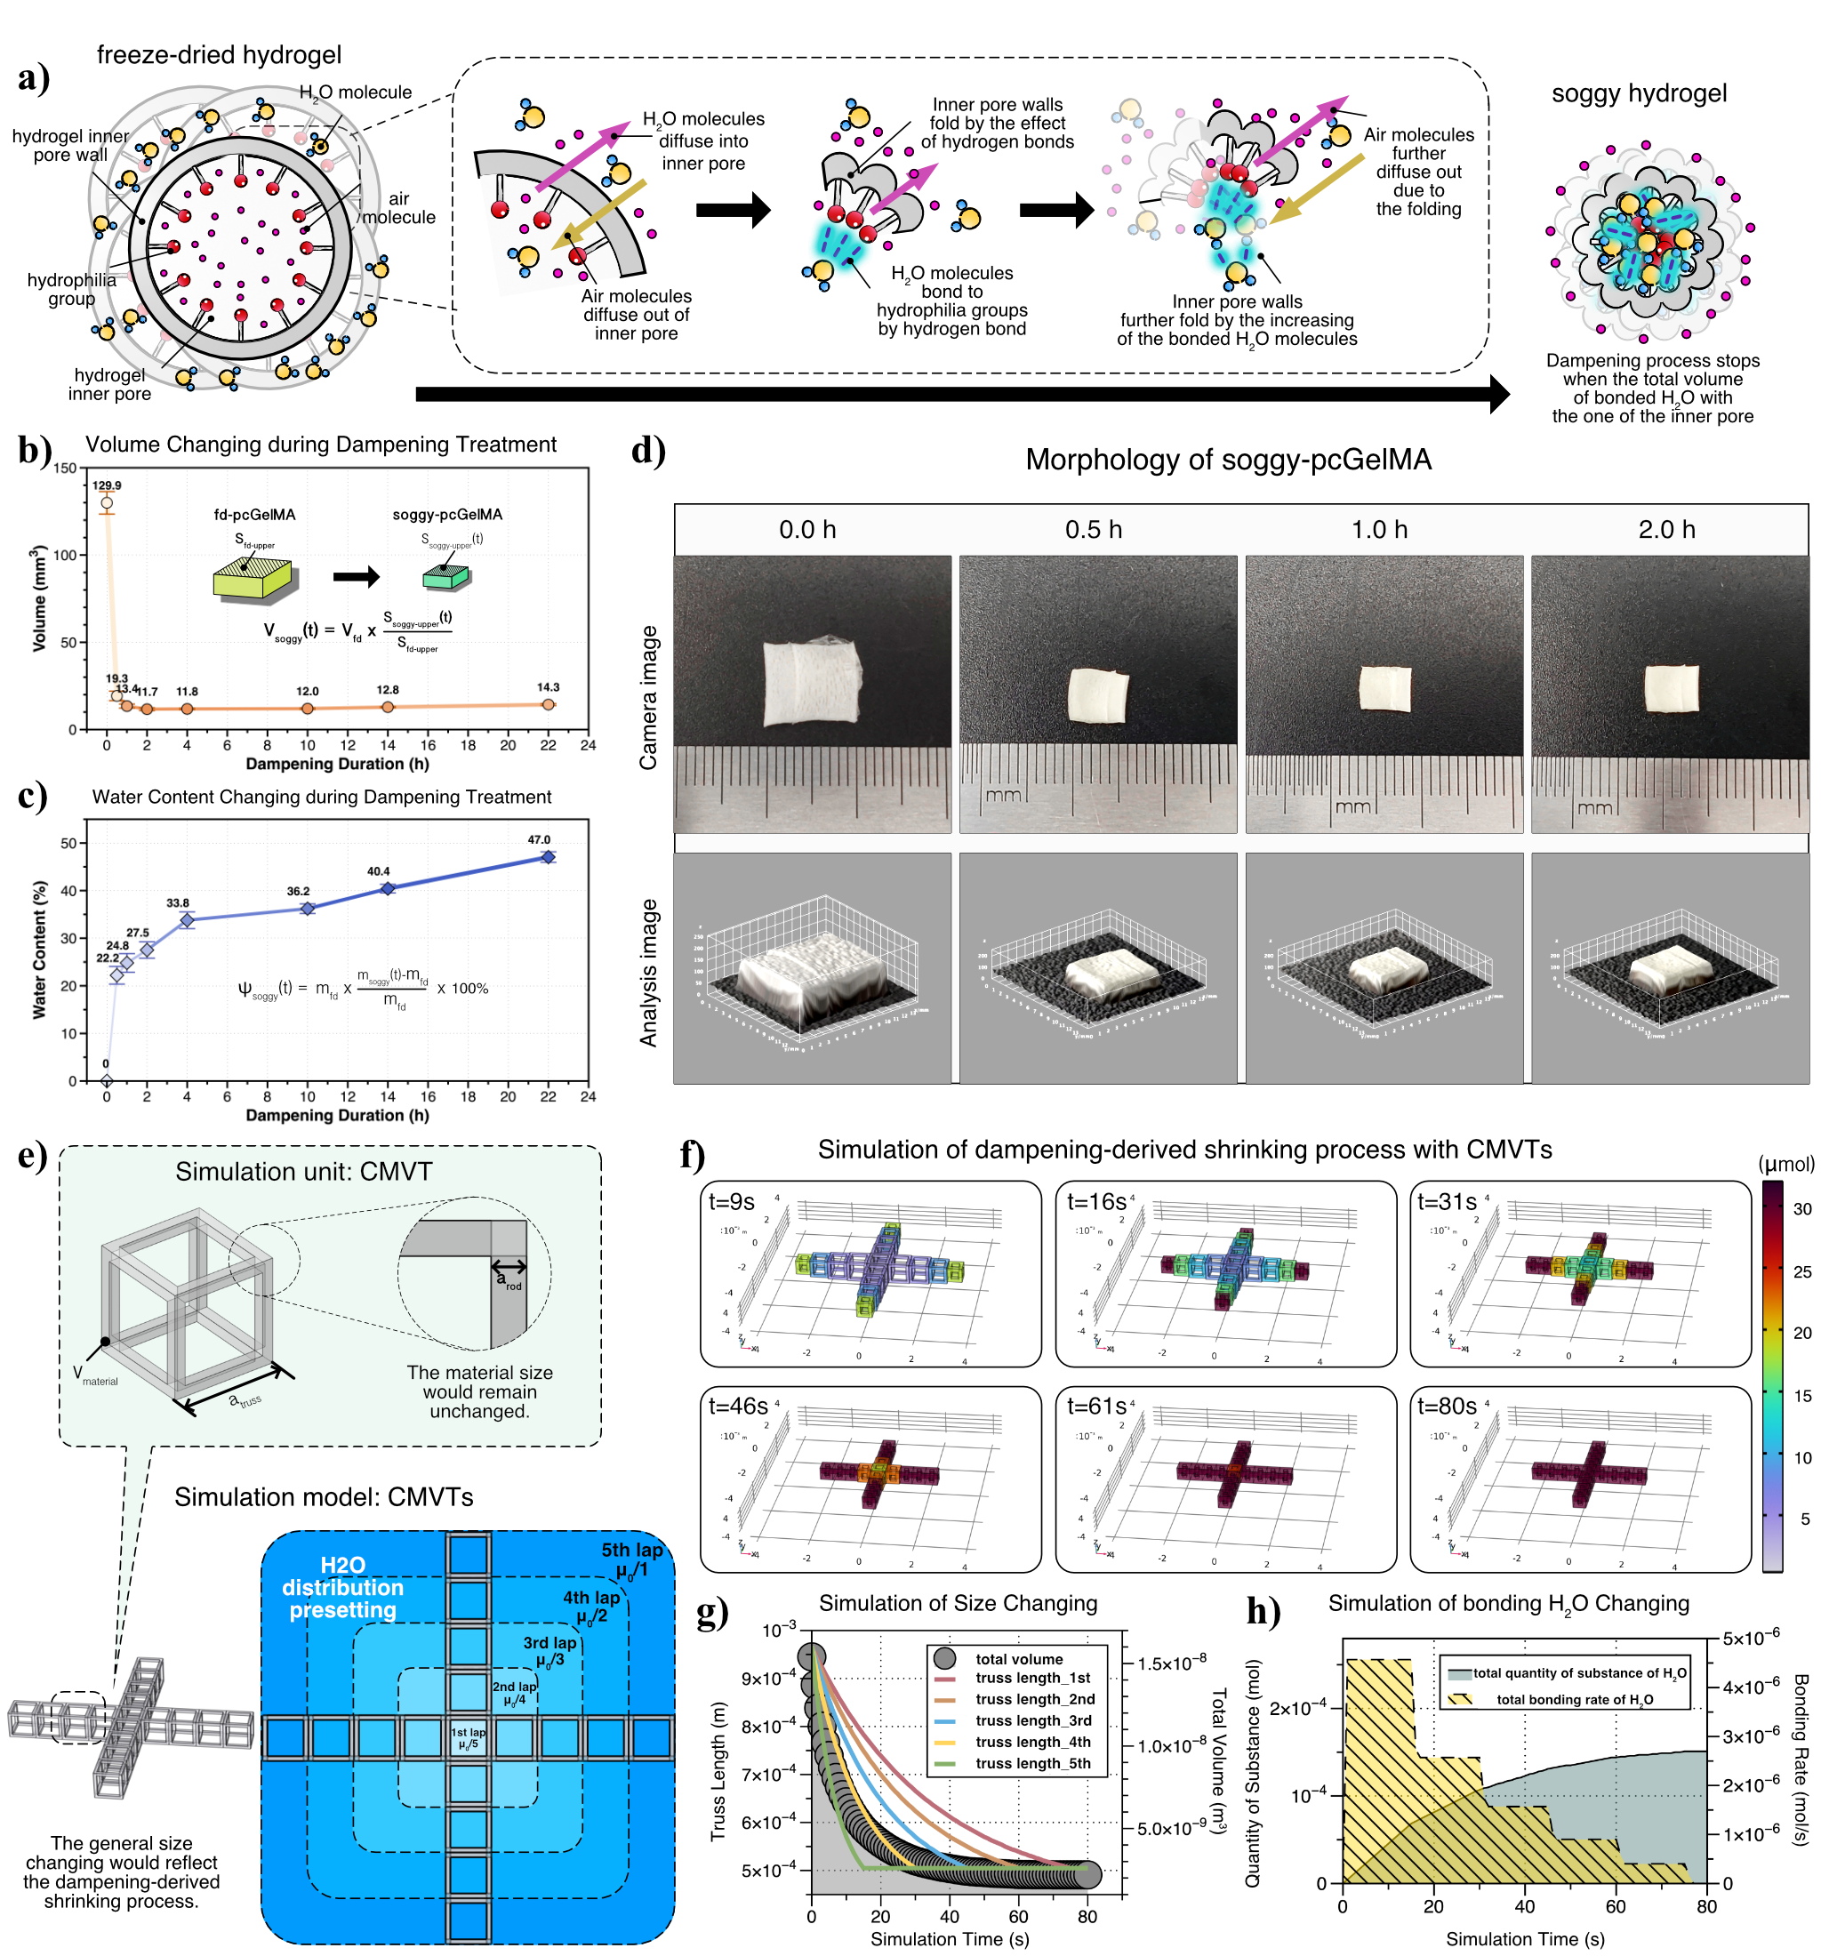
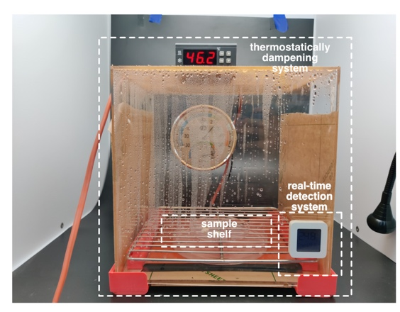
Miniaturization benefitted from volume shrinking
Dampening system
Having a scaffold size that is small enough is a key factor determining the success of scaffolds purposed for injection into the defect site of a patient, as a small size is what allows the scaffold to pass through a thin injection needle.
Dampening process reduces the printed hydrogel scaffold volume by around 90%.

Slide 6
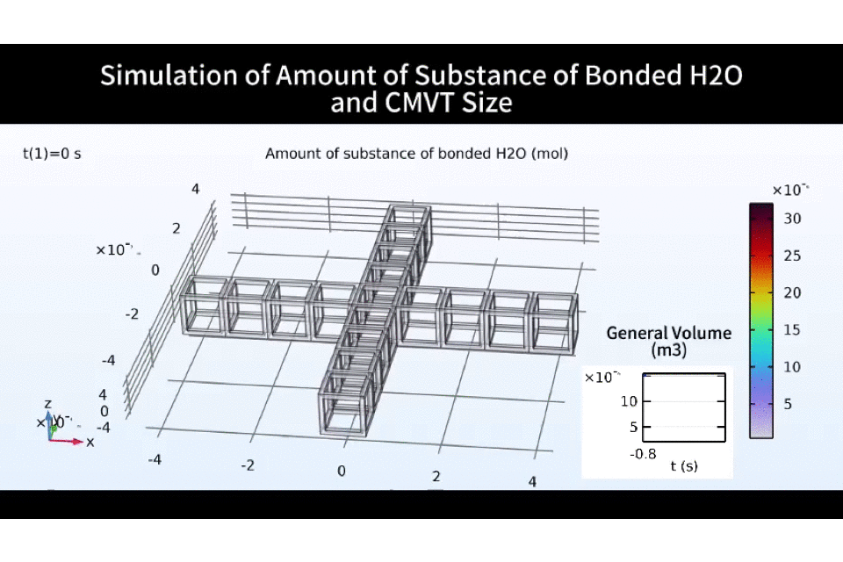
Simulation of the volume shrinking process
To further describe the fd-pcGelMA shrinking behavior during the dampening process, a finite element simulation model was established and parametric sweep analysis was carried out.
Each pore within the pore wall inside the fd-pcGelMA was simplified into a “constant material-volume truss (CMVT)” structure with hydrophilic bonds on the “rods”.

Slide 7
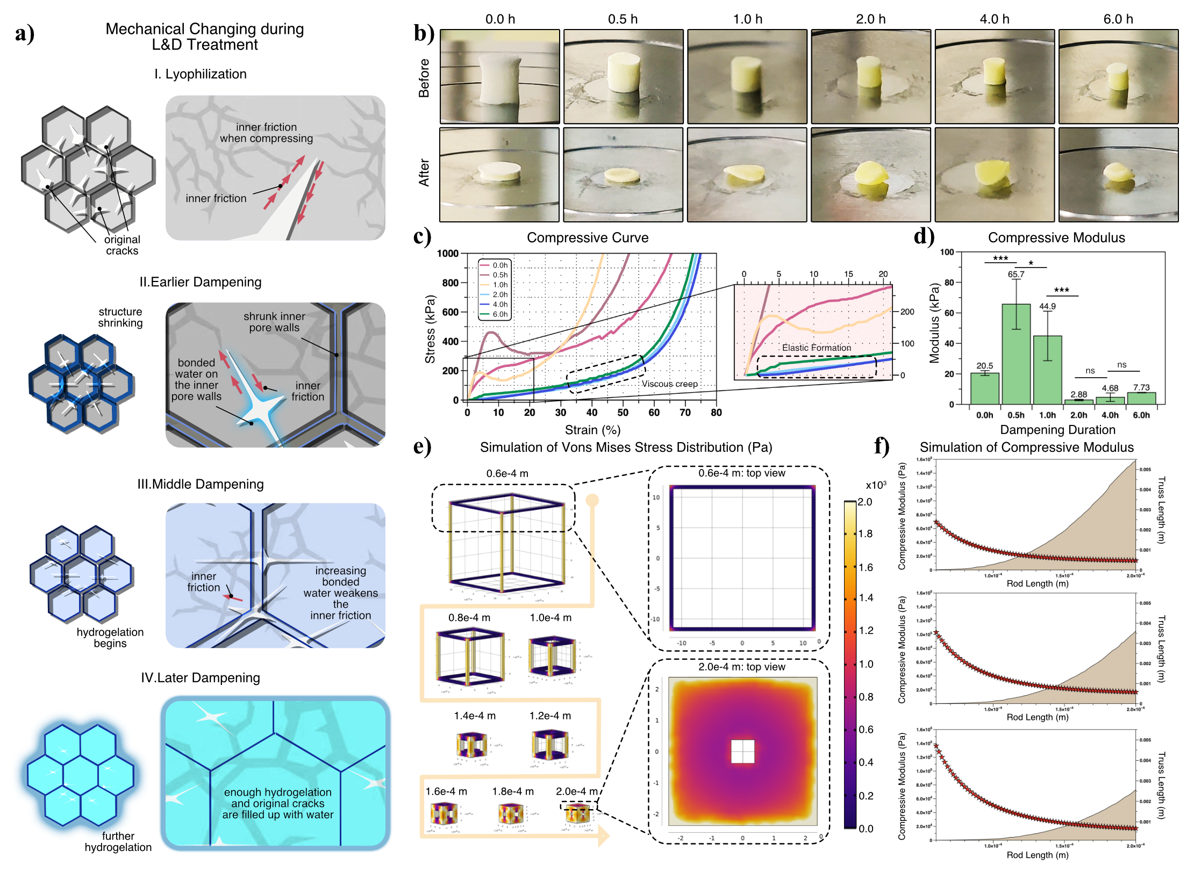
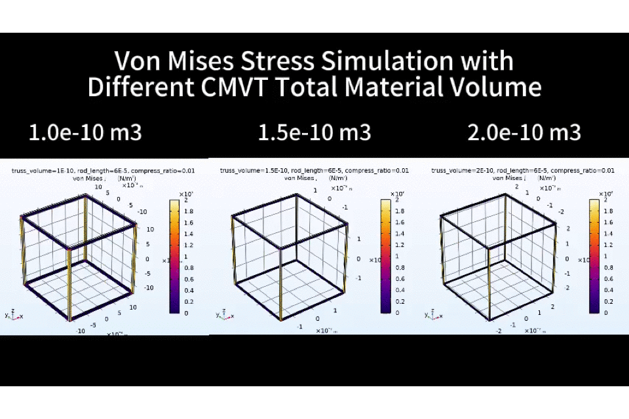
Potential foreign body sensation according to mechanical properties
The effect of causing a foreign body sensation in the treated patient is another key factor used to judge the feasibility of injectable scaffolds. The injected scaffold should strictly avoid causing a foreign body sensation to protect patients from secondary damage. Thus, such scaffolds should feature a relatively low mechanical modulus.

Slide 8
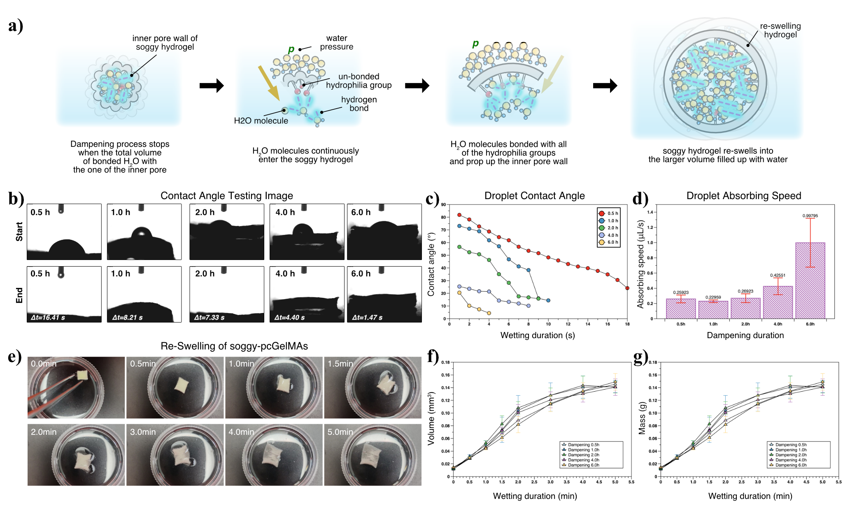
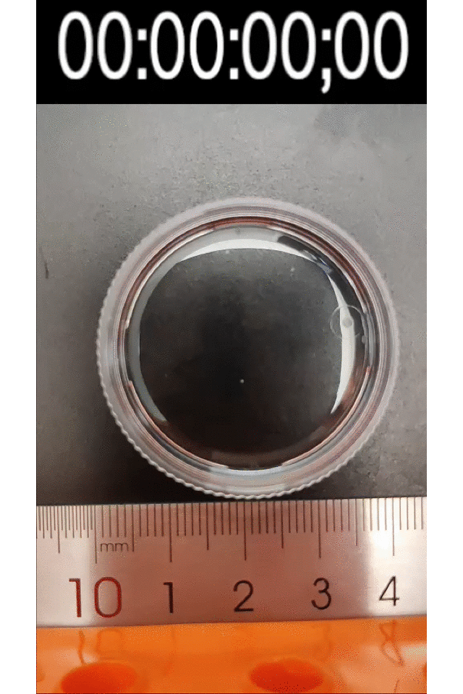
Defect-filling capability of the re-swelling process
After a soggy-GelMA is injected into a damaged site on an organ, it is expected to re-swell into a larger volume by absorbing the surrounding bodily fluids, subsequently filling the subcutaneous cavity.
The results and analysis verified that the soggy-pcGelMAs could successfully re-swell to fill the site of organ damage following scaffold injection.

Slide 9
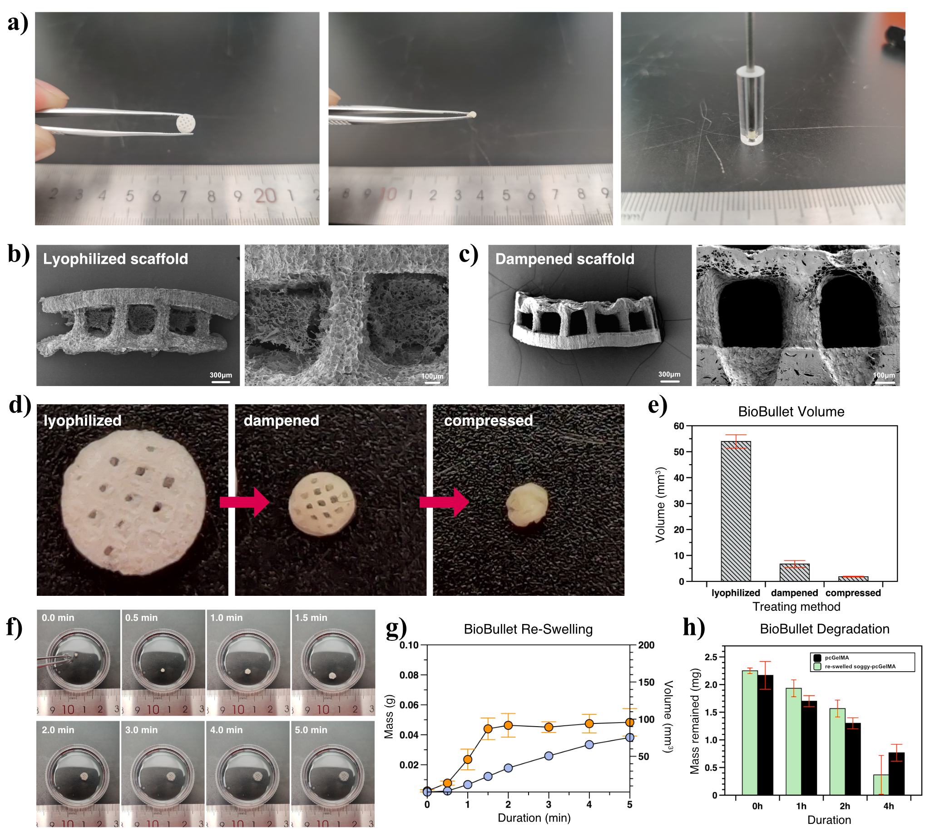
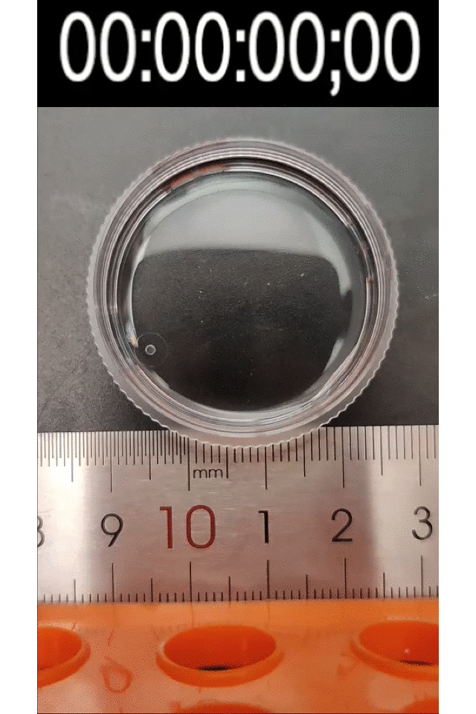
Physiochemical properties of BioBullets for adipose defects
Considering the convenience and mass production possibility, soggy-pcGelMAs were designed as “BioBullet”, that is, the soggy-pcGelMAs were loaded in glass tube and further compressed inside, resulting in lower volume.
Considering that the mammary gland tissue of mice is small and flat-lobed, when designing the scaffold structure, the external dimensions of the BioBullets employed in adipose defect repair were designed as a tablet shape.

Slide 10
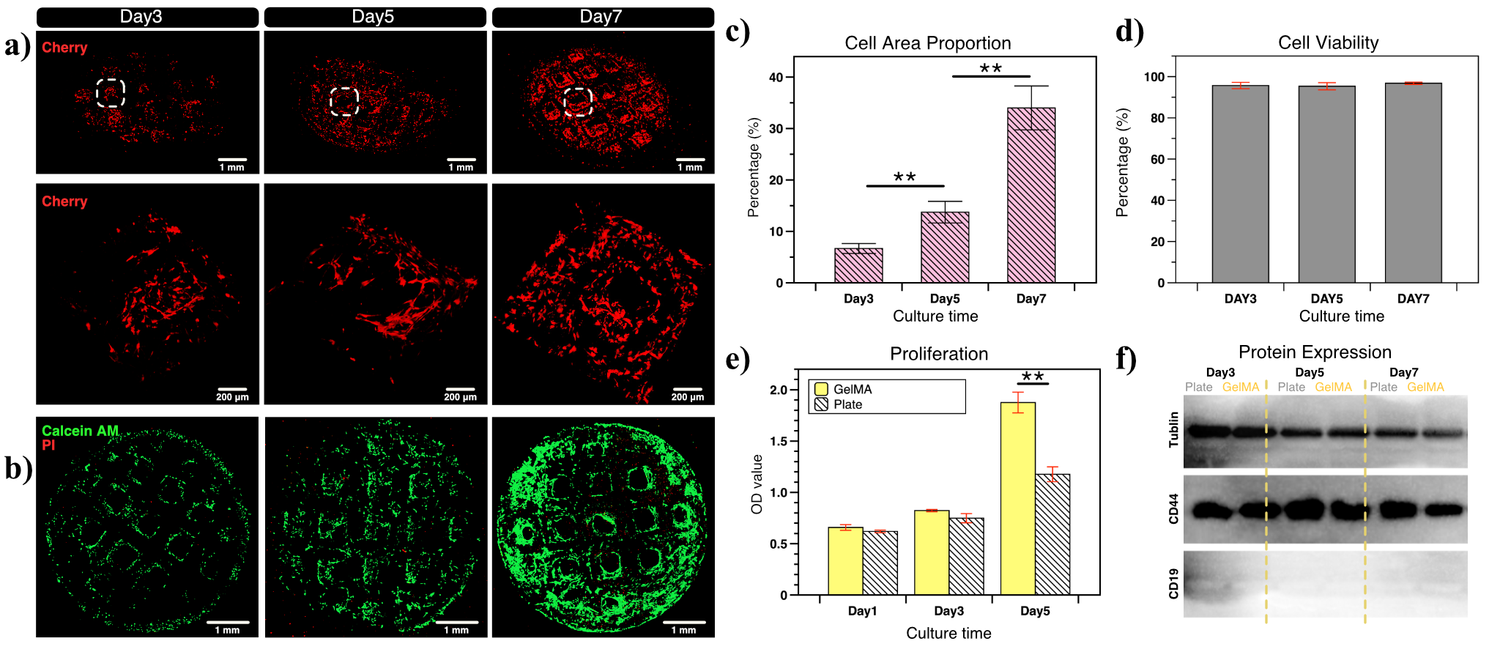
Biocompatibility of BioBullets to adipose-derived stem cells (ADSCs)
Once the BioBullets are “shot” into the adipose defect, they rapidly re-swell into much larger scaffolds to fill up the defect space. Then, cells surrounding the defect area can migrate to the re-swelled scaffolds to rapidly proliferate and differentiate on them.
The results verified the excellent cell compatibility and adipogenic induction effect of the BioBullets and the potential of their use in the clinical repair of soft tissue defects.

Slide 11
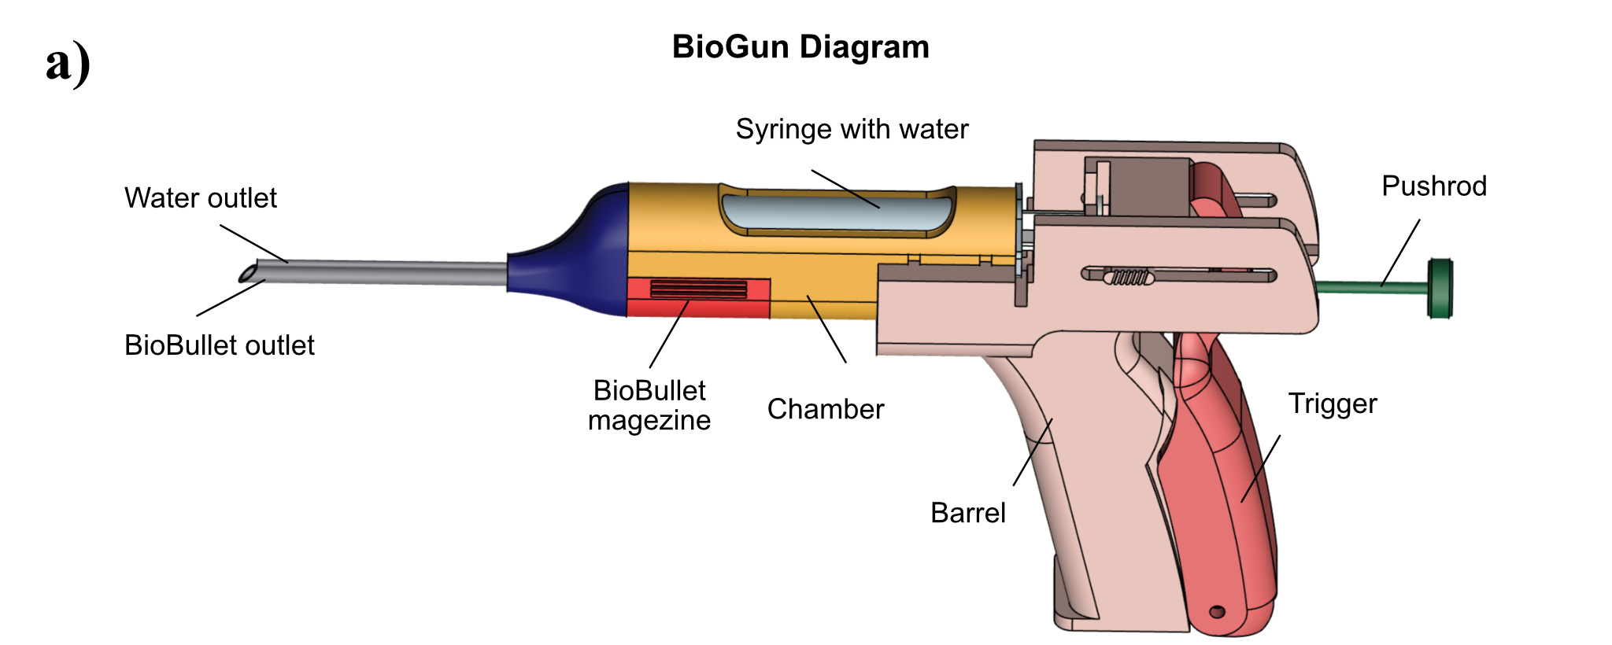
A portable minimally invasive therapy tool: BioGun
There was no corresponding surgical tool to deliver these BioBullets. Hence, by referring to the structure of the gun, a portable device called BioGun was also designed to realize the minimally invasive injection of the BioBullets.

Slide 12
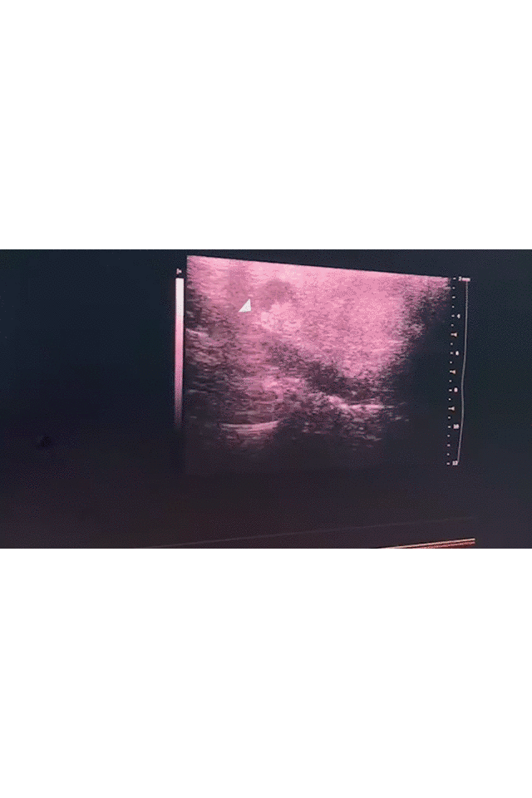
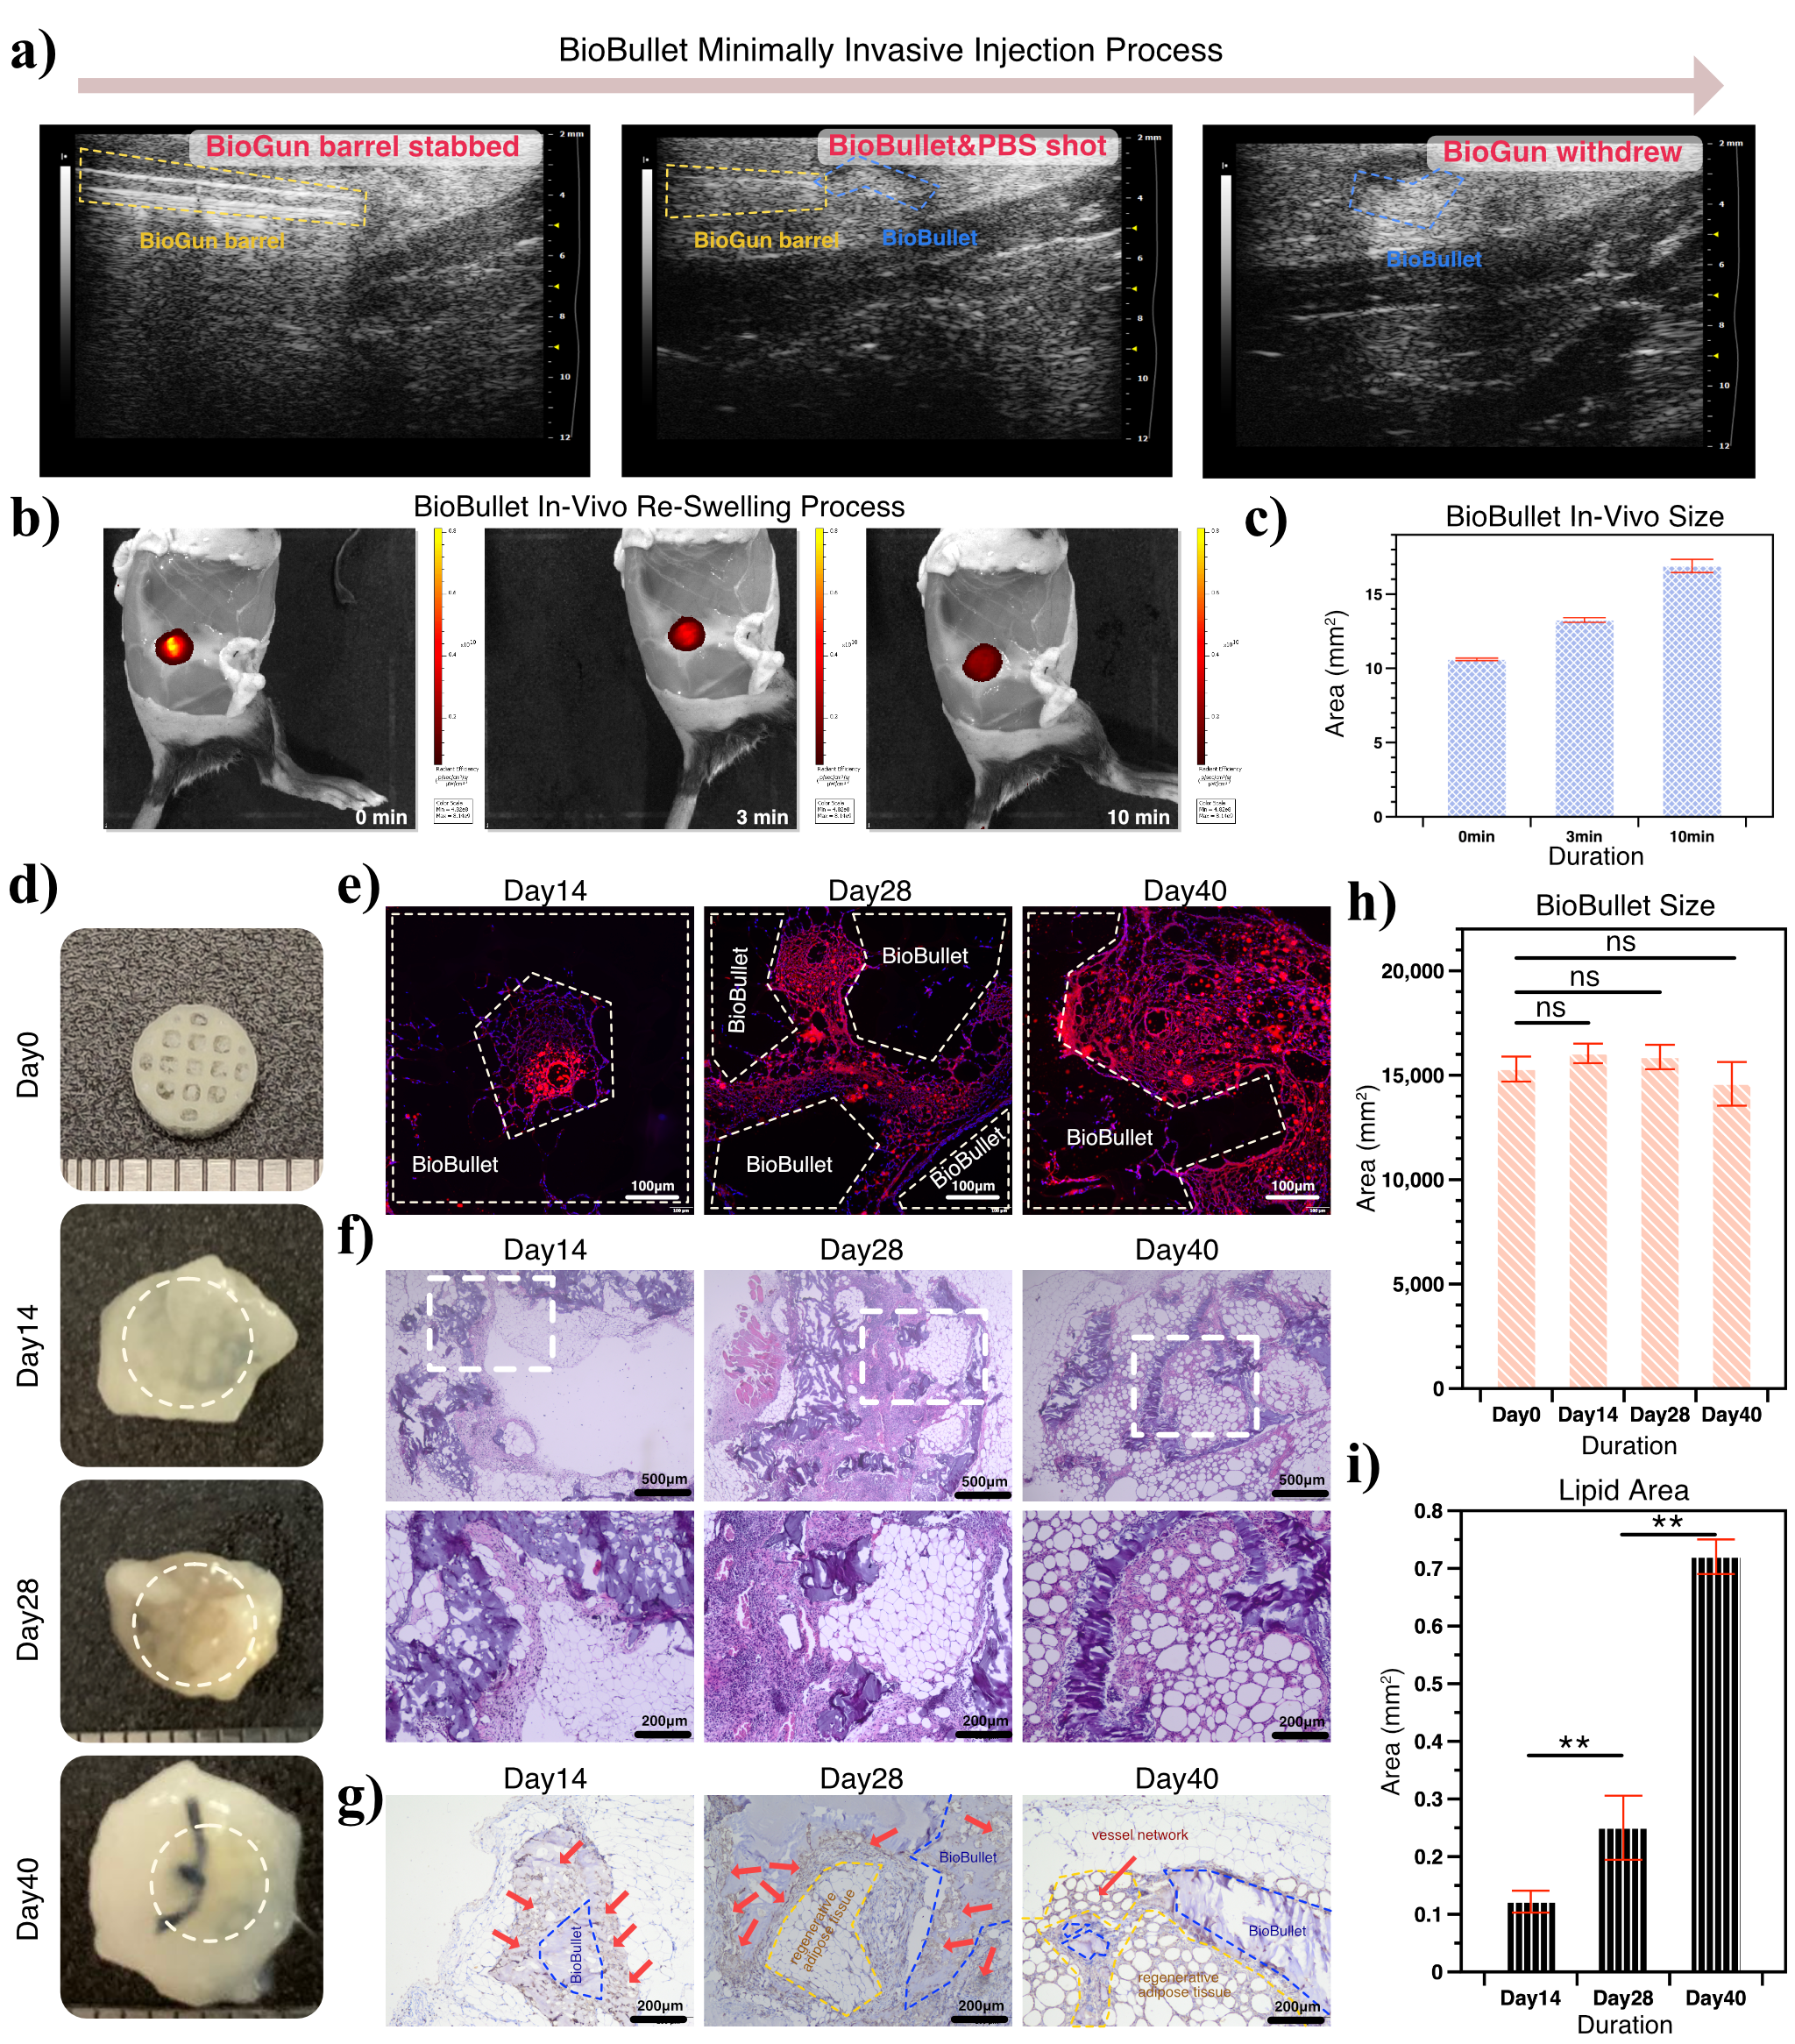
Minimally invasive repair of adipose tissue defects
B-ultrasound-guided minimally invasive injection
In applications for the repair of adipose tissue defects, the desired therapeutic goals are achieving the restoration of the appearance and the regeneration of adipose tissue.
On the 40th day, a large amount of adipose tissue had grown into the inside of the BioBullet and endothelial cells had formed large blood vessels around the vacuolated adipocytes. This network provides a channel for nutrient loosening and material exchange for the new growth of adipose tissue.

Slide 13
Conclusion & Outlook
Advancement of L&D Treatment
Outlook
Suitable Tiny Size
Morphology matching. The injected BioBullet will perfectly fill up not only the main body space, but also the tiny gaps in the soft tissue defect area.
Low Foreign Body Sensation
Functional additives. By introducing hydrogels with the property of specific controlled release, the releasing behavior can be strictly manipulated to achieve a better repair effect.
Defect Filling (Re-Swelling)
Tool development. The magazine of BioGun can be re-designed to automatically load a new group of BioBullets once the previous have been “shot”out.
Promising repair effect in vivo

