Slide 1
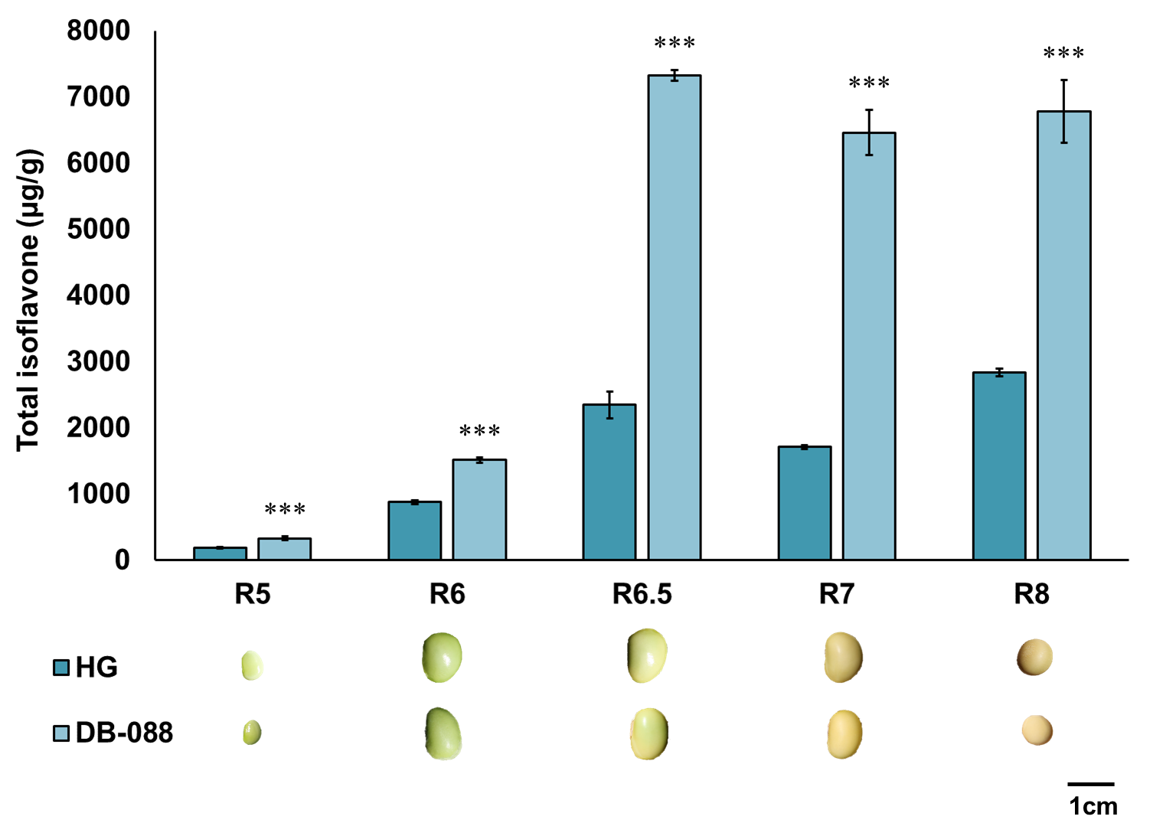
Figure S3. Total isoflavone content in seeds of Hwanggeum and DB-088 according to developmental stages. *, **, and *** indicate significance at p < 0.05, 0.01, and 0.001, respectively

