Slide 1
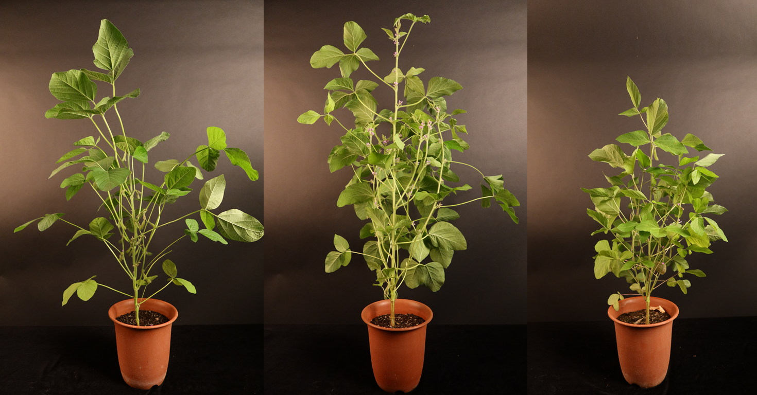
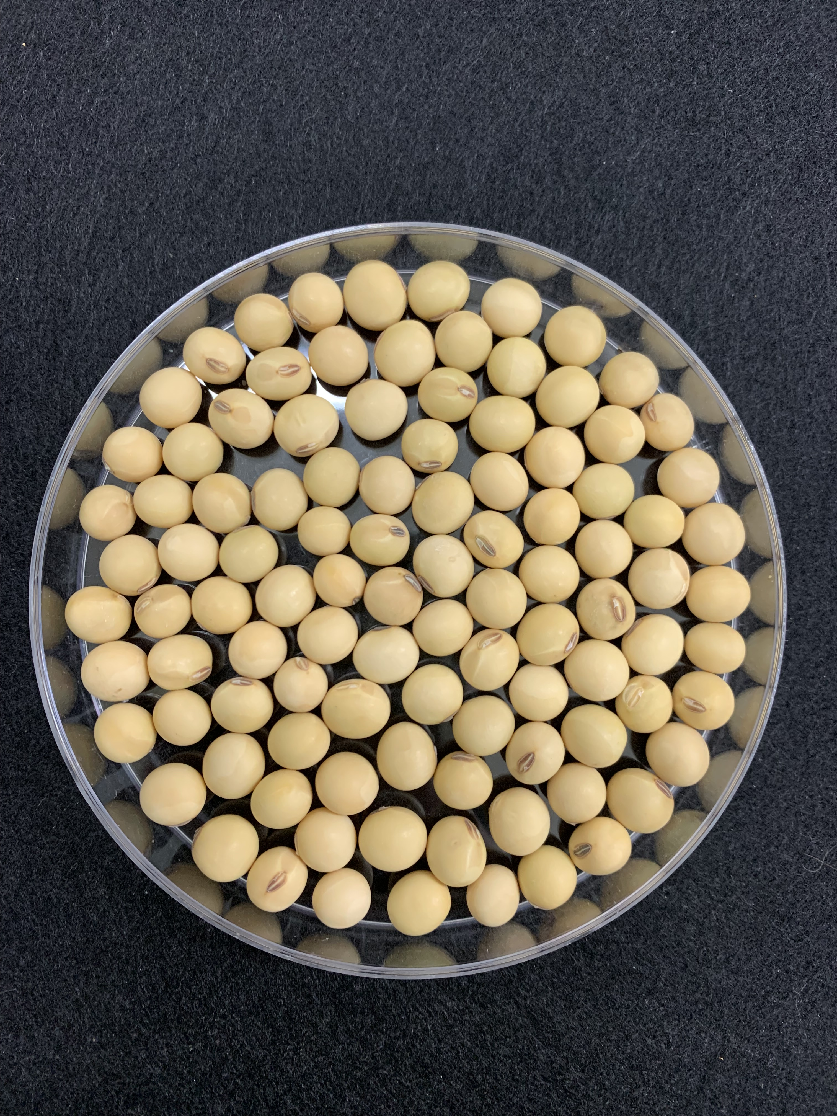
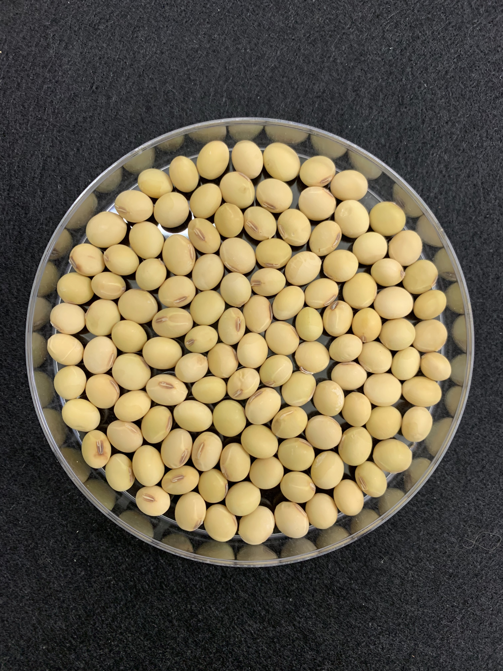
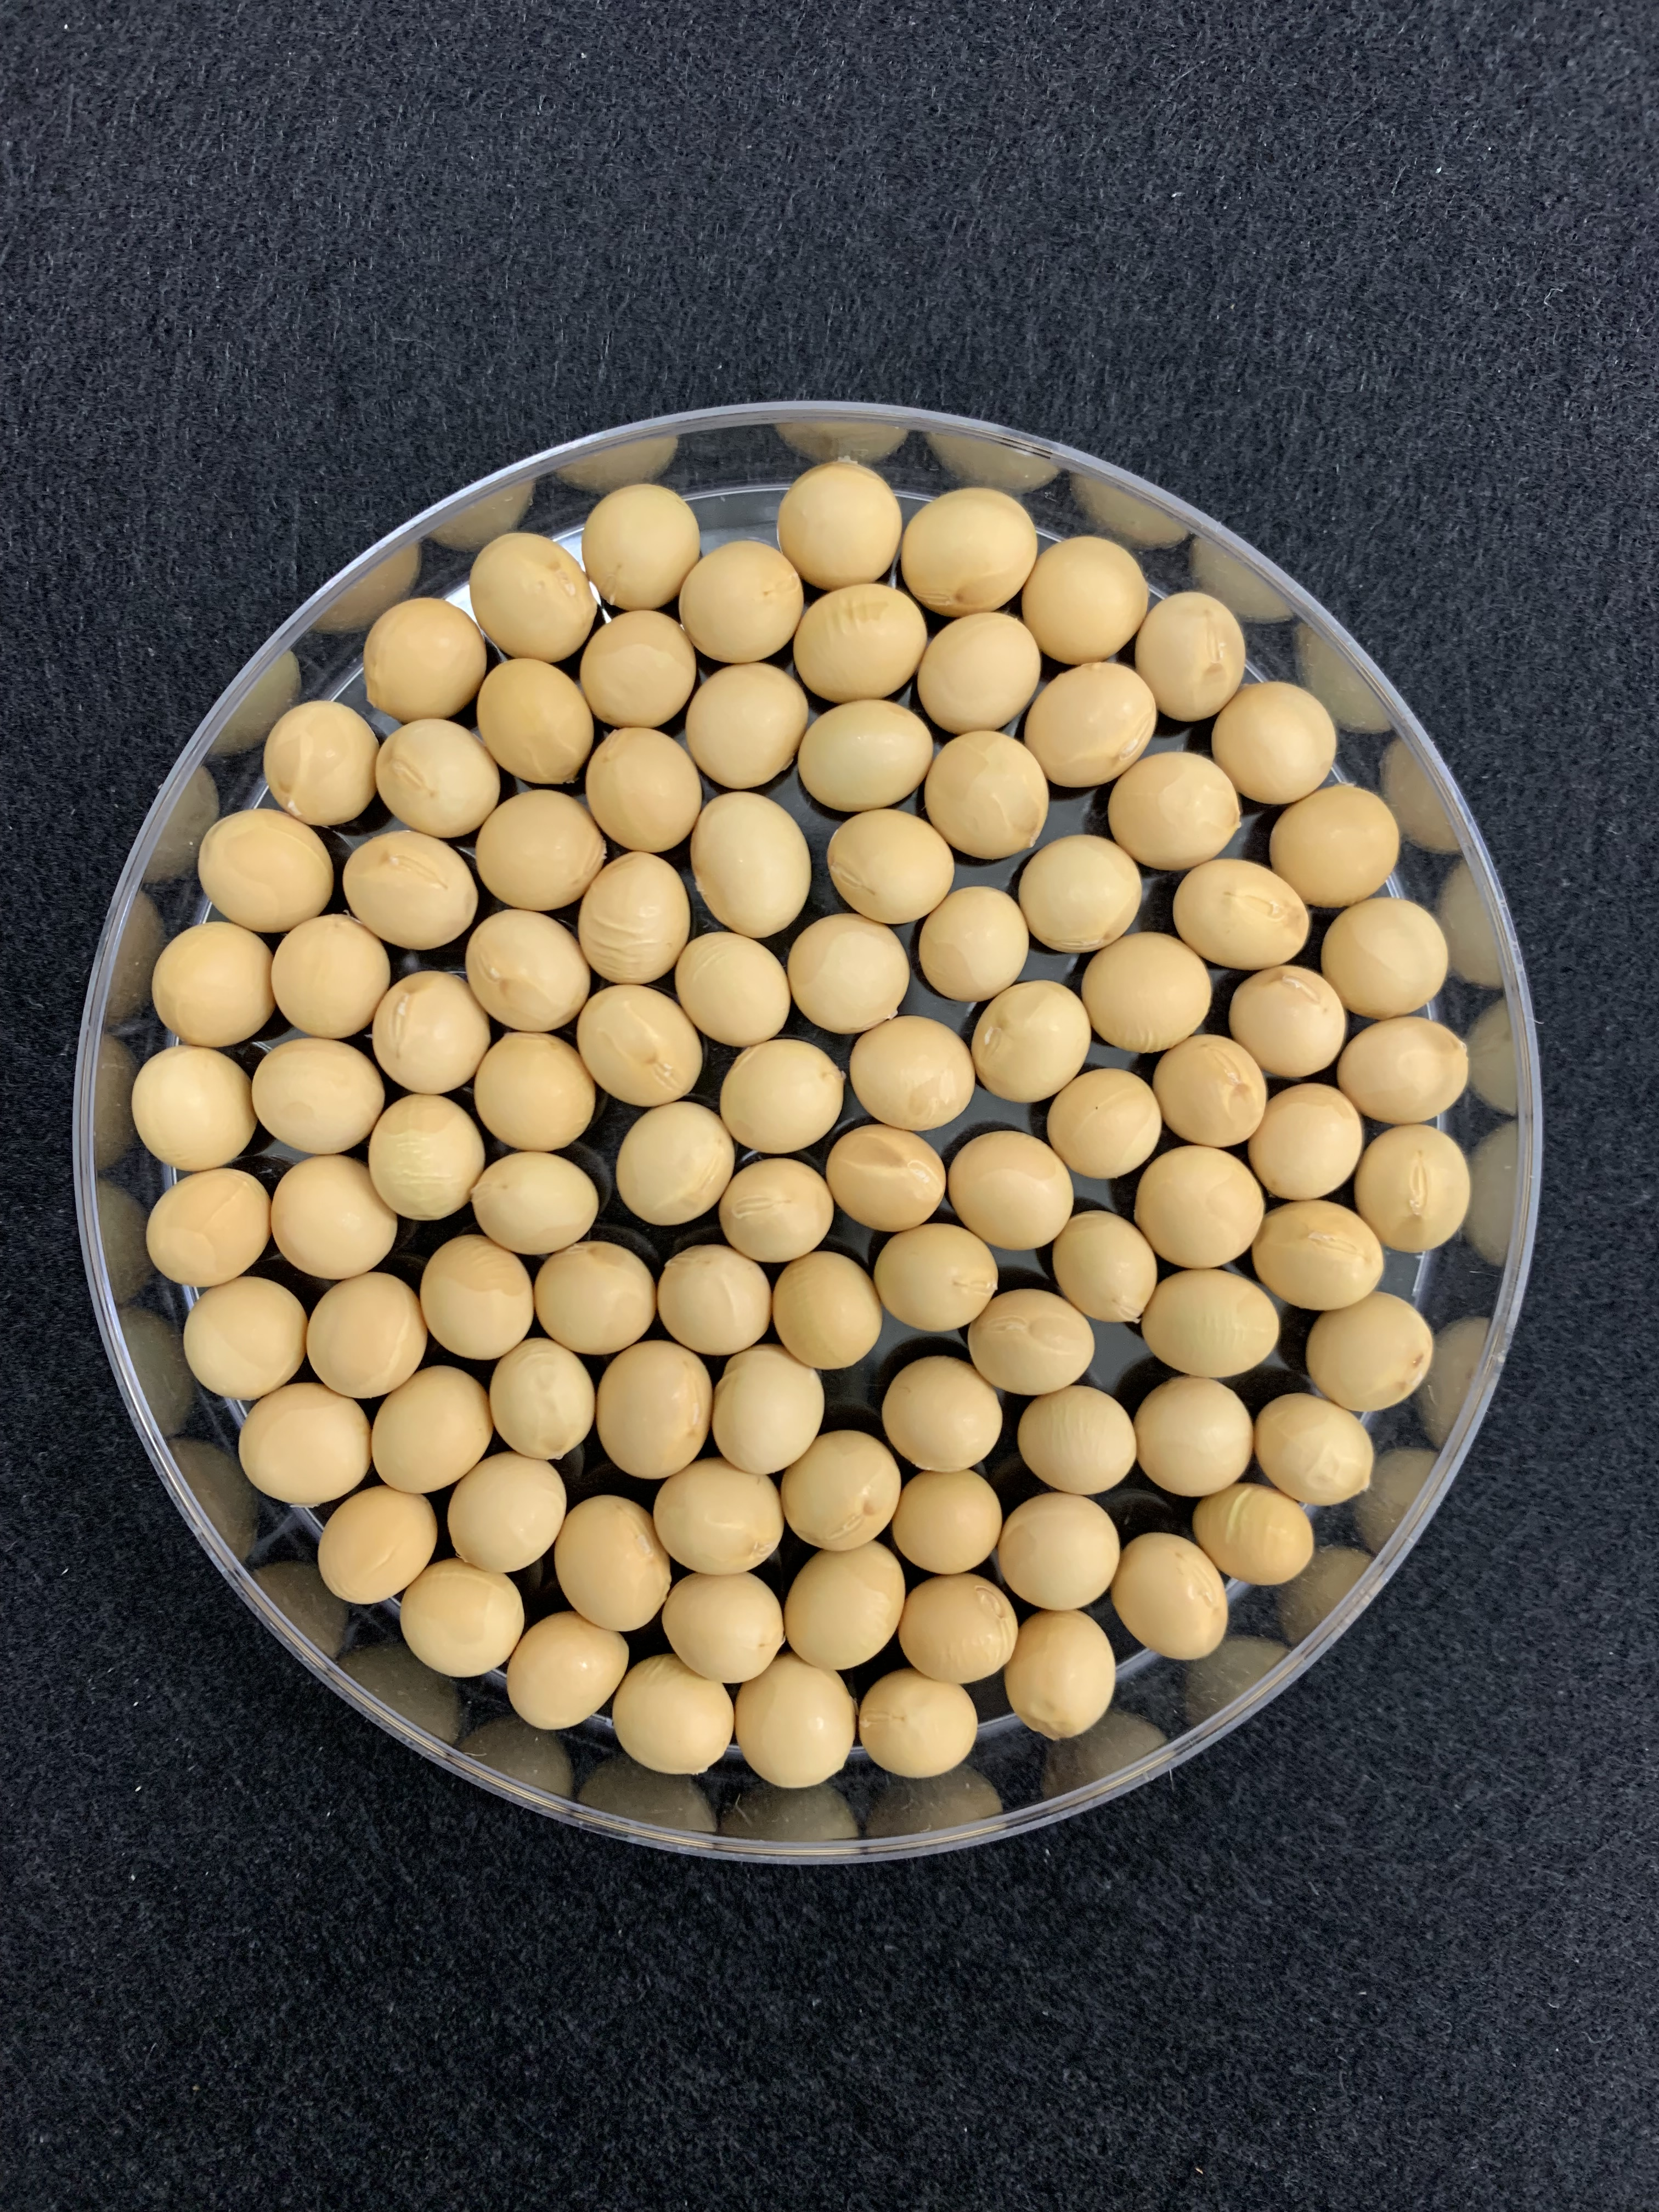
A
DB
DB-088
HG
10cm
B
1cm
Figure S1. Morphology of plants and their seeds. From left to right: Danbaek, DB-088, and Hwangguem. (A) Plants. (B) Seeds

