Slide 1
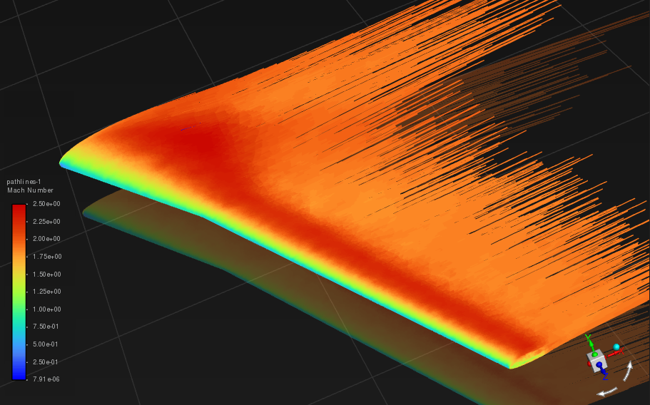
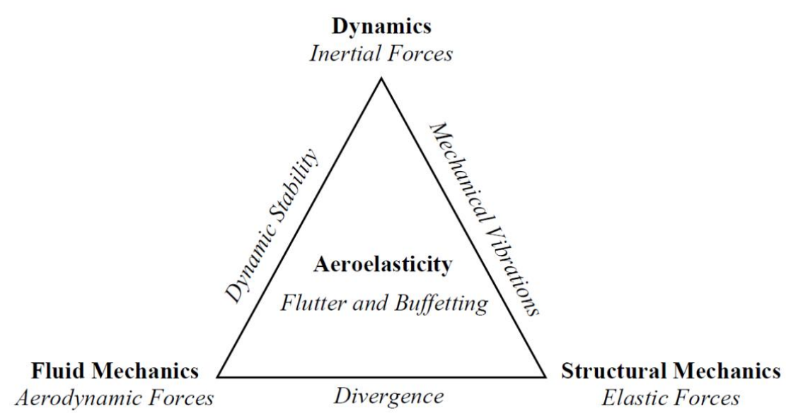
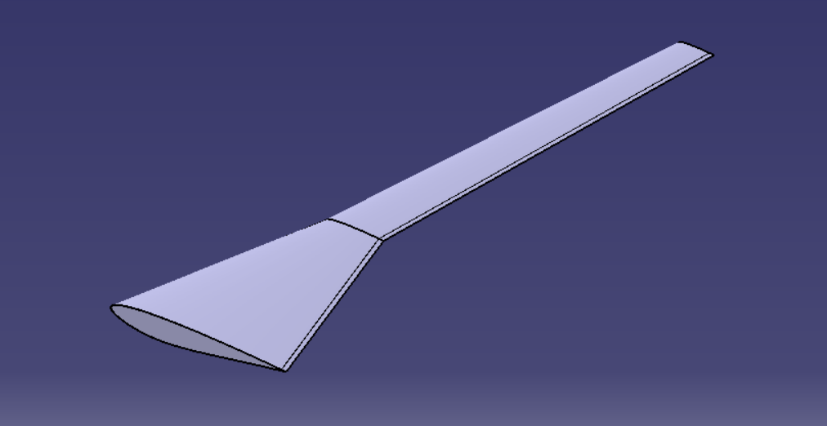
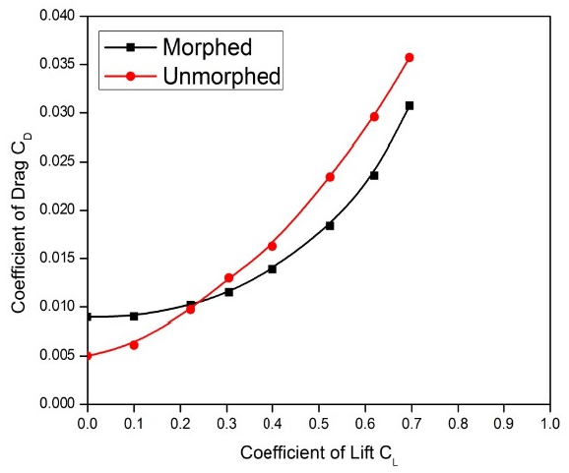
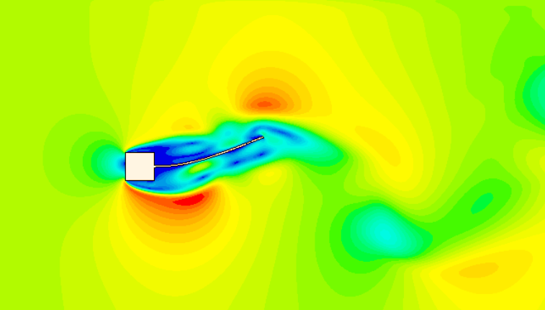
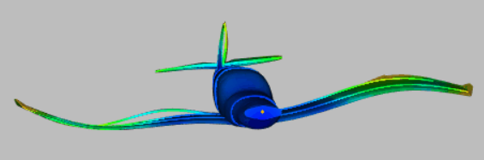
Coupling and Numerical solvers
Wing design
Steady aerodynamics CFD simulations
Coupling and Numerical solvers
Neglect the Dynamic/inertial loads for justification of Steady aerodynamics
Plots assessment
Fluid-Structure interaction to analyse flutter
Fluttering in Steady and Unsteady aerodynamics are remarkably similar!!

