Slide 1
Table S1. Soil characteristics
Physicochemical properties | Clay loam soil | Sandy loam soil
pH | 8.12±0.02 | 8.3±0.03
P mg/100g | 7.95±1.78 | 23.92±0.73
K mg/100g | 32.1±2.6 | 23.17±0.16
S mg/100g | 15.65±1.26 | 14.02±0.33
Mg mg/100g | 49.37±3.52 | 44.57±0.83
Mn mg/100g | 9.11±0.57 | 16.5±0.07
Fe mg/100g | 9.65±0.38 | 7.71±0.46
Ca mg/100g | 2633.05±241.5 | 524.3±13.2
Na mg/100g | 3.31±0.36 | 12.57±0.16
SOM% | 1.61±0.13 | 0.67±0.01
Clay% | 29.42±0.26 | 14.37±0.07
Sand% | 21.58±0.45 | 61.47±0.08
Silt% | 49.0±0.37 | 24.12±0.12
CO₃Ca | 12.02±0.56 | 4.99±0.18
CEC mekv/100g | 10.45±0.51 | 8.75±0.43
EC mS/cm | 0.22±0.01 | 0.28
Assim. Ca mekv/100g | 8.92±0.37 | 7.92±0.08
Assim. Mg mekv/100g | 2.33±0.21 | 2.32±0.02

Slide 2
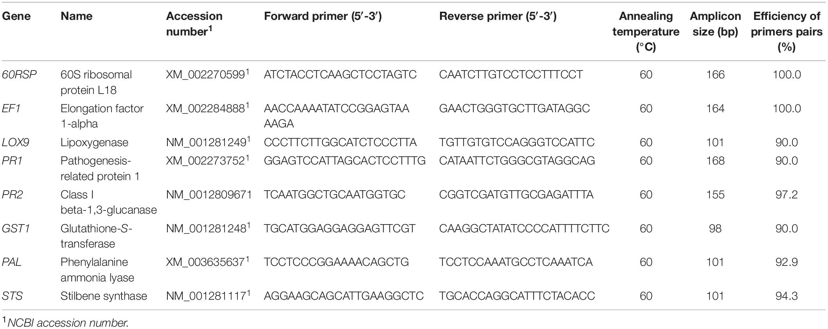
Table S2. Primer sequences used for qRT-PCR analysis of defense-related genes [20].

Slide 3
Table S3. Number of fungal and bacterial sequences reads per sample.
Fungi |  | Bacteria
Sample | Size | Sample | Size
S1 | 71471 | S1 | 32019
S2 | 63175 | S2 | 64740
S3 | 56770 | S3 | 59621
S4 | 69034 | S4 | 60684
S5 | 59605 | S5 | 65134
S6 | 37635 | S6 | 58209
S7 | 54681 | S7 | 22238
S8 | 41434 | S8 | 59802
S9 | 64774 | S9 | 80998
S10 | 64518 | S10 | 76008
S11 | 62988 | S11 | 82049
S12 | 59372 | S12 | 67212
S13 | 40472 | S13 | 42059
S14 | 36900 | S14 | 58851
S15 | 41352 | S15 | 66248
S16 | 49871 | S16 | 61329
S17 | 48290 | S17 | 69599
S18 | 63969 | S18 | 69653
S19 | 53380 | S19 | 66407
S20 | 60539 | S20 | 49594
S21 | 51341 | S21 | 67878
S22 | 78739 | S22 | 51487
S23 | 67538 | S23 | 64428
S24 | 56977 | S24 | 70951
S25 | 76766 | S25 | 46806
S26 | 45709 | S26 | 58699
S27 | 44043 | S27 | 61558
S28 | 95730 | S28 | 76973
S29 | 38175 | S29 | 63197
S30 | 80494 | S30 | 74862
S31 | 42434 | S31 | 46546
S32 | 58825 | S32 | 49980
S33 | 61152 | S33 | 70082
S34 | 61612 | S34 | 59285
S35 | 50915 | S35 | 64280
S36 | 37789 | S36 | 41757
S37 | 33812 | S37 | 50632
S38 | 30599 | S38 | 51775
S39 | 39393 | S39 | 55387
S40 | 43223 | S40 | 63083
S41 | 82036 | S41 | 62607
S42 | 39853 | S42 | 59855
S43 | 63296 | S43 | 50382
S44 | 49949 | S44 | 53079
S45 | 6843 | S45 | 45834
Fungi |  | Bacteria
Sample | Size | Sample | Size
S46 | 75014 | S46 | 47950
S47 | 91666 | S47 | 62374
S48 | 72766 | S48 | 60186
S49 | 73742 | S49 | 58723
S50 | 46942 | S50 | 41113
S51 | 41133 | S51 | 50791
S52 | 50295 | S52 | 49440
S53 | 5032 | S53 | 79210
S54 | 30292 | S54 | 83397
S55 | 21230 | S55 | 68207
S56 | 18645 | S56 | 60565
S57 | 155656 | S57 | 73019
S58 | 140717 | S58 | 72377
S59 | 151334 | S59 | 58246
S60 | 104876 | S60 | 56727
S61 | 71963 | S61 | 59666
S62 | 92691 | S62 | 61394
S63 | 86640 | S63 | 56573
S64 | 93665 | S64 | 63655
S65 | 64019 | S65 | 67566
S66 | 77373 | S66 | 115595
S67 | 60506 | S67 | 118598
S68 | 101212 | S68 | 92934
S69 | 65610 | S69 | 61984
S70 | 44681 | S70 | 66352
S71 | 84515 | S71 | 73872
S72 | 62164 | S72 | 81600
S73 | 54098 | S73 | 54098
S74 | 108199 | S74 | 64463
S75 | 82486 | S75 | 75135
S76 | 72186 | S76 | 73175
S77 | 78584 | S77 | 106328
S78 | 72369 | S78 | 103216
S79 | 93106 | S79 | 109738
S80 | 52406 | S80 | 42421
S81 | 75908 | S81 | 48717
S82 | 75690 | S82 | 93666
S83 | 51643 | S83 | 77866
S84 | 63503 | S84 | 67688
S85 | 69375 | S85 | 55315
S86 | 88756 | S86 | 65656
S87 | 82681 | S87 | 57125
S88 | 73478 | S88 | 48531
S89 | 63217 | S89 | 79410
S90 | 4183 | S90 | 77387
S91 | 58625 | S91 | 76002
S92 | 26756 | S92 | 52841
S93 | 74942 | S93 | 60421
S94 | 84787 | S94 | 79493
S95 | 62197 | S95 | 64574
S96 | 72141 | S96 | 59784

Slide 4
sample | Bacteria | Fungi
S1 | 99.769 | 99.990
S2 | 99.920 | 99.997
S3 | 99.900 | 99.989
S4 | 99.922 | 99.994
S5 | 99.923 | 99.992
S6 | 99.933 | 99.984
S7 | 99.716 | 99.994
S8 | 99.920 | 99.995
S9 | 99.948 | 99.985
S10 | 99.936 | 99.992
S11 | 99.941 | 99.994
S12 | 99.967 | 99.995
S13 | 99.836 | 99.983
S14 | 99.932 | 99.997
S15 | 99.933 | 99.988
S16 | 99.938 | 99.994
S17 | 99.944 | 99.985
S18 | 99.931 | 99.995
S19 | 99.923 | 99.977
S20 | 99.863 | 99.985
S21 | 99.920 | 99.978
S22 | 99.912 | 99.992
S23 | 99.927 | 99.990
S24 | 99.942 | 99.989
S25 | 99.889 | 99.995
S26 | 99.913 | 99.991
S27 | 99.917 | 99.983
S28 | 99.928 | 99.997
S29 | 99.924 | 99.976
S30 | 99.941 | 99.996
S31 | 99.882 | 99.983
S32 | 99.904 | 99.994
S33 | 99.944 | 99.987
S34 | 99.904 | 100.000
S35 | 99.947 | 99.996
S36 | 99.849 | 99.989
S37 | 99.923 | 99.994
S38 | 99.911 | 99.990
S39 | 99.919 | 99.997
S40 | 99.949 | 99.993
S41 | 99.925 | 99.989
S42 | 99.950 | 99.992
S43 | 99.903 | 99.985
S44 | 99.904 | 99.998
S45 | 99.895 | -
S46 | 99.900 | 99.992
S47 | 99.928 | 99.987
S48 | 99.942 | 99.985
S49 | 99.932 | 99.984
S50 | 99.878 | 99.989
sample | Bacteria | Fungi
S51 | 99.909 | 99.995
S52 | 99.933 | 99.990
S53 | 99.949 | -
S54 | 99.945 | 99.993
S55 | 99.940 | 99.957
S56 | 99.906 | 99.978
S57 | 99.952 | 99.997
S58 | 99.941 | 99.999
S59 | 99.929 | 99.997
S60 | 99.938 | 99.995
S61 | 99.928 | 99.994
S62 | 99.915 | 99.990
S63 | 99.911 | 99.984
S64 | 99.937 | 99.985
S65 | 99.938 | 99.998
S66 | 99.968 | 99.997
S67 | 99.966 | 99.995
S68 | 99.965 | 99.995
S69 | 99.916 | 99.994
S70 | 99.938 | 99.987
S71 | 99.944 | 99.995
S72 | 99.950 | 99.994
S73 | 99.917 | 99.991
S74 | 99.942 | 99.993
S75 | 99.941 | 99.988
S76 | 99.944 | 99.983
S77 | 99.972 | 99.991
S78 | 99.967 | 99.983
S79 | 99.971 | 99.999
S80 | 99.877 | 99.983
S81 | 99.878 | 99.983
S82 | 99.955 | 99.996
S83 | 99.947 | 99.988
S84 | 99.936 | 99.994
S85 | 99.902 | 99.986
S86 | 99.922 | 99.988
S87 | 99.932 | 99.983
S88 | 99.891 | 99.988
S89 | 99.961 | 99.989
S90 | 99.938 | -
S91 | 99.951 | 99.988
S92 | 99.918 | 99.966
S93 | 99.927 | 99.986
S94 | 99.943 | 99.995
S95 | 99.922 | 99.987
S96 | 99.923 | 99.990
Table S4. Bacterial and fungal Good’s Coverage per sample.

Slide 5
Table S5. Major fungal OTUs (relative abundance <0.5%) identity and correlation with Trichoderma sp. in sandy soil, on control treatment (control), treatment with Bacillus subtilis PTA-271 (Bs PTA-271), Trichoderma atroviride SC1 (Ta SC1), and both BCAs (Bs PTA-271 + Ta SC1).
Control
ID | Genus | Correlation with Trichoderma | Correlation coefficient | Accession No. | NCBI blast result | Identity | E-value
Otu_53 | Botryotrichum | positive | 0.8 | KX976601 | Botryotrichum spirotrichum | 100.0% | 1.28141e-075
Otu_63 | Cadophora | negative | 0.64467725 | AY249066 | Cadophora luteo-olivacea | 100.0% | 9.43062e-072
Otu_91 | Coniosporium | negative | -0.8 | AM279681 | Coniosporium sp. | 97.0% | 3.07713e-072
Otu_128 | Diaporthe | positive | 0.8 | AF439625 | Diaporthe columnaris | 99.4% | 4.68076e-075
Otu_214 | Chaetomium | positive | 0.8 | MG775226 | Chaetomium megalocarpum | 100.0% | 4.57275e-075
Otu_220 | Ilyonectria | positive | 0.8 | FJ224100 | Ilyonectria liriodendri | 100.0% | 1.36184e-080
Otu_253 | Lophiostoma | negative | 0.69882605 | EF042107 | Lophiostoma sp. | 100.0% | 4.27886e-070
Otu_287 | Mortierella | positive | 1 | HQ630355 | Mortierella hyalina | 100.0% | 2.08974e-130
Otu_379 | Psathyrella | negative | 0.64622444 | KJ917666 | Psathyrella candolleana | 99.0% | 2.24999e-099
Otu_601 | Unknown_Diaporthales | negative | 0.96344438 | KF428567 | Diaporthales sp. | 100.0% | 1.02928e-076
Otu_609 | Unknown_Hypocreales | negative | -0.8 | KC180712 | Hypocreales sp. | 90.9% | 9.93167e-047
Otu_638 | Unknown_Ascomycota | positive | 1 | KT878342 | Ascomycota sp. | 100.0% | 5.1475e-085
Bs PTA-271
ID | Genus | Correlation with Trichoderma | Correlation coefficient | Accession No. | NCBI blast result | Identity | E-value
Otu_53 | Botryotrichum | negative | -1 | KX976601 | Botryotrichum spirotrichum | 100.0% | 1.28141e-075
Otu_63 | Cadophora | negative | 0.60079362 | AY249066 | Cadophora luteo-olivacea | 100.0% | 9.43062e-072
Otu_128 | Diaporthe | negative | 0.69707817 | AF439625 | Diaporthe columnaris | 99.4% | 4.68076e-075
Otu_165 | Fusarium | positive | 1 | MF817197 | Fusarium sp. | 100.0% | 5.82207e-074
Otu_379 | Psathyrella | negative | 4.41996701 | KJ917666 | Psathyrella candolleana | 99.0% | 2.24999e-099
Otu_418 | Roesleria | negative | 4.89520925 | EF060306 | Roesleria subterranea | 99.3% | 5.71607e-064
Otu_437 | Serendipita | negative | -0.8 | EU910920 | Serendipita sp. | 97.6% | 1.7517e-095
Otu_536 | Unknown_Ceratobasidiaceae | negative | 0.63962616 | JN648710 | Ceratobasidiaceae sp. | 99.6% | 6.90701e-115
Otu_563 | Unknown_Nectriaceae | negative | -0.8 | MK041291 | Nectriaceae sp. | 100.0% | 2.99117e-082
Otu_574 | Unknown_Pyronemataceae | negative | 0.60260321 | KY321435 | Pyronemataceae sp. | 99.4% | 3.67412e-076
Otu_609 | Unknown_Hypocreales | negative | -0.8 | KC180712 | Hypocreales sp. | 90.9% | 9.93167e-047
Ta SC1
ID | Genus | Correlation with Trichoderma | Correlation coefficient | Accession No. | NCBI blast result | Identity | E-value
Otu_53 | Botryotrichum | positive | 0.8 | KX976601 | Botryotrichum spirotrichum | 100.0% | 1.28141e-075
Otu_63 | Cadophora | positive | 0.31529632 | AY249066 | Cadophora luteo-olivacea | 100.0% | 9.43062e-072
Otu_79 | Cistella | positive | 0.09895707 | KT269719 | Cistella albidolutea | 99.3% | 2.53156e-067
Otu_85 | Clonostachys | negative | -0.8 | AF358231 | Clonostachys rosea | 100.0% | 2.99117e-082
Otu_91 | Coniosporium | positive | 0.8 | AM279681 | Coniosporium sp. | 97.0% | 3.07713e-072
Otu_128 | Diaporthe | positive | 0.30773985 | AF439625 | Diaporthe columnaris | 99.4% | 4.68076e-075
Otu_165 | Fusarium | positive | 0.28562029 | MF817197 | Fusarium sp. | 100.0% | 5.82207e-074
Otu_214 | Chaetomium | positive | 0.10556324 | MG775226 | Chaetomium megalocarpum | 100.0% | 4.57275e-075
Otu_253 | Lophiostoma | negative | 0.5247445 | EF042107 | Lophiostoma sp. | 100.0% | 4.27886e-070
Otu_287 | Mortierella | positive | 0.30668402 | HQ630355 | Mortierella hyalina | 100.0% | 2.08974e-130
Otu_339 | Penicillium | positive | 0.32114926 | KC427191 | Penicillium kongii | 100.0% | 1.73593e-079
Otu_536 | Unknown_Ceratobasidiaceae | negative | 0.56351202 | JN648710 | Ceratobasidiaceae sp. | 99.6% | 6.90701e-115
Otu_574 | Unknown_Pyronemataceae | negative | -0.8 | KY321435 | Pyronemataceae sp. | 99.4% | 3.67412e-076
Otu_609 | Unknown_Hypocreales | negative | -0.8 | KC180712 | Hypocreales sp. | 90.9% | 9.93167e-047
Otu_620 | Unknown_Sebacinales | positive | 0.8 | HQ154252 | Sebacinales sp. | 97.2% | 1.84564e-100
Otu_638 | Unknown_Ascomycota | negative | -0.99581262 | KT878342 | Ascomycota sp. | 100.0% | 5.1475e-085
Bs PTA-271 + Ta SC1
ID | Genus | Correlation with Trichoderma | Correlation coefficient | Accession No. | NCBI blast result | Identity | E-value
Otu_12 | Alternaria | positive | 0.54752847 | KP114405 | Alternaria sp. | 100.0% | 2.81875e-077
Otu_63 | Cadophora | negative | 0.6514685 | AY249066 | Cadophora luteo-olivacea | 100.0% | 9.43062e-072
Otu_79 | Cistella | positive | 0.14438486 | KT269719 | Cistella albidolutea | 99.3% | 2.53156e-067
Otu_85 | Clonostachys | negative | -0.6 | AF358231 | Clonostachys rosea | 100.0% | 2.99117e-082
Otu_128 | Diaporthe | negative | -0.4 | AF439625 | Diaporthe columnaris | 99.4% | 4.68076e-075
Otu_165 | Fusarium | positive | 0.22341009 | MF817197 | Fusarium sp. | 100.0% | 5.82207e-074
Otu_214 | Chaetomium | positive | 1 | MG775226 | Chaetomium megalocarpum | 100.0% | 4.57275e-075
Otu_253 | Lophiostoma | positive | 0.09981446 | EF042107 | Lophiostoma sp. | 100.0% | 4.27886e-070
Otu_287 | Mortierella | positive | 0.39123483 | HQ630355 | Mortierella hyalina | 100.0% | 2.08974e-130
Otu_339 | Penicillium | negative | -0.4 | KC427191 | Penicillium kongii | 100.0% | 1.73593e-079
Otu_379 | Psathyrella | negative | -0.97379885 | KJ917666 | Psathyrella candolleana | 99.0% | 2.24999e-099
Otu_437 | Serendipita | positive | 0.07981393 | EU910920 | Serendipita sp. | 97.6% | 1.7517e-095
Otu_536 | Unknown_Ceratobasidiaceae | positive | 0.58710506 | JN648710 | Ceratobasidiaceae sp. | 99.6% | 6.90701e-115
Otu_563 | Unknown_Nectriaceae | negative | -0.4 | MK041291 | Nectriaceae sp. | 100.0% | 2.99117e-082
Otu_574 | Unknown_Pyronemataceae | negative | -0.8 | KY321435 | Pyronemataceae sp. | 99.4% | 3.67412e-076
Otu_601 | Unknown_Diaporthales | negative | -0.73786479 | KF428567 | Diaporthales sp. | 100.0% | 1.02928e-076
Otu_620 | Unknown_Sebacinales | positive | 0.27899892 | HQ154252 | Sebacinales sp. | 97.2% | 1.84564e-100
Otu_638 | Unknown_Ascomycota | positive | 1 | KT878342 | Ascomycota sp. | 100.0% | 5.1475e-085

Slide 6
Table S6. Major fungal OTUs (relative abundance <0.5%) identity and correlation with Trichoderma sp. in clay soil, on control treatment (control), treatment with Bacillus subtilis PTA-271 (Bs PTA-271), Trichoderma atroviride SC1 (Ta SC1), and both BCAs (Bs PTA-271 + Ta SC1).
Control
ID | Genus | Correlation with Trichoderma | Correlation coefficient | Accession No. | NCBI blast result | Identity | E-value
Otu_12 | Alternaria | positive | 0.15454168 | KP114405 | Alternaria sp. | 100.0% | 2.81875e-077
Otu_53 | Botryotrichum | positive | 0.60655997 | KX976601 | Botryotrichum spirotrichum | 100.0% | 1.28141e-075
Otu_85 | Clonostachys | negative | -0.8 | AF358231 | Clonostachys rosea | 100.0% | 2.99117e-082
Otu_91 | Coniosporium | positive | 0.81826094 | AM279681 | Coniosporium sp. | 97.0% | 3.07713e-072
Otu_214 | Chaetomium | positive | 0.66826178 | MG775226 | Chaetomium megalocarpum | 100.0% | 4.57275e-075
Otu_253 | Lophiostoma | positive | 0.49894771 | EF042107 | Lophiostoma sp. | 100.0% | 4.27886e-070
Otu_287 | Mortierella | positive | 1.01231608 | HQ630355 | Mortierella hyalina | 100.0% | 2.08974e-130
Otu_339 | Penicillium | negative | -0.4 | KC427191 | Penicillium kongii | 100.0% | 1.73593e-079
Otu_418 | Roesleria | negative | -0.77459667 | EF060306 | Roesleria subterranea | 99.3% | 5.71607e-064
Otu_536 | Unknown_Ceratobasidiaceae | negative | -0.4 | JN648710 | Ceratobasidiaceae sp. | 99.6% | 6.90701e-115
Otu_563 | Unknown_Nectriaceae | positive | 0.873975 | MK041291 | Nectriaceae sp. | 100.0% | 2.99117e-082
Otu_574 | Unknown_Pyronemataceae | positive | 0.1594883 | KY321435 | Pyronemataceae sp. | 99.4% | 3.67412e-076
Otu_609 | Unknown_Hypocreales | positive | 0.2725685 | KC180712 | Hypocreales sp. | 90.9% | 9.93167e-047
Otu_620 | Unknown_Sebacinales | positive | 0.9486833 | HQ154252 | Sebacinales sp. | 97.2% | 1.84564e-100
Otu_638 | Unknown_Ascomycota | positive | 1.22139941 | KT878342 | Ascomycota sp. | 100.0% | 5.1475e-085
Bs PTA-271
ID | Genus | Correlation with Trichoderma | Correlation coefficient | Accession No. | NCBI blast result | Identity | E-value
Otu_12 | Alternaria | negative | -0.8 | KP114405 | Alternaria sp. | 100.0% | 2.81875e-077
Otu_53 | Botryotrichum | positive | 0.60050768 | KX976601 | Botryotrichum spirotrichum | 100.0% | 1.28141e-075
Otu_63 | Cadophora | negative | -0.91997875 | AY249066 | Cadophora luteo-olivacea | 100.0% | 9.43062e-072
Otu_79 | Cistella | negative | -0.8 | KT269719 | Cistella albidolutea | 99.3% | 2.53156e-067
Otu_85 | Clonostachys | positive | 0.67770927 | AF358231 | Clonostachys rosea | 100.0% | 2.99117e-082
Otu_91 | Coniosporium | negative | -0.8314615 | AM279681 | Coniosporium sp. | 97.0% | 3.07713e-072
Otu_128 | Diaporthe | positive | 0.8 | AF439625 | Diaporthe columnaris | 99.4% | 4.68076e-075
Otu_214 | Chaetomium | positive | 0.17204469 | MG775226 | Chaetomium megalocarpum | 100.0% | 4.57275e-075
Otu_220 | Ilyonectria | positive | 0.88855266 | FJ224100 | Ilyonectria liriodendri | 100.0% | 1.36184e-080
Otu_253 | Lophiostoma | positive | 0.8 | EF042107 | Lophiostoma sp. | 100.0% | 4.27886e-070
Otu_287 | Mortierella | positive | 0.25787411 | HQ630355 | Mortierella hyalina | 100.0% | 2.08974e-130
Otu_339 | Penicillium | positive | 0.81297305 | KC427191 | Penicillium kongii | 100.0% | 1.73593e-079
Otu_574 | Unknown_Pyronemataceae | positive | 0.78281421 | KY321435 | Pyronemataceae sp. | 99.4% | 3.67412e-076
Otu_609 | Unknown_Hypocreales | positive | 0.51322405 | KC180712 | Hypocreales sp. | 90.9% | 9.93167e-047
Ta SC1
ID | Genus | Correlation with Trichoderma | Correlation coefficient | Accession No. | NCBI blast result | Identity | E-value
Otu_12 | Alternaria | negative | -0.4 | KP114405 | Alternaria sp. | 100.0% | 2.81875e-077
Otu_91 | Coniosporium | negative | -0.6 | AF358231 | Clonostachys rosea. | 100.0% | 2.99117e-082
Otu_128 | Diaporthe | negative | -0.8 | AF439625 | Diaporthe columnaris | 99.4% | 4.68076e-075
Otu_253 | Lophiostoma | positive | 0.8 | EF042107 | Lophiostoma sp. | 100.0% | 4.27886e-070
Otu_339 | Penicillium | positive | 0.8 | KC427191 | Penicillium kongii | 100.0% | 1.73593e-079
Otu_418 | Roesleria | negative | -0.77459667 | EF060306 | Roesleria subterranea | 99.3% | 5.71607e-064
Otu_437 | Serendipita | positive | 0.8 | EU910920 | Serendipita sp. | 97.6% | 1.7517e-095
Otu_601 | Unknown_Diaporthales | positive | 0.77459667 | KF428567 | Diaporthales sp. | 100.0% | 1.02928e-076
Bs PTA-271 + Ta SC1
ID | Genus | Correlation with Trichoderma | Correlation coefficient | Accession No. | NCBI blast result | Identity | E-value
Otu_12 | Alternaria | positive | 0.3150645 | KP114405 | Alternaria sp. | 100.0% | 2.81875e-077
Otu_53 | Botryotrichum | negative | -0.8 | KX976601 | Botryotrichum spirotrichum | 100.0% | 1.28141e-075
Otu_79 | Cistella | positive | 0.46572988 | KT269719 | Cistella albidolutea | 99.3% | 2.53156e-067
Otu_91 | Coniosporium | positive | 0.31645058 | AM279681 | Coniosporium sp. | 97.0% | 3.07713e-072
Otu_165 | Fusarium | negative | -0.8 | MF817197 | Fusarium sp. | 100.0% | 5.82207e-074
Otu_214 | Chaetomium | negative | -0.8 | MG775226 | Chaetomium megalocarpum | 100.0% | 4.57275e-075
Otu_220 | Ilyonectria | positive | 0.42745208 | FJ224100 | Ilyonectria liriodendri | 100.0% | 1.36184e-080
Otu_253 | Lophiostoma | positive | 0.19931192 | EF042107 | Lophiostoma sp. | 100.0% | 4.27886e-070
Otu_287 | Mortierella | positive | 0.18938865 | HQ630355 | Mortierella hyalina | 100.0% | 2.08974e-130
Otu_339 | Penicillium | positive | 0.22712521 | KC427191 | Penicillium kongii | 100.0% | 1.73593e-079
Otu_437 | Serendipita | positive | 0.47470667 | EU910920 | Serendipita sp. | 97.6% | 1.7517e-095
Otu_536 | Unknown_Ceratobasidiaceae | positive | 0.41070126 | JN648710 | Ceratobasidiaceae sp. | 99.6% | 6.90701e-115
Otu_563 | Unknown_Nectriaceae | positive | 0.82865609 | MK041291 | Nectriaceae sp. | 100.0% | 2.99117e-082
Otu_609 | Unknown_Hypocreales | positive | 0.2221082 | KC180712 | Hypocreales sp. | 90.9% | 9.93167e-047
Otu_638 | Unknown_Ascomycota | positive | 0.47715228 | KT878342 | Ascomycota sp. | 100.0% | 5.1475e-085

Slide 7
Table S7. Major bacterial OTUs (relative abundance <0.5%) identity and correlation with Bacillus sp. in sandy soil, on control treatment (control), treatment with Bacillus subtilis PTA-271 (Bs PTA-271), Trichoderma atroviride SC1 (Ta SC1), and both BCAs (Bs PTA-271 + Ta SC1).
Control
ID | Genus | Correlation with Bacillus | Correlation coefficient | p-value | Accession No. | NCBI blast result | Identity | E-value
Otu_362 | Chitinophaga | negative | -0.792088925 | 0.02 | AB681041 | Chitinophaga sancti | 94.9% | 7.02112e-129
Otu_435 | Luteimicrobium | negative | -0.93590863 | 0 | AJ298927 | Luteimicrobium sp. | 96.6% | 3.22071e-137
Otu_458 | Mechercharimyces | positive | 0.975103681 | 0 | AB239529 | Mechercharimyces mesophilus | 88.0% | 3.43245e-092
Otu_463 | Mesorhizobium | negative | -0.907373213 | 0 | X67230 | Mesorhizobium loti | 92.8% | 3.31316e-117
Otu_522 | Novosphingobium | negative | -0.961598041 | 0 | X94103 | Novosphingobium resinovorum | 96.2% | 1.49845e-135
Otu_660 | Rubrobacter | positive | 0.952747681 | 0 | CP000386 | Rubrobacter xylanophilus DSM 9941 | 89.0% | 7.32556e-099
Otu_714 | Stappia | negative | -0.739925733 | 0.03 | Y10913 | Stappia sp. | 91.4% | 3.33668e-112
Otu_732 | Sva0996 marine group | positive | 0.970699325 | 0 | AF382139 | Sva0996 marine group sp. | 90.8% | 9.37768e-108
Otu_771 | Thiohalophilus | negative | -0.826687131 | 0 | FN553616 | Thiohalophilus sp. | 92.8% | 7.12116e-119
Otu_842 | Gemmatimonadaceae_unknown | positive | 0.844994113 | 0 | AY218680 | Gemmatimonadaceae sp. | 94.5% | 3.26661e-127
Otu_947 | Vicinamibacteraceae_unknown | positive | 0.985911704 | 0 | AY281356 | Vicinamibacteraceae sp. | 94.2% | 1.5198e-125
Otu_955 | Actinomarinales_unknown | positive | 0.992629431 | 0 | AF419678 | Actinomarinales sp. | 88.4% | 9.51131e-098
Otu_1035 | Vicinamibacterales_unknown | positive | 0.969997939 | 0 | Z95737 | Vicinamibacterales sp. | 97.6% | 3.19801e-142
Otu_1036 | WD260_unknown | positive | 0.721153627 | 0.02 | AB179525 | WD260 sp. | 93.2% | 1.53059e-120
Otu_1040 | Alphaproteobacteria_unknown | positive | 0.988627705 | 0 | AJ581348 | Alphaproteobacteria sp. | 89.7% | 7.27392e-104
Otu_1051 | KD4-96_unknown | positive | 0.973594575 | 0 | AY218649 | KD4-96 sp. | 88.7% | 3.40825e-097
Otu_359 | Hyphomicrobium | positive | 0.769586194 | 0.03 | AF234719 | Hyphomicrobium | 93.5% | 3.2898e-122
Bs PTA-271
ID | Genus | Correlation with Bacillus | Correlation coefficient | p-value | Accession No. | NCBI blast result | Identity | E-value
Otu_333 | Haliangium | negative | -0.828964053 | 0.03 | DQ451495 | Haliangium sp. | 96.9% | 6.92247e-139
Otu_339 | Hassallia | positive | 0.853006417 | 0 | AJ318145 | Hassallia sp. | 94.5% | 3.26661e-127
Otu_359 | Hyphomicrobium | positive | 0.783726596 | 0.03 | AF098790 | Hyphomicrobium sp. | 94.5% | 3.26661e-127
Otu_362 | Chitinophaga | negative | -0.873585032 | 0 | AB681041 | Chitinophaga sancti | 94.9% | 7.02112e-129
Otu_458 | Mechercharimyces | positive | 0.984839721 | 0 | AB239529 | Mechercharimyces mesophilus | 88.0% | 3.43245e-092
Otu_492 | Mycobacterium | positive | 0.877999968 | 0 | AF480587 | Mycobacterium petroleophilum | 97.9% | 6.87367e-144
Otu_514 | Nocardioides | negative | -0.728578945 | 0.01 | AF005010 | Nocardioides simplex | 95.9% | 6.97162e-134
Otu_522 | Novosphingobium | negative | -0.979938495 | 0 | X94103 | Novosphingobium resinovorum | 96.2% | 1.49845e-135
Otu_607 | Pseudarthrobacter | negative | -0.975830954 | 0 | AJ243423 | Pseudarthrobacter oxydans | 98.3% | 1.4774e-145
Otu_660 | Rubrobacter | positive | 0.9455355 | 0 | CP000386 | Rubrobacter xylanophilus DSM 9941 | 89.0% | 7.32556e-099
Otu_705 | Sphingomonas | negative | -0.813024159 | 0.01 | KF214258 | Sphingomonas lacus | 95.9% | 6.97162e-134
Otu_714 | Stappia | negative | -0.832422558 | 0 | Y10913 | Stappia sp. | 91.4% | 3.33668e-112
Otu_719 | Streptomyces | positive | 0.635384495 | 0.05 | AB045858 | Streptomyces viridochromogenes | 98.3% | 1.4774e-145
Otu_732 | Sva0996 marine group | positive | 0.937638462 | 0 | AF382139 | Sva0996 marine group sp. | 90.8% | 9.37768e-108
Otu_765 | Thermostaphylospora | negative | -0.825999547 | 0.01 | AF116560 | Thermostaphylospora chromogena | 89.0% | 1.57453e-100
Otu_791 | Variovorax | negative | -0.735401069 | 0.03 | AY177770 | Variovorax sp. | 97.6% | 3.19801e-142
Otu_842 | Gemmatimonadaceae_unknown | positive | 0.948739451 | 0 | AY218680 | Gemmatimonadaceae sp. | 94.5% | 3.26661e-127
Otu_847 | Chitinophagaceae_unknown | negative | -0.730143063 | 0.03 | AY177767 | Chitinophagaceae sp. | 97.6% | 3.19801e-142
Otu_861 | Microscillaceae_unknown | positive | 0.739238792 | 0.05 | AF507701 | Microscillaceae sp. | 94.5% | 1.5198e-125
Otu_893 | Xanthomonadaceae_unknown | positive | 0.94552743 | 0 | AJ318204 | Xanthomonadaceae sp. | 94.5% | 3.26661e-127
Otu_947 | Vicinamibacteraceae_unknown | positive | 0.902772852 | 0 | AY281356 | Vicinamibacteraceae sp. | 94.2% | 1.5198e-125
Otu_955 | Actinomarinales_unknown | positive | 0.930821641 | 0 | AF419678 | Actinomarinales sp. | 88.4% | 9.51131e-098
Otu_102 | Blastopirellula | positive | 0.940324886 | 0 | X86388 | Blastopirellula sp. | 91.8% | 7.17172e-114
Otu_1035 | Vicinamibacterales_unknown | positive | 0.969153294 | 0 | Z95737 | Vicinamibacterales sp. | 97.6% | 3.19801e-142
Otu_1035 | Vicinamibacterales_unknown | positive | 0.773651056 | 0.02 | Z95737 | Vicinamibacterales sp. | 97.6% | 3.19801e-142
Otu_1040 | Alphaproteobacteria_unknown | positive | 0.96968576 | 0 | AJ581348 | Alphaproteobacteria sp. | 89.7% | 7.27392e-104
Otu_1058 | Subgroup 22_unknown | negative | -0.75604314 | 0 | AJ241004 | Subgroup 22 sp. | 91.4% | 3.33668e-112
Ta SC1
ID | Genus | Correlation with Bacillus | Correlation coefficient | p-value | Accession No. | NCBI blast result | Identity | E-value
Otu_362 | Chitinophaga | positive | 0.827607571 | 0 | AB681041 | Chitinophaga sancti | 94.9% | 7.02112e-129
Otu_607 | Pseudarthrobacter | positive | 0.907482018 | 0 | AJ243423 | Pseudarthrobacter oxydans | 98.3% | 1.4774e-145
Otu_615 | Pseudomonas | negative | -0.853843555 | 0.01 | DQ453817 | Pseudomonas sp. F96.27 | 97.9% | 6.87367e-144
Otu_616 | Pseudonocardia | positive | 0.753690537 | 0.02 | D85472 | Pseudonocardia yunnanensis | 98.3% | 4.12294e-146
Otu_622 | Pseudoxanthomonas | negative | -0.86502852 | 0 | KJ607172 | Pseudoxanthomonas sangjuensis | 95.5% | 3.24358e-132
Otu_660 | Rubrobacter | positive | 0.811697301 | 0.02 | CP000386 | Rubrobacter xylanophilus DSM 9941 | 89.0% | 7.32556e-099
Otu_705 | Sphingomonas | positive | 0.753185167 | 0.03 | KF214258 | Sphingomonas lacus | 95.9% | 6.97162e-134
Otu_714 | Stappia | negative | -0.779220024 | 0.02 | Y10913 | Stappia sp. | 91.4% | 3.33668e-112
Otu_732 | Sva0996 marine group | positive | 0.904627212 | 0.01 | AF382139 | Sva0996 marine group | 90.8% | 9.37768e-108
Otu_771 | Thiohalophilus | negative | -0.792111034 | 0 | FN553616 | Thiohalophilus sp. | 92.8% | 7.12116e-119
Otu_806 | Xanthomonas | negative | -0.887439349 | 0 | Y10765 | Xanthomonas codiaei | 98.6% | 5.31367e-145
Otu_842 | Gemmatimonadaceae_unknown | positive | 0.912089664 | 0 | AY218680 | Gemmatimonadaceae sp. | 94.5% | 3.26661e-127
Otu_893 | Xanthomonadaceae_unknown | negative | -0.68458306 | 0.05 | AJ318204 | Xanthomonadaceae sp. | 94.5% | 3.26661e-127
Otu_947 | Vicinamibacteraceae_unknown | positive | 0.832540278 | 0.03 | AY281356 | Vicinamibacteraceae sp. | 94.2% | 1.5198e-125
Otu_1035 | Vicinamibacterales_unknown | positive | 0.86769892 | 0.01 | Z95737 | Vicinamibacterales sp. | 97.6% | 3.19801e-142
Otu_1040 | Alphaproteobacteria_unknown | positive | 0.806859631 | 0 | AJ581348 | Alphaproteobacteria sp. | 89.7% | 7.27392e-104
Otu_1058 | Subgroup 22_unknown | positive | 0.894488912 | 0 | AJ241004 | Subgroup 22 sp. | 91.4% | 3.33668e-112
Bs PTA-271 + Ta SC1
ID | Genus | Correlation with Bacillus | Correlation coefficient | p-value | Accession No. | NCBI blast result | Identity | E-value
Otu_102 | Blastopirellula | positive | 0.758339711 | 0.02 | X86388 | Blastopirellula sp. | 91.8% | 7.17172e-114
Otu_339 | Hassallia | negative | -0.866479659 | 0.03 | AJ318145 | Hassallia sp. | 94.5% | 3.26661e-127
Otu_362 | Chitinophaga | negative | -0.905302594 | 0.01 | AB681041 | Chitinophaga sancti | 94.9% | 7.02112e-129
Otu_435 | Luteimicrobium | negative | -0.908545153 | 0 | AJ298927 | Luteimicrobium sp. | 96.6% | 3.22071e-137
Otu_660 | Rubrobacter | positive | 0.795422089 | 0.03 | CP000386 | Rubrobacter xylanophilus DSM 9941 | 89.0% | 7.32556e-099
Otu_719 | Streptomyces | negative | -0.859402228 | 0.01 | AB045858 | Streptomyces viridochromogenes | 98.3% | 1.4774e-145
Otu_732 | Sva0996 marine group | positive | 0.865118195 | 0.01 | AF382139 | Sva0996 marine group | 90.8% | 9.37768e-108
Otu_765 | Thermostaphylospora | negative | -0.793755958 | 0 | AF116560 | Thermostaphylospora chromogena | 89.0% | 1.57453e-100
Otu_842 | Gemmatimonadaceae_unknown | positive | 0.924079305 | 0.01 | AY218680 | Gemmatimonadaceae sp. | 94.5% | 3.26661e-127
Otu_861 | Microscillaceae_unknown | negative | -0.755088285 | 0.02 | AF507701 | Microscillaceae sp. | 94.5% | 1.5198e-125
Otu_893 | Xanthomonadaceae_unknown | positive | 0.737460427 | 0.05 | AJ318204 | Xanthomonadaceae sp. | 94.5% | 3.26661e-127
Otu_947 | Vicinamibacteraceae_unknown | positive | 0.891513358 | 0 | AY281356 | Vicinamibacteraceae sp. | 94.2% | 1.5198e-125
Otu_955 | Actinomarinales_unknown | positive | 0.715312908 | 0.03 | AF419678 | Actinomarinales sp. | 88.4% | 9.51131e-098
Otu_1035 | Vicinamibacterales_unknown | positive | 0.961196707 | 0 | Z95737 | Vicinamibacterales sp. | 97.6% | 3.19801e-142
Otu_1036 | WD260_unknown | positive | 0.787461705 | 0.03 | AB179525 | WD260 sp. | 93.2% | 1.53059e-120
Otu_1040 | Alphaproteobacteria_unknown | positive | 0.91914229 | 0 | AJ581348 | Alphaproteobacteria sp. | 89.7% | 7.27392e-104

Slide 8
Table S8. Major bacterial OTUs (relative abundance <0.5%) identity and correlation with Bacillus sp. in sandy soil, on control treatment (control), treatment with Bacillus subtilis PTA-271 (Bs PTA-271), Trichoderma atroviride SC1 (Ta SC1), and both BCAs (Bs PTA-271 + Ta SC1).
Control
ID | Genus | Correlation with Bacillus | Correlation coefficient | p-value | Accession No. | NCBI blast result | Identity | E-value
Otu_362 | Chitinophaga | negative | -0.887938223 | 0 | AB681041 | Chitinophaga sancti | 94.9% | 7.02112e-129
Otu_435 | Luteimicrobium | positive | 0.875118017 | 0 | AJ298927 | Luteimicrobium sp. | 96.6% | 3.22071e-137
Otu_522 | Novosphingobium | negative | -0.887864007 | 0.01 | X94103 | Novosphingobium resinovorum | 96.2% | 1.49845e-135
Otu_616 | Pseudonocardia | positive | 0.772985721 | 0.01 | D85472 | Pseudonocardia yunnanensis | 98.3% | 4.12294e-146
Otu_719 | Streptomyces | positive | 0.820607687 | 0.02 | AB045858 | Streptomyces viridochromogenes | 98.3% | 1.4774e-145
Otu_847 | Chitinophagaceae_unknown | negative | -0.872379124 | 0 | AY177767 | Chitinophagaceae sp. | 97.6% | 3.19801e-142
Otu_861 | Microscillaceae_unknown | positive | 0.841078059 | 0 | AF507701 | Microscillaceae sp. | 94.5% | 1.5198e-125
Bs PTA-271
ID | Genus | Correlation with Bacillus | Correlation coefficient | p-value | Accession No. | NCBI blast result | Identity | E-value
Otu_349 | Homoserinibacter | negative | -0.745672277 | 0.04 | JQ639055 | Homoserinibacter gongjuensis | 97.6% | 3.19801e-142
Otu_463 | Mesorhizobium | negative | -0.729594294 | 0.04 | X67230 | Mesorhizobium loti | 92.8% | 3.31316e-117
Otu_514 | Nocardioides | positive | 0.656451372 | 0.05 | AF005010 | Nocardioides simplex | 95.9% | 6.97162e-134
Otu_522 | Novosphingobium | positive | 0.59566577 | 0.04 | X94103 | Novosphingobium resinovorum | 96.2% | 1.49845e-135
Otu_622 | Pseudoxanthomonas | negative | -0.911451624 | 0 | KJ607172 | Pseudoxanthomonas sangjuensis | 95.5% | 3.24358e-132
Otu_714 | Stappia | negative | -0.837284401 | 0.01 | Y10913 | Stappia sp. | 91.4% | 3.33668e-112
Otu_791 | Variovorax | negative | -0.85539192 | 0 | AY177770 | Variovorax sp. | 97.6% | 3.19801e-142
Otu_847 | Chitinophagaceae_unknown | positive | 0.82287097 | 0 | AY177767 | Chitinophagaceae sp. | 97.6% | 3.19801e-142
Otu_893 | Xanthomonadaceae_unknown | negative | -0.891298823 | 0 | AJ318204 | Xanthomonadaceae sp. | 94.5% | 3.26661e-127
Ta SC1
ID | Genus | Correlation with Bacillus | Correlation coefficient | p-value | Accession No. | NCBI blast result | Identity | E-value
Otu_102 | Blastopirellula | positive | 0.691353265 | 0.05 | X86388 | Blastopirellula sp. | 91.8% | 7.17172e-114
Otu_1035 | Vicinamibacterales_unknown | positive | 0.952299184 | 0 | Z95737 | Vicinamibacterales sp. | 97.6% | 3.19801e-142
Otu_1040 | Alphaproteobacteria_unknown | positive | 0.795801244 | 0.01 | AJ581348 | Alphaproteobacteria sp. | 89.7% | 7.27392e-104
Otu_1051 | KD4-96_unknown | positive | 0.671785697 | 0.03 | AY218649 | KD4-96 sp. | 88.7% | 3.40825e-097
Otu_1058 | Subgroup 22_unknown | positive | 0.791593235 | 0.02 | AJ241004 | Subgroup 22 sp. | 91.4% | 3.33668e-112
Otu_249 | Devosia | negative | -0.966852056 | 0 | AY512822 | Devosia riboflavina | 97.6% | 6.92247e-139
Otu_333 | Haliangium | positive | 0.76856868 | 0.01 | DQ451495 | Haliangium sp. | 96.9% | 6.92247e-139
Otu_349 | Homoserinibacter | negative | -0.968687403 | 0 | JQ639055 | Homoserinibacter gongjuensis | 97.6% | 3.19801e-142
Otu_359 | Hyphomicrobium | negative | -0.869271227 | 0.01 | AF098790 | Hyphomicrobium sp. | 94.5% | 3.26661e-127
Otu_435 | Luteimicrobium | negative | -0.927112285 | 0 | AJ298927 | Luteimicrobium sp. | 96.6% | 3.22071e-137
Otu_463 | Mesorhizobium | negative | -0.968976042 | 0 | X67230 | Mesorhizobium loti | 92.8% | 3.31316e-117
Otu_615 | Pseudomonas | negative | -0.713444396 | 0.05 | DQ453817 | Pseudomonas sp. F96.27 | 97.9% | 6.87367e-144
Otu_616 | Pseudonocardia | positive | 0.679776728 | 0.05 | D85472 | Pseudonocardia yunnanensis | 98.3% | 4.12294e-146
Otu_622 | Pseudoxanthomonas | negative | -0.901394995 | 0 | KJ607172 | Pseudoxanthomonas sangjuensis | 95.5% | 3.24358e-132
Otu_660 | Rubrobacter | positive | 0.849373369 | 0 | CP000386 | Rubrobacter xylanophilus DSM 9941 | 89.0% | 7.32556e-099
Otu_705 | Sphingomonas | positive | 0.932315771 | 0 | KF214258 | Sphingomonas lacus | 95.9% | 6.97162e-134
Otu_719 | Streptomyces | negative | -0.698970516 | 0.04 | AB045858 | Streptomyces viridochromogenes | 98.3% | 1.4774e-145
Otu_732 | Sva0996 marine group | positive | 0.916356092 | 0 | AF382139 | Sva0996 marine group | 90.8% | 9.37768e-108
Otu_771 | Thiohalophilus | negative | -0.899241398 | 0 | FN553616 | Thiohalophilus sp. | 92.8% | 7.12116e-119
Otu_791 | Variovorax | negative | -0.785116592 | 0.03 | AY177770 | Variovorax sp. | 97.6% | 3.19801e-142
Otu_842 | Gemmatimonadaceae_unknown | positive | 0.810797883 | 0.03 | AY218680 | Gemmatimonadaceae sp. | 94.5% | 3.26661e-127
Otu_1036 | WD260_unknown | positive | 0.914256754 | 0 | AB179525 | WD260 sp. | 93.2% | 1.53059e-120
Otu_458 | Mechercharimyces | positive | 0.756854616 | 0.01 | AB239529 | Mechercharimyces mesophilus | 88.0% | 3.43245e-092
Otu_850 | Ilumatobacteraceae_unknown | positive | 0.869169051 | 0 | AY218559 | Ilumatobacteraceae sp. | 92.8% | 7.14754e-119
Otu_861 | Microscillaceae_unknown | positive | 0.90346443 | 0 | AF507701 | Microscillaceae sp. | 94.5% | 1.5198e-125
Otu_893 | Xanthomonadaceae_unknown | negative | -0.97070834 | 0 | AJ318204 | Xanthomonadaceae sp. | 94.5% | 3.26661e-127
Otu_947 | Vicinamibacteraceae_unknown | positive | 0.734149055 | 0.01 | AY281356 | Vicinamibacteraceae sp. | 94.2% | 1.5198e-125
Bs PTA-271 + Ta SC1
ID | Genus | Correlation with Bacillus | Correlation coefficient | p-value | Accession No. | NCBI blast result | Identity | E-value
Otu_333 | Haliangium | positive | 0.943061938 | 0 | DQ451495 | Haliangium sp. | 96.90% | 6.92247e-139
Otu_339 | Hassallia | negative | -0.711757028 | 0.03 | AJ318145 | Hassallia sp. | 94.50% | 3.26661e-127
Otu_435 | Luteimicrobium | negative | -0.765939369 | 0.01 | AJ298927 | Luteimicrobium sp. | 96.60% | 3.22071e-137
Otu_458 | Mechercharimyces | positive | 0.888885557 | 0 | AB239529 | Mechercharimyces mesophilus | 88% | 3.43245e-092
Otu_514 | Nocardioides | positive | 0.842980226 | 0 | AF005010 | Nocardioides simplex | 95.90% | 6.97162e-134
Otu_607 | Pseudarthrobacter | positive | 0.905894265 | 0 | AJ243423 | Pseudarthrobacter oxydans | 98.30% | 1.4774e-145
Otu_660 | Rubrobacter | positive | 0.835192928 | 0 | CP000386 | Rubrobacter xylanophilus DSM 9941 | 89% | 7.32556e-099
Otu_705 | Sphingomonas | positive | 0.818509041 | 0 | KF214258 | Sphingomonas lacus | 95.90% | 6.97162e-134
Otu_771 | Thiohalophilus | negative | -0.659339328 | 0.01 | FN553616 | Thiohalophilus sp. | 92.80% | 7.12116e-119
Otu_806 | Xanthomonas | negative | -0.810770979 | 0 | Y10765 | Xanthomonas codiaei | 98.60% | 5.31367e-145
Otu_842 | Gemmatimonadaceae_unknown | positive | 0.779712697 | 0.01 | AY218680 | Gemmatimonadaceae sp. | 94.50% | 3.26661e-127
Otu_847 | Chitinophagaceae_unknown | positive | 0.920872886 | 0 | AY177767 | Chitinophagaceae sp. | 97.60% | 3.19801e-142
Otu_850 | Ilumatobacteraceae_unknown | positive | 0.72135472 | 0.03 | AY218559 | Ilumatobacteraceae sp. | 92.80% | 7.14754e-119
Otu_893 | Xanthomonadaceae_unknown | negative | -0.784020404 | 0.01 | AJ318204 | Xanthomonadaceae sp. | 94.50% | 3.26661e-127
Otu_1035 | Vicinamibacterales_unknown | positive | 0.94324053 | 0 | Z95737 | Vicinamibacterales sp. | 97.60% | 3.19801e-142
Otu_1036 | WD260_unknown | negative | -0.854590578 | 0 | AB179525 | WD260 sp. | 93.20% | 1.53059e-120
Otu_1040 | Alphaproteobacteria_unknown | negative | -0.907644316 | 0 | AJ581348 | Alphaproteobacteria sp. | 89.70% | 7.27392e-104
Otu_1058 | Subgroup 22_unknown | positive | 0.951038288 | 0 | AJ241004 | Subgroup 22 sp. | 91.40% | 3.33668e-112

Slide 9
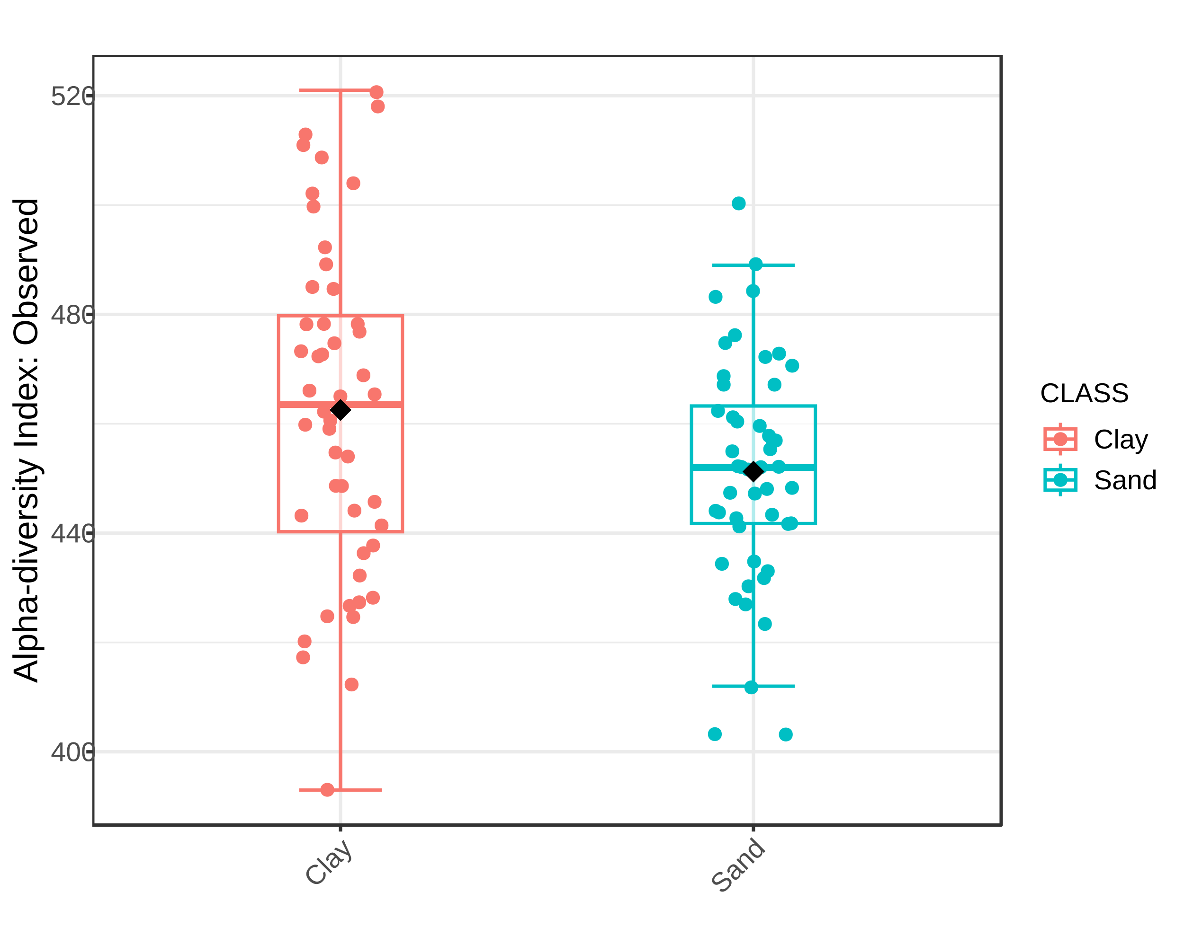
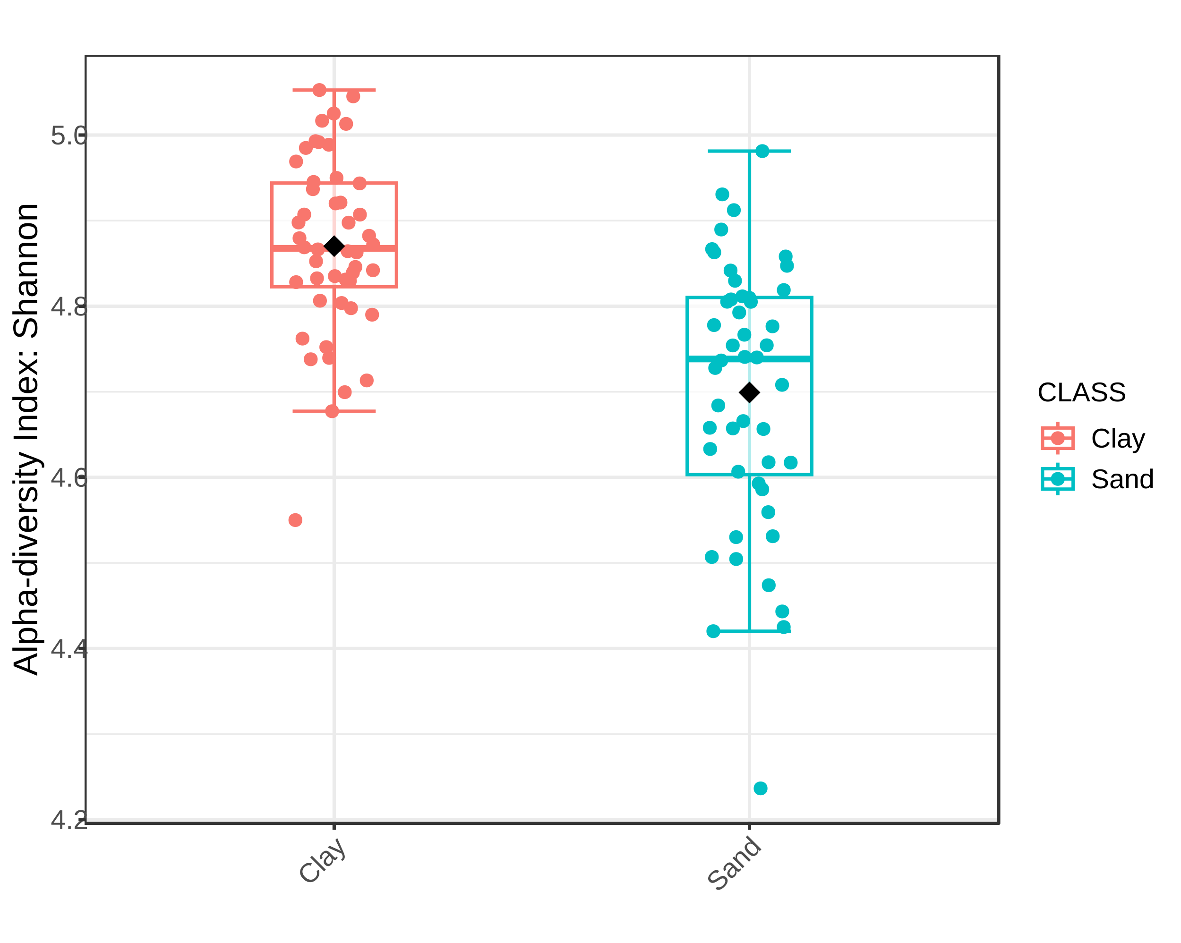
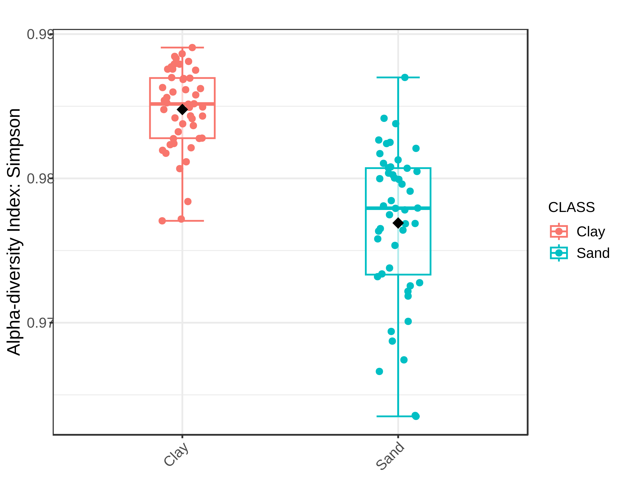
Figure S1. Boxplot illustrating the differences in (A) Observed richness, (B) Shannon and (C) Simpson diversity measures of the bacterial communities in each type of soil. Asterisks indicate significant diferences between treatments (p < 0.05).
*
*
*

Slide 10
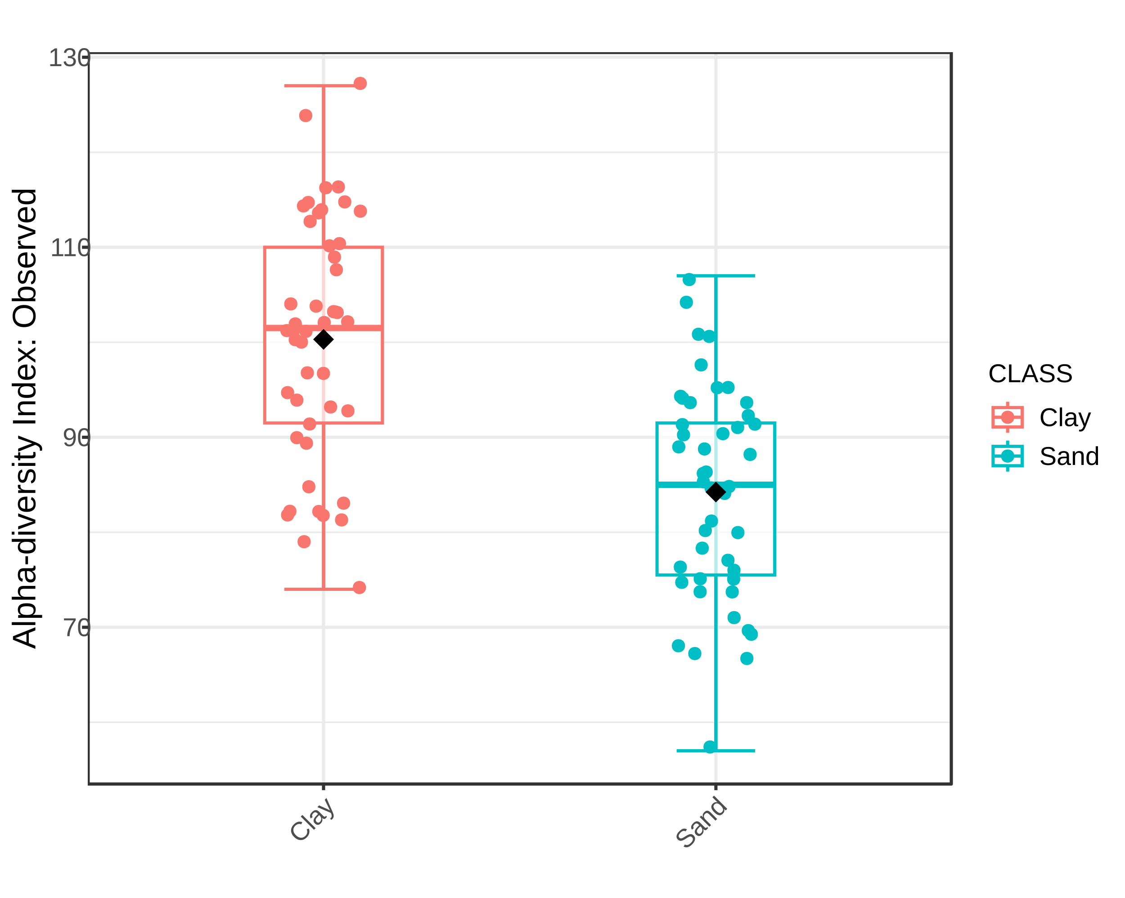
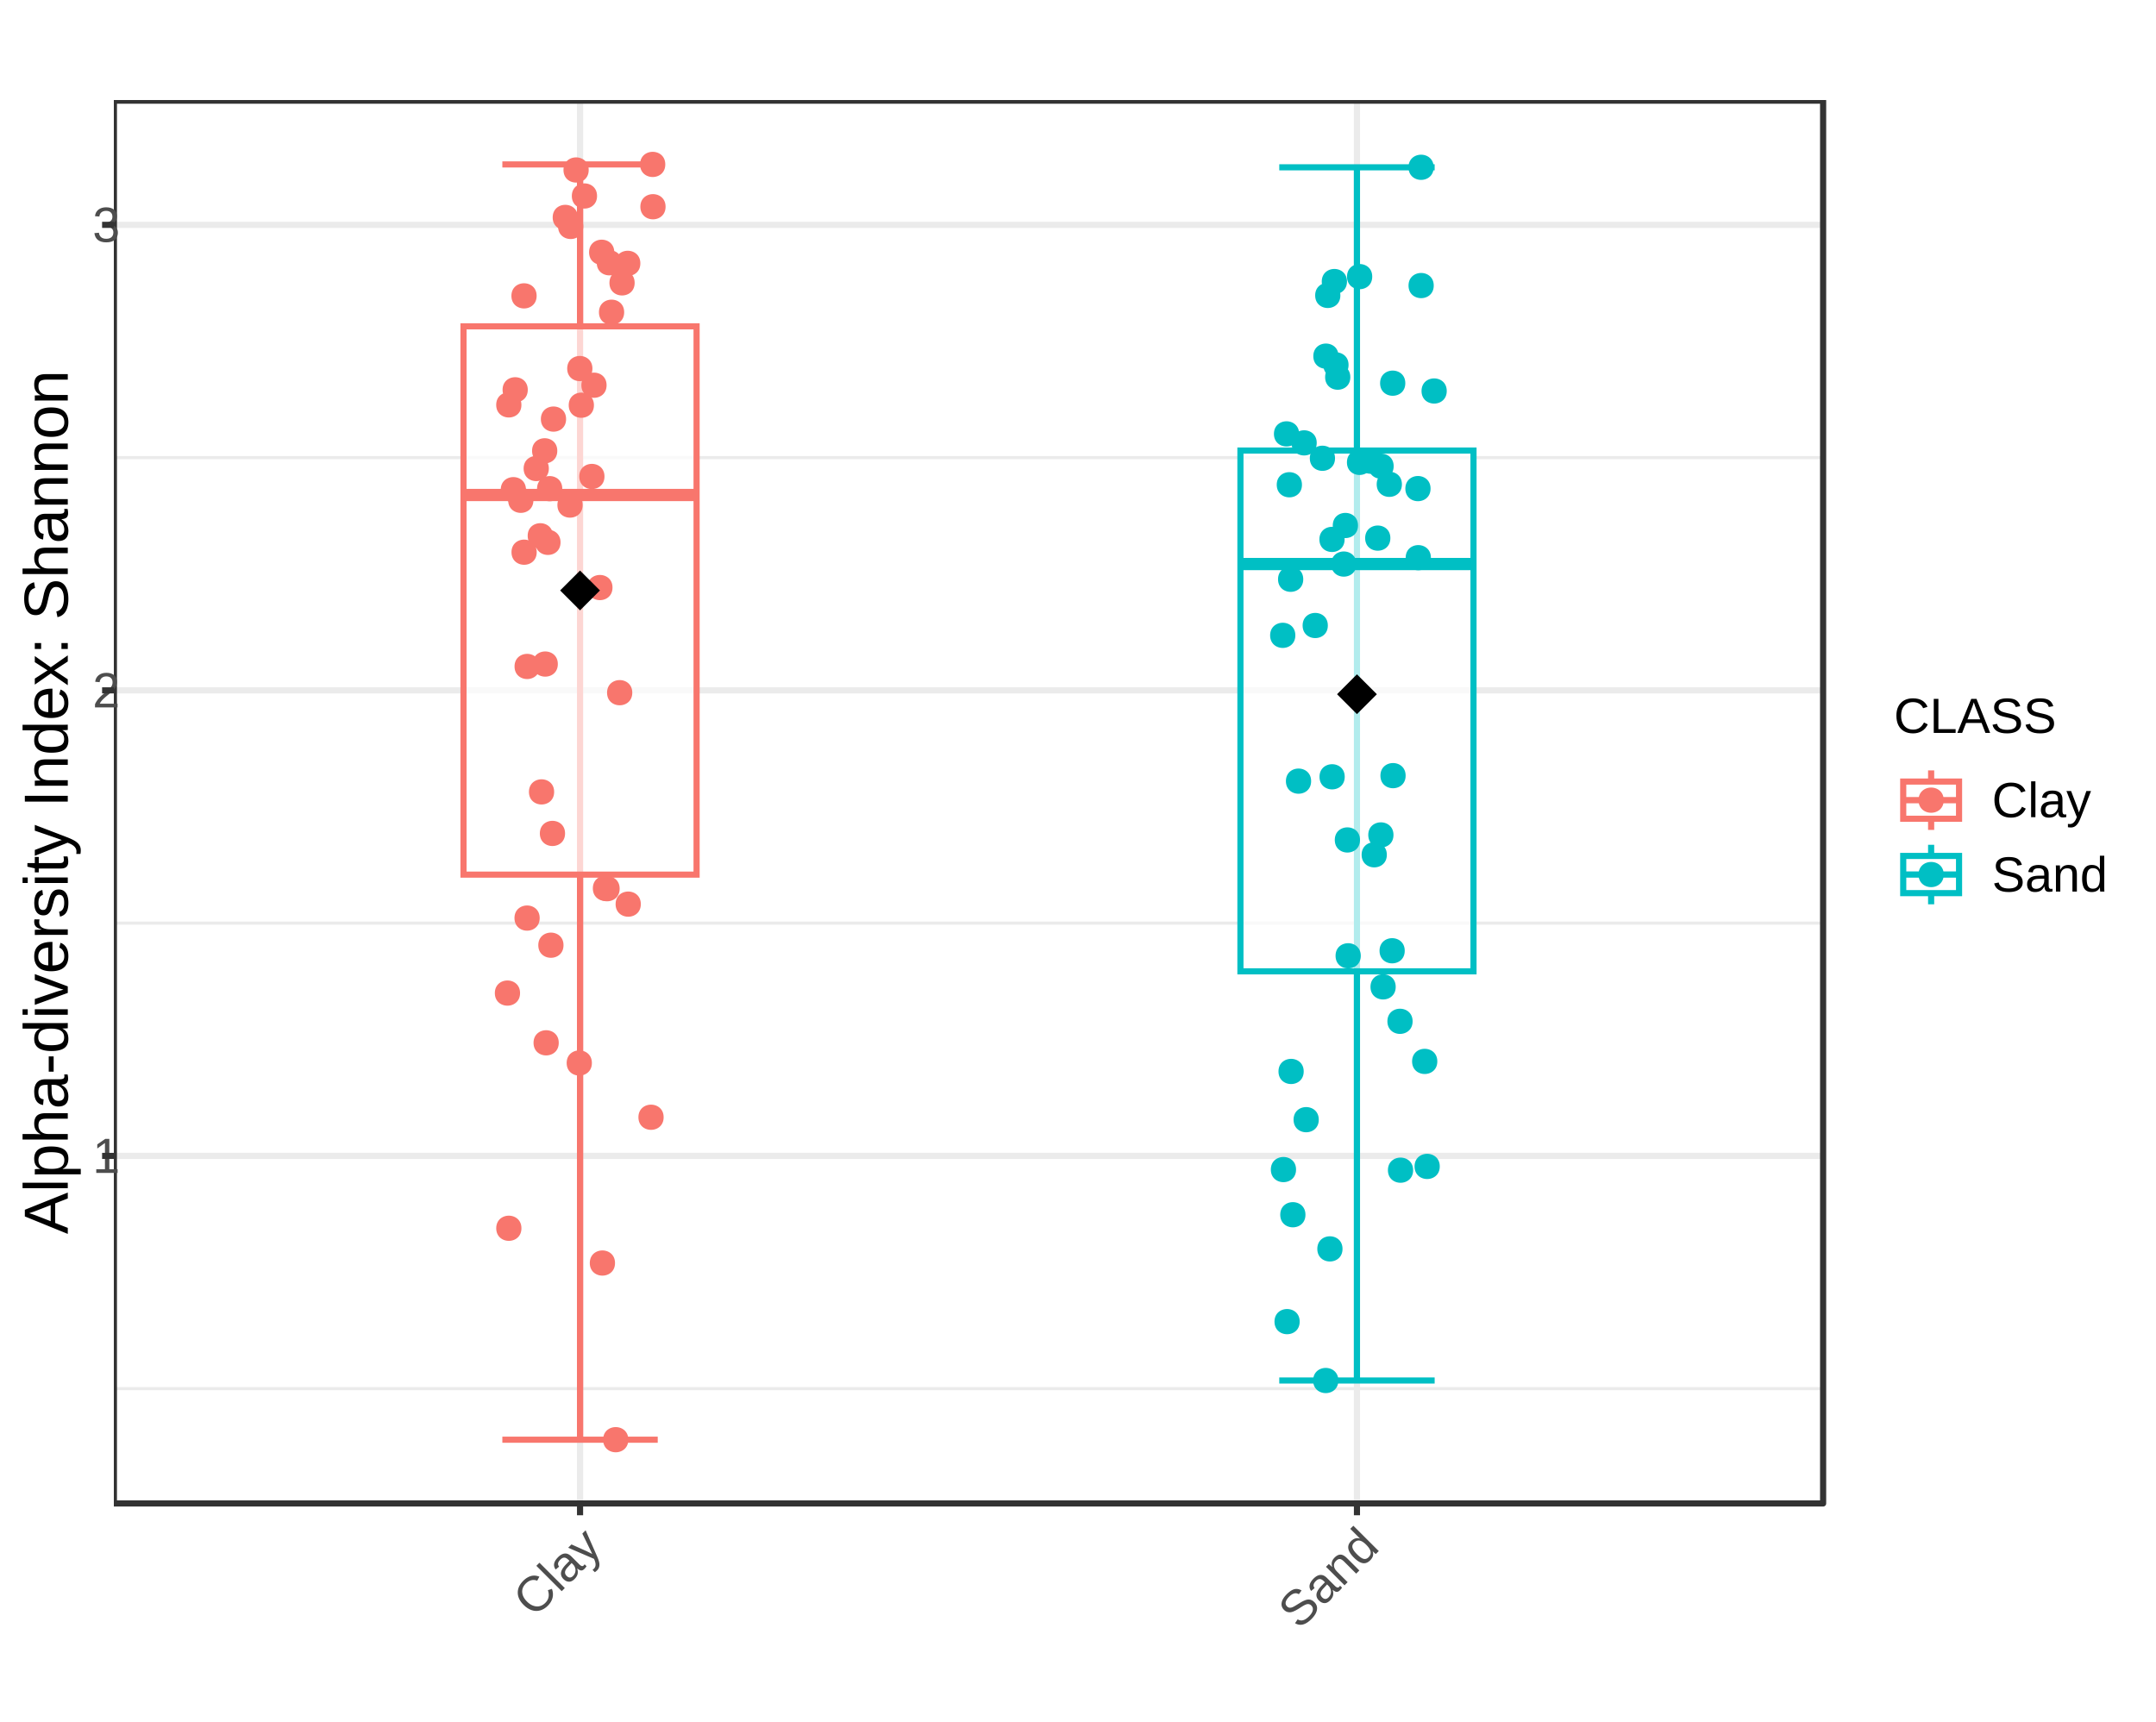
Figure S2. Boxplot illustrating the differences in (A) Observed richness, (B) Shannon and (C) Simpson diversity measures of the fungal communities in each type of soil. Asterisks indicate significant diferences between treatments (p < 0.05).
*

