Slide 1
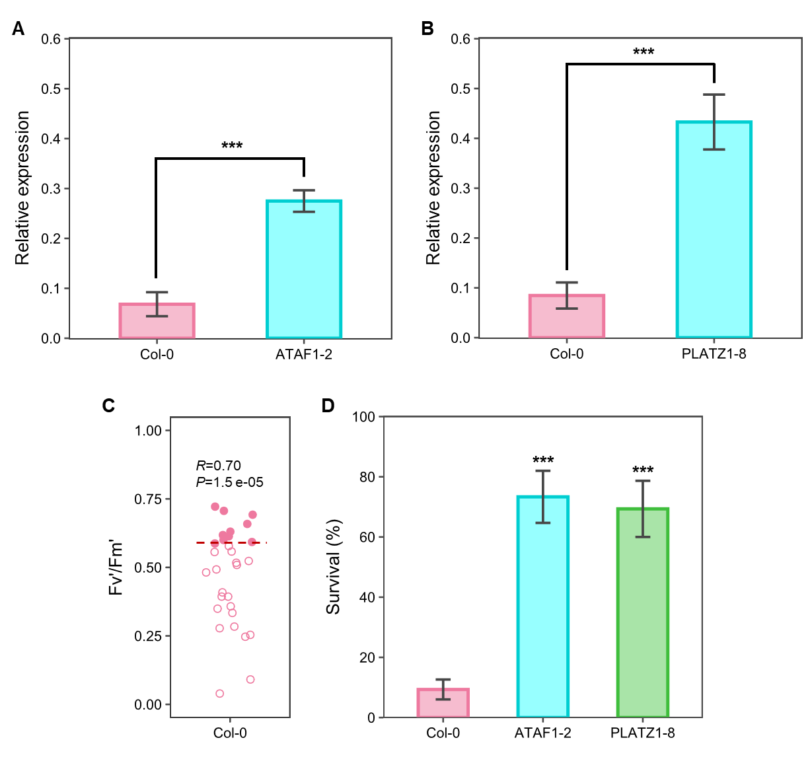
Supplementary Figure S1: Relative expression and drought survival analysis of two Arabidopsis transgenic lines. A) and B) Analysis of ATAF1 (A) and PLATZ1 (B) expression level in their respective transgenic lines and Col-0 by real-time PCR. ACT2 was used as reference gene. Bar plots show the mean and standard deviation of three biological and technical replicates (Student’s t-test, P<0.001). C) Single Fv’/Fm’ measurements of drought-treated Col-0 individuals before recovery irrigation. Red line, threshold with the minimum predictive error; R, point biserial correlation coefficient (n=30 plants, three independent experiments). D) Survival rate of the different genotypes after receiving a recovery irrigation. Bar plot shows the mean and standard deviation of 15 biological replicates in three independent experiments (n=75 plants). Asterisks, significant differences (Fisher’s exact test, P<0.001).

Slide 2
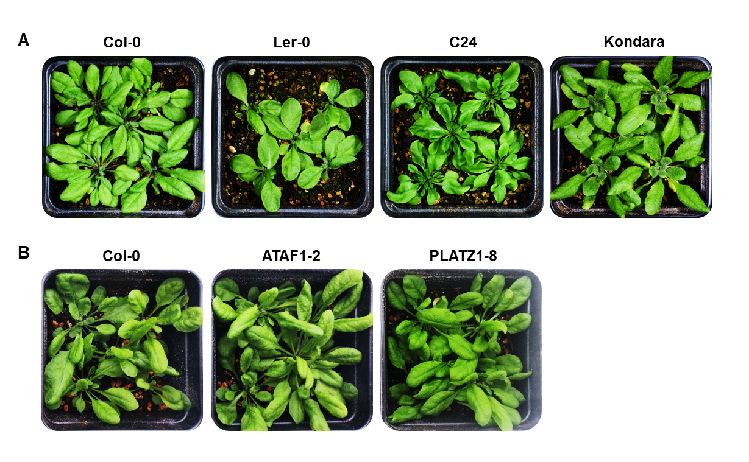
Supplementary Figure S2: Plants of different Arabidopsis genotypes grown under well-watered conditions. Representative rosettes of A) Arabidopsis accessions and B) ATAF1-2 and PLATZ1-8 transgenic lines grown for 40 days in the control treatments.

