Slide 1

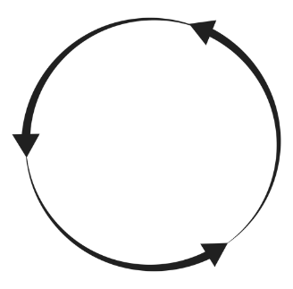
(a)
(b)
+
+
+
+
+
+
+
+
+
+
+
+
+
+
-
+
+
-
+
-
+
+
+
-
+
+
-
+
-
+
+
+
-
-
S
C
+
Na⁺
dative interaction
O
H
-
ClO₄⁻
intermolecular H bond
Illustration of chemical interactions in Bz-κcar matrix at (a) low concentration and (b) high concentration of NaClO₄ dopant.

