Slide 1
Supplemental Figure 1. Patient selection flowchart
N=1288
･ 2011/1/1 – 2016/12/31
･ Consecutive resected cases
･ Primary lung adenocarcinoma
Excluded
･ AIS, MIA, Pathological stage Ⅱ–Ⅳ (n=449)
･ Incomplete resection (n=87)
･ Preoperative therapy (n=10)
･ Sublober resection (n=139)
･ Synchronous/metachronous multiple lung
cancers (n=46)
N=557
･ Pathological pT1a–2aN0M0
･ Completely resected
Excluded
･ Invasive mucinous and other variant
adenocarcinoma (n=59)
・Unevaluable EGFR mutation status (n=4)
N=494
･ Final dataset

Slide 2
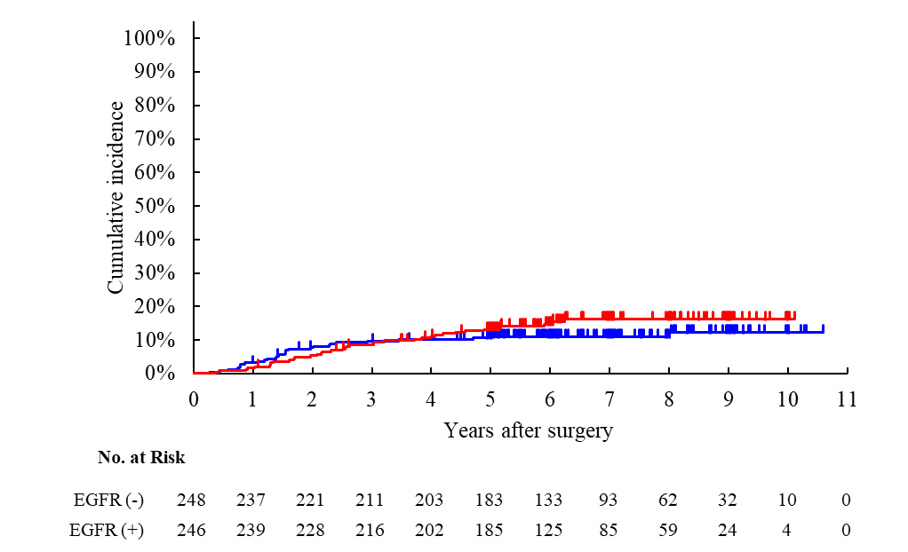
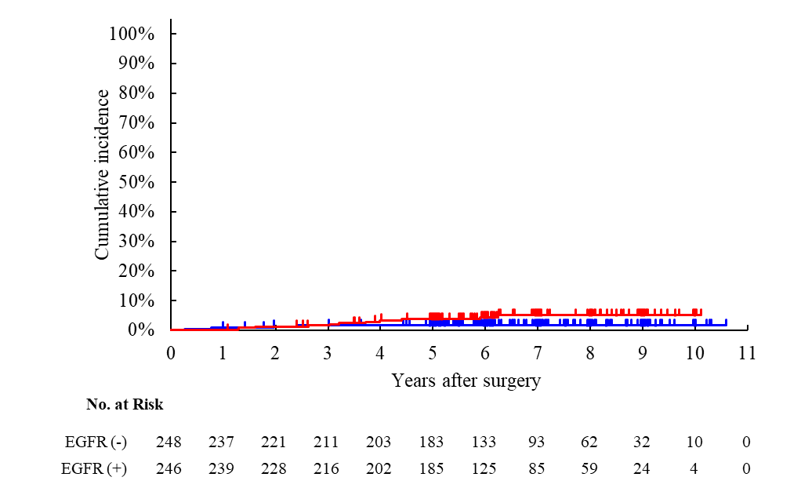
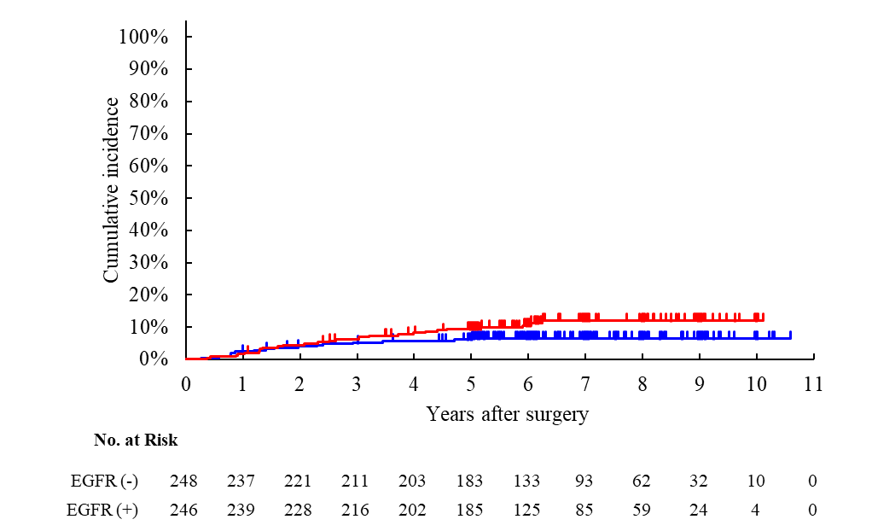
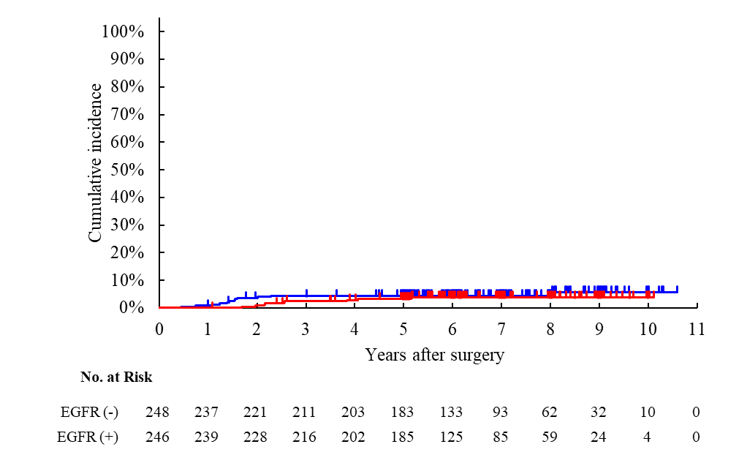
Supplemental Figure 2. Cumulative recurrence curve with competing risks in the entire study population. (A) All recurrence. (B) First metastatic recurrence to the central nervous system (CNS). (C) Distant recurrence (including CNS metastasis). (D) Local recurrence.
A. All recurrence
B. CNS metastasis
EGFRm (–)
EGFRm (+)
Gray P = 0.2575
HR 1.326 (95%CI 0.810 – 2.170)
EGFRm (–)
EGFRm (+)
Gray P = 0.0653
HR 2.799 (95%CI 0.886 – 8.839)
C. Distant recurrence
D. Local recurrence
EGFRm (–)
EGFRm (+)
Gray P = 0.080
HR 1.724 (95%CI 0.927 – 3.207)
EGFRm (–)
EGFRm (+)
Gray P = 0.4943
HR 0.740 (95%CI 0.313 – 1.749)

Slide 3
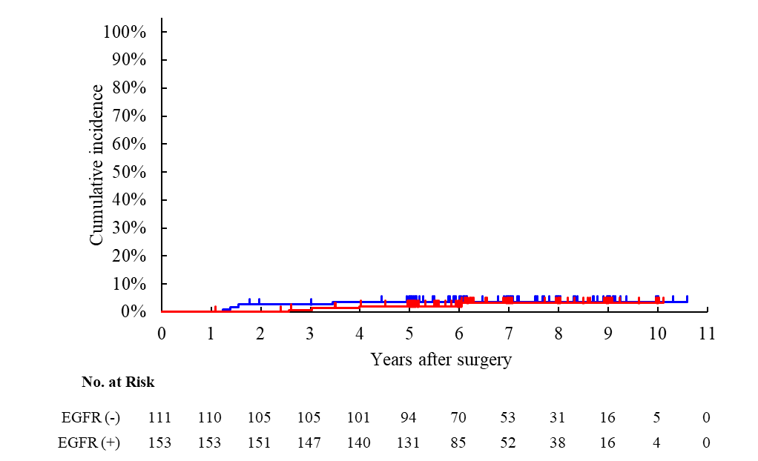
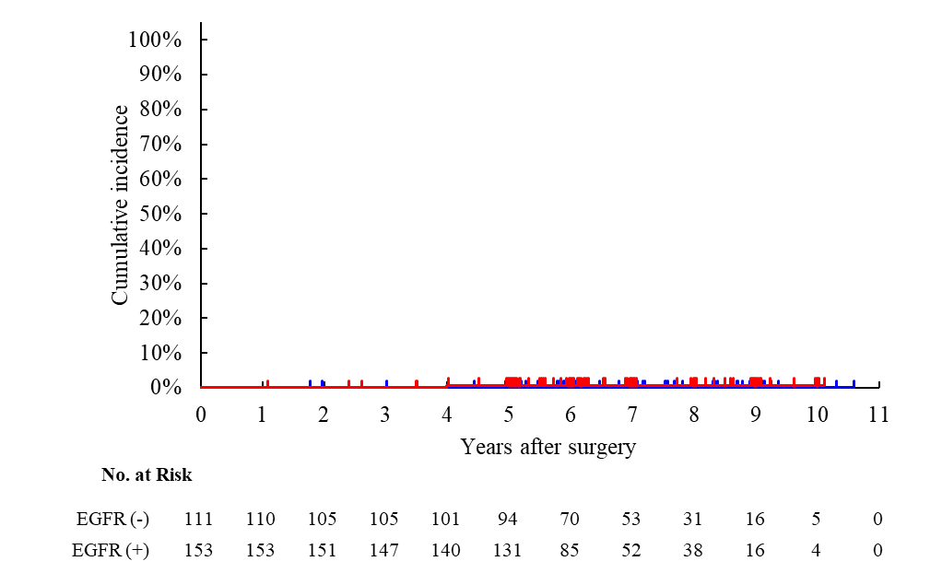

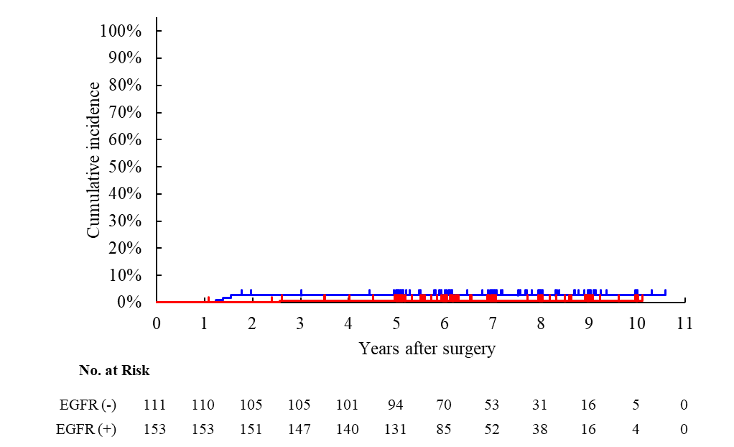
Supplemental Figure 3. Cumulative recurrence curve with competing risks in the low-risk group. (A) All recurrence. (B) First metastatic recurrence to the central nervous system (CNS). (C) Distant recurrence (including CNS metastasis). (D) Local recurrence.
A. All recurrence
B. CNS metastasis
EGFRm (–)
EGFRm (+)
Gray P = 0.6651
HR 0.735 (95%CI 0.181 – 2.988)
EGFRm (–)
EGFRm (+)
Gray P = 0.3937
HR Not estimable
C. Distant recurrence
D. Local recurrence
EGFRm (–)
EGFRm (+)
Gray P = 0.4528
HR 2.311 (95%CI 0.231 – 23.149)
EGFRm (–)
EGFRm (+)
Gray P = 0.1787
HR 0.239 (95%CI 0.025 – 2.259)

