Slide 1
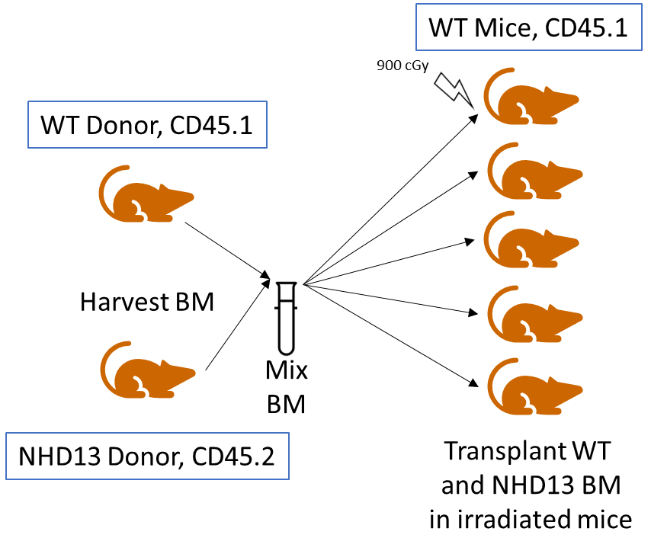
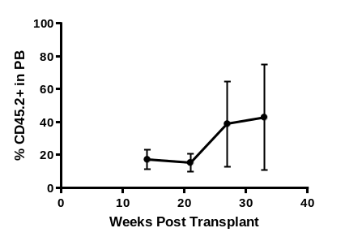
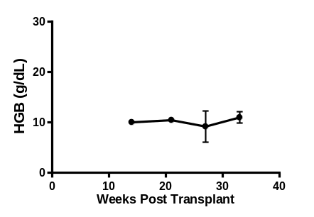
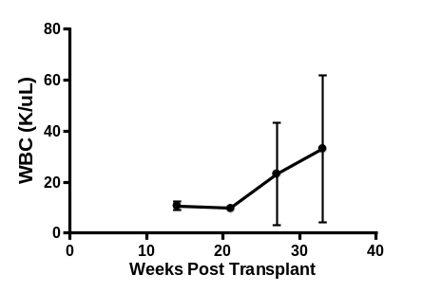
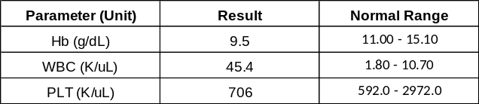
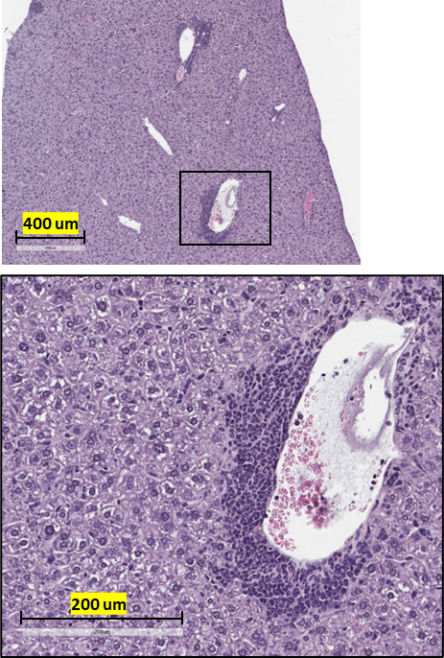
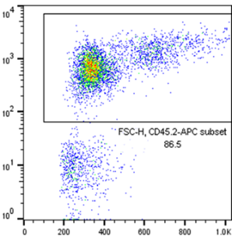
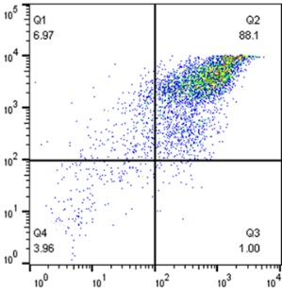
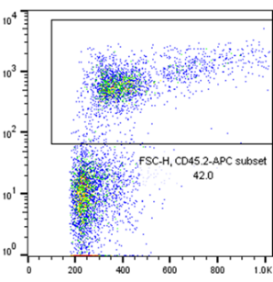
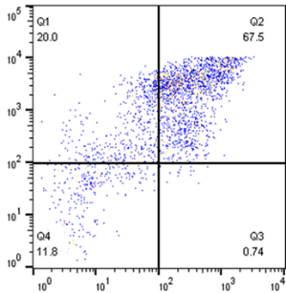
Extended Data Fig. 1
A
B
C
D
E
G
F
Bone Marrow
Spleen
CD45.2-APC
Mac1-PE
FSC
Gr1-FITC
Extended Data Fig. 1. Engraftment of NHD13 cells and transformation to AML. A. Schematic of transplant to generate chimeric mice. B. Engraftment of NHD13 cells in peripheral blood of transplant recipients. C. Hemoglobin (Hgb) levels in peripheral blood of transplant recipients. D. White blood cell (WBC) count in peripheral blood of transplant recipients E. Hematologic parameters of recipient (#3618) with AML transformation. F. Flow cytometry profile. G. H&E staining of liver. Note peri-portal and perivascular invasion of myeloblasts.

Slide 2
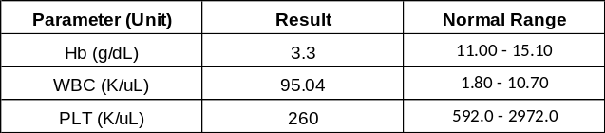
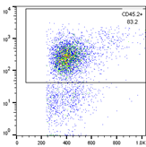
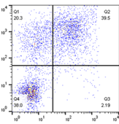
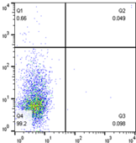
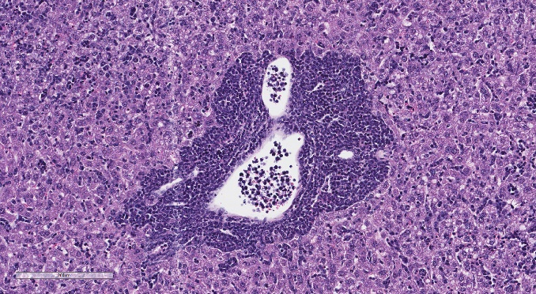
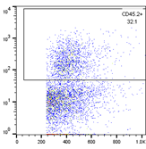
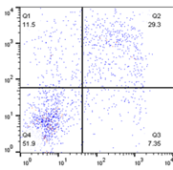
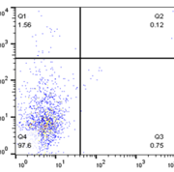
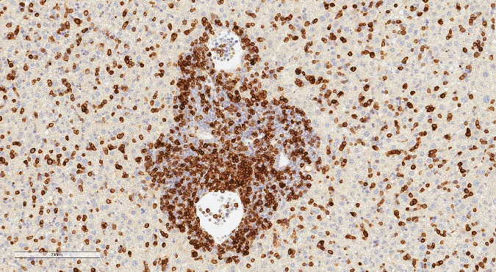
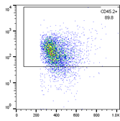
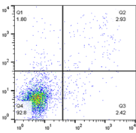
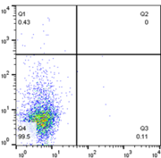
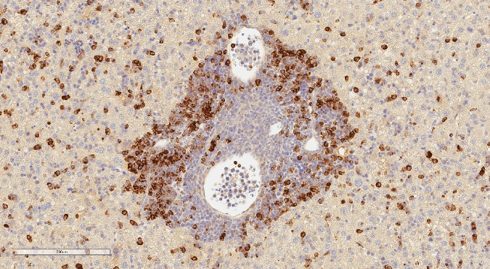
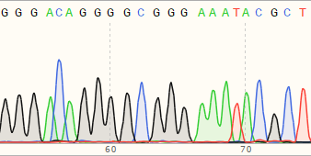
Extended Data Fig. 2
A
B
C
Liver
Bone
Marrow
H&E
200 um
Spleen
CD3
200 um
Thymus
MPO
200 um
CD45.2-APC
Mac1-PE
CD4-PE
FSC
Gr1-FITC
CD8-FITC
D
D Segment
J Segment
Extended Data Fig. 2. Characteristics of donor ETP-ALL (dETP; mouse #3597) treated with ATC.
A. Key hematologic parameters. B. Flow cytometry profile. C. H&E, CD3, and MPO staining of the liver. Note positive staining for both CD3 and MPO. D. Clonal Trb DJ Rearrangement.

Slide 3






























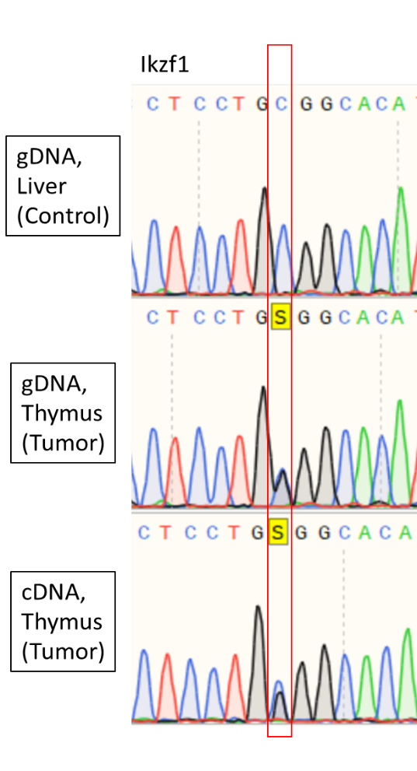
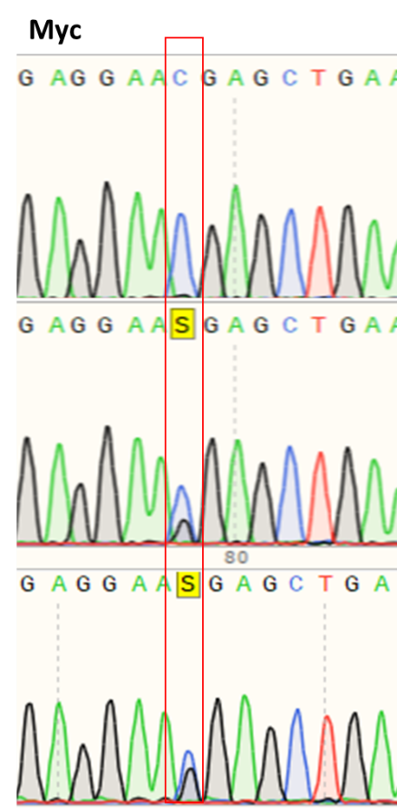
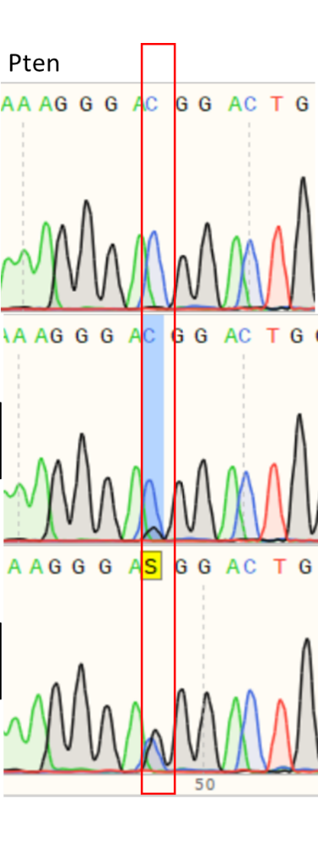
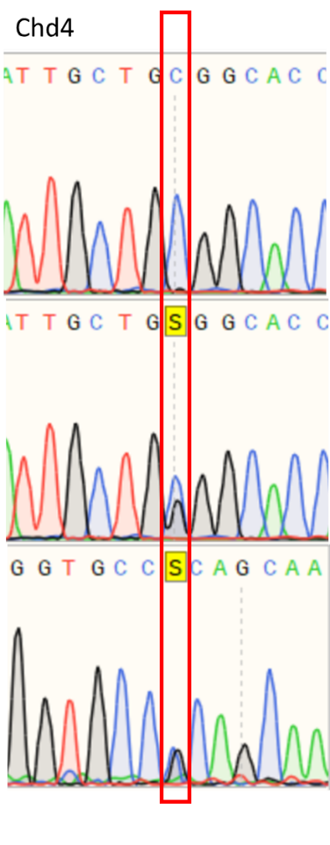
Extended Data Figure 3
A
Bcl11b
(3600)
Cxcr1
(3598)
Flt3
(3598)
Notch1
(3598)
Gdf2
(3598)
Neurl1b
(3598)
Cxcr1
(3600)
Ikzf1
(3600)
gDNA,
Liver
(control)
gDNA,
Thymus
(Tumor)
Notch1
(3600)
Lgmn
(3600)
Tmem204
(3600)
Mep1b
(3600)
Mmrn1
(3600)
Loxhd1
(3600)
Dnah2
(3600)
gDNA,
Liver
(control)
gDNA,
Thymus
(Tumor)
B
Myc
(3598)
Pten
(3598)
Chd4
(3598)
Ikzf1
(3600)
Reverse
Primer Used
Extended Data Figure 3. C>G Transversions are detected in gDNA and cDNA using Sanger sequencing. A. Sequence tracings from gDNA isolated from leukemic tissue and non-leukemic germline tissue. B. Sequence tracings from gDNA and cDNA isolated from leukemic tissue and non-leukemic germline tissue. A reverse primer was used for the Chd4 cDNA tracing.

Slide 4
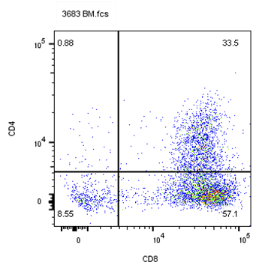
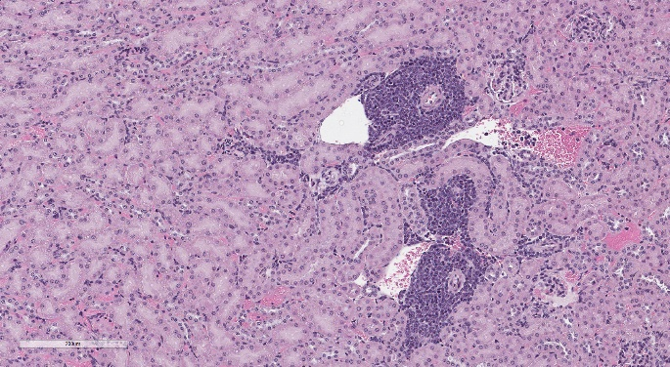
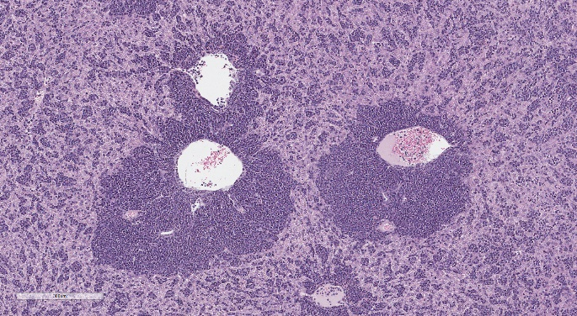
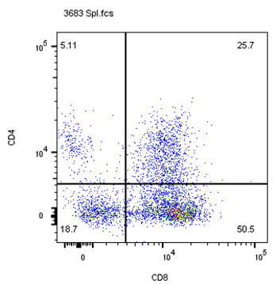
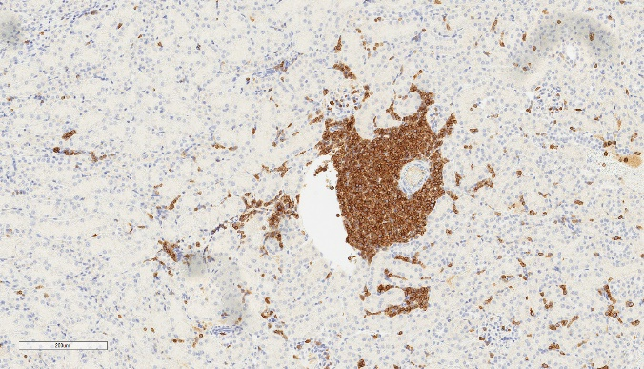
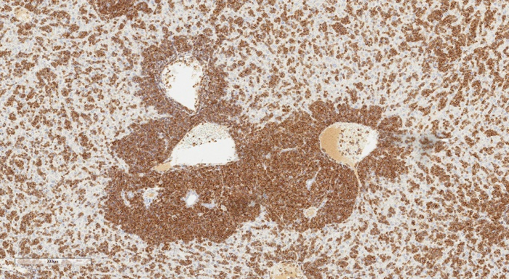
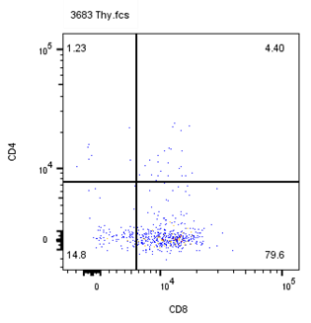
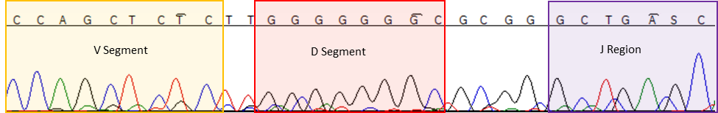
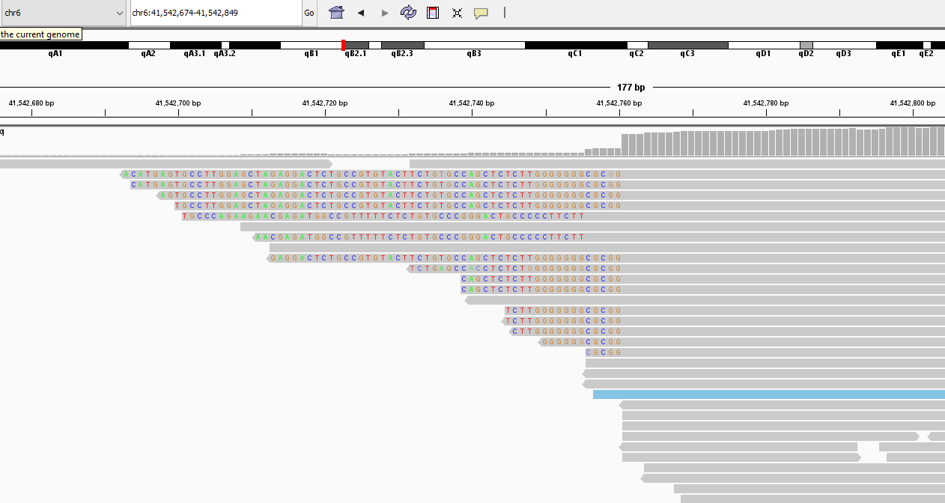
Extended Data Figure 4
B
A
Kidney
Liver
Bone
Marrow
H&E
200 um
300 um
Spleen
CD3
200 um
200 um
C
Thymus
CD4-PerCP/Cy5.5
D
CD8-APC/Cy5.5
Start of
WT Trbj2-1
Extended Data Figure 4. T-ALL in ATC treated WT mouse (#3683). A. Flow cytometry revealing infiltration of CD8+ cells in BM and spleen. B. H&E and CD3 staining revealing characteristic peri-vascular and peri-portal invasion of liver and kidney. C. Sanger sequence tracing of clonal Trb gene rearrangements. D. IGV view from WES assay demonstrating two clonal Trb gene rearrangements.

Slide 5
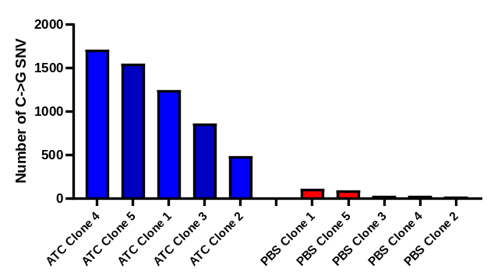
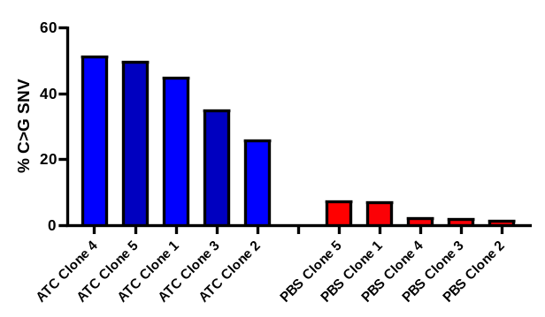

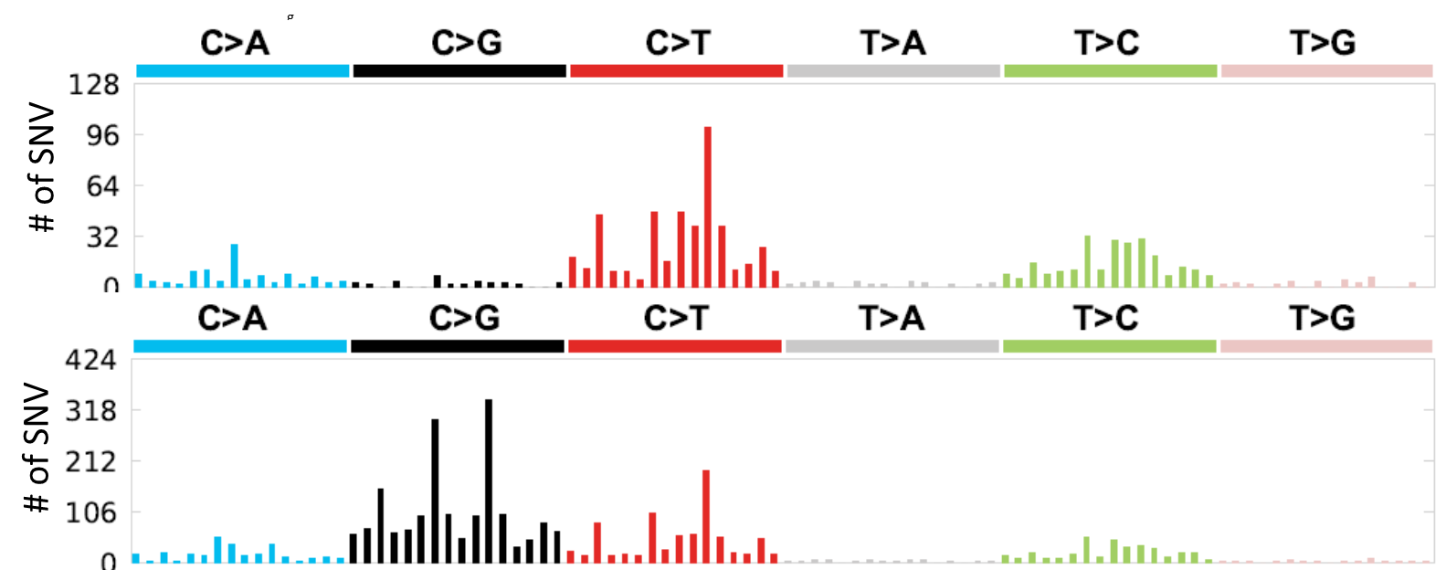
Extended Data Figure 5
A
B
*
*
p=0.00794
p=0.00794
C
CEM-PBS-C2
CEM-ATC-C2
Extended Data Figure 5. The human T cell leukemia cell line CEM develops C>G transversions after treatment with ATC in vitro. A. Number of C>G transversion in clonal CEM cell lines treated with either ATC or PBS. B. C>G transversions percent of all SNV’s in clonal CEM cell lines treated with either ATC or PBS. C. Representative Sanger SBS plots of clonal CEM lines treated with ATC vs. PBS. Note that C>G transversions preferentially occur in a 5’-VCG-3’ context.

Slide 6
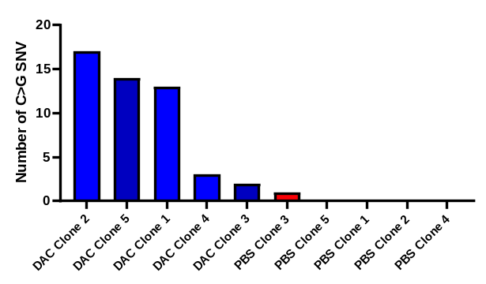
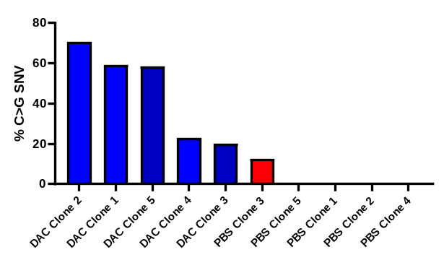

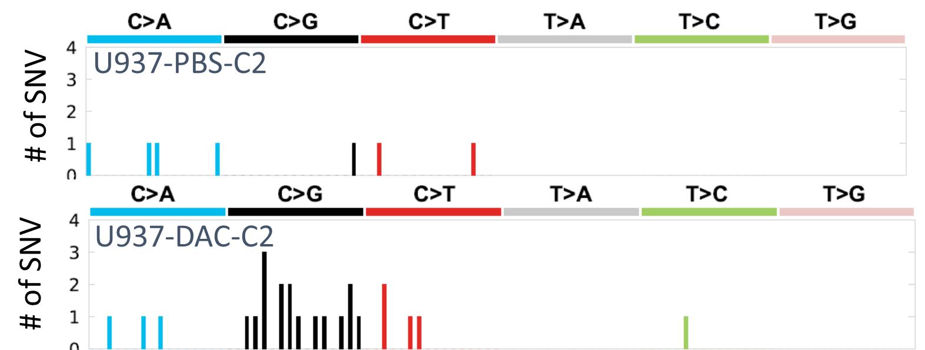
Extended Data Figure 6
A
B
*
*
p=0.009701
p=0.009701
C
Extended Data Figure 6. The human cell line U937 develops C>G transversions following treatment with decitabine (DAC) in vitro. A. Number of C>G transversion in clonal U937 cell lines treated with either DAC or PBS. B. C>G transversions percent of all SNV’s in clonal U937 cell lines treated with either DAC or PBS. C. Representative Sanger SBS plots of clonal U937 lines treated with DAC vs. PBS.

