Slide 1
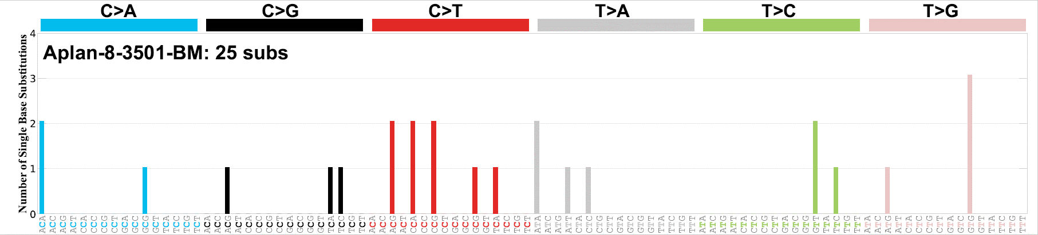
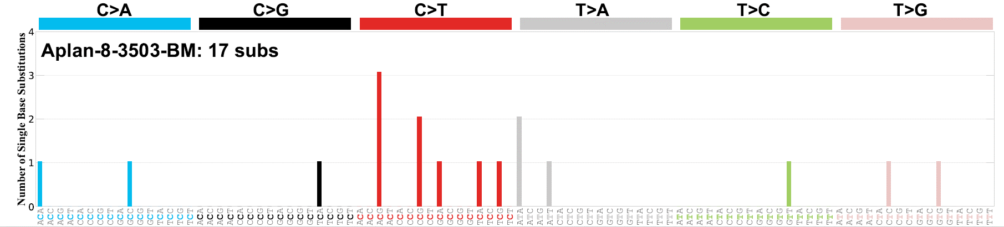
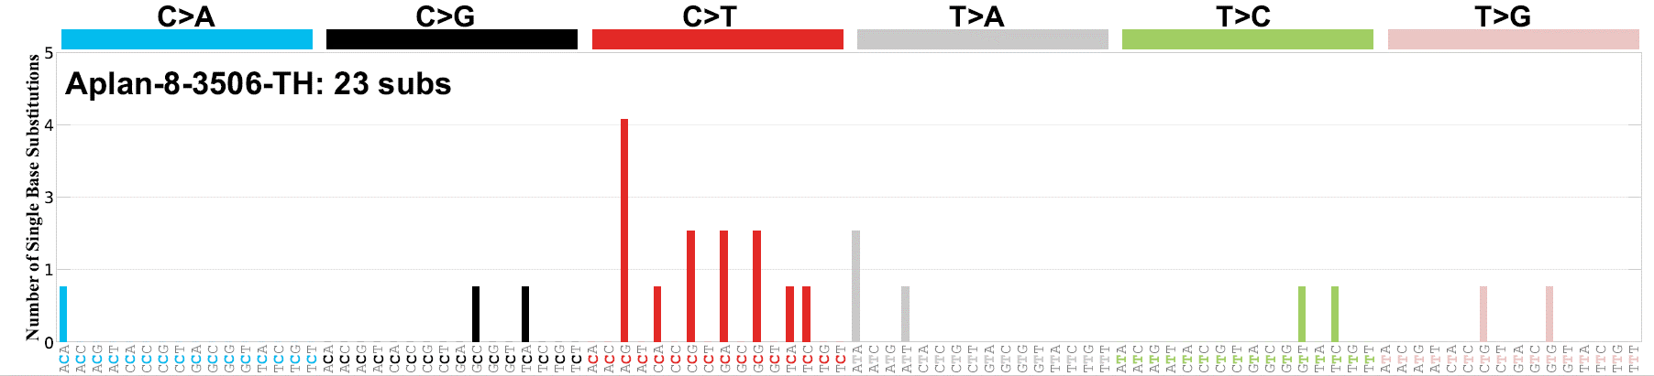
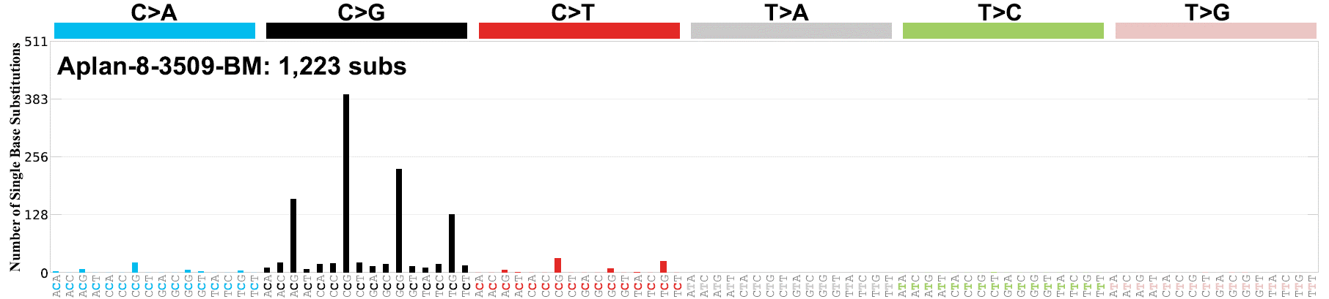
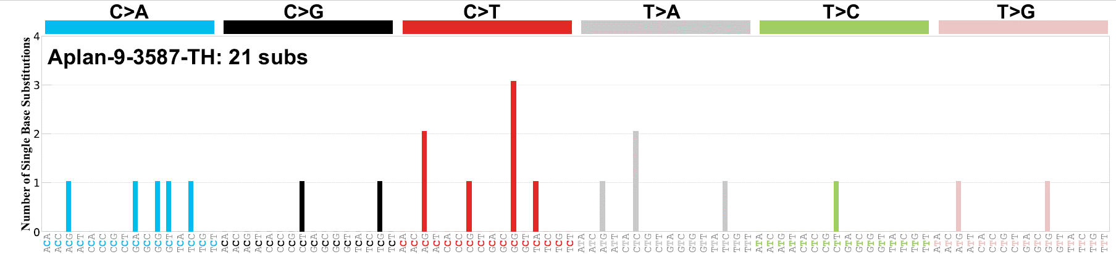
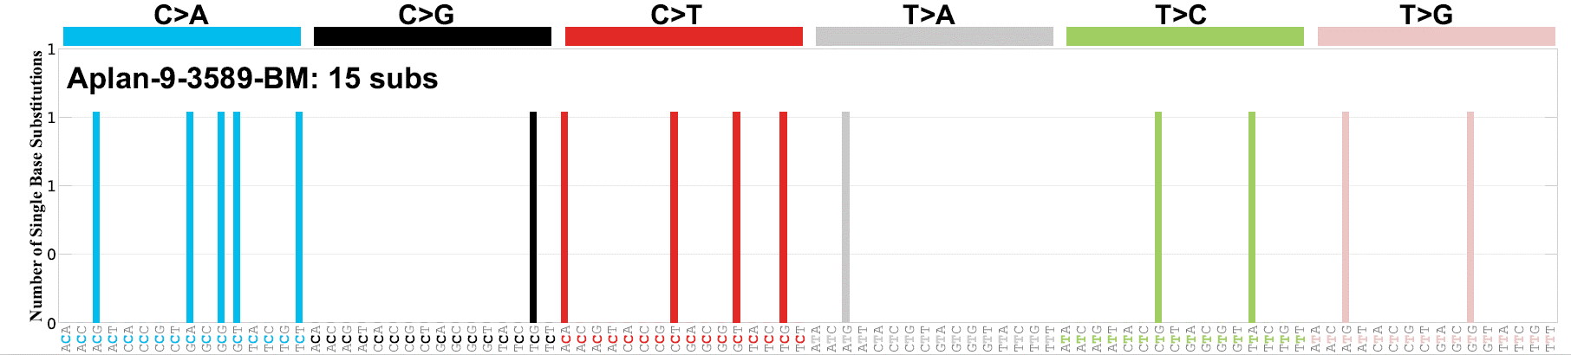
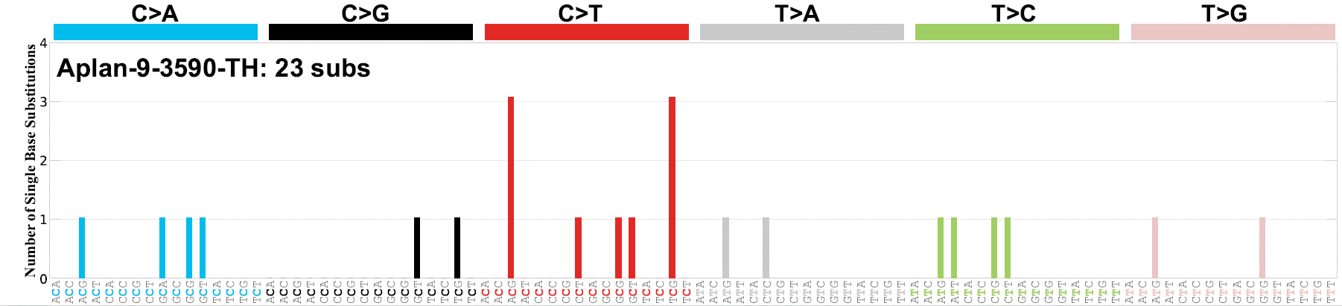
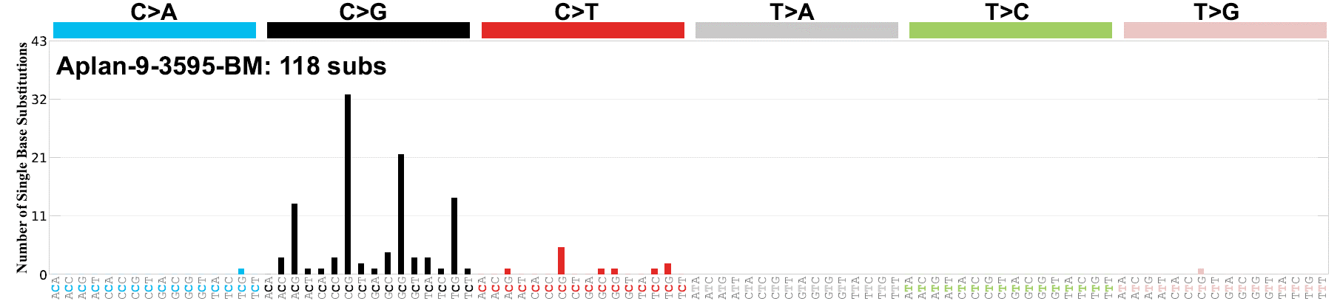

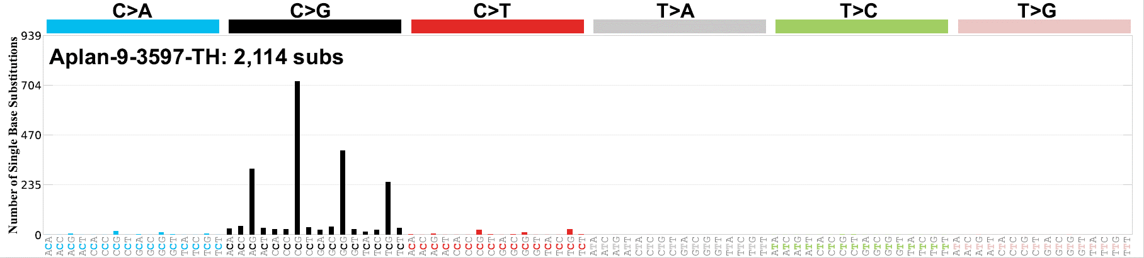

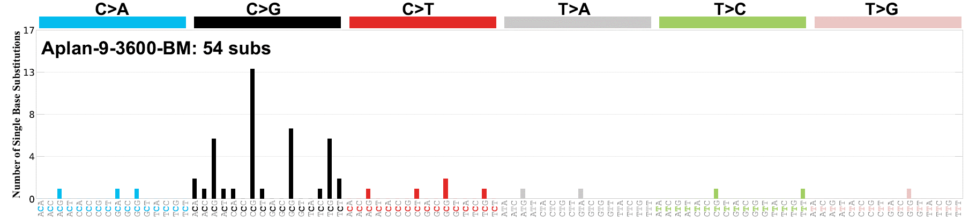


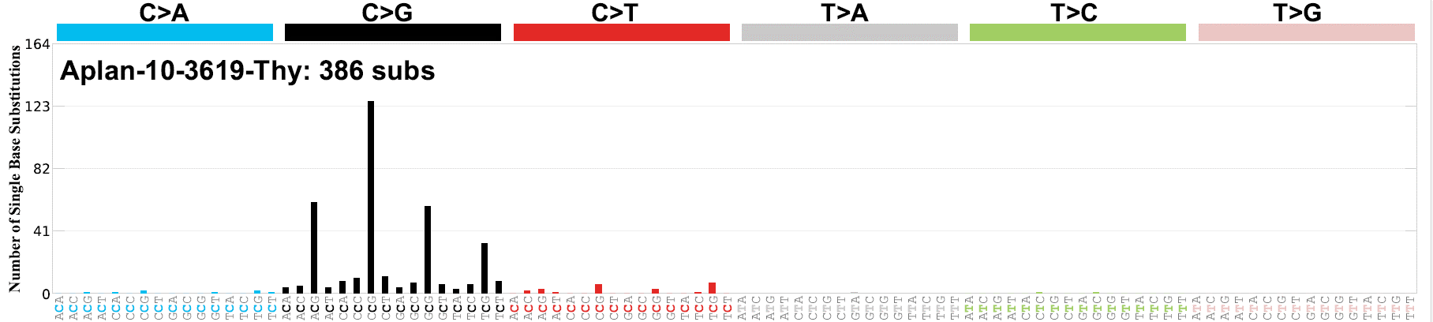
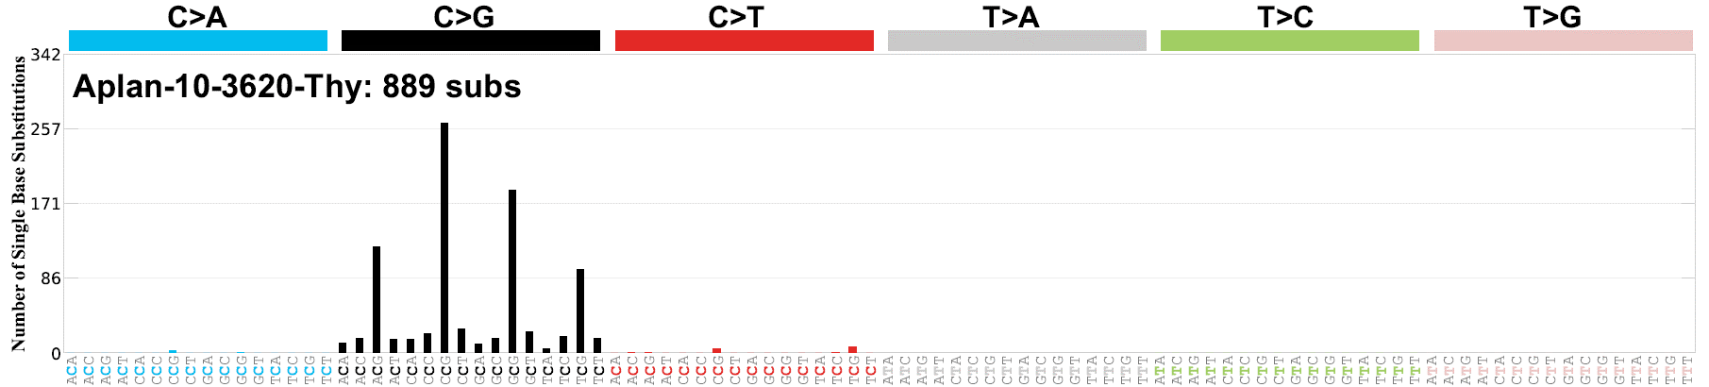
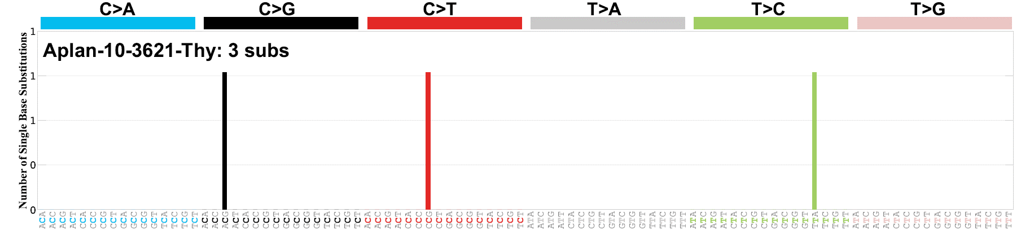
Supp Fig. 1A – IR Transplant Experiments
#3501 BM
PBS
rT-ALL
#3503 BM
PBS
rT-ALL
#3506 Thy
PBS
rT-ALL
SBS-ATC
#3509 BM
1.0 mg/kg ATC
dB-ALL
#3587 Thy
PBS
dT-ALL
#3589 BM
PBS
dAML
#3590 Thy
PBS
Donor ETP
SBS-ATC
#3595 BM
0.5 mg/kg ATC
rT-ALL
SBS-ATC
#3596 Thy
0.5 mg/kg ATC
dAML
SBS-ATC
#3597 BM
0.5 mg/kg ATC
dETP
SBS-ATC
#3598 Thy
0.5 mg/kg ATC
rT-ALL
SBS-ATC
#3600 BM
0.5 mg/kg ATC
dAML
SBS-ATC
#3600 Thy
0.5 mg/kg ATC
rT-ALL
SBS-ATC
#3617 BM
0.1 mg/kg ATC
dAML
SBS-ATC
#3619 Thy
0.1 mg/kg ATC
rT-ALL
SBS-ATC
#3620 Thy
0.1 mg/kg ATC
dAML
#3621 Thy
0.1 mg/kg ATC
dAML
Supp Figure 1. SBS Profiles of leukemias from mice treated with ATC or PBS
A. SBS profiles from IR-based transplant experiments. B. SBS profiles from CASIN-based transplant experiment. C. SBS profiles from non-transplant experiments. D. SBS profiles from whole genome sequencing

Slide 2
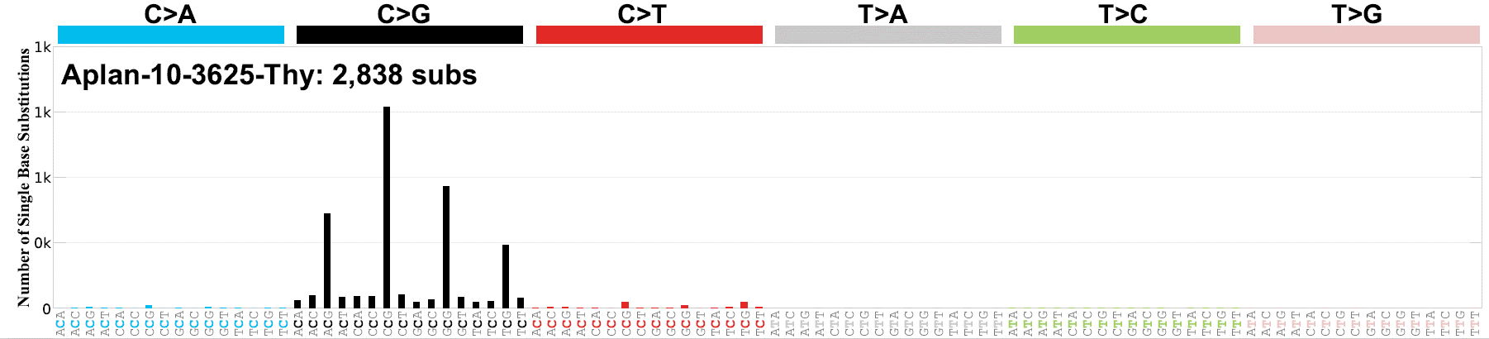
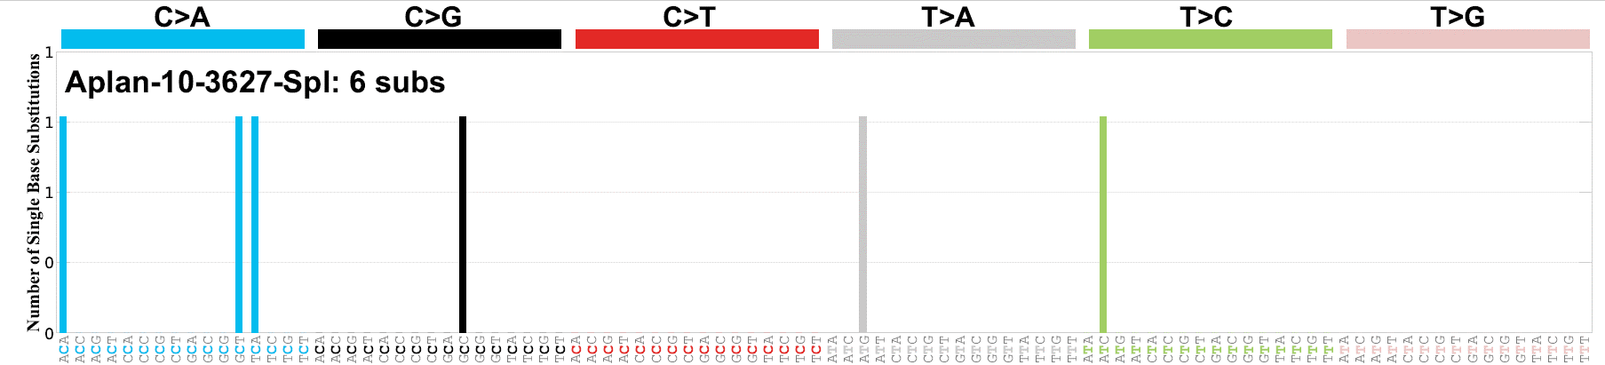

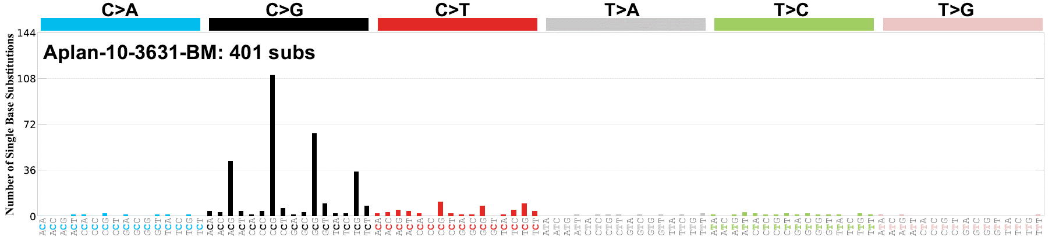

Supp Fig. 1A – IR Transplant Experiments
SBS-ATC
#3625 Thy
0.5 mg/kg ATC
rT-ALL
#3627 Spl
0.1 mg/kg ATC
dAML
SBS-ATC
#3630 Thy
1.0 mg/kg ATC
rT-ALL
SBS-ATC
#3631 BM
1.0 mg/kg ATC
rT-ALL
SBS-ATC
#3634 Thy
1.0 mg/kg ATC
rT-ALL

Slide 3


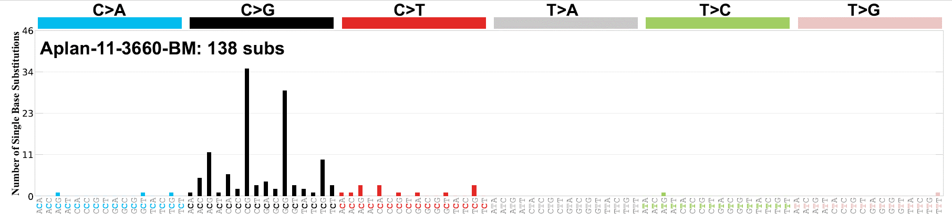


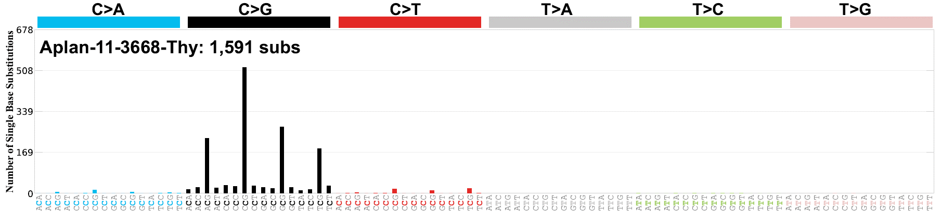
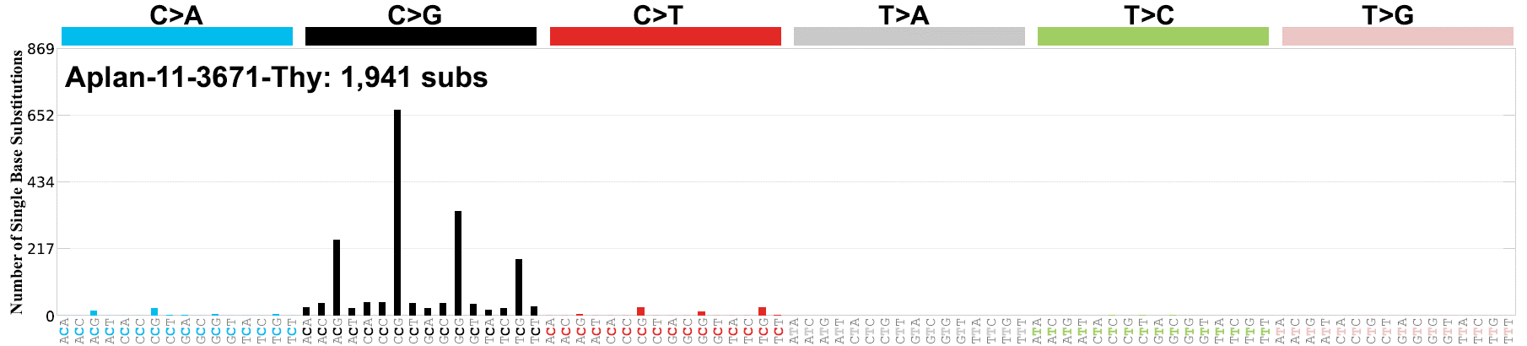

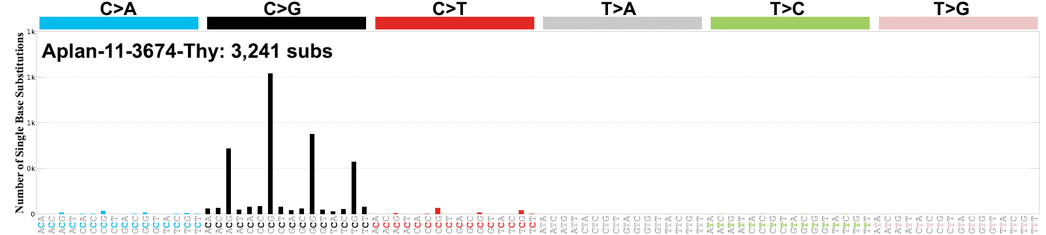
Supp Fig. 1B – CASIN Transplant Experiments
SBS-ATC
#3656 Thy
0.1 mg/kg ATC
rT_ALL
SBS-ATC
#3658 BM
0.1 mg/kg ATC
dAML
SBS-ATC
#3660 BM
0.1 mg/kg ATC
dAML
SBS-ATC
#3664 Thy
0.5 mg/kg ATC
rT-ALL + rETP
SBS-ATC
#3668 BM
0.5 mg/kg ATC
Immature dAML
SBS-ATC
#3668 Thy
0.5 mg/kg ATC
rETP
SBS-ATC
#3671 Thy
1.0 mg/kg ATC
rT-ALL
SBS-ATC
#3674 Spl
1.0 mg/kg ATC
rB-ALL
SBS-ATC
#3674 Thy
1.0 mg/kg ATC
rT-ALL

Slide 4





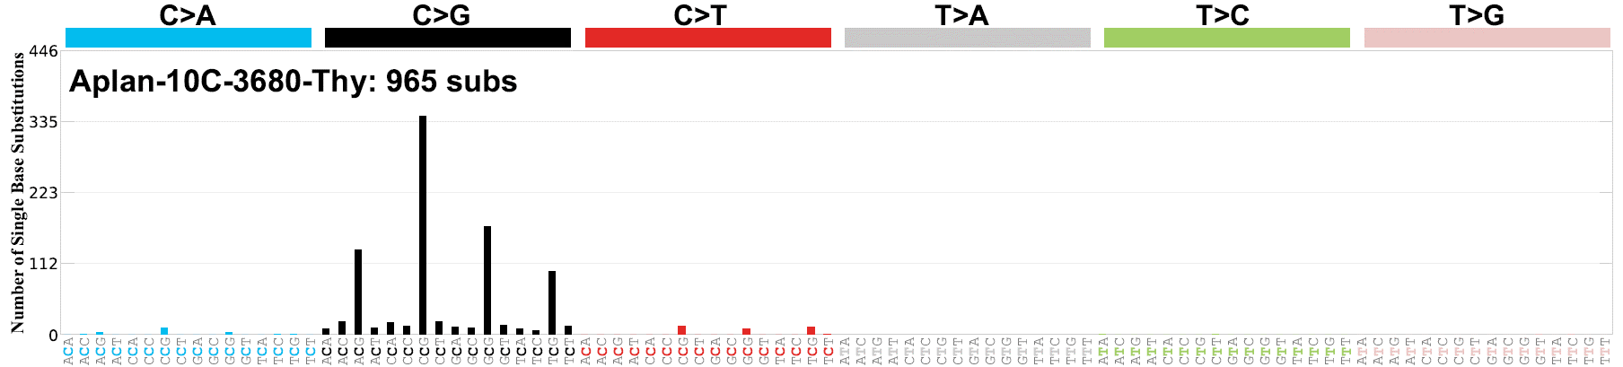






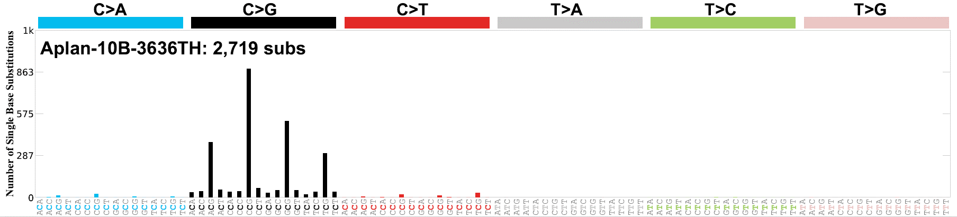




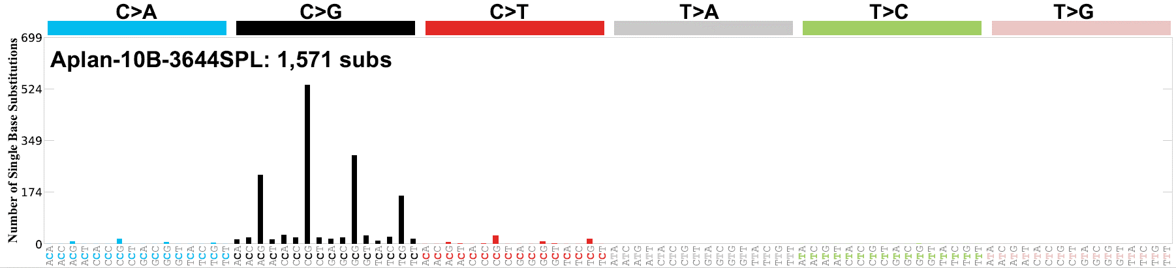
Supp Fig. 1C – Non-Transplant Experiments
2 month-old mice
SBS-ATC
#3676 Thy
ATC
ETP
SBS-ATC
#3677 Thy
ATC
T-ALL
SBS-ATC
#3678 BM
ATC
B-ALL
SBS-ATC
#3678 Thy
ATC
T-ALL
SBS-ATC
#3679 Thy
ATC
T-ALL
SBS-ATC
#3680 Thy
ATC
T-ALL
SBS-ATC
#3683 LN
ATC
T-ALL
SBS-ATC
#3684 Thy
ATC
T-ALL
SBS-ATC
#3689 Thy
ATC
T-ALL
SBS-ATC
#3690 Thy
ATC
T-ALL
SBS-ATC
#3691 LN
ATC
ETP
8 month-old mice
SBS-ATC
#3635
ATC
T-ALL
SBS-ATC
#3636
ATC
T-ALL
SBS-ATC
#3637
ATC
T-ALL
SBS-ATC
#3638
ATC
T-ALL
SBS-ATC
#3639
ATC
T-ALL
SBS-ATC
#3642
ATC
T-ALL
SBS-ATC
#3644
ATC
B-ALL

Slide 5

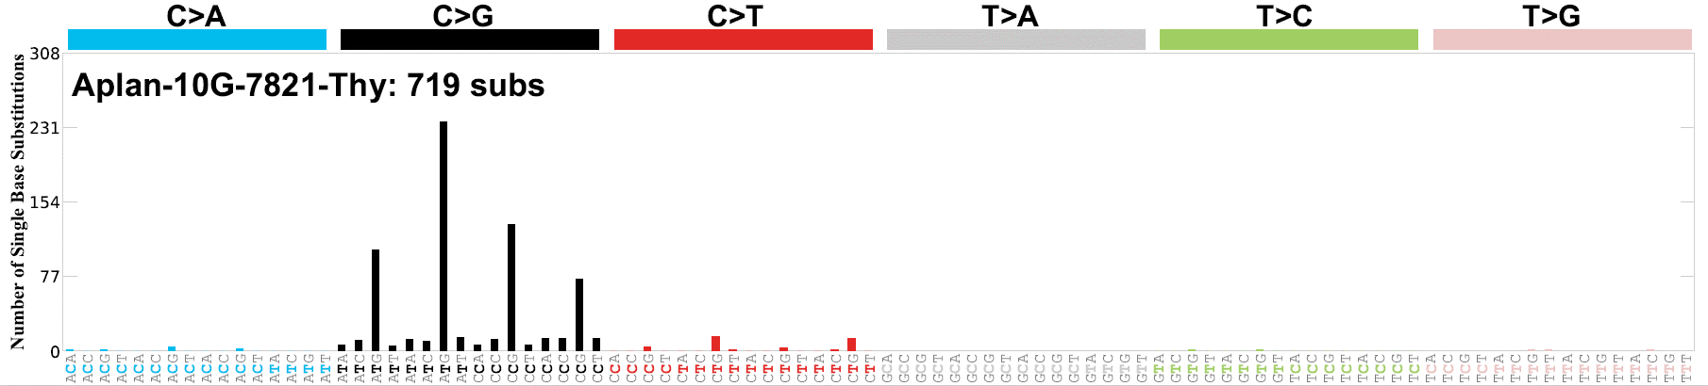
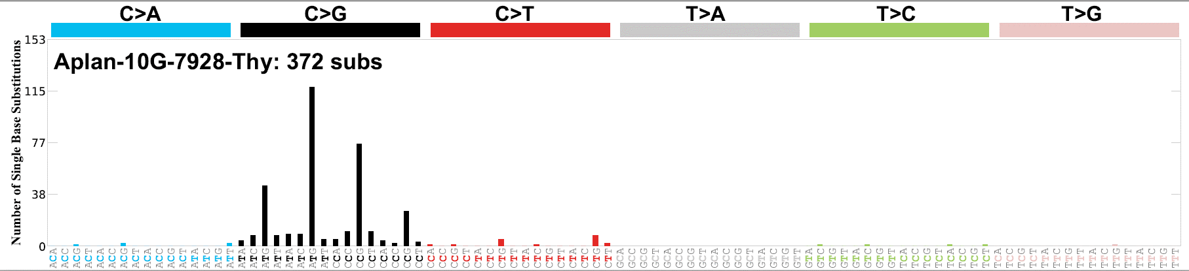

Supp Fig. 1C – Non-Transplant Experiments
12-15 month-old mice
SBS-ATC
#5158 Thy
ATC
T-ALL
SBS-ATC
#7821 Thy
ATC
T-ALL
SBS-ATC
#7928 Thy
ATC
T-ALL
SBS-ATC
#8387 Spl
ATC
B-ALL

Slide 6
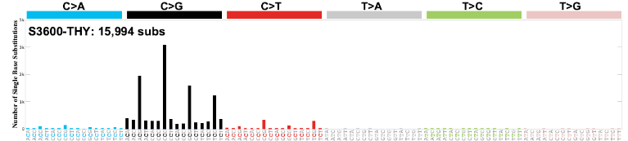
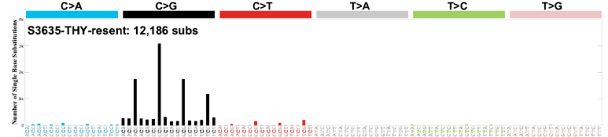
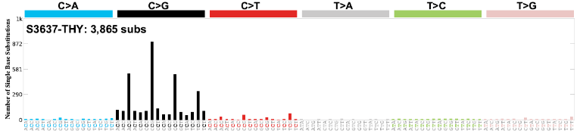
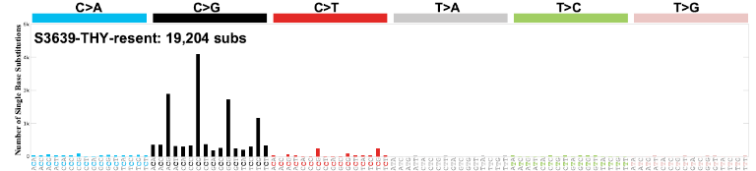
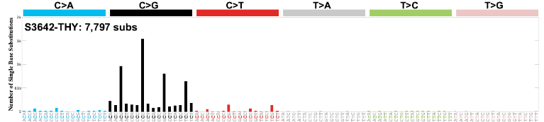
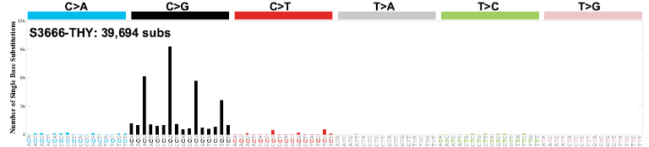
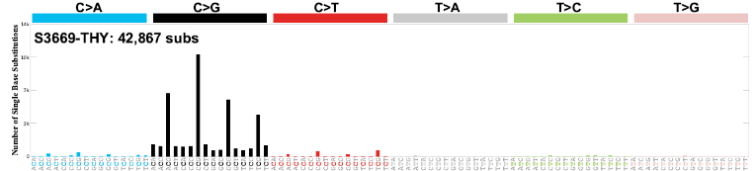
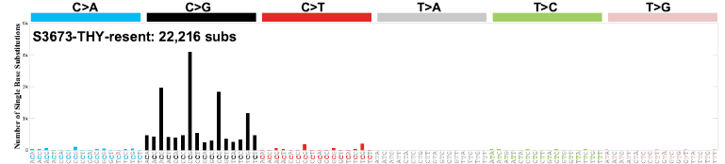
Supp Fig. 1D – Whole Genome Sequencing Experiment
SBS-ATC
#3600
ATC
T-ALL
SBS-ATC
#3635
ATC
T-ALL
SBS-ATC
#3637
ATC
T-ALL
SBS-ATC
#3639
ATC
T-ALL
SBS-ATC
#3642
ATC
T-ALL
SBS-ATC
#3666
ATC
T-ALL
SBS-ATC
#3669
ATC
T-ALL
SBS-ATC
#3673
ATC
T-ALL

Slide 7
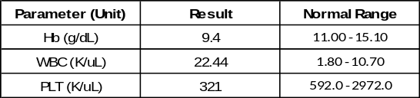
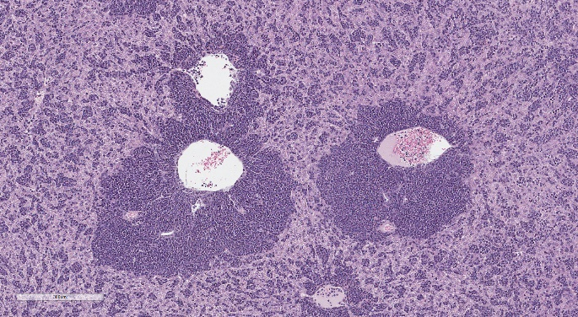
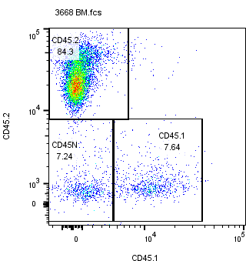
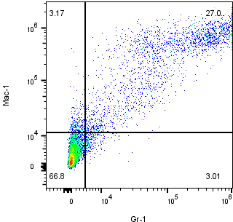
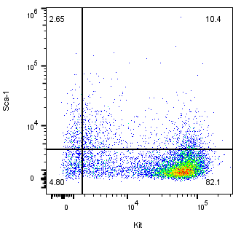
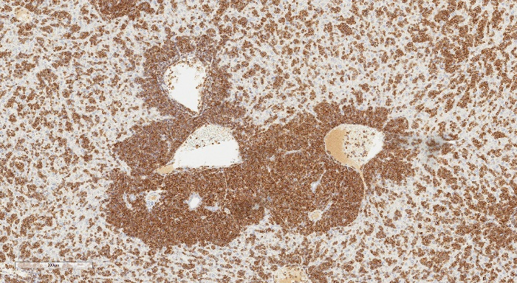
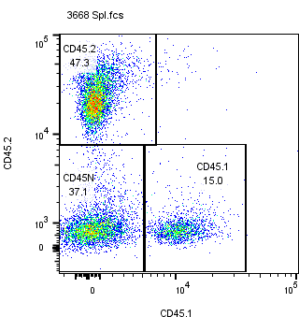
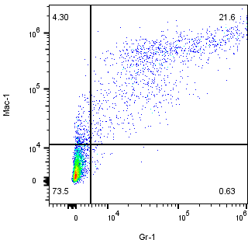
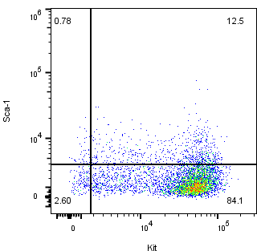
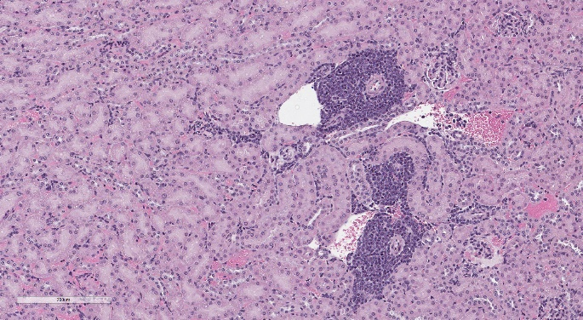
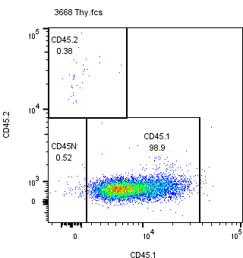
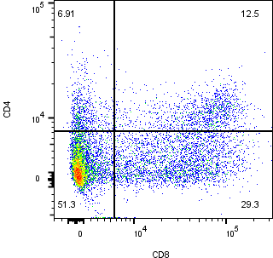
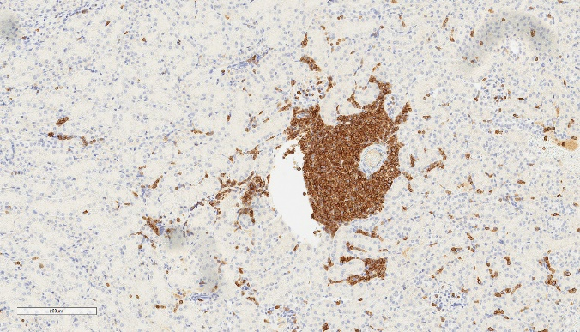
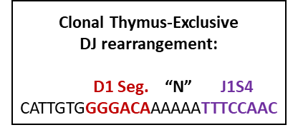

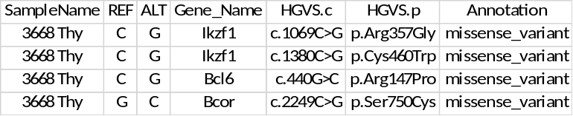
Supp Fig. 2
A
C
Liver
H&E
300 um
B
Bone
Marrow
CD3
300 um
Kidney
Spleen
H&E
200 um
Thymus
CD3
CD45.2-Alexa Flour 532
CD4-PerCP/Cy5.5
200 um
Sca1-PE/Cy7
CD45.1-PerCP
CD8-APC/Cy5.5
cKit-APC/Cy7
D
E
Supp. Figure 2. Concurrent rETP and dAML in ATC treated mouse #3668.
A. Key hematologic parameters. B. Flow cytometry profile. C. H&E and CD3 staining of the liver and kidney. D. Clonal Trb DJ rearrangement from thymus of mouse #3668 with rETP; the DJ assay for BM and spleen revealed only WT sequence. E. WES of the BM reveals Ptpn11 and Trp53 missense mutations not found in the thymus, and Ikzf1, Bcl6 and Bcor missense mutations found in the thymus but not the BM.

Slide 8
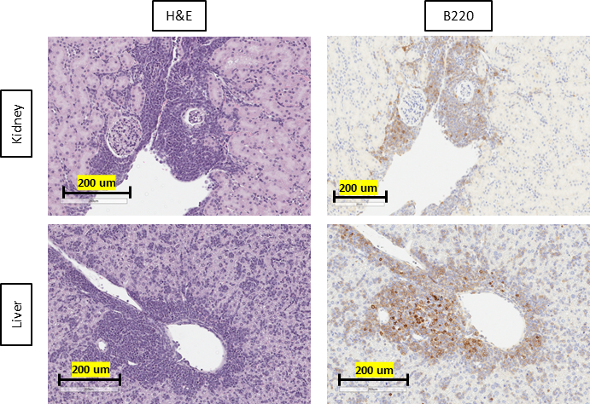
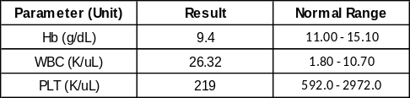







Supp Fig. 3
A
C
B
D
E
F
G
H
I
Supp Figure 3. Characteristics of B-ALL (mouse #3644) and concurrent B-ALL and T-ALL (mouse #3674) associated with ATC treatment. A. Key hematologic parameters for mouse #3644. B. Flow cytometry profile. C. H&E and B220 staining of the kidney and liver. D. Clonal Igh rearrangement from mouse #3644. E. Key hematologic parameters of mouse #3674 with concurrent B-ALL and T-ALL. F. Flow cytometry profile. G. Monoclonal Trb gene rearrangement in the thymus, monoclonal Igh gene rearrangement is found in the BM and spleen. H. Mutations shared between #3674 T-ALL and B-ALL are not statistically different than the number of shared mutations between #3674 B-ALL and the average of all other T-ALL in mice from this cohort. I. WES of the spleen reveals a Bcor nonsense mutation not found in the thymus, and a Notch1 PEST domain frameshift mutation found in the thymus but not the spleen.

Slide 9



Supp Fig. 4A
Mouse #3600
T-ALL
Legend (Values are in
number of features/Mb)
C>G
Transversions
CpG
Islands
Supp Figure 4. C>G transversion ChromoMaps of individual mice
A. ChromoMap of C>G transversions and CpG islands in mouse #3600, B. #3635, C. #3637, D. #3639, E. #3642, F. #3666 G. #3669, H. #3673.

Slide 10

Supp Fig. 4B
Legend (Values are in
number of features/Mb)
C>G
Transversions
CpG
Islands
Mouse #3635
T-ALL

Slide 11

Supp Fig. 4C
Legend (Values are in
number of features/Mb)
C>G
Transversions
CpG
Islands
Mouse #3637
T-ALL

Slide 12

Supp Fig. 4D
Legend (Values are in
number of features/Mb)
C>G
Transversions
CpG
Islands
Mouse #3639
T-ALL

Slide 13

Supp Fig. 4E
Legend (Values are in
number of features/Mb)
C>G
Transversions
CpG
Islands
Mouse #3642
T-ALL

Slide 14

Supp Fig. 4F
Legend (Values are in
number of features/Mb)
C>G
Transversions
CpG
Islands
Mouse #3666
T-ALL

Slide 15

Supp Fig. 4G
Legend (Values are in
number of features/Mb)
C>G
Transversions
CpG
Islands
Mouse #3669
T-ALL

Slide 16

Supp Fig. 4H
Legend (Values are in
number of features/Mb)
C>G
Transversions
CpG
Islands
Mouse #3673
T-ALL

Slide 17










Supp Fig. 5A – U937 treated with ATC
U937
PBS Clone 1
U937
PBS Clone 2
U937
PBS Clone 3
U937
PBS Clone 4
U937
PBS Clone 5
U937
ATC Clone 1
U937
ATC Clone 2
U937
ATC Clone 3
U937
ATC Clone 4
U937
ATC Clone 5
Supp Figure 5. SBS Profiles of cell lines treated with ATC, DAC, or PBS.
A. SBS profiles from U937 treated with ATC or PBS. B. SBS profiles from CEM treated with ATC or PBS. C. SBS profiles from U937 treated with DAC or PBS

Slide 18










Supp Fig. 5B – CEM treated with ATC
CEM
ATC, 25nM, Clone 1
CEM
ATC, 25nM, Clone 2
CEM
ATC, 25nM, Clone 3
CEM
ATC, 50nM, Clone 4
CEM
ATC, 50nM, Clone 5
CEM
PBS Clone 1
CEM
PBS Clone 2
CEM
PBS Clone 3
CEM
PBS Clone 4
CEM
PBS Clone 5

Slide 19





Supp Fig. 5C – U937/treated with DAC
U937
PBS Clone 1
U937
PBS Clone 2
U937
PBS Clone 3
U937
PBS Clone 4
U937
PBS Clone 5
U937
DAC Clone 1
U937
DAC Clone 2
U937
DAC Clone 3
U937
DAC Clone 4
U937
DAC Clone 5

Slide 20


















Supp Fig. 6 – Dck Experiment
7298
PBS Clone 1
7298
PBS Clone 2
7298
PBS Clone 3
7298
PBS Clone 4
7298
PBS Clone 5
7298
10nM Clone 1
7298
10nM Clone 2
7298
10nM Clone 3
7298
10nM Clone 4
7298
10nM Clone 5
SBS-ATC
7298
1000nM Clone 1
SBS-ATC
7298
1000nM Clone 2
SBS-ATC
7298
1000nM Clone 3
SBS-ATC
7298
1000nM Clone 4
SBS-ATC
7298
1000nM Clone 5
7298CR
PBS Clone 1
7298CR
PBS Clone 2
7298CR
PBS Clone 3
Supp Figure 6. SBS Profiles of 7298 and 7298CR.
A. SBS profiles from treatment of 7298 and 7298CR with ATC.

Slide 21












Supp Fig. 6 – Dck Experiment
7298CR
PBS Clone 4
7298CR
PBS Clone 5
7298CR
10nM Clone 1
7298CR
10nM Clone 2
7298CR
10nM Clone 3
7298CR
10nM Clone 4
7298CR
10nM Clone 5
7298CR
1000nM Clone 1
7298CR
1000nM Clone 2
7298CR
1000nM Clone 3
7298CR
1000nM Clone 4
7298CR
1000nM Clone 5

Slide 22




Supp Fig. 7
Cell Surface Markers of Interest
Cell Surface Markers of Interest
Supp Figure 7. Cytometry Gating Strategy
A. The gating strategy used for all flow cytometry before phenotypic marker analysis.
Notes:
-remove negative region cd45

