Slide 1
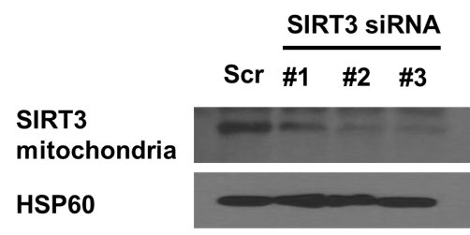
Supplementary Figure 1. Confirmation of mitochondrial SIRT3 expression upon treatment with three custom-designed SIRT3 siRNAs and scramble control. The #3 siRNA was selected for subsequent experiments.

Slide 2
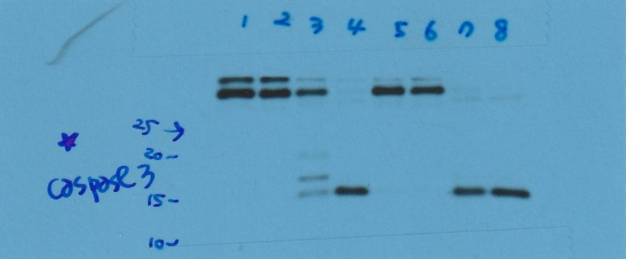
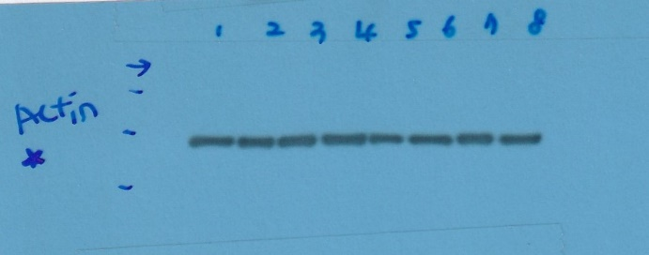
Supplementary Figure 2. Original blots of westerns in Figure 1.

Slide 3
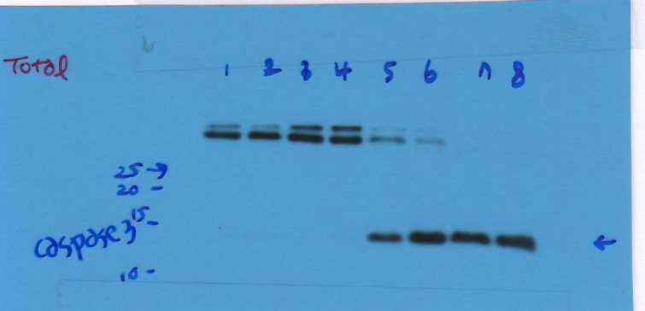
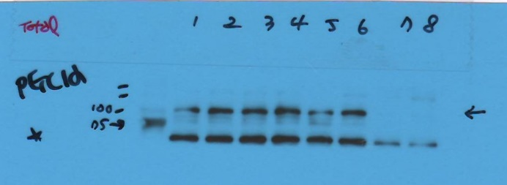
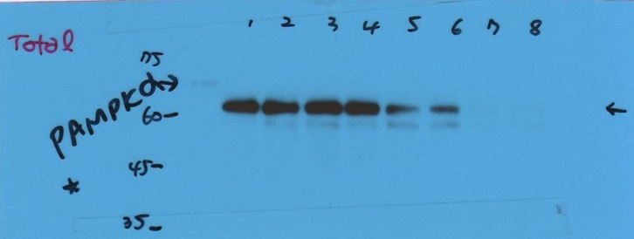
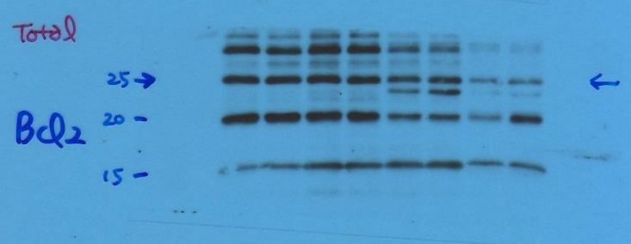


Supplementary Figure 3. Original blots of westerns in Figure 2A & 2B.

Slide 4
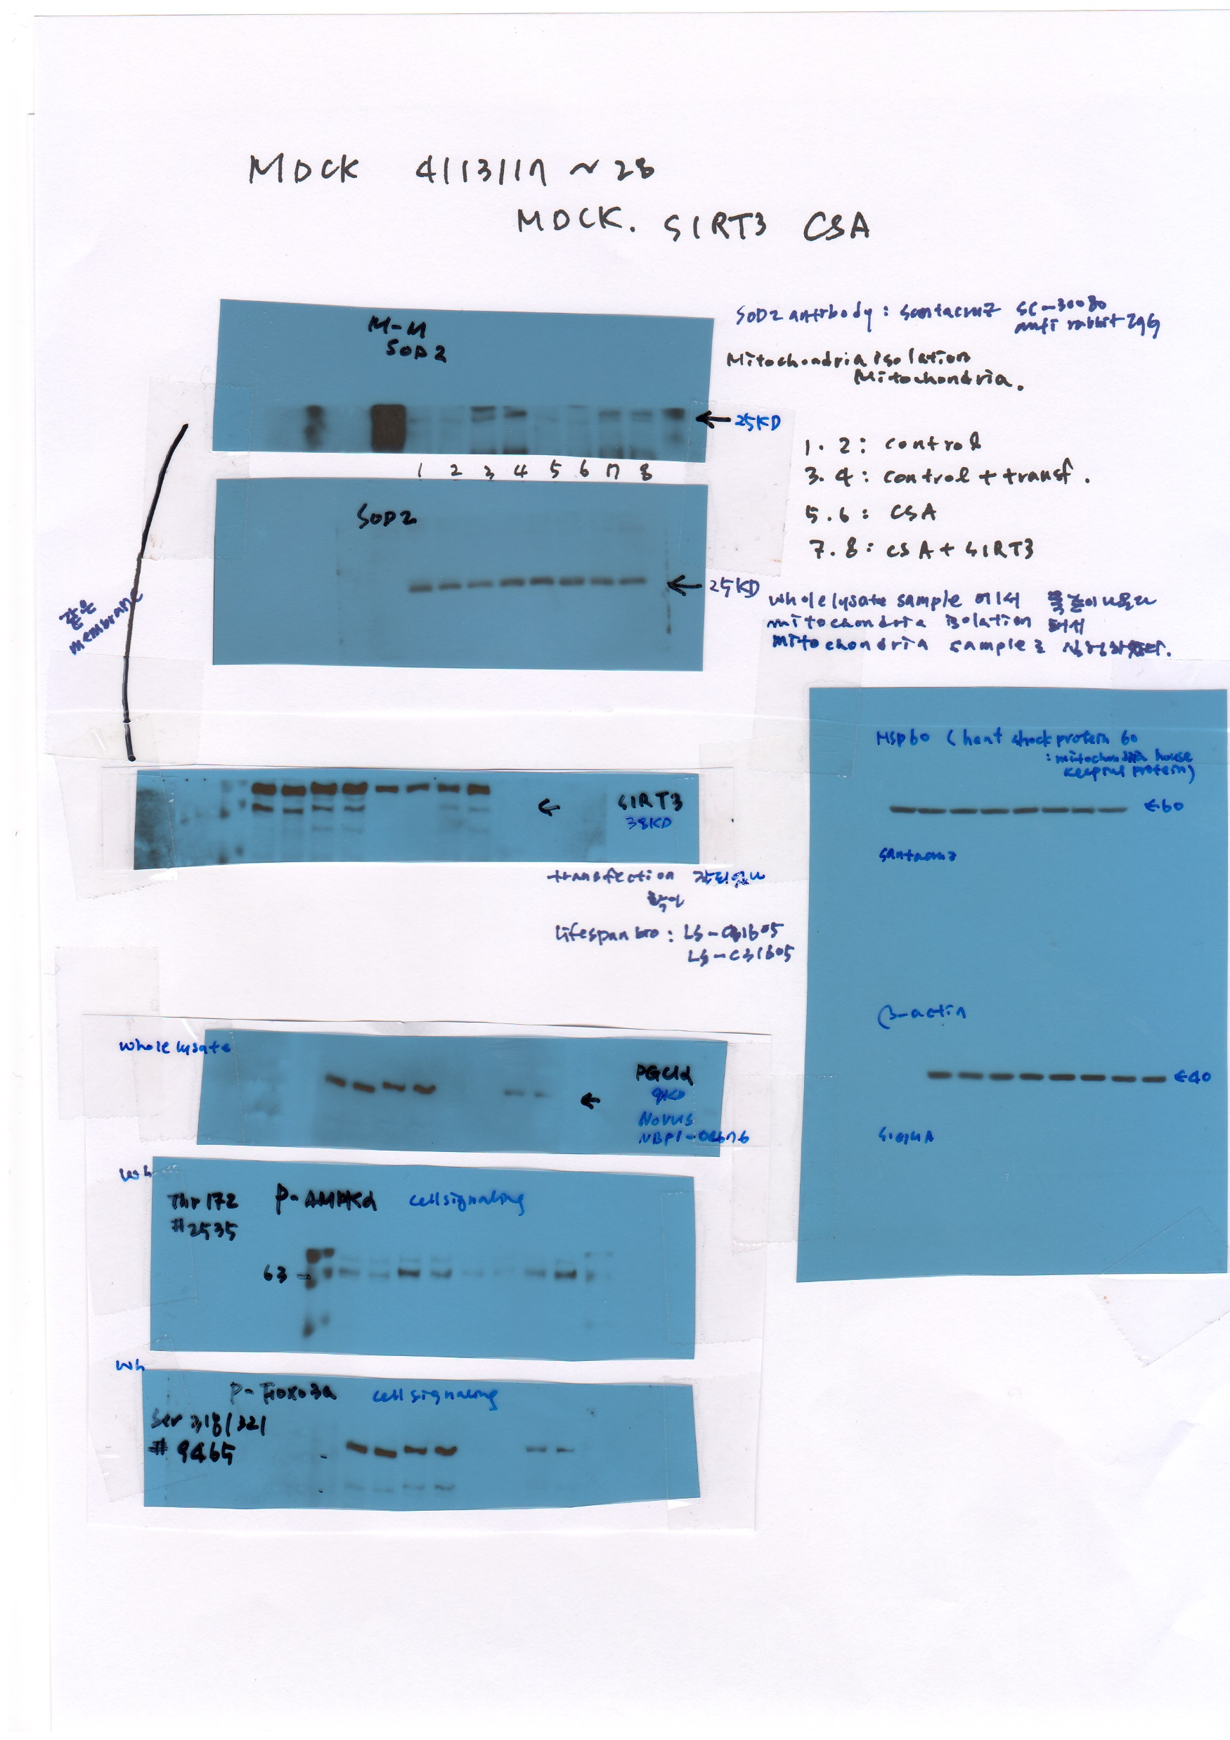

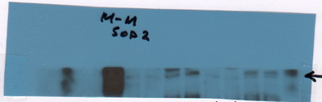

Supplementary Figure 4. Original blots of westerns in Figure 3C & 3D.

Slide 5





Supplementary Figure 5. Original blots of westerns in Figure 4B.

