Slide 1
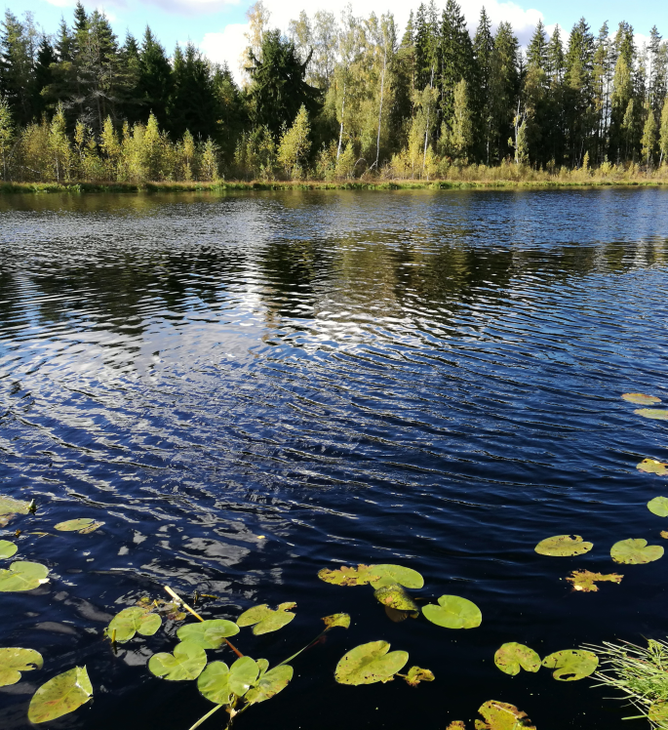
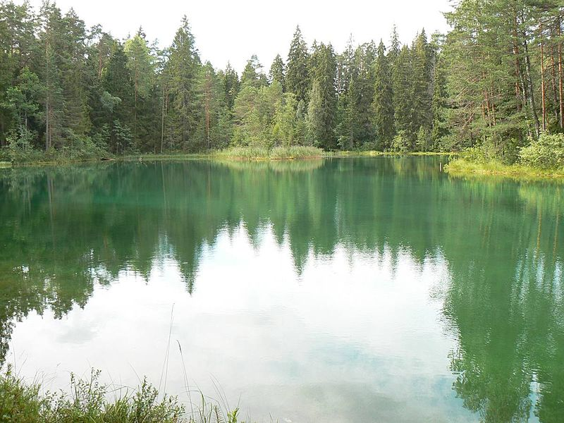
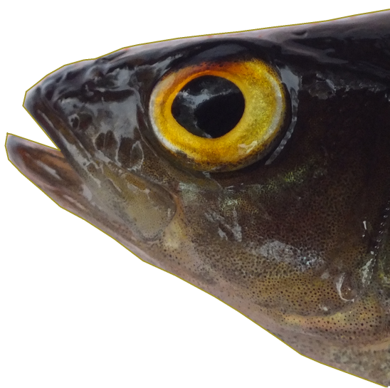
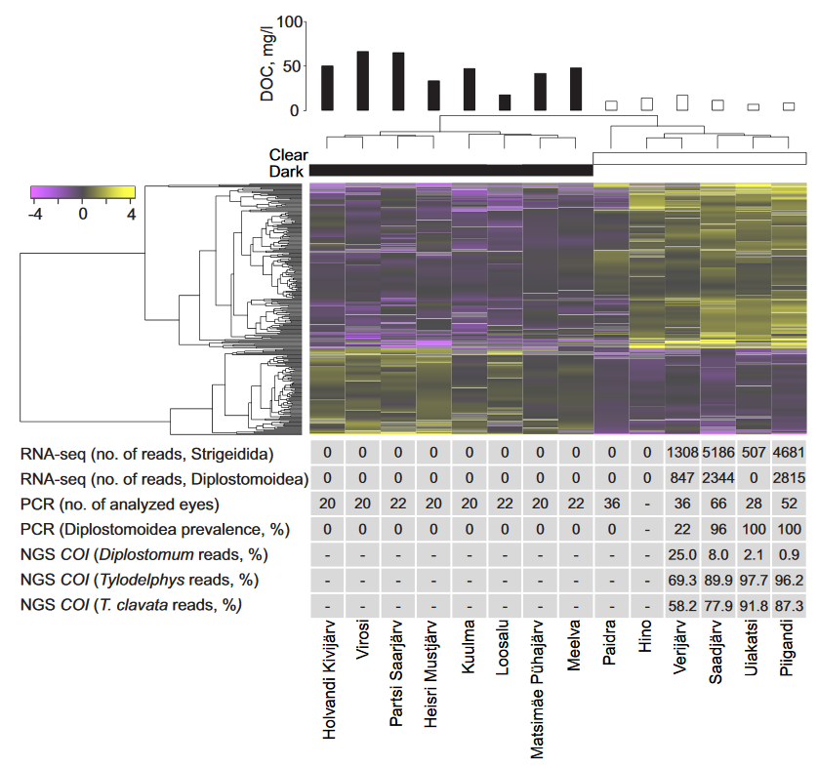
Brown water colour
Low pH
Scarce underwater vegetation
Snails absent
Diplostomidae absent
Transparent water
Neutral-high pH
Abundant underwater vegetation
Snails present
Diplostomidae present
Eurasian perch (Perca fluviatilis)
Humic lakes
Clear-water lakes
Whole eye RNA-seq and targeted metabarcoding analysis
Tylodephys clavata (Diplostomidae) haplotype diversity in clear-water lakes

