Slide 1
Western blotting
Figure 1A original blot
MMP-9 (92 kDa)
β-actin (45 kDa)

Slide 2
Figure 2B original blot
24 h
48 h
MMP-9 (92 kDa)
β-actin (45 kDa)

Slide 3
Figure 5B original blot
MMP-9 (92 kDa)
β-actin (45 kDa)

Slide 4
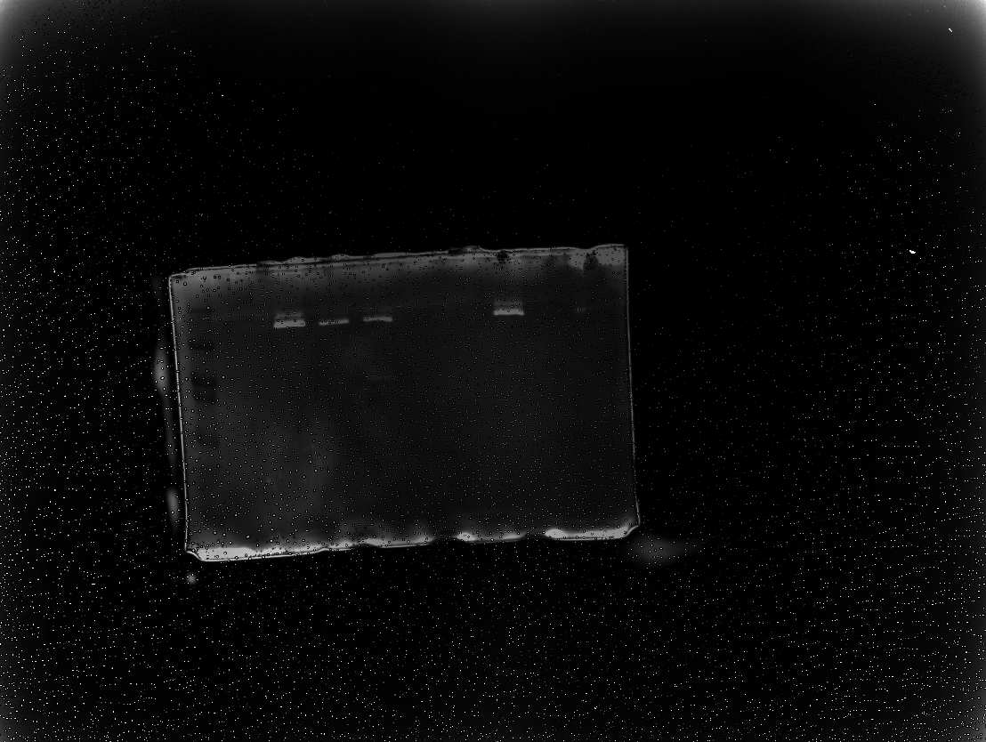
Zymography
Figure 1A and 5B original blot
MMP-9 (92 kDa)
Figure 1A
Figure 5B

