Slide 1
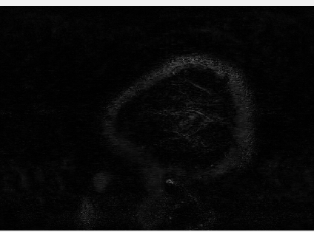
Suppl. video 1: High-resolution CSF-signal in the entire human brain
CSF-signal

Slide 2


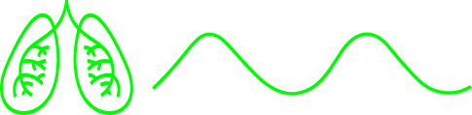
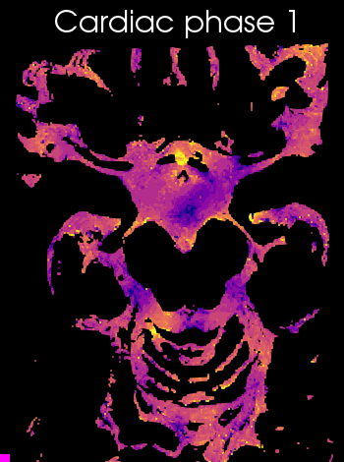
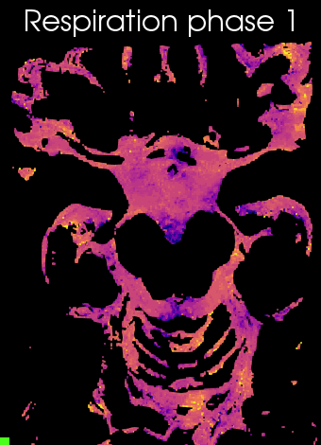
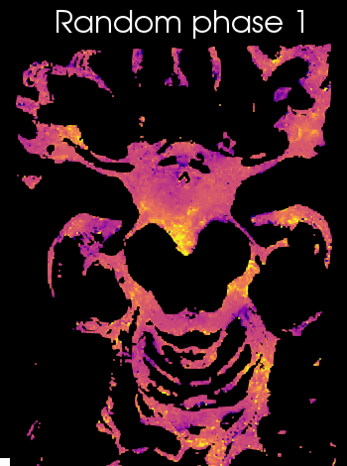
Suppl. video 2: Animation of CSF-mobility change across driving forces in the subarachnoid space around the circle of Willis
-10
CSF-mobility change (%)
10

Slide 3
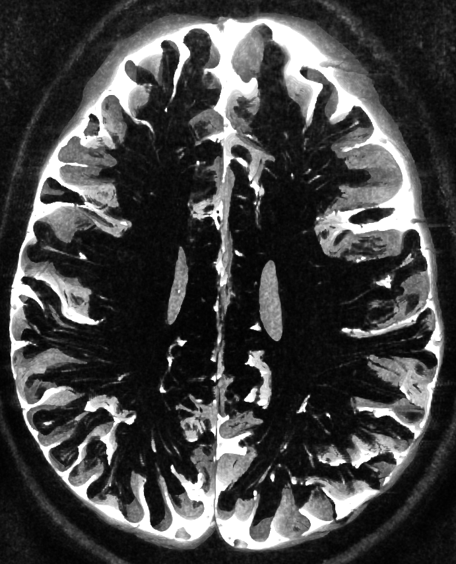
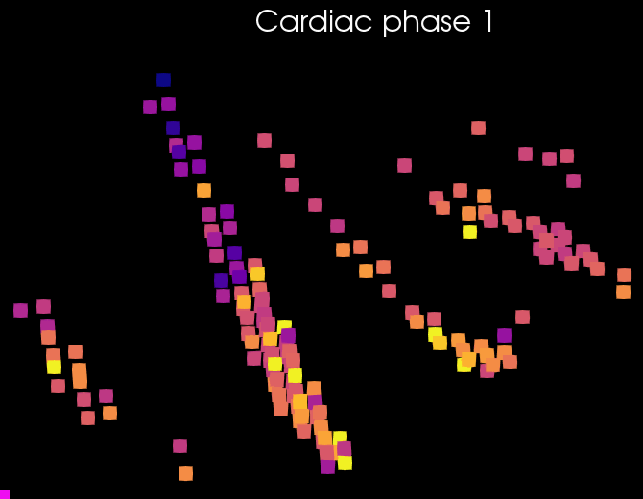
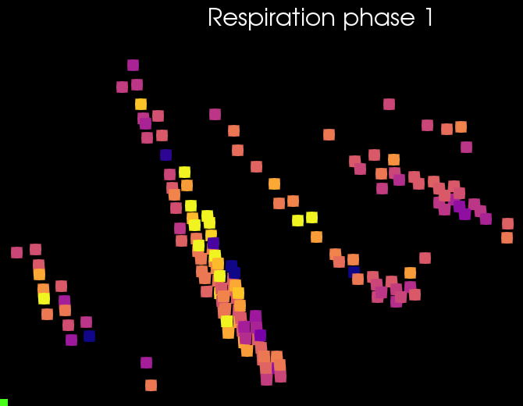
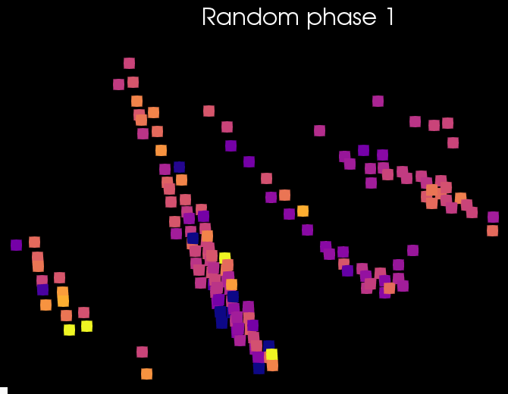
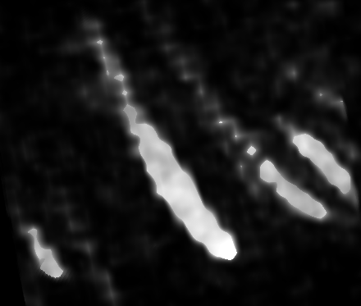
Suppl. video 3: Animation of CSF-mobility change across driving forces in PVS around penetrating arteries
-10
CSF-mobility change (%)
10

